Slide 1
Key Concepts in Microeconomics/ Energy Infrastructure Microeconomics Summer Institute Day One
Presented by Theodore Opderbeck
7/14/21 opderbeckt@waldwickschools.org

Slide 2
EconEdLink Membership
You can now access CEE’s professional development webinars directly on EconEdLink.org! To receive these new professional development benefits, become an EconEdLink member. As a member, you will now be able to:
Automatically receive a professional development certificate via e-mail within 24 hours after viewing any webinar for a minimum of 45 minutes
Register for upcoming webinars with a simple one-click process
Easily download presentations, lesson plan materials and activities for each webinar
Search and view all webinars at your convenience
Save webinars to your EconEdLink dashboard for easy access to the event
You may access our new Professional Development page here

Slide 3
Professional Development Certificate
To earn your professional development certificate for this webinar, you must:
Watch a minimum of 45-minutes and you will automatically receive a professional development certificate via e-mail within 24 hours.
Accessing resources:
You can now easily download presentations, lesson plan materials, and activities for each webinar from EconEdLink.org/professional-development/

Slide 4
https://bit.ly/CEEConference2021

Slide 5
60th Financial Literacy and Economic Education Conference
September 29th - October 1st, 2021
2-7 PM ET Daily
$20 discount for Summer Institute attendees
Register
https://councilforeconed2021.us2.pathable.com/
Promo Code
CEE60SI
SEE YOU THERE!!!

Slide 6
How did we do? Let us know! Please complete our survey: https://www.surveymonkey.com/r/SummerInstitute2021

Slide 7
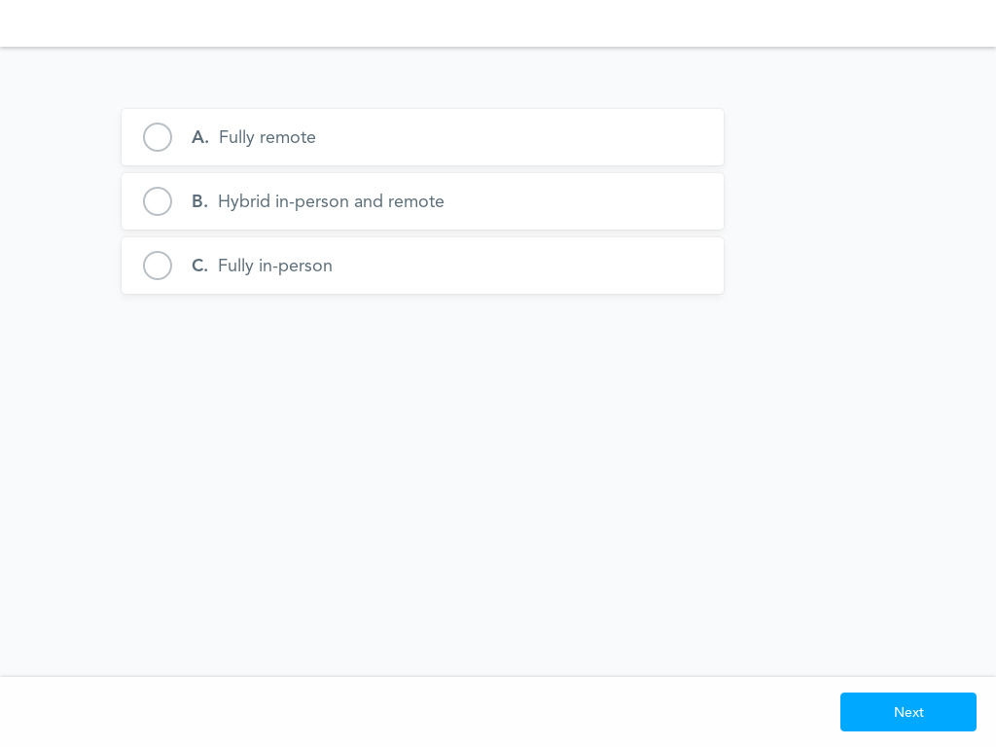
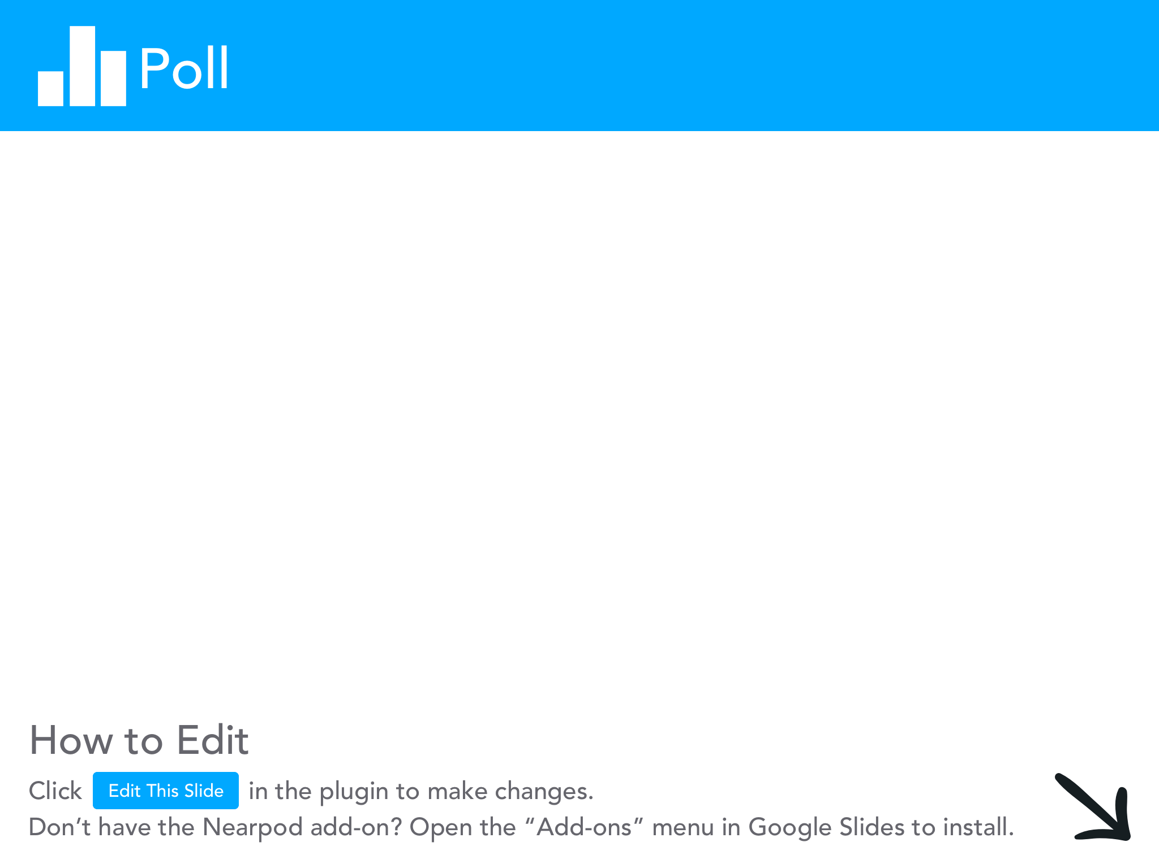

Slide 8
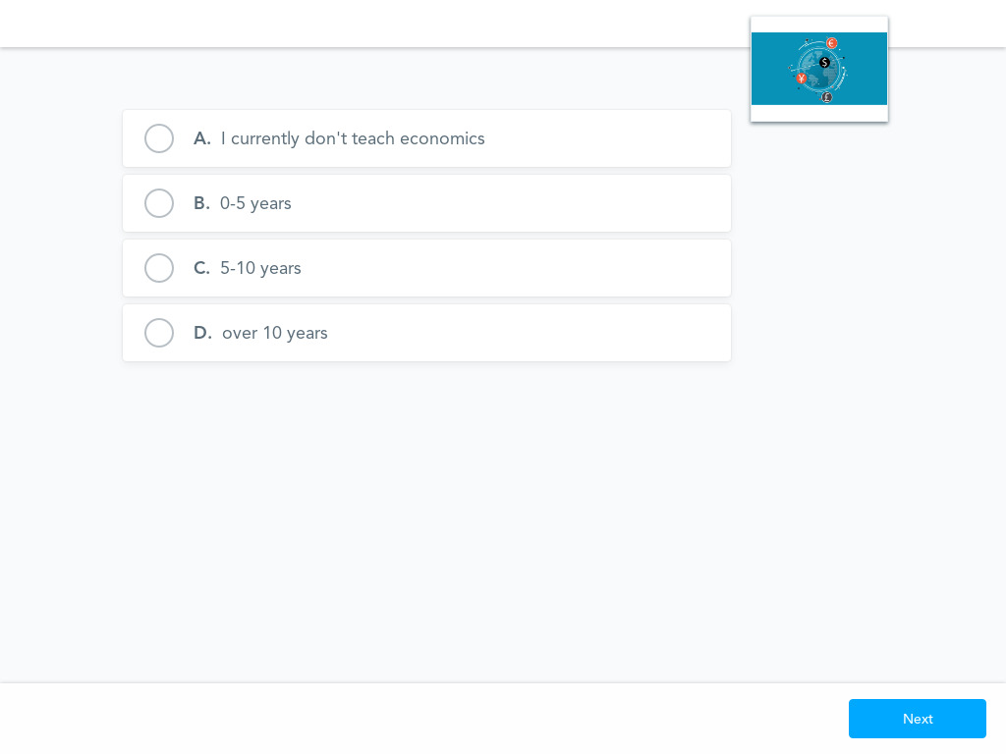

Slide 9
Objectives
To discuss how buyers and sellers interact in a free market to determine price signals that are influenced by supply and demand.
To explore how elasticity affects consumption and production decisions.
To analyze the impact of government intervention/ price controls in a market.
To introduce dynamic learning activities and lesson plans to bring content alive for students.
To model digital formative assessment tools to use with your students in order to maximize learning.
To discuss how current energy infrastructure and renewable energy policy illustrate microeconomic concepts.

Slide 10
National Standards
NCEE Standard 7: Markets and Prices. A market exists when buyers and sellers interact. This interaction determines market prices and thereby allocates scarce goods and services.
NCEE Standard 8: Role of Prices. Prices send signals and provide incentives to buyers and sellers. When supply or demand changes, market prices adjust, affecting incentives
https://www.councilforeconed.org/wp-content/uploads/2012/03/voluntary-national-content-standards-2010.pdf

Slide 11
State Standards
NY State Common Core Social Studies Standard 12.E2b: The choices of buyers and sellers in the marketplace determine supply and demand, market prices, allocation of scarce resources, and the goods and services that are produced. In a perfect world, consumers influence product availability and price through their purchasing
http://www.nysed.gov/curriculum-instruction

Slide 12
State Standards
NY State Common Core Social Studies Standard 12.E2c Businesses choose what to supply in the product market, based on product market prices, available technology, and prices of factors of production. The prices of those factors are determined based on supply and demand in the factor market. The supply and demand of each factor market is directly related to employment. Debates surround various ways to minimize unemployment (frictional, structural, cyclical).
http://www.nysed.gov/curriculum-instruction

Slide 13
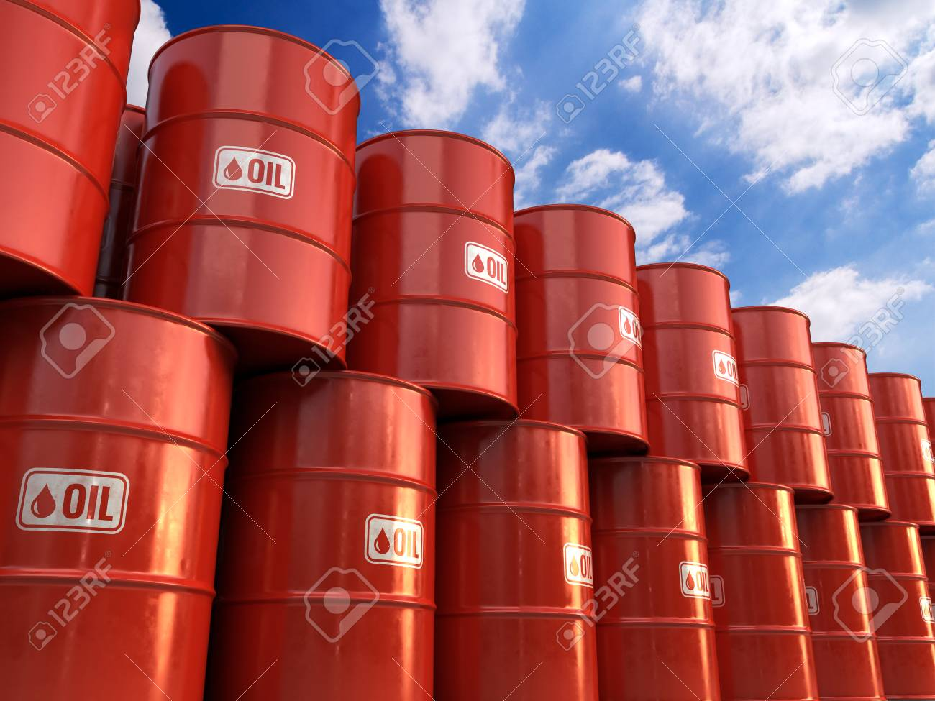
Question of the Day
Which nation is the top oil producer in the world, accounting for 19% of world production?
the United States
Saudi Arabia
Russia
Iraq

Slide 15
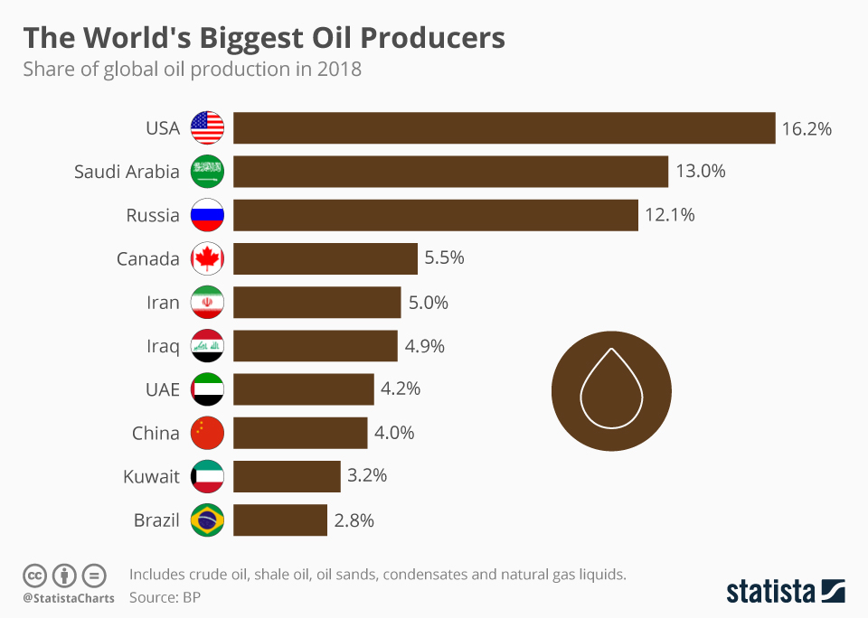

Slide 16
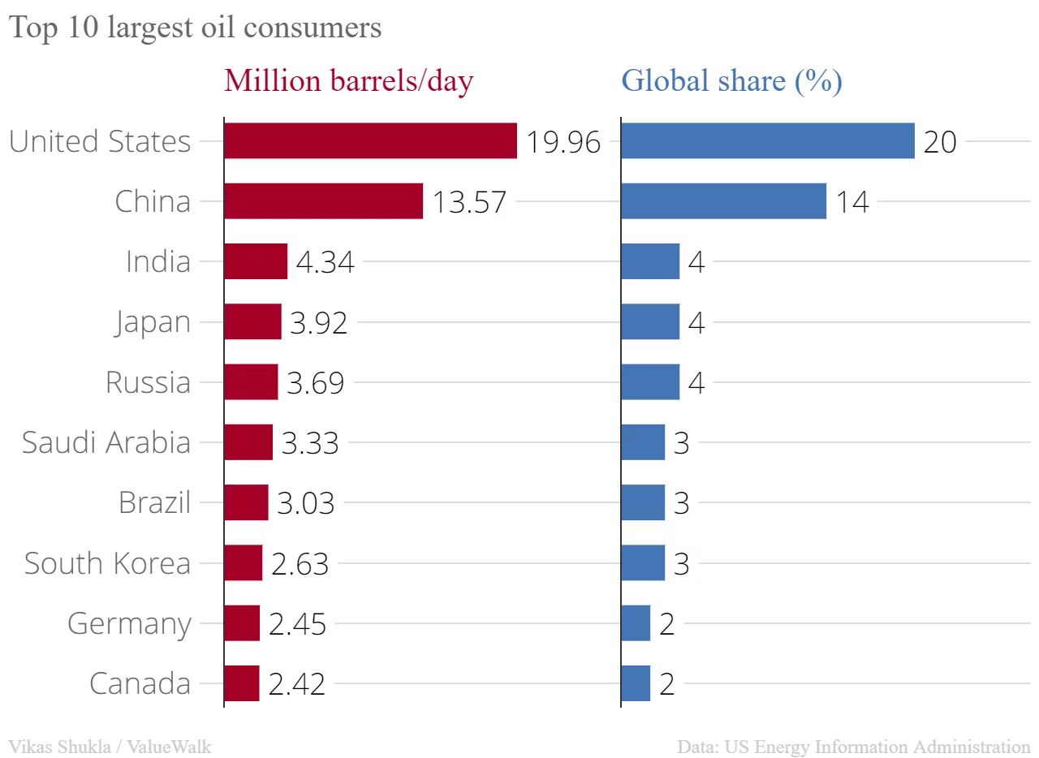

Slide 17
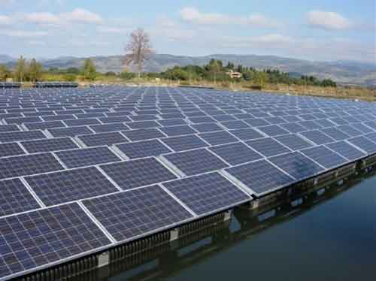
Question of the Day
What percentage of the energy production in the U.S. is derived from renewable energy sources? (ex: solar, wind, tidal)
2%
20%
12%
8%

Slide 18
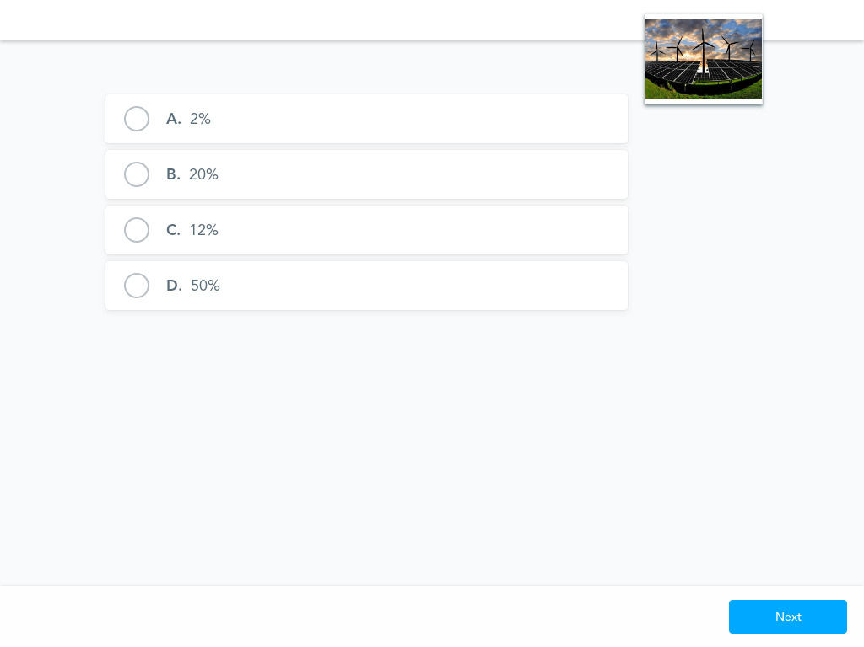

Slide 19
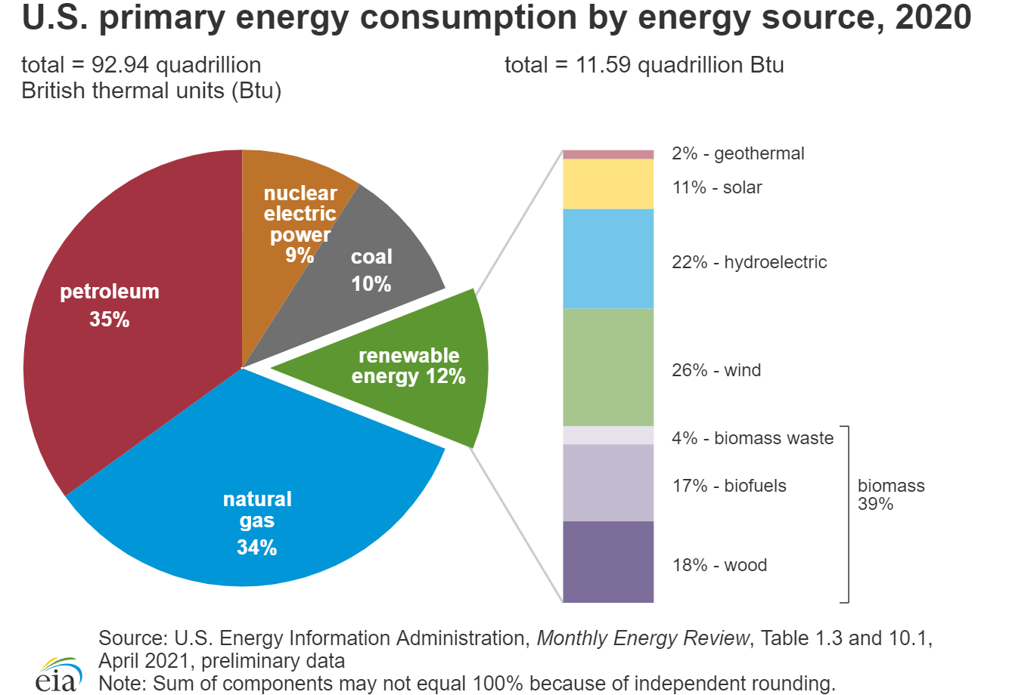

Slide 20
Key Concepts/ Vocab
Renewable Energy: energy that is derived from natural sources that are constantly replenished
Non-renewable Energy: energy that is derived from sources that are depleted and cannot be replaced for a long period of time, perhaps millions of years.
Fossil Fuels: natural fuels formed from the remains of living organisms in the geologic past (ex: coal, oil, natural gas)
Energy Policy: actions governments take to affect the supply of and demand for energy within a nation.

Slide 21
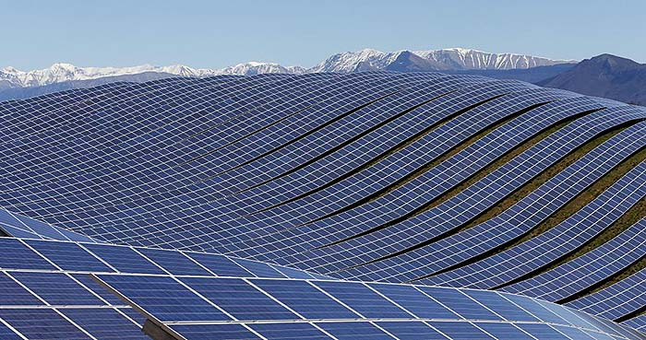
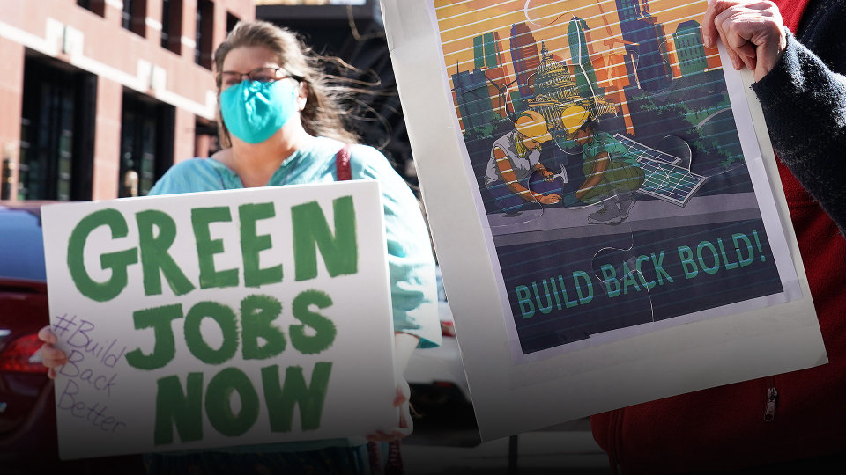
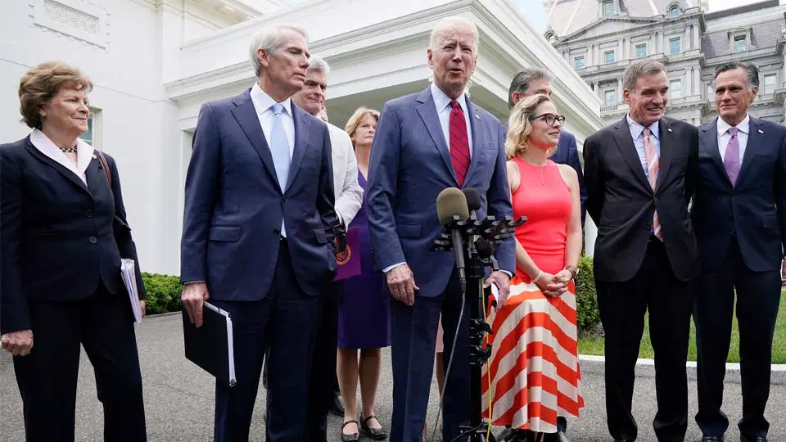
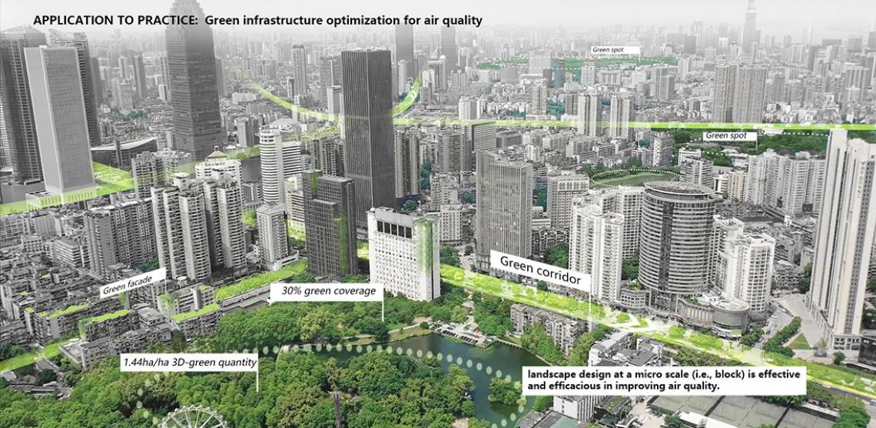

Slide 22
Agenda: Wed 7/14
Supply and Demand
Elasticity
Government Price Controls
Externalities
Consumer Theory

Slide 23
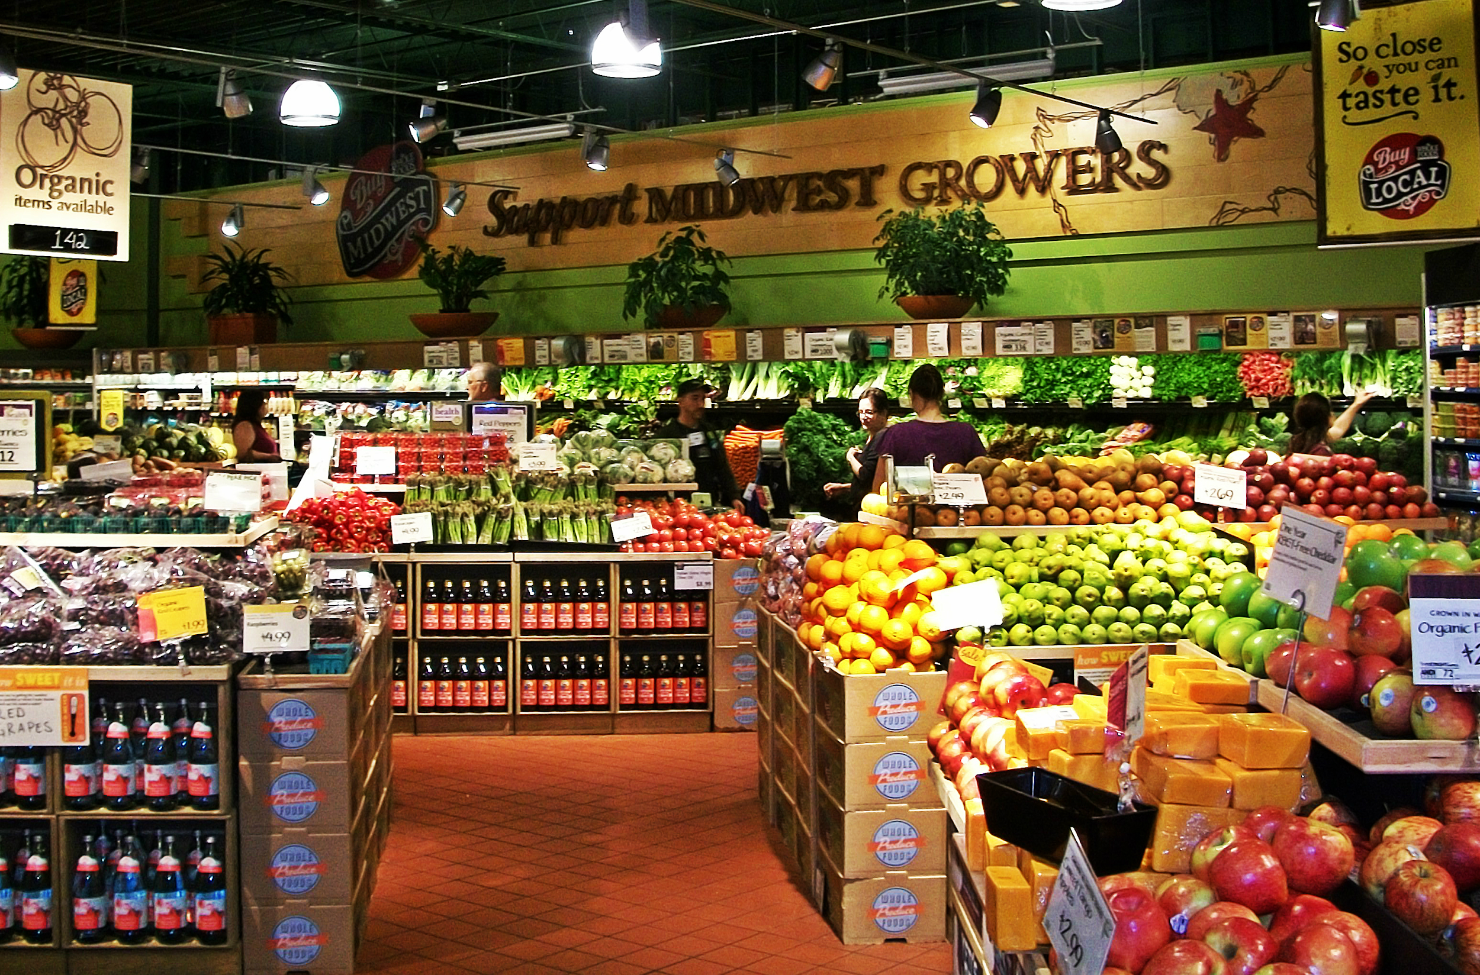
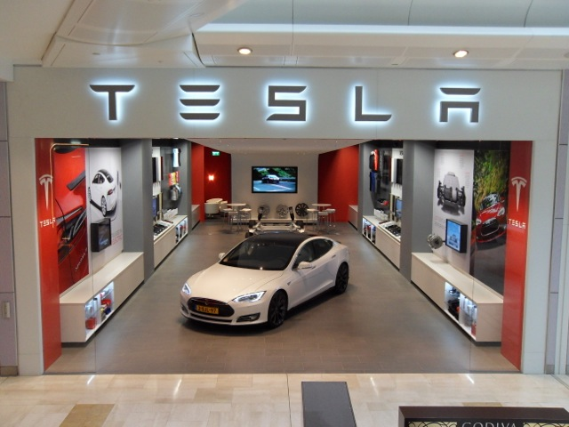
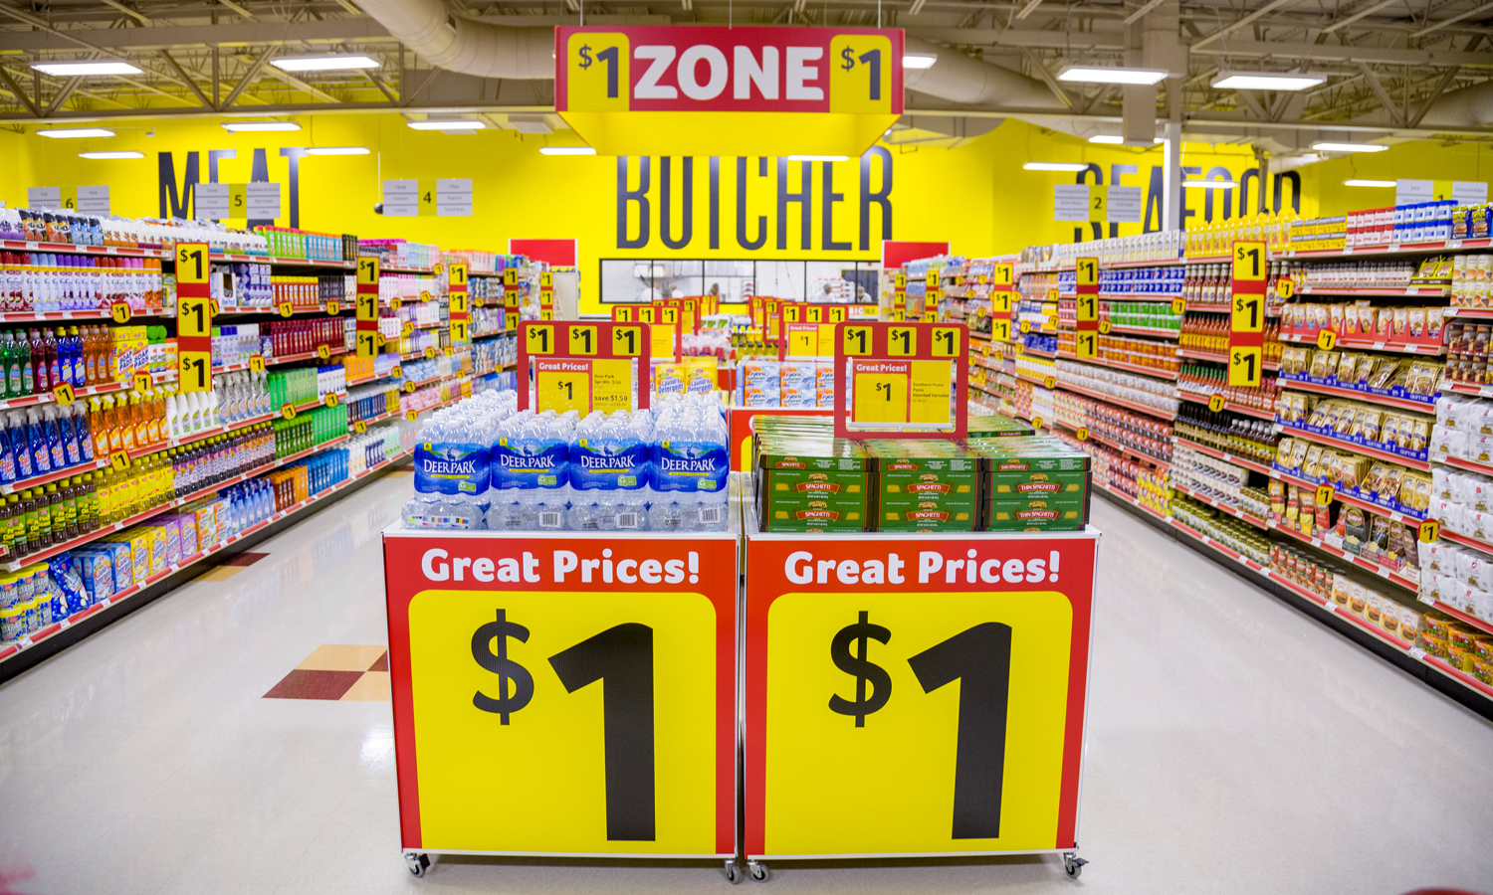
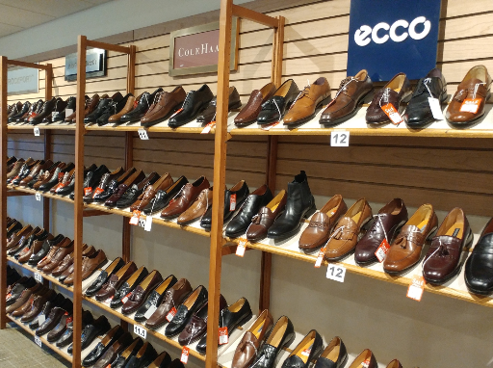
Supply and Demand
Notes:
Get kids atttention - mention iPhones

Slide 24
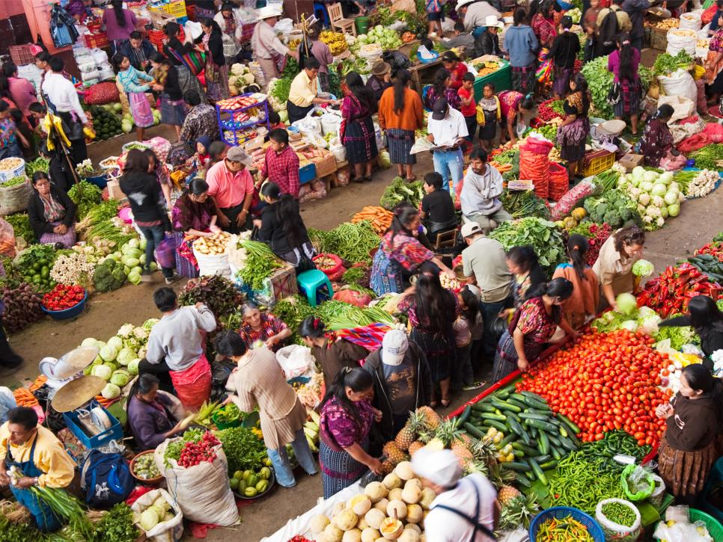
Market Economy
MARKET: Any arrangement that brings buyers and sellers together to exchange goods and services for money.
FREE MARKET: little to no government interference or involvement. The forces of supply and demand determine output levels and prices.

Slide 25
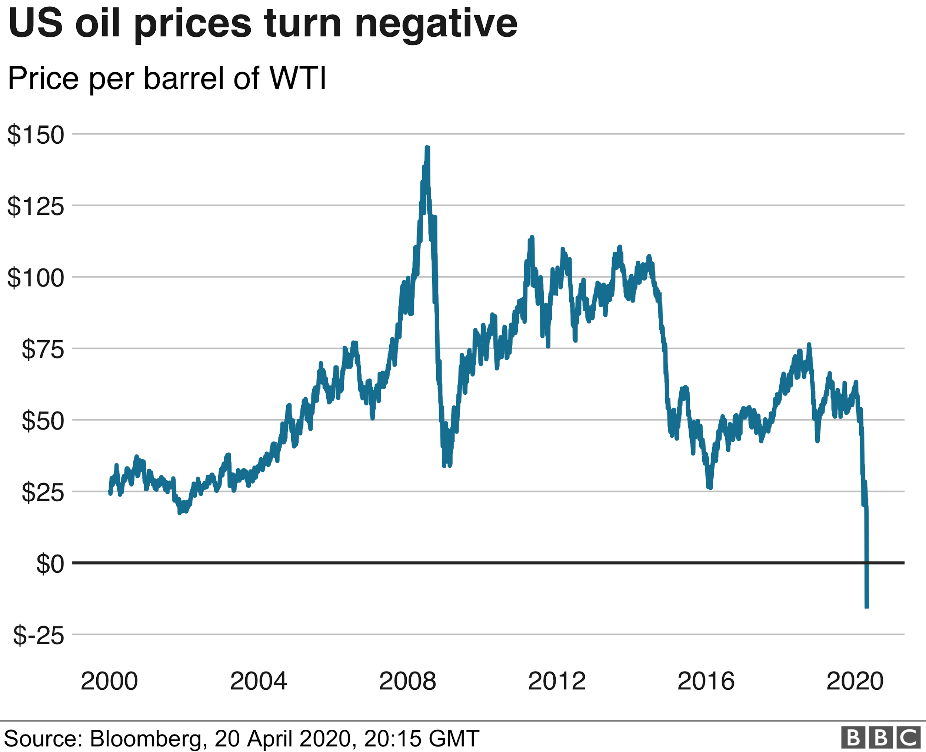
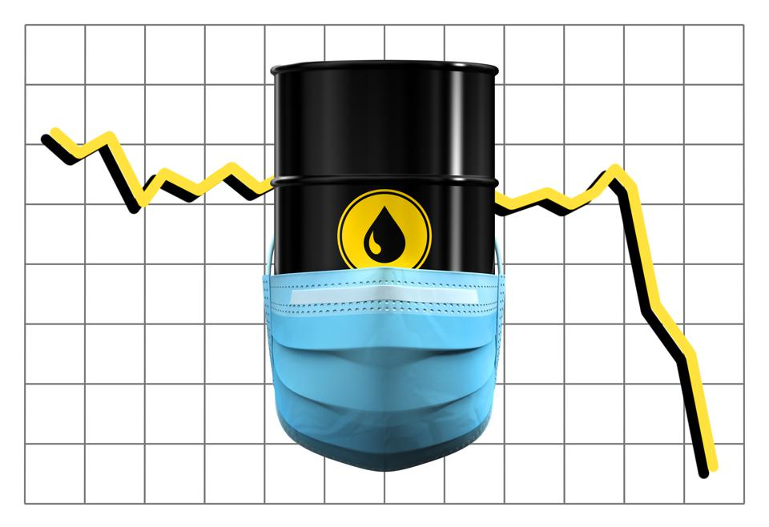
Choose a time period of a few years on the graph above regarding oil prices.
Explain, to the best of your ability, why oil prices may have risen, fallenl, or stayed constant during that period.

Slide 26
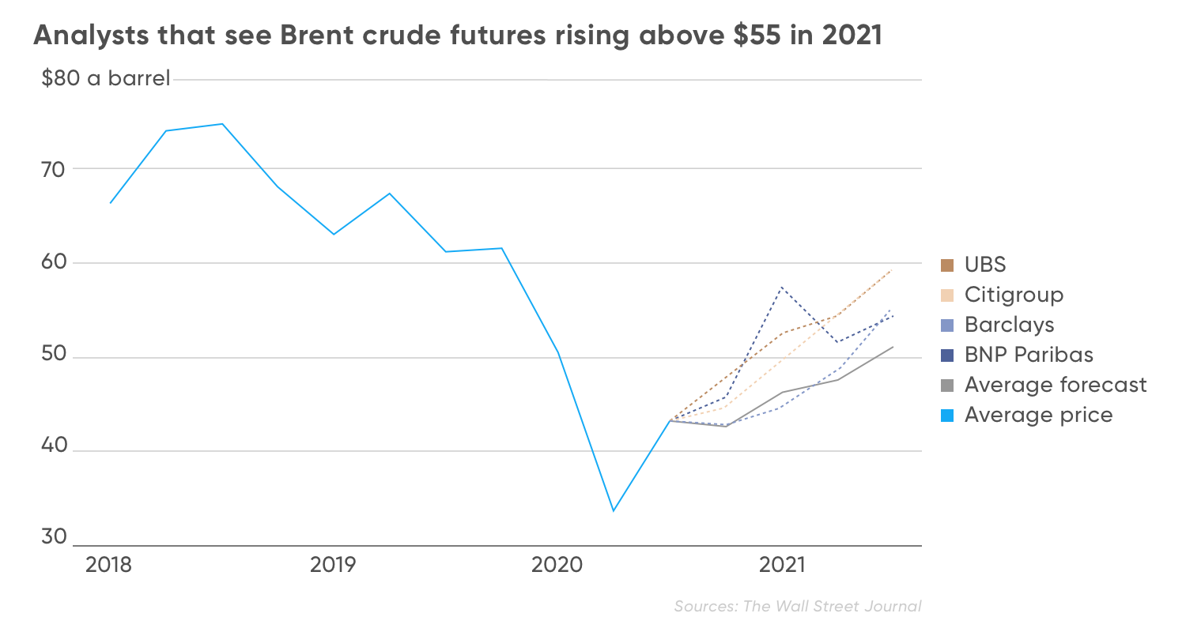
https://www.reuters.com/article/us-global-oil/oil-rises-on-fears-of-heightened-tensions-in-middle-east-idUSKBN2AF013?utm_term=OZY&utm_campaign=pdb&utm_content=Monday_02.15.21&utm_source=Sailthru&utm_medium=email

Slide 27
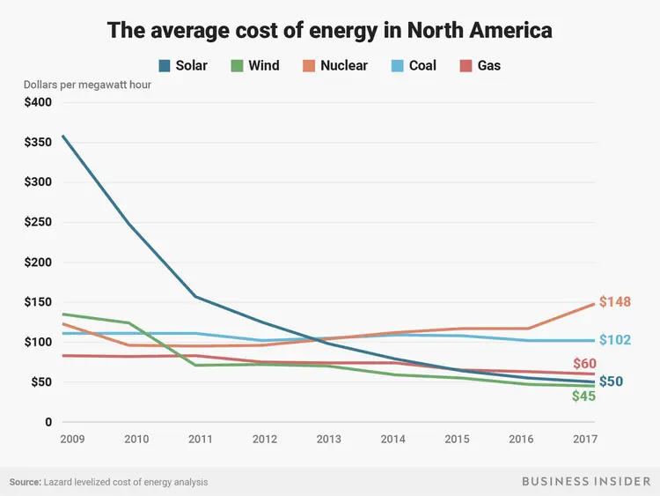

Slide 28
Quick Current Events Roundup (I occasionally start class this way)
Teacher summary with whole class discussion
Assign short articles to groups
Collaborative Google Doc
Article with Poll questions
Ex:
https://www.cnbc.com/2021/06/02/it-could-be-a-hot-summer-ahead-for-oil-prices.html
https://www.forbes.com/sites/woodmackenzie/2021/06/17/how-high-can-oil-prices-go-in-2021/?sh=103bf9f65c3f

Slide 29
Introductory Teaching Activity
Hang various items (10) around the room with incorrect prices.
Students examine a total of five items and record whether they think the price is lower or higher than the listed price. They list one reason for their response.
Display the actual prices. Hold brief discussions introducing “supply and demand” concepts. For every correct response, students get two fictional dollars for an auction.
Auction (non-allergenic) food items to the class. Construct supply and demand tables to display and discuss for selected items. Discuss how supply and demand influence the prices of the items you auctioned.

Slide 30
Snuggie Fleece Blanket with Sleeves Zebra
$30

Slide 31
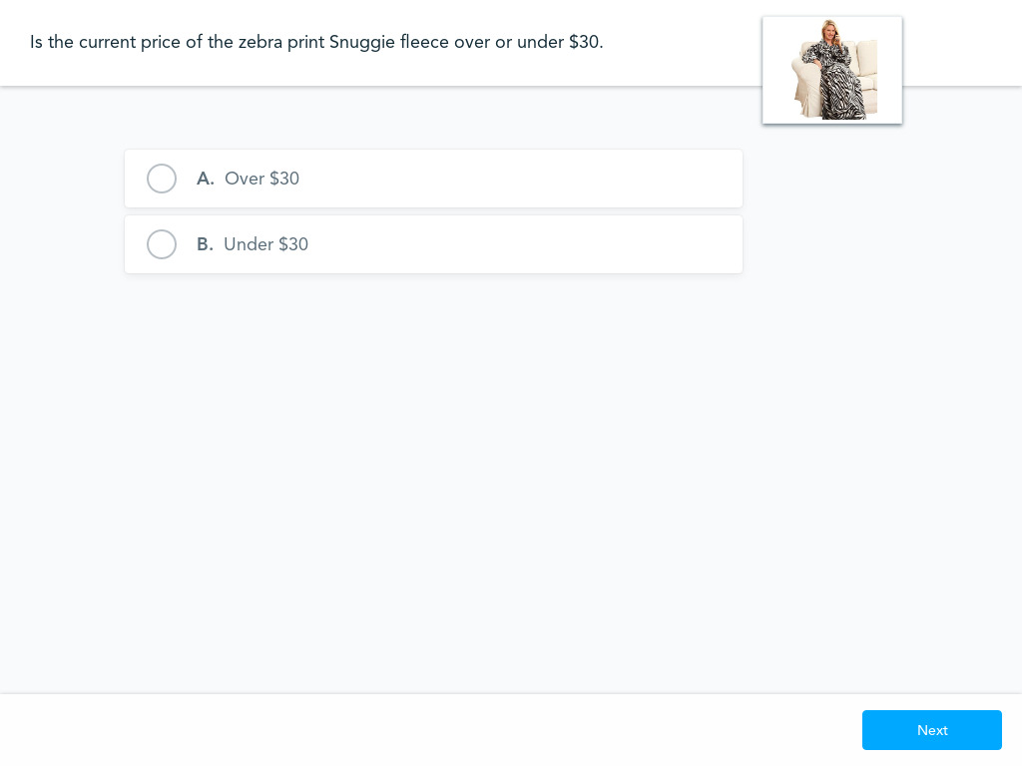

Slide 32
Atlas Apex Snowshoe
$200

Slide 33
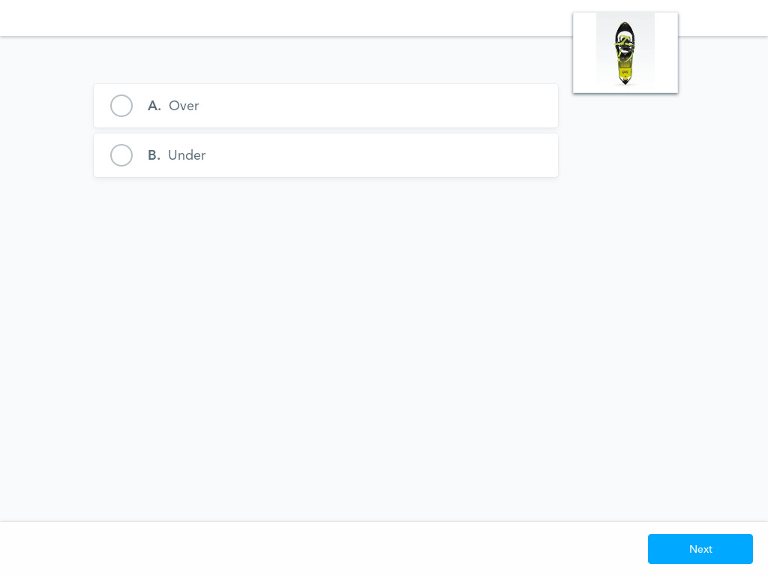

Slide 34
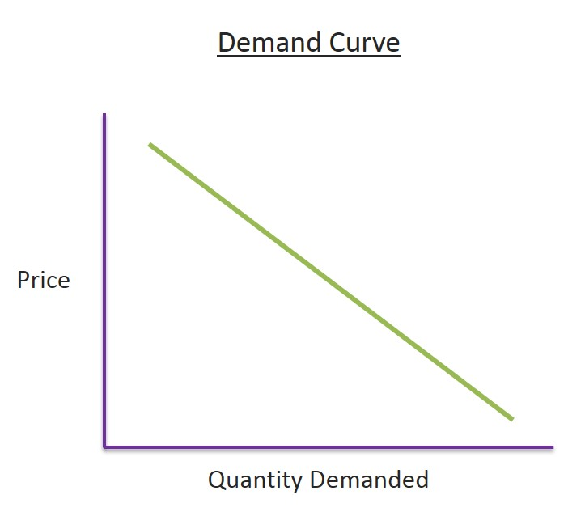
Supply/Demand

Slide 35
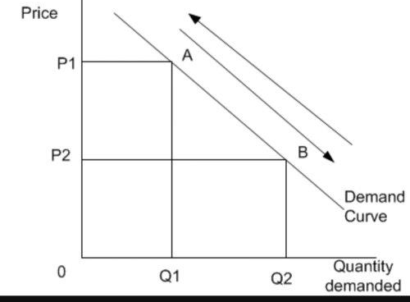
Supply/Demand
Change in Quantity Demanded

Slide 36
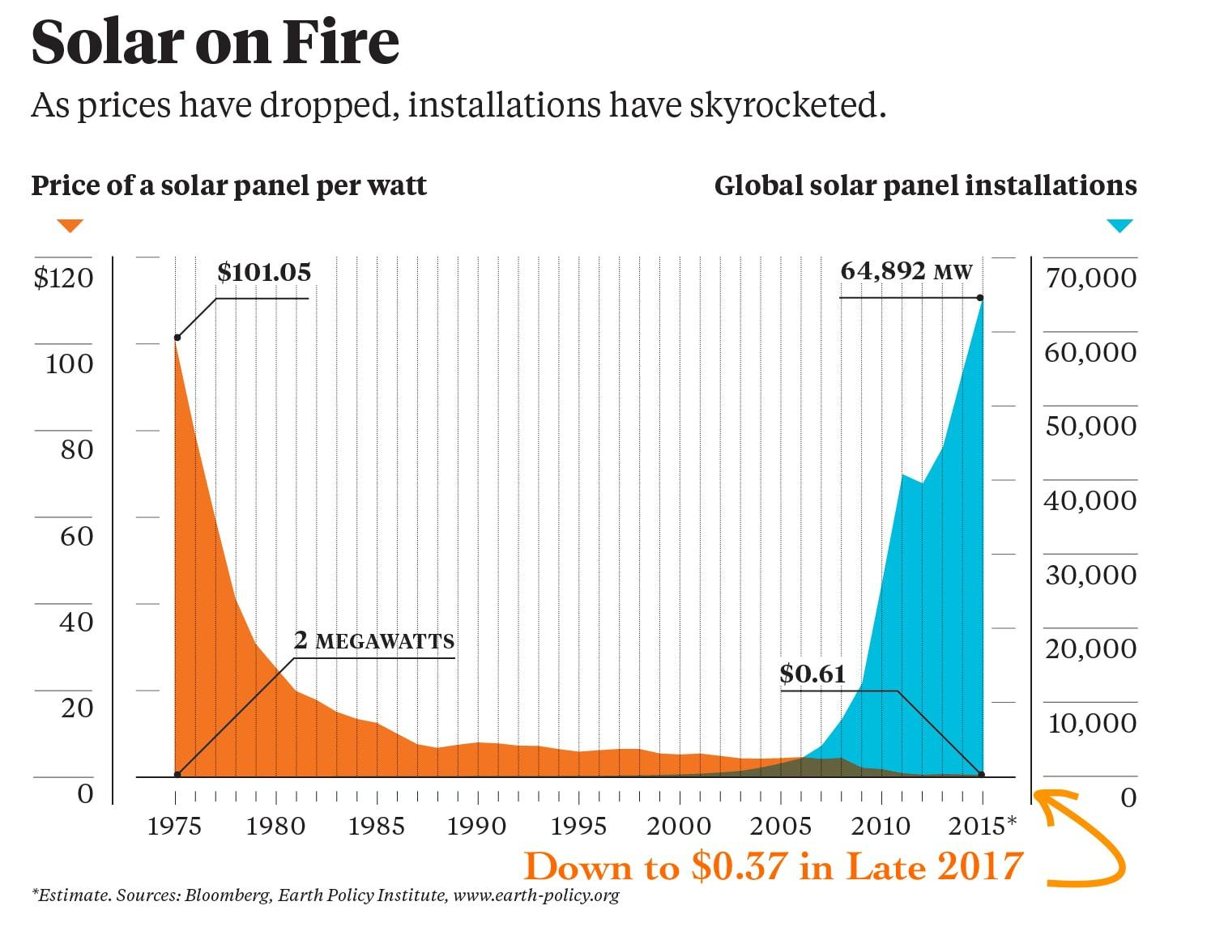
Supply/Demand
Law of Demand
CETERIS PARIBUS (“holding all other things constant”)
As prices rise, quantity demanded will fall; as prices fall, quantity demanded will rise.
WHY?
Income Effect - when price rises for a good or service, purchasing it takes up a greater share of your discretionary income.
Substitution Effect - when price rises for a good or service, consumers will purchase the good or service’s substitute

Slide 37
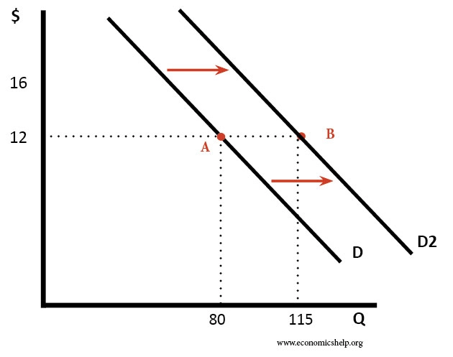
Supply/Demand
Shift in Demand

Slide 38
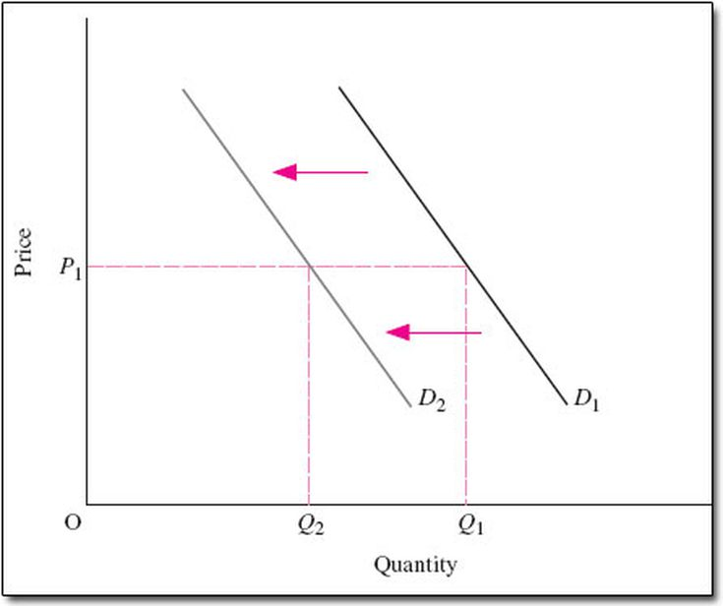
Supply/Demand

Slide 39
Supply/Demand
Factors that Cause a Shift in Demand (Increase or Decrease in Demand)
Consumer Preferences
Advertising/ Marketing
Population Level
Income Level
Normal Good: income increases, demand increases; income decreases, demand decreases
Examples:
Inferior Good: income increases, demand decreases; income decreases, demand increases
Examples:

Slide 40
Supply/Demand
Normal or Inferior?
https://forms.gle/sKgLWXco6ZEtGAW18

Slide 41
Supply/Demand
Factors that Cause a Shift in Demand (Increase or Decrease in Demand) Cont’d
Prices of Related Goods:
Complementary goods - goods that are bought and used together.
Assume that pancakes and maple syrup are complementary goods. If the price of pancakes increases, the quantity demanded for pancakes decreases; therefore the demand for syrup (pancake’s complement) decreases.
Substitute goods - goods that are used in place of one another.
Assume that pizza and hamburgers are substitute goods. If the price of pizza increases the quantity demanded for pizza decreases; therefore the demand for hamburgers (pizza’s substitute) increases.

Slide 42
Supply/Demand
Law of Supply
CETERIS PARIBUS . . .
As prices rise, the quantity supplied increases; as prices fall, the quantity supplied decreases
WHY?
At higher prices, suppliers make a larger profit so they have an incentive to produce/supply more of the good or service.
At lower prices, suppliers make a smaller profit so there is a disincentive to produce/supply more of the good or service.

Slide 43
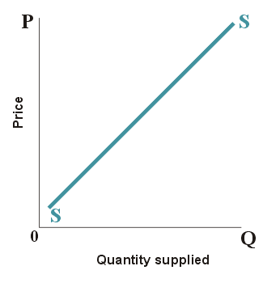

Slide 44
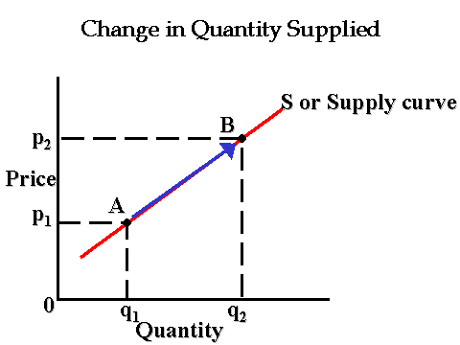

Slide 45
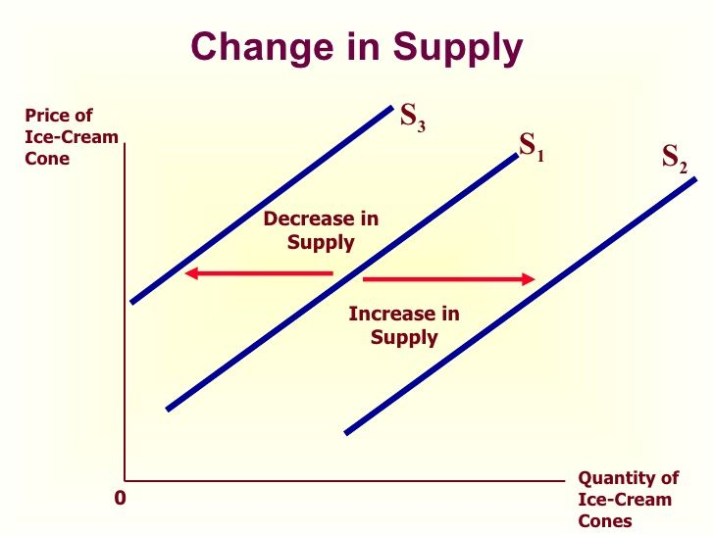

Slide 46
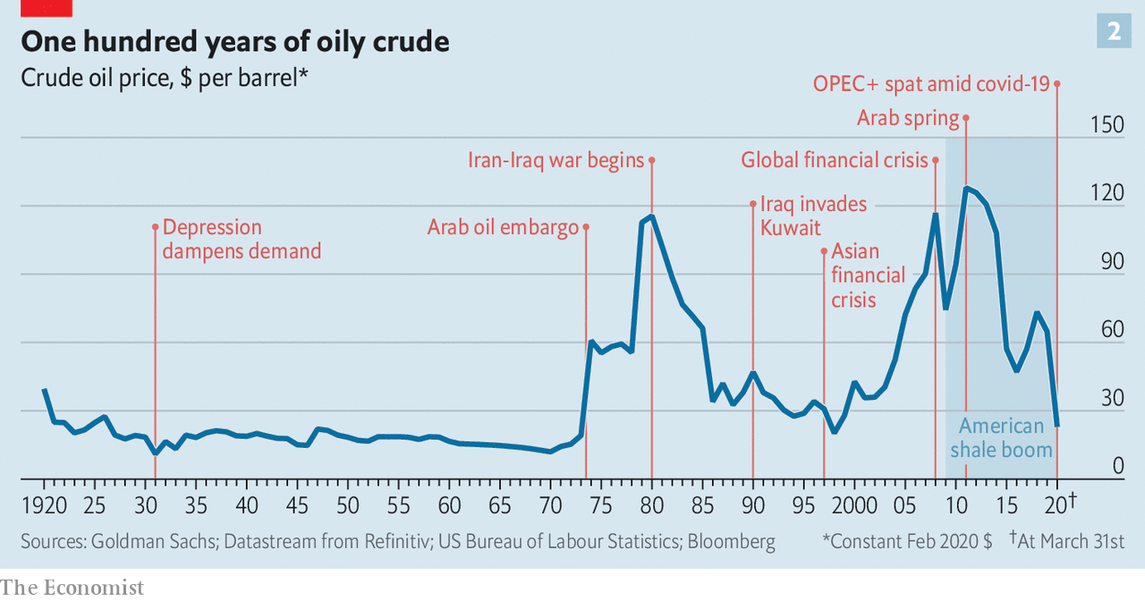

Slide 47
What factors cause a change in Supply (shift of the supply curve)?
Changes in the price of inputs/ resources used in production
Changes in the number of competitors in the market
Changes in technology/ productivity

Slide 49
DEMAND / SUPPLY FOR PIZZAS
PRICE | QUANTITY DEMANDED | QUANTITY SUPPLIED
$8 | 100 | 20
10 | 80 | 40
12 | 60 | 60
14 | 40 | 80
16 | 20 | 100

Slide 50
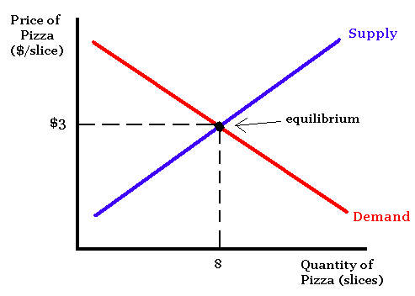

Slide 51
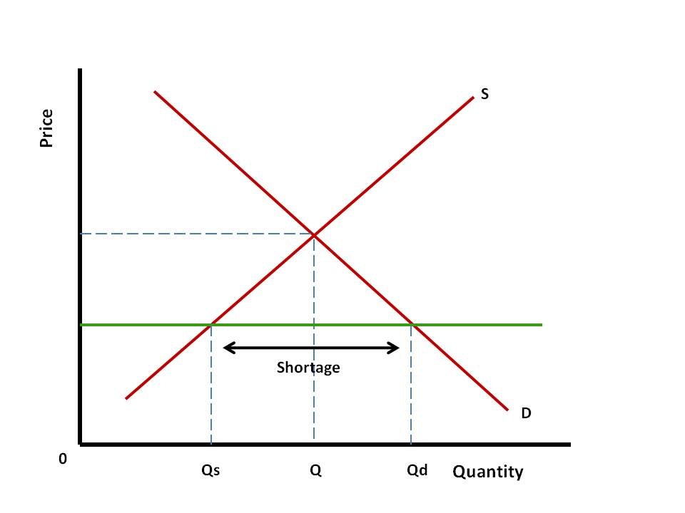

Slide 52
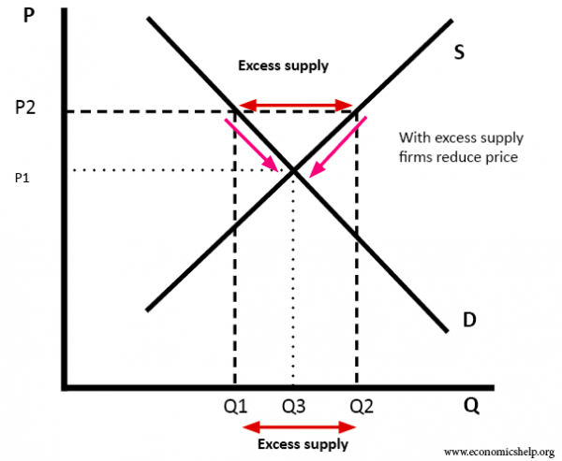

Slide 53
Graphing Example:
*The equilibrium price for a gallon of gas is $2.50. Draw a correctly labeled graph showing this. Now assume that there is an decrease in supply of oil worldwide. Draw a new curve (supply or demand) that reflects this change.

Slide 54
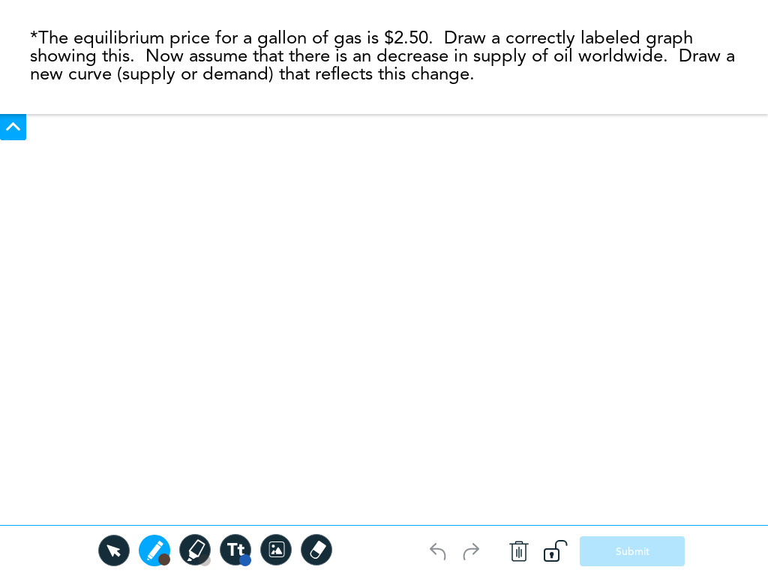
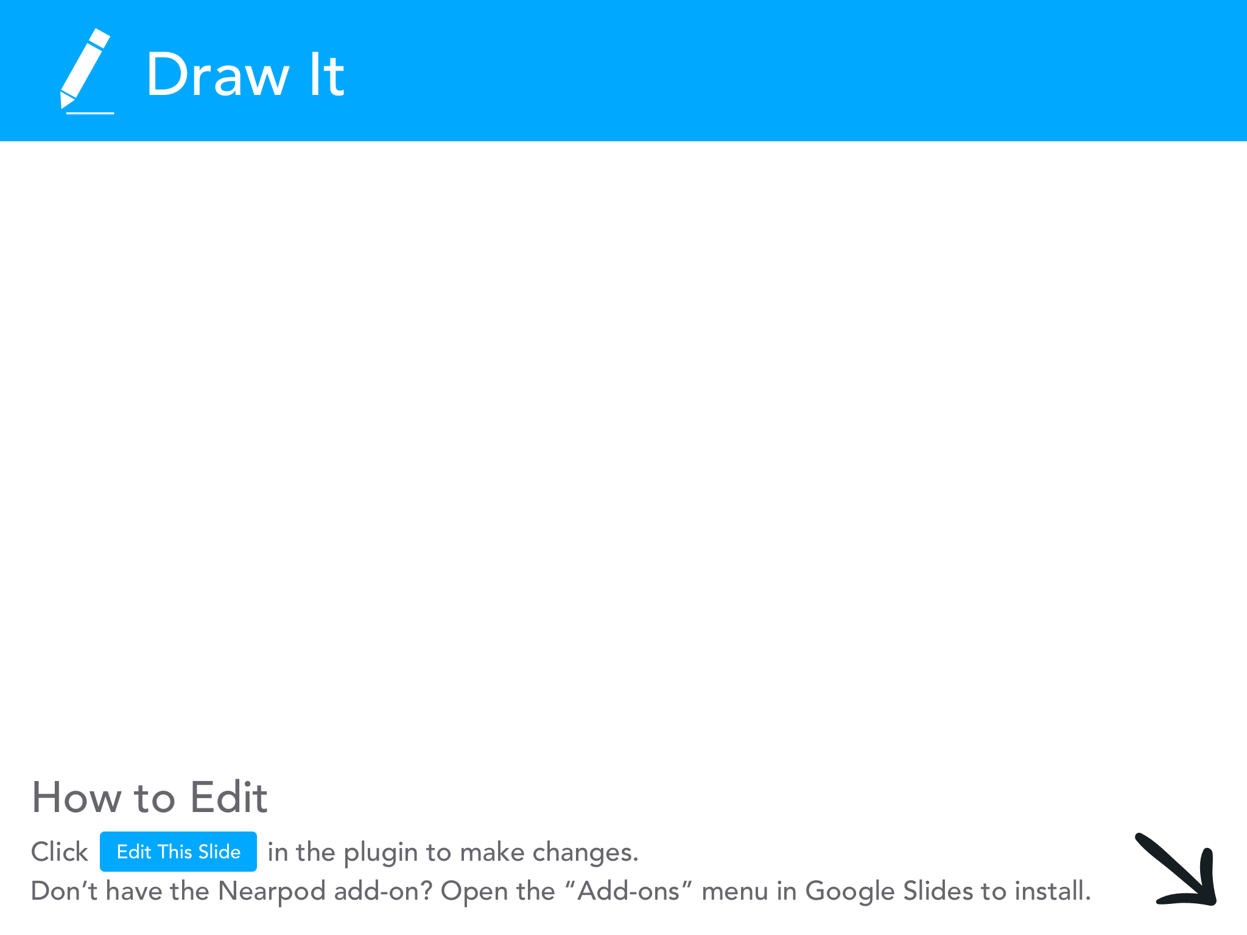

Slide 55
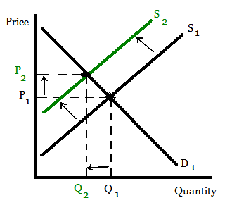

Slide 56
Graphing Example:
*The equilibrium price for a barrel of oil is $50. Draw a correctly labeled graph showing this. Now assume that there is a global economic expansion with a corresponding increase in production and shipping. Show this change on your graph using either an increase or decrease in supply / demand. What happens to the equilibrium price of oil?

Slide 58
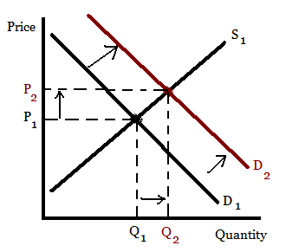

Slide 59
Sample Project:
Choose up to ten products.
Create a slide for each that includes the following:
Current market price
An analysis of the price - is it higher; lower; is the price influenced by high or low supply or demand.
Is it a normal or inferior good?
Include one substitute good and one complementary good
Is there a lot of competition and how might this influence supply?
Are there any increases in technology or productivity that might influence the future supply?
Where do you think the price of the product is heading?

Slide 60
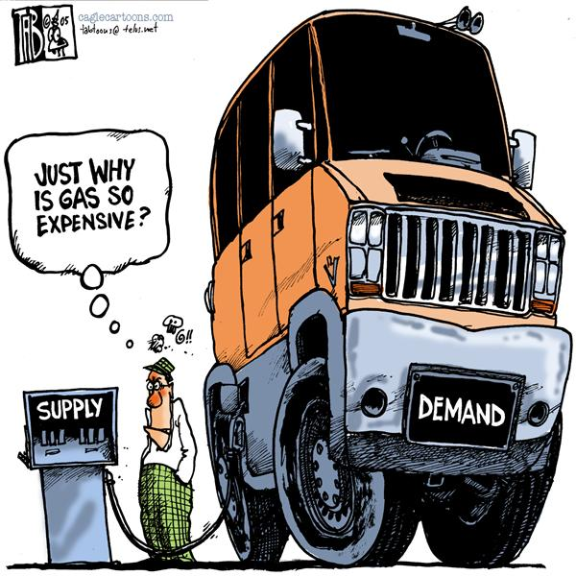

Slide 61
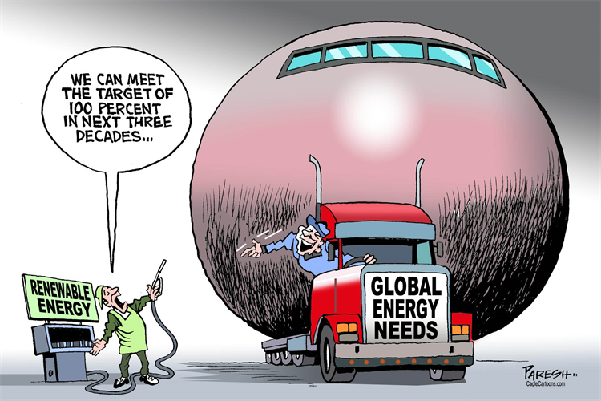

Slide 62
Why is supply/demand important in the “real world?”

Slide 63
Supply and Demand
Resources:
EconEdLink Lesson: Supply and Demand at the Gold Rush: https://www.econedlink.org/resources/economic-spotter-supply-and-demand-at-the-gold-rush/
EconEdLink Lesson: Who Determines Wages?:
https://www.econedlink.org/resources/who-decides-wage-rates/
EconEdLink Activity: Why Does Eli Manning Make $24 million a year?: https://www.econedlink.org/teacher-lesson/650/Why-does-Eli-Manning-Make-$24-million-per-year
EconEdLink Lesson: Where Does the Price of Pizza Come From?:
https://www.econedlink.org/resources/where-does-the-price-of-pizza-come-from/

Slide 64
Formative Assessment Option:
Kahoot
Go to kahoot.it

Slide 65
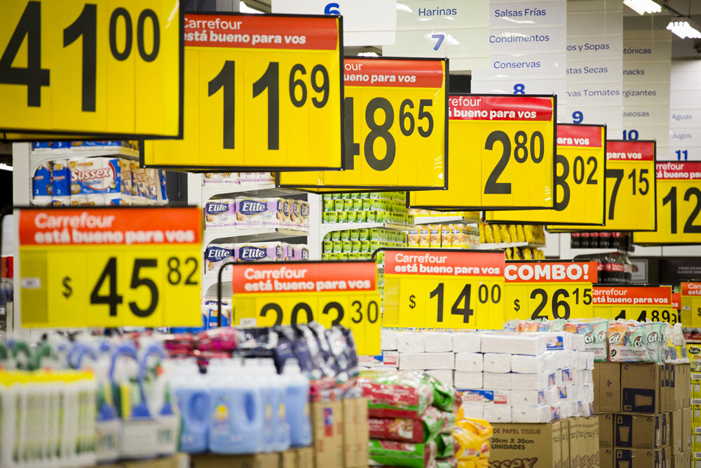
Elasticity

Slide 66
Elasticity
How responsive are consumers to changes in price?
To what extent will the quantity demanded change when the price of a good or service changes?

Slide 67
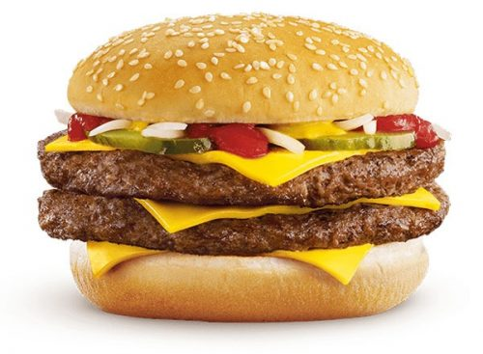
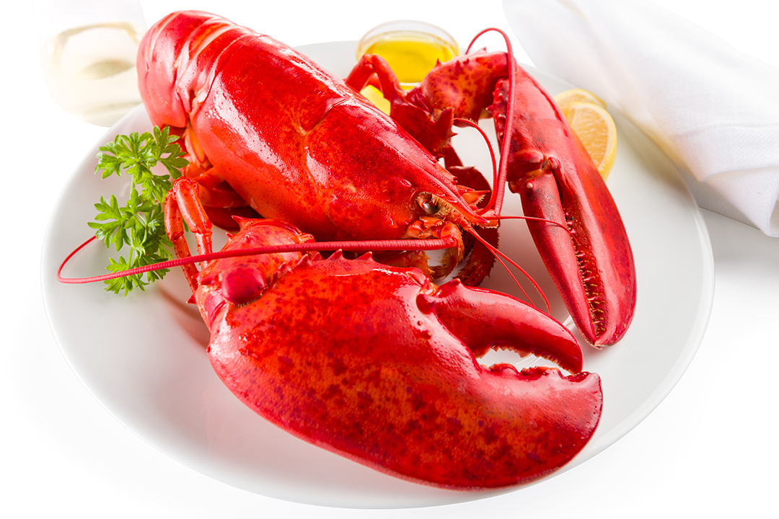
Elasticity

Slide 68
Elasticity
If the percentage change in quantity demanded is greater than the percentage change in price, demand is considered to be elastic.
If the percentage change in quantity demanded is less than the percentage change in price, demand is considered to be inelastic.
If the percentage change in quantity demanded is the same as the percentage change in price, demand is considered to be unit elastic.

Slide 69
Elasticity
Elastic: Consumers are highly responsive to price changes.
Inelastic: Consumers are relatively less responsive to price changes.
Examples of elastic goods?
Examples of inelastic goods?

Slide 70
Elasticity
What factors influence the elasticity of demand for specific goods and services?
How many close substitutes are there for a good/service?
How much of a typical consumer’s budget does the good or service take up?
How much time do consumers have to make a decision?

Slide 72
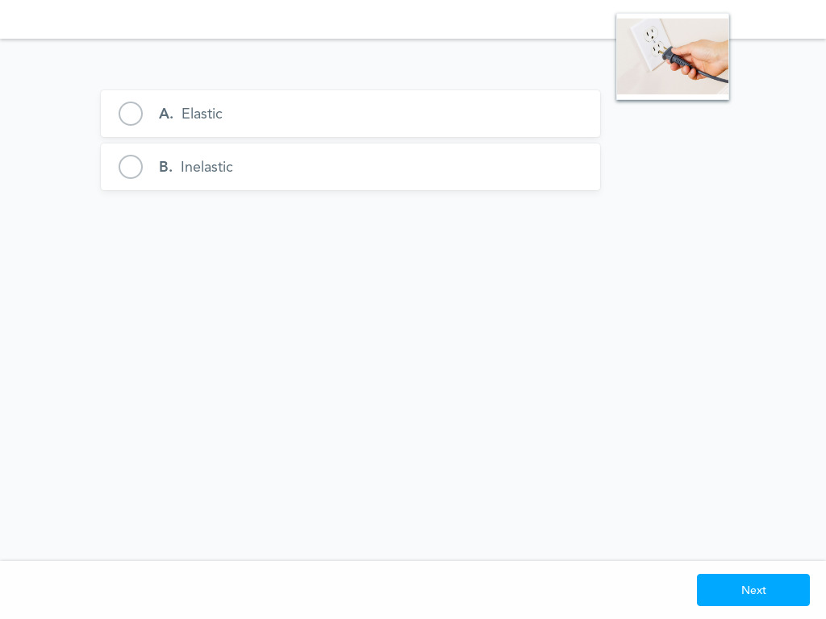

Slide 73
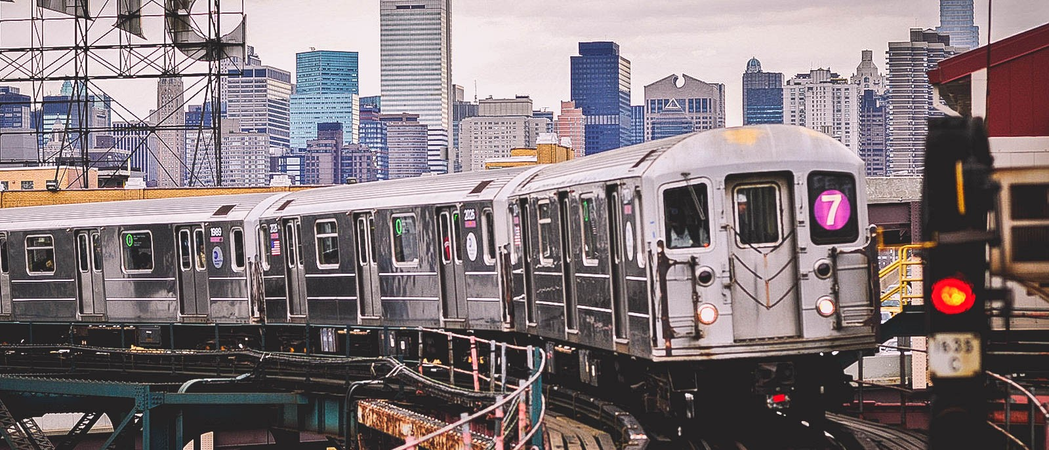

Slide 74
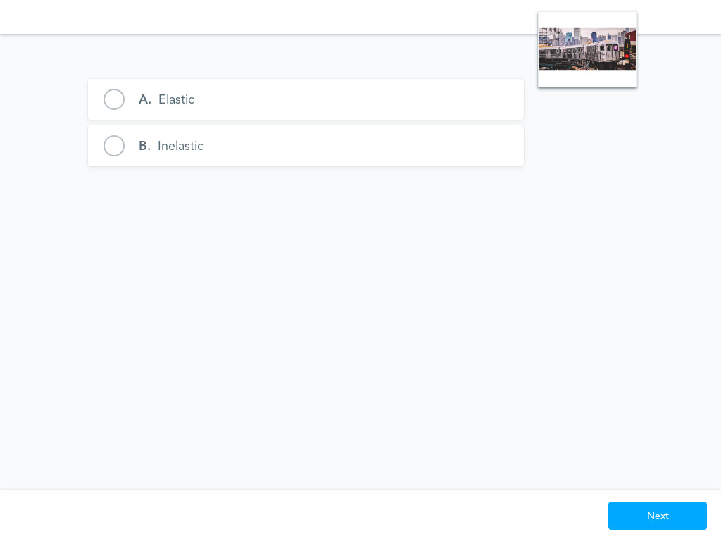

Slide 75
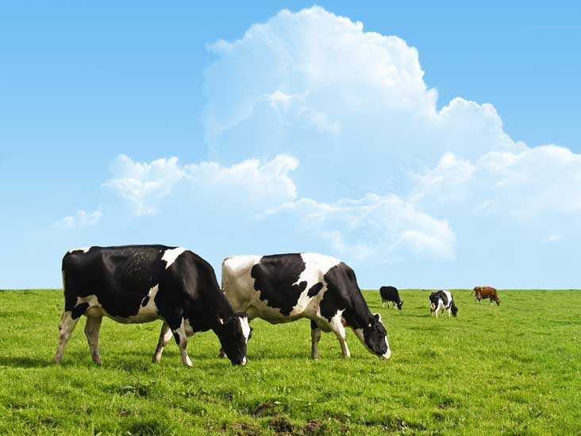

Slide 76
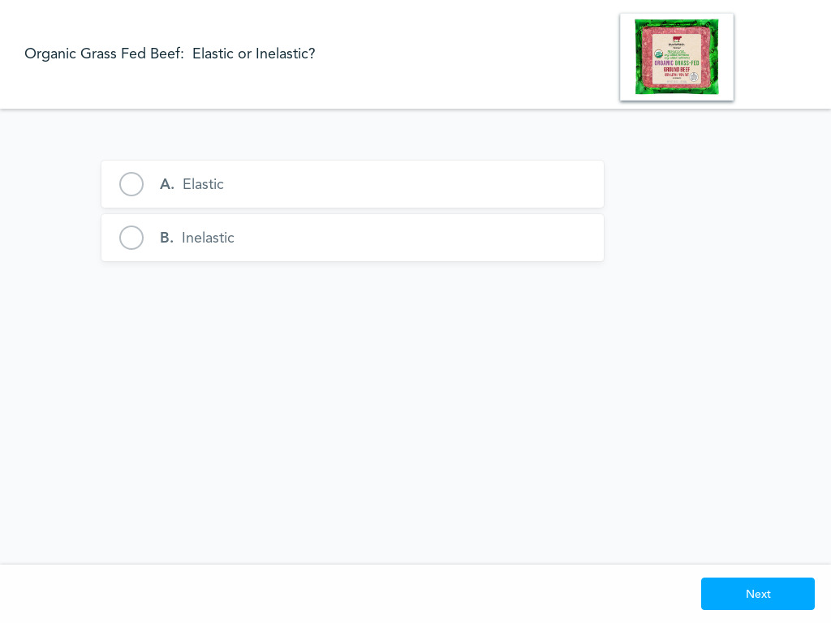

Slide 87
If the absolute value of the answer is greater than 1, demand is elastic
If the absolute value of the answer is less than 1, demand is inelastic
If the answer is equal to 1, demand is unit elastic
Calculating Elasticity:
Q2 - Q1
_______
Q1
____________
P2 - P1
______
P1
% change in quantity demanded / % change in price

Slide 88
Example:
The price of a subway fare is $3. At this price the quantity demanded is 100.
The price increases to $4 and the quantity demanded drops to 80.
Is demand for subway fares elastic or inelastic?

Slide 89
80 - 100 -20
_______ /2 = ___ /2 = -.056
80 + 100 180
__________ ____ ___ = [-.8] = 0.8
4 - 3 1
____ /2 = __ /2 = .07
4 + 3 7

Slide 90
Elasticity
Total Revenue Test
Total Revenue = Price x Quantity Sold
Demand is elastic if:
Price increases, total revenue decreases
Price decreases, total revenue increases
Demand is inelastic if:
Price increases, total revenue increases
Price decreases, total revenue decreases

Slide 91
Elasticity
Total Revenue Example:
The price of a subway fare is $3. At this price the quantity demanded is 100.
The price increases to $4 and the quantity demanded drops to 80.
Total Revenue 1 = $3 x 100 = $300
Total Revenue 2 = $4 x 80 = $320
Price increased and total revenue increased = _____________

Slide 92
Elasticity
Why is the concept of elasticity so important in the “real world”, especially for business firms?

Slide 93
Elasticity
Activities:
Students create a tutorial video on the issue of elasticity. In the video, they must teach the concept and interview at least two small business owners regarding their pricing decisions.
Students create an original skit centered on the concept of elasticity in which they portray consumers’ and producers’ reactions to pricing decisions.
Students choose a product and survey consumers regarding their reactions to various prices. The students then compile a table of data and corresponding graphs and conclude whether the product’s demand is elastic or inelastic.
Students create an original rap (can use a released song as a base) about the concept of elasticity.

Slide 94
b.socrative.com
Room: Opderbeck

Slide 95
Government Price Controls

Slide 96
Government Price Supports
In certain situations, the government intervenes in a market to establish minimum or maximum prices.
Price Floor - minimum price set by the government
Price Ceiling - maximum price set by the government

Slide 97
Government Price Controls
Price Floors - Minimum Wage
-Minimum price that employers must pay employees.
http://playspent.org/

Slide 98
https://www.epi.org/minimum-wage-tracker/
https://livingwage.mit.edu/

Slide 101
Is minimum wage fair?
Is minimum wage efficient?

Slide 102
Minimum Wage Survey
https://forms.gle/xciT3hGatt1naQcf7

Slide 103
Minimum Wage Simulation:
Round One:
A few students are solicited to be “managers” of a business that rearranges classroom furniture.
The rest of the class are workers seeking money to earn and spend for some incentive. (a lollipop, extra points, etc)
Students are hired in a free market with no minimum wage. They rearrange the room furniture as to the managers directions.
An equilibrium wage rate is established and a graph is drawn on the board.
Round Two:
Same as round one but the teacher now introduces and enforces a minimum wage. There should be a surplus of workers and some unemployment.

Slide 104
Background Information
Minimum Wage: Background, Arguments For/Against
https://drive.google.com/file/d/1Gll26pbBcmwfwfmLKBO0dKF_q33YqVDr/view?usp=sharing
Minimum Wage Webquest
https://docs.google.com/document/d/1_PjMfYPSSd2_GAEWz3J7dGSmuVEpRy8oLC8109oxagQ/edit?usp=sharing

Slide 105
Mock Congressional Hearing
Objective: Stage a mock Congressional hearing on whether the U.S. should enact a $15 minimum wage in the U.S. Students will be assigned or choose a role which they will fill during the hearing.
Procedure:
Teacher introduces the topic and provides some historical context.
Students are assigned roles. Here are some roles to use as examples.
Students research their roles and prepare for discussion. Here is a sample graphic organizer to help them prepare.
Stage a mock “Congressional Hearing” style meeting where students present in their roles and openly discuss the issue of agricultural price supports and their impact on the economy
Debrief with a formative assessment.

Slide 106
Price Floors - Agricultural Price Supports
-Minimum prices set by the government for farm produce
-Introduced in the 1930’s as farm prices dropped dramatically
Implementation:
*Isolate the domestic market through quotas and tariffs
*Introduce a price floor above equilibrium
*The government offers a subsidy to farmers in exchange for the surplus
*The government distributes surplus in foreign markets or offers as direct aid

Slide 110
Consequences of Agricultural Price Controls:
-Artificially high agricultural commodity prices
-Arbitrary enforcement of which products are supported
-Subsidies go to corporate “farmers” who donate to politicians
-Over production of cheap processed food
-Environmental consequences
-Depressed prices in less developed foreign markets

Slide 113
Agricultural Price Support Simulation:
Round 1: Three students represent “farmers” from the U.S. and two other nations. Rest of class is given fake money. The farmers sell a product (pretzels, M&M’s, etc.). An equilibrium price is established and a graph is drawn on the board.
Round 2: The teacher removes the two foreign farmers and explains that quotas and tariffs are introduced.
The teacher introduces a price support (price floor)
Students purchase the produce at the new higher price. There should be a surplus
The teacher then buys the surplus and pays the U.S. farmer a subsidy
The teacher sells the surplus in the foreign markets.

Slide 114
Mock Congressional Hearing
Objective: Stage a mock Congressional hearing on the economic impact of Farm Subsidies in the U.S. Students will be assigned or choose a role which they will fill during the hearing.
Procedure:
Teacher introduces the topic and provides some historical context.
Students are assigned roles. Here are some roles to use as examples.
Students research their roles and prepare for discussion. Here is a sample graphic organizer to help them prepare.
Stage a mock “town hall” style meeting where students present in their roles and openly discuss the issue of agricultural price supports and their impact on the economy
Debrief with a formative assessment.

Slide 115
Price Ceilings - Rent Control
-Maximum prices allowed to be charged in housing rental markets.
-Designed to help the working class afford housing in urban locations.

Slide 117
Rent Control

Slide 119
Consequences of Rent Control:
Positive:
Helps tenants afford rent
Prevents mass displacement
Allows tenants to invest in their communities
Negative:
Blocks voluntary exchange
Promotes black market activity (ex: “key fees”)
Could lead to poor housing quality
Lost resources - increased search activity

Slide 121
Rent Control Activity
Divide room into four quarters. Each quarter is a model “apartment” owned by a selected “landlord.”
Each landlord delivers a sales pitch to the “tenants” (rest of class)
Teacher gives varying fake money amounts to tenants.
Round 1: Tenants rent apartments from landlords in a free market. Establish a city wide equilibrium price.
Round 2: Teacher establishes a rent control in one of the quarters. Tenants rent apartments again. There should be excess demand in the rent controlled area.

Slide 122
Government Price Controls
Price Controls Activity:
Role Playing Debate: Assign students a role. They research the role and formulate arguments supporting their position. The teacher sets up a “town meeting” in which students voice their opinions on the various types of rent control.
Examples of roles:
https://docs.google.com/document/d/1LzJx-dM_juGiy7udK5ziNczCfFqZQmseq3SqF281wuc/edit?usp=sharing

Slide 123
Econ Ed Link Lessons:
EconEdLink Rent Control Lesson: https://www.econedlink.org/teacher-lesson/47/Who-Knows-What-Inefficiencies-Lurk-Hearts-Rent-Controlled-Housing-Markets-Shadow-Market-Knows
EconEdLink Minimum Wage Lesson:
https://www.econedlink.org/resources/minimum-wage-the-challenge-of-living-on-it/
EconEdLink Agricultural
https://www.econedlink.org/resources/the-economics-of-the-family-farm/

Slide 124
Formative Assessment Option: Blooket.com

Slide 125
Externalities

Slide 126
Externalities
Externality: a consequence of an economic transaction/activity experienced by an unrelated third party.
Positive externality: a positive consequence that falls on a third party unrelated to the original economic transaction.
Negative externality: a negative consequence that falls on a third party unrelated to the original economic transaction.

Slide 127
Externalities
Examples:
A factory opens that dumps industrial waste into nearby waterways.
A consumer purchases fairtrade coffee from a retailer.
An energy company fracks for natural gas. Several earthquakes result that cause property damage.
A college student gains a degree in social work.
A solar power farm opens in a desert.
A Wal-Mart opens in a small town.

Slide 128
Government Intervention:
Negative Externalities:
Tax on production
Emission Charges
Marketable Permits
Positive Externalities:
Subsidies
Vouchers
Provide as a public good

Slide 129
Federal Energy Subsidies 2010

Slide 132
Assessment Questions
In what ways do supply and demand determine market prices?
Why is the concept of elasticity such an important determinant of setting prices for business firms?
Are price controls necessary in a free market economy? Do they do more harm than good?
How can the government respond in light of negative and positive externalities?
Is consumer behavior generally rational and predictable?

Slide 134
References
Khan Academy: https://www.khanacademy.org/economics-finance-domain/microeconomics
Mr. Clifford EconMovies: https://www.youtube.com/channel/UCCQEbqDL8i40d83Au55lYMQ
Investopedia: https://www.investopedia.com/terms/l/law-of-supply-demand.asp

Slide 135
CEE Affiliates
https://www.councilforeconed.org/resources/local-affiliates/

Slide 136
Thank You to Our Sponsors!

