Slide 1
Macroeconomics Summer Institute Engaging Activities to Help Students See the Big Picture Day 2: Monetary Policy, Inflation, Unemployment, Redlining, Government Spending John Kruggel JMU Center for Economic Education 7/16/21 kruggejb@jmu.edu

Slide 2
EconEdLink Membership
You can now access CEE’s professional development webinars directly on EconEdLink.org! To receive these new professional development benefits, become an EconEdLink member. As a member, you will now be able to:
Automatically receive a professional development certificate via e-mail within 24 hours after viewing any webinar for a minimum of 45 minutes
Register for upcoming webinars with a simple one-click process
Easily download presentations, lesson plan materials and activities for each webinar
Search and view all webinars at your convenience
Save webinars to your EconEdLink dashboard for easy access to the event
You may access our new Professional Development page here

Slide 3
Professional Development Certificate
To earn your professional development certificate for this webinar, you must:
Watch a minimum of 45-minutes and you will automatically receive a professional development certificate via e-mail within 24 hours.
Accessing resources:
You can now easily download presentations, lesson plan materials, and activities for each webinar from EconEdLink.org/professional-development/

Slide 4
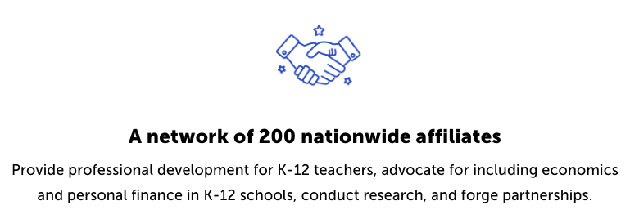
CEE Affiliates
https://www.councilforeconed.org/resources/local-affiliates/

Slide 5
https://bit.ly/CEEConference2021

Slide 6
60th Financial Literacy and Economic Education Conference
September 29th - October 1st, 2021
2-7 PM ET Daily
$20 discount for Summer Institute attendees
Register
https://councilforeconed2021.us2.pathable.com/
Promo Code
CEE60SI
SEE YOU THERE!!!

Slide 7
How did we do? Let us know! Please complete our survey: https://www.surveymonkey.com/r/SummerInstitute2021

Slide 8
Agenda
5 mins: Introduction, objectives and standards
20 mins: Some like it hot, what does it mean when the Fed heats up the economy?
25 mins: Inflation: Friend or foe?
15 mins: Out with the old! What are the new tools the Fed uses for monetary policy?
35 mins: Can monetary policy defeat unemployment?
35 mins: Can banks help marginalized populations?
35 mins: Is government crowding out small business or is it growing the pie?
10 mins: Assessment questions

Slide 9
Objectives
Teachers will:
Gain access to activities they can use to bring timely macroeconomic topics to their students.
Explore how to adapt existing activities to address current events in the classroom.
Utilize additional resources they can use to integrate macroeconomic concepts into their existing curriculum.

Slide 10
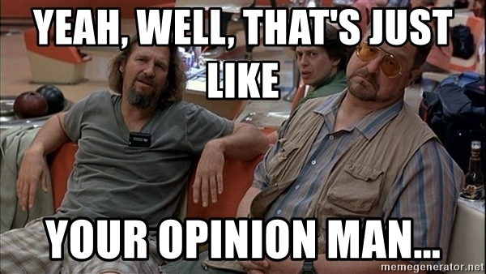

Slide 11
Macroeconomics
Macroeconomics gets a bit of a bum wrap because when we NEED macro theory to work (recessions), we NEED it to be both accurate and effective.
If macroeconomists are off even a little, people’s livelihoods are at stake.
But, that’s just my opinion man...

Slide 12
National Standards
Standard 11: Money and Inflation: Money makes it easier to trade, borrow, save, invest, and compare the value of goods and services. The amount of money in the economy affects the overall price level. Inflation is an increase in the overall price level that reduces the value of money.
Standard 16: Role of Government and Market Failure: There is an economic role for government in a market economy whenever the benefits of a government policy outweigh its costs.
Standard 19: Unemployment and Inflation: Unemployment imposes costs on individuals and the overall economy. Inflation, both expected and unexpected, also imposes costs on individuals and the overall economy. Unemployment increases during recessions and decreases during recoveries.
Standard 20: Fiscal and Monetary Policy: Federal government budgetary policy and the Federal Reserve System’s monetary policy influence the overall levels of employment, output, and prices.

Slide 13
Nearpod Info
This presentation will use Nearpod to help demonstrate a number of the activities.
Nearpod has a maximum capacity of 150 participants.
We have 300 or so registrations.
We will operate on a first come, first served allocation for Nearpod.

Slide 14
Introductions
The next slide will use Nearpod to give us a chance to see where everyone is from and what you teach.
Recall, we are operating on the first come, first served method of allocating spots for Nearpod.

Slide 16
Some Like it Hot
What does it mean when the Fed heats up the economy?

Slide 17
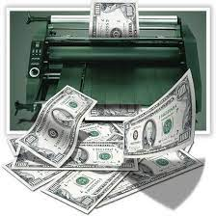
What does it mean to run the economy hot?
Running a hot economy is when monetary and/or fiscal policy focuses on lowering unemployment below the normal level and growing the economy to boost spending by both consumers and businesses.
Basically, sacrificing inflation to lower unemployment.

Slide 18
Why would the Fed want to run the economy hot?
It should create lower unemployment and nominal and real wage gains, especially for lower wage earners and marginalized populations.
It could also help low skill workers gain training to achieve upward mobility.
This is especially of interest given the concerns of a K-shaped recovery.

Slide 19
What are the downsides to running it hot?
The near zero interest rates make stocks more valuable, which could actually increase inequities in wealth.
Overvaluation of stocks could lead to another asset bubble.
Higher inflation could disproportionately impact lower wage earners.

Slide 20
What are some people warning about?
Inflation is becoming a major talking point.
Are we seeing an overheating of the economy?
Is this inflation transitory (brief/short-lived)?
Are we in the beginning of a wage-price spiral like the 1970s?
Let’s look at a GREAT one page reading you can use to introduce some of the information you need.

Slide 21
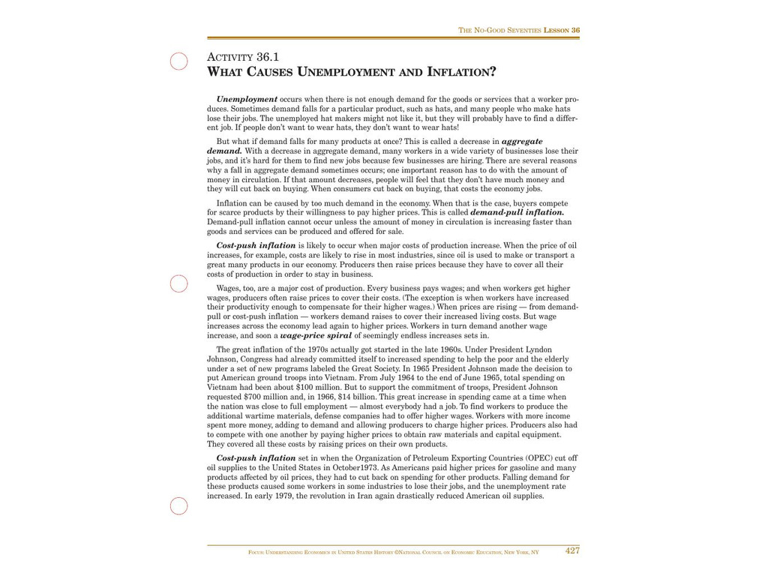
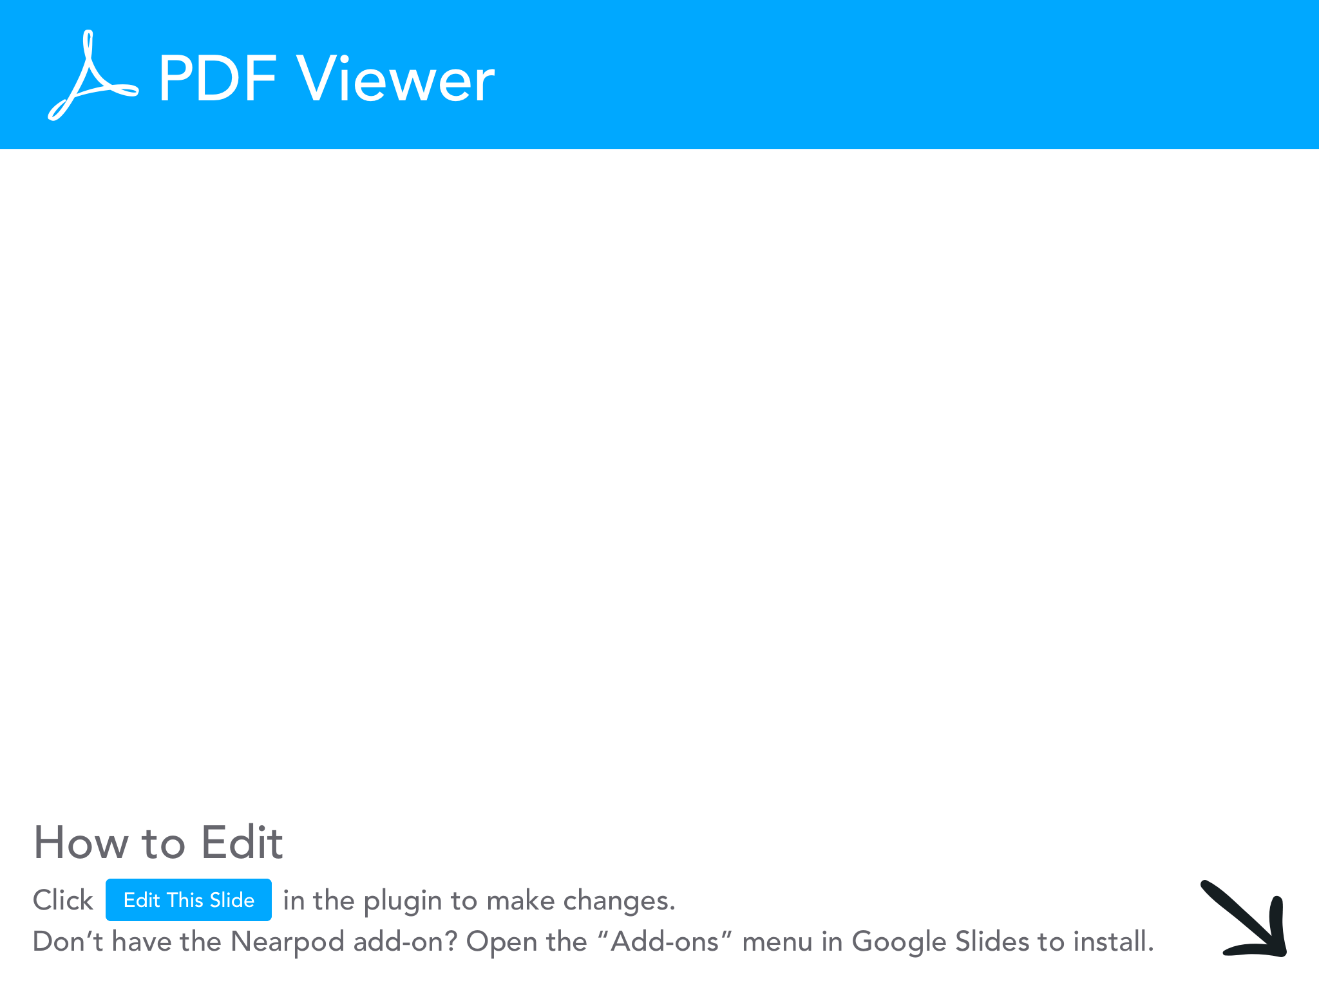

Slide 22
Something to consider
The Fed was created in 1913 in an effort to end (or reduce) the numerous financial panics (recessions) of the 1800s.
The Fed was given a dual mandate in 1977 to maintain price stability and promote maximum employment.
Is the Fed risking running afoul of their dual mandate by running the economy hot?

Slide 23
Inflation!
Friend or foe?

Slide 24
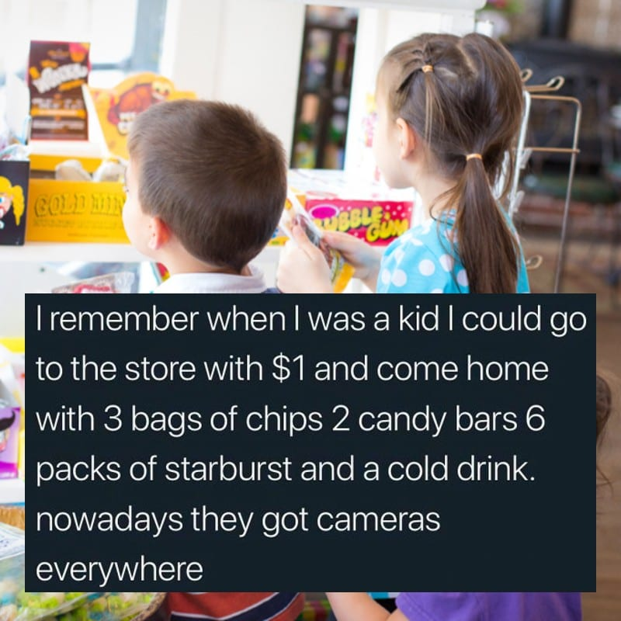

Slide 25
Inflation Activity
Inflation is a sustained increase in the average price level of all the goods/services produced in the economy.
This activity is an easy way to illustrate how increasing the money supply can lead to inflation. Which would help when discussing the Fed running the economy hot.
You will need either 2 sets of beans (one white and one black) or 2 sets of fake money (ones and fives).
You will also need 2 matching sets of 3 desirable items for an auction.

Slide 26
Auction
Items | Round 1 | Round 2
Totals

Slide 27
So, is inflation good or bad?
The BEST answer in economics is “it depends.”
If you are on a fixed income (Social Security), inflation shrinks your spending power.
However, stable levels of inflation helps grow the economy.
The Bank of Jamaica probably puts it best.

Slide 28
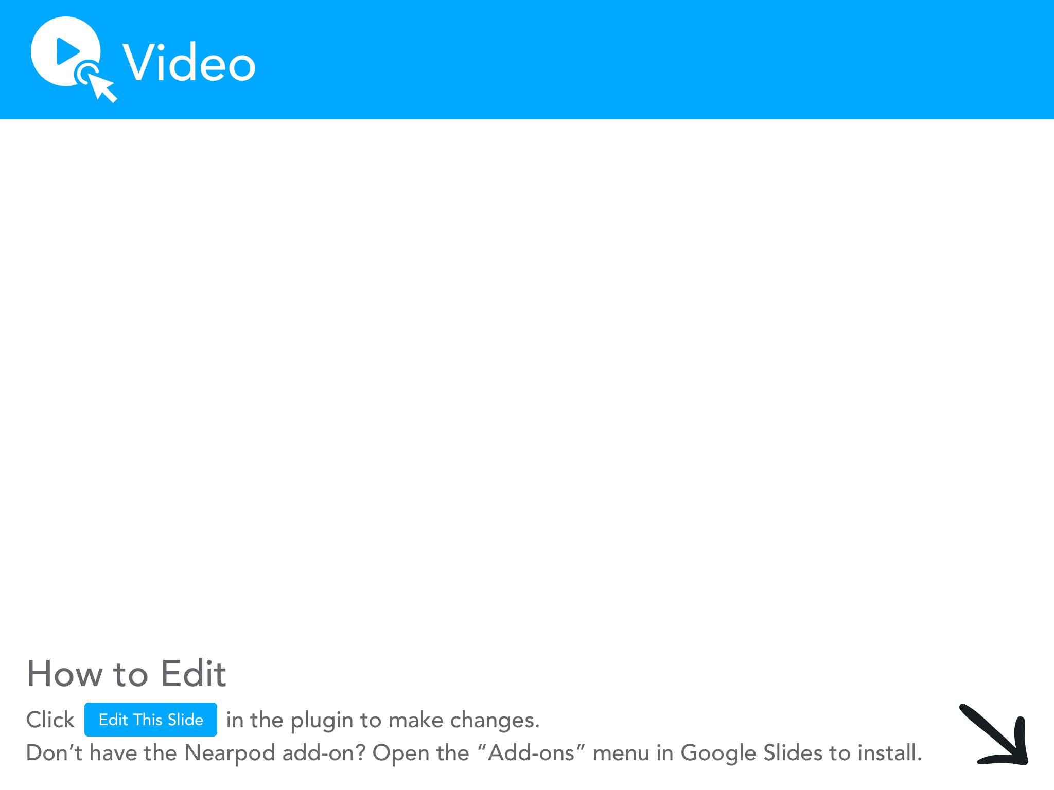

Slide 29
Possible Extension
This extension helps students understand the connection between the money supply and inflation.
Print off 5 sheets of paper with M, V,=,P, and Q in large print.
Have 5 students hold each sign in front of the class in the order of MV=PQ.
Either print the definitions of each term on the back of each paper and have the students read them….
Or, display the definitions for the class to see.
Let’s see how you do with the definitions for each…

Slide 30
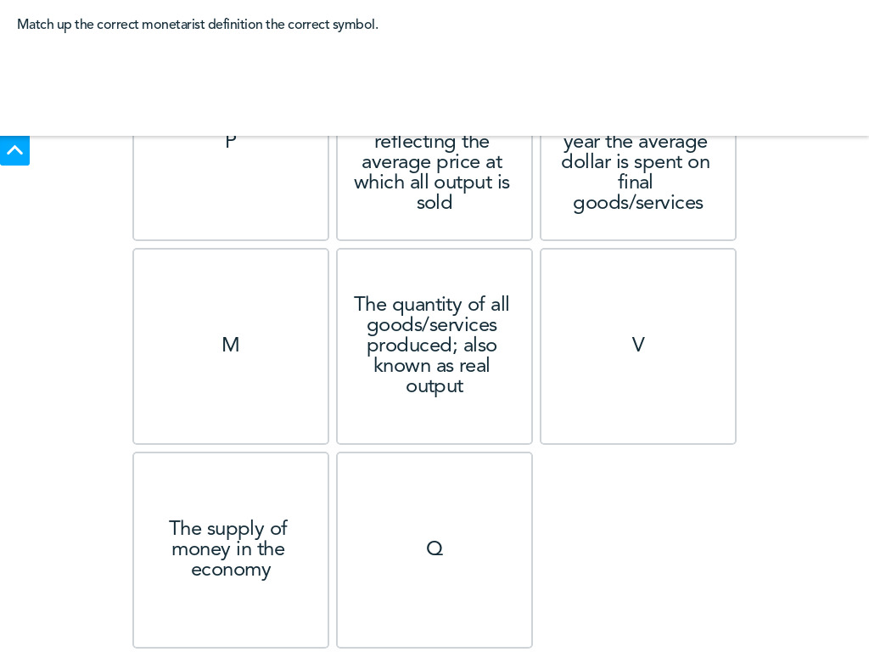

Slide 31
Answers
M: the supply of money in the economy.
V: the velocity of money, or the number of times a year that the average dollar is spent on final goods/services.
P: the overall price level in the economy, reflecting the average price at which all output is sold.
Q: the quantity of all goods/services produced; also known as real output.

Slide 32
MV=PQ
The equation MV=PQ is a simple model of a macro economy during a time period.
MV represents the total amount spent by buyers in the economy. (demand side)
PQ represents the total amount received by sellers, so they two must be equal. (supply side)
If there is a change in one of the variables, there must be a change in one of the other variables to keep MV equal to PQ.
Here’s how you can demonstrate that with students.

Slide 33
MV=PQ
Get chairs for 4 of the students holding the M, V, P, and Q cards (student with = stands).
Have the 4 students all sit.
Tell the student with the M card there has been an increase in the money supply (they should stand).
Ask P what they should do if V and Q stay seated (they should stand).
WHY?

Slide 34
MV=PQ
An increase in the money supply will cause an increase in the price level.
Tell the students the velocity of money may increase during bouts of inflation, ask V what they should do if there’s inflation (stand).
Ask P what they should do if M and Q stay seated and V is standing? (stand).

Slide 35
Lifetime Inflation Activity
We’re going to look at an activity to help students plot out inflation over their lifetime.
Something to consider with inflation, is it better to see the value of a dollar throughout your lifetime or to measure how many hours it takes to earn something?
Example: How many hours did the median earner have to work in 1979 to pay for a couch vs. 2021?

Slide 36
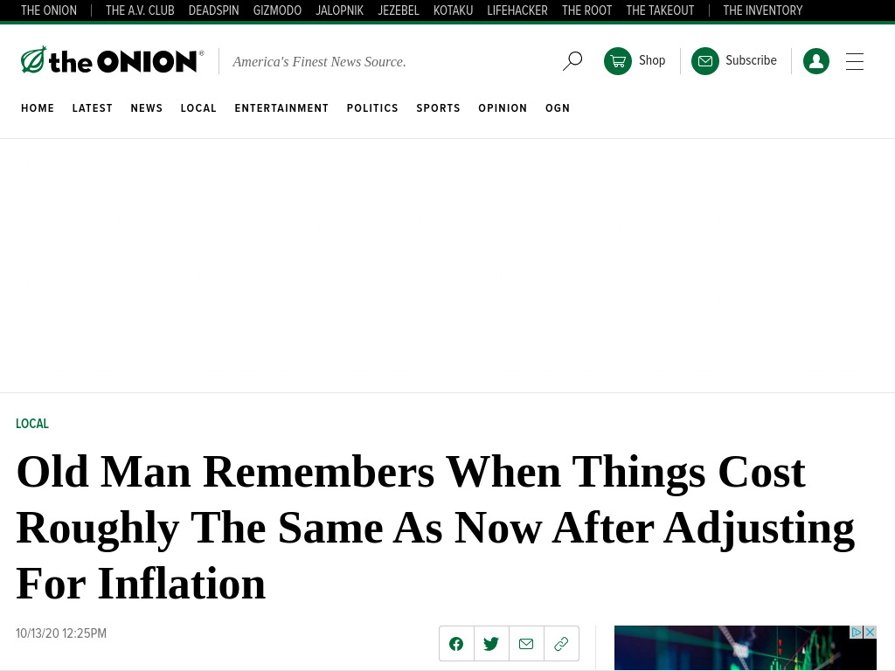
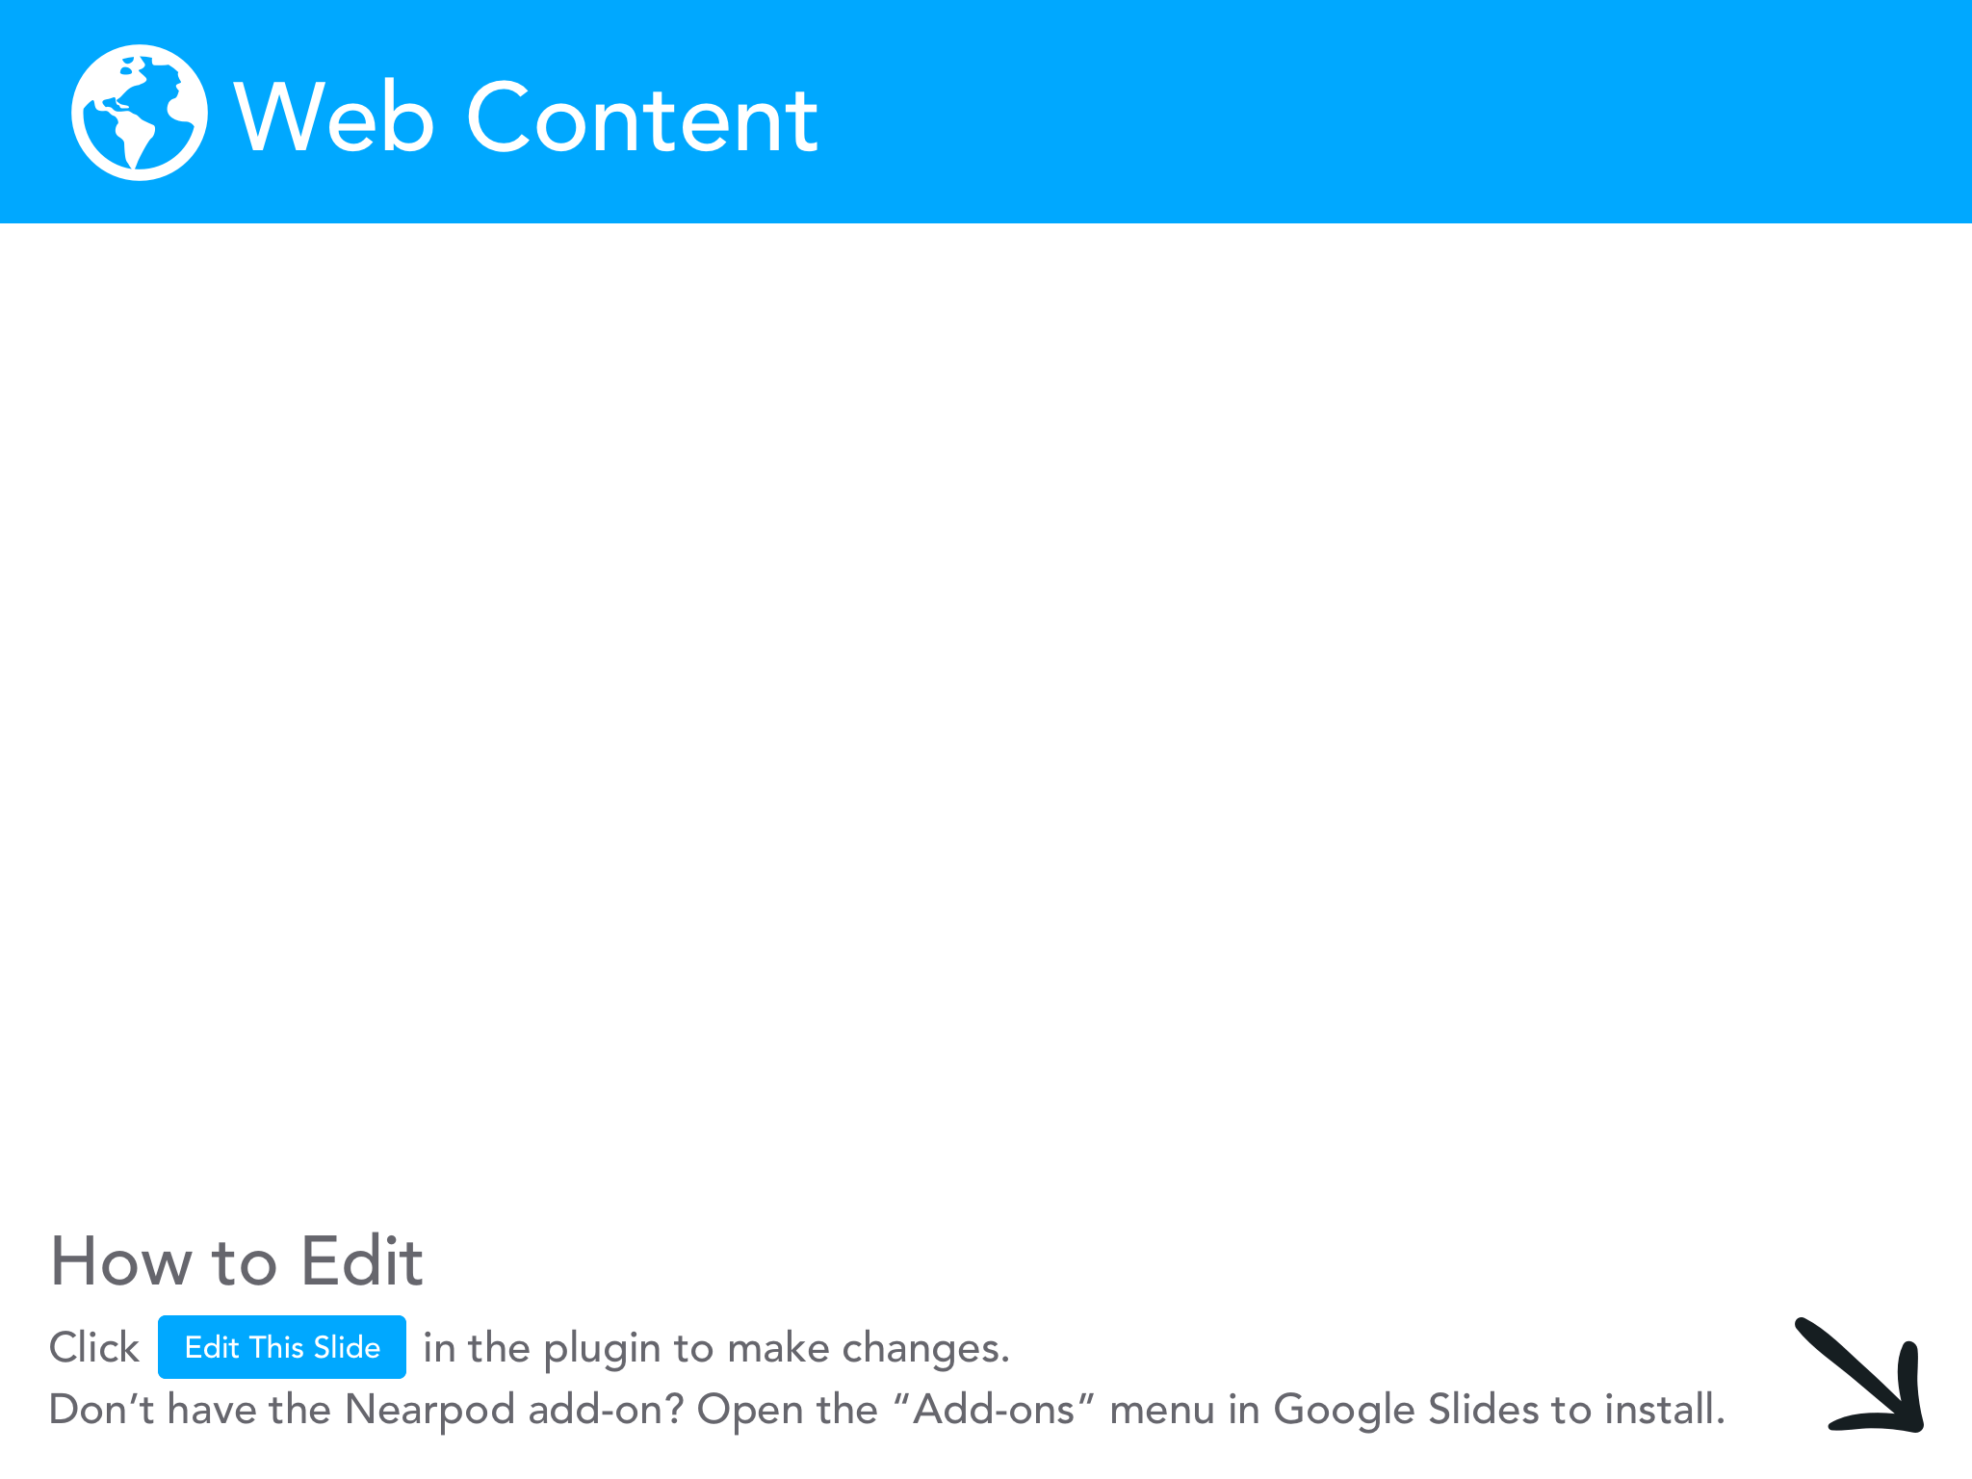

Slide 37
Lifetime Inflation Activity
This activity is a GREAT way to introduce your students to FRED (Federal Reserve Economic Database) while teaching about inflation by creating a graph in FRED.
We will walk through the steps of the activity, then we will take time to create our own graphs to see what it will be like for your students.

Slide 38
Lifetime Inflation Activity
Step 1: go to https://fred.stlouisfed.org/
Step 2: type “consumer price index” into the search bar.
Step 3: click on Consumer Price Index for All Urban Consumers

Slide 39
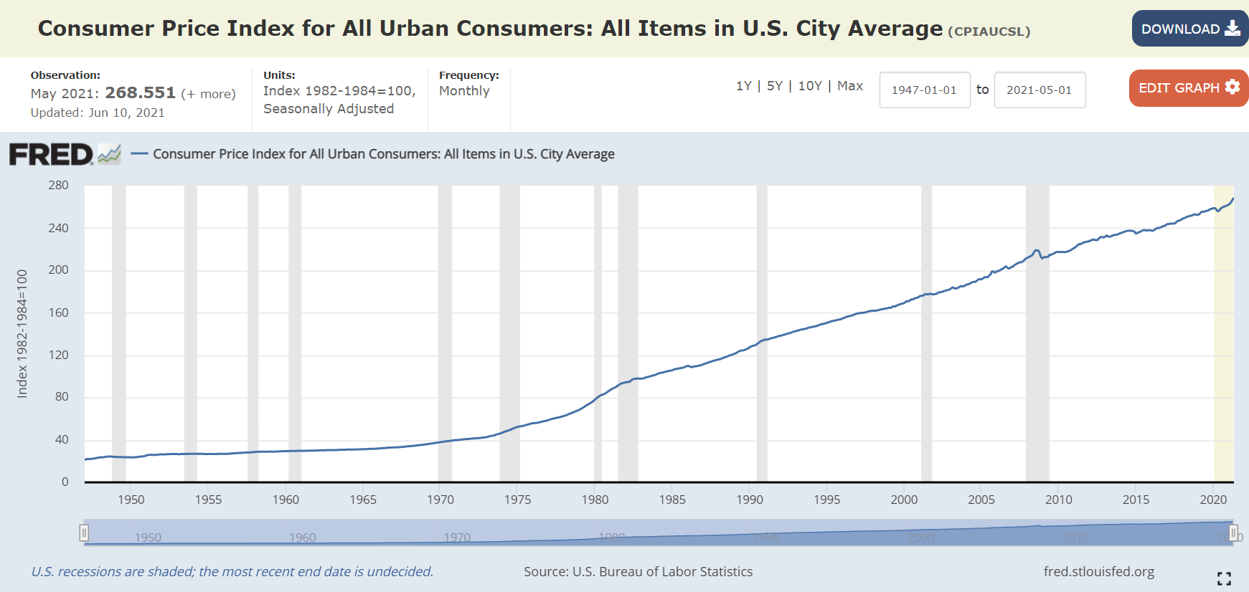
Graph
Enter the year and month of your birth here

Slide 40
Graph
AFTER you entered your DOB click Edit Graph

Slide 41
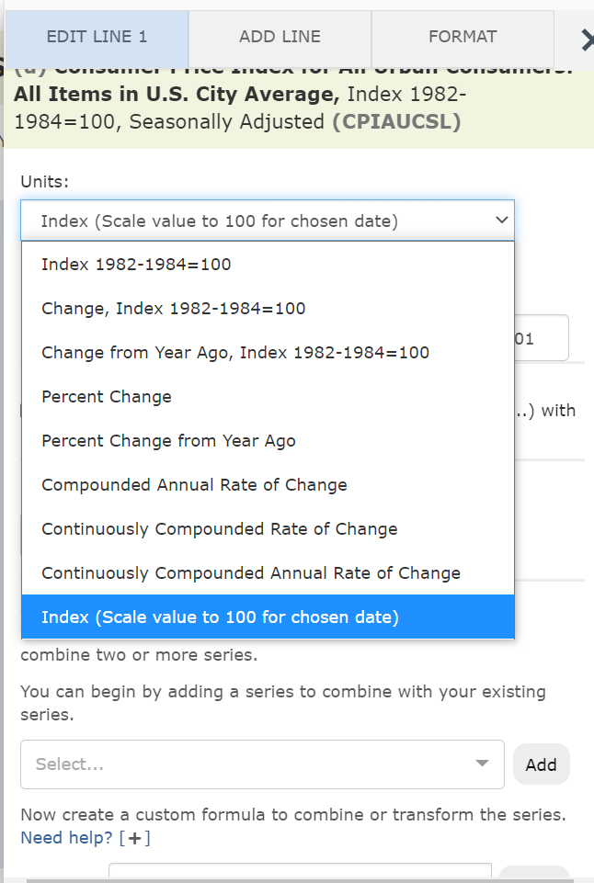
Graph
Now you need to adjust the CPI to start on your DOB.
Click on “Units”
Use the drop-down menu to pick “Index (scale value to 100 for chosen date).

Slide 42
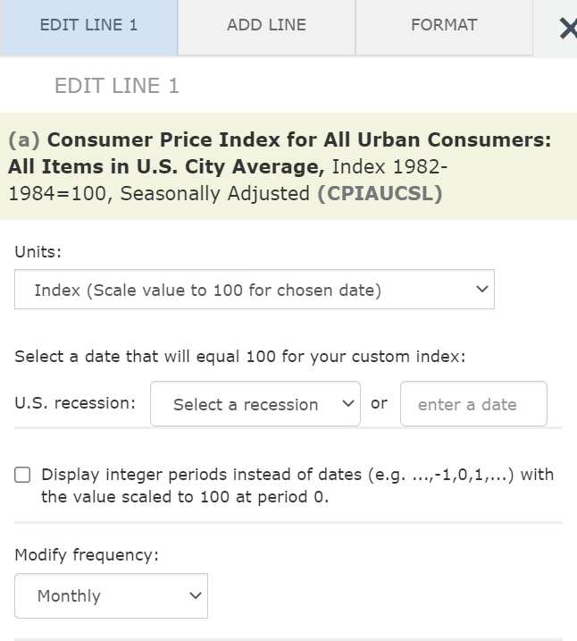
2 options
After you set the “Units” to Index (Scale value to 100…) you can select the date that will equal 100 (base for the index).
You can choose either a recession OR enter a date.
You need to enter as: YYYY, MM, DD.

Slide 43
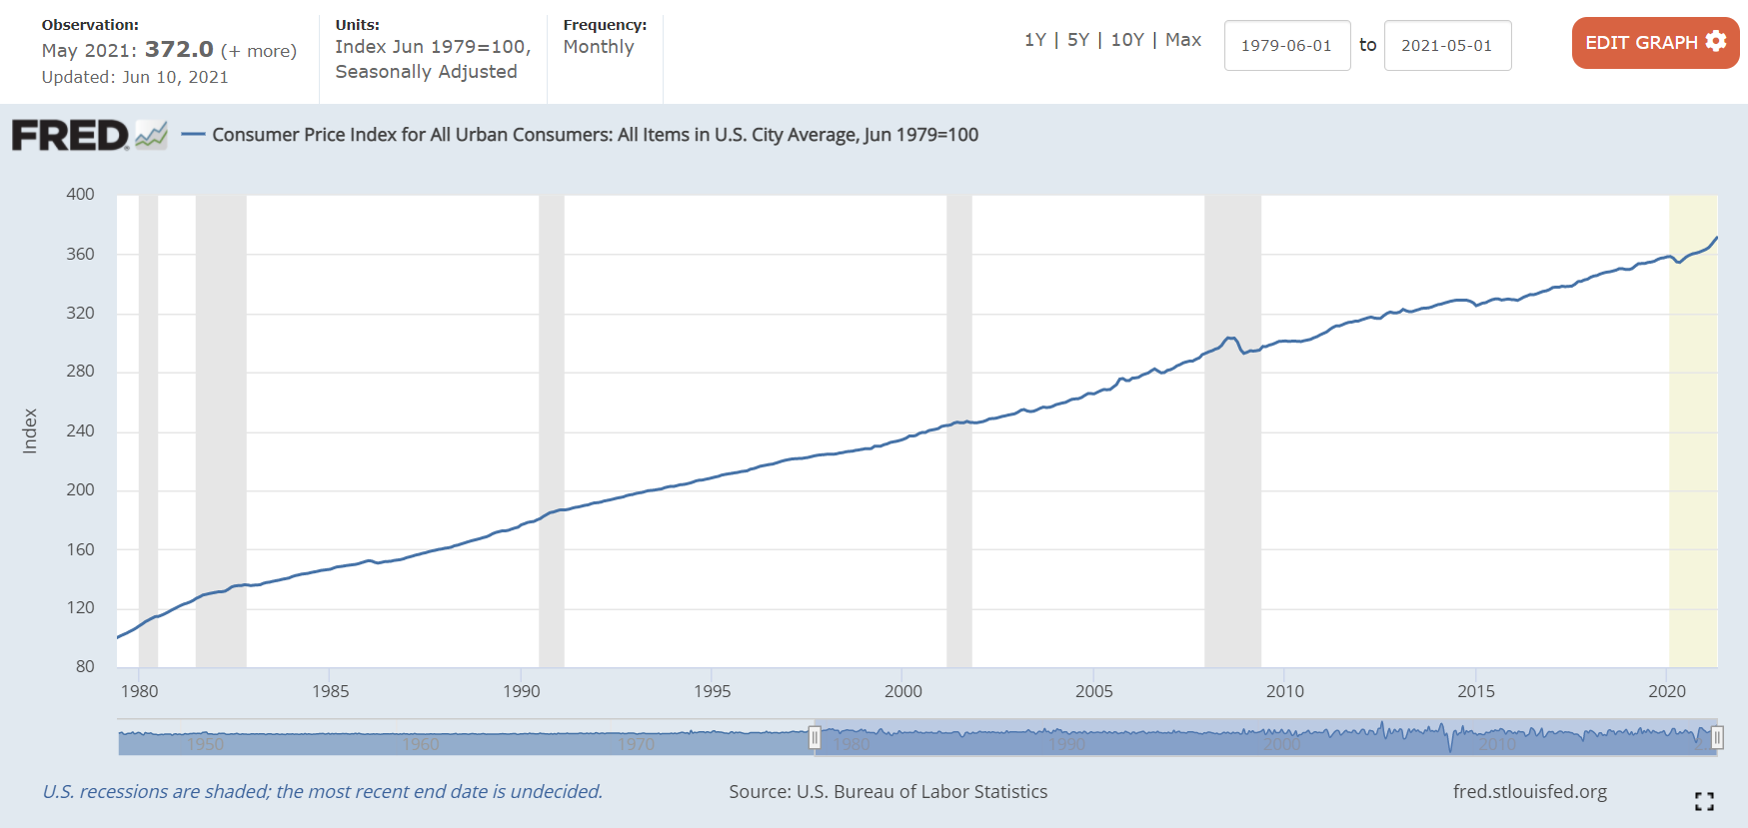
Finalized Graph!
Your students can now see how much inflation has risen in their lifetime!

Slide 44
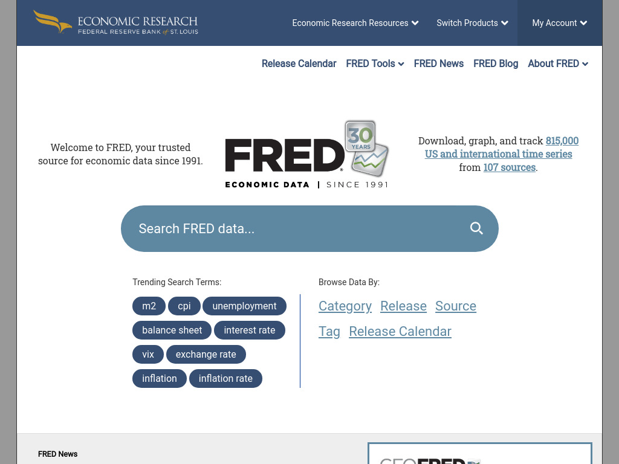

Slide 45
FRED wrap-up
Students can download their graphs and send them to you/upload it to your LMS.
This activity will help students gain confidence in their ability to navigate FRED, which can be a somewhat intimidating site.
Tutorials on using FRED in the classroom: https://www.stlouisfed.org/education/ten-fred-activities-in-ten-minutes

Slide 46
Econoland Adaptation for Inflation via Labor
Increase prices of FOPs for businesses.
cost-push inflation: prices have been pushed up by costs.
See what happens to price of Econos afterwards.
Increase the number of households and decrease the number of businesses.
demand-pull inflation: demand exceeds supply, buyers bid up prices.
See what happens to the price of Econos afterwards.

Slide 47
How Interdependent Economies Can Help Explain Inflation
This video does a GREAT job of illustrating the interconnectivity of the economy and how changes in one part of the market can impact prices in another sector.

Slide 49
Fed’s Dual Mandate
Recall, the Fed was given a dual mandate from Congress to maintain stable money supply and unemployment levels.
Let’s look at some of the new tools used by the Fed to achieve their dual mandate.

Slide 50
Out With the Old
What are the new tools the Fed uses for monetary policy?

Slide 51
The Fed’s Old Monetary Policy Tool
Prior to the housing crisis in 2008, the Fed’s main tool for implementing monetary policy was open market operations.
Open market operations (very simple definition): when the Fed buys or sells U.S. Treasury securities in the open market.
Here’s a simple explanation of how it works.

Slide 52
Open Market Operations
When the Fed BUYS securities (Treasury bills AKA T-Bills, notes and bonds) it pays for them by making a deposit in the seller’s bank. The deposit increases the bank’s reserves, thus increasing the money supply.
When the Fed adds even a relatively small amount of new reserves into the banking system, banks taken as a whole can create money by holding on to required reserves and loaning out the rest.
In contrast, when the Fed SELLS treasury bills to a bank, the bank must use deposits to purchase the securities. This action means the bank will have fewer reserves to support loans and must reduce their lending.

Slide 53
The Fed’s NEW Monetary Policy Tool
In response to the 2008 crisis the Fed implemented new monetary policies and now have a new preferred tool.
In 2008, Congress gave the Fed the power to pay interest on reserves it held. Meaning, the Fed pays banks interest to hold the bank’s excess reserves. This is called interest on reserves.
Again, a simple explanation of how this works. If the Fed raises the IOR it will encourage banks to hold excess reserves at the Fed and reduce the lending banks do (vice versa).
Check out this workshop from the St. Louis Fed on teaching this topic!
8/26 from 3-4pm CT

Slide 54
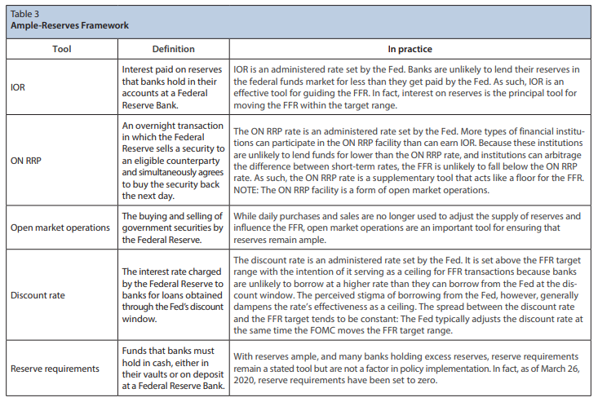

Slide 56
If your students complain about this reading...
If your students are like mine, they won’t like learning about the tools of monetary policy.
This video might help explain why the Fed can be a bit dry (of course, they might want to take some tips from their Jamaican counterparts…)

Slide 58
Sidebar: Urban legend of the founding of the Fed
There is a fun urban legend you can use with your classes to get them interested in learning about the founding of the Fed.
JP Morgan owned the Titanic and was a key part of creating the Fed (Jekyll Island Hotel).

Slide 59
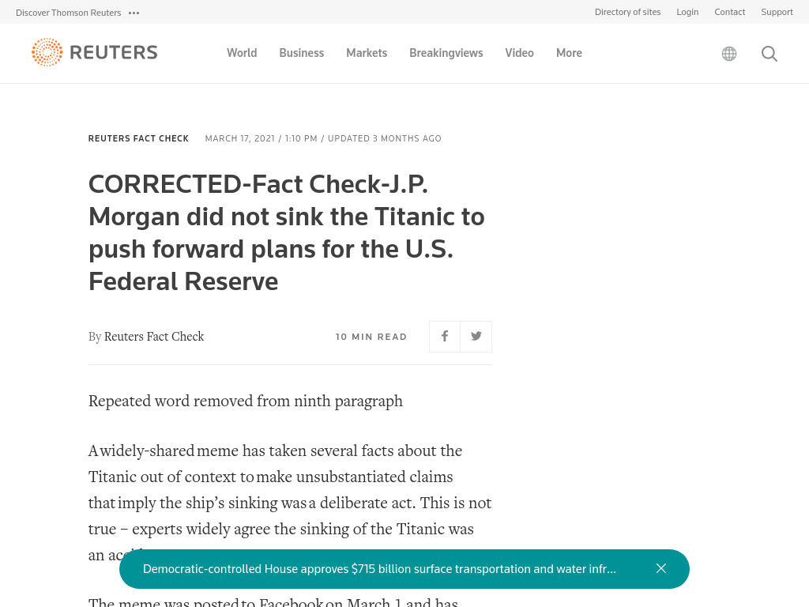

Slide 60
Can Monetary Policy Defeat Unemployment?
Something to consider: One month does not make a trend

Slide 61
Monetary Policy
Yesterday we discussed fiscal policy.
Today we are focusing on monetary policy.
The Atlanta Fed has a GREAT infographic you can use to help differentiate between the two concepts.

Slide 63
The Fed and Unemployment
One of the goals given to the Fed is to promote full employment.
It attempts to achieve this goal through the tools of monetary policy it controls we just discussed.
One reason for running the economy hot is to reduce unemployment.
Let’s look at the different types of unemployment and see if the Fed can influence them using monetary policy.

Slide 64
Unemployment Game Show
The Mint put together a short video explaining who qualifies as unemployed and who does not.
The video is short, but does a very good job explaining how the BLS decides who counts and who doesn’t when counting unemployment numbers.

Slide 66
What about the tone of that last clip?
The Mint has a bit of an inappropriate tone in this video that can be problematic when using it in the classroom.
However, the content is solid.
And, I would argue a gameshow like this is not outside of the realm of possibilities for U.S. TV viewers.
Exhibit A….the Paid Off game show...

Slide 68
4 Types of Unemployment
Frictional Unemployment: occurs when people voluntarily leave their job to get a better one.
This is a positive sign of economic growth.

Slide 69
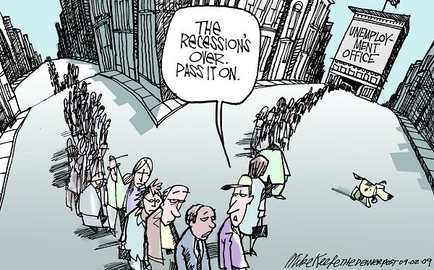
4 Types of Unemployment
Cyclical Unemployment: occurs as a natural result of the business cycle.
This is one of main causes for high unemployment rates.

Slide 70
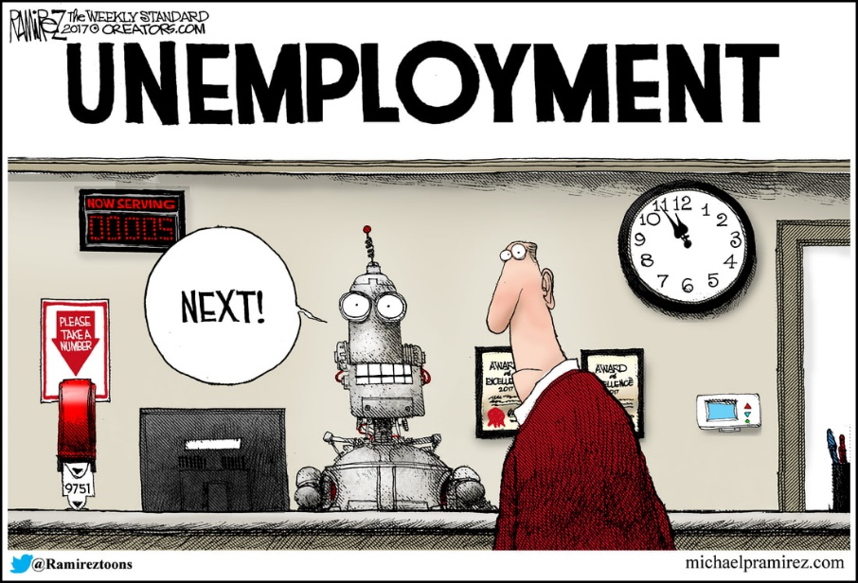
4 Types of Unemployment
Structural Unemployment: occurs when the skillset of workers no longer match the available jobs.
Changes in technology are a driving force behind this type of unemployment. Outsourcing is another.

Slide 71
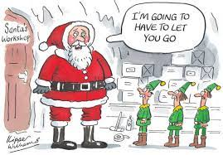
4 Types of Unemployment
Seasonal Unemployment: This occurs because a change in seasonal needs for work.
The BLS adjusts its unemployment measurements to account for seasonal unemployment.

Slide 72
Unemployment CFU
Here’s a quick check for understanding activity you can do to cover the different types of unemployment.
Place signs around the room with the different types of unemployment.
Come up with a list of scenarios of people who lost their job.
Have students walk to the sign they think fits that scenario.

Slide 73
Sample Scenarios
Here are some samples from students:
A custodian lost their job from COVID, because they can’t clean from home.
Susan quit her job at BWs before starting her job as a factory worker.
Janet lost her job at the ice cream shop over the winter because the shop wasn’t selling enough ice cream during this time to pay her.
Deborah just lost her job at a local restaurant that closed due to the recession.
Karen is having trouble finding a job because the only jobs available require a high school diploma...which she does not have.
John works at Microsoft as a computer programmer, but was offered a new job at Google. He decided to leave Microsoft for a new position at Google.
A college student working at Taco Bell loses their job to a tablet mounted on the wall.

Slide 74
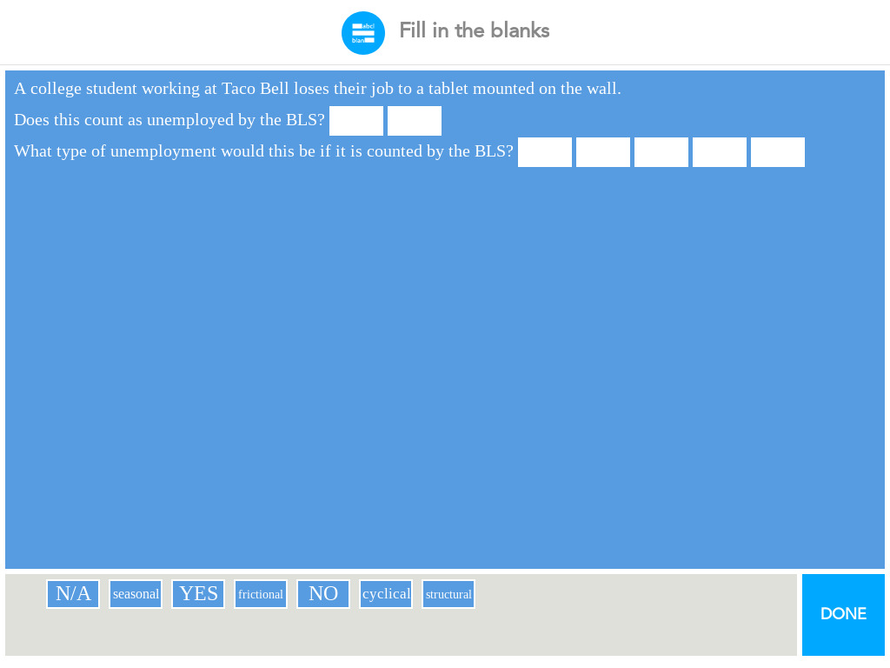

Slide 75
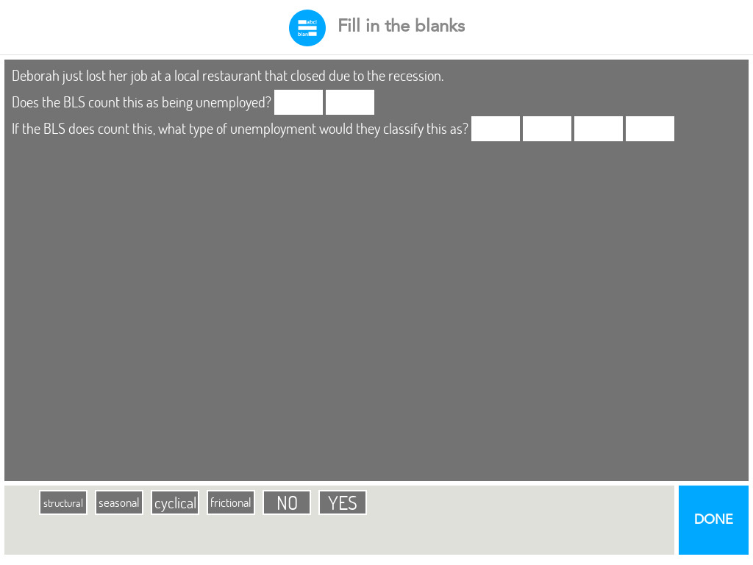

Slide 76
Extensions/Adaptations
Give students the same scenarios.
Have them walk to the sign they think fits the scenario.
Ask if they think the tools used by the Fed could help the person in that scenario keep their job/get a new job.
Have them specify how monetary policy might help reduce unemployment.

Slide 77
Extensions/Adaptations
Prior to discussing unemployment. Give students a 3x5 card.
Have them list different scenarios of how people may have lost their job.
Have them place their card on the board.
Define the classifications of unemployment and list them at the top of the board.
Have students sort their scenarios into the different categories.

Slide 78
Econoland Adaptation for Unemployment Insurance
Give households money at the beginning of the activity.
Allow them to purchase Econos without selling any FOPs.
See what happens to businesses.
Here are some resources you can use when discussing Unemployment Insurance with your classes.

Slide 79
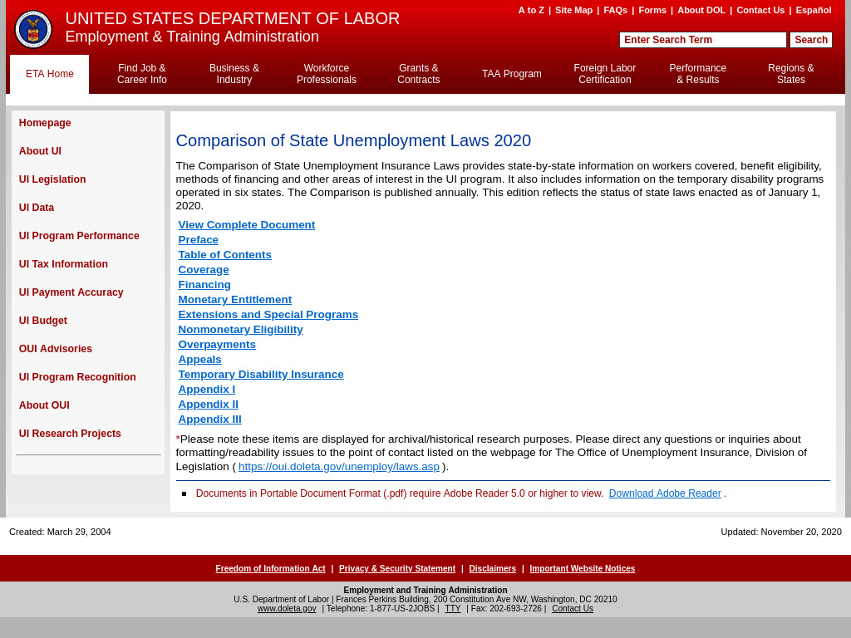

Slide 81
Can Banks Help Marginalized Populations?

Slide 82
Redlining
Something the Fed has become more vocal about is their attempt to create monetary policy to help marginalized populations.
One reason for this is the K-shaped recovery we discussed yesterday.
Another reason for this emphasis on banks helping marginalized populations is the history of redlining.
Redlining was (is?) a discriminatory practice that gets its name from the government rating communities for lending risk and assigning a color to each community based on risk.

Slide 83
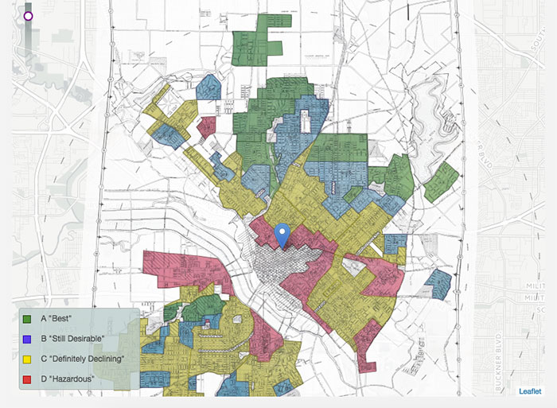
Sample Map
HOLC definitions/key:
Green was for the “best,” blue was “still desirable,” yellow was “definitely declining,” red was “hazardous.”

Slide 84
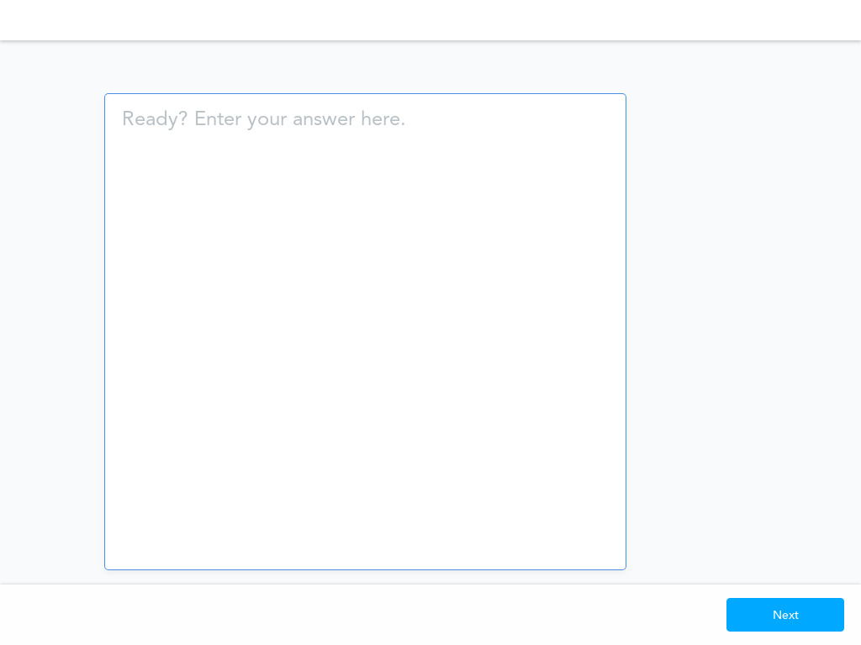

Slide 86
Brief History
A New Deal program (Home Owner’s Loan Act) was established to “provide emergency relief with respect to home mortgage indebtedness” (seem familiar?).
The law ALSO created the Home Owners’ Loan Corporation (HOLC) to make loans to homeowners in need.
As a part of this, HOLC began to assess communities it would lend to.
Another item to consider is the rise of suburbs in the 1950s. Many suburbs HOAs or the builders themselves had rules against selling property to minorities.

Slide 87
More Brief History
The Supreme Court ruled that racial covenants were unconstitutional (or rather that states upholding and enforcing them were) in 1948.
William Levitt had a racial covenant when he first created Levittown after WWII, however he removed it when the Supreme Court decision was handed down.
That doesn’t mean that Levittowns became less segregated, far from it. Levitt claimed that was because he wouldn’t sell houses if he didn’t exclude minorities.
There are harrowing stories from minorities who attempted to live in Levittowns.

Slide 89
NY Fed Redlining Activity
Just a heads-up. Part of this lesson delves into what we call normative economics. Normative economics: Focuses on the value of economic fairness.
Positive economics: Based on fact and cannot be approved or disapproved.
Both normative and positive economics have good and bad elements to consider when teaching.
I will try to stick to positive statements, but it is hard to read some of the HOLC statements and stay neutral.

Slide 90
Heads up for this lesson
This lesson contains a video explaining the history of redlining.
This video starts with an uncensored clip from Chris Rock. In the first 30 seconds or so it uses language I would strongly advise AGAINST showing.
That video would get me fired from my high school when I was teaching, and may still get me fired from JMU if I showed it to my underclassmen.
I am going to stick to the maps and activities in the lesson that I think would fit any classroom with minimal issues.

Slide 91
Breakout Groups
We’re going to get into Breakout Groups for this next activity.
I am going to send a link to a Google Drive document you need.
As a group you need to use the map to write as many questions as you can about the map.
Come up with your top question as a group.
We will share out the top question BE SURE TO WRITE IT DOWN.

Slide 93
HOLC Descriptions
Now, let’s look at the Area Descriptions used by HOLC for The Bronx, New Haven, CT, Rochester, NY, and Newark, NJ.
You can use these handouts to demonstrate how HOLC descriptions were problematic.

Slide 94
Breakout Time!
We’re going to get back into our Breakout Groups.
I will share out another link to a Google file.
This file will have the HOLC comments for the 4 neighborhoods.
As a group, pick one page and answer the 2 questions.
We will share out answers after BE SURE TO WRITE THEM DOWN.

Slide 96
Extension
The site Not Even Past: Social Vulnerability and the Legacy of Redlining is a GREAT complement to the NY Fed lesson.
This site contains maps of 200 cities. Each city contains a side-by-side comparison 1930s vs today.
On the left is the map of the city developed by HOLC in the 1930s. On the right is a map displaying the CDC’s Social Vulnerability Index (SVI) scores.

Slide 97
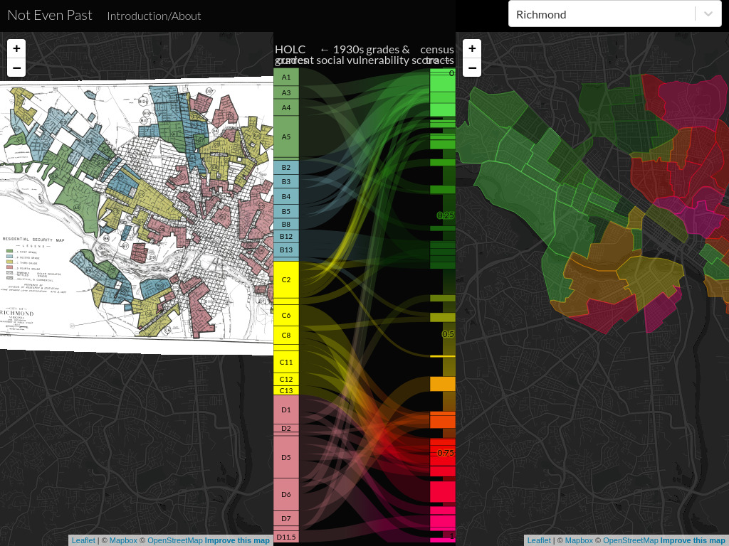

Slide 98
Social Vulnerability Index
Here is a fact sheet from the CDC on the Social Vulnerability Index (SVI) you can use with your students.

Slide 100
Closing Racial & Gender Gaps
The Federal Reserve has become very active in addressing marginalized populations and as we have discussed is guiding policy to address wealth gaps.
Here’s a site you can use to illustrate the gains your state could have from closing the racial and gender wealth gaps identified by the Fed.

Slide 101
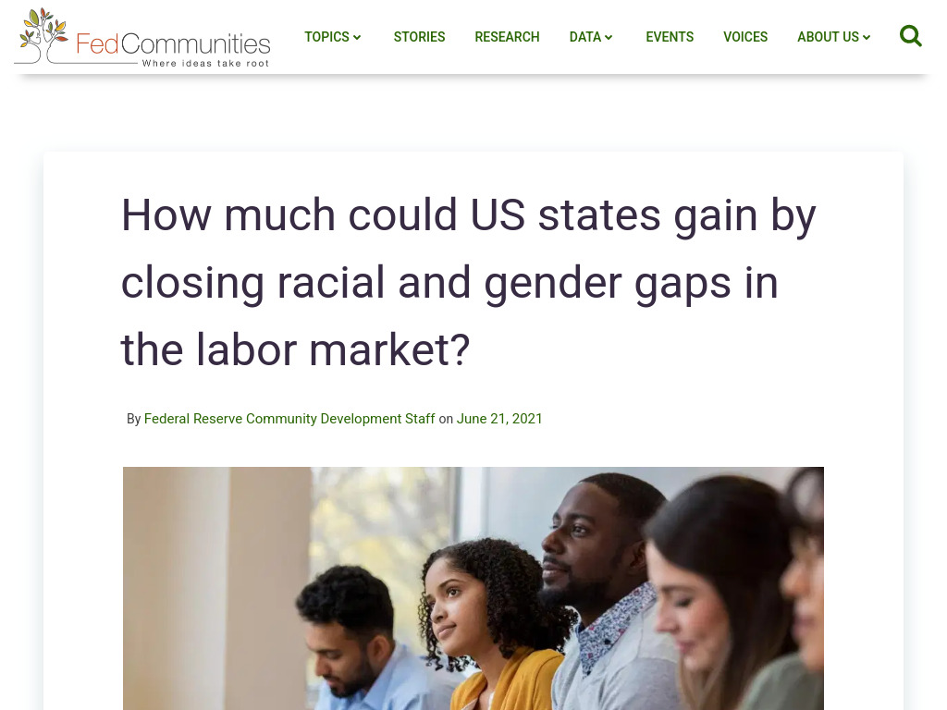

Slide 102
Is the Government Crowding Out Small Business?
OR, is it growing the pie for everyone?

Slide 103
Crowding Out Activity
There is a virtual clearinghouse that matches savers and borrowers called the market for loanable funds.
There are 2 sides to the loanable funds market:
Borrowers and savers.

Slide 104
Borrowers and Savers
Borrowers demand loanable funds for investment, to buy capital such as buildings, machines, and tools for consumers goods such as boats and automobiles.
If the interest rates are low, they will demand more loanable funds than they would if the interest rate is high.
Savers supply loanable funds. Savers hope to earn interest on their savings. High interest rates encourage more saving and allow more money to be lent out.

Slide 105
Loanable Funds Market
Businesses go to the market for loanable funds to get money the need for growth.
However, businesses are not alone in coming to this market.
Individuals borrow money, and so does the government.

Slide 106
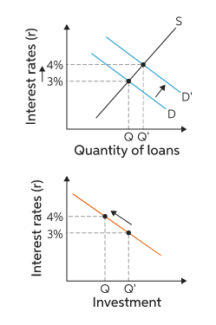
Crowding Out Effect
The U.S. Government is willing to pay whatever rate of interest it takes to attract loanable funds away from businesses. This action crowds businesses out of the market for loanable funds.
This is referred to as the crowding out effect.

Slide 107
Tips for this lesson
This lesson should come after you’ve discussed supply and demand and when you’re covering fiscal policy.
Increase in borrowers shifts the demand curve (population)
Understanding this concept will help students understand more about banking and how government policy can impact the loans they can get.

Slide 108
Tips for this lesson
A great clip you can use to help explain how this all works is the It’s a Wonderful Life bank run scene.
Here’s a fun clip if you want to discuss some of the risky practices used by some lenders during the 2008 crisis while discussing banking.

Slide 109
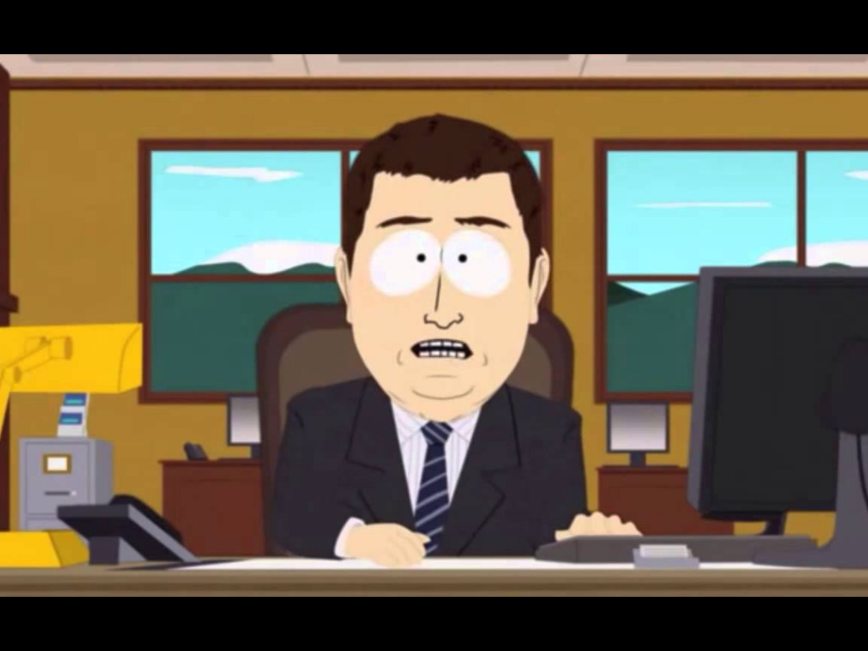

Slide 110
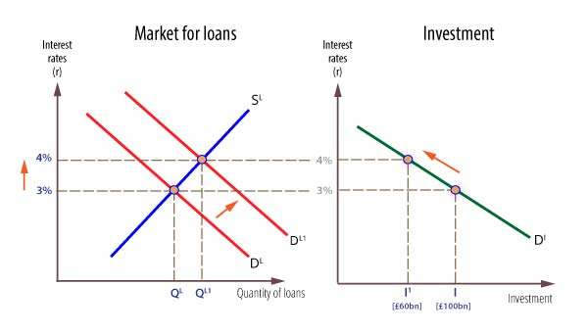
In the market for loanable funds, forces of supply and demand establish the interest rate.
Demand relies on borrowers, savers provide the supply of money. So if the gov’t gets involved, D will shift right (increase).
If no savers enter the market, S will stay the same.
There are MANY different interest rates so they are impacted differently.

Slide 111
Lesson
Hand out a U.S. government borrowing card (next slide) to nine students.
Hand out the rest of the cards representing businesses (2 slides ahead) to the rest of the students.
Have a “Market for Loanable Funds” sign on the wall and use masking tape to outline a 6’x6’ square in front of the sign.
Divide the square in half (one for savers and one for borrowers).
You can have some students pretend to be savers if you’d like.

Slide 113
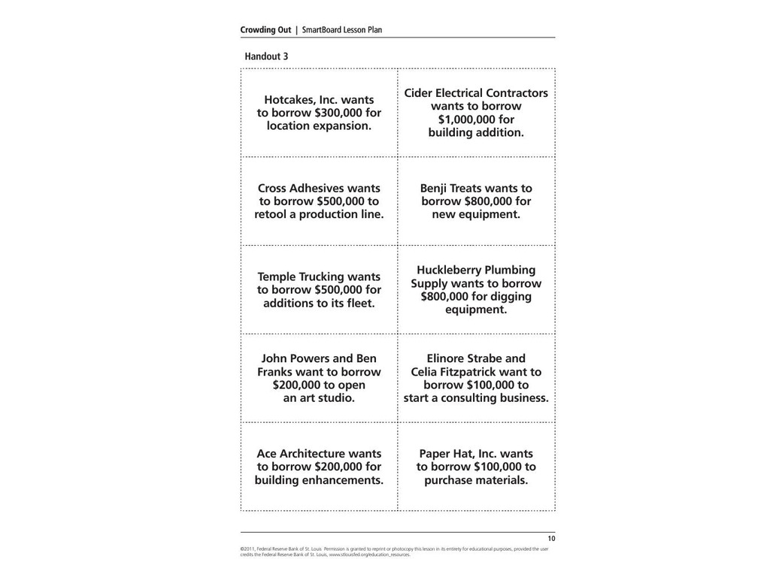

Slide 114
Loanable Funds
Have the students with the business cards go to the part of the square reserved for borrowers (one at a time).
Have each student read their business scenario out loud when they enter the square.
Have the students with the government cards come into the square (one at a time).
Have them read their government scenario out loud.
As the square gets crowded, have the students with the business cards leave the square to make room for the government.

Slide 115
Extension
Use the business scenarios to develop a class discussion.
With each scenario, determine how the government spending impacted the individuals or businesses listed.
Be sure to think about additional businesses that might be impacted (construction, vendors, hired workers, etc.)

Slide 116
Question for Scenarios
Some questions to ask for each scenario:
What kind of business(es) would be involved?
What type of capital resources would those companies involved need to purchase?
What kind of human resources would be involved?
What kind of income would workers involved receive?
How was the business or individual crowded out?

Slide 118
Possible Answers
Capital resources: a leased storefront, tables, chairs, griddles, light fixtures, counters, spatulas, etc.
From whom would they lease the store? A local building owner.
What kind of income would the building owner receive? Rent
Who would receive income from the sale of tables, etc.? The sellers/stores who sold the capital resources.
What type of human resources would the restaurant need? Host, managers, wait staff, cooks
What kind of income would they get? Wages, salaries, tips.

Slide 119
Crowding Out?
If the government borrows to invest in projects, does it also create jobs just as private sector investment does?
If the government builds a road, does it hire workers to build that road?
What if the government works with a contractor like Lockheed Martin? Is that a public sector company?

Slide 120
Wrap-Up
When the government invests in projects like road or schools it also helps create jobs.
Ask students what the difference is between the private sector creating private sector jobs and the government creating private sector jobs?

Slide 121
The government requires taxpayers pay off the debt incurred when it borrows to buy goods and services.
Private sector companies must pay their debts from revenues they receive from the sale of their products.

Slide 122
Adaptation for Crowding Out
Change the scenarios to reflect pop culture references.
I used the Empire building the Death Star and created scenarios on how it impacted characters in the Star Wars universe who needed loans, but could no longer afford the payments due to increased interest rates.
I have another set I’m working on with Marvel characters, but this could work with a number of sprawling universes.

Slide 123
Assessment Questions
Can you think of a group who could be hurt by inflation?
What groups might be helped by increasing the money supply?
Do you think we are currently facing transitory inflation or are we at the beginning of a wage-price spiral?
Which activity was your favorite?
Which online resource do you think you will use?

Slide 124
References
Economics in Action: Money and Inflation
High School Economics: Econoland
Understanding Economics in US History: The No-Good Seventies
St. Louis Federal Reserve: Lifetime Inflation Activity
Unemployment Insurance facts and comparisons
Page One Economics: The Fed’s New Monetary Policy Tools
NY Federal Reserve: How Does Where You Live Influence How You Live?
St. Louis Federal Reserve: Crowding Out

Slide 125
Thank You to Our Sponsors!

