Slide 1
Mixing It Up: Unique Review Games Presented by Andrew Menfi August 10th, 2021 amenfi3@gmail.com

Slide 2
EconEdLink Membership
You can now access CEE’s professional development webinars directly on EconEdLink.org! To receive these new professional development benefits, become an EconEdLink member. As a member, you will now be able to:
Automatically receive a professional development certificate via e-mail within 24 hours after viewing any webinar for a minimum of 45 minutes
Register for upcoming webinars with a simple one-click process
Easily download presentations, lesson plan materials, and activities for each webinar
Search and view all webinars at your convenience
Save webinars to your EconEdLink dashboard for easy access to the event
You may access our new Professional Development page here

Slide 3
Professional Development Certificate
To earn your professional development certificate for this webinar, you must:
Watch a minimum of 45-minutes and you will automatically receive a professional development certificate via e-mail within 24 hours.
Accessing resources:
You can now easily download presentations, lesson plan materials, and activities for each webinar from EconEdLink.org/professional-development/

Slide 4
Objective
Engaging, unique review games that can be used in any classroom setting [Digital/Hybrid/In Person]

Slide 6
Agenda
Game #1: Jenga
Game #2: Bingo
Game #3: Meme Game
Game #4: Speed Run
Game #5: Hands On Deck
Game #6: The Picture Game
Game #7: Spot The Lie
Game #8: Digital Scavenger Hunt
Game #9: Lightning Round
Game #10: Escape The Room

Slide 7
National Standards
STANDARDS 1-20

Slide 8
State Standards
New York:
9.1 Through 12.4

Slide 9
Game #1: Jenga
Group Trivia
Wrong Answer → Jenga Tower
Fallen Tower → Other Groups Benefit
Points/Prize

Slide 10
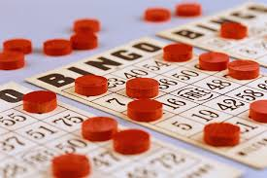
Game #2: Bingo
Study Guide / Key Terms List
Fill Blank Bingo Card With Terms
DESCRIBE Terms
Winner: Points / Prize

Slide 11
Game #3: Meme Game
Give Students Memes → Explain The Joke
Give Students Terms → Make Best Meme
Meme Generator
[https://imgflip.com/memegenerator]

Slide 12
Game #4: Speed Run
Print Out Key Terms → Put On Class Walls
DESCRIBE Terms → Slap Correct Term
Individual / Groups / VERSUS

Slide 13
Game #5: Hands On Deck
Terms on Notecards → One Set Per Group
DESCRIBE Terms → Walk With Arms Out
Race To Put Correct Term In One Hand
+/- Points for Correct/Incorrect

Slide 14
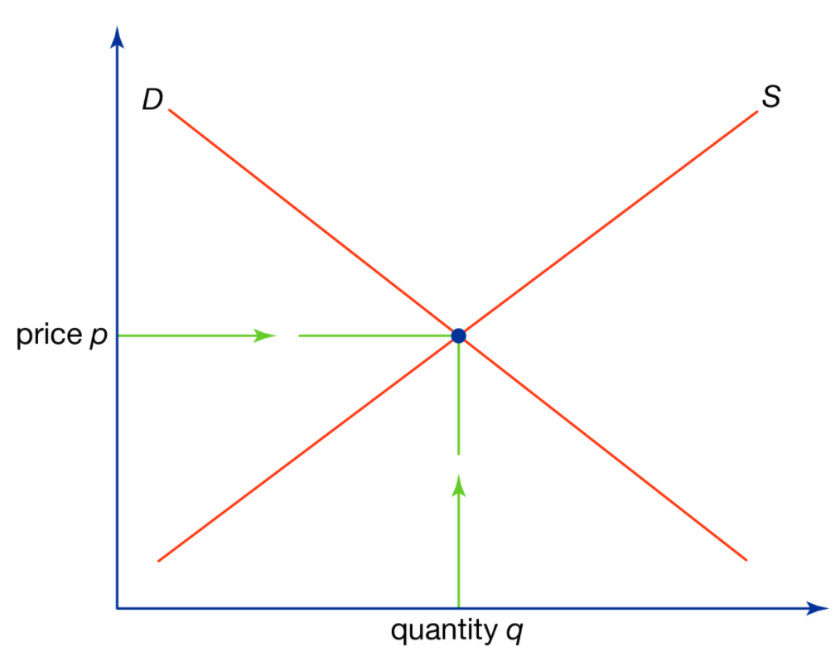
Game #6: The Picture Game
Create Images For Key Terms
Match Key Terms With Images
Points/Prize
Market Price
Incentive
Scarcity

Slide 15
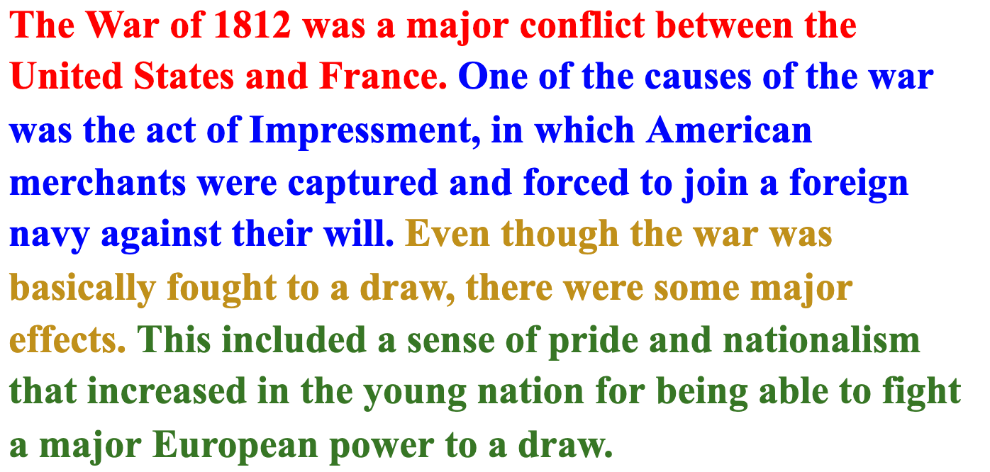
Game #7: Spot The Lie
Read/Write Short Paragraph
Contains One Falsehood
Identify the Lie
Kahoot Optional [Color Coded]

Slide 16
Game #8: Digital Scavenger Hunt
Questions Answered In Digital Classroom
Videos [Timestamp]
Presentations [Slide Numbers]
Documents [Specific Details]
Assignments [Dates]

Slide 17
Game #9: Lightning Round
Questions & Challenges [Randomized]
Time Limit [Points Awarded]
Online
In Person

Slide 18
Game #10: Escape The Room
Google Forms [Response Validation]
Mix of Content & Silly Questions
Winner → Fastest Team

Slide 19
Contact & Questions?
Andrew Menfi
Social Studies Teacher
New Visions Charter High School
for Advanced Math & Science
amenfi3@gmail.com
Thanks For Your Time!

Slide 20
https://bit.ly/CEEConference2021

Slide 21
CEE Affiliates
https://www.councilforeconed.org/resources/local-affiliates/

Slide 22
Thank You to Our Sponsors!

