Slide 1

Presented by Tawni Hunt Ferrarini, PhD
June 15, 2021 tferrarini@lindenwood.edu

Slide 2
EconEdLink Membership
You can now access CEE’s professional development webinars directly on EconEdLink.org! To receive these new professional development benefits, become an EconEdLink member. As a member, you will now be able to:
Automatically receive a professional development certificate via e-mail within 24 hours after viewing any webinar for a minimum of 45 minutes
Register for upcoming webinars with a simple one-click process
Easily download presentations, lesson plan materials and activities for each webinar
Search and view all webinars at your convenience
Save webinars to your EconEdLink dashboard for easy access to the event
You may access our new Professional Development page here

Slide 3
Professional Development Certificate
To earn your professional development certificate for this webinar, you must:
Watch a minimum of 45-minutes and you will automatically receive a professional development certificate via e-mail within 24 hours.
Accessing resources:
You can now easily download presentations, lesson plan materials, and activities for each webinar from EconEdLink.org/professional-development/

Slide 4

Discussion Starter
What do you want to know about cryptocurrency?

Slide 5
Agenda
Highlight key learning objectives
Link to national and state standards
Integrate the crypto craze, a current event, into the social studies or personal finance curriculum
Relate the topic of speculative cryptocurrencies into a well-diversified portfolio of investments
Provide a “Once Over Lightly” Review

Slide 6
Objectives
Define the three functions of stable money in a prospering economy
Distinguish sound money from financial investments
Introduce speculative investments and other tech investments
Compare sound money to cryptocurrencies and other speculative assets
Relate both to growth and prosperity

Slide 7

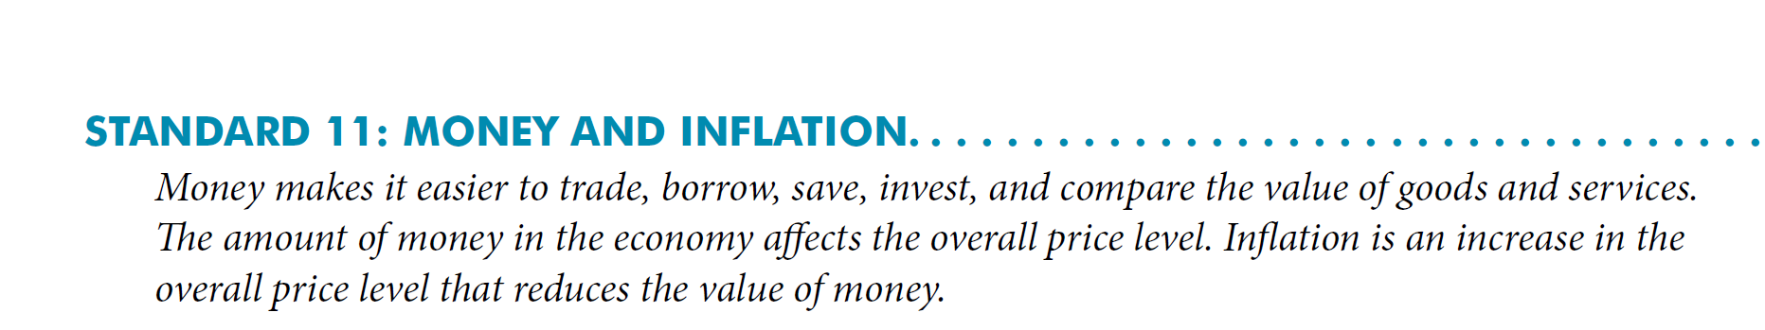
National Standards

Slide 8
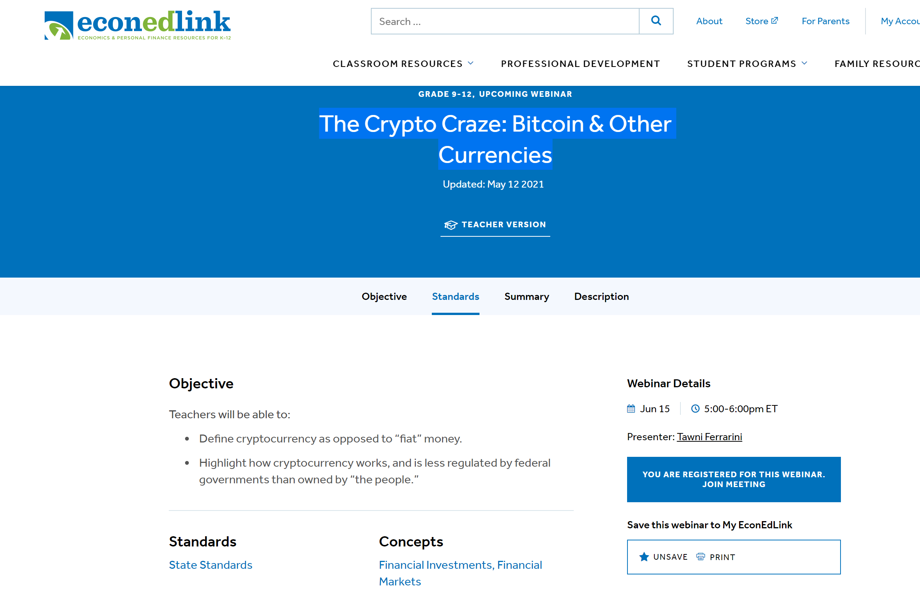
State Standards
List corresponding regional standards you may have > http://www.nysed.gov/curriculum-instruction

Slide 9

Three Functions of Sound Money in Modern Society
1. Medium of exchange
2. Store of value
3. Unit of account
Specialization, division of labor, and operation on basis of comparative advantage.
All of this contributes to:
Growth in production and income through voluntary trade with others without increasing resources
Sound money backed by limited government supports:

Slide 10
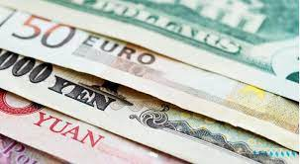
Three Functions of Sound Money in Modern Society
1. Medium of exchange
2. Store of value
3. Unit of account

Slide 11

Assessment for Sound Money
Have you purchased a good or service using a cryptocurrency?
Would you accept payment in Bitcoin for one month of work?
Would you build up your retirement account using cryptocurrency?

Slide 12
Growth through Savings and Investment
Prudent Savings (not immediate consumption)
Diversified Investment
Growth and prosperity
Production is based on comparative advantage and people trade for the rest

Slide 13
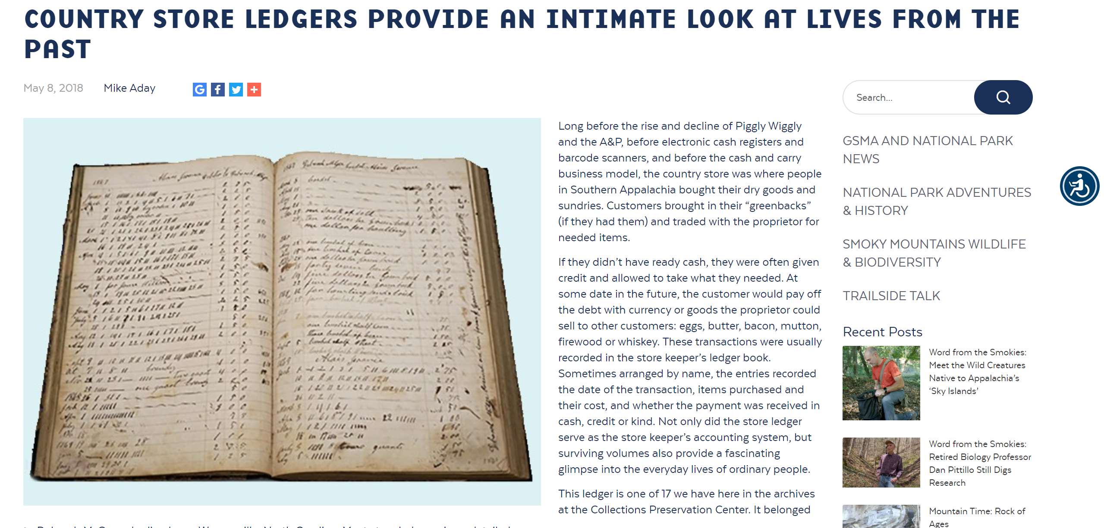
Saving/Dissaving

Slide 14
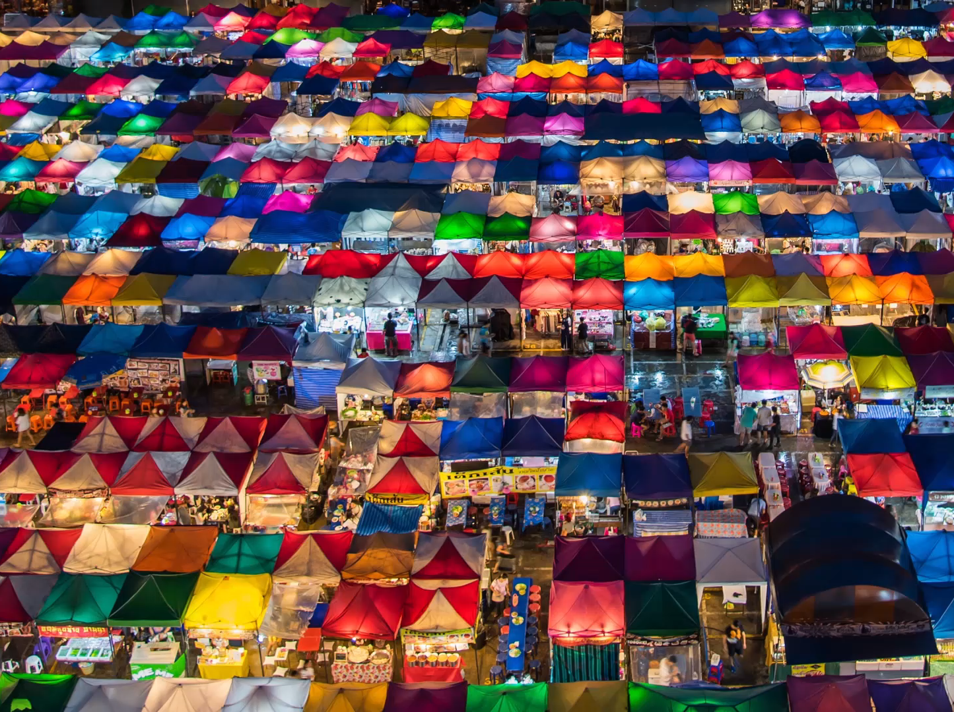
From the local store to installment credit to small loans to credit cards to cryptocurrency

Slide 15

What is cryptocurrency?
Cryptocurrency is a peer-to-peer electronic cash system.
  Provides an alternative to the current system of money
  Do not have to go through the central banking system, a financial institution, or electronic payment system such as Paypal*

Slide 16
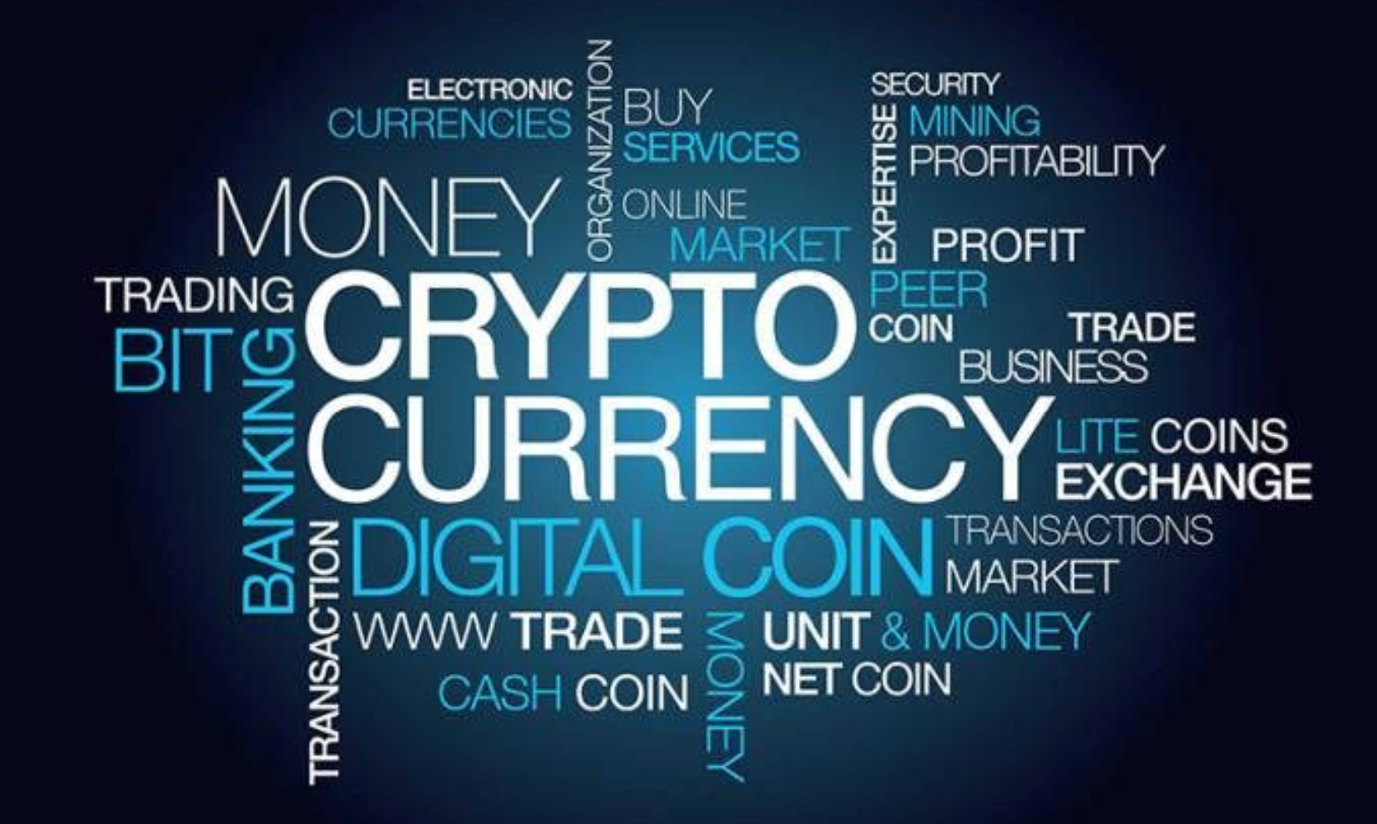
bitcoin
Bitcoin is the most notable cryptocurrency. There thousands of others.
  Was introduced by “Satoshi Nakamoto” in late 2008 and early 2009
  Concurrent with the Great Recession of 2008
  Thousands of competitive cryptocurrencies exist, including ETHEREUM, LITECOIN, DOGECOIN, and others
Image source: https://www.iflg.uk.com/blog/should-cryptocurrency-be-part-my-divorce-settlement

Slide 17
What is blockchain technology?
Blockchain describes the computerized networks that allow peer-to-peer transactions without central planners, government, banks, or financial intermediaries of any type.
It is maintained by a network of computer “geeks” or “geniuses” known as miners. They are paid cryptocurrency for their work.
References:
Explainer: What is a blockchain? - MIT Technology Review, June 14, 2021
Bitcoin and Beyond: The Possibilities and Pitfalls of Virtual Currencies – Federal Reserve Bank of St. Louis, October 21, 2014

Slide 18


Three traits of cryptocurrency in a blockchain
(a decades old computerized network)
Transparent
Authenticated
Can be audited
This Photo by Unknown Author is licensed under CC BY-SA

Slide 19






Who uses it?
Peer-to-peer exchanges
A few retailers like Overstock, Expedia, Dish, subway, and Microsoft
Mt. Gox (2010-14), the largest Bitcoin exchange which was based in Tokyo, Japan
Above is my list from 2018 of retailers accepting Bitcoin. Little has changed in three years. See: https://www.buybitcoinworldwide.com/who-accepts-bitcoin/

Slide 20
Cryptocurrency
It is…
At this time, it is not…
Different than “fiat” money
A part of a decentralized system subject to no government regulation or insurances
Network is supported by the transactions by consumers, savers, producers and investors through blockchain technology
A widely utilized medium of exchange
Unit of account
Store of value

Slide 21
Choose one to feed your family…
$1000 in Bitcoin
$1000 USD

Slide 22

You’re a small business owner in need of specialized computer skills. Who do you hire?
$1000 in labor services paid only in Bitcoin
$1000 in labor services paid in US Dollars

Slide 23

The following falls from the sky! You can pick up only one. Choose.
A claim to $1000 worth of Bitcoin
An envelope with $1000 US Dollars

Slide 24
Bottom line…
Proceed with caution and information. Invest what you can lose
Bitcoin is a speculative asset at this point

Slide 25
Upside to Bitcoin
It is transparent, authenticated, and can be audited.
From the first chain forward, you can trace the origins of the chain and everything that makes it up.
It is not directly subjected to government policy influences, political interests, and short-sightedness.
It makes use of blockchain technology – an advancement in technology.

Slide 26
Blockchain Technology
Used to track healthcare services by patients and their providers
Mobilized in the supply chain to track everything from original extraction of natural resources to final consumer
NFTs (Non Fungible Tokens) allow artists to create original art and sell it without the risk of copyright infringement
In theory, it allows consumers and others to trace property – even intellectual property

Slide 27
As an educator…
It provides teachable moments for family members and students
Educate others about blockchain technology, long-term investment practices, cryptocurrencies, and sound money
Understand when “speculative” investments make sense

Slide 28
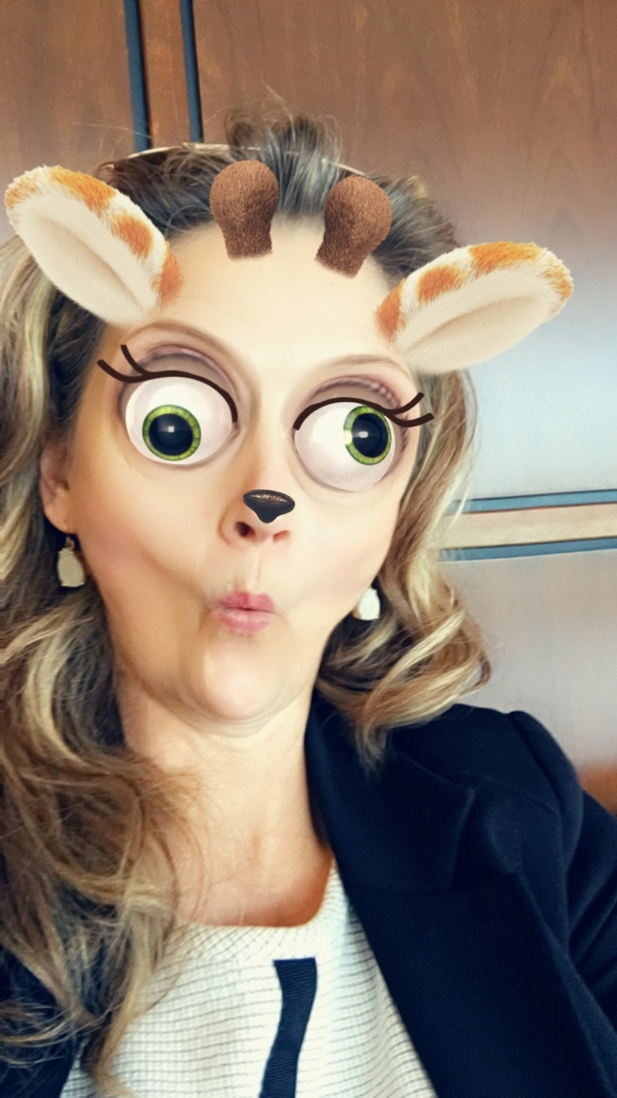
My “Bitcoin” Story
LIVE! LAUGH! LEARN!
Within a year, I lost 70 percent of the value of my cryptocurrency portfolio, with an initial investment of $841!!!
Yikes! It was not a growing asset
Since December of 2017, “Bitcoin” has not been used it to purchase anything. I also haven’t been paid in Bitcoin, BUT….

Slide 29
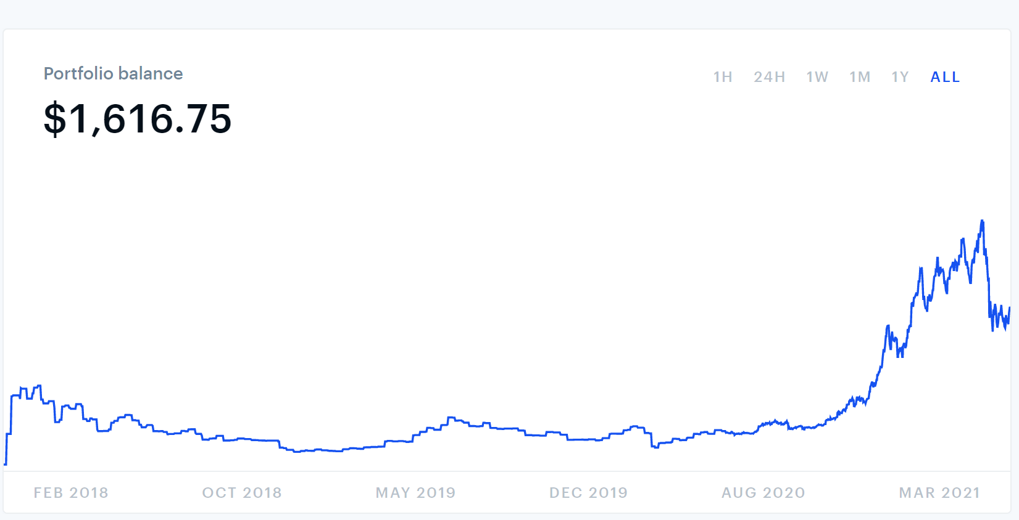
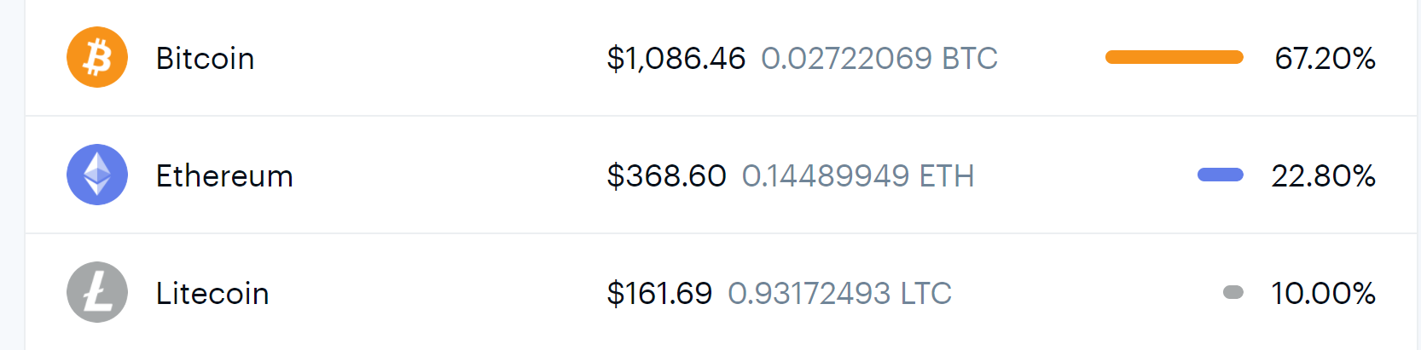
My portfolio has grown in value…

Slide 30
Advice from all of you…
I have $250 USD. What do you advise?
Buy Bitcoin
Buy Ethereum
Buy Litecoin
Buy another crypto
Save it for a “rainy” day (withdraw $$ due to car problems)
Invest it in an index fund

Slide 31
References
Böhme, Rainer, Nicolas Christin, Benjamin Edelman, and Tyler Moore. 2015. "Bitcoin: Economics, Technology, and Governance." Journal of Economic Perspectives, 29 (2): 213-38.
Clark, J.R., M. Scott Niederjohn, and William C. Wood. 2018. “Understanding Bitcoin: Money, Asset, or Bubble?” Social Education.
Lorne Lantz. 2016. YouTube video “TED Talks: The Blockchain Explained Simply.” New Kids on the blockchain.
Wolla, Scott. 2017. “Bitcoin: Money or Financial Investment? (Page One Economics),” St. Louis Federal Reserve Bank, https://files.stlouisfed.org/files/htdocs/publications/page1-econ/2018/03/01/bitcoin-money-or-financial-investment_SE.pdf.

Slide 32

CEE Affiliates
https://www.councilforeconed.org/resources/local-affiliates/

Slide 33




Thank You to Our Sponsors!

