Slide 1
Using Tech Tools to Teach:
Flipgrid & PowToon
Presented by Kathy Pondy, Arizona Council on Economic Education
July 21, 2021 kathy.pondy@azecon.org

Slide 2
EconEdLink Membership
You can now access CEE’s professional development webinars directly on EconEdLink.org! To receive these new professional development benefits, become an EconEdLink member. As a member, you will now be able to:
Automatically receive a professional development certificate via e-mail within 24 hours after viewing any webinar for a minimum of 45 minutes
Register for upcoming webinars with a simple one-click process
Easily download presentations, lesson plan materials and activities for each webinar
Search and view all webinars at your convenience
Save webinars to your EconEdLink dashboard for easy access to the event
You may access our new Professional Development page here

Slide 3
Professional Development Certificate
To earn your professional development certificate for this webinar, you must:
Watch a minimum of 45-minutes and you will automatically receive a professional development certificate via e-mail within 24 hours.
Accessing resources:
You can now easily download presentations, lesson plan materials, and activities for each webinar from EconEdLink.org/professional-development/

Slide 4
Agenda
EdTech Tool Demonstrations
Implementation Suggestions
Questions

Slide 5
Objectives
Participants will be given an overview of PowToon
Participants will be given an overview of Flipgrid
Participants will communicate with others using Flipgrid

Slide 6
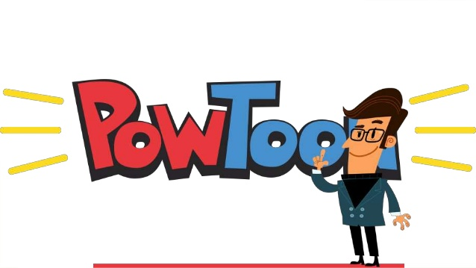
https://www.powtoon.com/s/emOwaca9Evi/1/m
Notes:
Agenda and introductions – 5 minutes.

Slide 7

Visual Communication platform
What Is PowToon?
User- friendly animation video tool
Easy to customize
Free templates to quickly create videos
Upgraded accounts offer additional features
Notes:
Open PowToon
Navigate to learning and development videos
Uses dropdown menu to display sliding bar of template choices
Select Personal
Open and show basics of editing included swapping images, editing text, etc.

Slide 8



I love using
PowToon
for class announcements!
It works great for class rules too!
Notes:
What is it? - Intro video and overview of 6 slide Nearpod – 10 minutes
How can I access - Attendees will participate in Nearpod for appx 10 minutes to see activities. I will then show how to add an activity.
How can I use it – Add 3 activities – 10 minutes
Show teachers how to import PowerPoint or Google Slide presentation (remember the size limit) - 5 minutes

Slide 9
Ideas for Your Classroom
Red Carpet Introductions
School/Class Rules
Class announcement/newsletter
Book Talk
Introducing new content
How to videos
Notes:
Open PowToon
Navigate to learning and development videos
Uses dropdown menu to display sliding bar of template choices
Select Personal
Open and show basics of editing included swapping images, editing text, etc.

Slide 10
Visual Communication platform
Getting Started
Have your idea in mind
Go to Powtoon.com and select a template
Template will open in workspace in “edit” mode
CREATE!!!
Notes:
Open PowToon
Navigate to learning and development videos
Uses dropdown menu to display sliding bar of template choices
Select Personal
Open and show basics of editing included swapping images, editing text, etc.

Slide 11
Resources for Classroom Use of PowToon
https://www.powtoon.com/blog/11-ways-to-use-powtoon-in-your-classroom/
https://www.powtoon.com/blog/case-study-superstar-educator-christi-rocks-powtoon-classroom/
https://amandawritenow.com/10-ways-to-use-powtoon-in-the-english-classroom/
http://teachersterritory.blogspot.com/2017/01/tech-thursday-using-powtoon-in-classroom.html

Slide 12


Slide 13
What is Flipgrid?
Video discussion platform
Students record responses in a video format
Engages learners in an alternative way
Builds community
Easy to use for students

Slide 14
Getting Started
Create Flipgrid account
Create group
Select how students will join
Create topic
Customize the grid
Notes:
Open PowToon
Navigate to learning and development videos
Uses dropdown menu to display sliding bar of template choices
Select Personal
Open and show basics of editing included swapping images, editing text, etc.

Slide 15
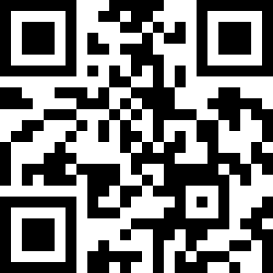
Let’s Try It…
Using any device with a camera to join my Flipgrid
Use the QR code or this link: https://flipgrid.com/6e3e0ff2
Respond to topic
React to others’ responses
Notes:
Open PowToon
Navigate to learning and development videos
Uses dropdown menu to display sliding bar of template choices
Select Personal
Open and show basics of editing included swapping images, editing text, etc.

Slide 16
Ideas for Your Classroom
Ticket out- the- door
Student Reflection
Practicing World Language Skills
Supporting Absent Students
Article Response
Goal Setting
Global Pen Pals
Aha Moments
End of Year Memories
Notes:
Open PowToon
Navigate to learning and development videos
Uses dropdown menu to display sliding bar of template choices
Select Personal
Open and show basics of editing included swapping images, editing text, etc.

Slide 17
Resources for Classroom Use of Flipgrid
https://youtu.be/n5s3URLpDWM
https://www.edutopia.org/article/9-new-ways-use-flipgrid-classroom
https://www.teachthought.com/technology/ideas-ways-to-use-flipgrid-in-the-classroom/

Slide 18

Questions?
Kathy Pondy
Director of Student Programs
Arizona Council on Economic Education
Kathy.pondy@azecon.org

Slide 19

CEE Affiliates
https://www.councilforeconed.org/resources/local-affiliates/

Slide 20

https://bit.ly/CEEConference2021

Slide 21




Thank You to Our Sponsors!

