Slide 1
Fundamentals of
AP Economics
Cost-Benefit Analysis
Presented by Kathleen Brennan
March 1, 2021 kbrennan@mountsaintmary.org

Slide 2
EconEdLink Membership
You can now access CEE’s professional development webinars directly on EconEdLink.org! To receive these new professional development benefits, become an EconEdLink member. As a member, you will now be able to:
Automatically receive a professional development certificate via e-mail within 24 hours after viewing any webinar for a minimum of 45 minutes
Register for upcoming webinars with a simple one-click process
Easily download presentations, lesson plan materials and activities for each webinar
Search and view all webinars at your convenience
Save webinars to your EconEdLink dashboard for easy access to the event
You may access our new Professional Development page here

Slide 3
Professional Development Certificate
To earn your professional development certificate for this webinar, you must:
Watch a minimum of 45-minutes and you will automatically receive a professional development certificate via e-mail within 24 hours.
Accessing resources:
You can now easily download presentations, lesson plan materials, and activities for each webinar from EconEdLink.org/professional-development/

Slide 4
Agenda
Discuss the concepts of opportunity cost and marginal analysis in the context of the AP Microeconomics curriculum
Understand how cost-benefit analysis is used to make personal, government and business decisions
Examine how these concepts are tested on the AP Micro exam

Slide 5
AP Microeconomics
Unit 1- Basic Economic Concepts (12-15% of exam)
  1.1: Scarcity
  1.2: Resource Allocation/Economic Systems
  1.3: Production Possibilities Curve
  1.4 Comparative Advantage and Trade
  1.5 Cost-Benefit Analysis
  1.6 Marginal Analysis and Consumer Choice

Slide 6
Learning Objectives
Define opportunity cost.
Explain and calculate the opportunity costs associated with choices.
Explain and calculate the total benefits and total costs of a decision.
Use a table or graph to evaluate total benefits and total costs.
Use cost-benefit analysis to evaluate alternatives.

Slide 7
National Standards
Standard 2
Students will understand that: Effective decision making requires comparing the additional costs of alternatives with the additional benefits. Many choices involve doing a little more or a little less of something: few choices are “all or nothing” decisions.
Students will be able to use this knowledge to make effective decisions as consumers, producers, investors, and citizens.

Slide 8
New York State Standards
Standard 4- Economics
Students define and apply basic economic concepts such as scarcity, supply/demand, opportunity costs, production, resources, money and banking, economic growth, markets, costs, competition, and world economic systems.
The study of economics requires an understanding of major economic concepts and systems, the principles of economic decision making, and the interdependence of economies and economic systems throughout the world.

Slide 9

Question of the Day
How long should you be willing to stand in line for a “free” ice cream???

Slide 10

TANSTAAFL
(0:00- 0:45)

Slide 11
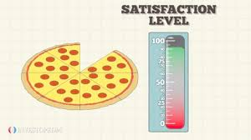
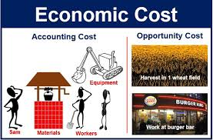
Quantifying Benefits and Costs
Benefits
Utility (the amount of satisfaction from an action or purchase)
Costs
Explicit
Implicit

Slide 12
Costs
  Explicit Costs- Monetary payment made to an outsider to acquire an item, service or activity
  Implicit Costs- The imputed costs of the next best alternative
  Total Costs = Explicit Costs + Implicit Costs
  Both explicit and implicit costs are considered opportunity costs.

Slide 13
Sunk Costs
A cost that has been incurred and cannot be reversed. A sunk costs exists regardless of whatever choice you make. Sunk costs ARE NOT opportunity costs.

Slide 14

Paul Solman: Opportunity Cost

Slide 15
The Opportunity Cost Principle
The true cost of something is the next best alternative you must give up to get it. Your decision should reflect all your opportunity costs, rather than just your out-of-pocket expenses.

Slide 16
The Opportunity Cost of Pursuing a College Education (per year)
If you go to College… | If you decide to work full-time… | Cost of College relative to working full-time…
Tuition- $50,000 | You won’t pay tuition | $50,000 tuition
You don’t get a job | You earn $30,000 | $30,000 foregone income
Room and board- $20,000 | Rent and meals- $20,000 | No opportunity cost (You have to pay for housing and food regardless)
8 hours per day studying | 8 hours per day working | No opportunity cost
 |  | Total = $80,000 opportunity cost
You should only pursue a college education if the benefits exceed the total opportunity costs of $320,000 (4 years of college).

Slide 17
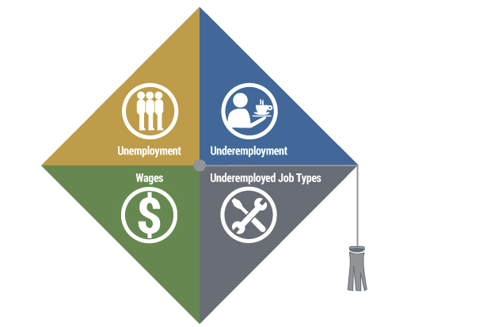
The Labor Market for Recent College Graduates

Slide 18

Opportunity Cost Kahoot

Slide 19

Learning to Think at the Margin

Slide 20
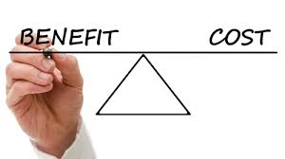
Benefit- Cost Analysis

Slide 21
A Systematic Framework for Analyzing Decisions
Consider the costs and benefits of a choice
Before making a choice, consider the alternative by asking “Or What?”
Think at the margin. “Will a little more or less of something be an improvement?”
How do different decisions depend on each other?

Slide 22
The Cost-Benefit Principle
Costs and benefits are the incentives that shape decisions.
  Calculate the costs and benefits of alternative choices
  Consider only those choices where the benefits are at least as large as the costs
  Net benefit is maximized where total benefits exceed total cost by the greatest amount or where marginal benefit equals marginal cost

Slide 23
Important Concepts
Total Utility- The total amount of satisfaction received by consuming a specified number of units of a good, service, or activity
Marginal Utility- The change in total utility (satisfaction) from consuming an additional unit of a good, service, or activity
Law of Diminishing Marginal Utility- As additional units of an item are consumed beyond a certain point, each successive unit consumed will add less to total utility than the previous unit.

Slide 24

Benefit-Cost Analysis of Taking a Hike

Slide 25
Benefits of a Hike
Number of Hours Hiking | Total Benefit (Utility) | Marginal Benefit (Utility)
0 | 0 points | -
1 | 400 points | 400 points
2 | 700 points | 300 points
3 | 900 points | 200 points
4 | 1,000 points | 100 points
5 | 1,000 points | 0 points

Slide 26
Costs of a Hike
Number of Hours Hiking | Total Cost | Marginal Cost
0 | 0 points | -
1 | 25points | 25 points
2 | 75 points | 50 points
3 | 175 points | 100 points
4 | 375 points | 200 points
5 | 1,000 points | 625 points

Slide 27
Net Benefit Maximizing Rules
Net benefit is maximized where total benefits exceed total costs by the greatest amount
Net benefit is maximized where marginal benefit equals marginal cost

Slide 28
Cost-Benefit Analysis
Number of Hours Hiking | Total Benefit | Total Cost | Net Benefit | Marginal Benefit | Marginal Cost
0 | 0 | 0 | 0 | 0 | -
1 | 400 | 25 | 375 | 400 | 25
2 | 700 | 75 | 625 | 300 | 50
3 | 900 | 175 | 725 | 200 | 100
4 | 1,000 | 375 | 625 | 100 | 200
5 | 1,000 | 1,000 | 0 | 0 | 625
Net benefits are maximized at 3 hours

Slide 29
Cost-Benefit Analysis
Number of Hours Hiking | Net Benefit | Marginal Benefit (MB) | Marginal Cost (MC) | MB >MC ?
0 | 0 | 0 | -
1 | 375 | 400 | 25 | 400>25
2 | 625 | 300 | 50 | 300>50
3 | 725 | 200 | 100 | 200>100
4 | 625 | 100 | 200 | 100<200
5 | 0 | 0 | 625 | 0<625
Marginal Benefits exceed Marginal Costs at 3 hours, but not 4

Slide 30
Marginal Analysis
How many workers should I hire?
How many classes should I take?
How many children should I have?
How many hours a week should I study?

Slide 31
History of Cost-Benefit Analysis
Introduced by French engineer, Jules Dupuit, in the 1840s
Used in 1930s to evaluate federal water projects in the United States
Used to analyze policies affecting transportation, public health, defense, education and the environment

Slide 32
Cost-Benefit Analysis and Public Policy
There are two main purposes for using cost-benefit analysis:
To determine if a policy is sound, justifiable and feasible by figuring out whether its benefits outweigh its costs.
To determine a baseline for comparing alternative policies

Slide 33
Steps in Cost Benefit Analysis
Identify all costs and benefits
Quantify costs/benefits using a monetary value
Discount the costs and benefits back to a common time period
Assess whether benefits > costs
Perform sensitivity analysis

Slide 34
Discounting Future Benefits and Costs
Cost-benefit analysis should be a dynamic analysis, where future costs and benefits are discounted.
The simplest version of a discounting formula is PV=FV/(1+r)^{n}
  where PV is present value, FV is future value, r is the discount rate, and n is the time period

Slide 35
Cost-Benefit Analysis:
Highway Construction Project
(in Billions)
Plan | Total Cost | Marginal Cost | Total Benefit | Marginal Benefit | Net Benefit
No construction | $0 | - | 0 | - | -
Widen existing highway | 4 | 4 | 5 | 5 | 1
New 2-lane highway | 10 | 6 | 13 | 8 | 3
New 4-lane highway | 18 | 8 | 23 | 10 | 5
New 6-lane highway | 28 | 10 | 26 | 3 | -2

Slide 36
Using cost-benefit analysis, a local government would decide to build a bridge if:
The additional tax paid by an individual resident is greater than the additional benefit of building the bridge for all residents
The toll paid by an individual resident crossing the bridge is less than the resident’s benefit from crossing the bridge
The total cost of building the bridge are less than the total benefits of building the bridge
Total costs are at a minimum and total benefits are at a maximum

Slide 37
More Scenarios
Hours Spent on Micro | Expected Score on Micro Exam | Hours Spent on History | Expected Score on History Exam
5 | 100 | 0 | 0
4 | 96 | 1 | 40
3 | 90 | 2 | 60
2 | 82 | 3 | 72
1 | 60 | 4 | 77
0 | 0 | 5 | 80
Niral spends 3 hrs. studying micro and 2 hrs. studying history. Calculate her gain from the 2nd hour of studying history
Calculate the opportunity cost of the 2nd hour spent studying history
Assume she increases the time she spends studying history. What happens to the opportunity cost of studying history? Explain
Assume she has a goal of maximizing her test scores (score on micro + score on history). How many hours should she study for each?
5. Niral learns that tennis practice has been canceled, freeing up an additional hour for studying. Given your answer in (d), will she allocate the additional hour to studying micro or history to maximize the sum of her scores? Explain with marginal analysis

Slide 38
Answers
20 points (60-40)
6 points (she gives up 6 points on the micro exam)
The opportunity costs increases since the marginal cost of not studying micro is rising (i.e. the micro score is decreasing at an increasing rate)
2 hours on micro and 3 hours on history
Extra hour should be spent on micro since her expected score will increase by 8 compared to 5 if she studies history

Slide 39
Articles
Costs, Cancer, and Making Better Choices
Global Warming, Cost-Benefit Analysis, and the End of Doom

Slide 40
References
Marginal Revolution University (www.mru.org)
Making Sense: Paul Solman (https://www.pbs.org/newshour/economy/making-sense)
AP Classroom: AP Microeconomics (https://apcentral.collegeboard.org/courses/ap-microeconomics/classroom-resources)

Slide 41

CEE Affiliates
https://www.councilforeconed.org/resources/local-affiliates/

Slide 42




Thank You to Our Sponsors!

Slide 43



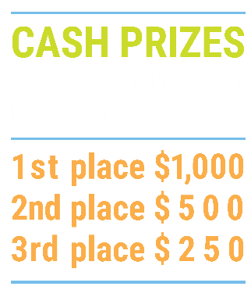

We’ve gone Virtual!
Teach Economics?
Your students may have what it takes to compete in the nation’s only high school economics competition!
Why Play?
• Fun team learning experience
• Great for college applications
• No other challenge like this
• Online participation makes access easy
• Chance for cash prizes
How it Works
Teams register
Teachers enroll team(s) of 3- 4 high school students from the same school. Multiple teams allowed.
Teams compete within their state
Compete to win your state competition for a
chance to advance to the National Semi-Finals.
National Semi-Finals: May 3-20, 2021
Teams answer multiple-choice questions on macroeconomics, microeconomics, and international & current events.
National Finals: May 22-24, 2021
Teams analyze an economic issue and present their solution. Top teams engage in the Finals Quiz Bowl where they face-off answering questions to claim the National Title.
Two divisions based on experience level
David Ricardo for first-time competitors who have taken no more than one economics course.
Adam Smith for returning competitors, AP, International Baccalaureate, and honors students.
Register Today at NationalEconomicsChallenge.org

Slide 44



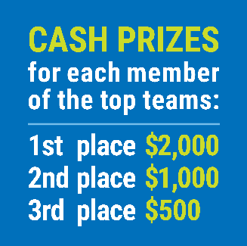

FIND YOUR LOCAL COMPETITION
AND REGISTER TODAY!
The National Personal Finance Challenge is a competition that provides high school students with an exciting and motivating opportunity to build, apply, and demonstrate their knowledge of money management.
Through online exams and a personal finance simulation, teams showcase their expertise in earning income, buying goods and services, saving, using credit, investing, as well as protecting and insuring.
Teams of up to four students, with one teacher/coach, can qualify to represent their state at the National Personal Finance Challenge by winning their local competition.
NATIONALS
Semi-Finals: First round elimination via online multiple-choice questions.
Finals: Case study round virtually co-hosted by the Cleveland Fed on June 3.
personalfinancechallenge.org

Slide 45
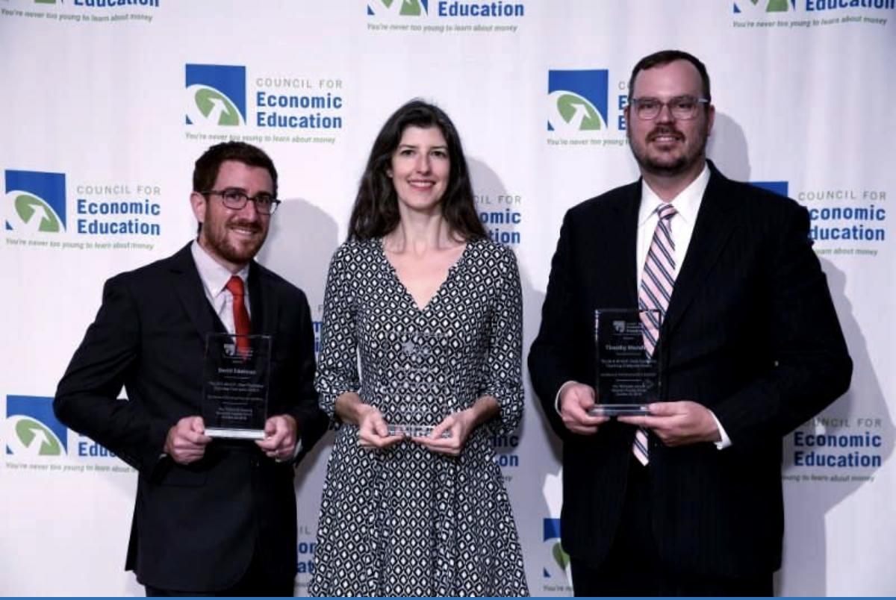
The 2021 Sloan Teaching Champion Award
Winners receive:
A cash award of $5,000
A cash award of $2,500 for their school to support economic education
Recognition at our annual Visionary Awards convening
This award promotes economic education by honoring three outstanding teachers who incorporate exemplary teaching techniques that improve their students’ economic understanding in and out of the classroom.
This award is open to New York metropolitan area high school teachers of all subjects, not just teachers of economics. Applicants must demonstrate how they integrate economics into their teaching.
Sound like you or someone you know?
Applicants must teach in one of the
Twelve New York state counties (New York, Kings, Bronx, Richmond, Queens, Nassau, Suffolk, Westchester, Putnam, Rockland, Orange and Dutchess)
Eight New Jersey counties (Bergen, Passaic, Essex, Hudson, Middlesex, Union, Morris, Monmouth), or the
Two Connecticut counties (Fairfield and New Haven)
Application will be launched on Friday February 19th 2021
You can access the application here.
CONTACT
Please feel free to e-mail us at rrivera@councilforeconed.org
with any questions you have.

