Slide 1
Fundamentals AP Economics 402:
Production Possibilities Frontier Model
Presented by Amanda Stiglbauer
Blythewood High School
Blythewood, SC
February 1, 2021 astiglbauer@richland2.org

Slide 2
EconEdLink Membership
You can now access CEE’s professional development webinars directly on EconEdLink.org! To receive these new professional development benefits, become an EconEdLink member. As a member, you will now be able to:
Automatically receive a professional development certificate via e-mail within 24 hours after viewing any webinar for a minimum of 45 minutes
Register for upcoming webinars with a simple one-click process
Easily download presentations, lesson plan materials and activities for each webinar
Search and view all webinars at your convenience
Save webinars to your EconEdLink dashboard for easy access to the event
You may access our new Professional Development page here

Slide 3
Professional Development Certificate
To earn your professional development certificate for this webinar, you must:
Watch a minimum of 45-minutes and you will automatically receive a professional development certificate via e-mail within 24 hours.
Accessing resources:
You can now easily download presentations, lesson plan materials, and activities for each webinar from EconEdLink.org/professional-development/

Slide 4
Agenda
Warm Up – Matching Pairs – Nearpod
AP Classroom Resources
Activity – Push Ups and Jumping Jacks
Content Delivery
Cartoons: Allocation and the PPF
Multiple Choice & and FRQ examples
Wrap Up – Kahoot!

Slide 5

Skills and Understandings
Skills: Draw an accurately labeled graph or visual to represent an economic model or market.
Enduring Understanding: Most resources are scarce, and in most cases the use of resources involves constraints and opportunity costs.

Slide 6
Objectives
I can:
Define the production possibilities curve and related terms.
Explain (using graphs as appropriate) how the production possibilities curve illustrates opportunity costs, tradeoffs, inefficiency, efficiency and economic growth or contraction.
Calculate opportunity cost.
Create a production possibilities model.

Slide 7
National Standards
National Standards for Economics
Standard 1: Scarcity
Standard 2: Decision Making
Standard 3: Allocation

Slide 8
Matching Pairs!
A NearPod Activity

Slide 9

AP Classroom Resources

Slide 10
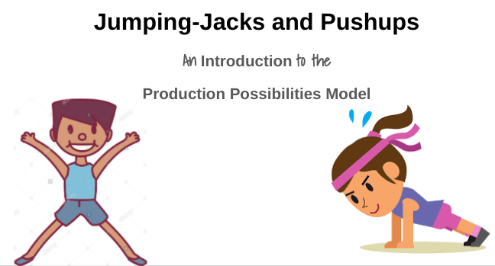

Slide 11
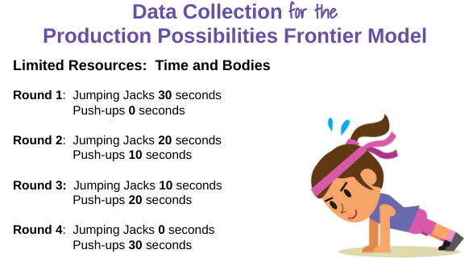

Slide 12
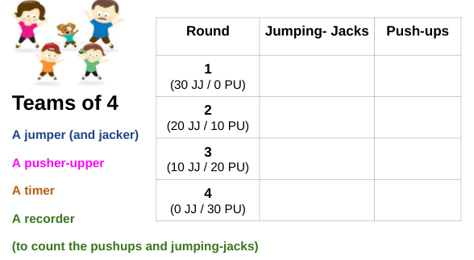

Slide 13
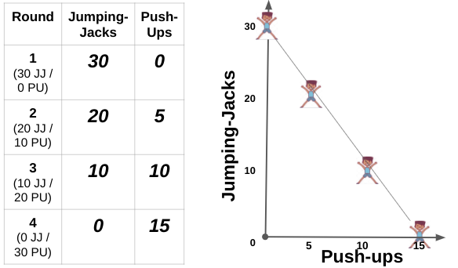

Slide 14


Slide 15
What is the Production Possibilities Curve?
Aka Production Possibilities Frontier – model that shows alternative ways an economy can use its scarce resources.
Graphically illustrates scarcity, opportunity costs, trade offs, (in)efficiency.
Key Assumptions:
  2 goods
  Full employment of resources
  Fixed factors of production/resources

Slide 16

Ceteris
Paribus
Other things being equal
The study of economics entails some “wand waving”
When working on a problem, assume only variables you’re working with will change….or else you’ll have a big ol’ mess!

Slide 17
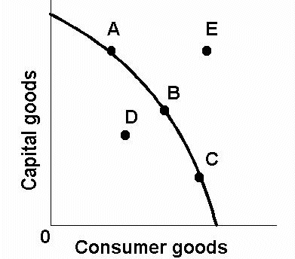
Points along the PPF

Slide 18
Points inside the PPF

Slide 19
Points outside the PPF

Slide 20
Open Ended Question
Explain how the PPC graphically demonstrates the ideas of scarcity, opportunity costs, inefficiency, and efficiency…

Slide 21
What Causes the PPF to Shift?

Slide 22
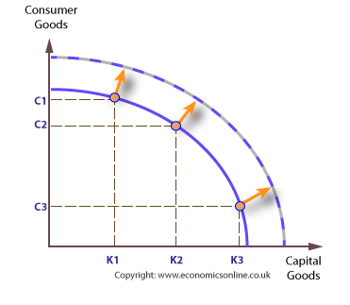
Outward Shift (Growth)

Slide 23
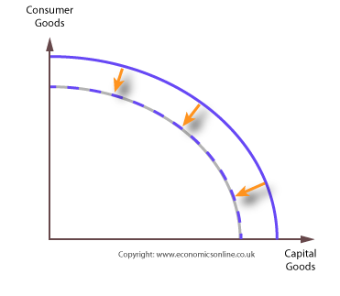
Inward Shift (Contraction)

Slide 24
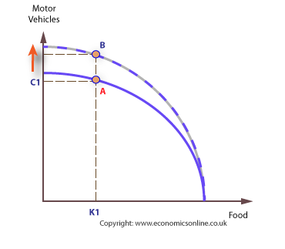
Improvements in Only One Industry

Slide 25
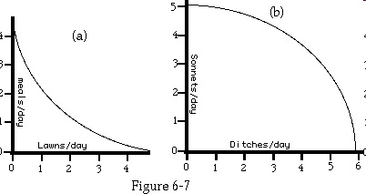
Why is the Production Possibilities Frontier Bowed Out (Concave)?
A: Because of increasing opportunity costs.
-Producing more of good A requires giving up more of good B.
-Resources are not perfectly interchangeable in most cases. (You can’t use the cream used to make butter to make a gun.) Law of Diminishing Returns.

Slide 26
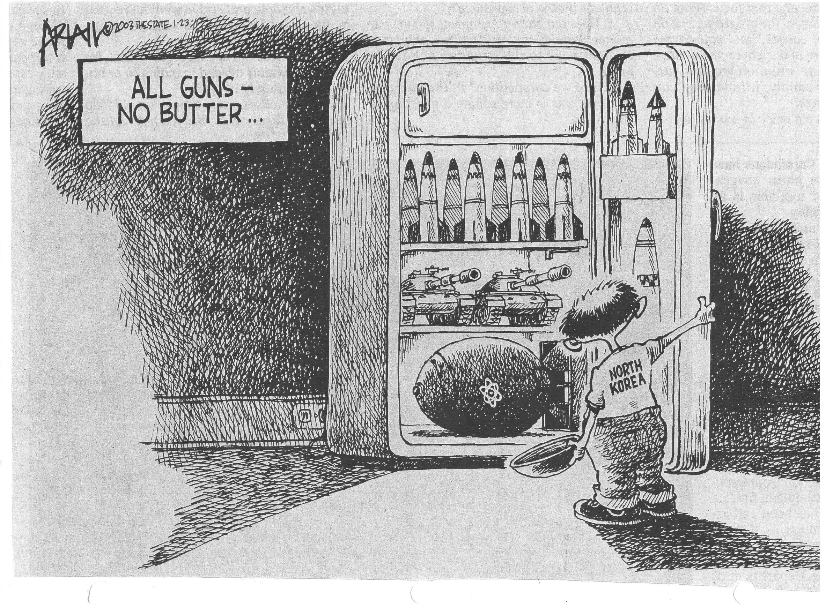

Slide 27

All butter, no guns

Slide 28
Collaboration Board
What do these cartoons tell us about how societies choose to allocate resources?

Slide 29
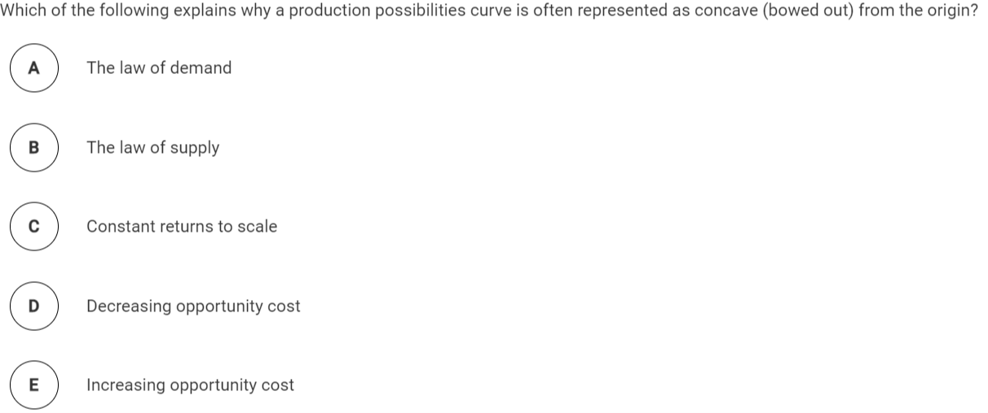
Multiple Choice Practice

Slide 30
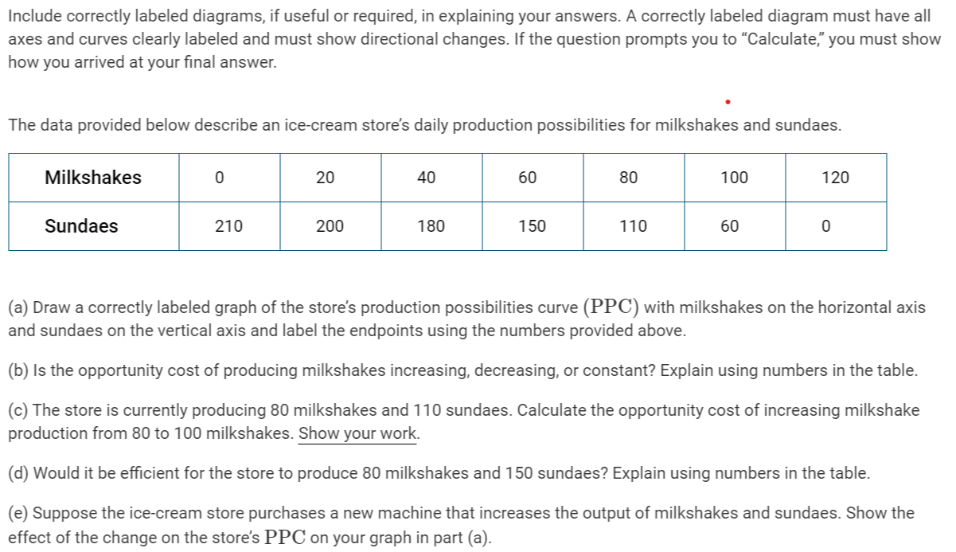

Slide 31
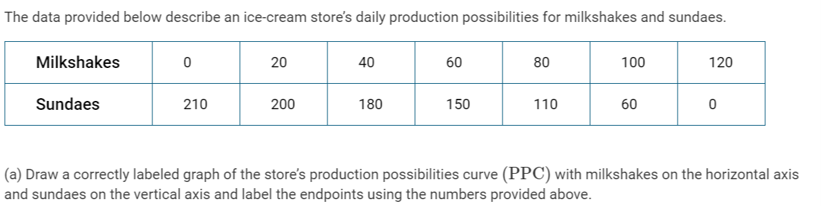
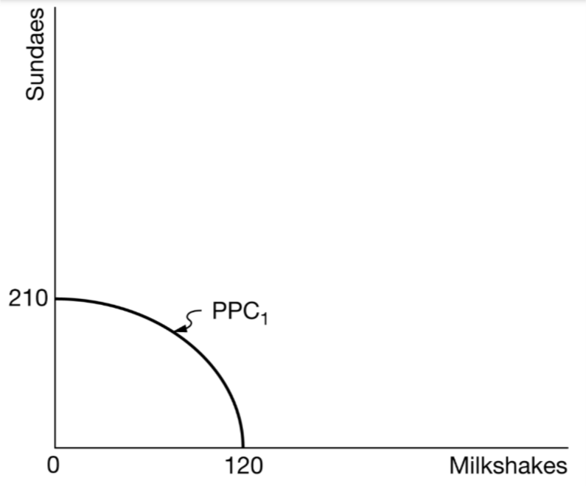

Slide 32
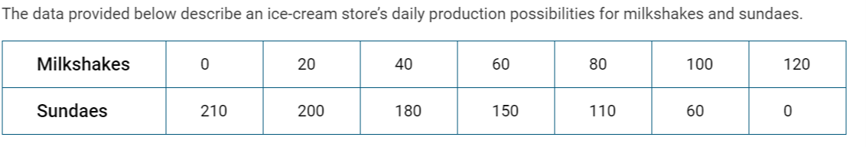
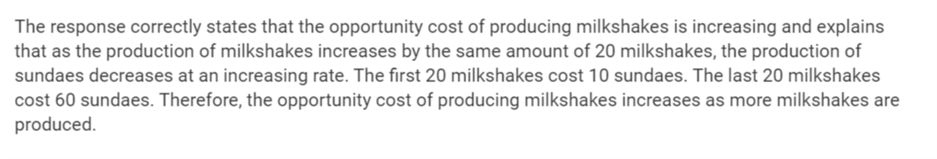

Slide 34


Slide 35
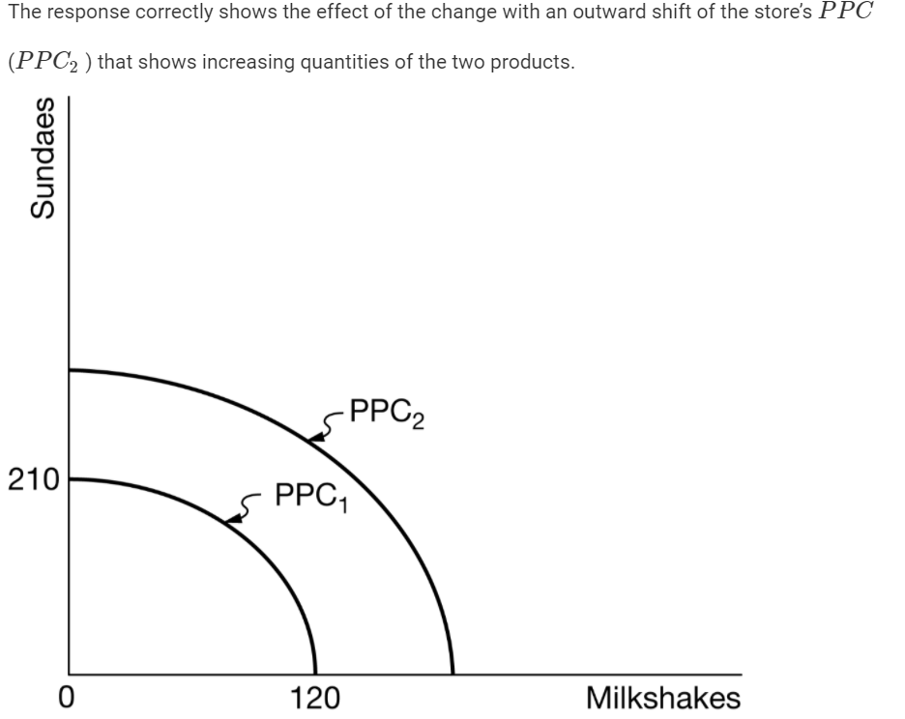
Suppose the ice cream store purchases a new machine that increases the output of milkshakes and sundaes. Show the effect of the change on the store’s PPC on your graph in part (a)

Slide 36

Kahoot!
Link Here!

Slide 37
Favorite Teaching Resources for PPF
EconMovies – Monster’s Inc
Push Ups and Jumping Jacks Activity
Review Econ YouTube Channel
ACDC Econ YouTube Channel

Slide 38

CEE Affiliates
https://www.councilforeconed.org/resources/local-affiliates/

Slide 39




Thank You to Our Sponsors!

