Slide 1
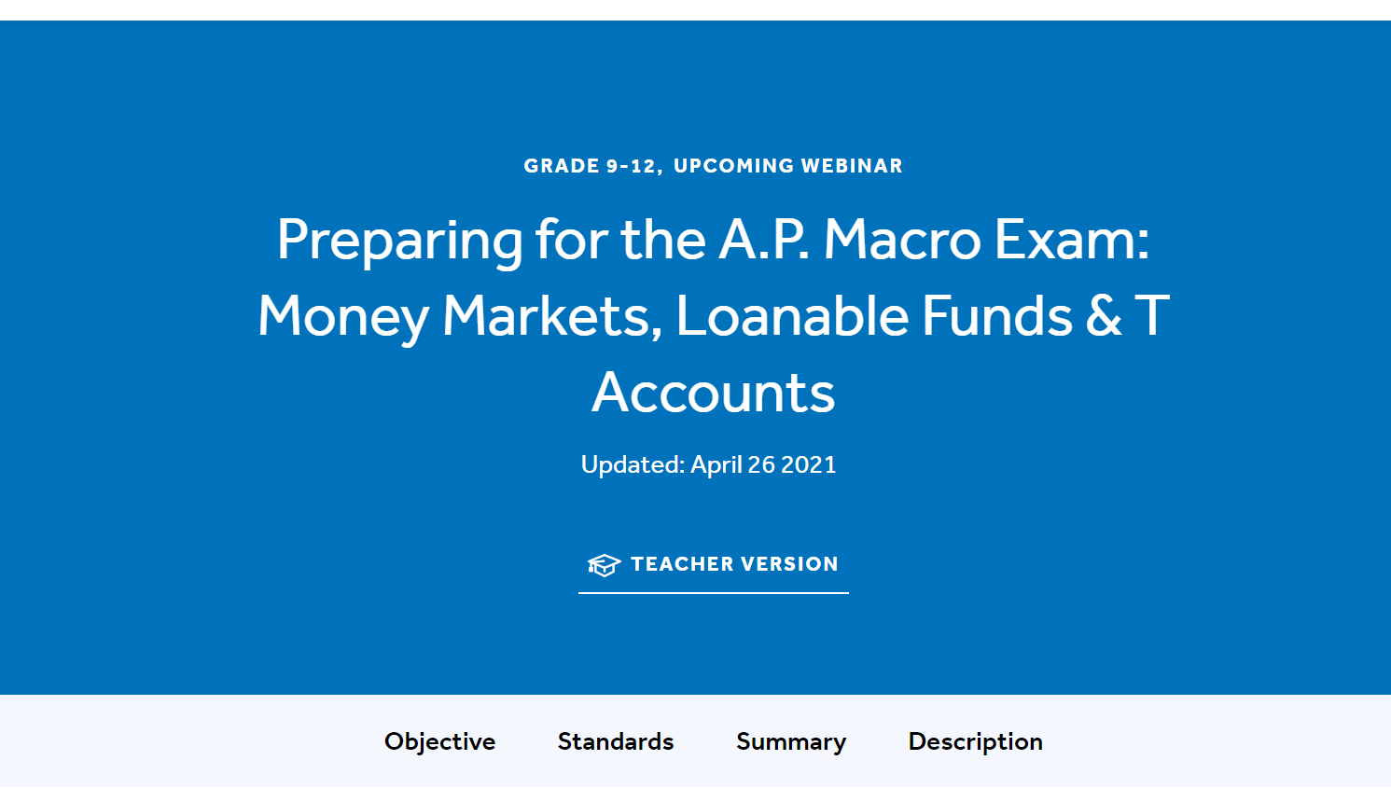
Tawni Hunt Ferrarini, PhD
Presenter
17 May 2021 tferrarini@lindenwood.edu tawni.org

Slide 2
Agenda
Overview
Key learning objectives
Foundational standards
Starter discussion
Teaching and learning strategies
Formative and summative assessments
Resources (provided along the way)
Once over lightly

Slide 3
Overview
You will have resources that serve students as they
Review the formulas of the banking system and fractional banking
Use the two major graphs of the banking system to investigate the intended and unintended consequences of monetary policy
Employ assessments strategies and pursue activities to help build a strong understanding of AP macroeconomics and acquire core skills that will help them meet and pass those expectations set forth by AP macro standards and benchmarks

Slide 4
Objectives
State important macro formulas
Apply fundamentals to analyze the loanable market and AD/AS macroeconomy
Investigate the direct impact of changes in monetary policy on real output, real income, and price levels
Analyze the secondary effects of these changes on interest rates and foreign currency exchange rates

Slide 5
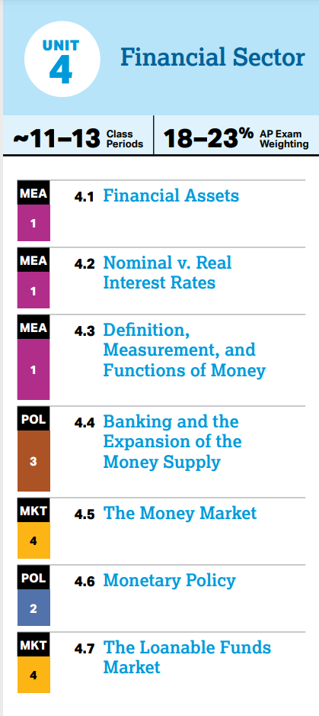
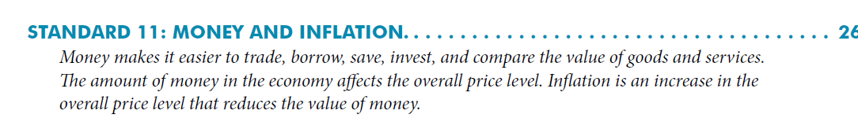
Foundation - National Standards and AP Macro Unit 4
Resources:
Voluntary National Content Standards in Economic. Available at: https://www.councilforeconed.org/wp-contentploads/2012/03/voluntary-national-content-standards-2010.pdf on May 16, 2021.
AP Macro Unit 6 Open Economy – International Trade and Finance. Available at https://apcentral.collegeboard.org/pdf/ap-macroeconomics-course-and-exam-description.pdf?course=ap-macroeconomics on May 16, 2021.

Slide 6
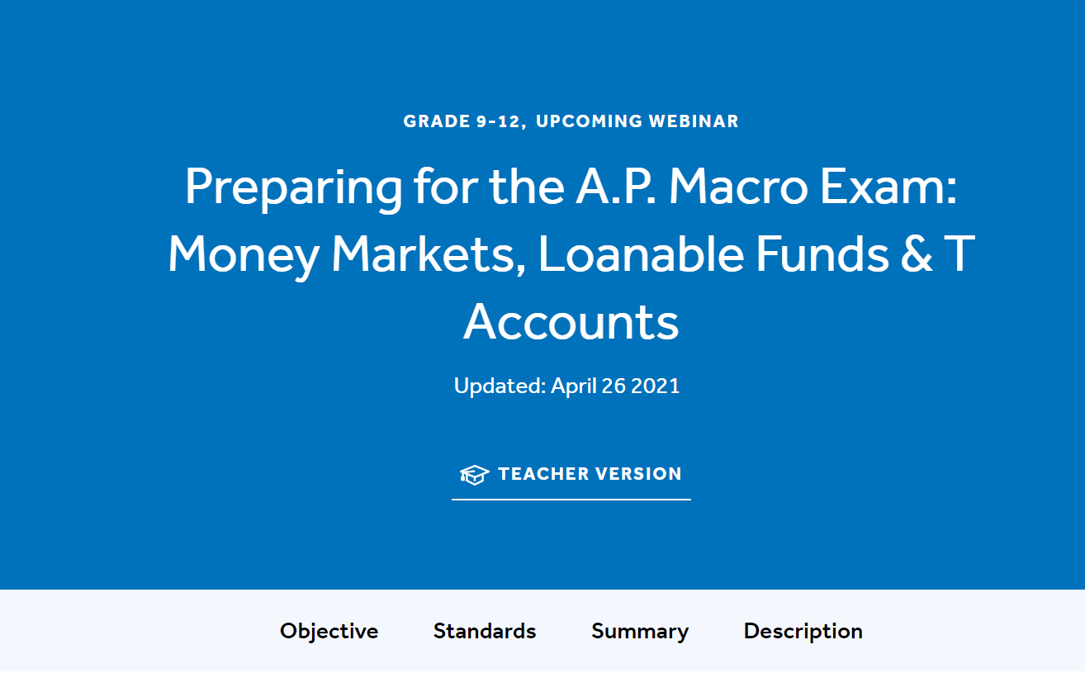
Standards:
National to State to Common Core State
(cont’d) Foundation - National Standards and AP Macro Unit 6
Resource: Available at https://www.econedlink.org/resources/exchange-rates/ on May 16, 2021

Slide 7
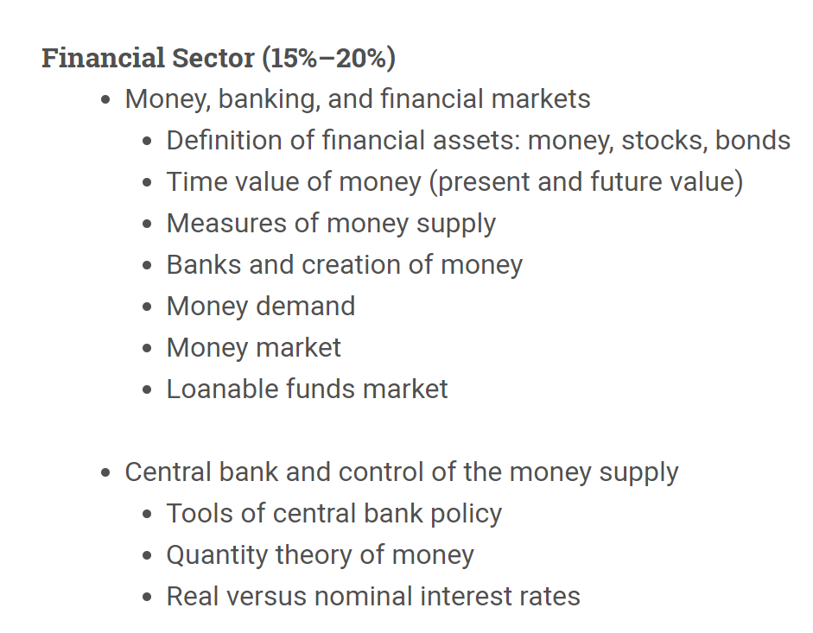


Slide 8


Discussion Starter
How do you help the macroeconomy grow sustainably through the financial system?

Slide 9
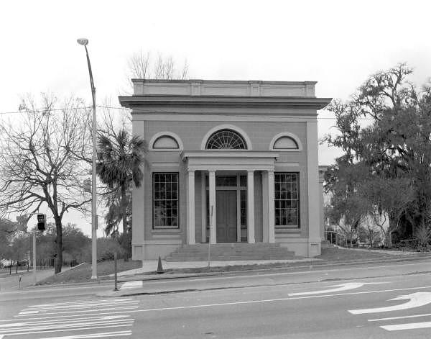
Borrowing (Strategic)
When individuals operating businesses and living in households borrow to accumulate capital and net returns are positive, real potential output and income grow.
Lending (Strategic)
Through private savings, individuals provide funds that enable others to invest through financing.

Slide 10
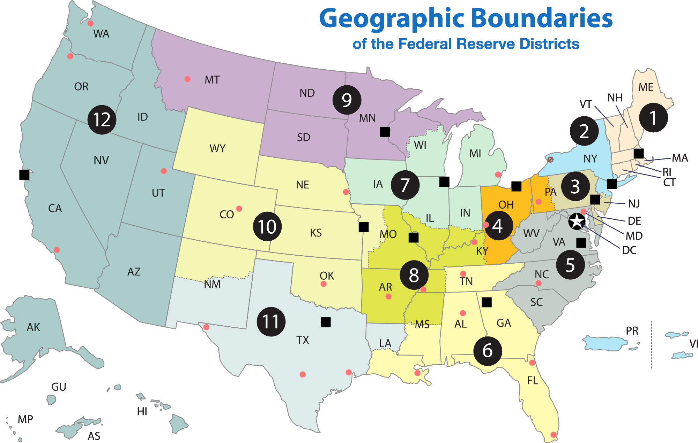

Slide 11
Your deposits
Provide banks with reserves that they can lend out after meeting their required reserve requirements.
Lending
Through savings and the fractional reserve banking systems, banks and individuals with deposits provide private funds that enable others to invest.

Slide 12
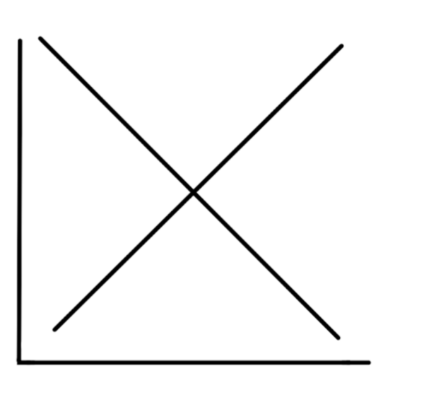
Equilibrium interest rate (e*); Equilibrium quantity of loanable funds (Q*), Demand for loanable funds (D); Real rate of interest (e), Supply of loanable funds (S)

Slide 13
Equilibrium interest rate (e*); Equilibrium quantity of loanable funds (Q*), Demand for loanable funds (D); Real rate of interest (e), Supply of loanable funds (S)
Supply of Private Loanable Funds
e*
Demand for Loanable Funds
Q*

Slide 14
Equilibrium interest rate (e*); Equilibrium quantity of loanable funds (Q*), Demand for loanable funds (D); Real rate of interest (e), Supply of loanable funds (S)
Introduce the FED and Monetary Policy
Draw along the dotted line.
Monetary Policy
Supply of Private Loanable Funds
e*
Demand for Loanable Funds
Q*

Slide 15
Equilibrium interest rate (e*); Equilibrium quantity of loanable funds (Q*), Demand for loanable funds (D); Real rate of interest (e), Supply of loanable funds (S)
Introduce the FED and
Expansionary Monetary Policy
Illustrate an increase in the Ms.
Show the impact on interest and quantity.
Monetary Policy
Supply of Private Loanable Funds
e*
Demand for Loanable Funds
Q*

Slide 16
Equilibrium interest rate (e*); Equilibrium quantity of loanable funds (Q*), Demand for loanable funds (D); Real rate of interest (e), Supply of loanable funds (S)
Monetary Policy
Monetary Policy
Supply
e*
e2*
Demand
Q*
Q*

Slide 17
Interest rates drop...
Consumption (C) that is financed increases.
Investment (Ig) that is financed increases.
Government is assumed constant.
Net exports (NX or EX - IM) increase as the lower rates of interest in the U.S. place downward pressure on value of the U.S. dollar making imports into the U.S. less attractive and making exports more attractive to other countries with stronger currencies

Slide 18
Equilibrium interest rate (e*); Equilibrium quantity of loanable funds (Q*), Demand for loanable funds (D); Real rate of interest (e), Supply of loanable funds (S)
Repeat for Contracting Monetary Policy
Monetary Policy
Monetary Policy
Supply
e*
Demand
Q*

Slide 19
Fractional Reserve Banking and You
How do you empower banks to create loans?
I don’t. The Fed does.
Using currency for cash transactions.
By placing deposits into banks and helping them create loans.
Using Bitcoin or another cryptocurrency to buy and sell.

Slide 20
Fractional Reserve Banking and You
How do you empower banks to create loans?
I don’t. The Fed does.
Using currency for cash transactions.
By placing deposits into banks and helping them create loans.
Using Bitcoin or another cryptocurrency to buy and sell.

Slide 21
Fractional Reserve Banking
and You
When individuals shift from holding currency and opening checking or savings accounts, they place money into the banking system.
There is no impact on M1.
  Currency goes down by the amount of the deposit while demand deposits go up by the same amount.
The impact on M1 comes when the banks start lending out their excess reserves. The reserves that are above what is required.

Slide 22
Simple example:
$1000 drops from a helicopter in your backyard.
Place it in your checking or savings account with checking privileges.

Slide 23
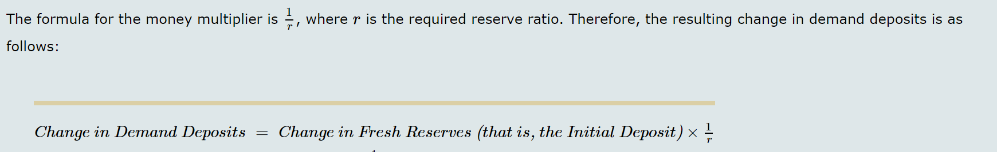
Important general formulas for the Fractional Reserve Banking system
Required Reserves
  RR = rrr*fresh/initial Demand Deposits where rrr is the required reserve ratio determined by the FRB
Excess Reserves
  ER = Total reserves less required reserves
Money Multiplier

Slide 24
Money Creation Process
Suppose First Main Street Bank, Second Republic Bank, and Third Fidelity Bank all have zero excess reserves.
The required reserve ratio is 20%.
Larry, a client of First Main Street Bank, deposits $750,000 into his checking account at First Main Street Bank.
Track what happens in the First Main Street Bank's T-account (before the bank makes any new loans).

Slide 25
First Main Street Bank's T-account
Required Reserve Ratio is 20%
Assets
Liabilities
Reserves: $750,000
Assume no loans outstanding
  RR =
  ER =
Fresh DD Larry $750,000

Slide 26
First Main Street Bank's T-account
Required Reserve Ratio is 20%
Assets
Liabilities
Reserves: $750,000
Assume no loans outstanding
DD Larry $750,000
What is the general formula for RR? Calculate.
What is the general formula for ER? Calculate.
How much can First Main Street Bank lend out?
Why does it want to lend out?
Why does someone want to borrow from the bank in order to boost Ig?

Slide 27
First Main Street Bank's T-account
Required Reserve Ratio is 20%
Assets
Liabilities
Reserves: $750,000
Assume no loans outstanding
DD Larry $750,000
What is the general formula for RR? Calculate.
  RR = rrr*change in DD = 0.20*$750,000 = $150,000
What is the general formula for ER? Calculate.
  ER = Reserves – RR = $750,000 - $150,000 = $600,000
How much can First Main Street Bank lend out?
  $600,000 in fresh reserves can be lent out. (TR – RR)
Why does it want to lend out?
  To generate business interest income with the intent of realizing net profits (keeps doors open)
Why does someone want to borrow for Ig?
  To earn higher expected profits in the future with the funds borrowed for physical or human capital accumulation (increases production and income capacity)

Slide 28
Fractional Reserve Banking Money Creation Process
New money through loanable funds that create new DD because of borrowing
Link this money creation to growth in real GDP
What is the general formula for money creation?
That is by how much will total demand deposits (and loans outstanding) increase because of Larry’s fresh deposit?
State the general formula for GDP calculated by the expenditures approach
Identify which component stimulates growth in future real GDP

Slide 29
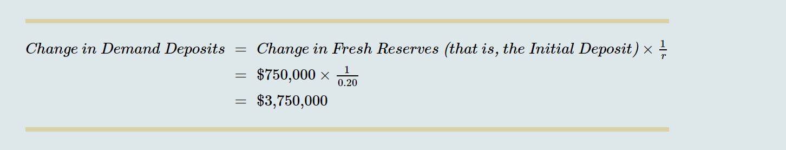
Fractional Reserve Banking Money Creation Process
New money through loanable funds that create new DD because of borrowing
Link this money creation to growth in real GDP
State the general formula for GDP calculated by the expenditures approach
…GDP=C+Ig+G+EX-IM
Identify which component stimulates growth in future real GDP
What is the general formula for money creation? = 1/rrr*DD
That is by how much will total demand deposits (and loans outstanding) increase because of Larry’s fresh deposit?

Slide 30
Monetary Tools
3 Traditional Tools
Adjust to expand ER during recessions and contract during inflationary periods
Reserve requirements
Discount rate of interest
  Banks can borrow from the Fed.
  The discount rate of interest is that rate in which a central bank charges on its loans and advances to a commercial banks.
Buying and selling of bonds through the Federal Open Market Committee
There is a recession (real GDP falls, production slows, employment decreases, prices move downward…)
How can the Fed incentivize lending through banks and borrowing from businesses and households? Specifically:
What will it do with the required reserve ratio?
How about the discount rate?

Slide 31
Monetary Tools
3 Traditional Tools
Adjust to expand ER during recessions and contract during inflationary periods
Reserve requirements
Discount rate of interest
  Banks can borrow from the Fed.
  The discount rate of interest is that rate in which a central bank charges on its loans and advances to a commercial banks.
Buying and selling of bonds through the Federal Open Market Committee
There is a recession
  Real GDP falls, production slows, employment decreases, payroll decreases, prices move downward…
How can the Fed incentivize lending through banks and borrowing from businesses and households? Specifically:
What will it do with the required reserve ratio? Decrease it.
How about the discount rate? Decrease it.

Slide 32
Interested about interest rates?
Discount Rate
Federal Rate
The discount rate is the interest rate on loans that the Federal Reserve makes to banks. Banks occasionally borrow from the Federal Reserve when they find themselves short on reserves.
The federal funds rate is the interest rate that banks charge one another for short-term (typically overnight) loans.

Slide 33
Monetary Tools
3 Traditional Tools
Adjust to expand ER during recessions and contract during inflationary periods
Reserve requirements
Discount rate of interest
  Banks can borrow from the Fed.
  The discount rate of interest is that rate in which a central bank charges on its loans and advances to a commercial banks.
Buying and selling of bonds through the Federal Open Market Committee
Banks hold U.S. Treasury bonds and they sell them.
When they hold them after purchasing them, they are not lending to business or households.
When they sell them, the FED credits their reserve accounts, making excess reserves available to banks for lending.

Slide 34
Analyze – Recessionary Times
The discount rate is the interest rate on loans that the Federal Reserve makes to banks. Banks occasionally borrow from the Federal Reserve when they find themselves short on reserves.
A lower discount rate increases/decreases banks' incentives to borrow reserves from the Federal Reserve.
This, thereby increases/decreases the quantity of reserves in the banking system and causing the money supply to increase through borrowing and the creation of demand deposits.

Slide 35
Analyze – Recessionary Times
The discount rate is the interest rate on loans that the Federal Reserve makes to banks. Banks occasionally borrow from the Federal Reserve when they find themselves short on reserves.
A lower discount rate increases/decreases banks' incentives to borrow reserves from the Federal Reserve.
This, thereby increases/decreases the quantity of reserves in the banking system and causing the money supply to increase through borrowing and the creation of demand deposits.

Slide 36
Analyze – Inflationary Periods
The federal funds rate is the interest rate that banks charge one another for short-term (typically overnight) loans.
When the Federal Reserve uses open-market operations to sell government bonds, the quantity of reserves in the banking system (increases/decreases).
Consequently, banks' need to borrow (more/less) from each other and the federal funds rate (increases/decreases).

Slide 37
Analyze – Inflationary Periods
The federal funds rate is the interest rate that banks charge one another for short-term (typically overnight) loans.
When the Federal Reserve uses open-market operations to sell government bonds, the quantity of reserves in the banking system (increases/decreases).
Consequently, banks' need to borrow (more/less) from each other and the federal funds rate (increases/decreases).

Slide 38
Great Recession reveals
In practice, banks can hold any level of excess reserves that they choose, much as households can hold as much currency as they like.
Since the Fed cannot precisely control the level of excess reserves or the fraction of money households wish to hold as currency, it cannot precisely increase or decrease the money supply.
However, it can get pretty close by monitoring the behavior of banks and households and adjusting monetary policy to reflect changes in banks' preferences for excess reserves or households' preferences for currency.

Slide 39
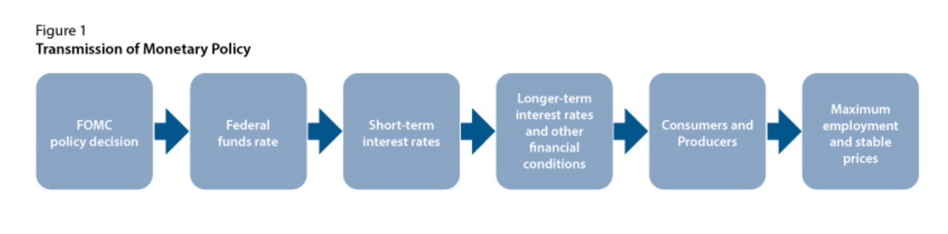
Period of Ample Reserves: Creative Monetary Policy

Slide 40

Leveraging
Within any balance sheet, the total value of all accounts on the left-hand side (the assets) must equal the total value of all accounts on the right-hand side (the liabilities) of the bank’s balance sheet.
The original leverage ratio equals the sum of the original assets divided by the original amount of capital:

Slide 41
Teaching and Learning Strategies
Shift students from looking at their clothes to applying their economic knowledge and using their skills to describe the how their shoes got on their feet.

Slide 42
Imports/Exports
The Difference
Goods and services produced in other countries but purchased by U.S. consumers or businesses are IMPORTS.
Goods and services produced in U.S. but purchased by consumers or businesses in other countries are EXPORTS

Slide 43
Things you should know how to do as you prepare for the “real world”...
1. Explain the relationship between net exports and net capital outflows.
2. Establish links between saving, investment, and international flows.
3. Define the exchange rate, and identify the one consistent with purchasing-power parity.

Slide 44
Relationship between net exports and net capital outflows
Define net exports of goods and services.
Define net capital flows of assets.
Establish a link between the two.
Evaluate how this link impacts the health and wealth of the macroeconomy.

Slide 45
Recall net exports in the GDP equation. Identify the correct definition of net exports.
Choose which represents net exports in the GDP equation:
The purchase of foreign assets by domestic residents minus the purchase of domestic assets by foreigners.
The purchase of domestic assets by foreigners minus the purchase of foreign assets by domestic residents.
Export of goods and services less imports.
Imports of goods and services less exports.

Slide 46
What are net exports in the GDP equation?
Choose which represents net exports in the GDP equation:
The purchase of foreign assets by domestic residents minus the purchase of domestic assets by foreigners.
The purchase of domestic assets by foreigners minus the purchase of foreign assets by domestic residents.
Exports of goods and services less imports.
Imports goods and services less exports.

Slide 47
Trade matters - key terms
Trade balance is the value of a nation’s exports of goods and services minus the value of its imports, also called net exports.
  Trade deficit exists if imports exceed exports.
  Trade surplus exists if exports exceed imports.
  Balanced trade exists if they are equal.

Slide 48
Circle all factors that can influence net exports of goods and services
The tastes of U.S. consumers for domestic and foreign goods
Relative price levels - the prices of domestic U.S. goods relative to foreign goods
The incomes of U.S. consumers at home relative to abroad
The cost of transporting goods from country to country
Exchange rates (what it takes in U.S. currency to buy foreign currencies)
Trade policies, domestic subsidies, fiscal policy, monetary policy, and bureaucracy

Slide 49
Circle all factors that can influence net exports of goods and services
The tastes of U.S. consumers for domestic and foreign goods
Relative price levels - the prices of domestic U.S. goods relative to foreign goods
The incomes of U.S. consumers at home relative to abroad
The cost of transporting goods from country to country
Exchange rates (what it takes in U.S. currency to buy foreign currencies)
Trade policies, domestic subsidies, fiscal policy, monetary policy, and bureaucracy

Slide 50
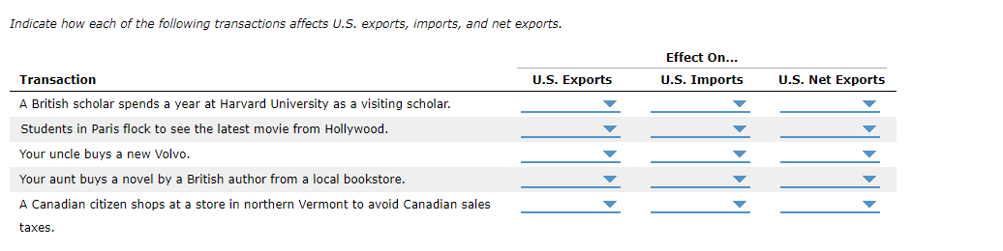
Problems & Applications
+ (increase); - (decrease), NC (no change)

Slide 51
When a British scholar spends a year at Harvard University as a visiting scholar, she spends money buying American goods and services.
  So, U.S. exports increase, imports are unchanged, and net exports increase.
When students in Paris flock to see the latest movie from Hollywood, foreigners are buying a U.S. good.
  So, U.S. exports increase, imports are unchanged, and net exports increase.
When your uncle buys a new Volvo, an American is buying a foreign good.
  So, U.S. exports are unchanged, imports increase, and net exports decrease.
When your aunt buys a novel by a British author from a local bookstore, an American is buying a foreign good.
  So, U.S. exports are unchanged, imports increase, and net exports decrease.
When a Canadian citizen shops at a store in northern Vermont to avoid Canadian sales taxes, a foreigner is buying U.S. goods.
  So, U.S. exports increase, imports are unchanged, and net exports increase.

Slide 53
Net exports versus net capital flows
Net capital outflows or NCO (stocks, bonds, real estate, and other assets)
The purchase of foreign assets by domestic U.S. residents minus the purchase of domestic assets by foreigners
Net exports (NX)
Export of goods and services (EX) less imports in the GDP equation.
GDP = Y = C + Ig + G + NX

Slide 54
The Flow of Financial Resources
Net Capital Outflow
Net capital flows include:
The purchase of foreign assets by domestic residents minus the purchase of domestic assets by foreigners.
Assets include stocks, bonds, buildings, and more.
Foreign direct investment occurs when a capital investment is owned and operated by a foreign entity.
Foreign portfolio investment involves an investment that is financed with foreign money but operated by domestic residents.

Slide 55
The net exports of any country are the difference between the value of its exports and the value of its imports.
However, net capital outflow refers to the difference between the purchase of foreign assets by U.S. residents and the purchase of U.S. assets by foreigners.

Slide 56
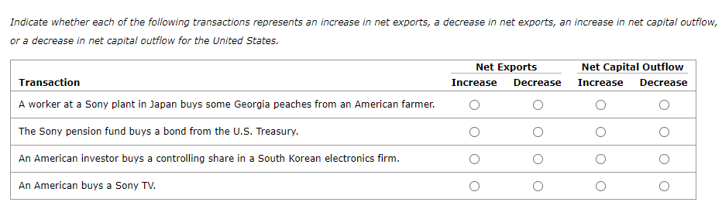
Net exports versus net capital outflows and inflows (NFFI)
NCO = Purchase of foreign assets by U.S. residents minus the purchase of U.S. assets by foreigners
NX = Ex - Im

Slide 57
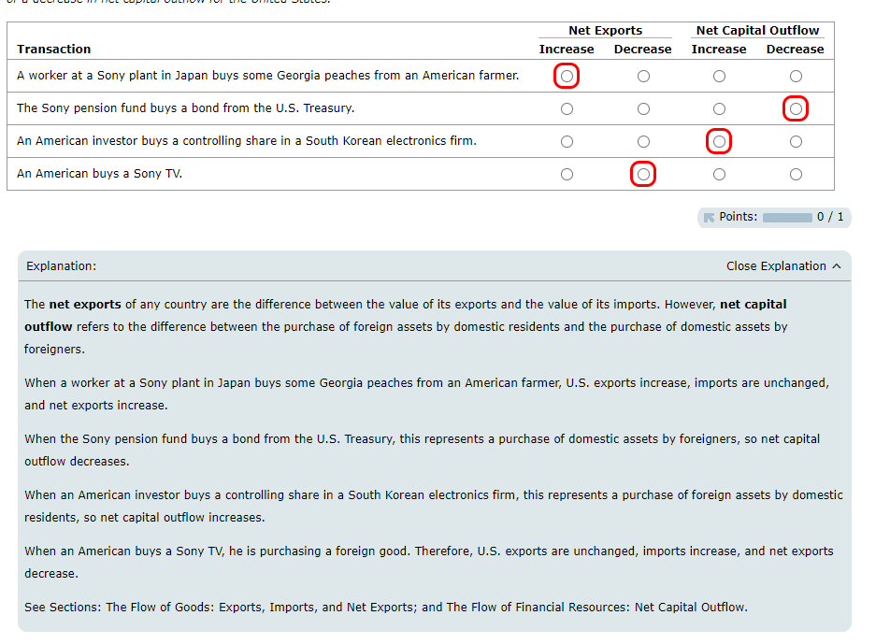

Slide 58
For an economy, net exports must be equal to net capital outflow.
Net capital outflows are influenced by these and other factors:
The real interest rates being paid on foreign assets relative to U.S. assets.
Perceived economic and political risks of holding assets abroad relative to the U.S.
The government policies that affect foreign ownership of foreign assets relative to the U.S. Policies include monetary, fiscal, and trade policies.

Slide 59
Going beyond domestic possibilities
Every international transaction involves exchange.
When a seller country transfers a good or service to a buyer country, the buyer country trades some asset to pay for the good or service.
For example, the U.S. has been operating with a trade deficit.
Net capital inflows have made this possible where the purchase of U.S. assets by foreigners has been greater than the purchase of foreign assets.

Slide 60
Link between saving, investment, and international flows
Recall:
Y = GDP = C + Ig + G + NX
Y - C - G = Ig + NX
National Savings = Ig + NX
National Savings = Ig + Net Capital Outflows

Slide 61
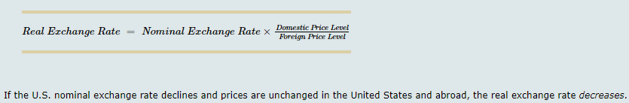
Define the exchange rate
The nominal exchange rate is the rate at which a person can trade the currency of one country for the currency of another.
The real exchange rate is the rate at which a person can trade the goods and services of one country for the goods and services of another.

Slide 62
Purchasing-power parity
Purchasing-power parity states that a unit of any given currency should be able to buy the same QUANTITY of goods in all countries.
Example: A can of soda costs $1.75 USD in the United States and 42 pesos in Mexico.
The peso–dollar exchange rate is:
  42 pesos/$1.75 USDs or 24 pesos per $1 USD

Slide 63
Currency appreciation or depreciation
A currency is said to appreciate if it can purchase more of another currency.
It is said to depreciate if it purchases less.
Economists focus on real considerations and quantity matters.
Economists make it REAL. They focus on quantities.

Slide 64




Put on your worldly hat

Slide 65
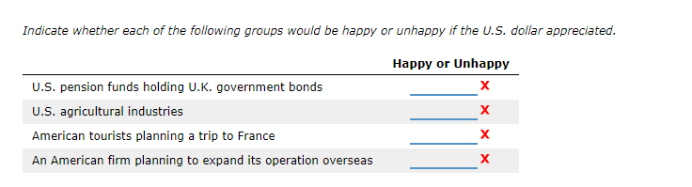


Happy (+) or Unhappy (-) with an appreciation of the U.S. dollar

Slide 66
U.S. “teacher” pension funds holding U.K. government bonds would be unhappy if the U.S. dollar appreciates. U.S. holders of U.K. debt would get fewer dollars for each British pound of interest income. In general, investments in foreign countries are better off if the foreign country's currency appreciates.
U.S. agricultural industries would be unhappy if the U.S. dollar appreciates and other currencies depreciates. U.S. prices are higher. This increases the cost of purchasing U.S. exports and reduces export sales.
American tourists planning a trip to France would be happy if the U.S. dollar appreciates. They get more euros for each U.S. dollar, making their vacation less expensive.
An American firm planning to expand its operation overseas would be happy if the U.S. dollar appreciates. It would get more units of the foreign currency for each U.S. dollar. It, therefore, can expand its operation overseas at lower costs.

Slide 67
More things you should know how to do as you prepare for the “real world”...
1. Explain the relationship between net exports and net capital outflows. 2. Establish links between saving, investment, and international flows.
3. Define the exchange rate, and identify the one consistent with purchasing-power parity.
4. Describe the market for foreign-currency exchange. 5. Contrast a country's nominal exchange rate with its real exchange rate.
6. Determine the implications of purchasing-power parity on exchange rates. 7. Investigate the influences of policies on exchange rates.

Slide 68
Reminder: Important relationship
The net exports of any country are the difference between the value of its exports and the value of its imports.
However, net capital outflow refers to the difference between the purchase of foreign assets by U.S. residents and the purchase of U.S. assets by foreigners.

Slide 69
Net capital outflow equals net exports
Imbalances in the net capital outflow (NCO) are associated with imbalances in the trade balance (or net exports, NX).
Each exchange that affects the net capital outflow, also affects net exports in the same amount.
For U.S. is running a trade deficit, it does so by financing the net purchase of goods and services by selling assets to nonresidents.

Slide 70
Countries that run trade deficits
Countries that run trade deficits must attract more foreign capital in their countries than what goes out of their countries in assets
Deficit-spending countries fund the deficits through net capital inflows

Slide 71
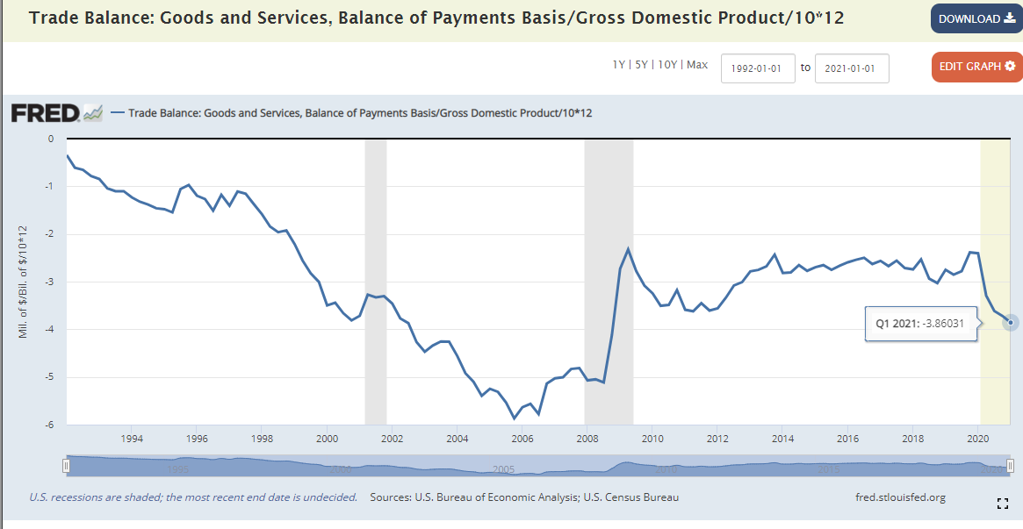
The U.S. Operates with a Trade Deficit
Retrieved from: https://fredblog.stlouisfed.org/2017/10/three-views-of-the-u-s-trade-deficit/?utm_source=series_page&utm_medium=related_content&utm_term=related_resources&utm_campaign=fredblog

Slide 72
Exchange Rates - Nominal vs Real
Nominal rate of exchange is the rate at which a person can trade the currency of one country for another. It determines number of units of foreign currency one currency can purchase.
Real rate of exchanges adjusts for price differentials. Real rates show how much quantity can be acquired in different countries using their currencies.

Slide 73
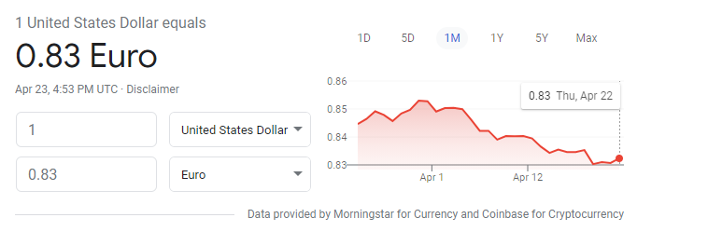
Nominal rate - Actual exchange rate (e)
The actual exchange rate for the USD or the foreign currency cost (€) of the USD.

Slide 74
Nominal rate (e) to real exchange rate (RER)
The RER between two currencies is the product of the nominal exchange rate (the dollar cost of a euro) AND the ratio of prices between the two countries (CPI_{US}/CPI_{EU})
The core equation is RER=eP*/P_{US}, where, in our example,
  e is the nominal dollar-euro exchange rate,
  P* is the average price of a good in the euro area, and
  P_{US} is the average price of the good in the United States.

Slide 75
Purchasing power parity
This “law of one price” states the price for good should be the same at every country or regional trading location.
For example, the price of a Big Mac should be the same whether paid in USDs or another country’s currency.

Slide 76
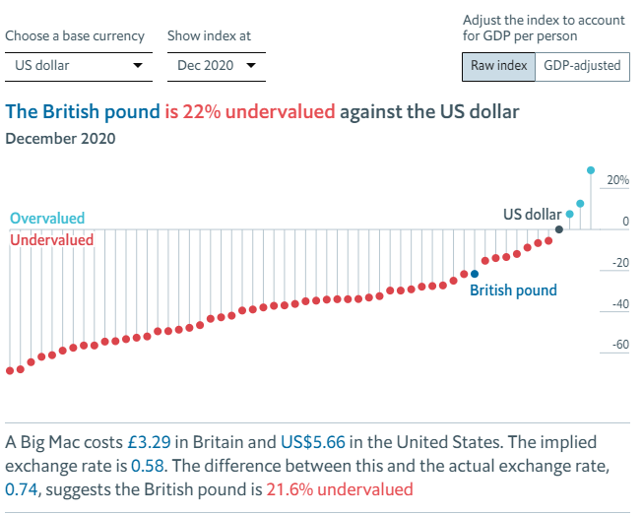


One Big Mac Is Purchased in Two Countries with the actual or nominal rate of US$1 = £0.74. Let’s make it real.
RER=eP*/P_{US}

Slide 77

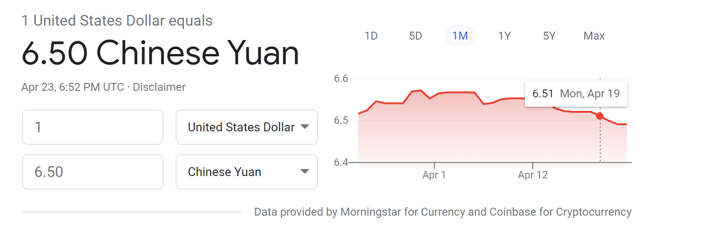
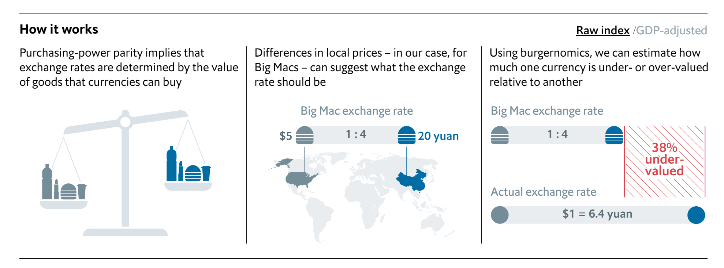
Nominal exchange rate: the dollar-yuan cost
Turning to China...
$1 USD = 6.5 yuan
“In Dec 2020, a Big Mac cost 22.40 yuan in China and US$5.66 in the United States. The implied exchange rate is 3.96. The difference between this and the actual exchange rate, 6.48, suggests the Chinese yuan is 38.9% undervalued.”
The Economist

Slide 78
Implications of the PPP
Purchasing-power parity means that the nominal exchange rate between the currencies of two countries will depend on the price levels in those countries.
If a dollar buys the same amount of goods and services in the United States (where prices are measured in dollars) as it does in China (where prices are measured in yuan), then the nominal exchange rate (the number of yuan per dollar) must reflect the price variances in the two countries.

Slide 79
PPP, Price Variances Connected to Policy Adjustments
Because the nominal exchange rate depends on the price levels, it must also depend on the money supply and money demand in each country.
  If the central bank increases the supply of money in a country and raises the price level, it also causes the country’s currency to depreciate relative to other currencies in the world. The demand for the U.S. dollar decreases.
  When a central bank prints large quantities of money, that money loses value both in terms of the goods and services it can buy and in terms of the amount of other currencies it can buy.

Slide 80
PPP, Price Variances Connected to Policy Adjustments
Because the nominal exchange rate depends on the price levels, it is also impacted by fiscal policy in each country.
  Similarly, if an expansionary fiscal policy raises prices through increased government spending and/or by reducing taxes while the macroeconomy operates at or close to its potential level, a country’s currency will depreciate as price levels rise.
  Finally, if a restrictive trade policy raises price levels, a country’s currency decreases.

Slide 81
PPP
Purchasing-power parity does tell us about exchange rates.
Large and persistent movements in nominal exchange rates typically reflect changes in price the price level at home relative to that abroad.
Trade restrictions, domestic subsidies, and other policy differentials are not directly accounted for the PPP. There are currency repercussions associated with policy changes.

Slide 82
Formative and Summative Assessments
AP Macroeconomics Unit 6
EconEdLink
EconLowDown

Slide 83

CEE Affiliates
https://www.councilforeconed.org/resources/local-affiliates/

Slide 84
Use Your EconEdLink Membership
Access CEE’s professional development webinars directly on EconEdLink.org! Be an active EconEdLink member and:
Automatically receive a professional development certificate via e-mail within 24 hours after viewing any webinar for a minimum of 45 minutes
Register for upcoming webinars with a simple one-click process
Easily download presentations, lesson plan materials and activities for each webinar
Search and view all webinars at your convenience
Save webinars to your EconEdLink dashboard for easy access to the event
You may access our new Professional Development page here

Slide 85
Look for Your Professional Development Certificate
Congratulations! You have earned your professional development certificate for this webinar. Please:
Watch for professional development certificate. It will be sent via email within 24 hours.
Access this presentation and other resources through: EconEdLink.org/professional-development/
Register for future webinars and invite others.

Slide 86




Thank You to Our Sponsors!

