Slide 1



Financial Literacy Month Boot Camp
Alex Lamon
CEE Master Teacher
lamonteach@gmail.com
Twitter: @AlexMLamon
4.1.21

Slide 2


Slide 3
EconEdLink Membership
You can now access CEE’s professional development webinars directly on EconEdLink.org! To receive these new professional development benefits, become an EconEdLink member. As a member, you will now be able to:
Automatically receive a professional development certificate via e-mail within 24 hours after viewing any webinar for a minimum of 45 minutes
Register for upcoming webinars with a simple one-click process
Easily download presentations, lesson plan materials and activities for each webinar
Search and view all webinars at your convenience
Save webinars to your EconEdLink dashboard for easy access to the event
You may access our new Professional Development page here

Slide 4
Professional Development Certificate
To earn your professional development certificate for this webinar, you must:
Watch a minimum of 45-minutes and you will automatically receive a professional development certificate via e-mail within 24 hours.
Accessing resources:
You can now easily download presentations, lesson plan materials, and activities for each webinar from EconEdLink.org/professional-development/

Slide 5

my teaching context
Notes:
Who do I teach?
What do I teach them?
And how...in a pandemic?!

Slide 6
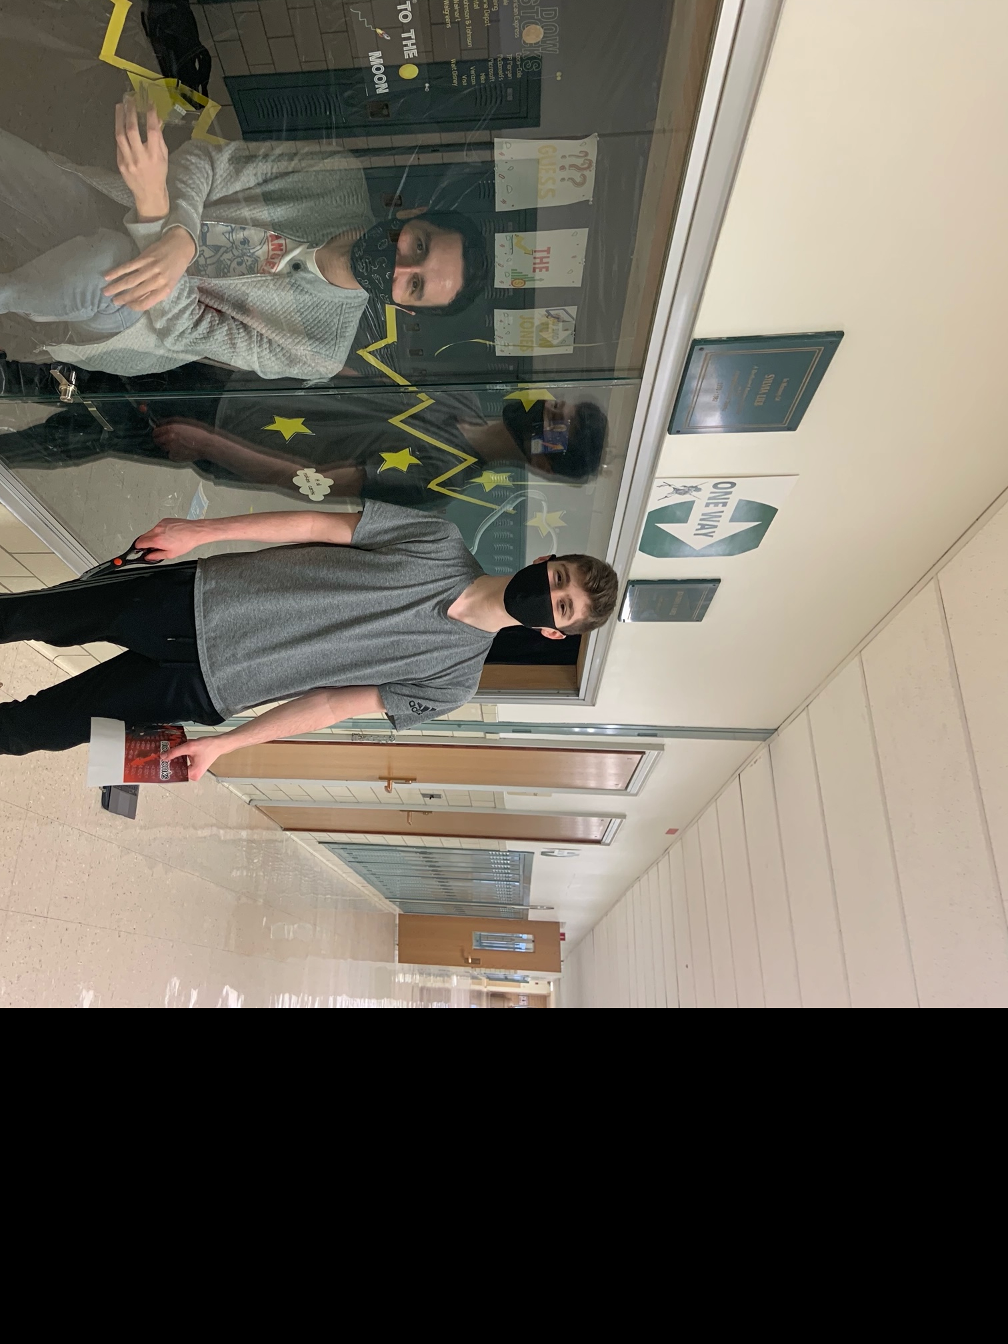
teaching in 2021

Slide 7

our job is hard now
but it’ll get better
Notes:
Do you best in this context. Toolbox session. The theme of opportunity

Slide 8

Notes:
https://padlet.com/lamonteach/finlitbootcamp

Slide 9

my course at a glance
Careers
Paying for College
Taxes/Income
Checking
Savings
Credit
Investing
Insurance
Budgeting
Notes:
talk about general way course operates

Slide 10

our topics today
income
savings
Notes:
they are linked and can touch in many units in your PF curriculum .
Padlet/chat: What do you think students need to know surrounding these topics?

Slide 11

teaching income
gig economy
reading my paystub
  assessment
dealing with [small] windfalls
do I need to file taxes?
  reference guide
payment decisions
paycheck to paycheck

Slide 12

teaching saving
fractional reserve simulation
  banker balance sheet & borrower balance sheet
  loan certificates
compound interest
saving challenges
unbanked NYC
  reflection
budgeting simulation

Slide 13
National Standards
Standard 2: Decision Making
Standard 13: Income
https://www.councilforeconed.org/wp-content/uploads/2012/03/voluntary-national-content-standards-2010.pdf

Slide 14

CEE Affiliates
https://www.councilforeconed.org/resources/local-affiliates/

Slide 15

thank you for learning with me
Alex Lamon
CEE Master Teacher
lamonteach@gmail.com
Twitter: @AlexMLamon
4.1.21

Slide 16

Thank You to Our Sponsor!

Slide 17





We’ve gone Virtual!
Teach Economics?
Your students may have what it takes to compete in the nation’s only high school economics competition!
Why Play?
• Fun team learning experience
• Great for college applications
• No other challenge like this
• Online participation makes access easy
• Chance for cash prizes
How it Works
Teams register
Teachers enroll team(s) of 3- 4 high school students from the same school. Multiple teams allowed.
Teams compete within their state
Compete to win your state competition for a
chance to advance to the National Semi-Finals.
National Semi-Finals: May 3-20, 2021
Teams answer multiple-choice questions on macroeconomics, microeconomics, and international & current events.
National Finals: May 22-24, 2021
Teams analyze an economic issue and present their solution. Top teams engage in the Finals Quiz Bowl where they face-off answering questions to claim the National Title.
Two divisions based on experience level
David Ricardo for first-time competitors who have taken no more than one economics course.
Adam Smith for returning competitors, AP, International Baccalaureate, and honors students.
Register Today at NationalEconomicsChallenge.org

Slide 18





FIND YOUR LOCAL COMPETITION
AND REGISTER TODAY!
The National Personal Finance Challenge is a competition that provides high school students with an exciting and motivating opportunity to build, apply, and demonstrate their knowledge of money management.
Through online exams and a personal finance simulation, teams showcase their expertise in earning income, buying goods and services, saving, using credit, investing, as well as protecting and insuring.
Teams of up to four students, with one teacher/coach, can qualify to represent their state at the National Personal Finance Challenge by winning their local competition.
NATIONALS
Semi-Finals: First round elimination via online multiple-choice questions.
Finals: Case study round virtually co-hosted by the Cleveland Fed on June 3.
personalfinancechallenge.org

Slide 19
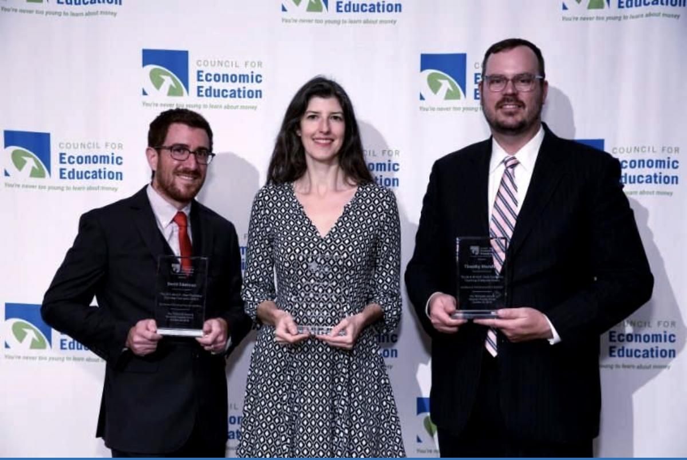
The 2021 Sloan Teaching Champion Award
Winners receive:
A cash award of $5,000
A cash award of $2,500 for their school to support economic education
Recognition at our annual Visionary Awards convening
This award promotes economic education by honoring three outstanding teachers who incorporate exemplary teaching techniques that improve their students’ economic understanding in and out of the classroom.
This award is open to New York metropolitan area high school teachers of all subjects, not just teachers of economics. Applicants must demonstrate how they integrate economics into their teaching.
Sound like you or someone you know?
Applicants must teach in one of the
Twelve New York state counties (New York, Kings, Bronx, Richmond, Queens, Nassau, Suffolk, Westchester, Putnam, Rockland, Orange and Dutchess)
Eight New Jersey counties (Bergen, Passaic, Essex, Hudson, Middlesex, Union, Morris, Monmouth), or these
Two Connecticut counties (Fairfield and New Haven)
Application will be launched on Friday February 19th 2021
You can access the application here.
CONTACT
Please feel free to e-mail us at rrivera@councilforeconed.org
with any questions you have.

