Slide 2
CREDIT
Use it to your advantage.
Notes:
Core Concept #2: Credit, and how to use it to your advantage

Slide 3
WHAT DO YOU THINK…
CREDIT
Of the phrases “good” and “bad” credit?
Makes credit good or bad? How does that affect your money choices?
Notes:
Ask students about their experience with credit and why they think it matters
Where have you heard of the phrases “good credit” or “bad credit” being used? (commercials, offers, your own life, etc.)
What do you think makes credit good or bad?
How do you think good or bad credit affects your money choices in life?
Credit comes in two flavors: there’s credit you use (like borrowing money and taking out a loan) and there’s credit you can build. The credit you use affects how you build credit - and the credit you build impacts so many other pieces of our money. Your credit history is one snapshot of your financial health. And it’s an important one, since many places will check on your credit to determine how trustworthy you are with your money. It can affect what kind of apartment you can rent to what kind of car you can buy. Luckily, you’ve got a lot of say in how healthy your credit history looks.

Slide 4
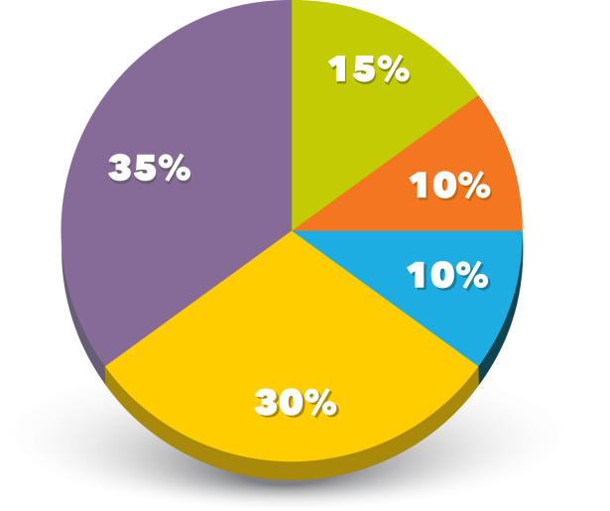
FICO CREDIT SCORE
CREDIT
LENGTH OF HISTORY
PAYMENT HISTORY
CREDIT MIX
NEW CREDIT
CREDIT UTILIZATION
SOURCE: FICO
Notes:
Your credit history is measured by your credit score - like a grade on a report card. And your credit score is made up of five slices: TRUST
Payment history (or how you repay your debts) (35%)
Credit utilization (or how much of your available credit you're using) (30%)
Length of your credit history (15%)
Credit mix (this is all your credit cards, auto loans, home loans, etc.) (10%)
New credit accounts (10%)
What is something in your life that falls into one of these categories? (e.g. credit cards, student loans, rent, cell phone bill, etc.)
Source: http://www.myfico.com/Downloads/Files/myFICO_UYFS_Booklet.pdf

Slide 5
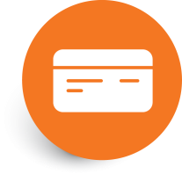
CREDIT
Check your credit health
Build credit as needed
Check your debt load
Read the fine print
Pay on time & pay at least the minimum
Notes:
The best way to manage your credit is to give yourself a regular credit check up. Like going to the doctor to check on your physical health, a regular check-in with your credit will ensure that this important snapshot of your finances is as healthy as possible.
Check your credit health: Check your credit report at least once a year to make sure your credit report looks healthy. You may request a free copy of your credit report once every 12 months from each of the nationwide credit reporting companies. Many credit cards also offer you an option to check your FICO score for free.
Build credit as needed: If you don’t have any credit history to your name, you may need to build up your credit. No history can be just as challenging as a bad credit history. You can build credit by opening a new line of credit (like a credit card or loan) and managing it responsibly.
Check your debt load: Your total monthly debt payments should not be more than one-third of your income.
Read the fine print: If you need to use credit, read the fine print and compare offers. Watch out for introductory offers (like 0% APR annual percentage rate) and avoid short-term, high-interest loans.
Pay on time and pay at least the minimum: Make sure you make all of your debt payments on time and you pay at least the minimum. Your payment history affects your credit history more than anything else!

Slide 6
ACTION PLAN
CREDIT
How can you check on your credit health this week?
How can you keep your credit history healthy?
Notes:
Review Action Plan, ask about Credit Check Up:
What’s something you could do this week to check in on your credit health?
What’s something you can do help keep your credit history healthy?

