Slide 1
The Massachusetts Council Presents: How to Prepare Your Students for the State Economics & Personal Finance Challenges Presented by Dr. Margaret Brooks March 15, 2021 mbrooks@councilforeconed.org

Slide 2
Agenda
Overview of 2021 MA Personal Finance Challenge rules, dates and online exam format
Overview of 2021 MA Econ Challenge rules, dates and online exam format
Review of EconEdLink resources to help prepare your students for the Challenges
Plans for 2020-2021 MA state winners Awards Ceremony

Slide 3
Benefits to Students
Provides them with the chance to participate in fun, engaging, and nationally-recognized competitions
Boosts their motivation to study and learn
Increases their confidence and knowledge of finance and economics concepts
Enhances their technology and team-building skills
Offers opportunities for state and national recognition for their achievements

Slide 4
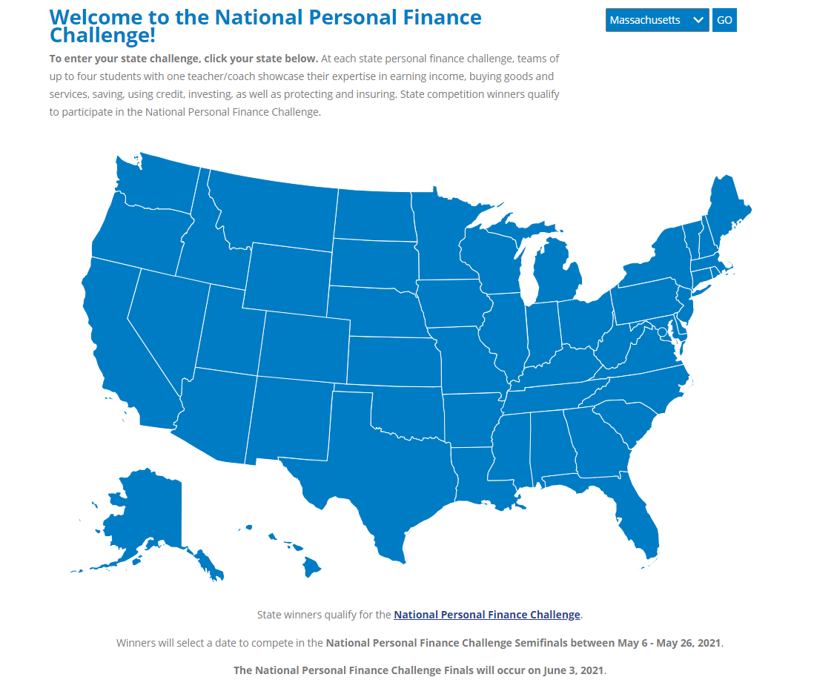
2021 MA Personal Finance Challenge
https://financechallenge.unl.edu

Slide 5
Overview: 2021 MA Personal Finance Challenge
https://financechallenge.unl.edu
2 Divisions: High School and Middle School
Individual students may take the online Personal Finance Challenge any time during the March 15 - April 23, 2021 Finance Challenge testing period
Students on the same team are allowed to take the exam at different times and even on different days within the testing period

Slide 6
Key Dates: 2021 MA Personal Finance Challenge
https://financechallenge.unl.edu
January 11, 2021 - April 23, 2021 - Registration is open for the Massachusetts Personal Finance Challenge. New teachers can register by going to FinanceChallenge (unl.edu) choose Massachusetts and then Teacher Registration. Once approved, they can register their students and assign them to teams
After teachers create their teams, they can download unique access codes for each student. They will then distribute these access codes to their students when they are ready to take the Challenge

Slide 7
Key Dates, cont’d: 2021 MA Personal Finance Challenge
https://financechallenge.unl.edu
March 15, 2021 to April 23, 2021 - The Massachusetts Finance Challenge Competition is available ONLINE. The Challenge exam consists of 30, rapid-fire questions
Students who are attending in-school classes will take the online Challenge at their schools under the supervision of their teachers. Students who are not attending in-school classes will take the online Challenge at home or other non-school location under the supervision of a parent/guardian

Slide 8
Key Dates, cont’d: 2021 MA Personal Finance Challenge
https://financechallenge.unl.edu
April 27, 2021 - The Massachusetts statewide high school and middle school top 3 winning teams for the 2 divisions will be announced by the MA State Challenges Coordinator Dr. Margaret Brooks
High School Division
Middle School Division

Slide 9
Format and Rules: 2021 MA Personal Finance Challenge
https://financechallenge.unl.edu
Each student is required to complete the Challenge as an individual; students do not work as a group
Students may not utilize any outside materials or testing aids during their Challenge testing session
The supervisor teacher or parent/guardian is not to help the students by guiding them or re-phrasing a question
Students may only use pencil and scratch paper

Slide 10
Format and Rules, cont’d: 2021 MA Personal Finance Challenge
https://financechallenge.unl.edu
Scoring: the sum of the three highest individual scores on each team make up the team score. Scoring on individual tests are as follows:
+10 points for each correct answer
0 points for each incorrect answer
0 points for each unanswered question

Slide 11
Format and Rules, cont’d: 2021 MA Personal Finance Challenge
https://financechallenge.unl.edu
After students have completed their individual online tests through the UNL platform, their teachers can log back in to obtain individual student scores and team scores.
Each team’s score will be calculated after all team members have individually taken the exam. This may happen at totally different times during the testing period.

Slide 12
Format and Rules, cont’d: 2021 MA Personal Finance Challenge
https://financechallenge.unl.edu
Topics covered on the Personal Finance Challenge online exam include:
Income and Money Management
Spending and Credit
Saving and Investing

Slide 13
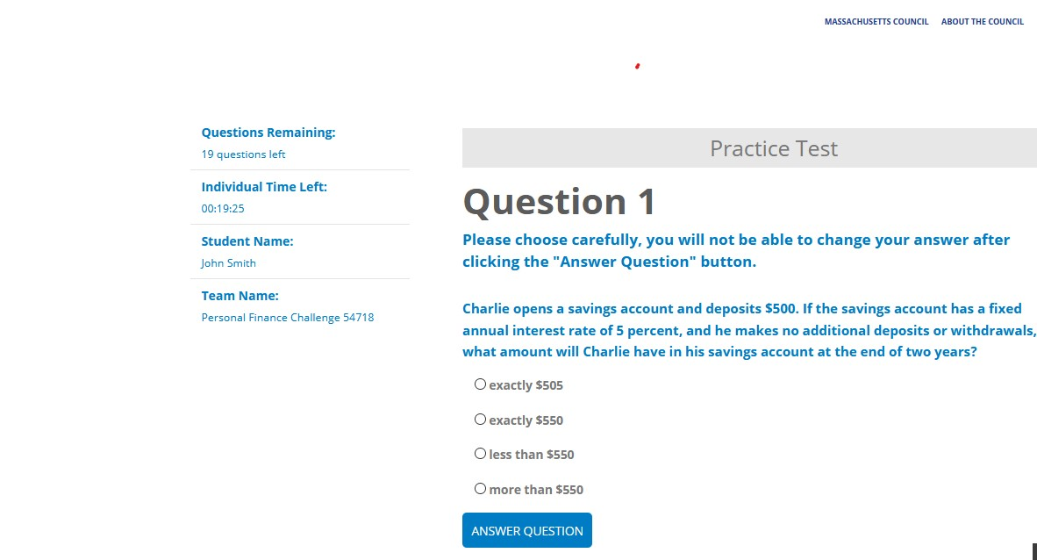
2021 MA Personal Finance Challenge Practice Test Available
https://financechallenge.unl.edu

Slide 14
Student Competition
National Timelines
National Personal Finance Challenge Link
Online Semi-Finals:
May 6 – May 26, 2021
Advancing teams announced:
May 28, 2021
Virtual Finals:
June 3, 2021

Slide 15
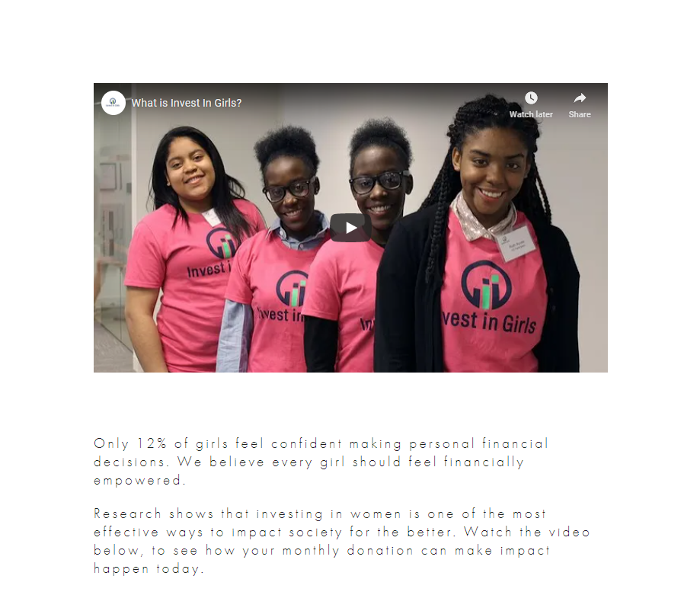
Invest in Girls
http://www.investgirls.org
Invest in Girls Inc., a program of Council for Economic Education, is seeking to promote the participation of
girls in the 2021 Personal Finance Challenge, especially the formation of all-girls teams.
Teachers who are interested in supporting their students’ participation in this program are encouraged to contact Shannan Taylor, Manager, Mid Atlantic and New England Programs, Invest In Girls Inc. at staylor@investgirls.org

Slide 16
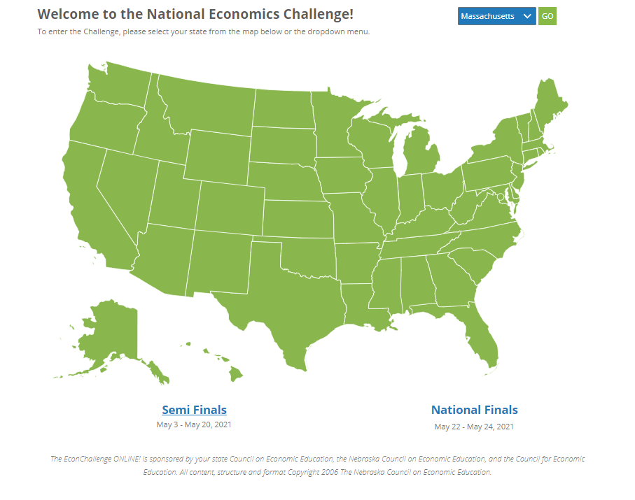
2021 MA Economics Challenge
https://econchallenge.unl.edu

Slide 17
3 Divisions - EconChallenge
https://econchallenge.unl.edu
The "Adam Smith" Division is restricted to students enrolled in any 2- semester econ macro and micro course sequence or any course labeled as AP, IB, honors, or differentiated. Additionally, if students who previously participated in the David Ricardo Division must register for Adam Smith in this year's competition
The "David Ricardo" Division is restricted to students enrolled in one-semester or less high school course not labeled as AP, IB, honors, differentiated, or college level
The "Milton Friedman" Division is restricted to middle school students, and teams do not compete beyond the state level. Separate prizes are awarded for the top 3 middle school teams

Slide 18
Format and Rules: 2021 EconChallenge
https://econchallenge.unl.edu
Topics covered on the EconChallenge online exam include:
Microeconomics
Macroeconomics
World Economy

Slide 19
Key Dates: 2021 MA EconChallenge
https://econchallenge.unl.edu
Monday January 11, 2021 to Wednesday April 28, 2021 - Registration is open now for the Massachusetts Economics Challenge. To register, go to econchallenge (https://econchallenge.unl.edu/ choose Massachusetts and then Teacher Registration. Teachers may register teams of 3 - 4 high school or middle school students. There are no limits to the number of teams a teacher may register
After teachers create their teams, they can download unique access codes for each student. They will then distribute these access codes to their students when they are ready to take the Challenge

Slide 20
Key Dates, cont’d: 2021 MA EconChallenge
https://econchallenge.unl.edu
Monday March 15, 2021 to Wednesday April 28, 2021 - The Massachusetts Economics Challenge is available online. The Challenge exam consists of 30, rapid-fire questions.
The competition is taken online by individual students at their schools under the supervision of their teacher if they are attending school in person, or at their homes or other non-school locations under the supervision of a parent/guardian if they are studying virtually.

Slide 21
Key Dates, cont’d: 2021 MA EconChallenge
https://econchallenge.unl.edu
Friday April 30, 2021 - The Massachusetts statewide high school and middle school winning teams for the 3 divisions will be announced by the MA State Challenges Coordinator Dr. Margaret Brooks.
Adam Smith
Division
David Ricardo Division
Milton Friedman
Division

Slide 22
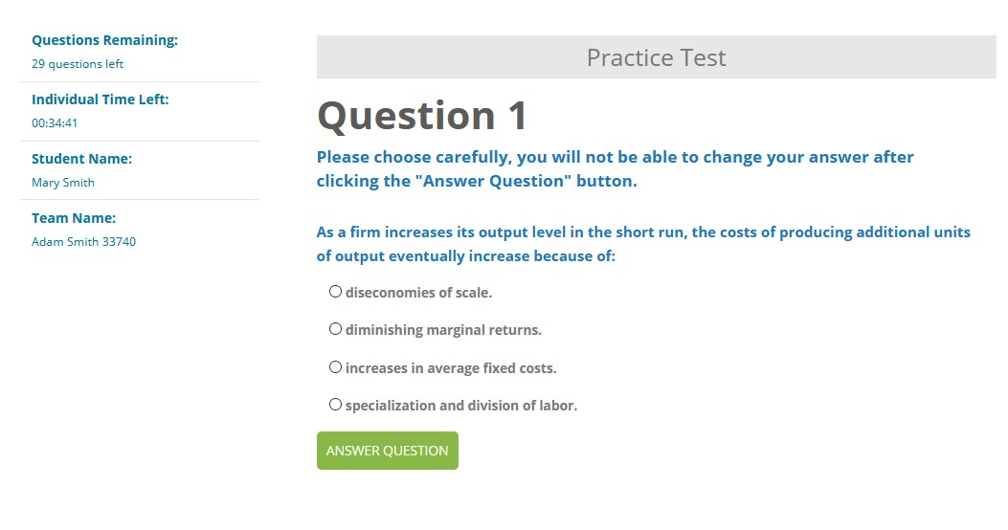
2021 MA EconChallenge Practice Test Available
https://econchallenge.unl.edu

Slide 23
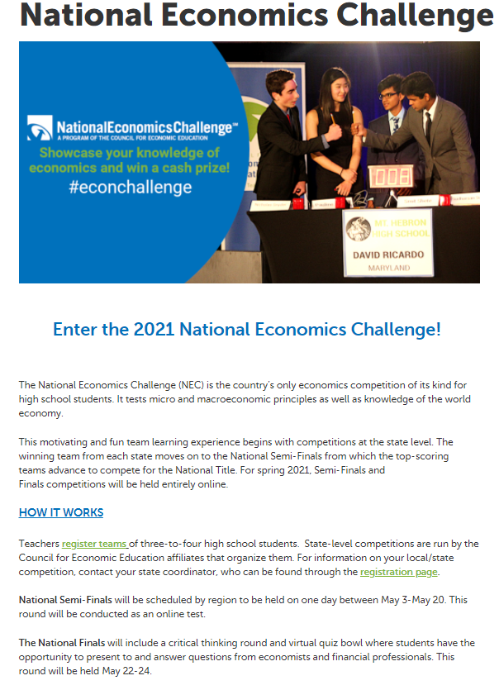
Student Competition
National Timelines
National Economics Challenge
Link
-- Online Semi-Finals: May 3 – May 20, 2021
-- Advancing teams announced:
May 21, 2021
-- Virtual Finals Weekend: May 22, 2021

Slide 24
EconEdLink Membership
You can now access CEE’s professional development webinars directly on EconEdLink.org! To receive these new professional development benefits, become an EconEdLink member. As a member, you will now be able to:
Automatically receive a professional development certificate via e-mail within 24 hours after viewing any webinar for a minimum of 45 minutes
Register for upcoming webinars with a simple one-click process
Easily download presentations, lesson plan materials and activities for each webinar
Search and view all webinars at your convenience
Save webinars to your EconEdLink dashboard for easy access to the event
You may access our new Professional Development page here

Slide 25
Free EconEdLink Resources
Teachers can now easily download presentations, lesson plan materials and activities for live and on demand webinars from EconEdLink.org/professional-development/
Teachers can measure students’ learning progress by accessing CEE’s ReadyAssesments https://econedlink.org/readyassessments/

Slide 26
EconEdLink Professional Development Certificates
To earn your professional development certificate for this webinar, you must:
Watch a minimum of 45 minutes and you will automatically receive a professional development certificate from EconEdLink via e-mail within 24 hours.
To work toward earning 10 MA PDP’s:
Share your EconEdLink PD certificates with Dr. Margaret Brooks at mbrooks@councilforeconed.org after you have acquired at least 10 hours of EconEdLink certification to receive your MA PDP’s.

Slide 27
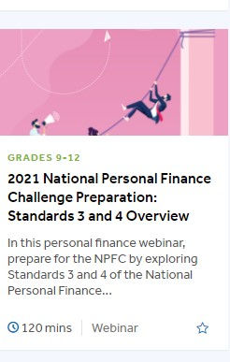
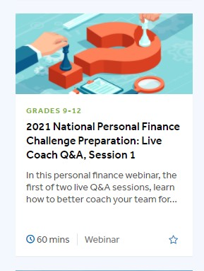
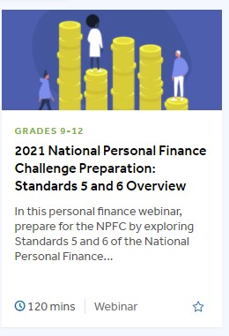
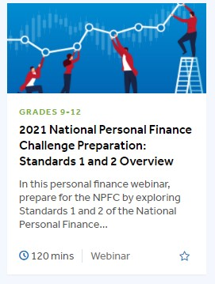
Sample EconEdLink On-Demand Webinars

Slide 28
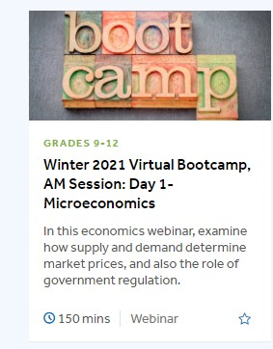
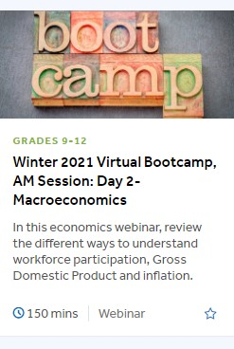
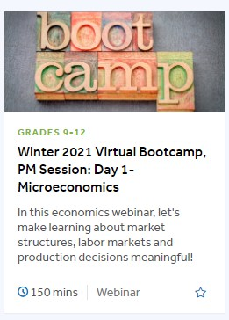
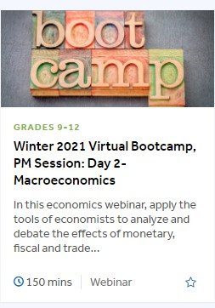
EconEdLink On-Demand Webinars

Slide 29
MA Learning Standards and Curriculum Frameworks
Preparing your middle and high school students to compete in the 2021 Economics and Personal Finance Challenges supports the learning objectives that are established in the MA State Learning Standards and Curriculum Frameworks:
https://www.doe.mass.edu/LearningStandards.html

Slide 30
2020-2021 MA State Awards Ceremony
MA Council for Economic Education is tentatively planning a virtual awards ceremony to be held on Thursday June 10, 2021 from 4:00 – 5:00 pm
Awards will be given to 1st, 2nd and 3rd place teams in all divisions of the two Challenges
Winners from both 2020 and 2021 will be recognized

Slide 31
Assessment Questions
Have your students ever participated in either of the MA Challenges before? What is different about this year?
What value do you see in facilitating your students’ participation in the Economics and/or Personal Finance Challenges?
How does preparing your students to compete in the Challenges support and relate to other content you are covering in your classes?

Slide 32
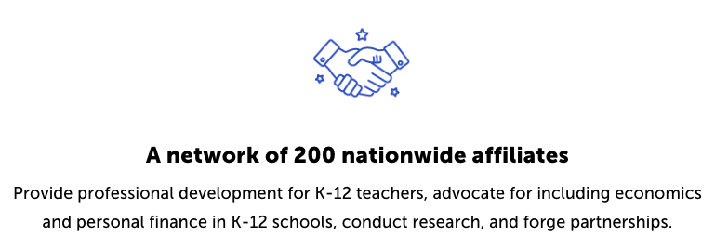
CEE Affiliates
https://www.councilforeconed.org/resources/local-affiliates/

Slide 33
Thanks for joining us today!
Massachusetts Council Contact Information
Executive Director Dr. Margaret Brooks mbrooks@councilforeconed.org
Mass Council Web page: https://www.councilforeconed.org/Massachusetts/
MA Council Facebook:
https://www.facebook.com/MACouncilforEconomicEducation
MA Council Twitter: https://twitter.com/macouncileconed

