Slide 1
THE ECONOMIC IMPACT OF THE CRISIS Why Doesn't Covid-19 Affect Everyone Equally?

Slide 2
ESSENTIAL QUESTION
Why Doesn’t Covid-19 Affect Everyone Equally?

Slide 3
LEARNING TARGETS
I will be able to explain the immediate universal impact the virus had on our economy and way of life.
I will understand that a significant number of American households were distressed financially before the pandemic.
I will recognize that the recovery from the pandemic has been very disparate creating different experiences along multiple demographic and economic lines.

Slide 4
Coronavirus Impact
What was the initial impact of the Coronavirus on your family and friends when it arrived at large in March 2020?

Slide 5
Post-Pandemic Life
What behaviors or habits do you think will change forever because of this pandemic episode?

Slide 6
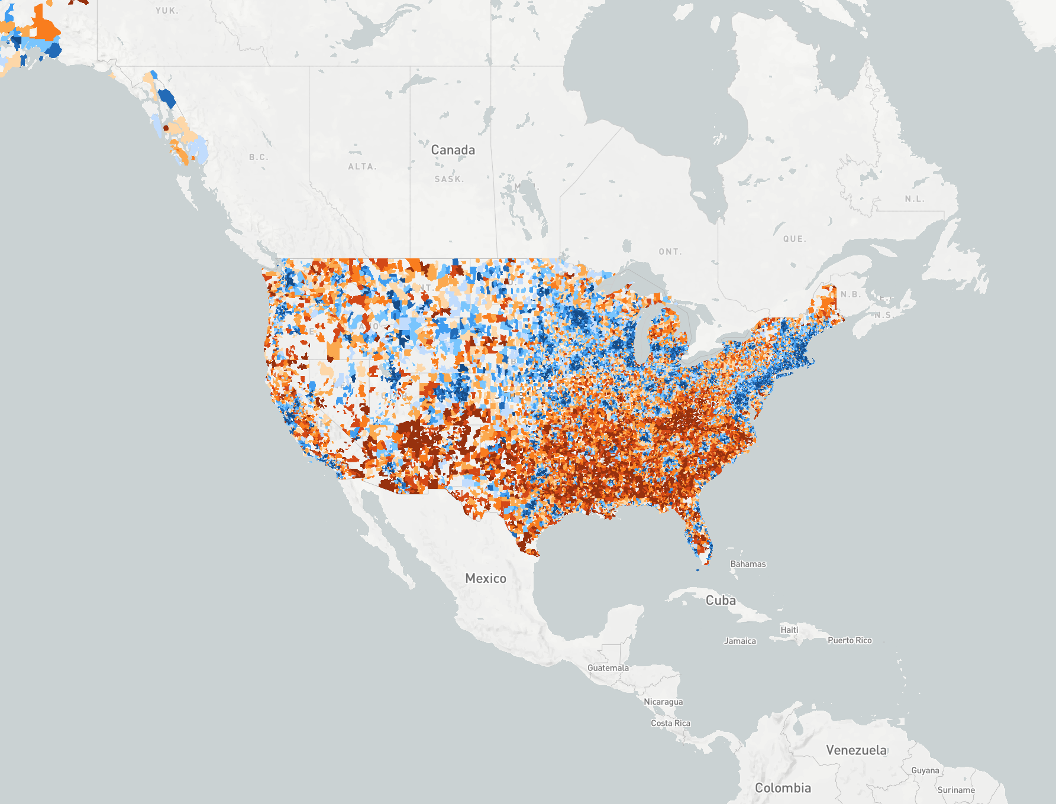
The blue zones are areas of prosperity
Prior to the arrival
of the virus, many Americans were already struggling
financially.
The different shades of brown denote zip codes experiencing
varying degrees of
economic distress.
Notes:
Source: https://eig.org/dci/2018-dci-map-national-zip-code-map

Slide 7
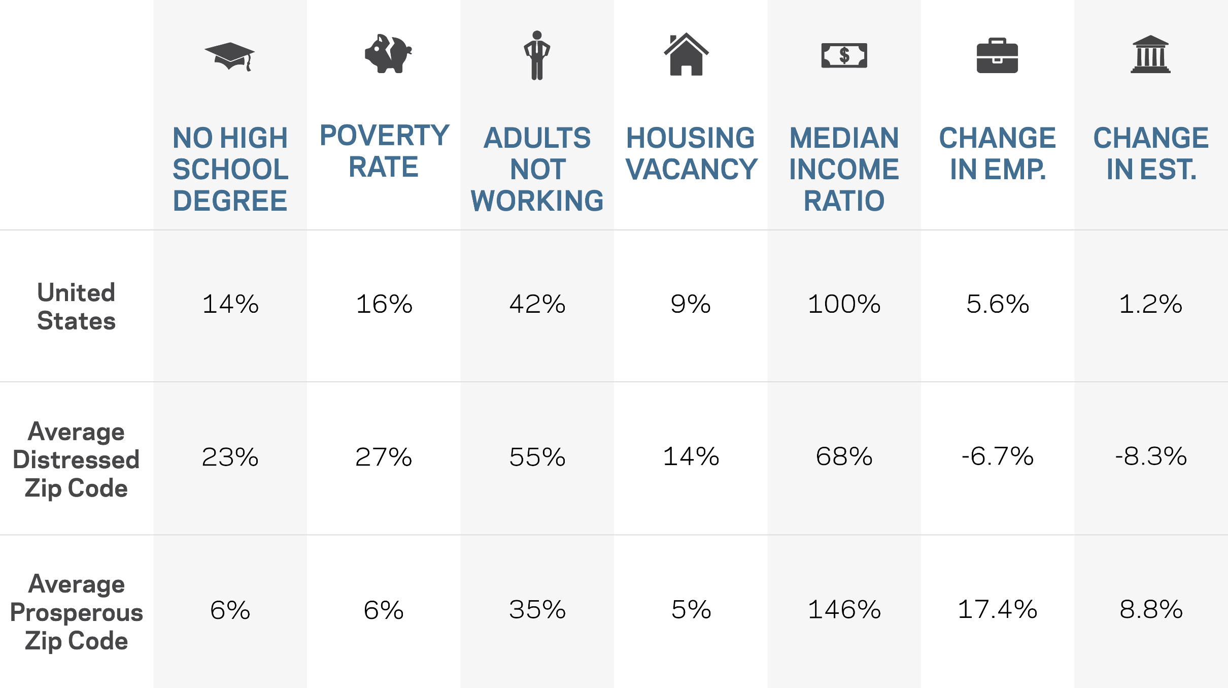
Source: EIG’s Distressed Communities Index, 2016
Notes:
The last two columns represent the change in employment and business establishments over the 2012-2016 assessed period.

Slide 8
Open Ended Question
What region of the country has the highest concentration of distressed zip codes?
When looking at the table on slide 7, which disparity stands out the most for you between prosperous and distressed communities?
What regions of the country have the highest degree of prosperity?
What characteristics of those thriving regions make them different from the distressed ones?

Slide 9
K-Shaped Recovery

Slide 10
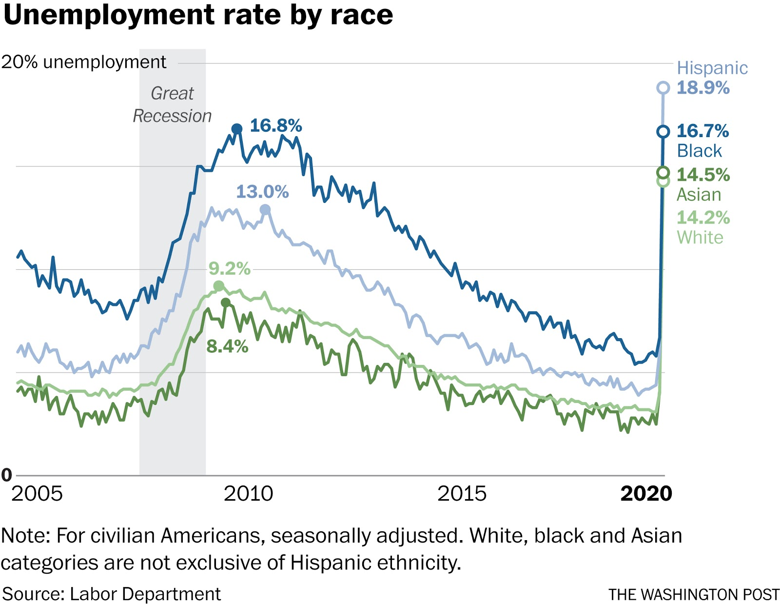
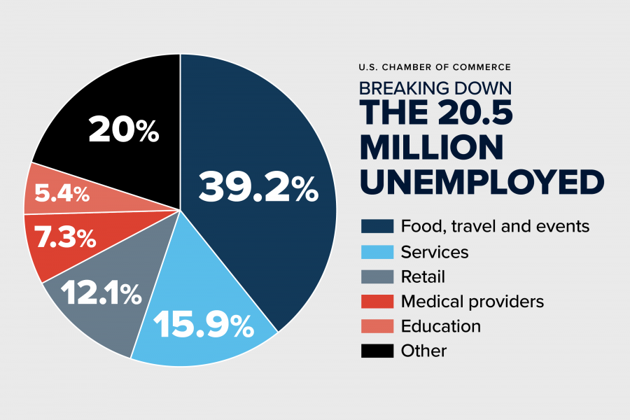
Pandemic Unemployment

Slide 11
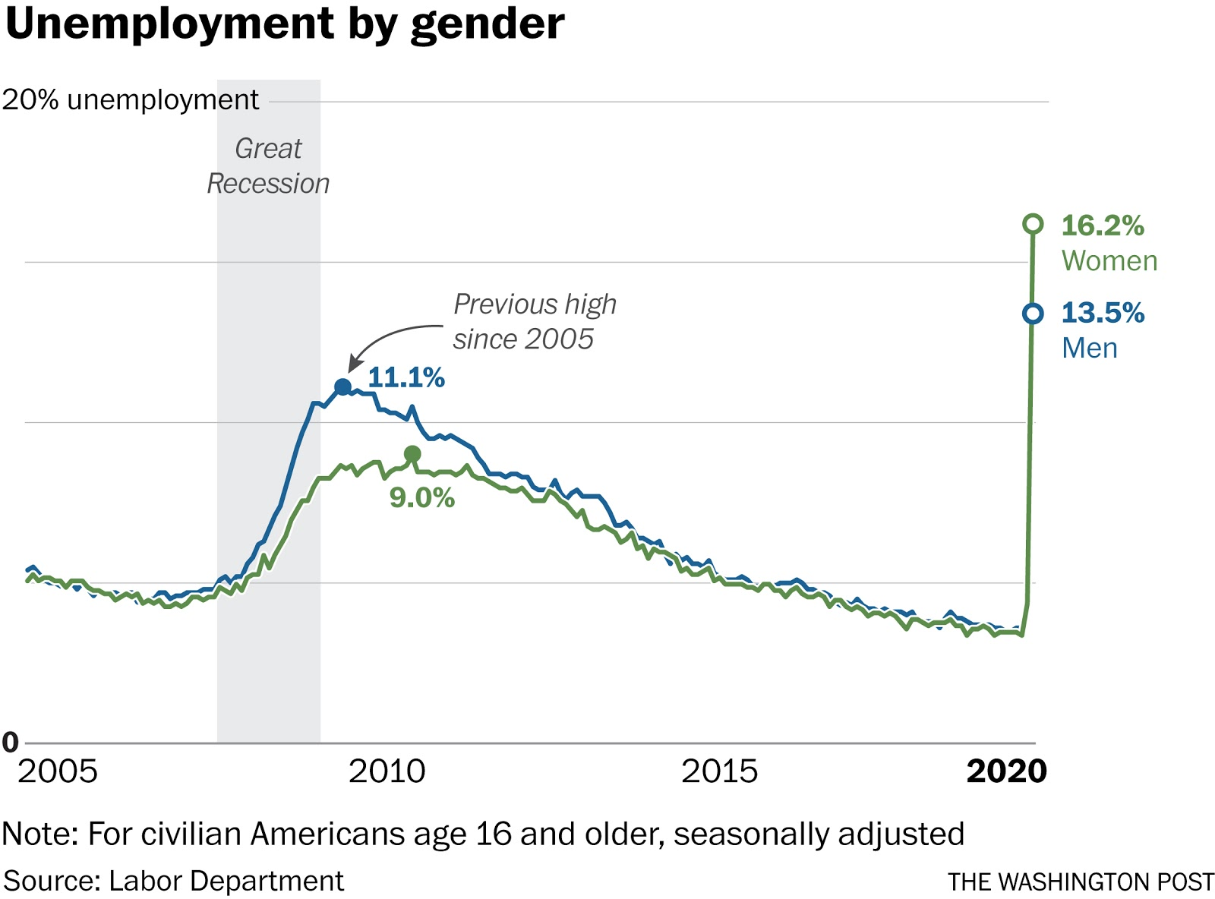
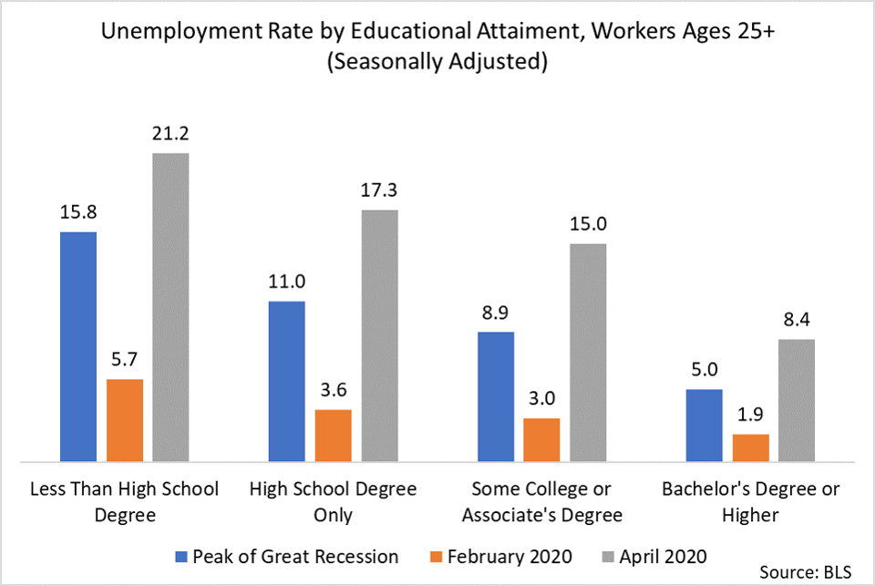
Pandemic Unemployment

Slide 12
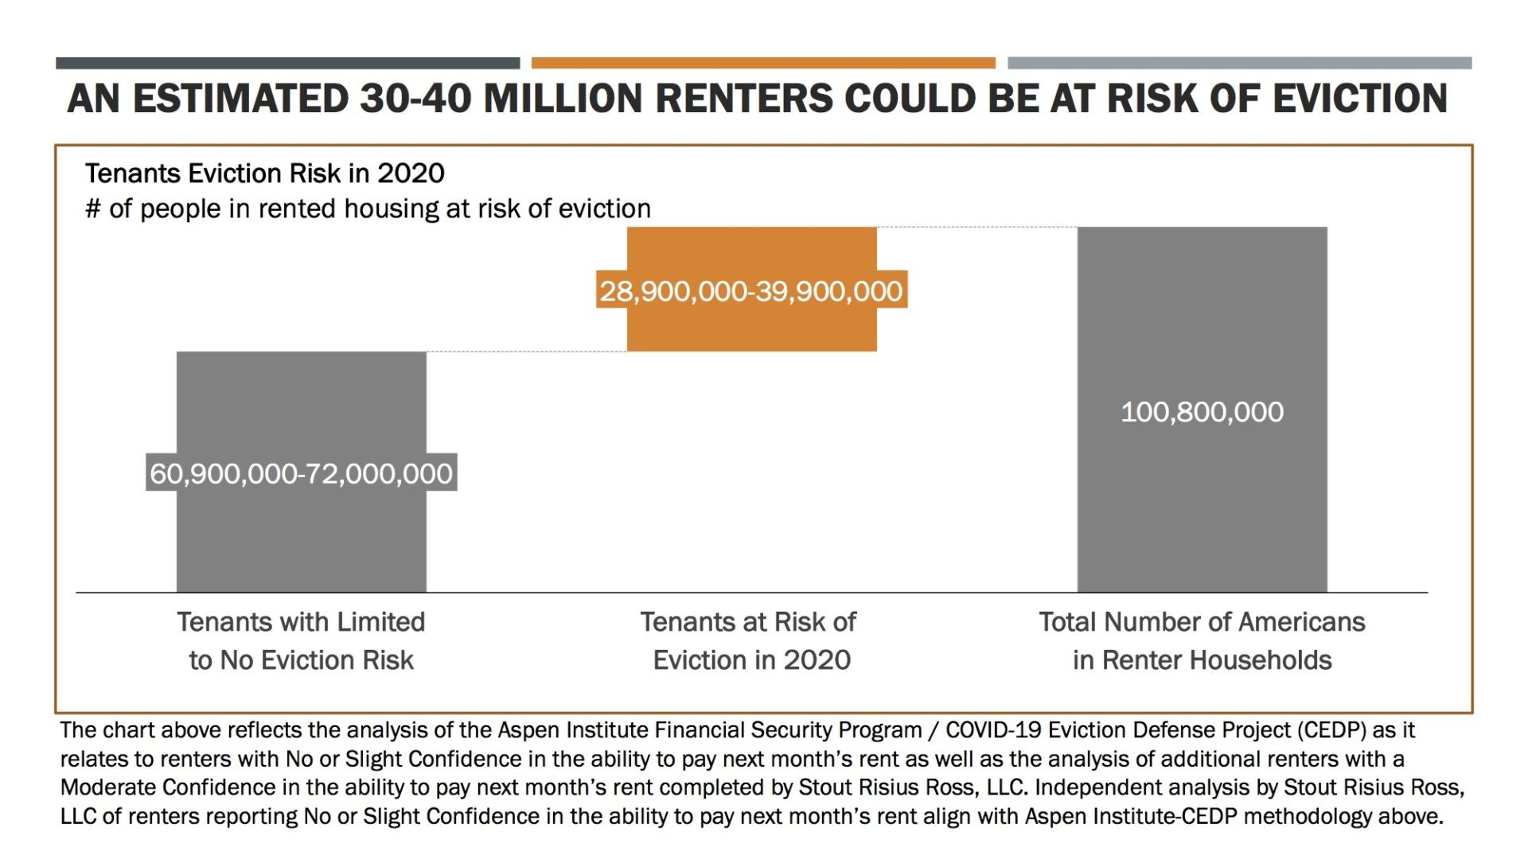
One in four renters spent more than half their income on housing in 2018
Notes:
https://www.aspeninstitute.org/blog-posts/the-covid-19-eviction-crisis-an-estimated-30-40-million-people-in-america-are-at-risk/?utm_campaign=MMS_Newsletter_20201030&utm_medium=email&utm_source=sfmc_Space%20and%20doughnuts&utm_content=&utm_term=127431357

Slide 13
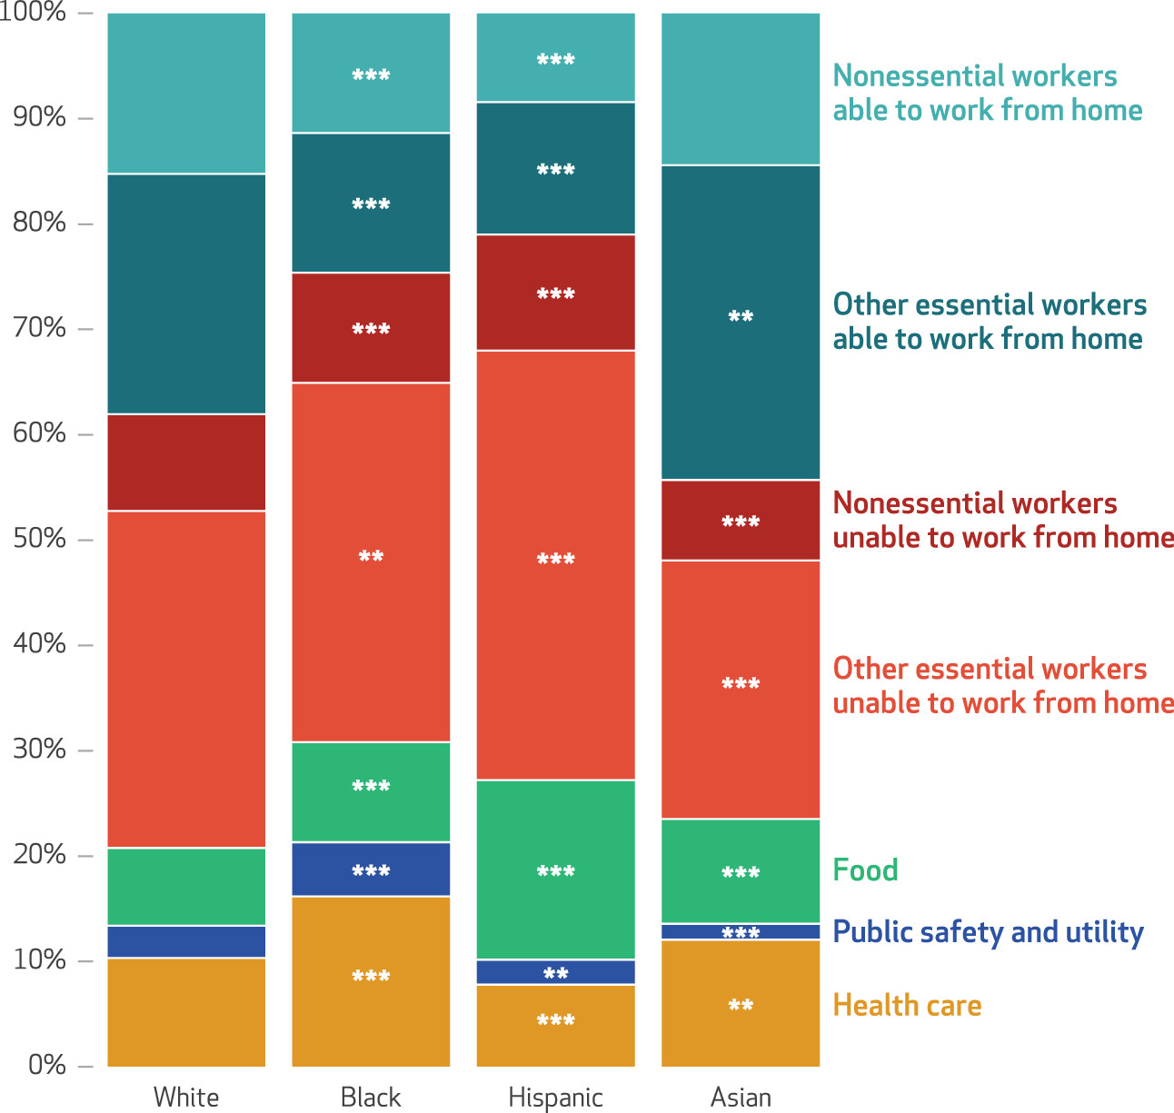
Job Characteristics
These job characteristics suggest the possibility of disparities in employment-related infection risk across race and ethnicity.

Slide 14
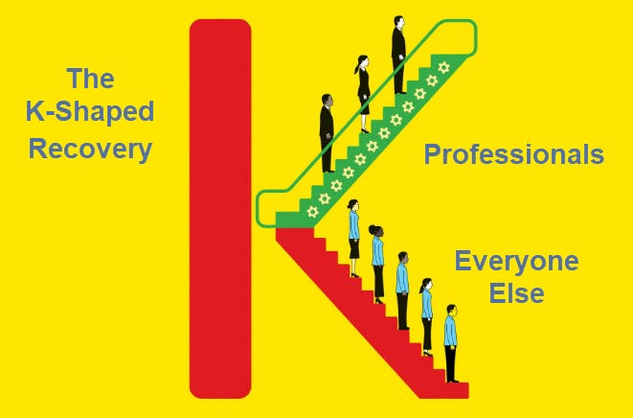
A “K” Shaped Recovery Illustrates The Post-Covid Divide
Wealthy and middle-class asset holders have retained or resumed their jobs. And the value of their assets, like stock portfolios and homes, has risen to all-time highs.
The average blue-collar worker or small business owner, and the half of the U.S. population not invested in the stock market, are witnessing unprecedented job losses and business closures.

