Slide 1
Fundamentals of A.P. Economics:
Supply and
Aggregate Supply
Presented by
Matthew Gherman
March 22, 2021 mgherman@schools.nyc.gov

Slide 2
EconEdLink Membership
You can now access CEE’s professional development webinars directly on EconEdLink.org! To receive these new professional development benefits, become an EconEdLink member. As a member, you will now be able to:
Automatically receive a professional development certificate via e-mail within 24 hours after viewing any webinar for a minimum of 45 minutes
Register for upcoming webinars with a simple one-click process
Easily download presentations, lesson plan materials, and activities for each webinar
Search and view all webinars at your convenience
Save webinars to your EconEdLink dashboard for easy access to the event
You may access our new Professional Development page here

Slide 3
Professional Development Certificate
To earn your professional development certificate for this webinar, you must:
Watch a minimum of 45-minutes and you will automatically receive a professional development certificate via e-mail within 24 hours.
Accessing resources:
You can now easily download presentations, lesson plan materials, and activities for each webinar from EconEdLink.org/professional-development/

Slide 4
Agenda
Micro Supply
Keynesian re-interpretation of Aggregate Supply
Implications of new Aggregate Supply Model

Slide 5
Objectives
Opening discussions for student engagement
Quantity Supply vs. Change in Supply
Keynesian Analysis: How the Great Depression changed the old model of Aggregate Supply
Fiscal Policy implications of the New Model
Keynes, in his own words

Slide 6
National Standards
7.1 Market prices are determined through the buying and selling decisions made by buyers and sellers.
7.2 The term ‘relative price’ refers to the price of one good or service compared to the prices of other goods and services. Relative prices are the basic measures of the relative scarcity of products when prices are set by market forces (supply and demand).
8.1 Demand for a product changes when there is a change in consumers’ incomes, preferences, the prices of related products, or in the number of consumers in a market.
8.2. Supply of a product changes when there are changes in either the prices of the productive resources used to make the product, the technology used to make the product, the profit opportunities available to producers from selling other products, or the number of sellers in a market.
8.3. Changes in supply or demand cause relative prices to change; in turn, buyers and sellers adjust their purchase and sales decisions.

Slide 7
State Standards
12.E2a Given that the resources of individuals (and societies) are limited, decisions as to what goods and services will be produced and to whom to sell one’s resources are driven by numerous factors, including a desire to derive the maximum benefit from and thus the most efficient allocation of those resources.
12.E2b The choices of buyers and sellers in the marketplace determine supply and demand, market prices, allocation of scarce resources, and the goods and services that are produced. In a perfect world, consumers influence product availability and price through their purchasing. Product market supply and demand determine product availability and pricing.
12.E2c Businesses choose what to supply in the product market, based on product market prices, available technology, and prices of factors of production. The prices of those factors are determined based on supply and demand in the factor market. The supply and demand of each factor market is directly related to employment. Debates surround various ways to minimize unemployment (frictional, structural, cyclical).

Slide 8
Law of Supply (Microeconomics)

Slide 9
Law of Supply
Class Discussion Motivation: How many people sell chocolate bars to raise money for senior dues? Why do you? Why don’t you?
Introduction of Input Costs: Total revenue, break even analysis profit
Input cost to buy chocolate box: $30
60 bars in the box, can be sold for $1 each
Total revenue = $60
Break even = total revenue - input costs = $30
Profit potential = $30

Slide 10
Law of Supply (cont’d)
- Create a schedule: at $1, how many of you would sell chocolate? If people were willing to pay $2, how many of you would sell chocolate? Why did this go up?
- Your break even went down, now you only need to sell 15 bars to break even and your max profit increased to $45.
- Inversely, if you could only make $.75, your break even cost went up, and now it takes longer to profit for less profit.
PRICE = PROFIT

Slide 11
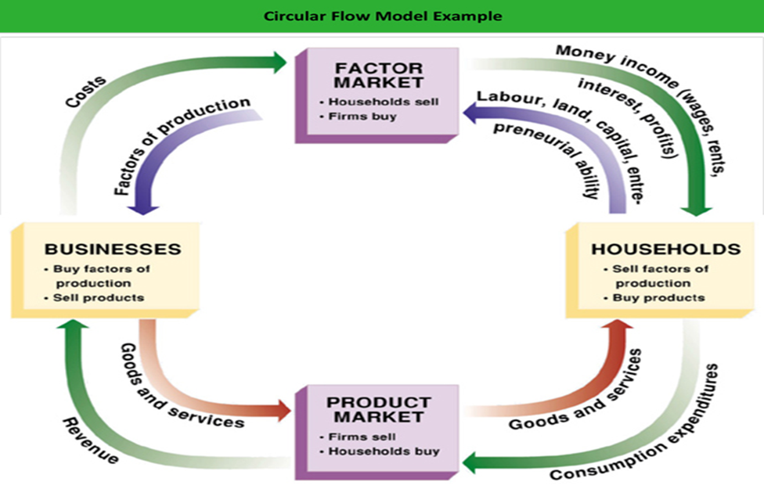

Slide 12
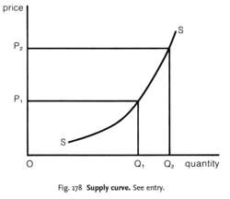
Supply Curve
These have all been changes in quantity supplied – the amount supplied from the suppliers’ perspective increased/decreased only due to the change in price.
If we plot the schedule, we see that as price increases, quantity supplied also increases and as price decreases, quantity supplied decreases.

Slide 13
Change in Supply
Now let’s think of the pizzeria introduced in previous demand lesson…what are the input costs (the costs of doing business)?
Have kids brainstorm wages, insurance, rent, utilities, resources, etc.
What happens to the ability and willingness to supply, if these input costs and resources change in price and availability?

Slide 14
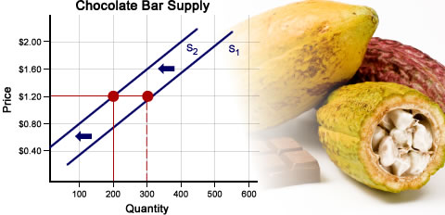
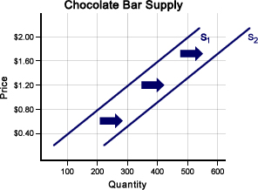
Change in Supply (cont’d)

Slide 15
Change in Supply (cont’d)
Changes due to factors other than the market price.
At the current market price, changes to these factors will cause suppliers to either be less or more willing and able to supply their products.
R – Resources (availability and cost of)
O – other products, related market products (televisions and gaming systems)
T -- taxes
T -- technology
E – expectations of prices
N – number of suppliers

Slide 16
Expectations of Prices
Price = Profit
If businesses expect future prices to increase, they will decrease Supply now to wait for higher prices
If businesses expect future prices to decrease, they will supply more now to make the most profit.
Current price did not change, just the expectation of future prices.

Slide 17
Supply and Demand Together
Equilibrium Price and Equilibrium Quantity
Compare the schedules from the previous two days for either pizza or chocolate bars
Where do we see the ability and willingness of consumers to purchase and businesses to supply aligned?
Price | Quantity Demanded | Quantity Supplied
$4.00 | 25 | 90
$2.50 | 70 | 70
$1.00 | 90 | 25

Slide 18
Equilibrium Price and Quantity
Equilibrium/Market Price: The price at which supply and demand intersect/are equal - a price that is established by the free market. Suppliers are willing and able to sell and consumers are willing and able to buy for this same price (shown graphically as "p")
Equilibrium/Market Quantity: The quantity for which the supply and demand for a product are equal. The amount the suppliers are willing/able to produce, the amount consumers are willing/able to purchase
(shown graphically as "q")

Slide 19
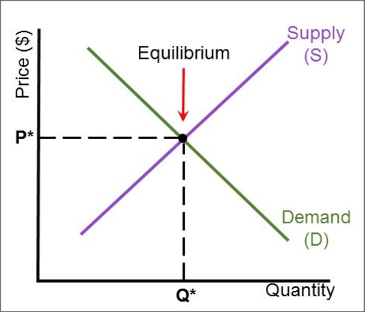

Slide 20
The Importance of Price
Signal to consumers and producers
Answers “WHO receives the goods and services?”
Answers HOW they are produced (efficiently, to break even)

Slide 21
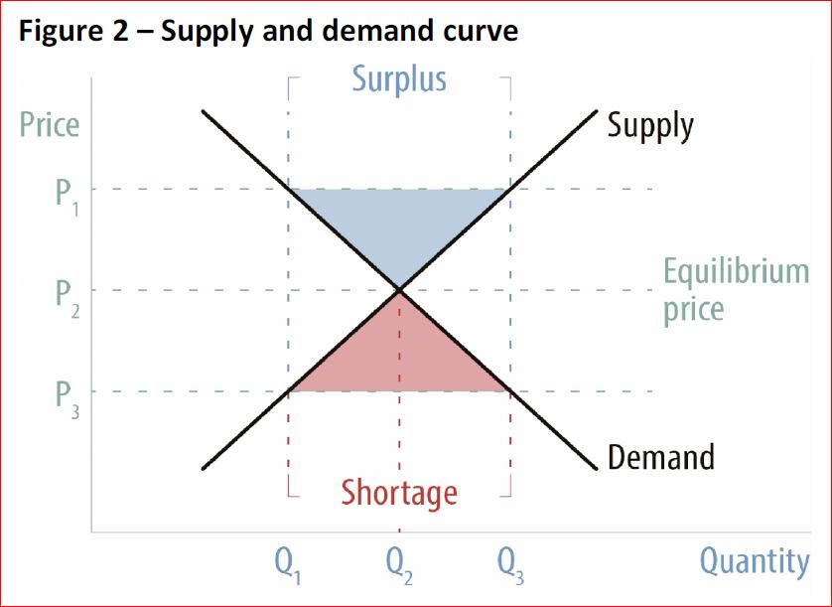
Surpluses and Shortages

Slide 22
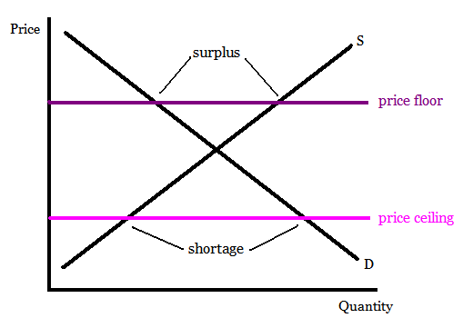
Price Ceilings and Floors
When the government believes the market price is too low, they will create a
Price Floor.
When the government believes the market price is too high, they will create a
Price Ceiling.

Slide 23
Problem Solving
What will happen to market price and quantity of pizza, if new studies show that pizza is healthy…?
Step 1: One scenario = one perspective
Step 2: Whose perspective is being affected?
Step 3: How is Ability and Willingness being affected?
Step 4: When in doubt, graph it out!

Slide 24
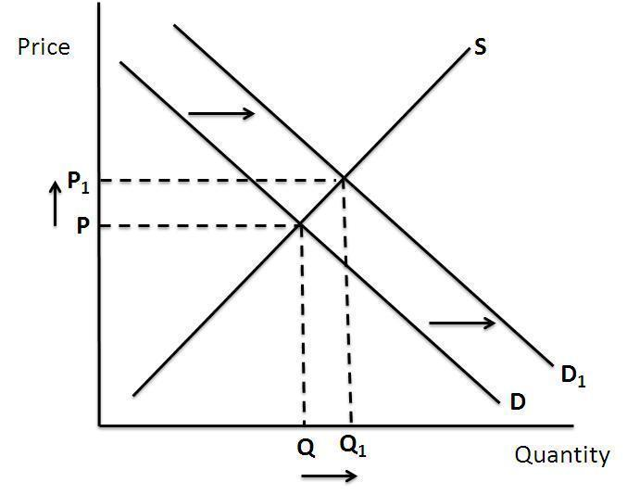
Results
e1
e

Slide 25
Aggregate Supply and Keynesian analysis

Slide 26
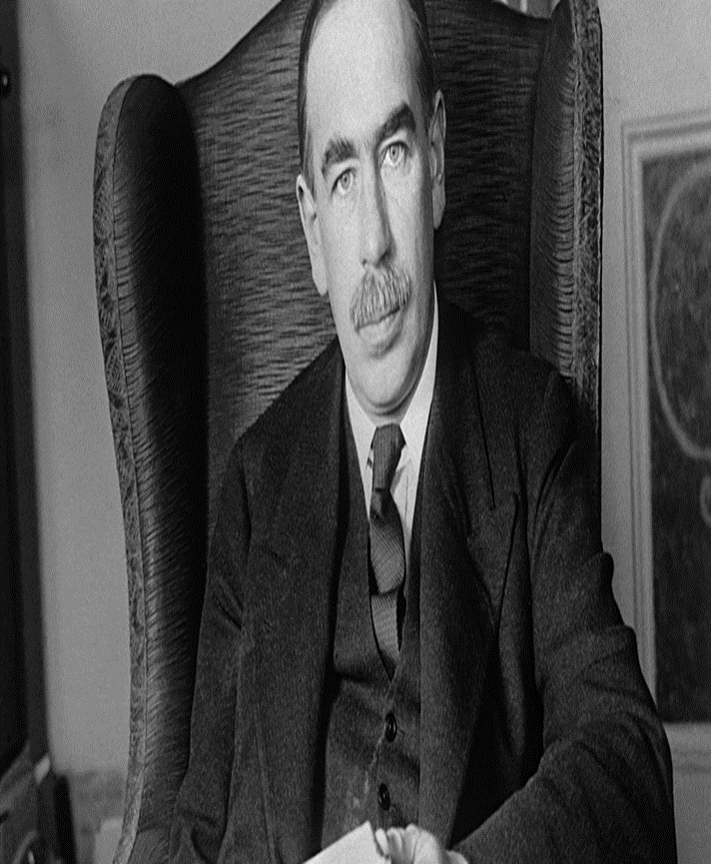
John Maynard Keynes
1883-1946
British economist
Most influential writing, The General Theory and The End of Laissez-Faire
New models of full employment, income, wages, interest and spending, investment
Will revolutionize the relationship between the role of government and the economy
Founder of modern macroeconomics
“We are all Keynesians now”
– Milton Friedman

Slide 27
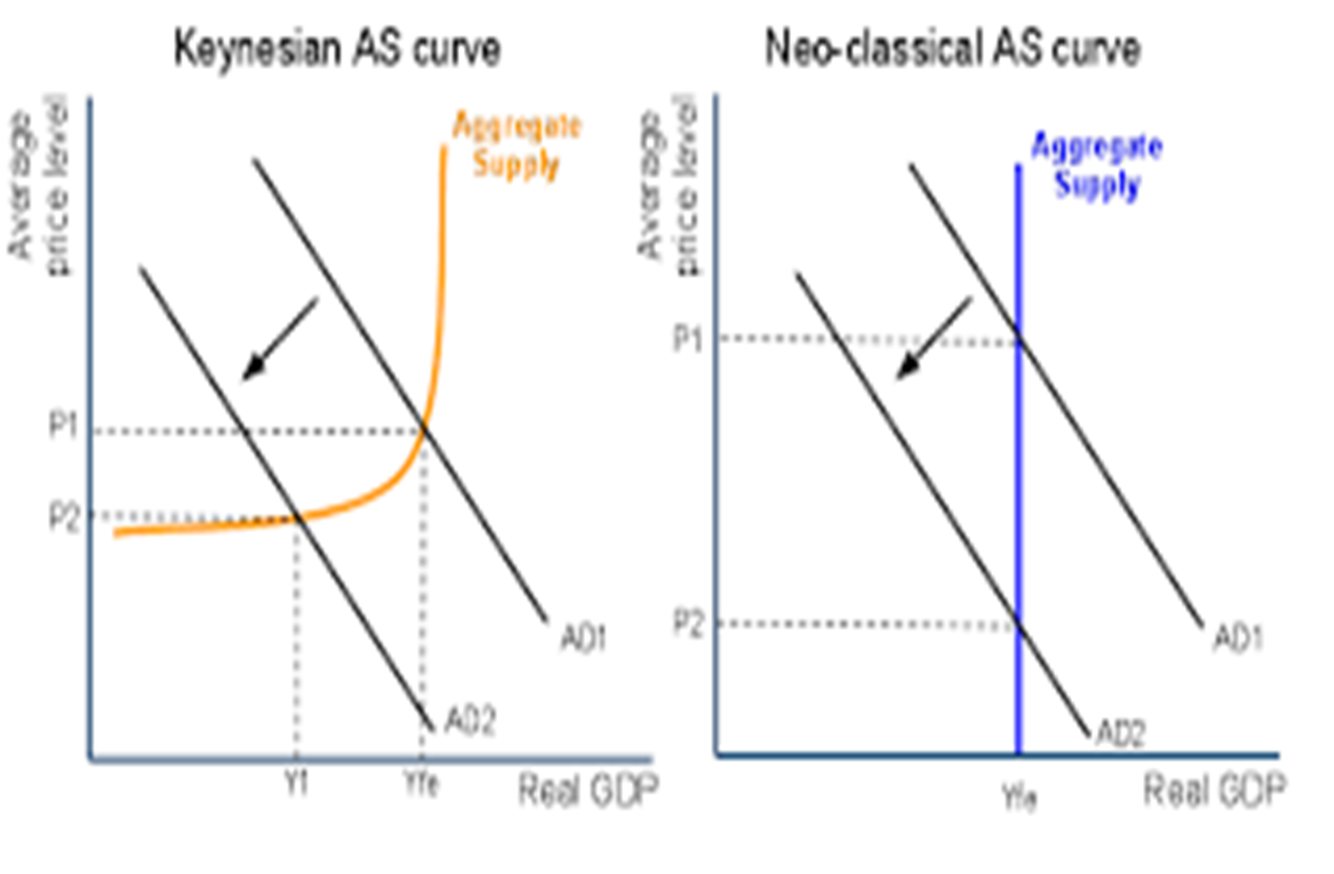
Re-visualizing Economics

Slide 28
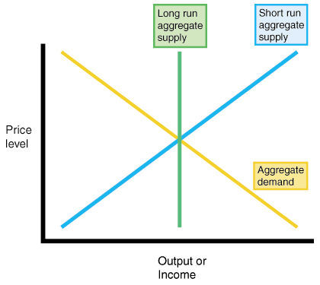
Long Run and Short Run
Aggregate Supply

Slide 29
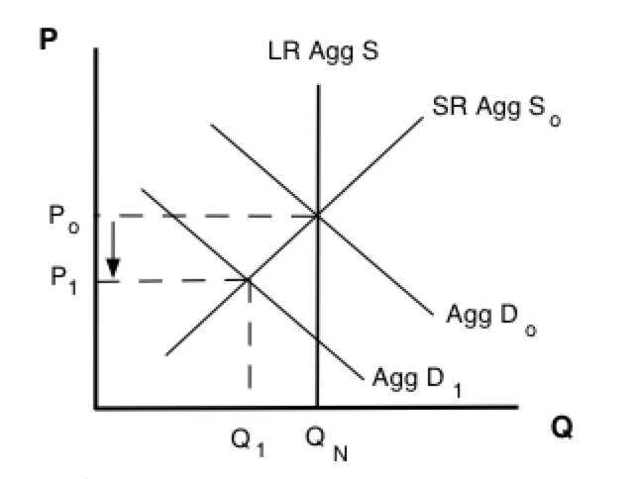
Keynesian Recessionary Graph

Slide 30
Model 1: Classical Model
Jean Baptiste Say: Supply creates its own demand
When products are created, the wage to buy those products is also created
Production will respond to changes in price level and changes in inventory
Inventory, wages and input costs adjust to change in prices
Lower prices will drive down input costs, which will result in lower wages and allow businesses to produce more

Slide 31
Keynes Theory
The Great Depression illustrates: 4 years into depression, prices are at lowest; no increase in production
1920’s already experienced maximum investment spending…all of this capital was still there in 1929, so businesses would not have incentive to do more investment spending
Recessions are caused by a decrease in Consumer Spending and a decrease in Aggregate Demand
Classical model is incorrect: Aggregate Supply is upward sloping; reflecting that price = profit and the ability to break even
Input costs are sticky (wages, rent, insurance, etc.), so don’t change with the price level
Businesses will decrease production as price level decreases

Slide 32
New Short Run and Long Run Aggregate Supply
SRAS
LRAS
Short Run Ability and Willingness to Produce
Price = profit but difference between Market Price (CPI) vs. Input Costs
Shifts due to changes in input costs/expectations of prices
Where we want to be
Resources are fully employed
RGDP is constant regardless of price level
Natural Rate of Unemployment

Slide 33
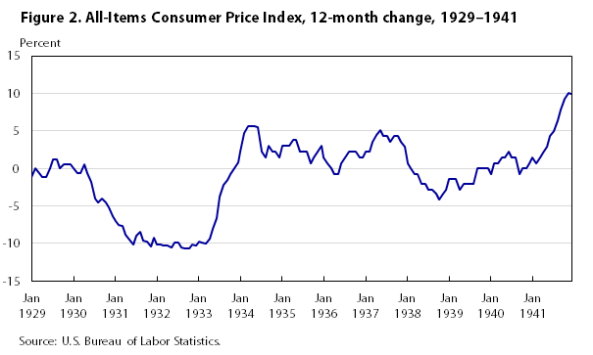

Slide 34
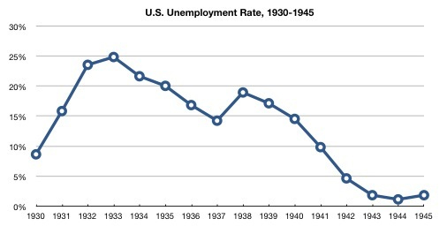

Slide 35
Keynesian Recessionary Graph

Slide 36
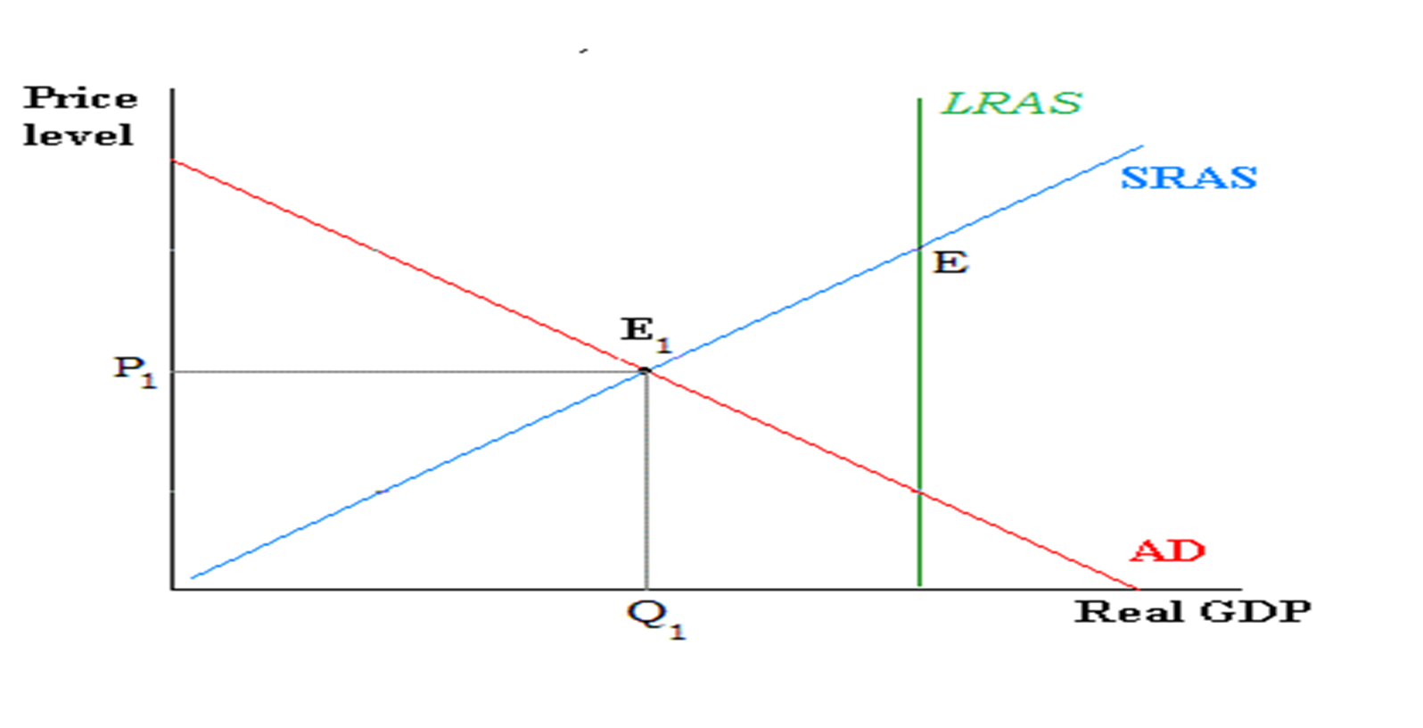
Recessionary Gap

Slide 37
– Keynes,
The End of Laissez-Faire (1926)
“Many of the greatest economic evils of our time are the fruits of risk, uncertainty, and ignorance. It is because particular individuals, fortunate in situation or in abilities, are able to take advantage of uncertainty and ignorance, and also because for the same reason big business is often a lottery, that great inequalities of wealth come about; and these same factors are also the cause of the unemployment of labour, or the disappointment of reasonable business expectations, and of the impairment of efficiency and production. Yet the cure lies outside the operations of individuals; it may even be to the interest of individuals to aggravate the disease.”

Slide 38
– Keynes,
The General Theory (1936)
“ ‘To dig holes in the ground,’ paid for out of savings, will increase, not only employment, but the real national dividend of useful goods and services. It is not reasonable, however, that a sensible community should be content to remain dependent on such fortuitous and often wasteful mitigations when once we understand the influences upon which effective demand depends.”

Slide 39
Keynes: How Should a Government Respond?
Government can’t trust the “animalistic spirit” of business
Government needs to use its powers of taxes and spending to improve consumer spending (changing disposable income)
As incomes change, people spend a portion of that income (marginal propensity to consume)
This has a multiplier effect

Slide 40

Multiplier Effect

Slide 41
Multiplier Effect
Initial spending keeps becoming another person’s income…That person’s income becomes spending…Which becomes another person’s income… And so on
Initial change in government spending has a multiplied effect on Aggregate Demand and Total GDP
Can deficit spend but can deficit spend responsibly
Know the Recessionary Gap; know the MPC; know the amount to spend

Slide 42
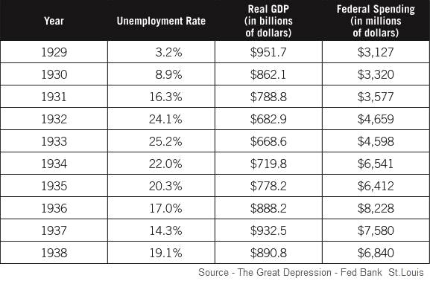

Slide 43
Keynes on “Invisible Hand vs. Design”
“There is no reason to suppose that there is ‘an invisible hand,’ an automatic control in the economic system which ensures of itself that the amount of active investment shall be continuously in the right proportion. Yet it is also very difficult to ensure by our own design, by what is now called ‘planning.’ “

Slide 44
Keynes on Adam Smith
“[Government controls must be used] not to defeat but to implement the wisdom of Adam Smith.”
“I find myself moved, not for the first time, to remind contemporary economists that the classical teaching embodied some permanent truths of great significance…There are in these matters deep under currents at work, natural forces, one can call them, or even the invisible hand, which are operating towards equilibrium…If we reject the medicine from our systems altogether, we may just drift on from expedient to expedient and never get really fit again.”

Slide 45
Assessment Questions
How do the laws of Supply and Demand affect your belief of where the flow of the dollar starts in the circular flow model?
To what extent do you agree/disagree with Keynesian solutions to recessions? What are the positives? What are the trade-offs?
To what extent have Keynes’ ideas successfully been applied to recent American cycles, such as the Great Recession? See: The Return of Depression Economics and the Crisis of 2008 and https://krugman.blogs.nytimes.com/2015/06/06/why-am-i-a-keynesian/
Research the current spending bill. To what extent does it align with Keynesian Economics?
How does the law of supply and aggregate supply illustrate the effectiveness of Supply Side Economics? How have we seen it successfully implemented in American History? What are the pros/cons of this theory?

Slide 46
References
https://www.ncsl.org/research/fiscal-policy/state-fiscal-responses-to-covid-19.aspx#:~:text=President%20Donald%20Trump%20declared%20a,response%20to%20the%20coronavirus%20epidemic.&text=The%20relief%20package%20allocates%20an,package%20in%20modern%20American%20history.
http://evonomics.com/new-keynesian-economics-betrays-keynes/
http://www.la.utexas.edu/users/hcleaver/368/368KeynesOpenLetFDRtable.pdf
http://www.iea.org.uk/sites/default/files/publications/files/KEYNES%20VERSUS%20THE%20KEYNESIANS.pdf
https://delong.typepad.com/egregious_moderation/2008/12/john-maynard-ke.html
http://www.panarchy.org/keynes/laissezfaire.1926.html
https://noahpinionblog.blogspot.com/2015/06/economic-arguments-as-stalking-horses.html

Slide 47
References
https://krugman.blogs.nytimes.com/2015/06/06/why-am-i-a-keynesian/
https://www.forbes.com/sites/modeledbehavior/2015/06/06/macro-ideology/#473a352a15c7
https://www.thebalance.com/bush-economic-stimulus-package-3305782
https://www.thebalance.com/what-was-obama-s-stimulus-package-3305625
https://www.treasury.gov/initiatives/financial-stability/Pages/default.aspx

Slide 48

CEE Affiliates
https://www.councilforeconed.org/resources/local-affiliates/

Slide 49




Thank You to Our Sponsors!

Slide 50





We’ve gone Virtual!
Teach Economics?
Your students may have what it takes to compete in the nation’s only high school economics competition!
Why Play?
• Fun team learning experience
• Great for college applications
• No other challenge like this
• Online participation makes access easy
• Chance for cash prizes
How it Works
Teams register
Teachers enroll team(s) of 3- 4 high school students from the same school. Multiple teams allowed.
Teams compete within their state
Compete to win your state competition for a
chance to advance to the National Semi-Finals.
National Semi-Finals: May 3-20, 2021
Teams answer multiple-choice questions on macroeconomics, microeconomics, and international & current events.
National Finals: May 22-24, 2021
Teams analyze an economic issue and present their solution. Top teams engage in the Finals Quiz Bowl where they face-off answering questions to claim the National Title.
Two divisions based on experience level
David Ricardo for first-time competitors who have taken no more than one economics course.
Adam Smith for returning competitors, AP, International Baccalaureate, and honors students.
Register Today at NationalEconomicsChallenge.org

Slide 51





FIND YOUR LOCAL COMPETITION
AND REGISTER TODAY!
The National Personal Finance Challenge is a competition that provides high school students with an exciting and motivating opportunity to build, apply, and demonstrate their knowledge of money management.
Through online exams and a personal finance simulation, teams showcase their expertise in earning income, buying goods and services, saving, using credit, investing, as well as protecting and insuring.
Teams of up to four students, with one teacher/coach, can qualify to represent their state at the National Personal Finance Challenge by winning their local competition.
NATIONALS
Semi-Finals: First round elimination via online multiple-choice questions.
Finals: Case study round virtually co-hosted by the Cleveland Fed on June 3.
personalfinancechallenge.org

Slide 52

The 2021 Sloan Teaching Champion Award
Winners receive:
A cash award of $5,000
A cash award of $2,500 for their school to support economic education
Recognition at our annual Visionary Awards convening
This award promotes economic education by honoring three outstanding teachers who incorporate exemplary teaching techniques that improve their students’ economic understanding in and out of the classroom.
This award is open to New York metropolitan area high school teachers of all subjects, not just teachers of economics. Applicants must demonstrate how they integrate economics into their teaching.
Sound like you or someone you know?
Applicants must teach in one of the
Twelve New York state counties (New York, Kings, Bronx, Richmond, Queens, Nassau, Suffolk, Westchester, Putnam, Rockland, Orange and Dutchess)
Eight New Jersey counties (Bergen, Passaic, Essex, Hudson, Middlesex, Union, Morris, Monmouth), or these
Two Connecticut counties (Fairfield and New Haven)
Application will be launched on Friday February 19th 2021
You can access the application here.
CONTACT
Please feel free to e-mail us at rrivera@councilforeconed.org
with any questions you have.

