Slide 1
Adulting 101: Teaching Personal Finance in the Algebra 1 & 2 Curricula Presented by Rachel Kessous RKessous@sljhs.org
Teacher and Math Department Chair
at Urban Assembly School of Law and Justice 4/6/21

Slide 2
Draw a picture that would go with the title of this workshop 😁

Slide 3
EconEdLink Membership
You can now access CEE’s professional development webinars directly on EconEdLink.org! To receive these new professional development benefits, become an EconEdLink member. As a member, you will now be able to:
Automatically receive a professional development certificate via e-mail within 24 hours after viewing any webinar for a minimum of 45 minutes
Register for upcoming webinars with a simple one-click process
Easily download presentations, lesson plan materials and activities for each webinar
Search and view all webinars at your convenience
Save webinars to your EconEdLink dashboard for easy access to the event
You may access our new Professional Development page here

Slide 4
Professional Development Certificate
To earn your professional development certificate for this webinar, you must:
Watch a minimum of 45-minutes and you will automatically receive a professional development certificate via e-mail within 24 hours.
Accessing resources:
You can now easily download presentations, lesson plan materials, and activities for each webinar from EconEdLink.org/professional-development/

Slide 5
Agenda
Welcome and overview of the webinar
What Math would you need to win the LeBron James Family Foundation Award?
Why use storytelling in the math classroom?
Examples of Economics-themed projects for Algebra 1 and Algebra 2 - Materials Folder
Brainstorm collaboratively on ways to integrate Mathematics and Economics concepts
Q & A

Slide 6
Objectives
To understand the advantages of using storytelling in the math classroom
To provide you with practical and effective tools that can be used in your classroom
To collaborate on stories that you can use in your lessons to engage students in the ideas of Economics
To be exposed to a variety of project based learning that integrates Economics into the Math curricula

Slide 7
National Standards
Standard 1: Scarcity
Standard 2: Decision Making
Standard 7: Markets and Prices
Standard 8: Role of Prices
Standard 12: Interest Rates
Standard 14: Entrepreneurship

Slide 8
State Standards
A.CED.3- Represent constraints by equations or inequalities, and by systems of equations and/or inequalities, and interpret solutions as viable or non-viable options in a modeling context.
A.REI.8, 9- Solve systems of equations.
A.REI.6- Solve systems of linear equations exactly and approximately (e.g., with graphs), focusing on pairs of linear equations in two variables.
A.REI.11- Represent and solve equations and inequalities graphically. Combine polynomial, rational, radical, absolute value, and exponential functions.
F.IF.4, 5, 6- Interpret functions that arise in applications in terms of a context. Emphasize selection of appropriate models.
F.BF.1b- Build a function that models a relationship between two quantities.

Slide 9
What is one of your favorite books or stories? Why do you love it? What’s your favorite moment in the story?
What commonalities do we see/hear in the responses?

Slide 10
Click here for the project: Investing in our Communities

Slide 11
What Math topics would be required to be successful in this project?
What Economics topics could tie into this project?

Slide 12
The Benefits of Storytelling in the Classroom
Storytelling is one of the oldest ways for humans to connect with each other and with ideas
A change from disparate and random “real world” math problems, to a thread of problems that utilize the math within the context of one larger story
Increased retention and recall of content by connecting it to a memorable and exciting story
Puts student’s stories into the curriculum and allows for more culturally responsive teaching and learning through a greater diversity of characters and stories

Slide 13
How I use storytelling in my classroom...
Themed units
Packets that begin with a story and connect all word problem questions back to the story throughout the unit
Projects that include student choice & decision making and require students to apply a variety of content within the same story

Slide 14
Project- based learning that integrates Economics in the Algebra 1 & 2 Curriculum
Supply & Demand Lesson (Systems in 2 Variables)
Shark Tank: Business Plan Project (Systems in 2 Variables, Operations with Polynomials and Profit Functions)
Investing in Our Communities (Systems in 3 Variables, Operations with Polynomials and Profit Functions)
Adulting 101: Dealing with Finances in the Real World (Exponential Functions, Compound Interest, Power Equations, Logarithmic Equations, Budgeting, Credit)

Slide 15
Supply & Demand Lesson
Introductory Lesson and Video and Guided Questions to go with video
What works well and what are common challenges about this lesson (Do Now/Hook, multimedia clips etc)
Burgerama Task

Slide 16
Shark Tank: Business Plan Project
Business Plan Project 2020
Shark Tank Presentation Rubric
Sample Student Presentation

Slide 17
Investing in Our Communities: A Systems Project
Why I chose to construct a project around the benefits and challenges of building a minority owned business
The project with links to readings
Sample Student Project and Sample Student Final Presentation

Slide 18
Adulting 101: How Exponential Functions Help Us Make Financial Decisions
Adulting 101 Project
Sample of a Student’s Part 1
Sample Student Presentation
Reflection on the project and how I have evolved it over the years

Slide 19
Explore and Collaborate
Go to the following link for our webinar’s Jamboard:
On slide 1: add a post-it note with a Math topic that you would like to teach through the lens of Economics or personal finance
On slide 2: add a post-it note with an Economics topic that you would like to include in your curriculum

Slide 20
Explore and Collaborate, cont’d
On our webinar’s Jamboard:
Read through other teacher’s ideas and add post-it notes, comments, drawings, etc. to give each other ideas on…
stories that would match well with that topic
Economics or Math topics that would support the learning of that content piece

Slide 21
Q & A
What questions do you have? Is there anything you would like me to elaborate on?
How do you think you could integrate Economics principles into your math classroom?
Do you have any resources that have been very useful, that you’d like to share with the group?

Slide 22
References
Folder of Materials from Webinar
NextGen Interactive Tools and Financial Literacy Games

Slide 23
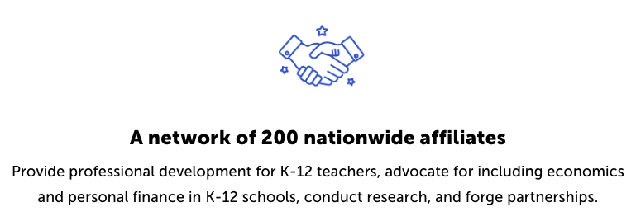
CEE Affiliates
https://www.councilforeconed.org/resources/local-affiliates/

Slide 24
Thank You to Our Sponsors!

Slide 25
We’ve gone Virtual!
Teach Economics?
Your students may have what it takes to compete in the nation’s only high school economics competition!
Why Play?
• Fun team learning experience
• Great for college applications
• No other challenge like this
• Online participation makes access easy
• Chance for cash prizes
How it Works
Teams register
Teachers enroll team(s) of 3- 4 high school students from the same school. Multiple teams allowed.
Teams compete within their state
Compete to win your state competition for a chance to advance to the National Semi-Finals.
National Semi-Finals: May 3-20, 2021
Teams answer multiple-choice questions on macroeconomics, microeconomics, and international & current events.
National Finals: May 22-24, 2021
Teams analyze an economic issue and present their solution. Top teams engage in the Finals Quiz Bowl where they face-off answering questions to claim the National Title.
Two divisions based on experience level
David Ricardo for first-time competitors who have taken no more than one economics course.
Adam Smith for returning competitors, AP, International Baccalaureate, and honors students.
Register Today at NationalEconomicsChallenge.org

Slide 26
FIND YOUR LOCAL COMPETITION AND REGISTER TODAY!
The National Personal Finance Challenge is a competition that provides high school students with an exciting and motivating opportunity to build, apply, and demonstrate their knowledge of money management.
Through online exams and a personal finance simulation, teams showcase their expertise in earning income, buying goods and services, saving, using credit, investing, as well as protecting and insuring.
Teams of up to four students, with one teacher/coach, can qualify to represent their state at the National Personal Finance Challenge by winning their local competition.
NATIONALS
Semi-Finals: First round elimination via online multiple-choice questions.
Finals: Case study round virtually co-hosted by the Cleveland Fed on June 3.
personalfinancechallenge.org

Slide 27
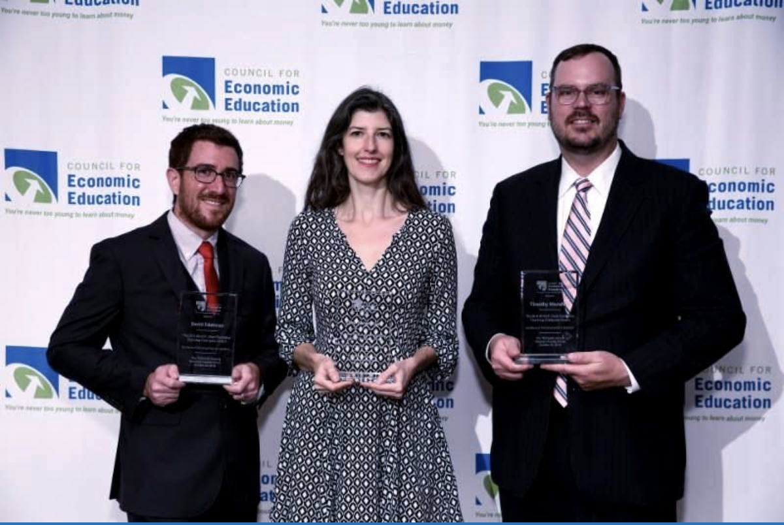
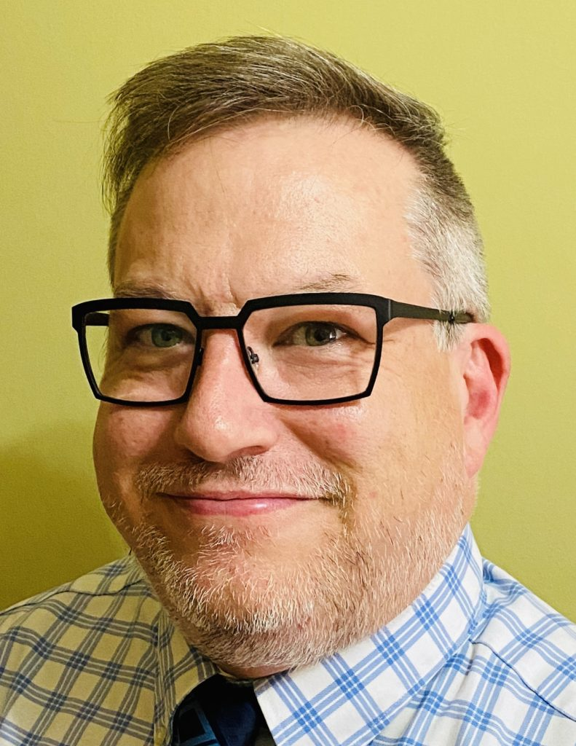
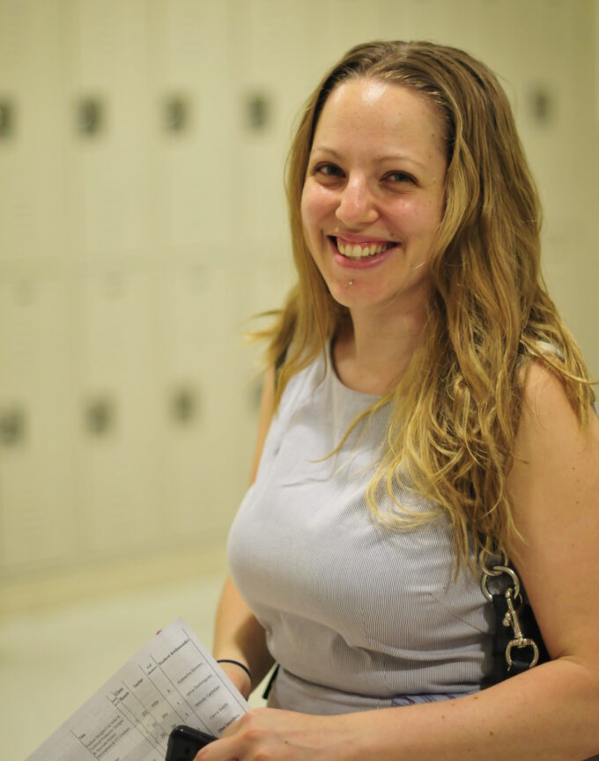
The 2021 Sloan Teaching Champion Award
Winners receive:
A cash award of $5,000
A cash award of $2,500 for their school to support economic education
Recognition at our annual Visionary Awards convening
This award promotes economic education by honoring three outstanding teachers who incorporate exemplary teaching techniques that improve their students’ economic understanding in and out of the classroom.
This award is open to New York metropolitan area high school teachers of all subjects, not just teachers of economics. Applicants must demonstrate how they integrate economics into their teaching.
Sound like you or someone you know?
Applicants must teach in one of the
Twelve New York state counties (New York, Kings, Bronx, Richmond, Queens, Nassau, Suffolk, Westchester, Putnam, Rockland, Orange and Dutchess)
Eight New Jersey counties (Bergen, Passaic, Essex, Hudson, Middlesex, Union, Morris, Monmouth), or the
Two Connecticut counties (Fairfield and New Haven)
Application will be launched on Friday February 19th 2021
You can access the application here.
CONTACT
Please feel free to e-mail us at rrivera@councilforeconed.org
with any questions you have.

