Slide 1
Women’s History Month NCCEE Presents Why Are There So Few Women in Economics? Amber Colley Thomas, North Carolina Council March 10, 2021 acthomas@nccee.org

Slide 2
EconEdLink Membership
You can now access CEE’s professional development webinars directly on EconEdLink.org! To receive these new professional development benefits, become an EconEdLink member. As a member, you will now be able to:
Automatically receive a professional development certificate via e-mail within 24 hours after viewing any webinar for a minimum of 45 minutes
Register for upcoming webinars with a simple one-click process
Easily download presentations, lesson plan materials and activities for each webinar
Search and view all webinars at your convenience
Save webinars to your EconEdLink dashboard for easy access to the event
You may access our new Professional Development page here

Slide 3
Professional Development Certificate
To earn your professional development certificate for this webinar, you must:
Watch a minimum of 45-minutes and you will automatically receive a professional development certificate via e-mail within 24 hours.
Accessing resources:
You can now easily download presentations, lesson plan materials, and activities for each webinar from EconEdLink.org/professional-development/

Slide 4
Agenda
Brainstorm: Why are there so few women in economics?
Speculations
Famous Economists Exploration
Careers in Economics
Resources to use in your classroom

Slide 5
Objectives
Teachers will be able to:
Examine why there are so few women with careers as economists.
Explain to students why they may want to pursue the field of economics.

Slide 6
National Standards
Standard 1: Scarcity
Standard 2: Decision Making
Standard 4: Incentives
Standard 13: Income

Slide 7
State Standards
North Carolina
The learner will demonstrate the role of economic choices within a market economy.
Standard: 1.01
Content area: Social Studies

Slide 8
Brainstorm
Why are there so few women in economics?
(Specifically Academia)

Slide 9
Speculation 1
Educational Paths
Social Norms
Mentors
Textbooks
People vs. Things

Slide 10
Speculation 2
Competing Clocks
Tenure
Papers published
Co-authoring and writing styles
Biological Clocks
Time off = Adjunct
Equal paternity and maternity leave
Different biological roles associated with taking care of a child

Slide 11
Speculation 3
Different Interests
Men
Macro, Econometrics, Finance
Women
Health, Education, Labor, Industrial Organization

Slide 12
Speculation 4
We’re presenting it all wrong!
We need to make it relatable before they choose their major
Focus on decision making aspect, people!

Slide 13
Why does it matter?
Policy Decisions
Different perspectives

Slide 14
Here’s the Good News!
More women are pursuing professional degrees
Some states have a requirement in place to teach economics in high school
Workplace leave is evolving
Economics is being made more exciting and real

Slide 15
Time to Explore
Famous Economists:
Claudia Goldin, Janet Yellen, Esther Duflo, Elinor Ostrom, Emily Oster

Slide 16
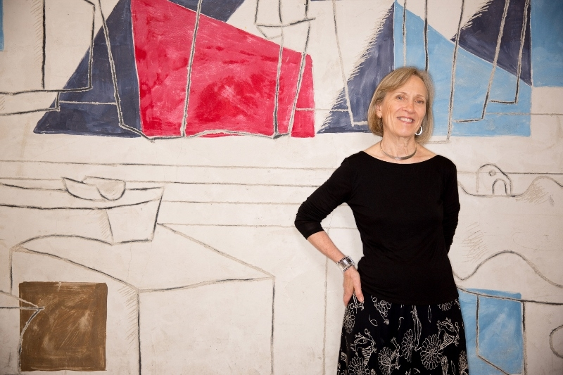
Famous Economists: Claudia Goldin
First Woman to Receive Tenure at Harvard

Slide 17
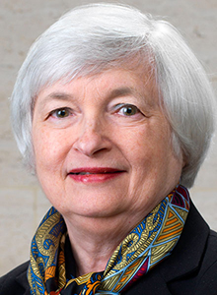
Famous Economists: Janet Yellen
Serving as US Secretary of the Treasury
Chair of the Federal Reserve
First woman to hold either role

Slide 18
Famous Economists: Elinor Ostrom
First woman to win Nobel Prize in Economics

Slide 19
Famous Economists: Esther Duflo
Youngest and second woman to win Nobel Prize in Economics

Slide 20
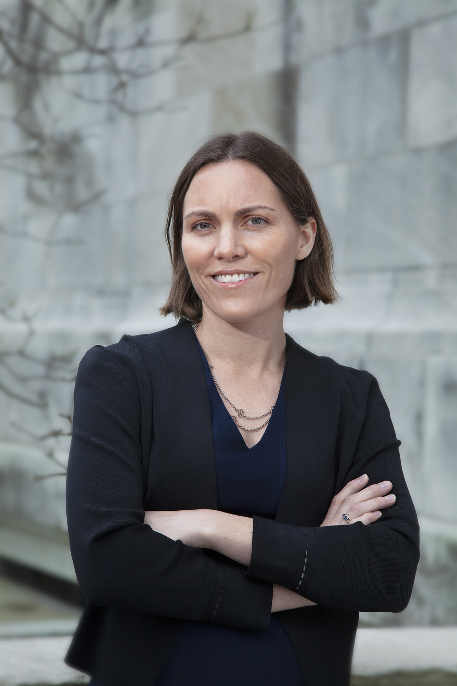
Famous Economists: Emily Oster
Interesting Research!
Data based guidance for parenting and pregnancy!

Slide 21
Careers in Economics

Slide 22
Careers in Economics

Slide 23
Resources for Your Classroom!

Slide 24
Resources for Your Classroom!

Slide 25
Let’s Change the Way We Introduce Economics

Slide 26
Assessment Questions
What are 3 of the speculations as to why there are so few women in economics?
Why does it matter if women are involved in the field of economics?
What is Janet Yellen best known for?
What is Claudia Goldin best known for?
What are Esther Duflo and Elinor Ostrom best known for?
How can we encourage more women to pursue a career in economics?

Slide 27
References
https://www.stlouisfed.org/timely-topics/women-in-economics
https://learn.mru.org/economics-careeer-guide/
https://learn.mru.org/women-economics-series/
https://review.chicagobooth.edu/economics/2019/article/why-are-there-so-few-women-economists
https://www.ted.com/talks/soumaya_keynes_why_are_there_so_few_women_in_economics
https://www.nytimes.com/2018/02/02/business/why-womens-voices-are-scarce-in-economics.html
https://scholar.harvard.edu/goldin/biocv
https://www.brookings.edu/author/janet-l-yellen/
https://www.nobelprize.org/prizes/lists/nobel-prize-awarded-women/
https://emilyoster.net/
https://www.councilforeconed.org/wp-content/uploads/2012/03/voluntary-national-content-standards-2010.pdf
https://www.econedlink.org/standards/?resource_id=40085#state_standard

Slide 28
CEE Affiliates
https://www.councilforeconed.org/resources/local-affiliates/

Slide 29
Thank You to Our Sponsors!

Slide 30
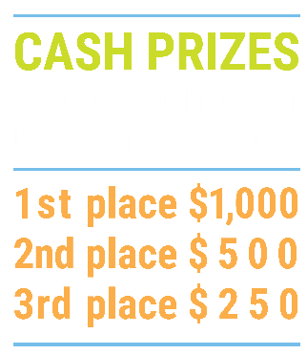
We’ve gone Virtual!
Teach Economics?
Your students may have what it takes to compete in the nation’s only high school economics competition!
Why Play?
• Fun team learning experience
• Great for college applications
• No other challenge like this
• Online participation makes access easy
• Chance for cash prizes
How it Works
Teams register
Teachers enroll team(s) of 3- 4 high school students from the same school. Multiple teams allowed.
Teams compete within their state
Compete to win your state competition for a chance to advance to the National Semi-Finals.
National Semi-Finals: May 3-20, 2021
Teams answer multiple-choice questions on macroeconomics, microeconomics, and international & current events.
National Finals: May 22-24, 2021
Teams analyze an economic issue and present their solution. Top teams engage in the Finals Quiz Bowl where they face-off answering questions to claim the National Title.
Two divisions based on experience level
David Ricardo for first-time competitors who have taken no more than one economics course.
Adam Smith for returning competitors, AP, International Baccalaureate, and honors students.
Register Today at NationalEconomicsChallenge.org

Slide 31
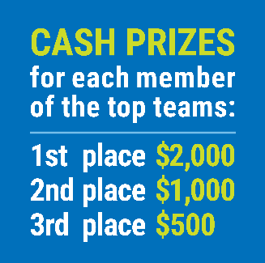
FIND YOUR LOCAL COMPETITION AND REGISTER TODAY!
The National Personal Finance Challenge is a competition that provides high school students with an exciting and motivating opportunity to build, apply, and demonstrate their knowledge of money management.
Through online exams and a personal finance simulation, teams showcase their expertise in earning income, buying goods and services, saving, using credit, investing, as well as protecting and insuring.
Teams of up to four students, with one teacher/coach, can qualify to represent their state at the National Personal Finance Challenge by winning their local competition.
NATIONALS
Semi-Finals: First round elimination via online multiple-choice questions.
Finals: Case study round virtually co-hosted by the Cleveland Fed on June 3.
personalfinancechallenge.org

Slide 32
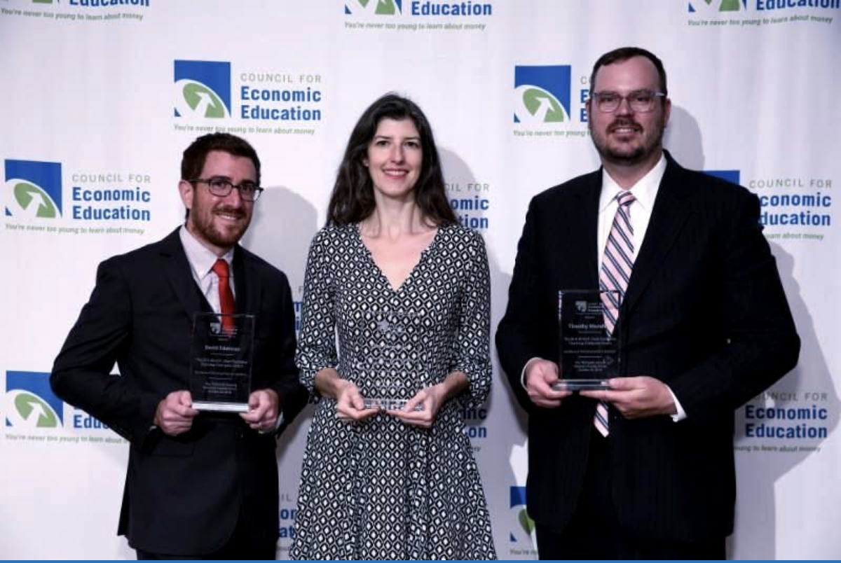
The 2021 Sloan Teaching Champion Award
Winners receive:
A cash award of $5,000
A cash award of $2,500 for their school to support economic education
Recognition at our annual Visionary Awards convening
This award promotes economic education by honoring three outstanding teachers who incorporate exemplary teaching techniques that improve their students’ economic understanding in and out of the classroom.
This award is open to New York metropolitan area high school teachers of all subjects, not just teachers of economics. Applicants must demonstrate how they integrate economics into their teaching.
Sound like you or someone you know?
Applicants must teach in one of the
Twelve New York state counties (New York, Kings, Bronx, Richmond, Queens, Nassau, Suffolk, Westchester, Putnam, Rockland, Orange and Dutchess)
Eight New Jersey counties (Bergen, Passaic, Essex, Hudson, Middlesex, Union, Morris, Monmouth), or the
Two Connecticut counties (Fairfield and New Haven)
Application will be launched on Friday February 19th 2021
You can access the application here.
CONTACT
Please feel free to e-mail us at rrivera@councilforeconed.org
with any questions you have.

