Slide 2
NEXT >

Slide 3
NEXT >

Slide 5
NEXT >

Slide 6
NEXT >

Slide 8
NEXT >

Slide 9
NEXT >

Slide 11
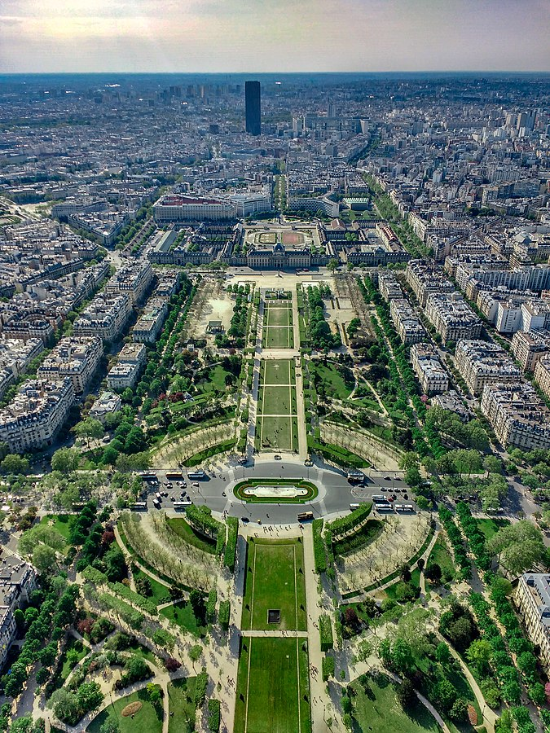
Congrats!
You were able to use your money to get this great view!
Good idea to buy water when it was the cheapest!
NEXT >

