Slide 1
National Personal Finance Challenge Webinar Series Standard 2: Buying Goods and Services Presented by Dr. Julie Heath and Susan McNamara julia.heath@uc.edu; mcnamarasa@vcu.edu

Slide 2
Professional Development Certificate
To earn your professional development certificate for this webinar, you must:
Watch a minimum of 45-minutes and you will automatically receive a professional development certificate via e-mail within 24 hours.
Once you receive your certificate, please submit it to your administrator for approval. Professional Development standards can differ from state to state
Accessing resources:
You can now easily download presentations, lesson plan materials, and activities for each webinar from EconEdLink.org/professional-development/

Slide 3
Agenda
Overview of Standard 2: Buying Goods and Services
Demonstration of Lessons
Lesson 1: Income and Choices
Lesson 2: Budgeting for Income and Expenses
Tie-in to National Personal Finance Challenge Case Study Competition

Slide 4
Objectives
Teachers will
Understand the scope and depth of Standard 2: Buying Goods and Services, including specific concepts;
Be able to demonstrate Standard 2: Buying Goods and Services to their students using the two lessons presented;
Synthesize Standard 2: Buying Goods and Services and the lessons to create actionable plans for classroom engagement.

Slide 5
Standard 2: Buying Goods and Services
People cannot buy or make all the goods and services they want; as a result, people choose to buy some goods and services and not buy others. People can improve their economic well-being by making informed spending decisions, which entails collecting information, planning, and budgeting.

Slide 6
Standard 2: Buying Goods and Services
People cannot buy or make all the goods and services they want; as a result, people choose to buy some goods and services and not buy others. People can improve their economic well-being by making informed spending decisions, which entails collecting information, planning, and budgeting.

Slide 7
Important Concepts
Scarcity, making choices, satisfying wants
Opportunity costs
Decision-making
Benefits/costs

Slide 8
Important Concepts
Budgeting
SMART
Time horizons
Categories of expenses

Slide 9
Important Concepts
Consumer Protections
Federal/state organizations
Scams

Slide 10
References
National Standards for Financial Literacy
https://www.councilforeconed.org/resource/national-standards-for-financial-literacy/#sthash.11CbykLO.dpbs

Slide 11
EconEdLink Membership
You can now access CEE’s professional development webinars directly on EconEdLink.org! To receive these new professional development benefits, become an EconEdLink member. As a member, you will now be able to:
Automatically receive a professional development certificate via e-mail within 24 hours after viewing any webinar for a minimum of 45 minutes
Register for upcoming webinars with a simple one-click process
Easily download presentations, lesson plan materials and activities for each webinar
Search and view all webinars at your convenience
Save webinars to your EconEdLink dashboard for easy access to the event
You may access our new Professional Development page here

Slide 12
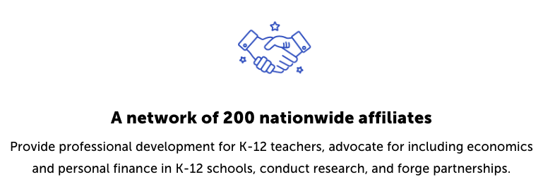
CEE Affiliates
https://www.councilforeconed.org/resources/local-affiliates/

