Slide 1
National Personal Finance Challenge Webinar Series Standard 1: Earning an Income Presented by Dr. Julie Heath and Susan McNamara Date julia.heath@uc.edu; mcnamarasa@vcu.edu

Slide 2
Professional Development Certificate
To earn your professional development certificate for this webinar, you must:
Watch a minimum of 45-minutes and you will automatically receive a professional development certificate via e-mail within 24 hours.
Once you receive your certificate, please submit it to your administrator for approval. Professional Development standards can differ from state to state
Accessing resources:
You can now easily download presentations, lesson plan materials, and activities for each webinar from EconEdLink.org/professional-development/

Slide 3
Agenda
Overview of Standard 1: Earning an Income
Demonstration of Lessons
Lesson 1: Time Value of Money
Lesson 2: Uncle Sam Takes a Bite + Tax Math
Tie-in to National Personal Finance Challenge Case Study Competition

Slide 4
Objectives
Teachers will
Understand the scope and depth of Standard 1: Earning an Income, including specific concepts;
Be able to demonstrate Standard 1: Earning an Income to their students using the two lessons presented;
Synthesize Standard 1: Earning an Income and the lessons to create actionable plans for classroom engagement.

Slide 5
Standard 1: Earning an Income
Income for most people is determined by the market value of their labor, paid as wages and salaries. People can increase their income and job opportunities by choosing to acquire more education, work experience, and job skills. The decision to undertake an activity that increases income or job opportunities is affected by the expected benefits and costs of such an activity. Income also is obtained from other sources such as interest, rents, capital gains, dividends, and profits.

Slide 6
Standard 1: Earning an Income
Income for most people is determined by the market value of their labor, paid as wages and salaries. People can increase their income and job opportunities by choosing to acquire more education, work experience, and job skills. The decision to undertake an activity that increases income or job opportunities is affected by the expected benefits and costs of such an activity. Income also is obtained from other sources such as interest, rents, capital gains, dividends, and profits.

Slide 7
Important Concepts
Investing in Human Capital
Education and trade-offs
Skills acquisition
Opportunity costs

Slide 8
Important Concepts
Time Value of Money
Present/Future values
Meaning
Applications
Inflation/interest rates and effect on value

Slide 9
Important Concepts
Job Characteristics
Benefit packages (examples)
HSA vs FSA
IRA vs. Roth vs 401(k)

Slide 10
Important Concepts
Market Determination of Wage Rates
Demand and supply/equilibrium determination
Changes in D/S leading to changes in wages

Slide 11
Important Concepts
Taxes
Types
Income, payroll (SS), sales, excise, federal, state, local
Tax Forms
Common IRS forms
Uses—public goods provision

Slide 12
References
National Standards for Financial Literacy
https://www.councilforeconed.org/resource/national-standards-for-financial-literacy/#sthash.11CbykLO.dpbs

Slide 13
EconEdLink Membership
You can now access CEE’s professional development webinars directly on EconEdLink.org! To receive these new professional development benefits, become an EconEdLink member. As a member, you will now be able to:
Automatically receive a professional development certificate via e-mail within 24 hours after viewing any webinar for a minimum of 45 minutes
Register for upcoming webinars with a simple one-click process
Easily download presentations, lesson plan materials and activities for each webinar
Search and view all webinars at your convenience
Save webinars to your EconEdLink dashboard for easy access to the event
You may access our new Professional Development page here

Slide 14
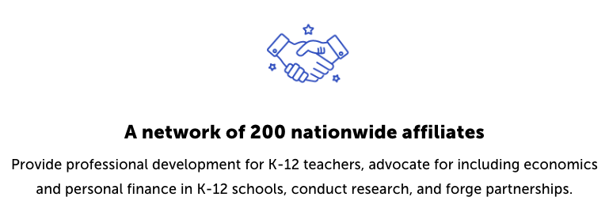
CEE Affiliates
https://www.councilforeconed.org/resources/local-affiliates/

