Slide 1
National Personal Finance Challenge Webinar Series Standard 3: Saving Lesson 1: Compound Interest Presented by Dr. Julie Heath julia.heath@uc.edu

Slide 2
Standard 3: Saving
Saving is the part of income that people choose to set aside for future uses. People save for different reasons during the course of their lives. People make different choices about how they save and how much they save. Time, interest rates, and inflation affect the value of savings.

Slide 3
Growing Money with Compound Interest
No-Frills Money Skills Video Series, Episode 1
http://www.stlouisfed.org/education_resources/no-frills-money-skills/episode-1-growing-money/

Slide 4
“Interest”ing Terms to Know
Interest rate: the price paid for using someone else’s money, expressed as a percentage of the amount borrowed.
Compound interest: interest earned on both the principal and any interest that has been earned previously.
Earned on accounts at banks, credit unions, etc.
Earned on certain investments such as annuities
Paid on most consumer loans, car loans, mortgages, and other unpaid credit balances
Simple interest: interest earned only on the principal.
May be used on some consumer loans and some types of savings
Easier to calculate but not as commonly used

Slide 5
Time Matters with Interest
Interest can be compounded over different lengths of time including:
Annually – computed and added at the end of each year
Semi-annually – (twice a year) computed and added every six months
Quarterly – (four times a year) computed and added at the end of each quarter (three months)
Monthly – computed and added at the end of each month

Slide 6
Calculating Simple and Compound Interest

Slide 7
Simple Interest Example
Dianna deposits $725 into a savings account that pays 2.3% simple annual interest.
How much interest will Dianna earn after 18 months?

Slide 8
Simple Interest Equation
To calculate simple interest we use the formula I = Pxr xt
I is the interest earned
P is the principal or the original amount of money with which you start
r is the annual interest rate as a decimal
t is the time in years.

Slide 9
Solution for Dianna
The annual interest rate is written as a decimal. (2.3 = .0023)
In the simple interest formula, time is measured in years. (18 months = 1.5 years)
I = Pxr xt
Interest earned = $725 x .0023 x 1.5

Slide 10
Two Problems to Solve
Determine the amount of interest earned. Use the formula for simple interest.
Problem 1
Principal: $550
Annual rate: 7%
Time: 4 years
Problem 2
Principal: $870
Annual rate: 3.7%
Time: 30 months

Slide 11
Compound Interest Equation
Use this formula to calculate compound interest: A=P(1+r) ^{t}
A is the amount of money in the account at the end of a time period
P is the principal
r is the annual interest rate
t is the time in years

Slide 12
Compound Interest Example
Simon deposits $400 in an account that pays 3% interest compounded annually. What is the balance of Simon’s account at the end of 2 years?

Slide 13
Calculating Simon’s Interest
Step 1. Find the balance at the end of the first year using the simple interest formula I = Pxr xt
$400 x .003 x 1 = $12
$400 + $12 = $412
Step 2. Find the interest at the end of the second year using the simple interest formula and the principal of $412.
$412 x .003 x 1 = $12.36
$412 + $12.36 = $424.36

Slide 14
Calculating Jackie’s Earnings
Jackie deposits $325 in an account that pays 4.1% interest compounded annually. How much money will Jackie have in her account after 3 years?

Slide 15
Calculating Long-term Savings
Use the following compound interest calculator to determine the amount earned by age 65, starting at two different ages.
Start saving $50 a month at age 18 at 4% interest
Start saving $50 a month at age 30 at 4% interest
https://archive.econedlink.org/interactives/EconEdLink-interactive-tool-player.php?iid=2

Slide 16
Questions?

Slide 17
References
National Standards for Financial Literacy
https://www.councilforeconed.org/resource/national-standards-for-financial-literacy/#sthash.11CbykLO.dpbs
What is Compound Interest
https://www.econedlink.org/resources/compound-interest/

Slide 18
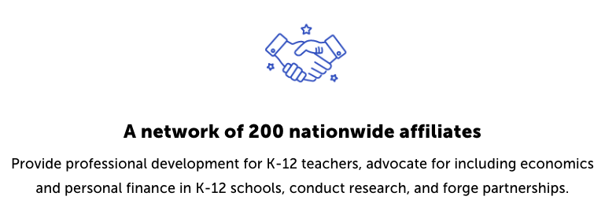
CEE Affiliates
https://www.councilforeconed.org/resources/local-affiliates/

