Slide 1
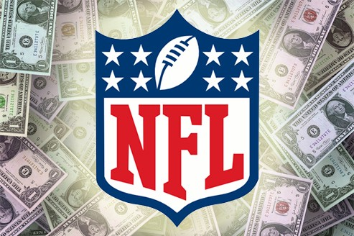
The Economics of
The Super Bowl and the NFL
John Kruggel
Associate Director for Program
JMU Center for Economic Education
3/23/2021 kruggejb@jmu.edu

Slide 2
EconEdLink Membership
You can now access CEE’s professional development webinars directly on EconEdLink.org! To receive these new professional development benefits, become an EconEdLink member. As a member, you will now be able to:
Automatically receive a professional development certificate via e-mail within 24 hours after viewing any webinar for a minimum of 45 minutes
Register for upcoming webinars with a simple one-click process
Easily download presentations, lesson plan materials and activities for each webinar
Search and view all webinars at your convenience
Save webinars to your EconEdLink dashboard for easy access to the event
You may access our new Professional Development page here

Slide 3
Professional Development Certificate
To earn your professional development certificate for this webinar, you must:
Watch a minimum of 45-minutes and you will automatically receive a professional development certificate via e-mail within 24 hours.
Accessing resources:
You can now easily download presentations, lesson plan materials, and activities for each webinar from EconEdLink.org/professional-development/

Slide 4
Agenda
Where Sports and Economics meet.
The NFL and oligopolistic behavior.
Owners fighting the NFL for revenue.
Should cities host the Super Bowl?
Should cities build new NFL stadiums with tax dollars?
AFL-NFL merger and political logrolling.
Free agency and monopolies.
The draft and monopsonies.

Slide 5
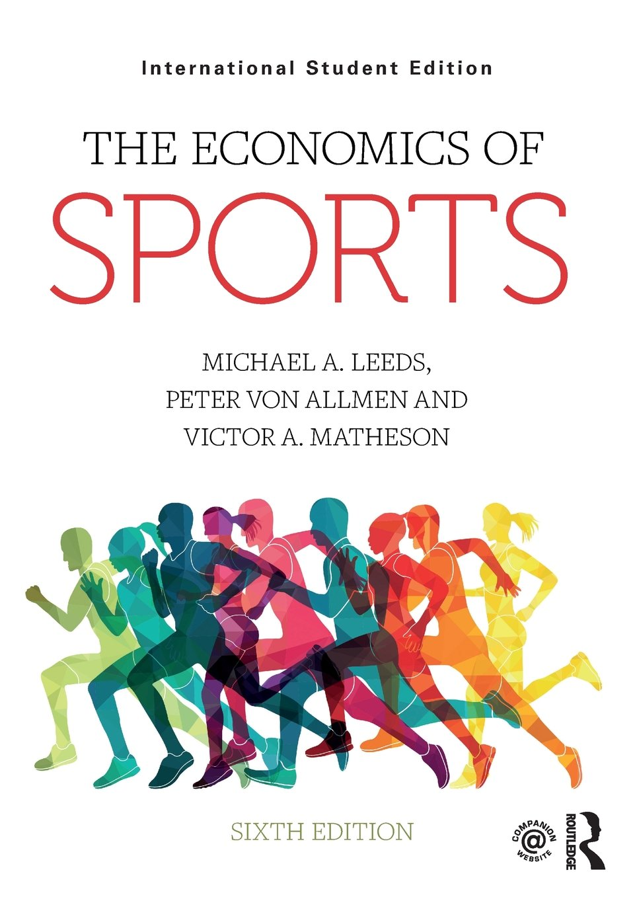
Objectives
I Can:
Identify how competition and collusion impact the NFL.
Discuss the role of public finance in stadium construction.
Explain the trade-offs to hosting a Super Bowl.
Identify the role of free agency and the draft on player sovereignty in the NFL.

Slide 6
National Standards
Standard 2: Decision Making:
Effective decision making requires comparing the additional costs of alternatives with the additional benefits. Many choices involve doing a little more or a little less of something: few choices are “all or nothing” decisions.
Standard 4: Incentives:
People usually respond predictably to positive and negative incentives.
Standard 9: Competition and Market Structure:
Competition among sellers usually lowers costs and prices, and encourages producers to produce what consumers are willing and able to buy.
Standard 10: Institutions:
Institutions evolve and are created to help individuals and groups accomplish their goals.

Slide 7
Where Sports & Economics Meet
How many TV shows/radio stations/newspaper columns/websites/social media sites are dedicated to sports?
How many shows are dedicated to Walmart or Pepsi?
“According to Forbes.com, the total revenues generated by the four largest North American sports leagues (basketball, baseball, football and hockey) totaled about $32.15B in 2017, which would rank 89th among the Fortune 500 list of largest revenue-generating companies.” --Leeds et al pg. 4
This is 1/16th of Walmart’s revenue and ½ of PepsiCo
Entire industries are built around sports (management, advertising, communications, etc.) …
BECAUSE SPORTS GETS PEOPLE’S ATTENTION.

Slide 8
The NFL and Competition
On the field, the NFL tries to make teams as competitive as possible
They have created many rules and regulations to establish parity among teams
  Or as much as possible. My beloved Bears seem to keep messing up regardless of how much the NFL tries to help
Examples of ways to maintain parity:
  Reverse-order draft, salary cap, free agency*, etc.
  What about the owners: how do they react to competition between themselves as well as with the NFL?

Slide 9
The NFL and Oligopolistic Behavior
One of the key characteristics of oligopolies is interdependence: the actions of one company greatly impacts business conditions for its competitors.
Large companies competing with other large companies often try to avoid direct price competition because of how their competitors will react.
In markets dominated by a few large companies, the lure of profits supports price collusion, although collusion must often be tacit (secret).
However, companies also have an incentive to cheat on their agreements.

Slide 10
NFL Example of Collusion:
In 1959, NFL commissioner Pete Rozelle wanted to increase the NFL’s revenue from their TV contracts
At that time each team had their own arrangement with local TV stations
This resulted in large market teams gaining large revenue from TV contracts and small market teams getting far less
Example: Baltimore Colts made $600,000 on TV deals, whereas the Packers made $80,000
  Sidebar: When Lombardi took the job in Green Bay, his children couldn’t find it on a map. Lombardi assured themthat when he was done, every map would have Green Bay on it.

Slide 11
Dominant Strategy
In order to solidify the NFL’s TV deals, Rozelle had to instill a league first mentality in the team owners
  He also needed to get Congress to pass a law making it legal for the NFL to negotiate a TV deal that wouldn’t violate the Sherman Anti-Trust Act and the Radovich case
Rozelle had to convince owners that a league first mentality was in their best interest, long run. In economics, we call this a dominant strategy.
This video is THE BEST example of a dominant strategy (Prisoner’s Dilemma) you can use in your classroom!

Slide 12
Was Rozelle Right?
In the 1962-63 season, the NFL’s first contract with CBS paid approximately $330,000 per franchise per year
  Not looking good for Baltimore, but GREAT news for Green Bay
By the 1964-65 season, payments had risen to about $1 million per franchise per year.
Rozelle’s league first emphasis allowed the NFL to create NFL Properties, which pooled the revenues from league licensing agreements.
  Which in turn, allowed the owners to withstand conflict with the player’s union better than most leagues
Of course, not every owner got on board with the league first mentality….

Slide 13

How ‘Bout Them Cowboys?!?
One example of owners doing what worked for them over the NFL (not following the League First mentality Pete Rozelle wanted):
Shortly after Jerry Jones bought the Dallas Cowboys in 1989, he signed licensing deals with Pepsi Cola and Nike, NEITHER of which had an agreement with NFL Properties at the time.
  So who gets the money?
The NFL tried to block the deal, so the Cowboys remain part of NFL Properties, BUT they are the ONLY NFL team allowed to sign their own licensing deals.

Slide 14
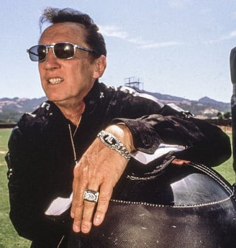
Al Davis
Another owner who bucked the “League First” mentality
In 1979, Davis wanted to move the Raiders from Oakland to L.A. wanted a new stadium and larger market
-Davis grew up in Brooklyn. Dodgers connection?
Davis was blocked from moving to L.A. Davis sued and eventually won the right to move to L.A. in 1982
-He moved the team back to Oakland in 1995
-Davis also had a history of contention with Pete Rozelle, when the AFL and NFL merged, Davis thought he should be commissioner of the NFL, the owners disagreed...

Slide 15
Hosting a Super Bowl
One reason teams/cities want new stadiums is the chance they will get to host the Super Bowl, but should cities host the Super Bowl?
The NFL claims the Super Bowl brings around $300-$500M to host cities.
Economists disagree: Victor Matheson Economics of the Super Bowl estimates that number to be closer to $30-$150M.
-Matheson cites the costs of building a new stadium, police overtime, increase use of public transit, there are also millions of dollars worth of additional specifications the NFL requires to host the Super Bowl
-There’s also the substitution effect (more later), crowding out of local consumers, and leakages (money usually goes to corporations rather than taxpayers)

Slide 16
Should Cities Build New Stadiums?
In international trade (works for cities, too)
net exports = exports - imports
New facility can increase a city’s net exports:
Increases the amount that outsiders spend in the city
Reduces what city residents spend elsewhere
Is there a multiplier effect?
People earning the first round of direct spending spend more themselves, increasing the incomes of others and so on

Slide 17
Public Finance of Sports: Who Pays?
Stadium subsidies began in the 1950s
Teams showed that they would move for subsidies
  Brooklyn Dodgers to LA in 1957
Until 1980s, cities picked up stadium costs
Since 1980s, more equal partnership, cities paying about 2/3 (after 2008, more like 1/3).
  Las Vegas paid ~37.5% for Allegiant (Death Star) Stadium
Leagues specifically limit number of teams to increase bargaining power over cities. Limiting output and increasing revenue
Cities argue new stadiums generate new wealth (more later)
New stadiums tend to get to host a Super Bowl
Teams have an incentive to create more luxury seats with a new stadium or renovations (more later)

Slide 18
Stadium Subsidies
What is the approximate cost of building an NFL stadium? (See example of Washington Football Team.)
How much did FedEx Field cost?
  $250 million in 1997 ($413.28 Million in real dollars)
  This amount DOES NOT include improvements made by Snyder (over 100 million)
  This also leaves out the value of the 200 acres it occupies (opportunity cost?)
  WFT attendance increased 40% with the new field, but they have NEVER sold out a game

Slide 19
FedEx Field
Who typically pays to build a stadium?
  WFT Original owner Jack Kent Cooke financed most of it (NOT the norm)
  Maryland contributed $70 million for improvements
  FedEx Field CANNOT redistrict until 2027
  But Dan Snyder and several D.C. politicians have been looking to build a new stadium in D.C.
  That stadium would cost close to 2 billion

Slide 20
Incentives for Luxury Suites
Luxury suite revenue only counts as part of team attendance (60% of a team’s ticket sales are shared throughout the League).
“For example, suppose a luxury suite in AT&T Stadium with 20 seats rents for $500,000 per year. If the Cowboys claim the value of the seats to be $50 each, they share only $3,200 (.04 x 20 x 50 x 8 games), and they keep the remaining $496,800.”
  Leeds et al (pg. 70)
“When the new LA Stadium at Hollywood Park opens in 2020, NFL stadiums built since 2009 will have an average of 220 luxury boxes, about 80 more than in the remaining 24 stadiums built prior to 2009.”
  Leeds et al (pg. 152)

Slide 21
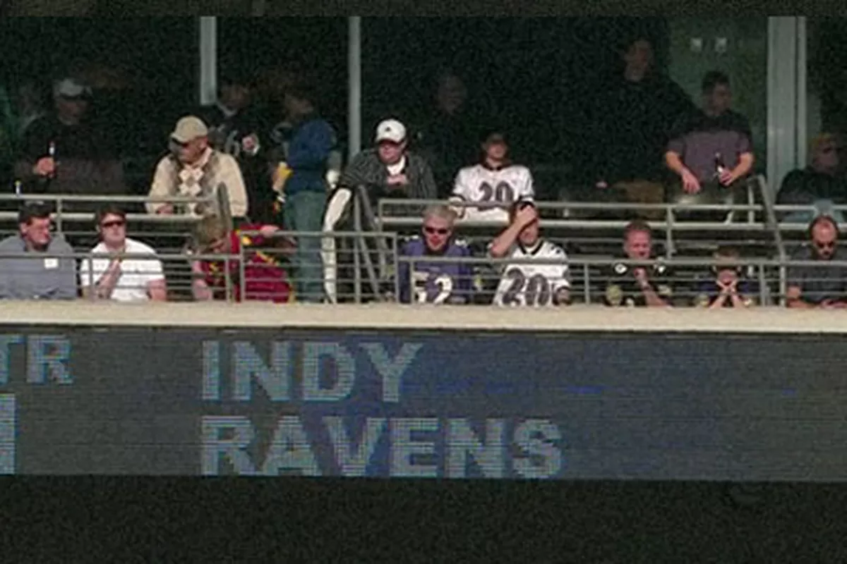
Colts Moving to Indy
In 1984, Colts owner Robert Irsay wanted a new stadium
Baltimore had an older multi-purpose stadium for both the Orioles and the Colts
The city refused to build a new stadium
Irsay moved the team to Indianapolis in a now infamous “Midnight Move”
Of Course Baltimore
was SO hurt by this
THEY would NEVER
"steal" another city's
team right?!?

Slide 22
To Build or Not to Build:
Do you think cities/states should help pay for stadiums?
For it or Against it?
  Incentives matter, people view decisions through the economic lens of incentives
  This activity from the Georgia Council on Economic Education does a GREAT job walking students through scenarios for different groups/individuals who would either support or oppose the building of the new Falcons stadium

Slide 23
Reality on Stadium Subsidies?
A 2015 Study by Prof. Dennis Coates showed the following about the impact of sports teams on a local economy:
Professional sports can have some impact on the economy.
This impact tends to be negative.
At most, sports account for less than 5% of the local economy.
Overall findings: Sports teams may actually hurt economic growth. Little of the money spent on sports stadiums makes its way back to taxpayers who subsidize them.

Slide 24
Institutions, According to
Douglass C. North
Institutions are the humanly devised constraints that structure political, economic and social interactions.
They consist of both informal constraints (sanctions, taboos, customs, traditions) and formal rules (constitutions, laws, property rights)….
Institutions provide the incentive structure of an economy; as that structure evolves, it shapes the direction of economic change towards growth, stagnation or decline

Slide 25
IRS Code 501(c)(6)
Section 501(c)(6) of the Internal Revenue Code provides for the exemption of business leagues, chambers of commerce, real estate boards, boards of trade and professional football leagues, which are not organized for profit and no part of the net earnings of which inures to the benefit of any private shareholder or individual

Slide 26
NFL-AFL Merger
Section 501(c)(6) was inserted into the tax code in 1966 when the NFL and AFL merged
  “Forty of the 123 franchises in the 4 major North American leagues began life as a member of rival leagues.” (Leeds et al 110)
  Major leagues often absorb rivals or drive them out of business
The language was added to help protect the merger from claims it would create a monopoly under the Clayton Antitrust Act or the Federal Trade Commissions Act
But why did the IRS add that language?

Slide 27

Logrolling
Informal = The practice of exchanging favors, especially in politics by reciprocal voting for each other’s proposed legislation
The head of the Senate Finance Committee (Russell Long) and the House majority whip (Hale Boggs) were both from the same state and wanted the NFL to expand their region
Many believe they pushed the change to the law in exchange for the NFL expanding the league

Slide 28
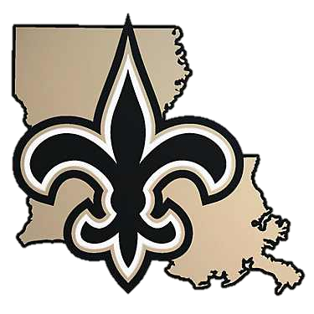
What Year Was This Law Changed?
Recall: 1966, which expansion team was added in 1967?
Which state did Russell Long and Hale Boggs represent?
Louisiana!!!

Slide 29
Rise of Free Agency
NFL was the first major sports league to lose a case on free agency (Supreme Court 1957: Radovich v. National Football League). But, after the ruling, Pete Rozelle created what became known as the “Rozelle Rule”
  Basically, if a team took a free agent from another team, the commissioner could then select a player from the team gaining the free agent and trade them to the team losing the free agent

Slide 30
Free Agency cont’d
This essentially eliminated free agency in the NFL until ANOTHER court case in 1992 (McNeil et al v. National Football League)
  After this ruling, the NFL created the “Franchise Tag” in 1993 to limit free agency
  The most common franchise tag gives the player a 1-yr contract that pays him the average salary of the 5 highest-paid players at his position over the last 5 years or 120% of his salary for the last year, whichever is greater
  Most players that get the franchise tag are finishing their rookie contract

Slide 31
Assessment Questions
Athletes that are drafted have no say in which team drafts them
Do you think we will have a “Curt Flood Moment” for the draft like there was for free agency?
Do you think athletes deserve a greater voice in who they play for at the beginning of their career?
Do you think more players will holdout like Eli Manning or John Elway?
Here’s a great EconEdLink lesson on a perfectly competitive labor market vs. one where a monopsony exists for buyers of labor.

Slide 32
NFL Draft Case
In 1968, the WFT drafted James “Yazoo” Smith (12th overall pick),an All-American DB for Oregon
In Week 14, Smith suffered a career ending (and life altering) broken neck
Two years later Smith sued, claiming the draft violated the Sherman Antitrust Act. Smith asserted that he could have negotiated a more lucrative contract had he not been forced to participate in the draft
In 1976, Judge William Bryant awarded $276,000 to Smith (Smith sought $4.2M) and ruled the draft violated federal antitrust laws. The NFL, of course, appealed the decision.
December 8, 1981 a US Appeals Court refuted Bryant’s numbers and reduced the payout to $12,000

Slide 33
Why is There Still a Draft?
The NFL and NFLPA agreed to maintain the draft in 1977
The Supreme Court has established in several cases a “non-statutory labor exemption” to antitrust law
  This means: leagues could still have a draft as long as the unions agreed to it
By 1977 the NFL also:
  Reduced the number of rounds in the draft from 17 to 12
  Allowed drafted players to sit out a year and then re-enter the draft pool
  Drafted players could play 2 years in the CFL and negotiate with any NFL team

Slide 34
Does the NFLPA Illustrate the Principal-Agent Problem?
The principal-agent problem is when there’s a conflict in priorities between a person and the representative authorized to act on their behalf
  An agent may act in a way that is best for them but not their client, thus creating the principal-agent problem
So, does the NFLPA have rookies' best interest at heart?
  If the NFL has a hard cap on salaries, doesn’t less money for rookies mean more money for veterans?
AND who is more likely to be an NFLPA representative, a new player or a veteran?

Slide 35
Asymmetric Information & The Draft
Asymmetric information exists when one side of a negotiation has more knowledge than the other side.
Example: Buying a used car
Should teams trade up in the draft to get what they see as a more skilled athlete?
According to Richard Thaler and Cade Massey, NO!
One reason is asymmetric information
A bigger one is the toss-up of knowing how successful a player will be
Thaler argues that teams are much better off trading down in the draft
How do teams try to offset asymmetric information?
Individual physicals
Pro Days at universities
NFL Draft Combine
Watching game film

Slide 36
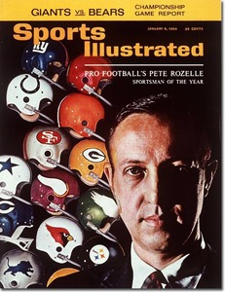
The League First Mentality
Recall what Pete Rozelle tried to accomplish back in the early 1960s?
His league first mentality has proven to be the dominant strategy regarding TV deals and revenue generation for the NFL

Slide 37
PAYDAY for the NFL
On Thursday (3/18/21) the NFL announced a new TV deal with Amazon, CBS, ESPN/ABC, Fox and NBC from 2023-2033:
CBS, Fox and NBC each get 3 Super Bowls, ESPN gets 2
NFL keeps rights to air exclusive games on NFL Network
Amazon Prime is now the host of Thursday Night Football
ESPN keeps MNF, NBC keeps SNF
The NFL gets $113 BILLION for this deal! This is nearly DOUBLE what they currently get per year!
Looks like there will be more Nickelodeon offerings as well
Rumor has it that ESPN+ will get Sunday Ticket since DirecTV is not a part of this deal

Slide 38
Thanks!
Questions?
Thank you all for attending, hopefully your MB ≥ MC!
Are there any questions?

Slide 39

CEE Affiliates
https://www.councilforeconed.org/resources/local-affiliates/

Slide 40




Thank You to Our Sponsors!

Slide 41



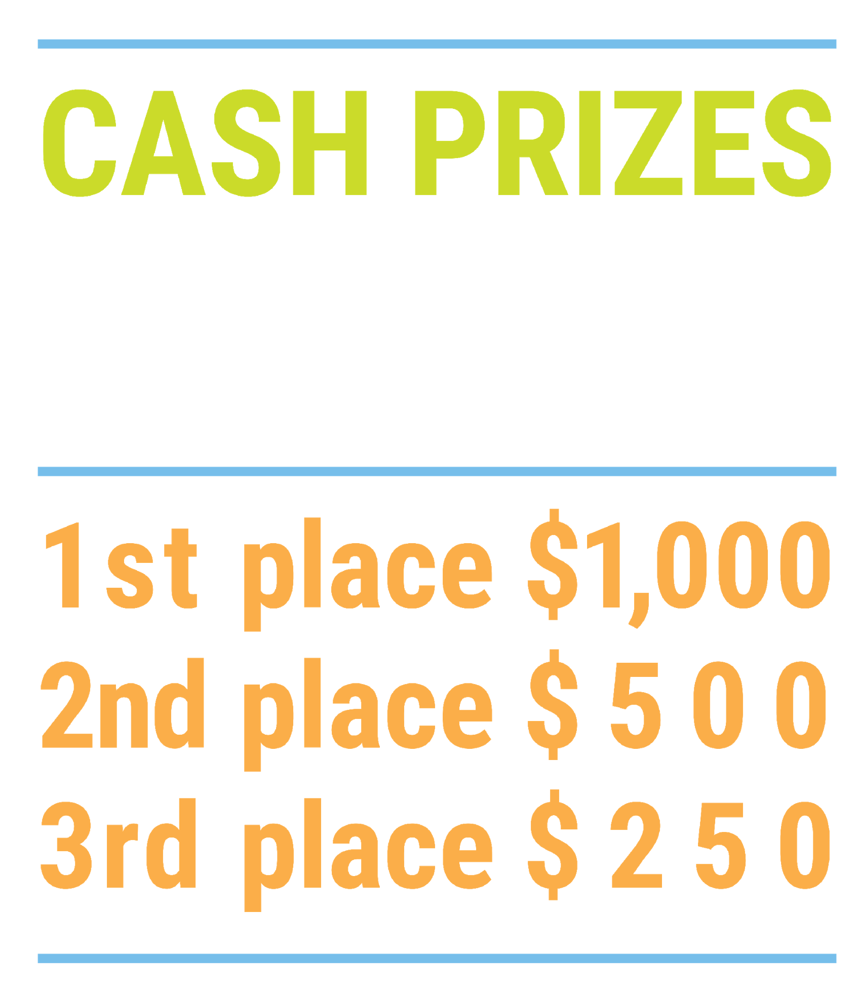

We’ve gone Virtual!
Teach Economics?
Your students may have what it takes to compete in the nation’s only high school economics competition!
Why Play?
• Fun team learning experience
• Great for college applications
• No other challenge like this
• Online participation makes access easy
• Chance for cash prizes
How it Works
Teams register
Teachers enroll team(s) of 3- 4 high school students from the same school. Multiple teams allowed.
Teams compete within their state
Compete to win your state competition for a
chance to advance to the National Semi-Finals.
National Semi-Finals: May 3-20, 2021
Teams answer multiple-choice questions on macroeconomics, microeconomics, and international & current events.
National Finals: May 22-24, 2021
Teams analyze an economic issue and present their solution. Top teams engage in the Finals Quiz Bowl where they face-off answering questions to claim the National Title.
Two divisions based on experience level
David Ricardo for first-time competitors who have taken no more than one economics course.
Adam Smith for returning competitors, AP, International Baccalaureate, and honors students.
Register Today at NationalEconomicsChallenge.org

Slide 42

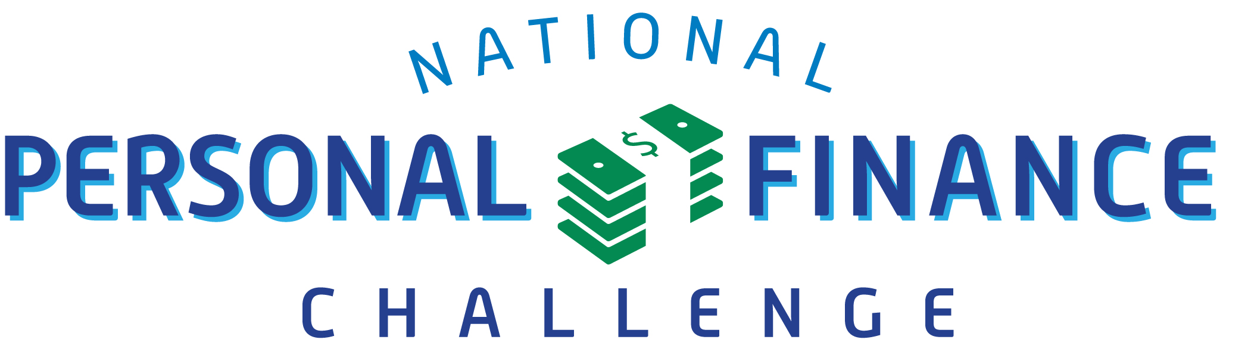
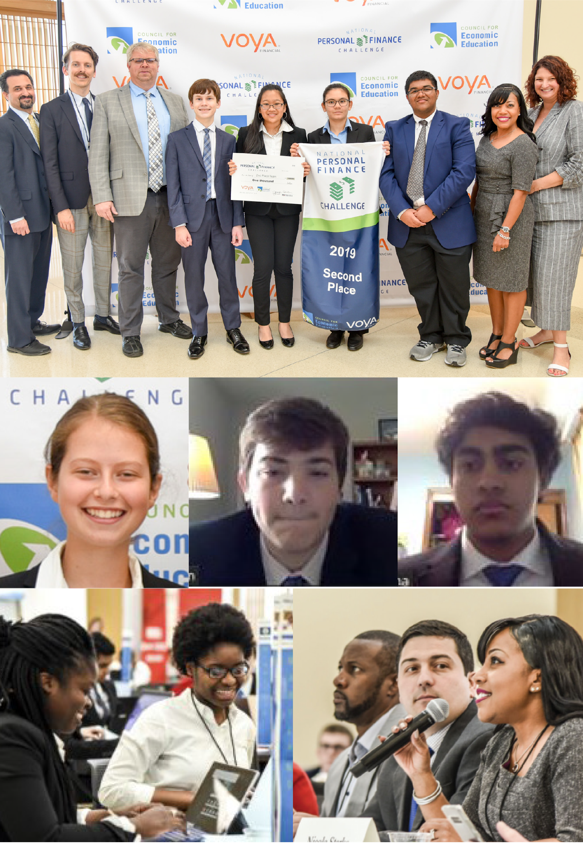
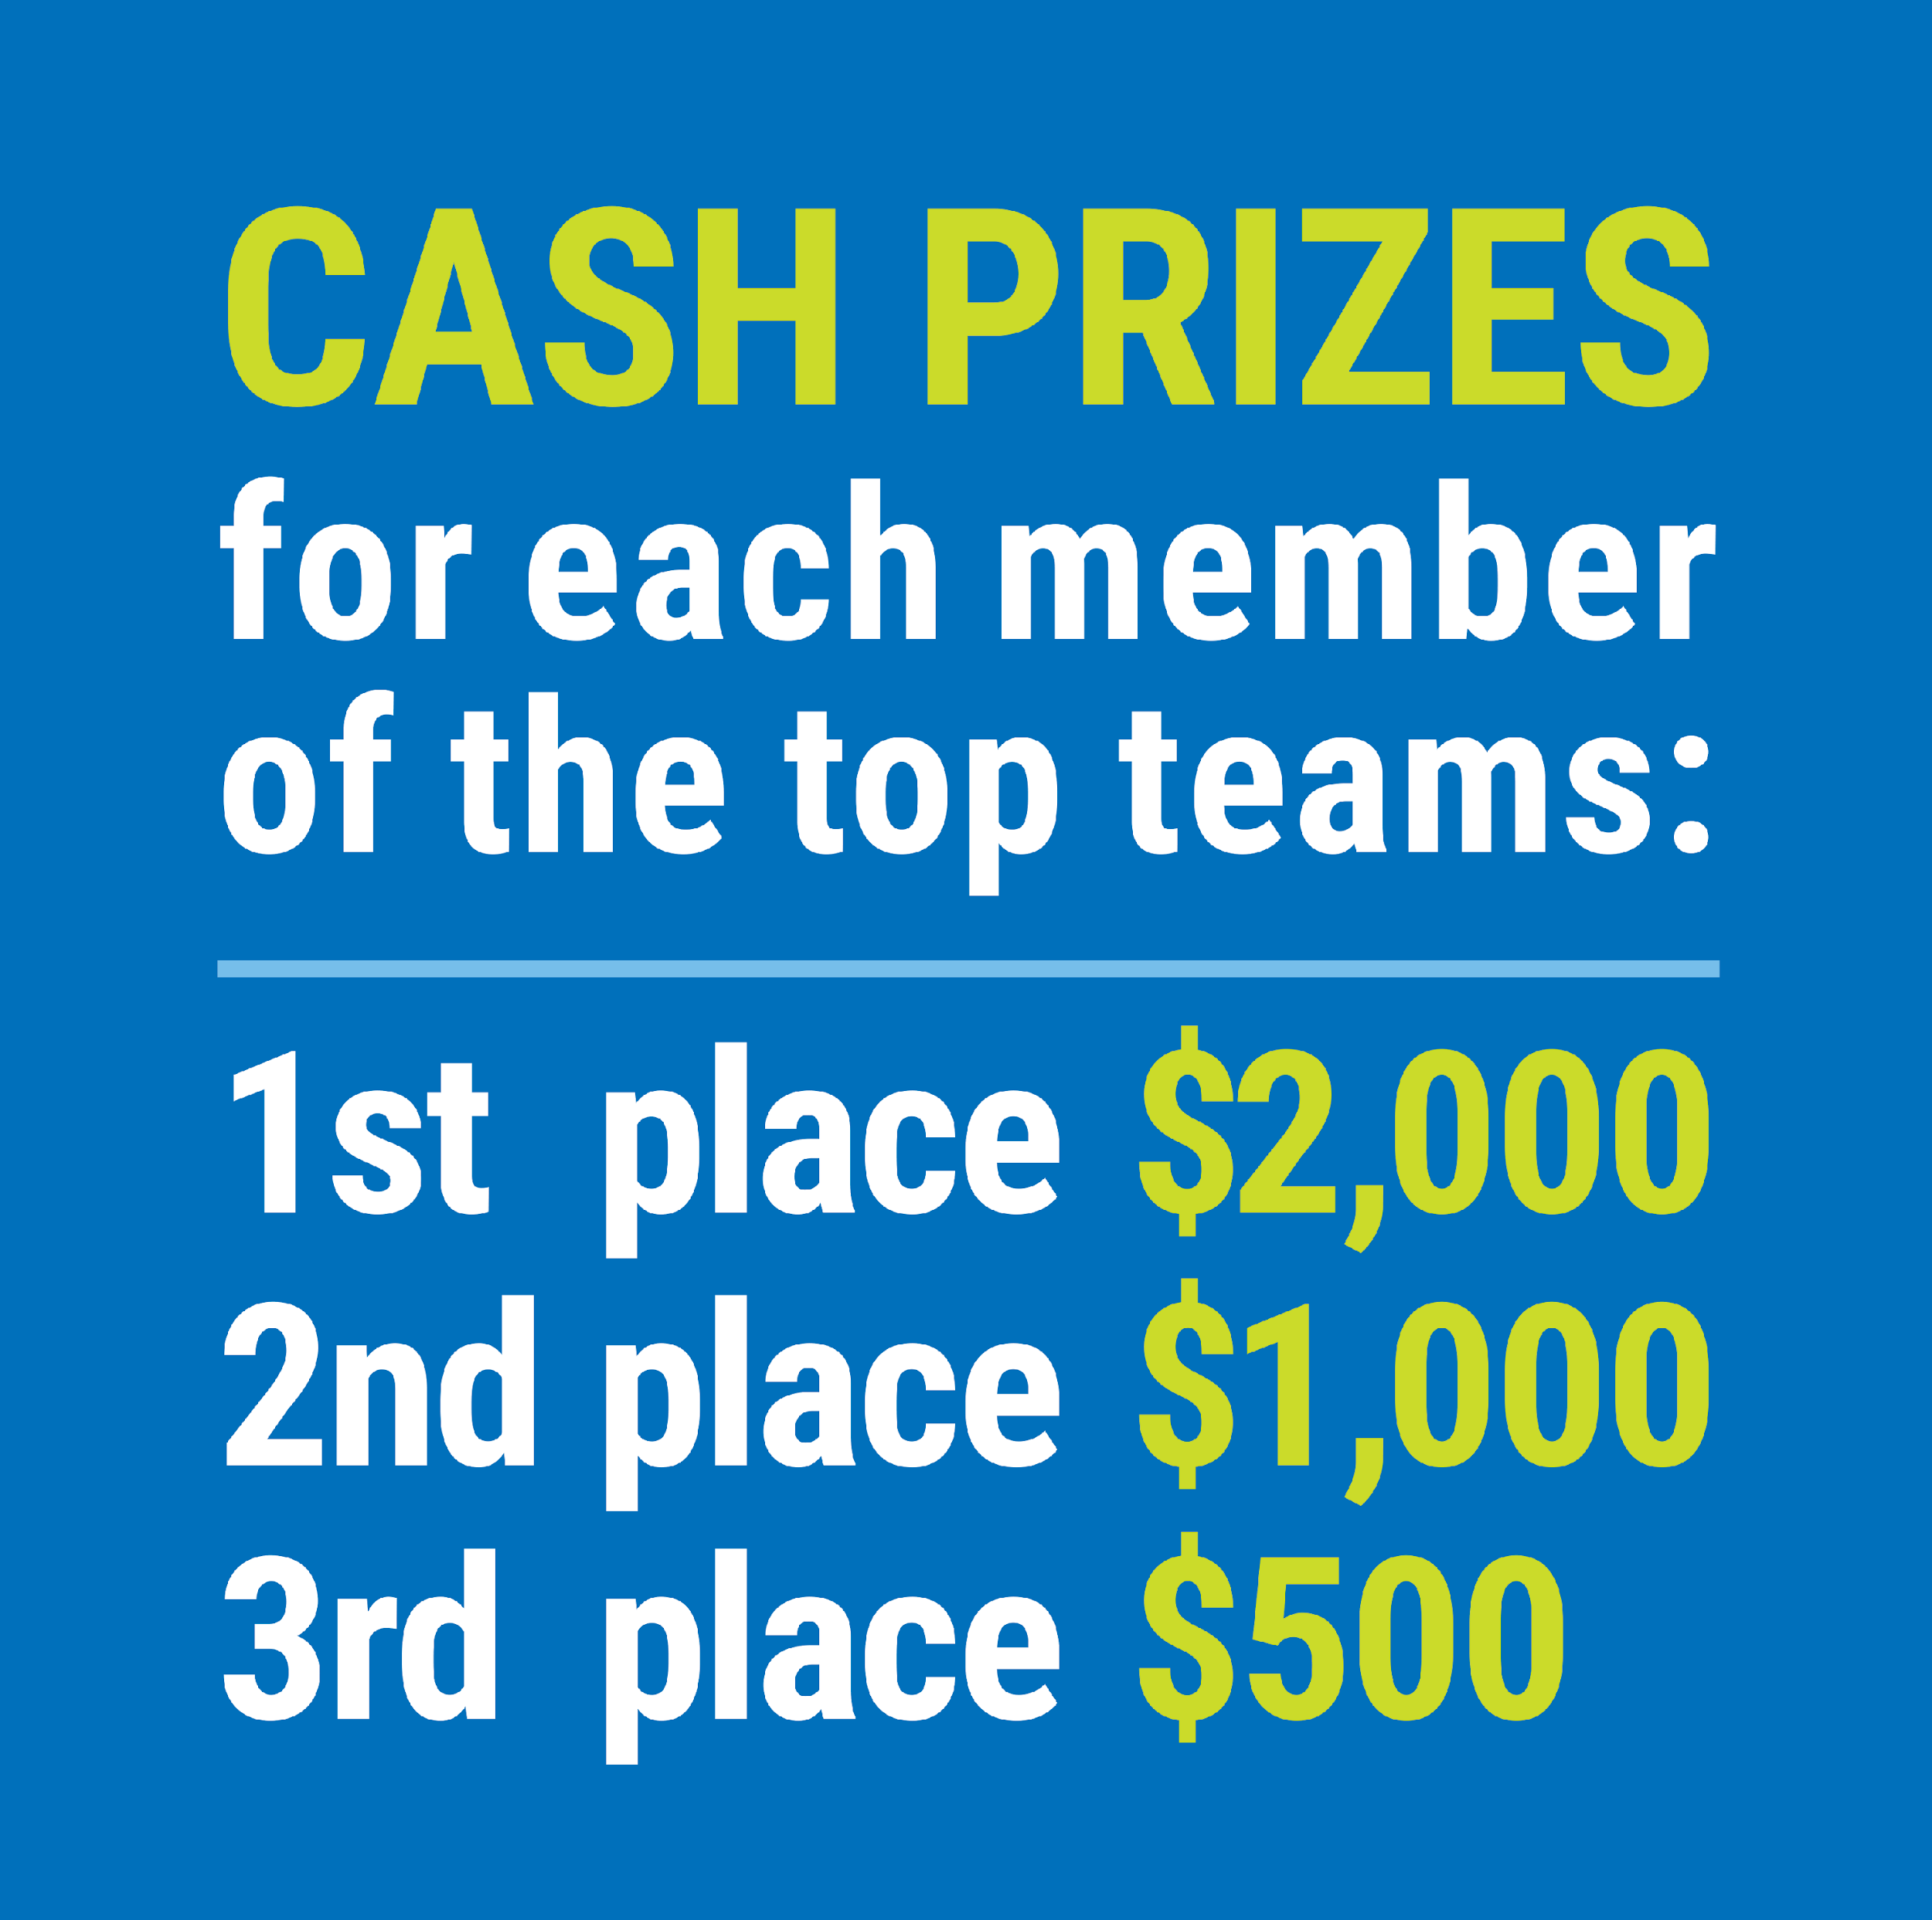

FIND YOUR LOCAL COMPETITION
AND REGISTER TODAY!
The National Personal Finance Challenge is a competition that provides high school students with an exciting and motivating opportunity to build, apply, and demonstrate their knowledge of money management.
Through online exams and a personal finance simulation, teams showcase their expertise in earning income, buying goods and services, saving, using credit, investing, as well as protecting and insuring.
Teams of up to four students, with one teacher/coach, can qualify to represent their state at the National Personal Finance Challenge by winning their local competition.
personalfinancechallenge.org
NATIONALS
Semi-Finals: First round elimination via online multiple-choice questions.
Finals: Case study round virtually co-hosted by the Cleveland Fed on June 3.

Slide 43
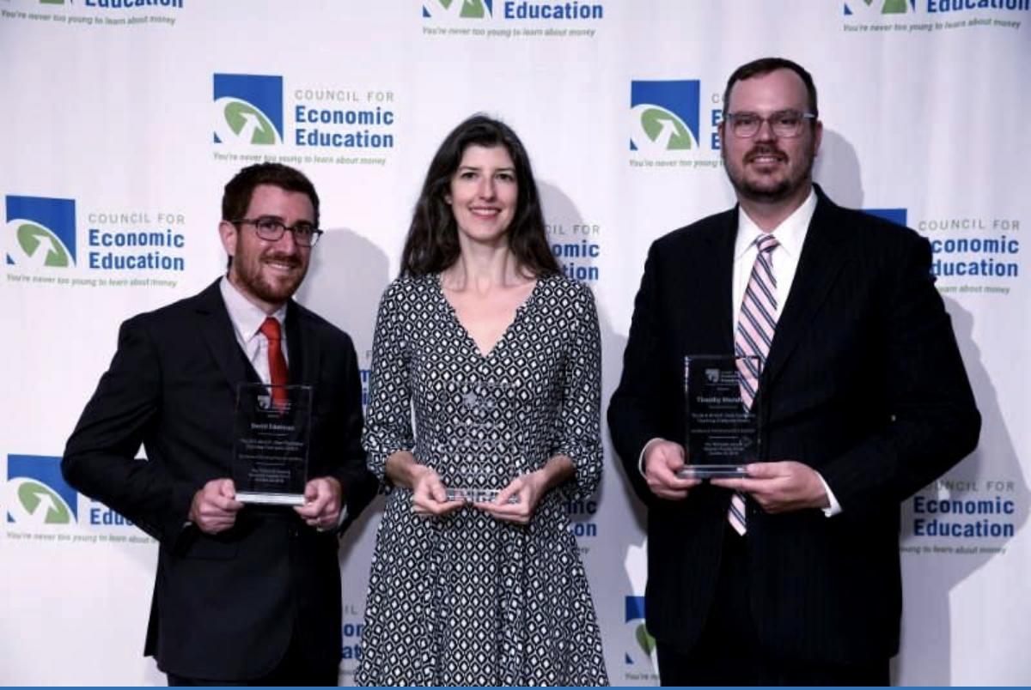
The 2021 Sloan Teaching Champion Award
Winners receive:
A cash award of $5,000
A cash award of $2,500 for their school to support economic education
Recognition at our annual Visionary Awards convening.
This award promotes economic education by honoring three outstanding teachers who incorporate exemplary teaching techniques that improve their students’ economic understanding in and out of the classroom.
This award is open to New York metropolitan area high school teachers of all subjects, not just teachers of economics. Applicants must demonstrate how they integrate economics into their teaching.
Sound like you or someone you know?
Applicants must teach in one of the
Twelve New York state counties (New York, Kings, Bronx, Richmond, Queens, Nassau, Suffolk, Westchester, Putnam, Rockland, Orange and Dutchess)
Eight New Jersey counties (Bergen, Passaic, Essex, Hudson, Middlesex, Union, Morris, Monmouth), or the
Two Connecticut counties (Fairfield and New Haven)
Application will be launched on Friday February 19th 2021
You can access the application here.
CONTACT
Please feel free to e-mail us at rrivera@councilforeconed.org
with any questions you have.

