Slide 1
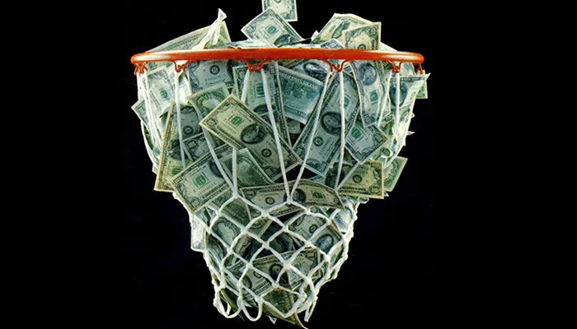
March Madness
The Economics of College Basketball
John Kruggel
Associate Director for Program
JMU Center for Economic Education
3/9/2021 kruggejb@jmu.edu

Slide 2
EconEdLink Membership
You can now access CEE’s professional development webinars directly on EconEdLink.org! To receive these new professional development benefits, become an EconEdLink member. As a member, you will now be able to:
Automatically receive a professional development certificate via e-mail within 24 hours after viewing any webinar for a minimum of 45 minutes
Register for upcoming webinars with a simple one-click process
Easily download presentations, lesson plan materials and activities for each webinar
Search and view all webinars at your convenience
Save webinars to your EconEdLink dashboard for easy access to the event
You may access our new Professional Development page here

Slide 3

CEE Affiliates
https://www.councilforeconed.org/resources/local-affiliates/

Slide 4
Agenda
Where Sports and Econ Meet
How does the NCAA earn revenue?
Impact of COVID on revenue?
Shoe money origins and evolution
To go “Pro” or not go Pro?
Bracketology and asymmetric information
Future of NCAA basketball?

Slide 5
Objectives
I Can:
Identify how the NCAA earns revenue and where that revenue goes.
Use the decision-making model to explore if student-athletes should play college basketball.
Discuss the role asymmetric information plays in March Madness.

Slide 6
National Standards
Standard 2: Decision Making:
Effective decision making requires comparing the additional costs of alternatives with the additional benefits. Many choices involve doing a little more or a little less of something: few choices are “all or nothing” decisions.
Standard 4: Incentives:
People usually respond predictably to positive and negative incentives.

Slide 7
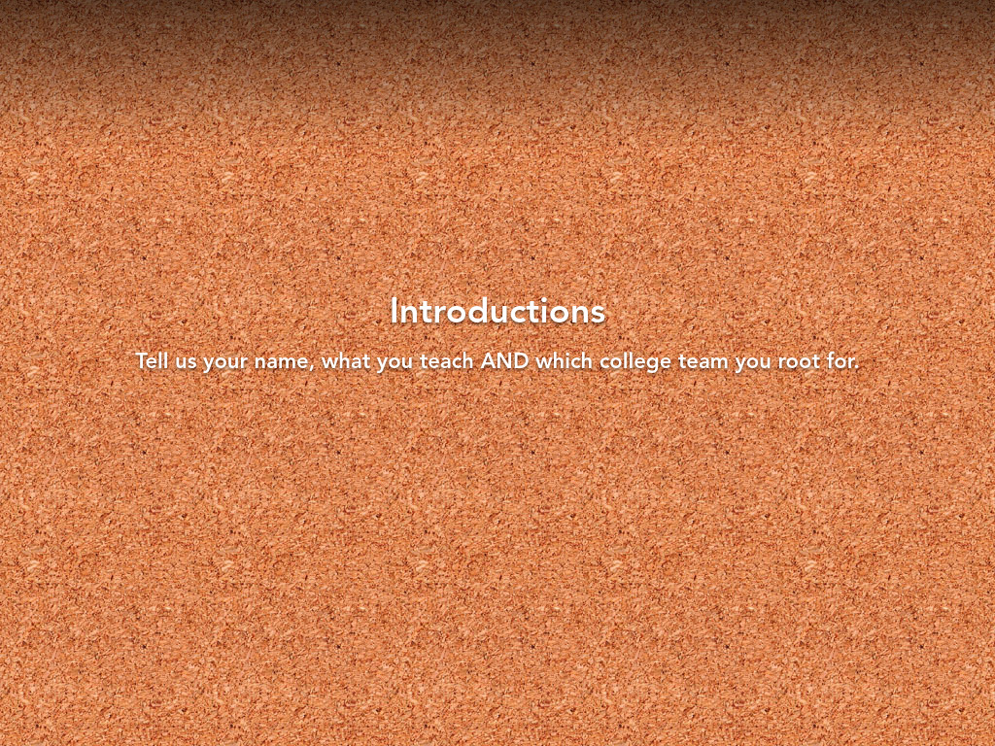
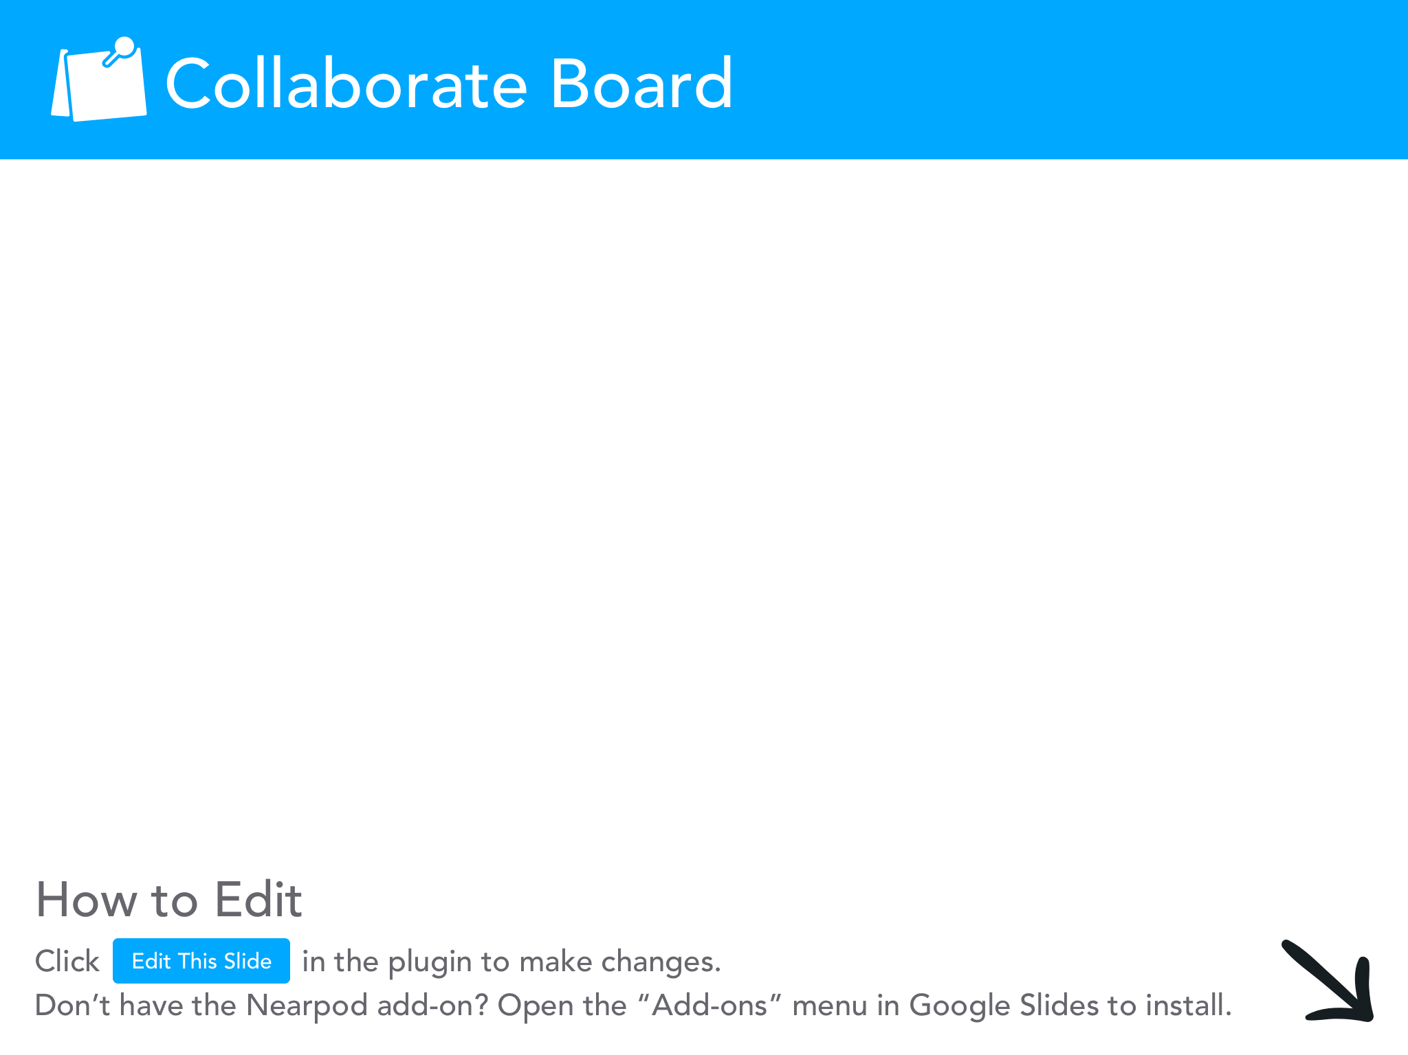

Slide 8
Where Sports & Economics Meet
How many TV shows/radio stations/newspaper columns/websites/social media sites are dedicated to sports?
How many shows are dedicated to Walmart or Pepsi?
“According to Forbes.com, the total revenues generated by the four largest North American sports leagues (basketball, baseball, football and hockey) totaled about $32.15B in 2017, which would rank 89th among the Fortune 500 list of largest revenue-generating companies.” --Leeds et al pg. 4
This is 1/16th of Walmart’s revenue and ½ of PepsiCo
Entire industries are built around sports (management, advertising, communications, etc.) BECAUSE SPORTS GETS PEOPLE’S ATTENTION.

Slide 9
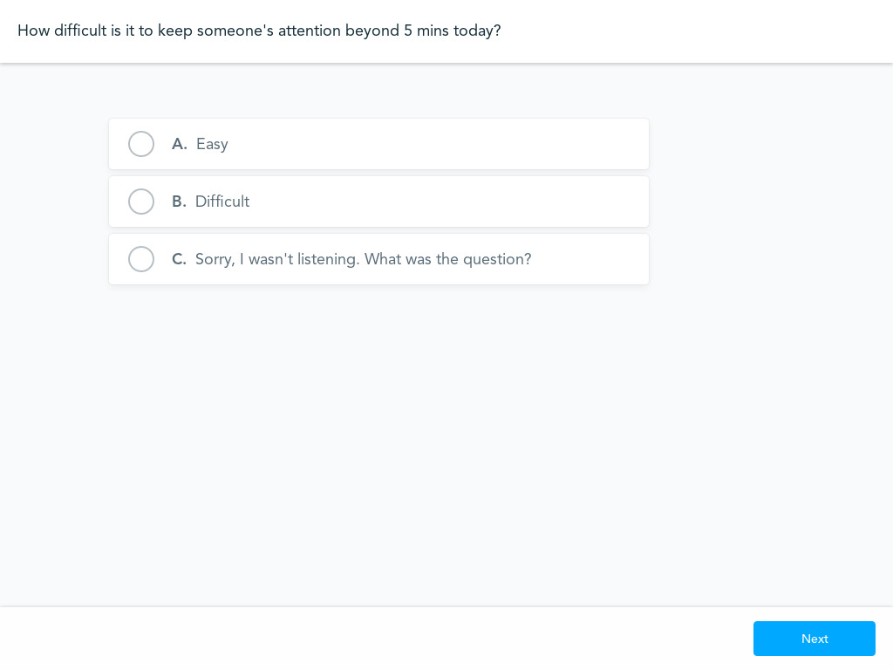
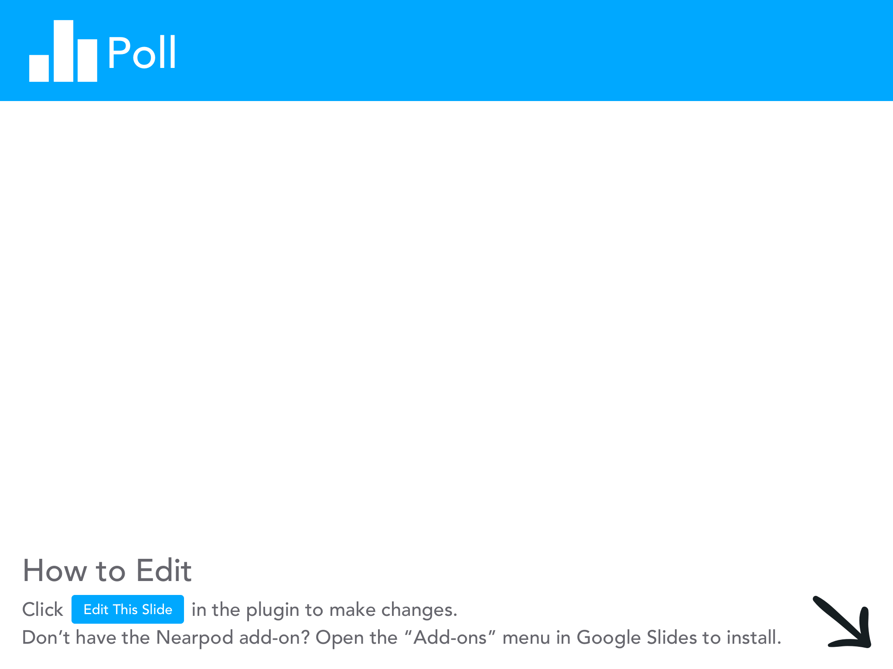

Slide 10
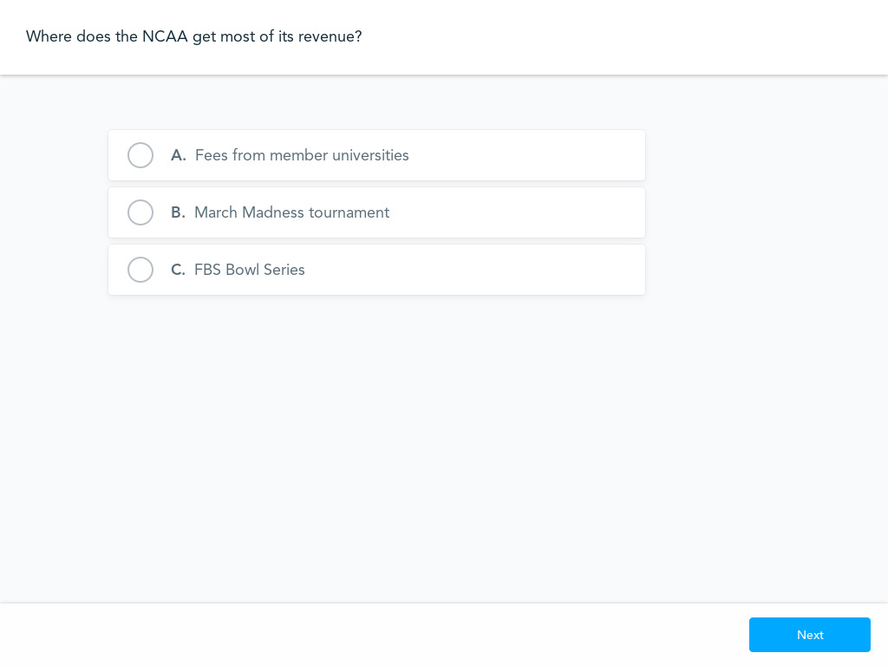

Slide 11
NCAA Revenue
The NCAA reported a revenue of $1.1B for 2017 (It’s a non-profit organization).
The NCAA gets most of its revenue from the NCAA basketball tournament.
  Television rights earned the NCAA $821.4M and ticket sales brought in another ~$130M.
The NCAA gets NO MONEY from the College Football Playoffs, that money goes directly to the conferences.
Also, many conferences have created their own TV networks and arrangements with networks for the majority of their games.

Slide 12
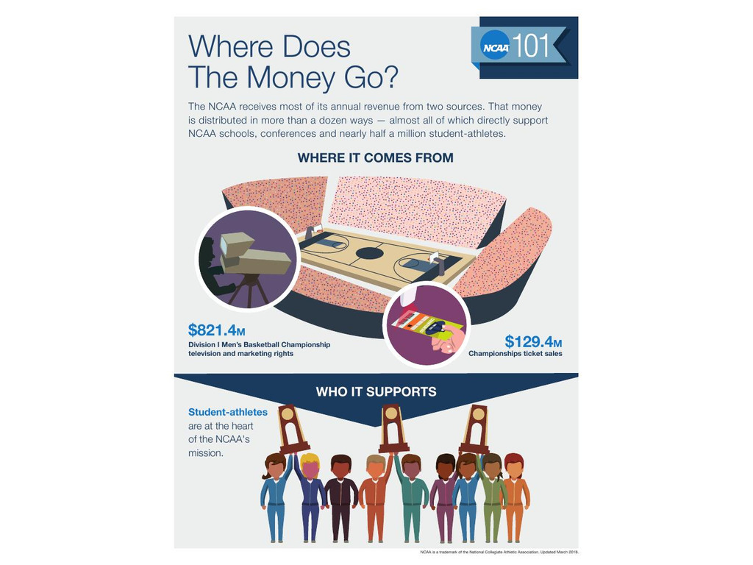
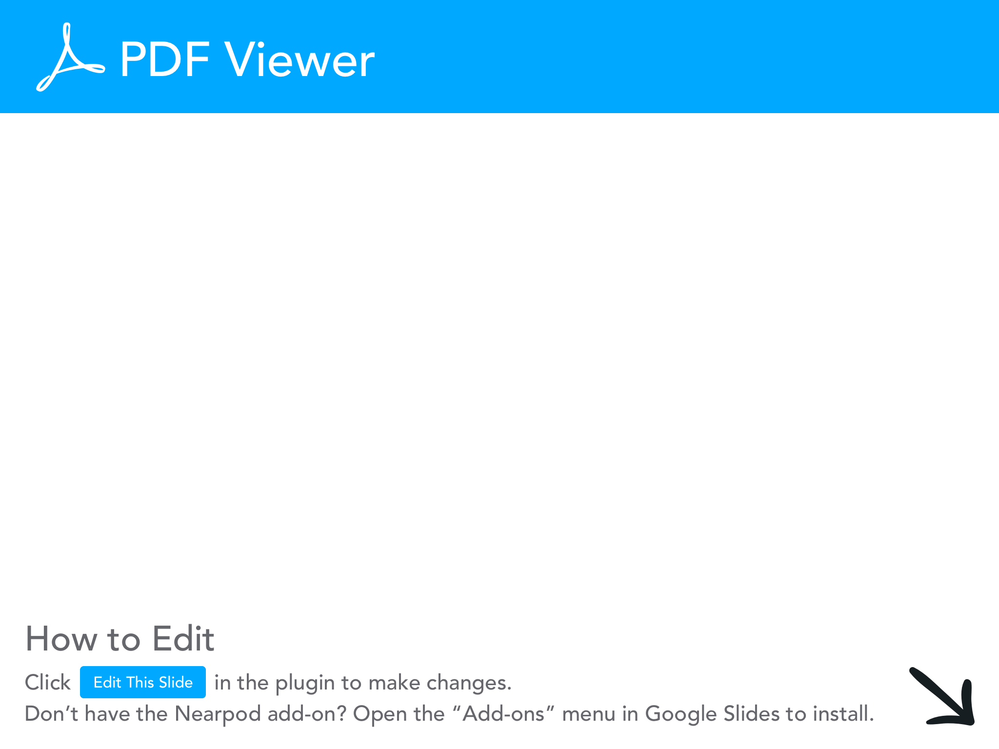

Slide 13
Basketball Fund
In 1990, the NCAA created the “basketball fund” to help fairly divide up its revenue from the basketball tournament.
Conferences get a share of the revenue (roughly 40% depending on the year).
That cut depends on how far teams from that conference go in the tournament.
  The cut grows the more frequently you get into the tournament over a 6 year period.
This has created a lopsided payout for the bigger conferences.
It also creates a huge incentive for smaller conferences to get teams into the tournament.

Slide 14
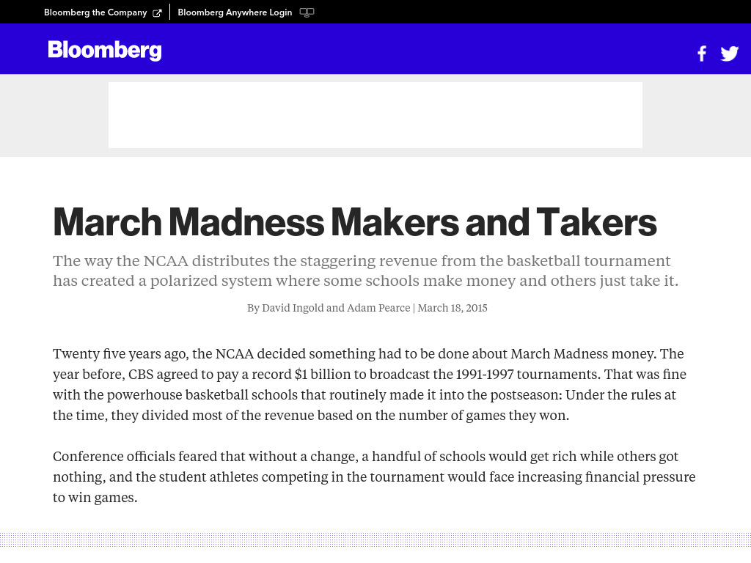
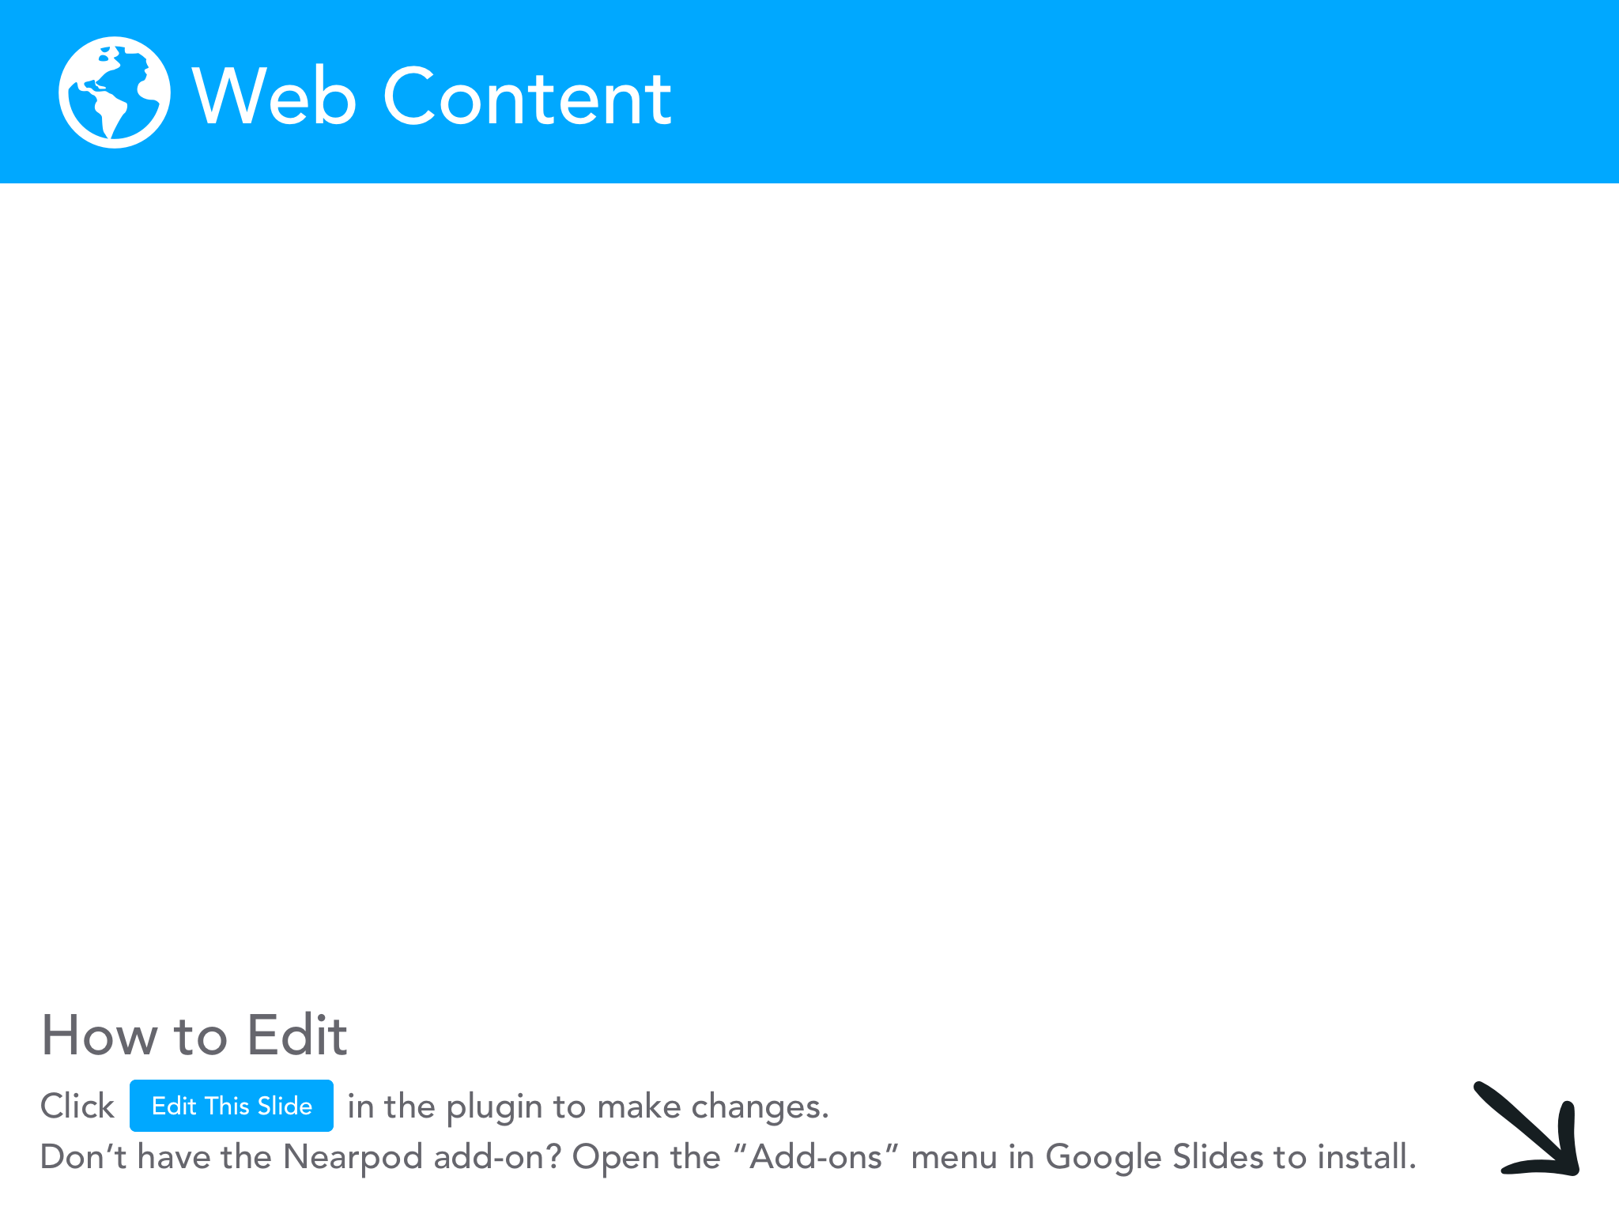

Slide 15
Impact of COVID
According to the USA Today, revenue for the NCAA fell 50% in 2020 due to cancelling the 2020 March Madness tournament.
They lost $700M in TV revenue.
Add in ticket revenue, they lost close to $800M.
They covered $270M in insurance claims.
So, how do they plan to offset their losses?

Slide 16
Indiana Tournament
This week’s Selection Sunday will look different.
The “regions” will all be in the state of Indiana in an effort to create a type of a bubble for the tournament.
  Sites will include: Purdue (Mackey), IU (Assembly Hall), Butler (Hinkle), Bankers Life Fieldhouse, Lucas Oil Stadium and a few other sites (Ball State, ISU, IUPUI, etc.)
Why Indiana?
  History?
  Home of the NCAA?

Slide 17
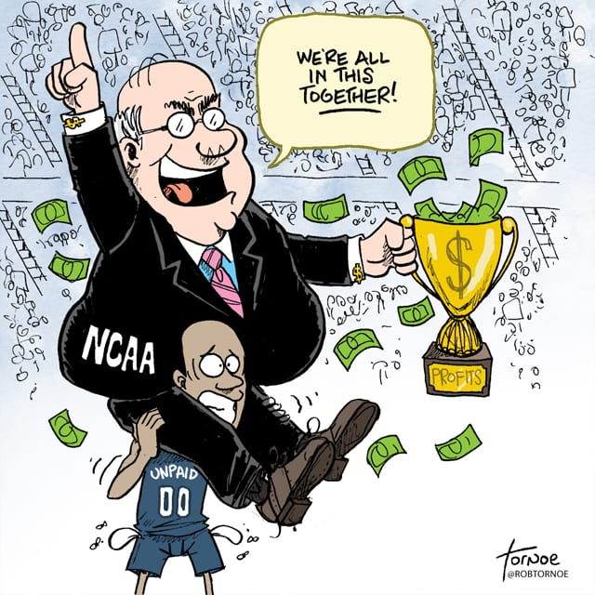
When Money Meets Academics
Next up: What role has money played in college basketball outside of the NCAA Tournaments?

Slide 18
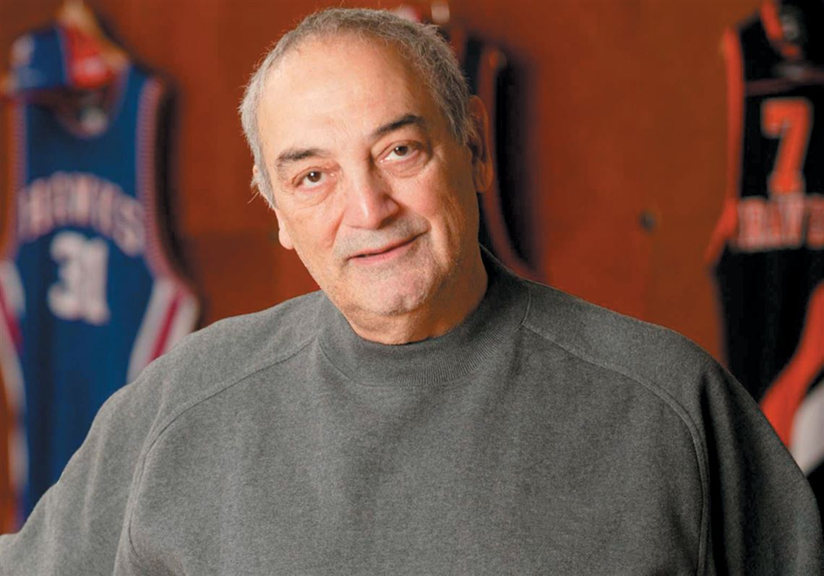
Sonny Vaccaro
Sonny Vaccaro started working at Nike Shoes in 1977.
He started by designing a basketball shoe for the then running shoe company.
He quickly evolved his position and created the idea of paying college coaches in exchange for their athletes wearing Nikes.
Universities quickly took
this money and the NCAA
created rules preventing
coaches and players from
getting paid.

Slide 19
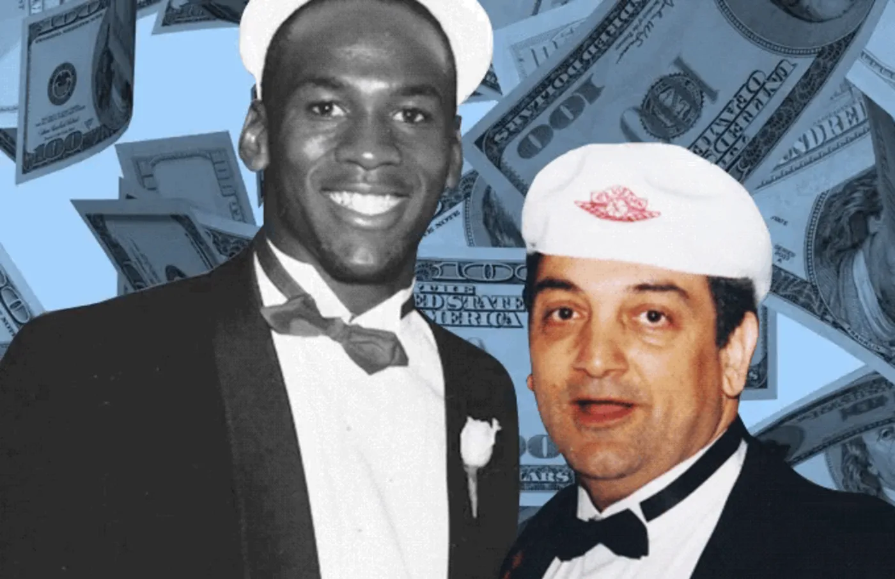
Air Jordan
In 1984, he insisted that Nike offer Michael Jordan a shoe contract.
MJ preferred Adidas and most people expected the then rookie to sign with them.
Nike offered $250,000 (its ENTIRE endorsement budget for the YEAR).
The offer was HALF of what Adidas offered, but it had 2 key provisions.

Slide 20
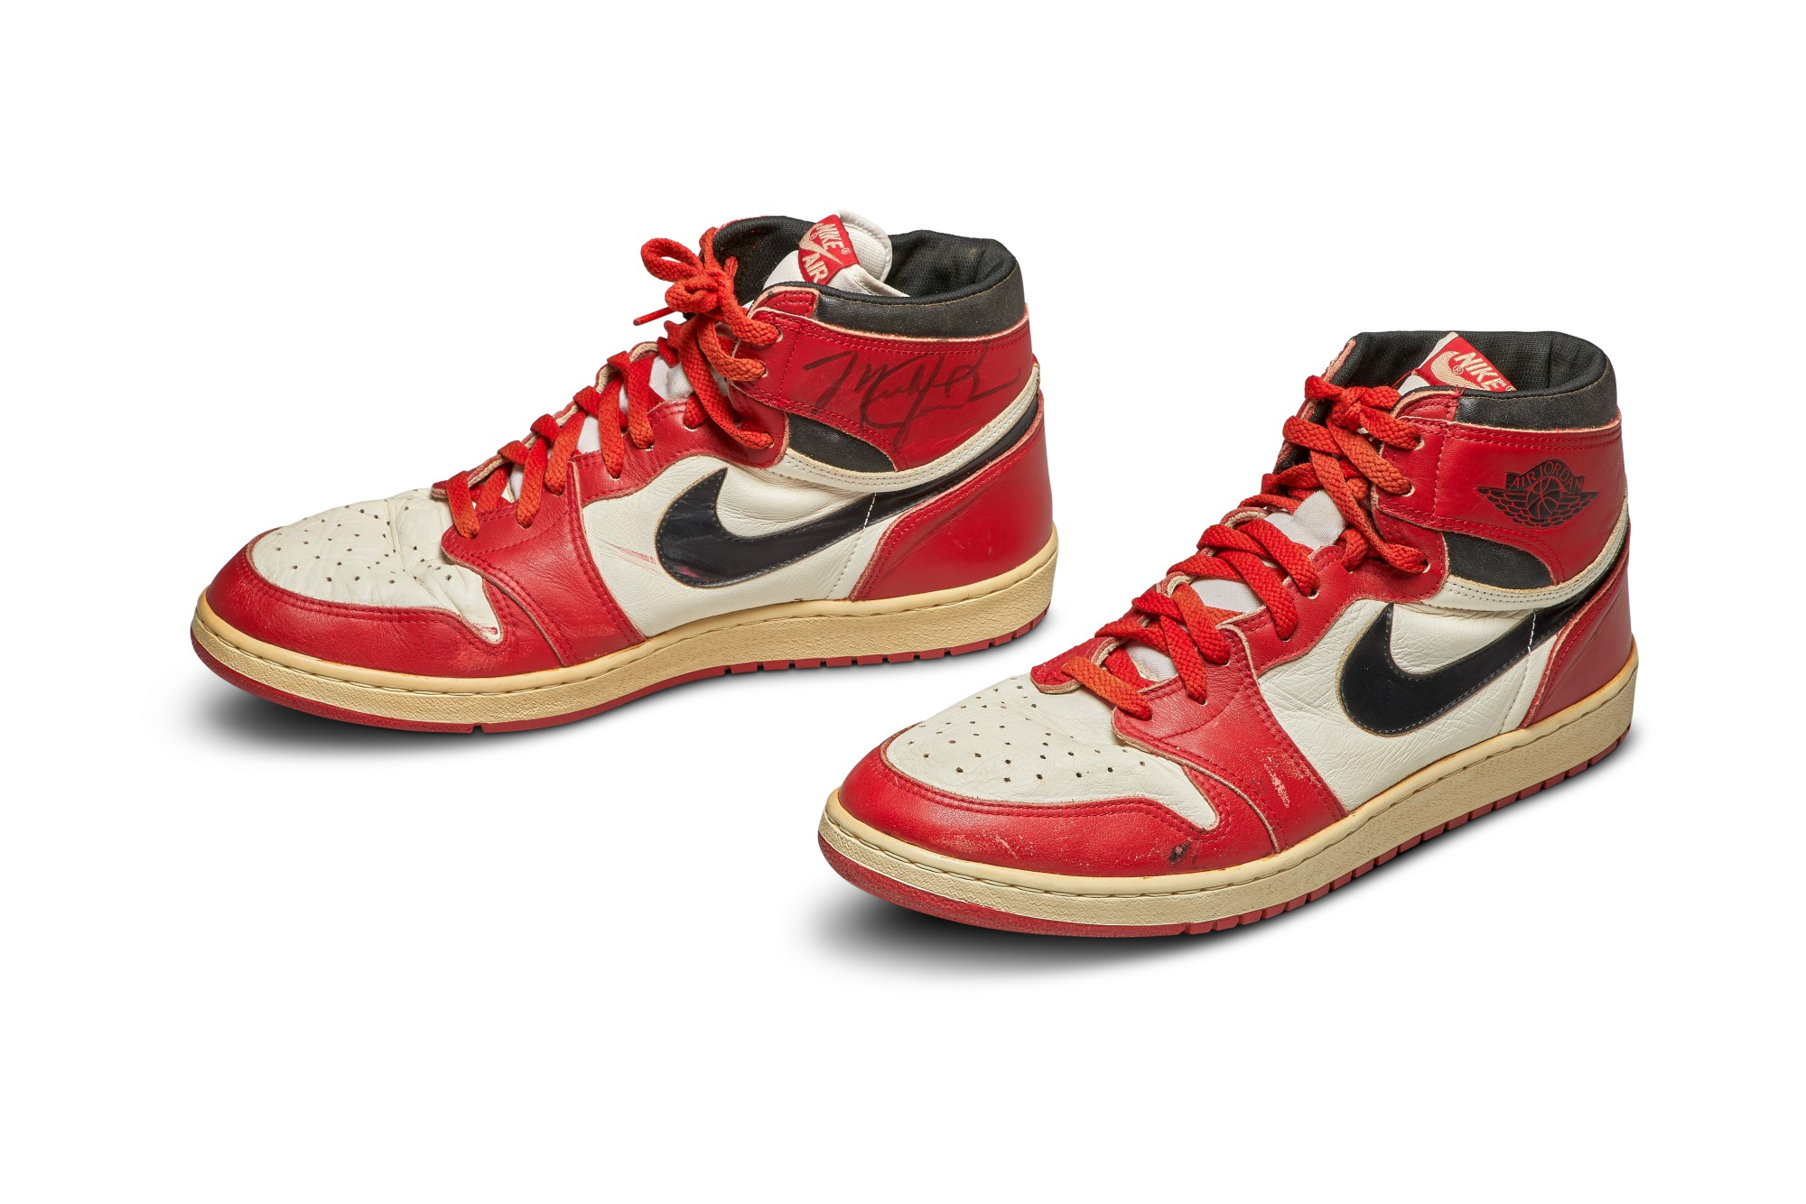
Air Jordan 1’s
A percentage of future sales.
A chance to opt out of the deal after 3 years IF sales did not reach $3M
Sales quickly reached $130M
Vaccaro would help Ed O’Bannon’s case later

Slide 21
Evolution of Pay
Shoe companies quickly saw the success of Nike’s partnership with Jordan and wanted to replicate it.
In the 2000s they began to partner with AAU teams to sponsor their young talent hoping to build brand loyalty.
Companies would sponsor AAU talent and in exchange that player would agree to attend a university who has a partnership with that shoe brand.
In 2017, the FBI began to investigate this practice for fraud, bribery, and corruption.

Slide 22
Results?
Many thought this investigation would destroy NCAA basketball and that many successful programs would be brought down because of this.
As of January 2021, not many punishments were handed down.
Oklahoma State was the only program penalized (so far).
Several individuals were punished, but most took plea deals.
Other programs fired coaches (most notably Rick Pitino from Louisville). Pitino is currently coaching at Iona...
Auburn imposed a postseason ban on itself hoping to avoid further issues.

Slide 23
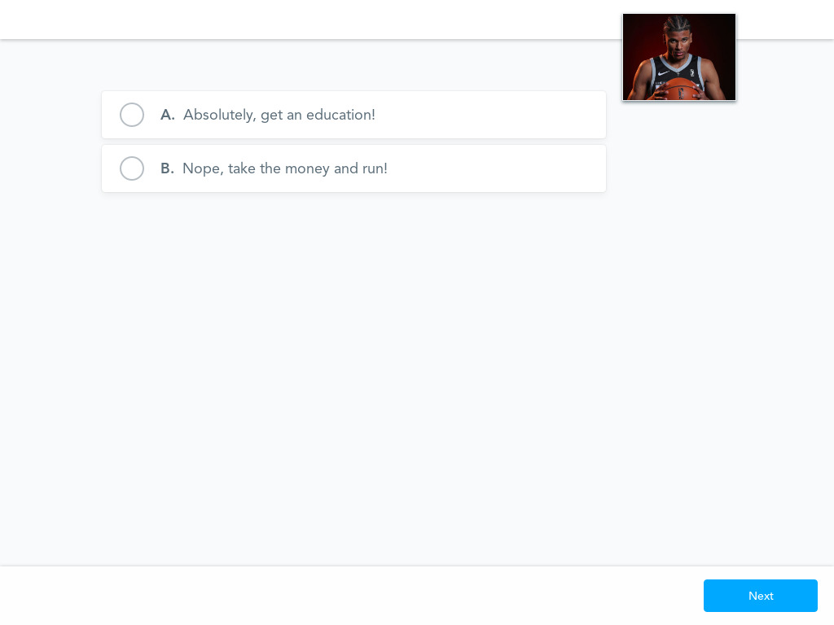

Slide 24
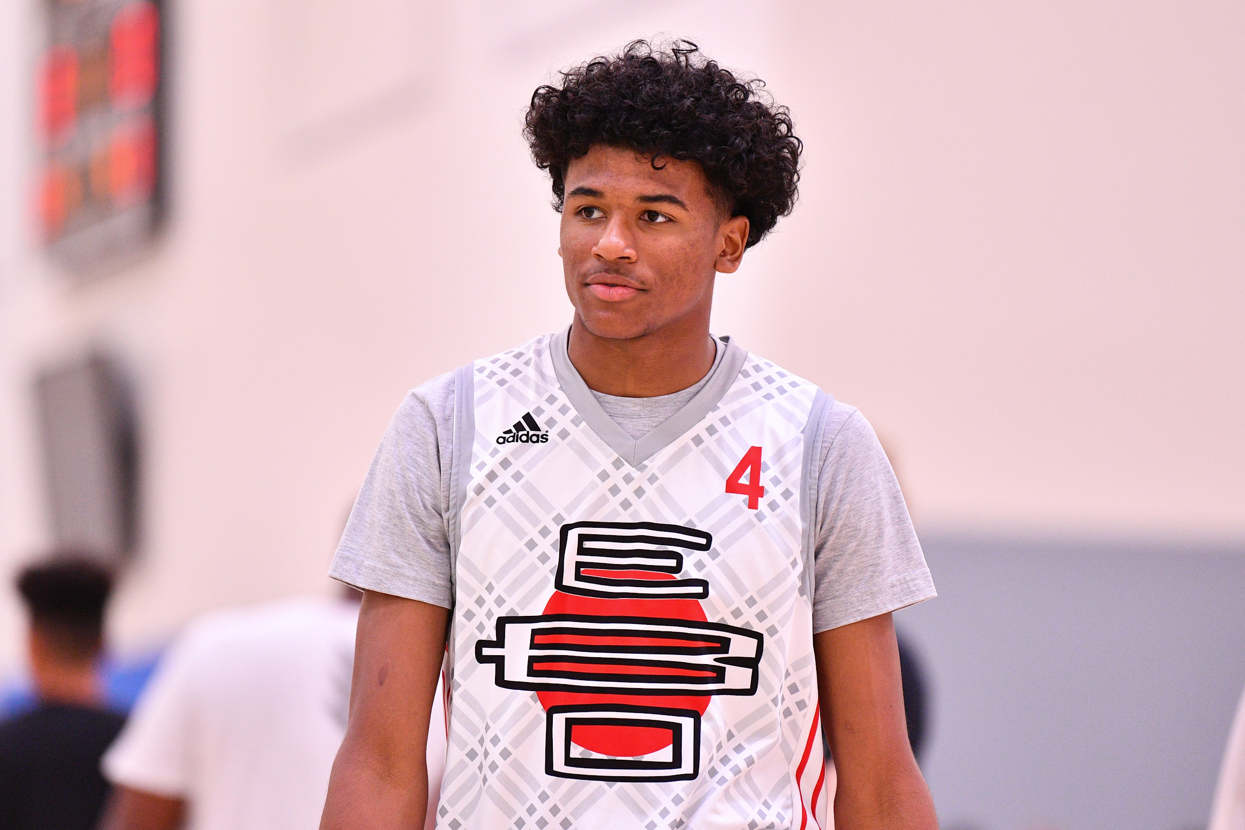
Decision-Making
Should a talented AAU player go to the NCAA after high school?
What options do they have?
Let’s look at Jalen Green…

Slide 25
Jalen Green
Jalen was the #1 recruit in the 2020 class.
He is a 5 star recruit, McDonald’s All-American.
He played for the USA Basketball Men’s Junior National Team.
He earned gold medals at BOTH the FIBA Under-19 and the 2017 FIBA Americas Under-16 Championship.
He was named the MVP of the 2018 FIBA Under-17 Basketball World Cup in Argentina.

Slide 26
PACED Model
The PACED Model is a great tool for decision-making.
Identify a Problem
Brainstorm Alternatives to the problem
Use Criteria to judge the alternatives
Evaluate the solution
Decide

Slide 27
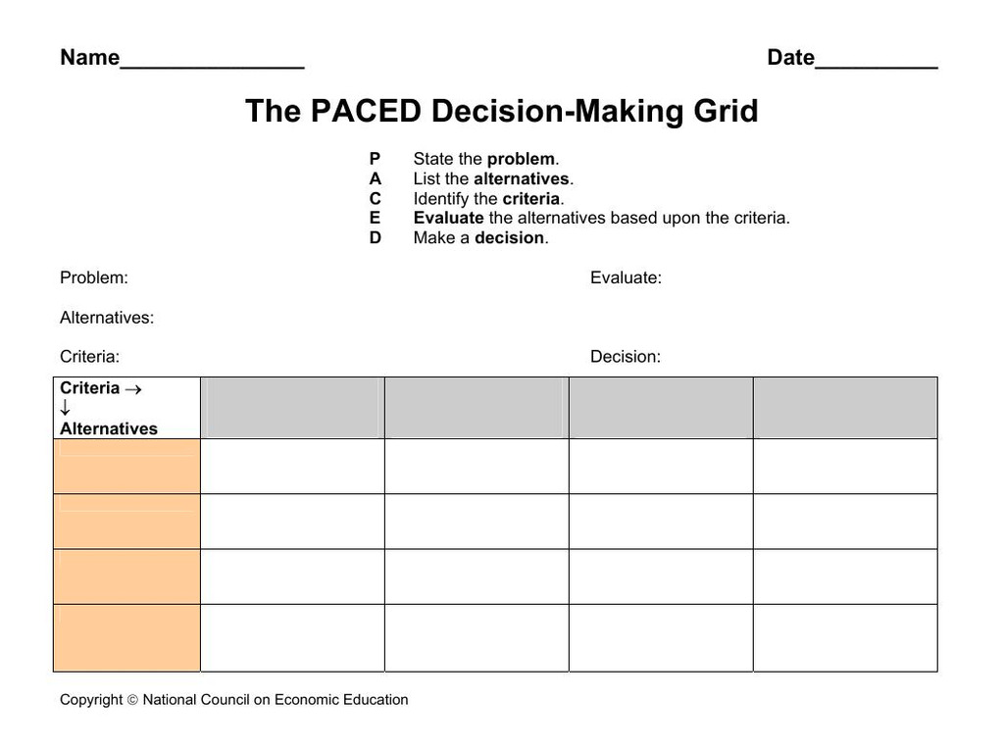

Slide 28
Jalen’s Model
Problem: Should Jalen Green play in the NCAA?
Alternatives: Does he have any?
NCAA
Europe
NBA “G League” (now paying athletes $7,000-$25,000/month, one team now pays up to $500,000)
Criteria: What should Jalen consider with each alternative?
Evaluate:
Decide: What did he do?

Slide 29
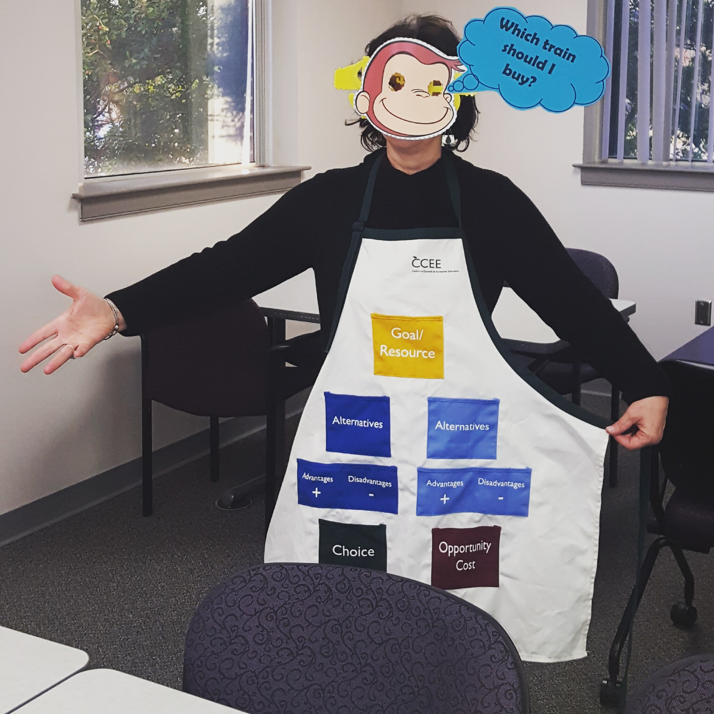
Alternative to Graphic Organizer/Matrix
A decision-making apron is a more hands on version of the typical PACED matrix.
The Arkansas Council on Economic Education has a great lesson that includes an image you can use to make one.

Slide 30
Which Team Gets Jalen?
In order to maintain a sense of parity, the NBA created a separate non-team affiliated team for the new talent coming straight in from high school.
Several top recruits coming out of high school decommitted from their NCAA programs to join the G League.
ALL of them will play for the same non-team affiliated G League team Team Ignite. All of them were 5 star recruits.
  Daishen Nix, Isaiah Todd, Jonathan Kuminga, (Kai Sotto was supposed to play)

Slide 31
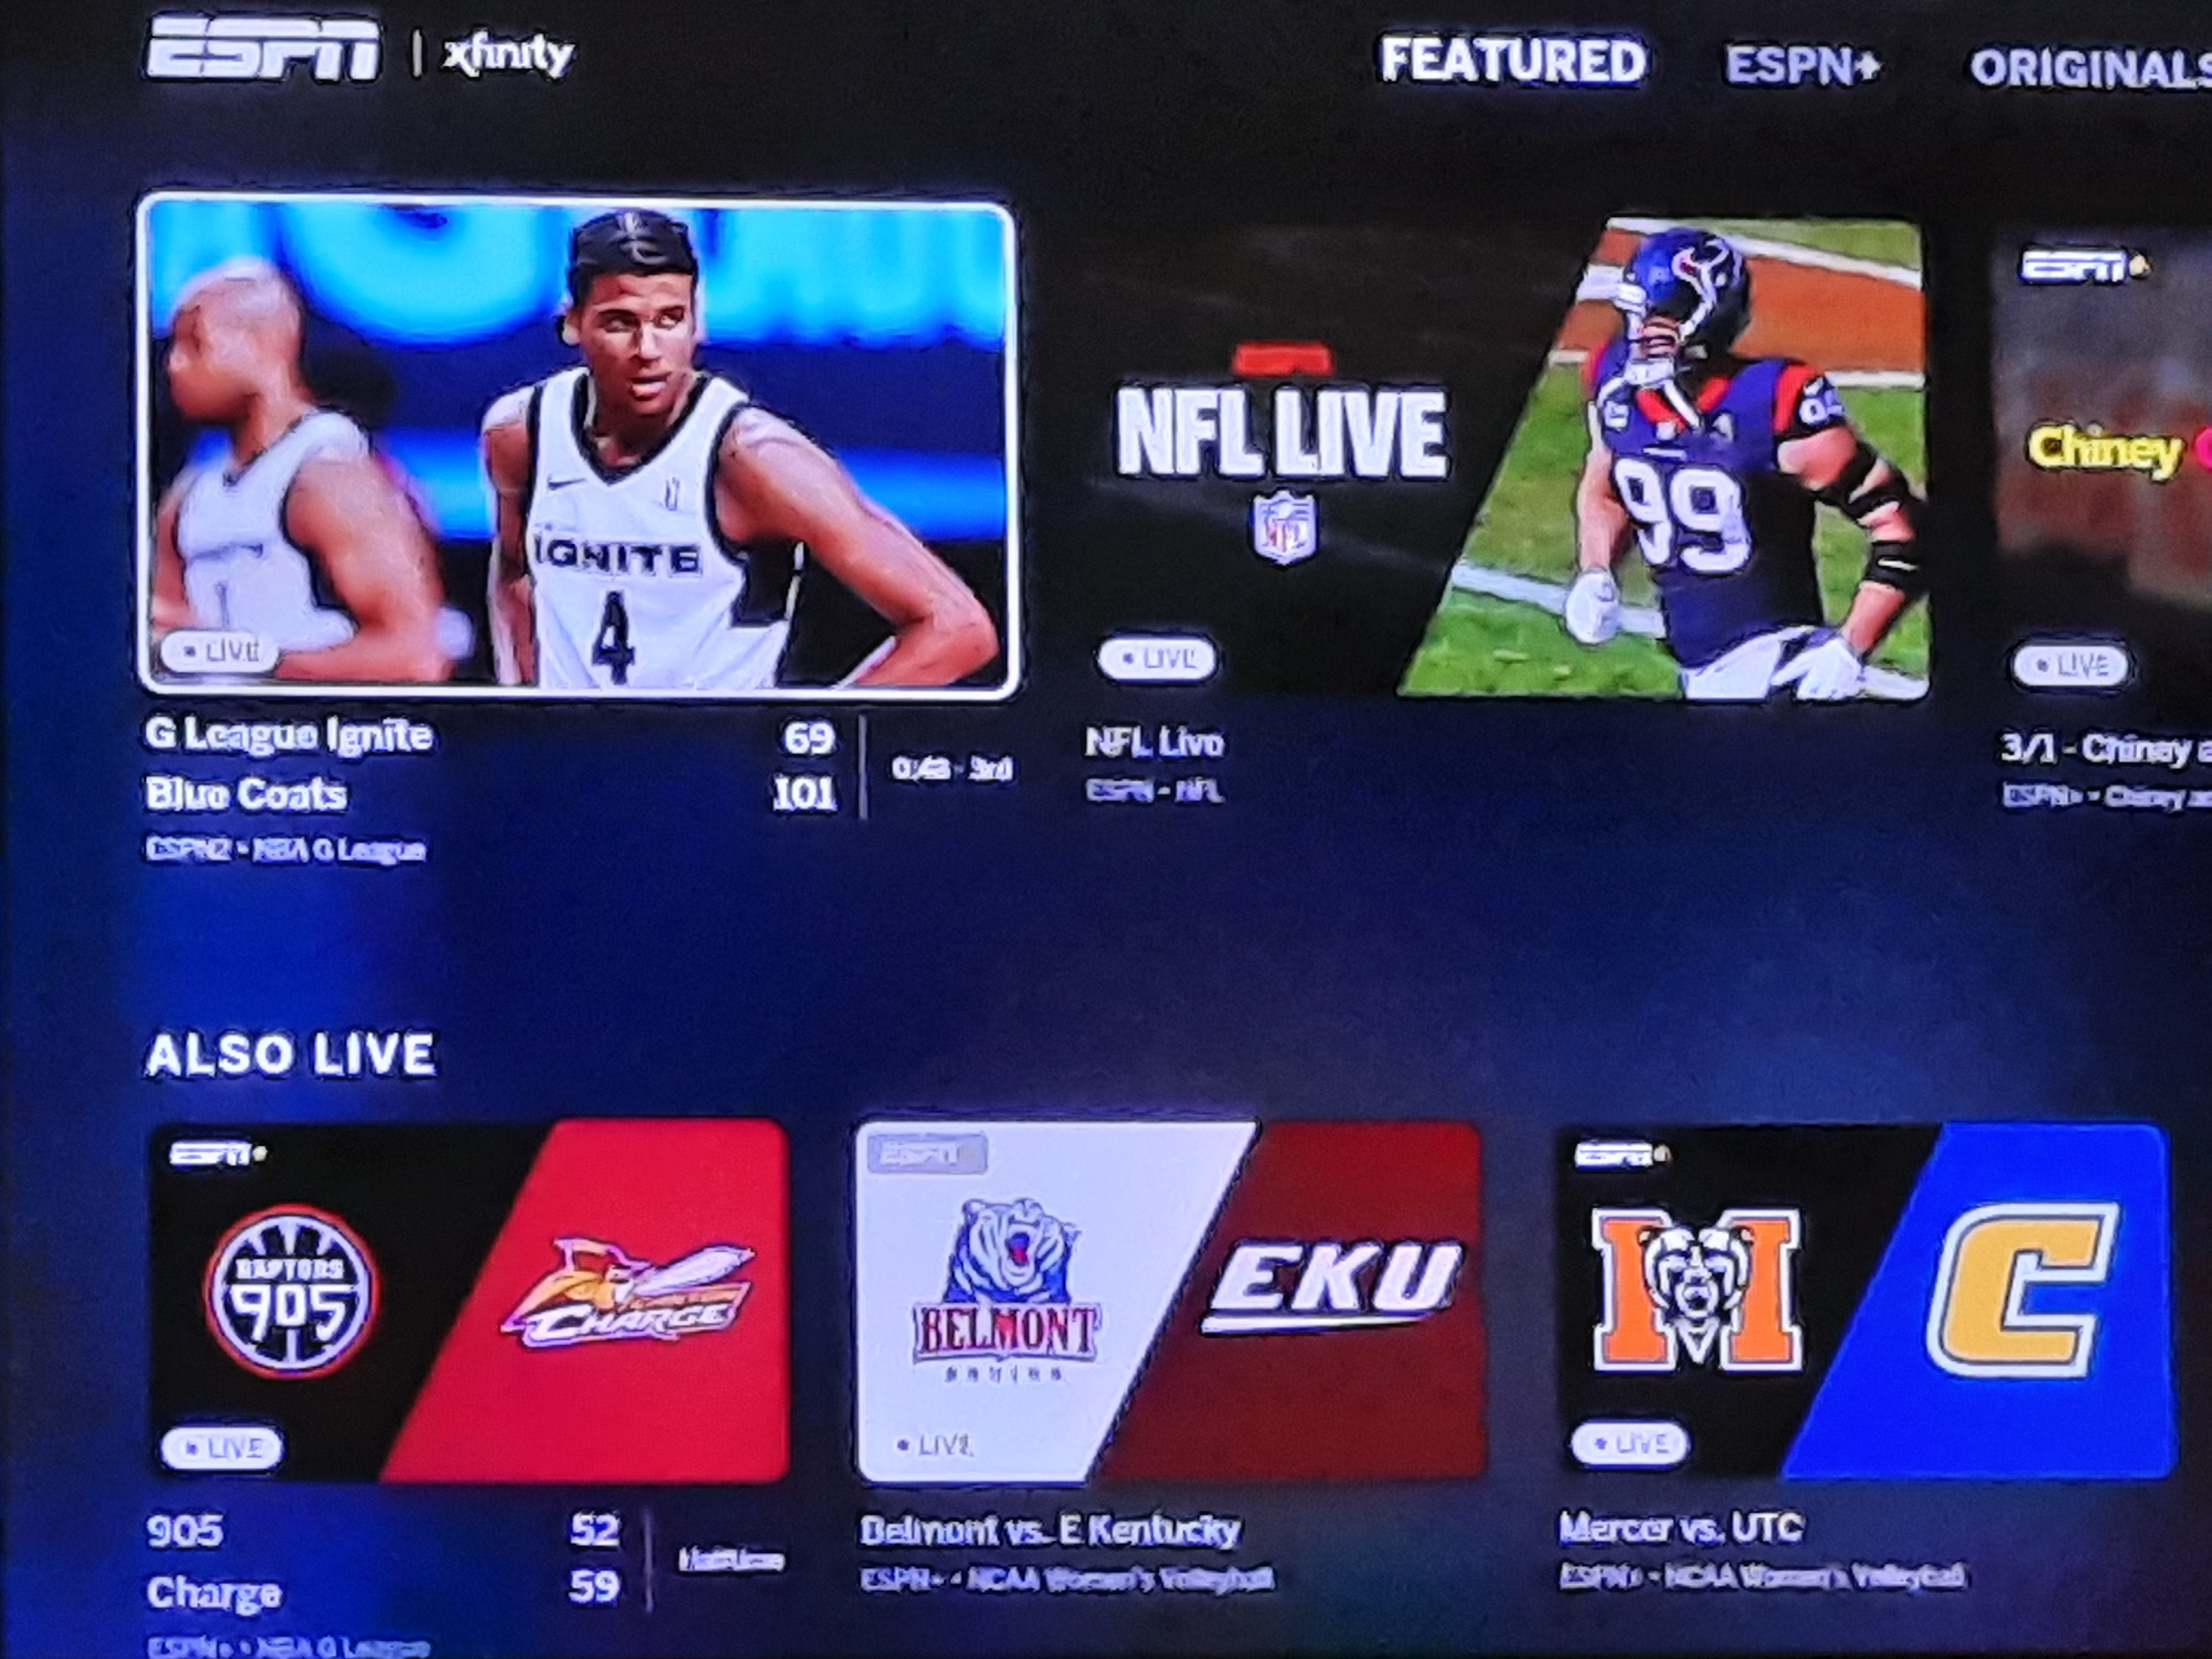

Slide 32
Overtime Elite
The next evolution of IMG Academy is Overtime Elite…
Like IMG, Overtime will offer an academic curriculum.
Unlike IMG, they will focus on basketball.
Like IMG, Overtime will compete against prep schools.
Unlike IMG, Overtime will pay their athletes a minimum of $100,000 (toward college tuition IF they don’t make it to the NBA).
Additional bonuses and compensation will include equity in the company, NIL opportunities and more.
This very new concept will be open for players 16-18 yrs old.

Slide 33
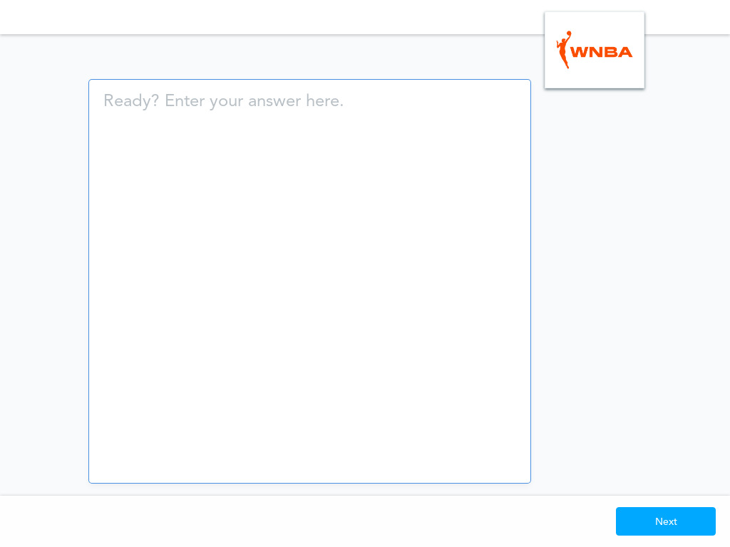
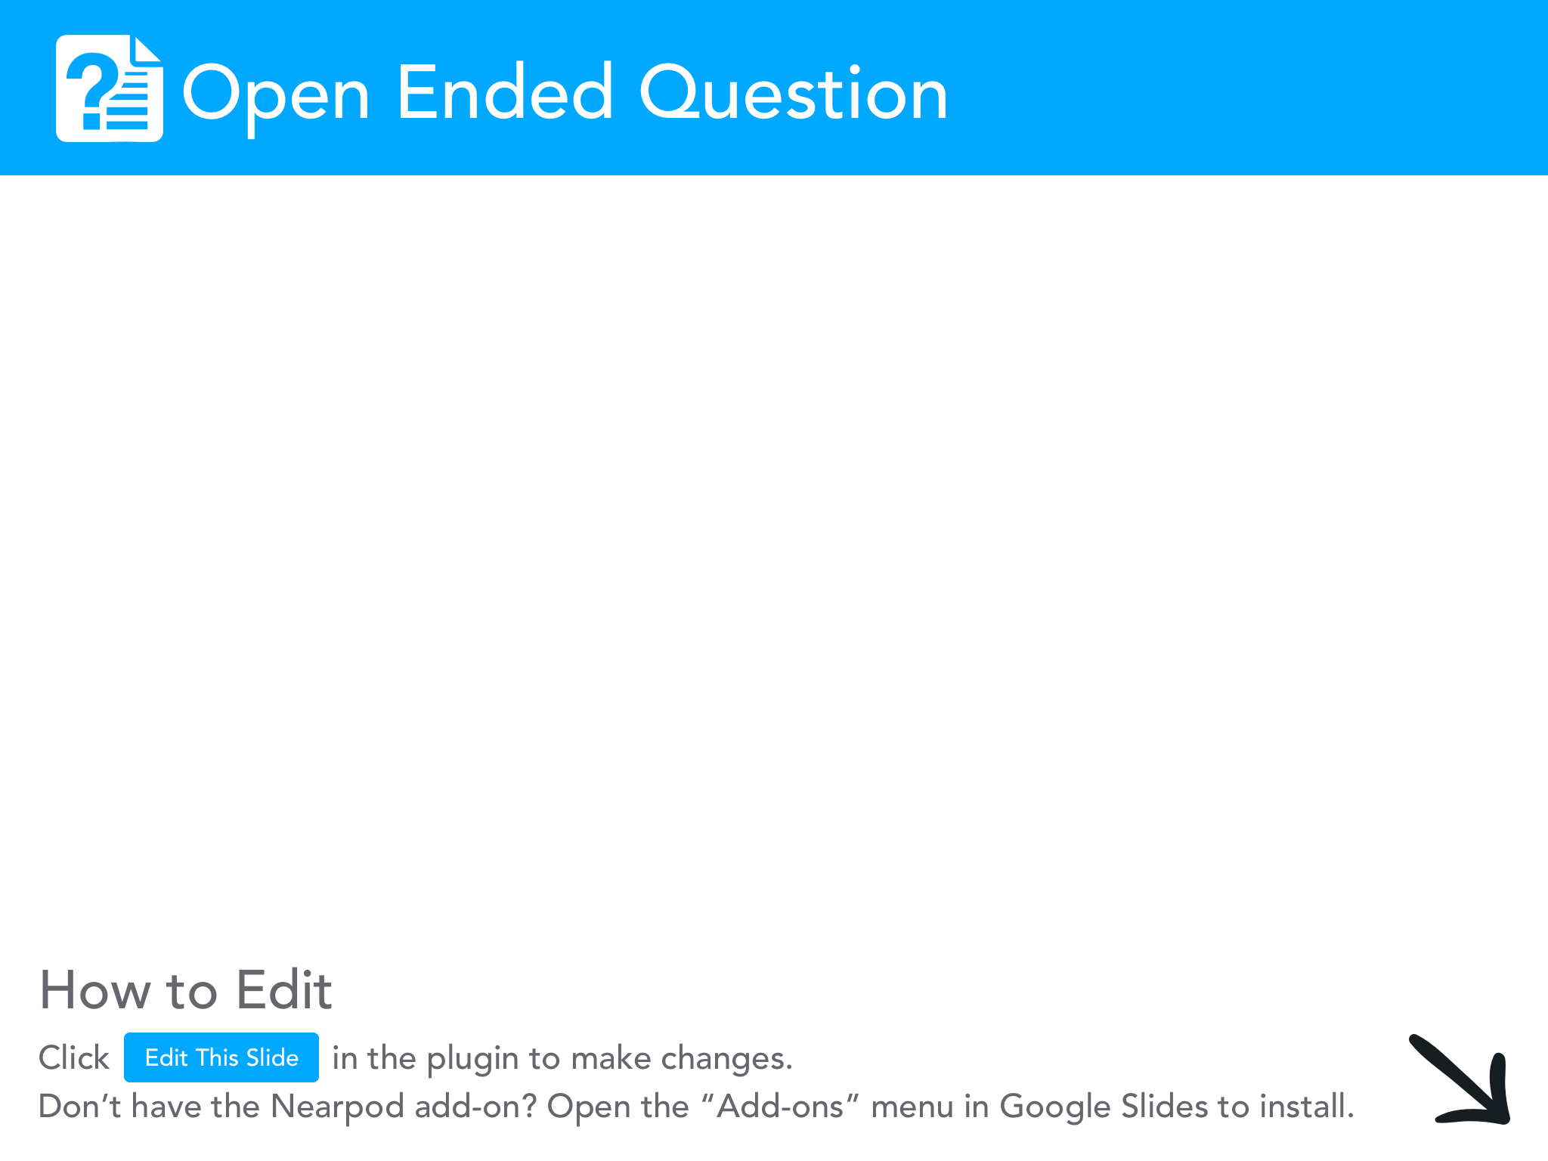

Slide 34
WNBA
The average WNBA salary for 2020 was $100,658.61.
In 2019, the average was $74,349.14
Minimum NBA salary for 2020 was $815,615!
Highest WNBA contract is set at $215,000 (could earn up to $500,000 with revenue sharing deal).
What impact do you think this wage discrepancy has on participation rates for the WNBA?
https://www.stlouisfed.org/~/media/Education/Lessons/pdf/Barbie-in-the-Labor-Force.pdf?la=en

Slide 35
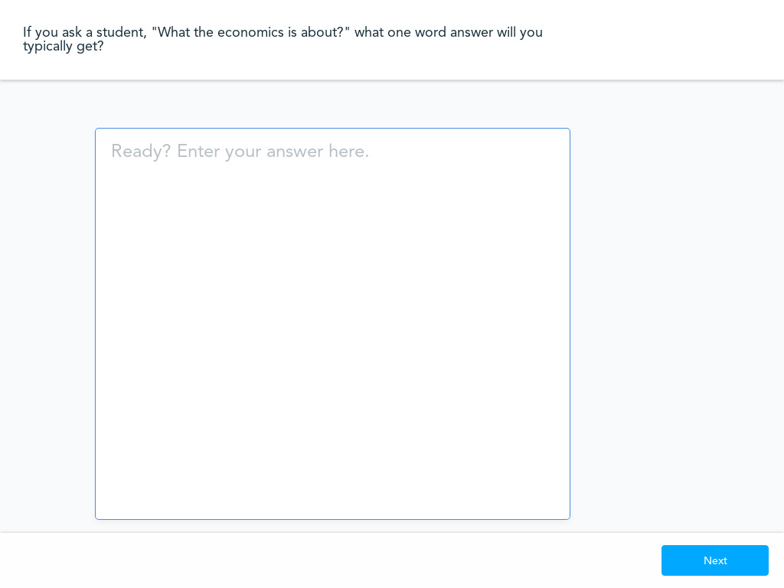

Slide 36
Key Economic Concepts
Economics is NOT just about money.
Economics is about decision-making and choices:
Why do we have to make choices?
What influences those choices?
What role does money play in decision-making (whether it’s Jalen Green, Sue Bird, or your students)?
Here’s a GREAT video introduction to incentives on EconEdLink you can share with your classes.

Slide 37
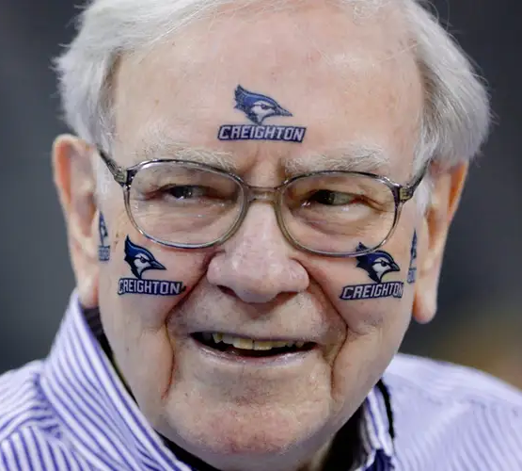
Bracketology
In 2018, an estimated 24 million people participated in NCAA office pools.
Those pools involved an estimated $3 BILLION!
If you included additional betting, that number is estimated to be somewhere between $10-$20 Billion!
Warren Buffet famously offers $1M a year FOR LIFE for anyone who works for him IF they can predict a perfect Sweet 16 (not even a full bracket!).
Why does he feel so confident doing this?

Slide 38
Asymmetric Information
Also called “information failure.”
People like Warren Buffet and the numerous gambling houses count on gamblers suffering from asymmetric information.
Meaning: They know more than you do.
  •Video definition from Investopedia
Example: Used cars (before the internet)
This lack of information held by gamblers helps build casinos.
For a fascinating look at March Madness gambling check out this ESPN article on March Madness Calcuttas: https://www.espn.com/chalk/story/_/id/12249586/espn-magazine-gambling-issue-top-dollar-ncaa-tourney-calcuttas

Slide 39
COVID’s Impact
Loss in revenue will lead to non football or basketball sports being cut.
  Stanford is cutting 11 sports for next year.
NCAA on the ropes? Given their main source of income is the March Madness tournament it stands to question whether or not they can survive much longer (especially if COVID’s impact lasts through Q2 of 2021).
The NCAA has stated it will give ALL revenue from the 2021 tournament to participating schools, so it’s going to forego ANOTHER year of earnings.
EA Sports NCAA Football game is returning, BUT it will be called EA Sports College Football (foreshadowing?)

Slide 40
Thanks!
Questions?
Thank you all for attending, hopefully your MB › MC!
Are there any questions?

Slide 41




Thank You to Our Sponsors!

Slide 42



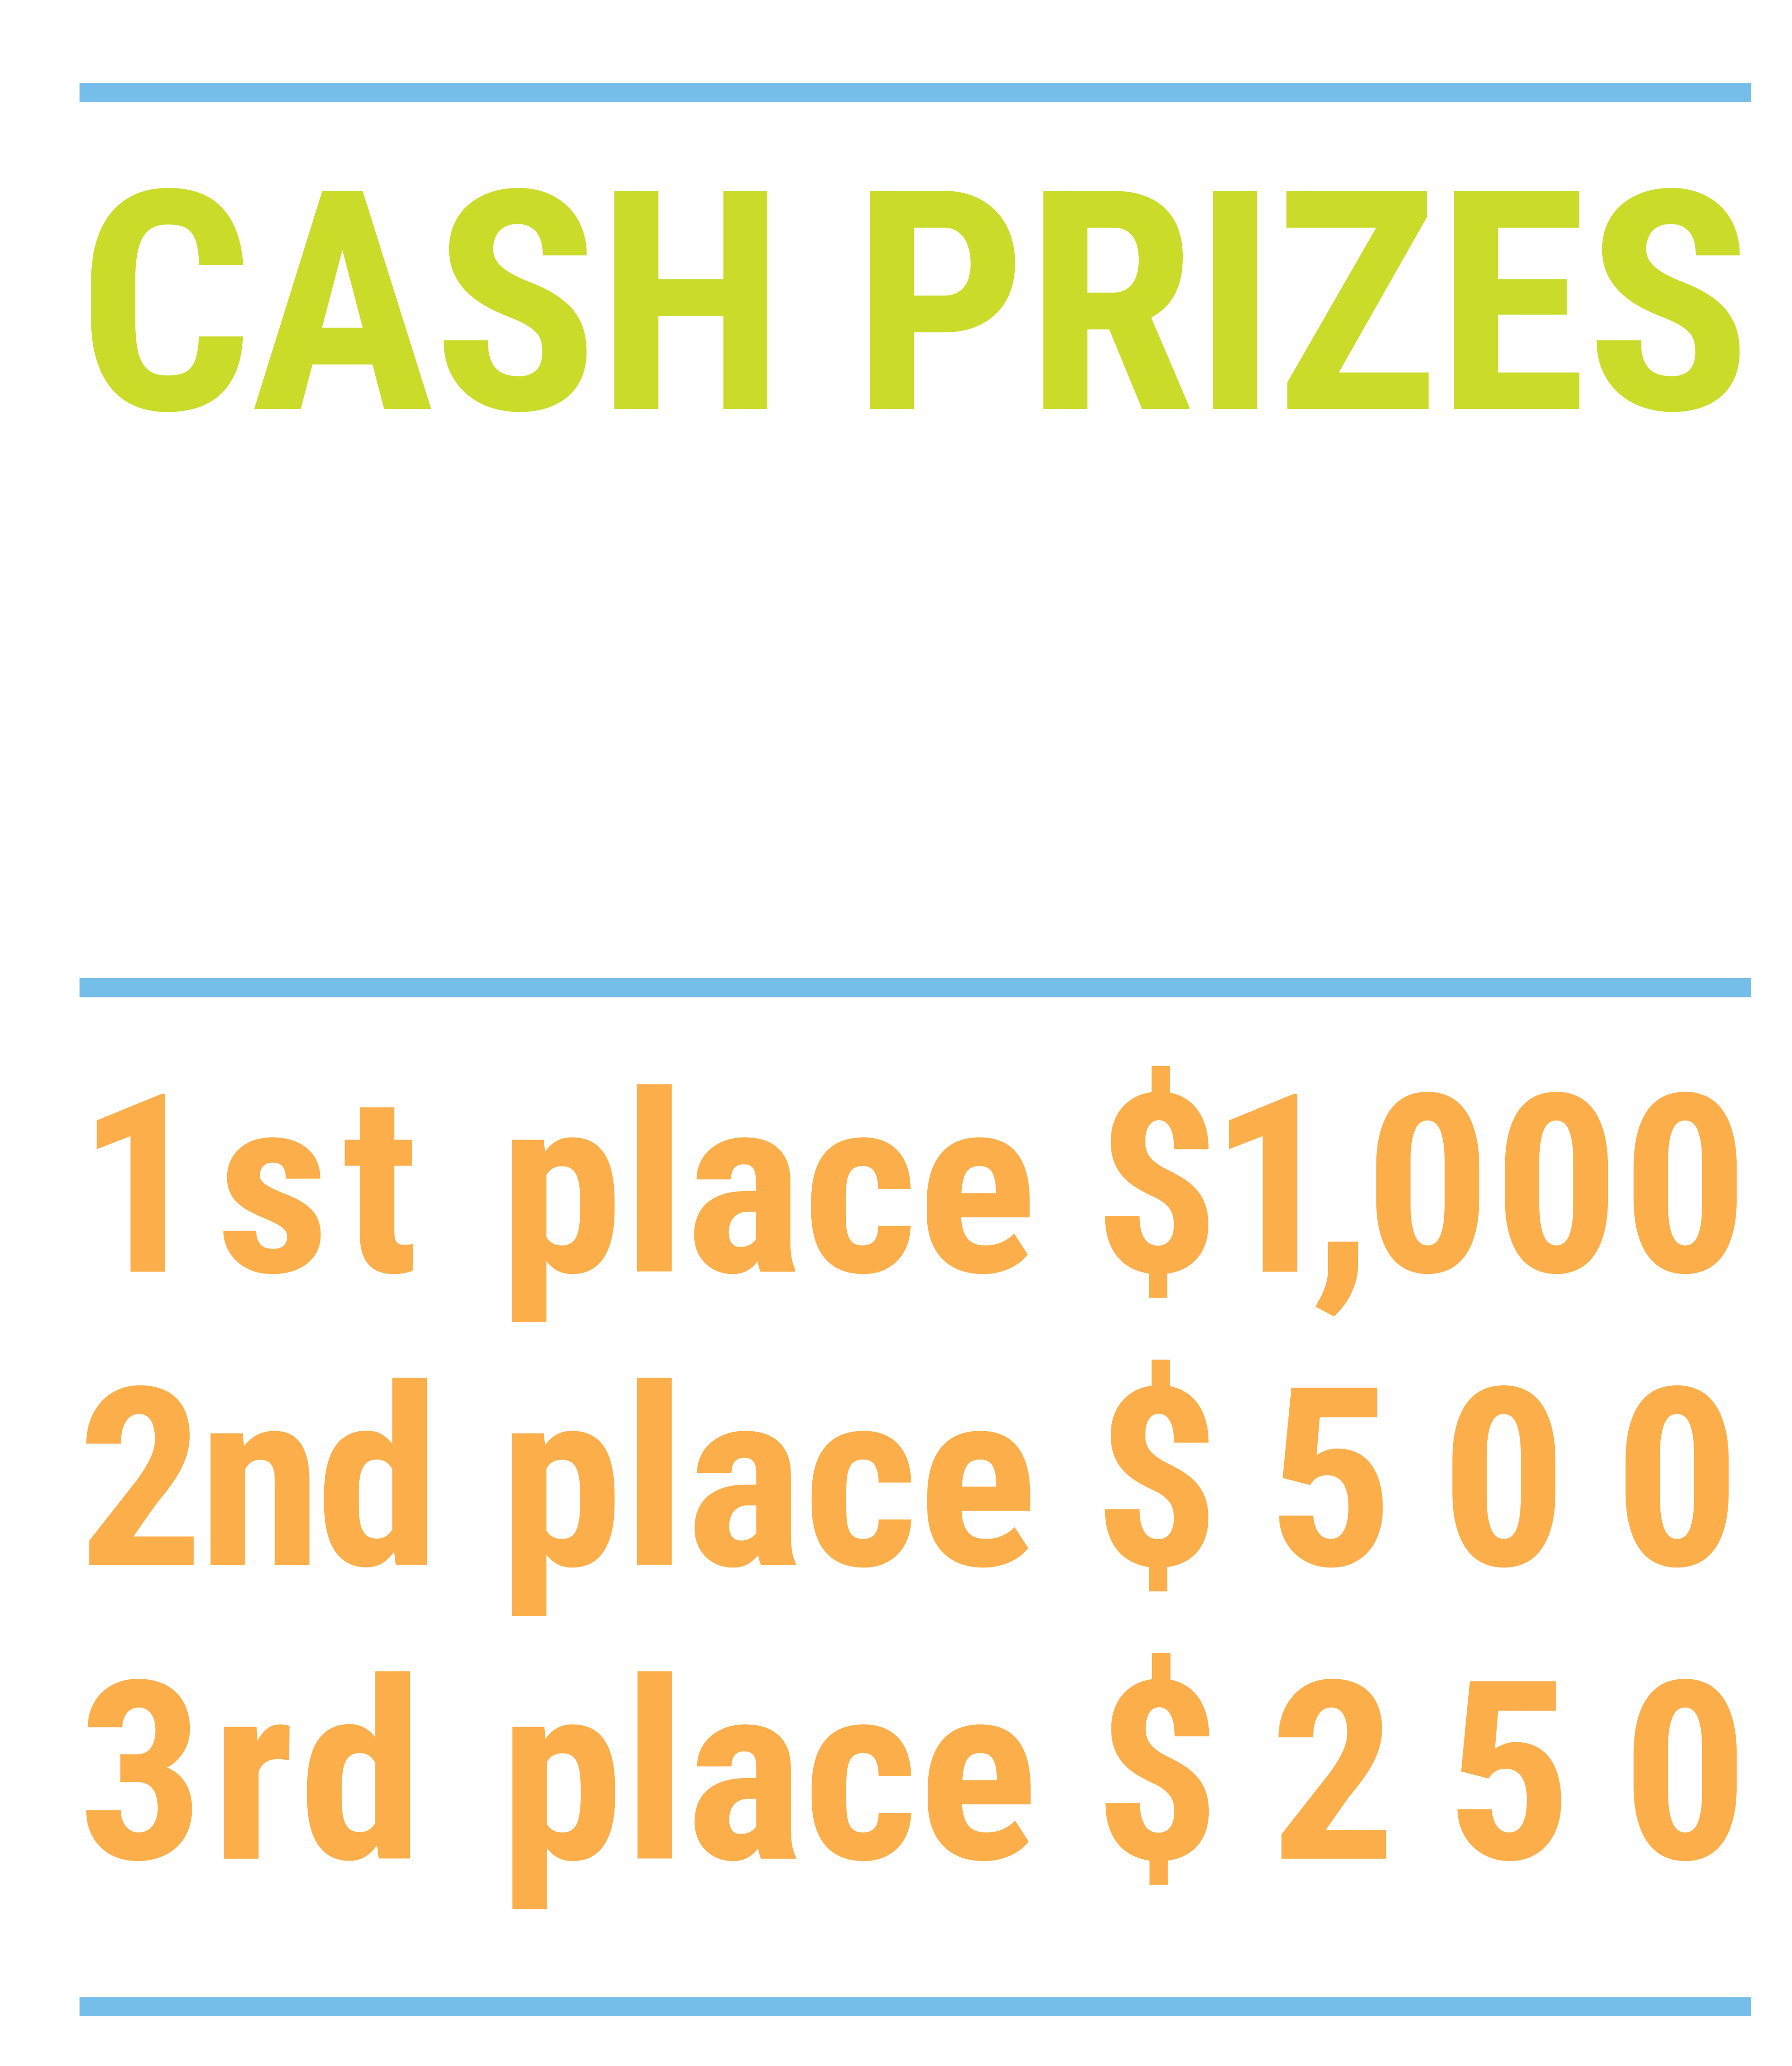

We’ve gone Virtual!
Teach Economics?
Your students may have what it takes to compete in the nation’s only high school economics competition!
Why Play?
• Fun team learning experience
• Great for college applications
• No other challenge like this
• Online participation makes access easy
• Chance for cash prizes
How it Works
Teams register
Teachers enroll team(s) of 3- 4 high school students from the same school. Multiple teams allowed.
Teams compete within their state
Compete to win your state competition for a
chance to advance to the National Semi-Finals.
National Semi-Finals: May 3-20, 2021
Teams answer multiple-choice questions on macroeconomics, microeconomics, and international & current events.
National Finals: May 22-24, 2021
Teams analyze an economic issue and present their solution. Top teams engage in the Finals Quiz Bowl where they face-off answering questions to claim the National Title.
Two divisions based on experience level
David Ricardo for first-time competitors who have taken no more than one economics course.
Adam Smith for returning competitors, AP, International Baccalaureate, and honors students.
Register Today at NationalEconomicsChallenge.org

Slide 43


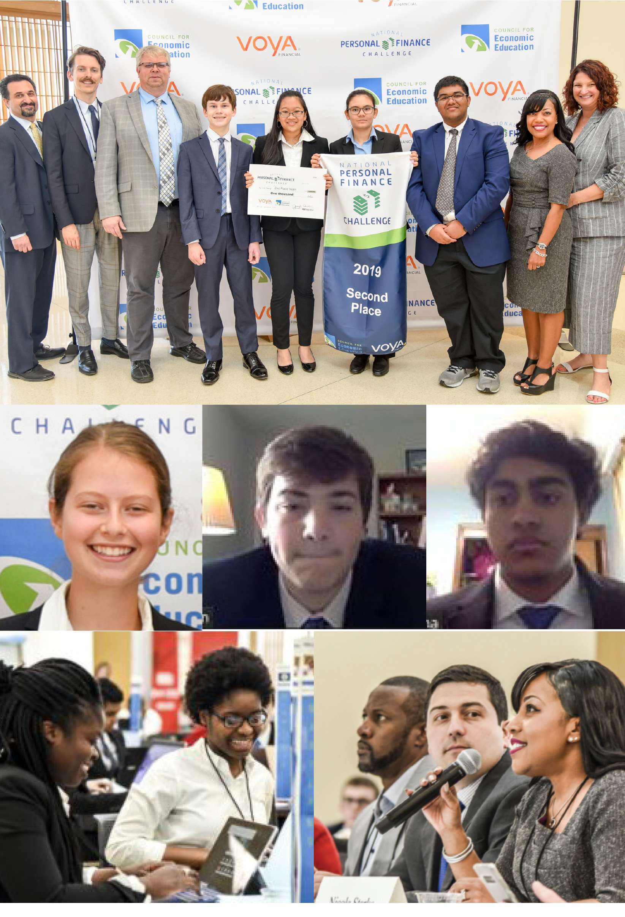
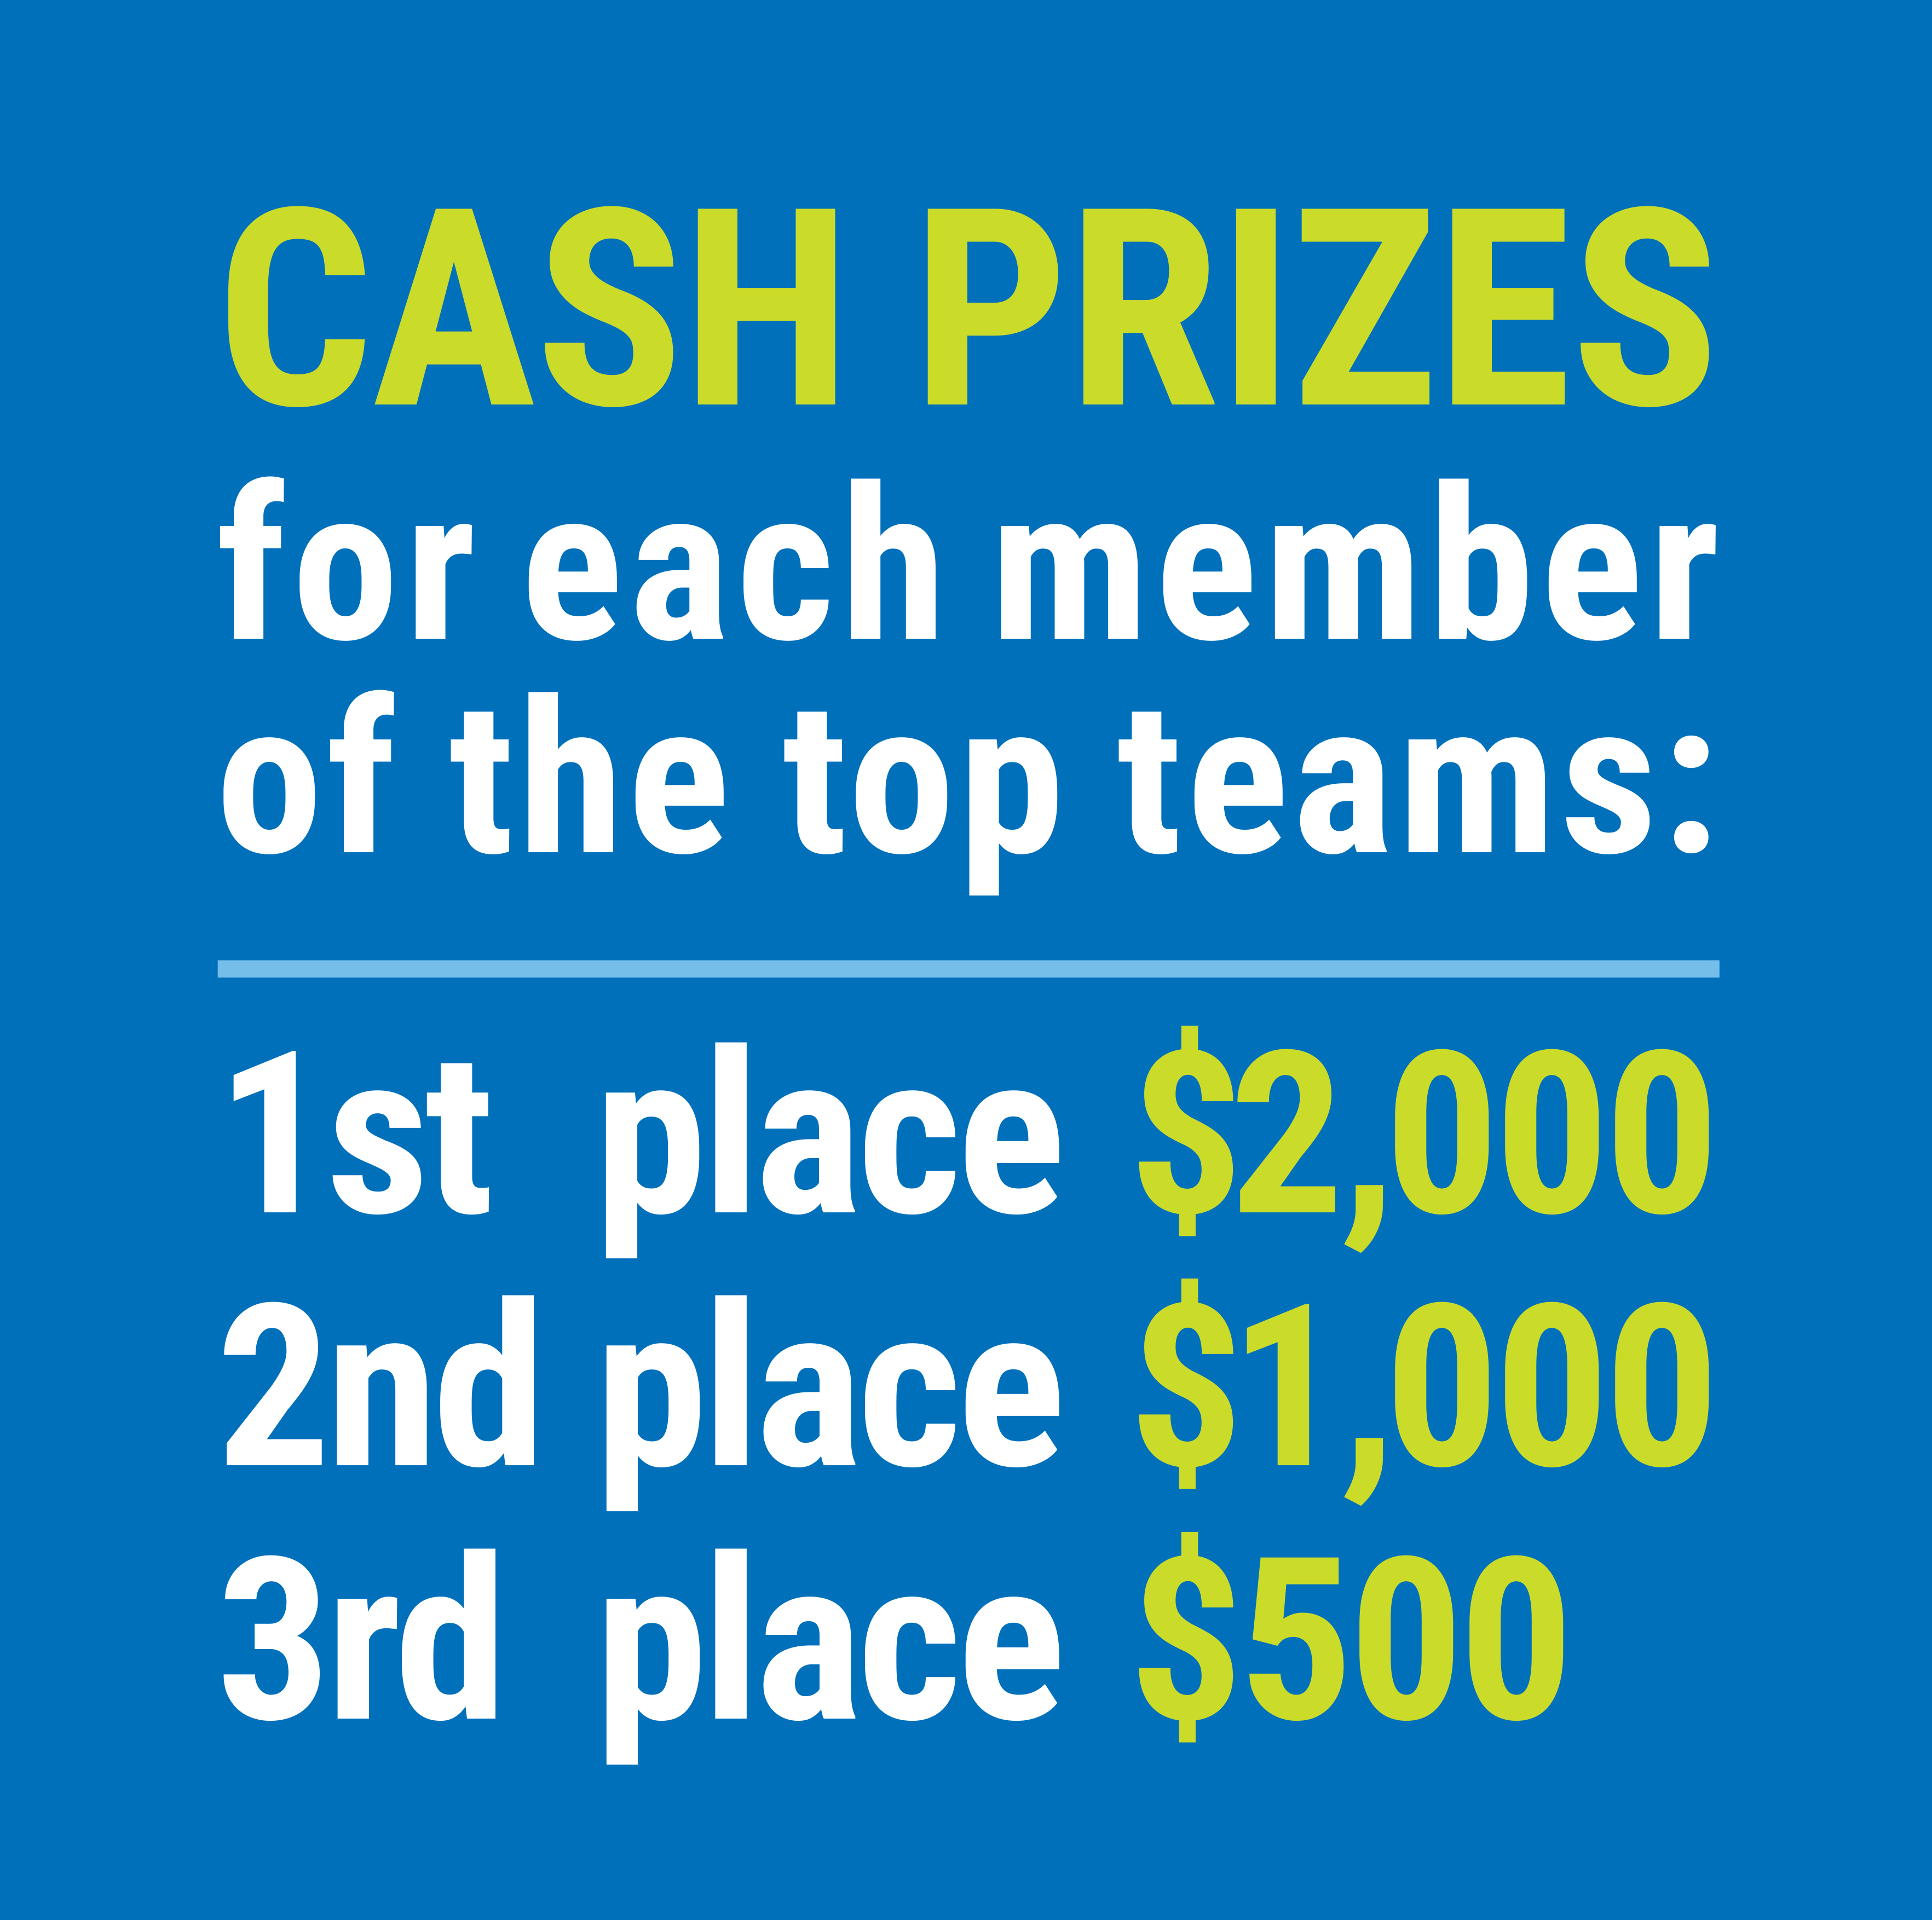

FIND YOUR LOCAL COMPETITION
AND REGISTER TODAY!
The National Personal Finance Challenge is a competition that provides high school students with an exciting and motivating opportunity to build, apply, and demonstrate their knowledge of money management.
Through online exams and a personal finance simulation, teams showcase their expertise in earning income, buying goods and services, saving, using credit, investing, as well as protecting and insuring.
Teams of up to four students, with one teacher/coach, can qualify to represent their state at the National Personal Finance Challenge by winning their local competition.
NATIONALS
Semi-Finals: First round elimination via online multiple-choice questions.
Finals: Case study round virtually co-hosted by the Cleveland Fed on June 3.
personalfinancechallenge.org

Slide 44
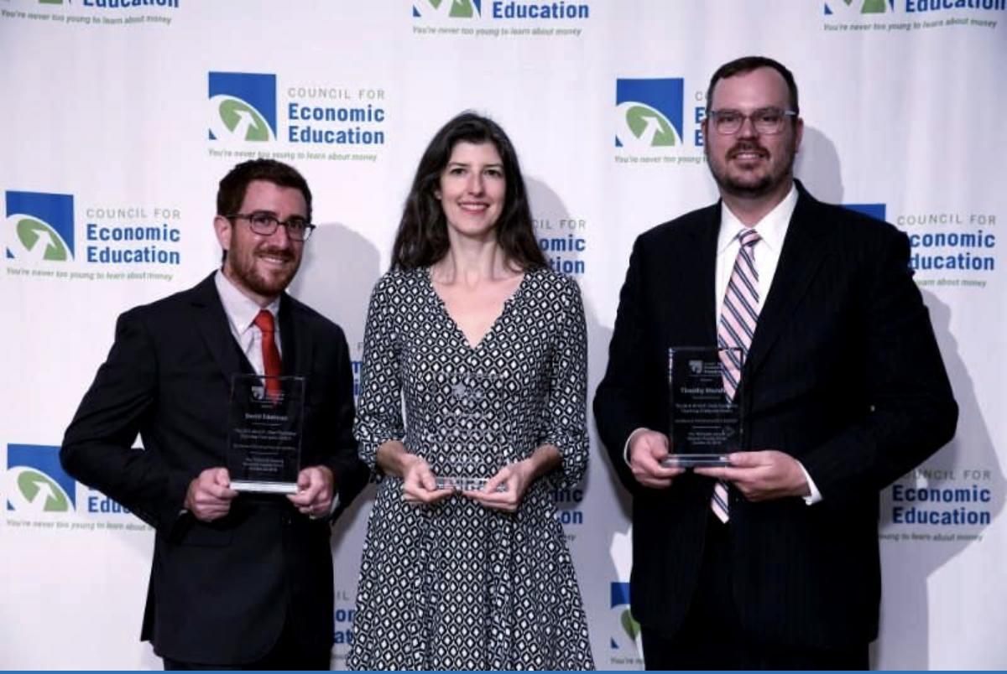
The 2021 Sloan Teaching Champion Award
Winners receive:
A cash award of $5,000
A cash award of $2,500 for their school to support economic education
Recognition at our annual Visionary Awards convening.
This award promotes economic education by honoring three outstanding teachers who incorporate exemplary teaching techniques that improve their students’ economic understanding in and out of the classroom.
This award is open to New York metropolitan area high school teachers of all subjects, not just teachers of economics. Applicants must demonstrate how they integrate economics into their teaching.
Sound like you or someone you know?
Applicants must teach in one of the
Twelve New York state counties (New York, Kings, Bronx, Richmond, Queens, Nassau, Suffolk, Westchester, Putnam, Rockland, Orange and Dutchess)
Eight New Jersey counties (Bergen, Passaic, Essex, Hudson, Middlesex, Union, Morris, Monmouth), or the
Two Connecticut counties (Fairfield and New Haven)
Application will be launched on Friday February 19th 2021
You can access the application here.
CONTACT
Please feel free to e-mail us at rrivera@councilforeconed.org
with any questions you have.

