Slide 1
K- 8 Essential Concepts
Jay LeBlanc (with thanks to Dr. John Brock from UCCS)
Economic Literacy Colorado
April 21, 2021
jay.leblanc@econlitco.org

Slide 2
EconEdLink Membership
You can now access CEE’s professional development webinars directly on EconEdLink.org! To receive these new professional development benefits, become an EconEdLink member. As a member, you will now be able to:
Automatically receive a professional development certificate via e-mail within 24 hours after viewing any webinar for a minimum of 45 minutes
Register for upcoming webinars with a simple one-click process
Easily download presentations, lesson plan materials and activities for each webinar
Search and view all webinars at your convenience
Save webinars to your EconEdLink dashboard for easy access to the event
You may access our new Professional Development page here

Slide 3
Professional Development Certificate
To earn your professional development certificate for this webinar, you must:
Watch a minimum of 45-minutes and you will automatically receive a professional development certificate via e-mail within 24 hours.
Accessing resources:
You can now easily download presentations, lesson plan materials, and activities for each webinar from EconEdLink.org/professional-development/

Slide 4
Agenda for Today’s Session
Focus on Key Concepts – Choice and Opportunity Cost
Focus on Key Concepts – Incentives and
Unintended Consequences
Resources for K-8 Teachers on the topics
We will do a few short activities in Nearpod as well

Slide 5
Objectives
Teachers will understand key concepts of the economic way of thinking.
Teachers will learn how to use and explain concepts like scarcity, choice, opportunity cost, and incentives that form the heart of K-8 standards.
Teachers will learn about and experience lessons/activities for the K-8 classroom, including a variety of resources.

Slide 6
Colorado State Standards
Preschool, Standard 3 Economics, “Individuals have many wants and have to make choices”, specifically identify choices that individuals can make and explain how they earn money and use it to make choices among their various wants
Kindergarten, Standard 3 Economics, “Individuals make choices based on wants”, specifically identify the costs and benefits of a choice an individual makes when acquiring an item
Kindergarten, Standard 3 Economics, “Describe choices people make about how to use the money they earn”, specifically recognizing choices people make and how decisions are made, and giving examples of the difference between spending income on something you want versus something you need
1st Grade, Standard 3 Economics, “Individuals work in different types of jobs to earn an income”, specifically compare at least two different job choices that individuals have with respect to the benefits and costs of each job
2nd Grade, Standard 3 Economics, “Resources are scarce, so individuals may not have access to the goods and services they want”, specifically being able to explain scarcity, give examples of choices people make when resources are scarce, and identifying possible solutions when there are limited resources and unlimited wants

Slide 7
Colorado State Standards (con’t)
2nd Grade, Standard 3 Economics, “Investigate costs and benefits to make informed financial decisions”, specifically assessing priorities when making financial decisions and predicting positive and negative consequences when making financial decisions
4th Grade, Standard 3 Economics, “Determine the opportunity cost when making a choice”, specifically defining choice and opportunity cost, determining the relationship between long-term goals and opportunity cost, and analyzing scenarios of choices including opportunity cost
5th Grade, Standard 3 Economics, “Examine how individuals use financial institutions to manage personal finances”, specifically what risks and benefits are associated with spending versus saving and investing, and how individuals research, analyze, and make choices regarding their needs when using financial institutions
6th Grade, Standard 3 Economics, “Investigate how societies create different economic systems in the Western Hemisphere”, specifically describe how economic systems allocate resources, how scarce resources are distributed in different types of economic systems, and study how and why individuals make decisions about purchases in different locations

Slide 8
Colorado State Standards (con’t)
6th Grade, Standard 3 Economics, “Investigate the role of consumers within the Western Hemisphere”, specifically explore how consumer spending decisions and demand impact market economies, and analyze how external factors might influence spending decisions for different individuals
7th Grade, Standard 3 Economics, “Investigate the role of consumers within the Eastern Hemisphere”, specifically summarize how the distribution of resources impacts consumerism, and compare/contrast choices available to consumers within different cultures
8th Grade, Standard 3 Economics, “Examine the role of consumer decisions and taxes within the market economies of early American history”, specifically that people make particular choices because they are responding to the underlying incentives
High School, Standard 3 Economics, “Productive resources are scarce; therefore, choices are made about how individuals, businesses, governments, and nonprofits allocate those resources”, specifically how economic thinkers assume that every choice, whether by governments, businesses, nonprofits, or individuals, has an opportunity cost; how positive and negative incentives influence the choices made by those same groups; and be able to explain how effective decision-making requires comparing the additional (marginal) costs of alternatives with the additional (marginal) benefits

Slide 9
Economic Concept #1
SCARCITY

Slide 10
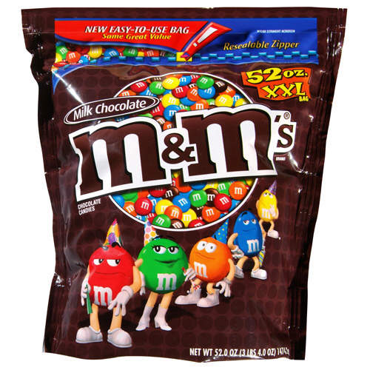
A Treat in the Classroom
Who would like a 1 pound bag
of plain M&Ms?
Wants: ______
Available: 1
THE economic problem?
This Photo by Unknown Author is licensed under CC BY-SA-NC
Notes:
🍐 This is a Pear Deck Multiple Choice Slide. Your current options are: A: Yes, B: No,
🍐 To edit the type of question or choices, go back to the "Ask Students a Question" in the Pear Deck sidebar.

Slide 11
Scarcity
THE Economic Problem:
Unlimited wants but limited resources
Must choose

Slide 12
What are some ways we could decide who gets the M&Ms?
Random selection
Authority
Price
First come, First served
Personal characteristics (need, physical strength)
Competition or contest
Sharing
Voting – majority rule

Slide 13
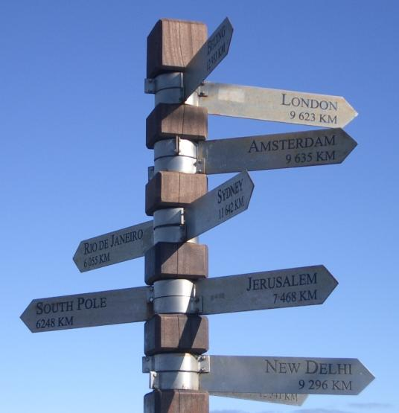
Scarcity Choice
Economics is:
  the study of choice

Slide 14
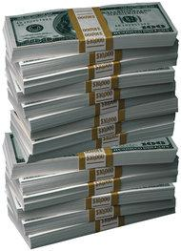

Average Citizen on Economics?
Economics is not about money, it is about … choice
Notes:
🍐 This is a Pear Deck Text Slide
🍐 To edit the type of question, go back to the "Ask Students a Question" in the Pear Deck sidebar.

Slide 15

Key Concept
Individuals face tradeoffs
    and must make choices.

Slide 16

Daily, Small Choices
Maybe go shopping at the mall?
Should I go to the library today?
Should I go hiking today?

Slide 17
Big, Strategic Decisions
Should I go to college?
Should I work instead of college?

Slide 18
We All Confront Choice
A school teacher?
A business person?

Slide 19

We All Confront Choice
Support cause A
Support cause B?

Slide 20

We All Confront Choice
Rob a bank?
Rob a house?

Slide 21
More on Scarcity
Wants > Availability
  or
Unlimited wants > Limited resources
factors of production available to produce goods & services

Slide 22
Scarcity Is Not An Option!
What are the scarce resources used in producing the bag of M&Ms?
    natural resources (land)
    human resources (labor)
      entrepreneurship
    man-made resources (capital)
technology
Notes:
🍐 This is a Pear Deck Text Slide
🍐 To edit the type of question, go back to the "Ask Students a Question" in the Pear Deck sidebar.

Slide 23

Scarcity
For a free good . . .
    wants > available
  How about . . .
    Mosquitoes in Colorado in January?
      Fit scarcity definition?
        No because
        there are few,
        but available > wants
        → not scarce
Notes:
23
🍐 This is a Pear Deck Multiple Choice Slide. Your current options are: A: Yes, B: No,
🍐 To edit the type of question or choices, go back to the "Ask Students a Question" in the Pear Deck sidebar.

Slide 24
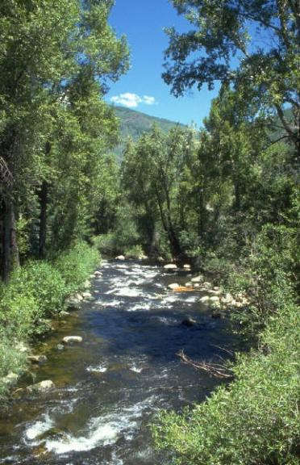
Scarcity
For a free good . . .
    wants > available
  How about . . .
      Water in Colorado in normal month of September
      Scarce?
        Yes, there is much available
        but wants > available
        → scarce
Notes:
24
🍐 This is a Pear Deck Multiple Choice Slide. Your current options are: A: Yes, B: No,
🍐 To edit the type of question or choices, go back to the "Ask Students a Question" in the Pear Deck sidebar.

Slide 25
Key Economic Proposition
Scarcity necessitates choice
  people choose &
  choices determine social outcomes

Slide 26
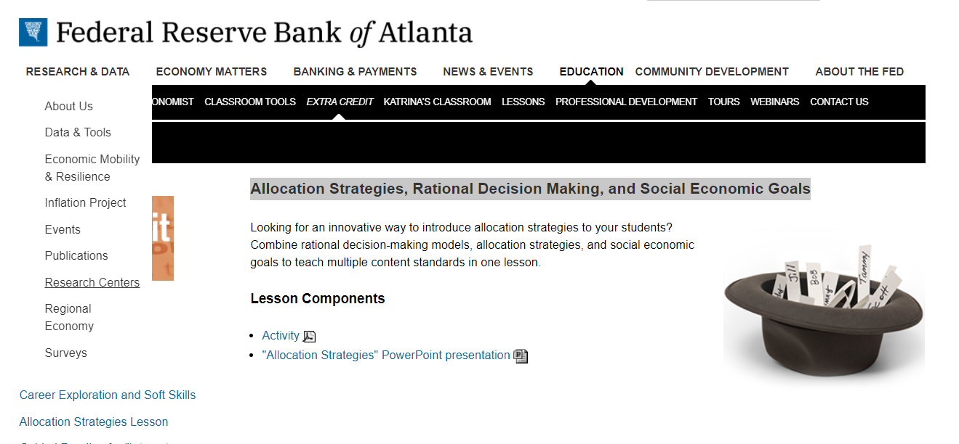


Slide 27
Economic Concept #2
OPPORTUNITY COST

Slide 28

Is Facebook Free?
Breakout Room Discussion
  About 2-3 minutes, then back to main room
  One person in your group will report
Questions to consider:
If free, why?
If not free, why not … what is the cost?

Slide 29



Candy Bar Activity
One Volunteer, please?
Suppose:
  I will give you ONE of these three candy bars
  Before you select the one you want, please rank order them, 1, 2 and 3

Slide 30
What Did Candy Bar Cost You?
What you give up to get something:
  Give up comfortable, risk-free life –
      volunteer
      incur risk – not sure what asked to do
    referred to as transactions costs
  Best foregone alternative candy bar
Explicit cost
+
Implicit cost
Opportunity Cost

Slide 31

Opportunity Cost
Opportunity lost → opportunity cost
  Value of the best foregone alternative
  “Choosing is refusing”
      choose A, refuse B –
        cost of A is value of B

Slide 32

Key Concept
Choice involves cost
        opportunity cost
Choice involves cost
        opportunity cost

Slide 33
Examples
Opportunity cost of joining our seminar today?
Notes:
🍐 This is a Pear Deck Text Slide
🍐 To edit the type of question, go back to the "Ask Students a Question" in the Pear Deck sidebar.

Slide 34
Examples
Opportunity cost of joining our seminar today?
  is what you gave up to be in class:
    sleep, income you could earn, grading papers, hike in park, …
Cost of changing the oil in your own car?
Notes:
🍐 This is a Pear Deck Text Slide
🍐 To edit the type of question, go back to the "Ask Students a Question" in the Pear Deck sidebar.

Slide 35
Examples
Cost of joining our class today?
  is what you gave up to be in class:
    sleep, income you could earn, grading papers, hike in park, …
Cost of changing the oil in your own car?
  Oil, filter
  Time – what you would have done
Explicit cost
Implicit cost
Total opportunity cost
Cost of going to a concert downtown?
Notes:
🍐 This is a Pear Deck Text Slide
🍐 To edit the type of question, go back to the "Ask Students a Question" in the Pear Deck sidebar.

Slide 36
Examples
Cost of joining our class today?
  is what you gave up to be in class:
    sleep, income you could earn, grading papers, hike in park, …
Cost of changing the oil in your own car?
  Oil, filter
  Time – what you would have done
Cost of going to a concert downtown?
  Concert ticket price
  Gas, parking
  Time – what you gave up to attend
Explicit cost
Total opportunity cost
Explicit cost
Implicit cost
Notes:
🍐 This is a Pear Deck Text Slide
🍐 To edit the type of question, go back to the "Ask Students a Question" in the Pear Deck sidebar.

Slide 37
Opportunity Cost Question
  You win $100 in a basketball pool.
  You have a choice between spending the money now or putting it away for a year in a bank account that pays 2% interest per year.
  What is the opportunity cost of spending the $100 now?
Notes:
🍐 This is a Pear Deck Multiple Choice Slide. Your current options are: A: $2, B: $100, C: $102,
🍐 To edit the type of question or choices, go back to the "Ask Students a Question" in the Pear Deck sidebar.

Slide 38
Opportunity Cost Question
  You win $100 in a basketball pool.
  You have a choice between spending the money now or putting it away for a year in a bank account that pays 2% interest per year.
  What is the opportunity cost of spending the $100 now?
    $100 given up for future spending
    + $2 interest foregone
    $102
Notes:
🍐 This is a Pear Deck Multiple Choice Slide. Your current options are: A: $2, B: $100, C: $102,
🍐 To edit the type of question or choices, go back to the "Ask Students a Question" in the Pear Deck sidebar.

Slide 39

Opportunity Cost Question
  You have 50,000 frequent flyer miles.
  You could exchange your miles for a round-trip ticket to Bermuda over the holiday break.
  Does this mean your flight to Bermuda is free?
  What is the opportunity cost of using your frequent flyer miles for a Bermuda ticket?
    Give up using 50,000 miles for flight somewhere else
      perhaps London or Hawaii

Slide 40

Your Alarm Went Off Today at 6 AM
What choice did you face? What alternatives did you face?
  Get up
  Don’t get up (i.e, get up later)
Why did you have to make a choice?
  Can’t get up & stay in bed at same time
    Scarcity!

Slide 41
Benefits of Each Alternative?
Get Up Early
Don’t have to rush
Time for coffee & bagel
Time to review econ
Get Up Later
Sleep longer
Stay warm
More alert during day
Suppose you choose get up now … what do you give up?
More sleep, staying warm, being alert
Suppose you choose get up later … what do you give up?
Not having to rush, coffee/bagel, review time
Notes:
🍐 This is a Pear Deck Text Slide
🍐 To edit the type of question, go back to the "Ask Students a Question" in the Pear Deck sidebar.

Slide 42
Opportunity Cost ↔ Cost
Value of best foregone alternative
“What you have to give up to get something”
What does this look like for bigger decisions . . . ?

Slide 43
Sustainable Development Goals (SDG)
List of global challenges identified by U.N.
Sequel to the Millennium Development Goals
adopted in 2000 with target end in 2015
SDGs: Adopted in 2015 with targets
achieved by 2030

Slide 44


Slide 45
United Nations’ Sustainable Development Goals
1: No Poverty
2: Zero Hunger
3: Good Health and Well-being
4: Quality Education
5: Gender Equality
6: Clean Water and Sanitation
7: Affordable and Clean Energy
8: Decent Work and Economic Growth
9: Industry, Innovation and Infrastructure

Slide 46
The UN’s SDGs
10: Reduced Inequality
11: Sustainable Cities and Communities
12: Responsible Consumption & Production
13: Climate Action
14: Life Below Water
15: Life on Land
16: Peace and Justice Strong Institutions
17: Partnerships to achieve the Goal

Slide 47
Post-2015 Consensus
(Sequel to the Copenhagen Consensus)
Bjorn Lomborg’s Copenhagen Consensus Centre commissioned a Post-2015 Consensus
60 teams of economists (along with UN, NGOs & business leaders)
    three Nobel Laureates in Economic Science
Task: identify which of 17 SDGs should be
given highest priority (benefit/cost)

Slide 48
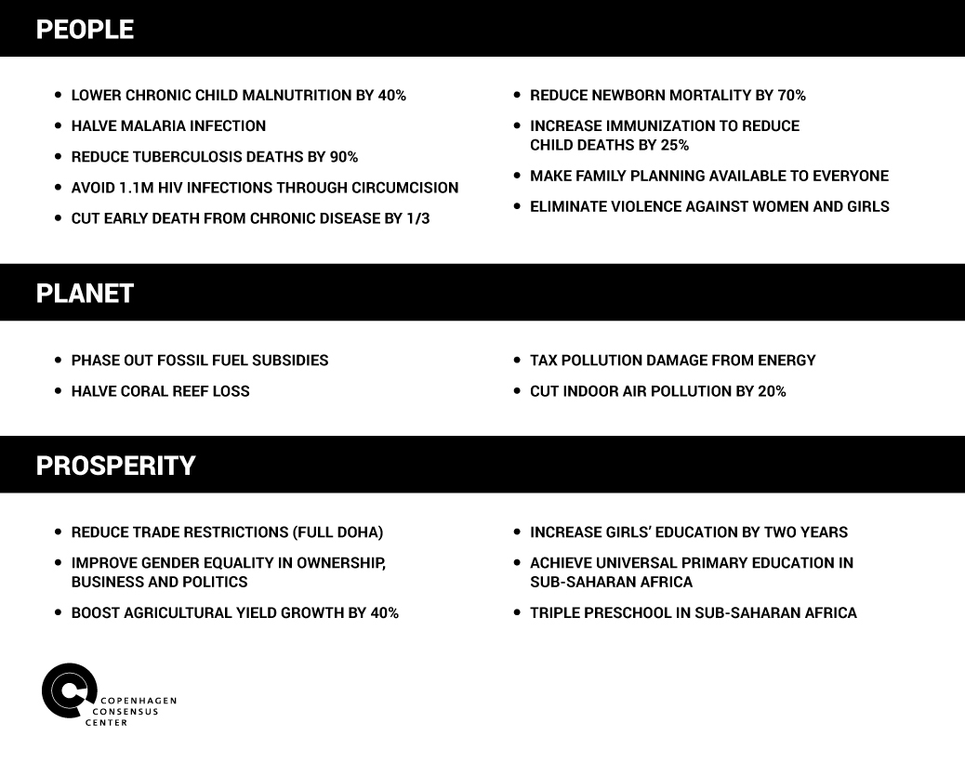

Slide 49
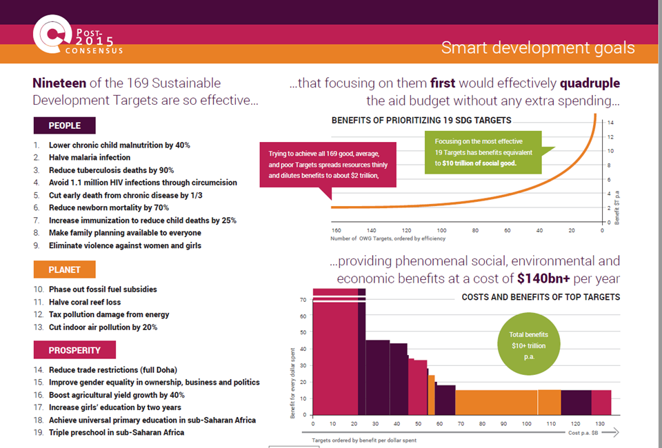

Slide 50
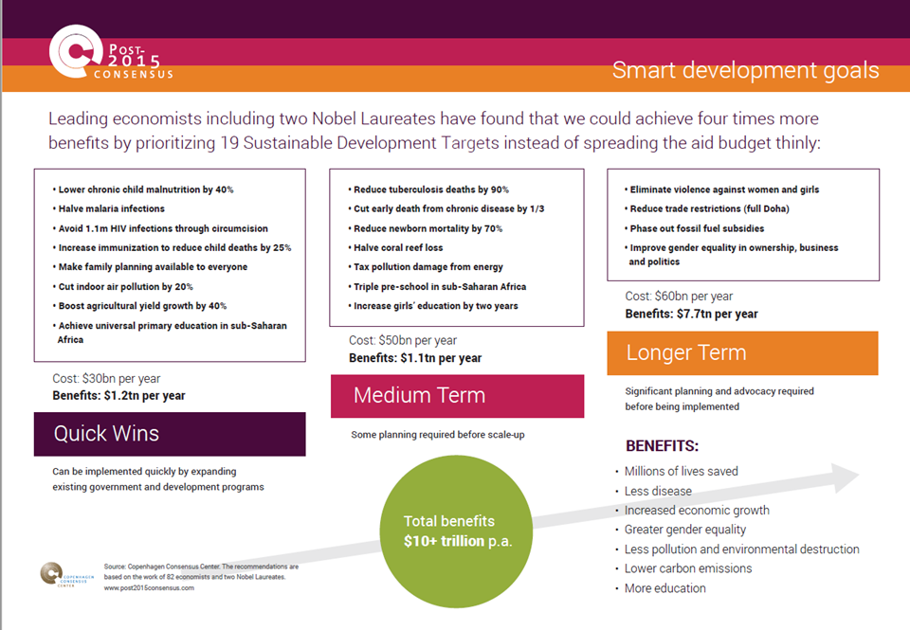

Slide 51
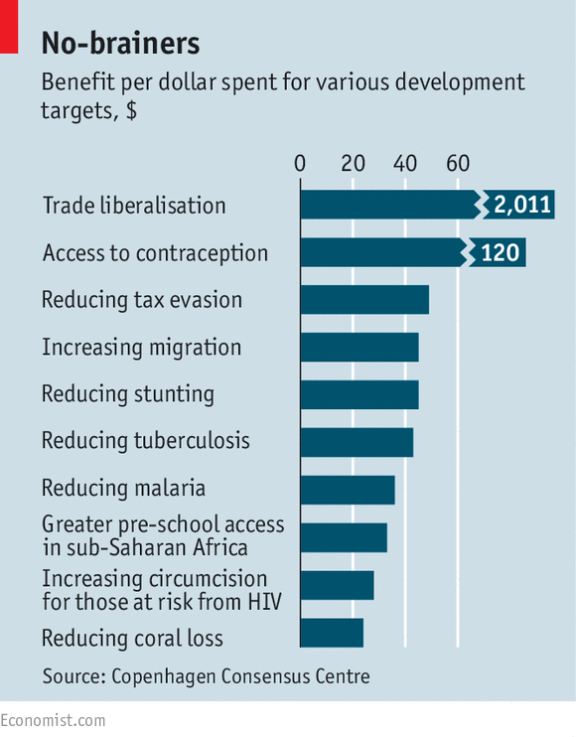
Benefits/$ Spent for Targets of SDG
(the no brainers to pursue)
Why not pursue
all SDGs?
Scarcity
  → Choice

Slide 52
So, Is Facebook Free?
NO!
What is the opportunity cost of using Facebook?
Facts:
  Average college student use: 1 hour per day
  Opportunity cost of an hour of time?
    Median wage for 16 – 24 year old (2018)? ≈ $14 per hour
    → ≈ $12/hour after tax (low wage → low tax)
    Total opportunity cost: $12 x 365 = $4,380
Notes:
🍐 This is a Pear Deck Text Slide
🍐 To edit the type of question, go back to the "Ask Students a Question" in the Pear Deck sidebar.

Slide 53
Your Choice to Use Facebook!
Economists will NOT tell you what to do
  Our objective is to help you identify the tradeoffs
  → This is positive economics (using data to support)
Normative issues?
  Assuming $12 per hour, the opportunity cost of using Facebook for an hour a day is $4,380
  Users weigh this cost versus the benefit received

Slide 54

B(X)
C(X)
Up-to-date with friends & family
Formation of new friendships
Entertaining
What you could do with the $4,280 $4,380 per year:
  What could you buy with $4,380?
Notes:
🍐 This is a Pear Deck Text Slide
🍐 To edit the type of question, go back to the "Ask Students a Question" in the Pear Deck sidebar.

Slide 55
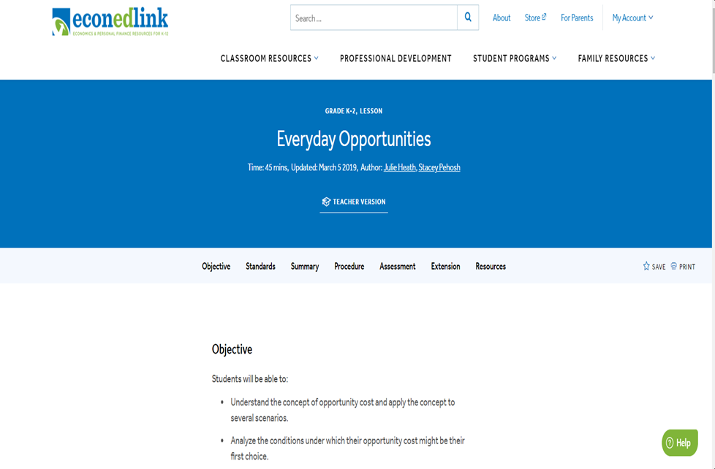

Slide 56
Economic Concept #3
INCENTIVES

Slide 57
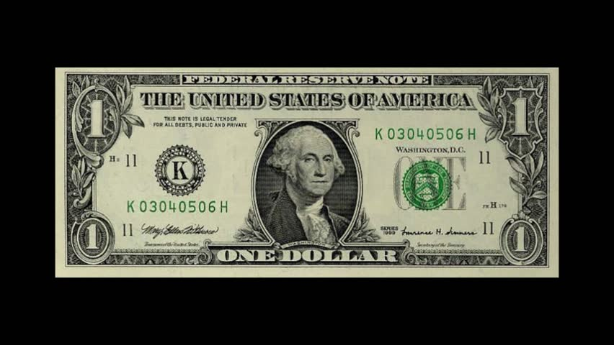

Candy Bar Activity
One Volunteer, please?
Suppose:
  I will give you ONE of these two candy bars
  Before you select the one you want, please rank order them, 1 and 2

Slide 58

Play It Again, Sam
Raise the cost
  if C(X) > B(X),
    choose another bar

Slide 59
Key Concept
“People respond to incentives
  and the rest is commentary!”
  Steven Landsburg, The Armchair Economistpond to incentives
  and the rest is commentary!”
      Steven Landsburg, The Armchair Economist

Slide 60
Intended Consequences
If people respond to incentives . . .
  then behavior can be altered in desired or intended ways
  For example …
If people respond to incentives . . .
  then behavior can be altered in desired or intended ways
  For example …

Slide 61
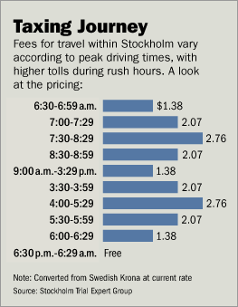
Congestion Pricing
  Tolls/taxes during peak traffic periods’
Idea dates to 1950s
  William Vickrey
    Nobel Prize economist
Started in Stockholm in 2007
  Singapore
  London
  NYC
  Tolls/taxes during peak traffic perio
Notes:
61

Slide 62
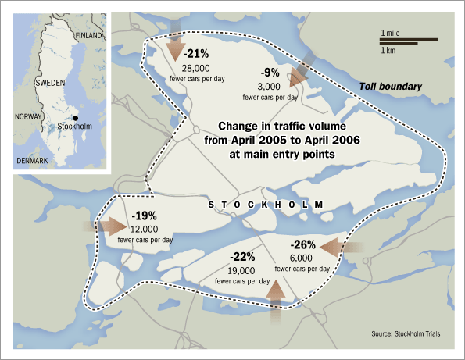
Notes:
62

Slide 63
Results in Stockholm Trial
“People changed their habits.”
  Traffic passing over the loop: down 22%
  Traffic accidents with injury: down 5 – 10%
  Exhaust emissions (inner city): down 14%
  Rush hour drive time: down 33%
  Public inner-city bus use: up 9%
  All forms of public transport: up 6%
Notes:
63

Slide 64
Intended Consequences of Connecticut Law
(effective in 2008)
To qualify for the written test to get a learner’s driving permit:
  16 & 17 year olds must take 8 hours of a “Safe Driving Class”
  Parent must attend 2 of these hours
In addition,
  law severely limits the kinds of driving you can do with these permits

Slide 65

People Respond to Incentives
Benefit of a permit falls:
  less that you can do with a permit if you do qualify.
Cost of getting permit rises:
  Hassle factor of the new legal restrictions looms large.

Slide 66
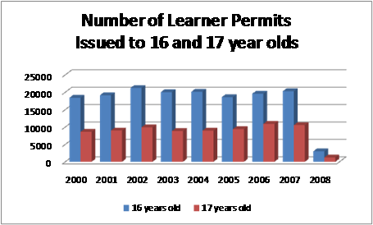
Impact of the Connecticut Law?
Deter young people from getting permits & licenses.
  16-year-olds that were licensed to drive:
    2001: 42%
    2010: 29%

Slide 67
Consequences
People respond to incentives causing
  intended consequences, and
  unintended consequences
    can offset the intended benefits

Slide 68
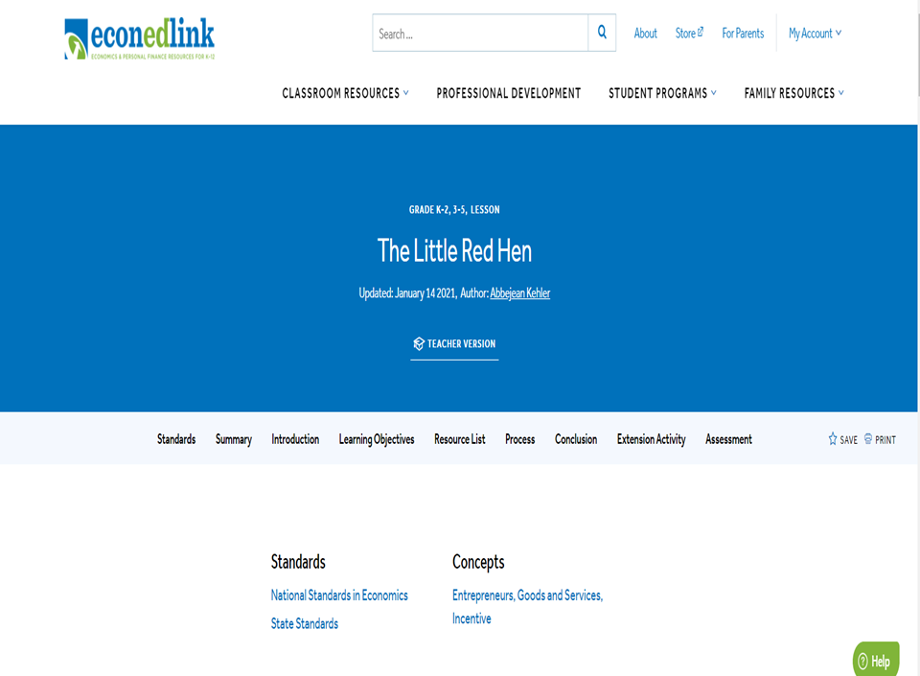

Slide 69

People Respond to Incentives
Mandated auto protection
  seat belts
  air bags
  antilock brakes
Intended consequence?
  “Seat belts save lives!”

Slide 70

Driving Speed
Benefits of driving fast, B(X)?
  Get there faster
  Thrill
Notes:
🍐 This is a Pear Deck Text Slide
🍐 To edit the type of question, go back to the "Ask Students a Question" in the Pear Deck sidebar.

Slide 71
Driving Speed
Benefits of driving fast, B(X)?
  Get there faster
  Thrill
Costs of driving fast, C(X)?
  Ticket, fine
  Accident, injury
  Insurance premium
Notes:
🍐 This is a Pear Deck Text Slide
🍐 To edit the type of question, go back to the "Ask Students a Question" in the Pear Deck sidebar.

Slide 72

Driving and Snow
What happens when it snows?
  On average, people slow down.
  Why?
    C(X) goes up
    for many, C(X) now exceeds B(X),
      people respond to incentives

Slide 73
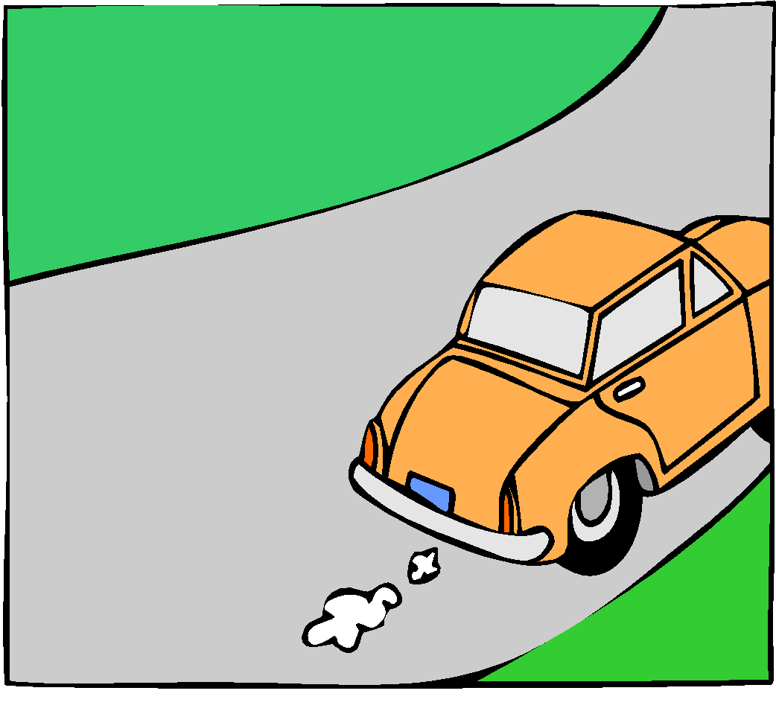
Driving & Seat Belts
What happens when people wear seat belts?
  C(X) goes down
    B(X) > C(X) for some
    who now drive faster
    more accidents
Unintended consequence?
  Seat belts increase injury!

Slide 74

Unintended Consequences
Example
Mandated ski helmets?
Intended consequence?
  Helmets reduce injury
Unintended consequence?
  Lower cost leads to faster skiing and more accidents.
Mandated ski helmets?
Intended consequence?
  Helmets reduce injury
Unintended consequence?
  Lower cost leads to faster skiing and more accidents.

Slide 75
Once Again – Key Concept
People respond to incentives People respond to incentives

Slide 76
Parting Shots
Future Professional Development Sessions with CEE:
Wed, May 5th – Personal and Corporate Debt, 6-7pm ET
Future Professional Development Sessions with NGPF:
Wed, May 19th – Using NGPF Arcade Games, 6-7pm ET

Slide 77
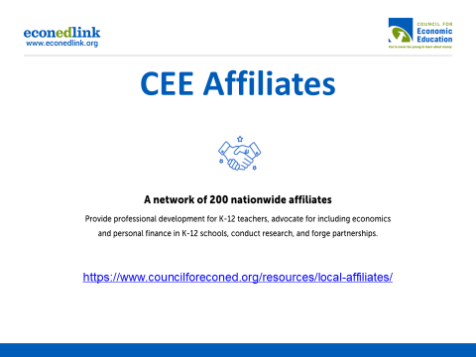

Slide 78


Slide 79



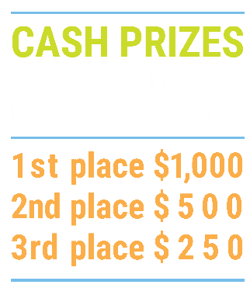

We’ve gone Virtual!
Teach Economics?
Your students may have what it takes to compete in the nation’s only high school economics competition!
Why Play?
• Fun team learning experience
• Great for college applications
• No other challenge like this
• Online participation makes access easy
• Chance for cash prizes
How it Works
Teams register
Teachers enroll team(s) of 3- 4 high school students from the same school. Multiple teams allowed.
Teams compete within their state
Compete to win your state competition for a
chance to advance to the National Semi-Finals.
National Semi-Finals: May 3-20, 2021
Teams answer multiple-choice questions on macroeconomics, microeconomics, and international & current events.
National Finals: May 22-24, 2021
Teams analyze an economic issue and present their solution. Top teams engage in the Finals Quiz Bowl where they face-off answering questions to claim the National Title.
Two divisions based on experience level
David Ricardo for first-time competitors who have taken no more than one economics course.
Adam Smith for returning competitors, AP, International Baccalaureate, and honors students.
Register Today at NationalEconomicsChallenge.org

Slide 80



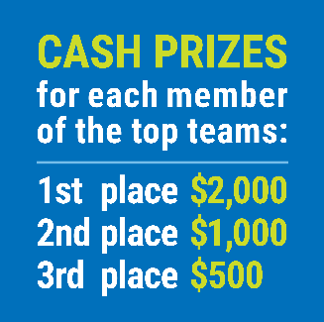

FIND YOUR LOCAL COMPETITION
AND REGISTER TODAY!
The National Personal Finance Challenge is a competition that provides high school students with an exciting and motivating opportunity to build, apply, and demonstrate their knowledge of money management.
Through online exams and a personal finance simulation, teams showcase their expertise in earning income, buying goods and services, saving, using credit, investing, as well as protecting and insuring.
Teams of up to four students, with one teacher/coach, can qualify to represent their state at the National Personal Finance Challenge by winning their local competition.
NATIONALS
Semi-Finals: First round elimination via online multiple-choice questions.
Finals: Case study round virtually co-hosted by the Cleveland Fed on June 3.
personalfinancechallenge.org

Slide 81
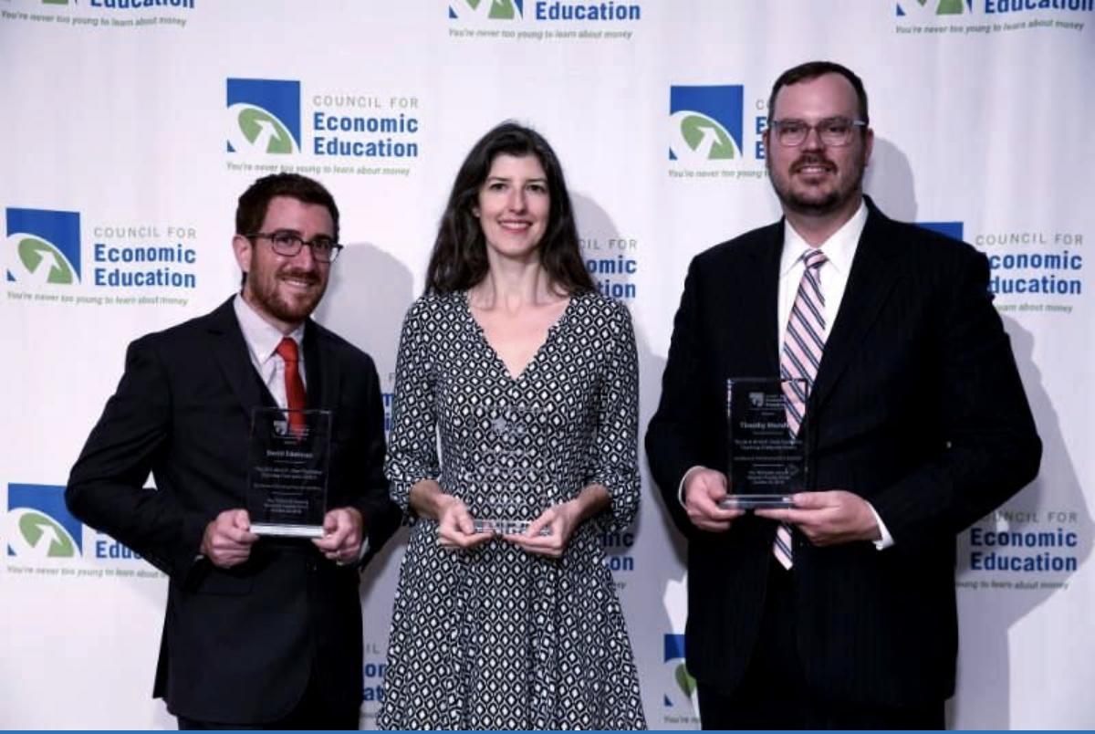
The 2021 Sloan Teaching Champion Award
Winners receive:
A cash award of $5,000
A cash award of $2,500 for their school to support economic education
Recognition at our annual Visionary Awards convening
This award promotes economic education by honoring three outstanding teachers who incorporate exemplary teaching techniques that improve their students’ economic understanding in and out of the classroom.
This award is open to New York metropolitan area high school teachers of all subjects, not just teachers of economics. Applicants must demonstrate how they integrate economics into their teaching.
Sound like you or someone you know?
Applicants must teach in one of the
Twelve New York state counties (New York, Kings, Bronx, Richmond, Queens, Nassau, Suffolk, Westchester, Putnam, Rockland, Orange and Duchess)
Eight New Jersey counties (Bergen, Passaic, Essex, Hudson, Middlesex, Union, Morris, Monmouth), or the
Two Connecticut counties (Fairfield and New Haven)
Application will be launched on Friday February 19th 2021
You can access the application here.
CONTACT
Please feel free to e-mail us at rrivera@councilforeconed.org
with any questions you have.

