Slide 1
Behavioral Finance: Saving
Saving & Misbehaving
Presented by: Tori Yauch
April 15, 2021
tyauch@nccee.org
Notes:
Hello everyone and welcome this webinar. And thank you Jarvon for such a kind introduction!
My name is Tori Yauch and I am here tonight to talk a bit about Behavioral Finance. We all aim to save, to invest, and to put away funds so that our future or the future of the next generation is secured.
But for many of us, these goals can seem difficult to achieve, impossible to manage, and just a struggle to accomplish.
We’re here tonight to learn a bit about these struggles and how understanding them can make us more effective at saving and investing money.

Slide 2
Standards
National Standard 12: Interest Rates
Interest rates, adjusted for inflation, rise and fall to balance the amount saved with the amount borrowed, which affects the allocation of scarce resources between present and future uses.

Slide 3
What is Today’s Goal?
By the end of today’s webinar, I want you to be able to do two things:
Describe and explain concepts to consider when discussing saving and financing.
Explain how these concepts impact our financial choices.

Slide 4
Agenda
What is Behavioral Finance?
Definition
History
The Relevance of Behavioral Finance
“Life happens!”
Good decisions make for more good decisions
A few major concepts of Behavioral Finance
Binmore Continuum
Time or Future Discounting
Self-Control
Buckets & Budgets
Want to Dive in More?
Resources
Notes:
This is the agenda we will be going through over the next hour…
We will start by quickly defining this field
As someone who absolutely loves history and is a huge history geek; I find it extremely important to look at where we have been to best understand where we are now and what might lie ahead. So we will spend a few minutes looking through the history that has led to this discipline.
Next is the relevance –
Finally, we will get into the content portion.
At the end, I will provide some of my favorite books and articles if you are interested in learning more about this discipline.

Slide 5
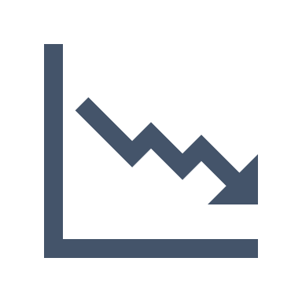
What is Behavioral Finance?
Classic finance asks how rational decisions makers should act when risk is accounted for.
Behavioral sciences focus more on how people actually respond to situations.

Slide 6
What is Behavioral Finance?
Behavioral Finance combines these disciplines and examines how people actually act when making decisions regarding financial choices that have a risk component.

Slide 7
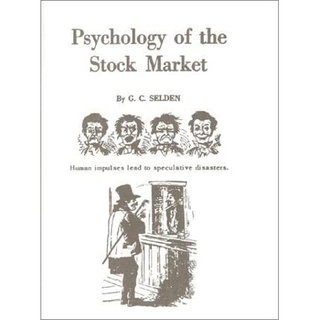
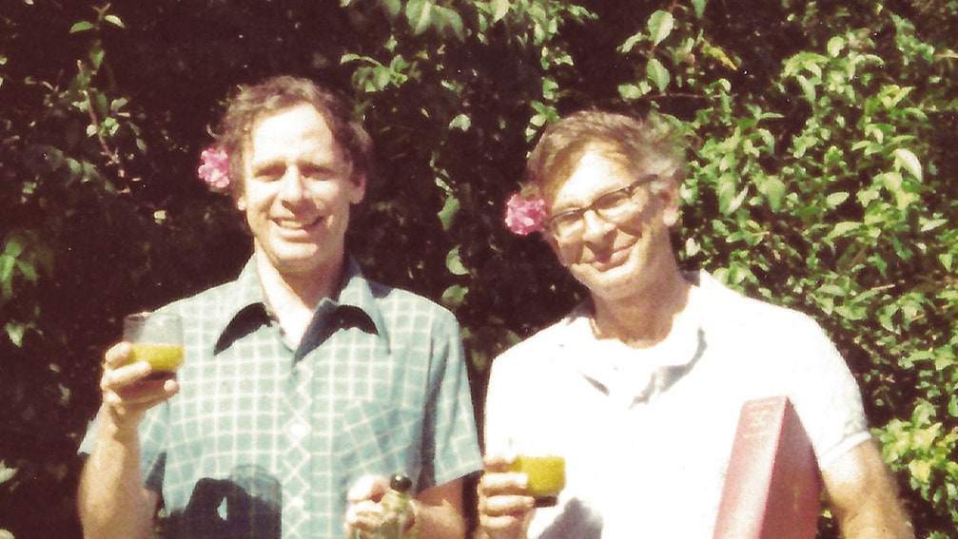
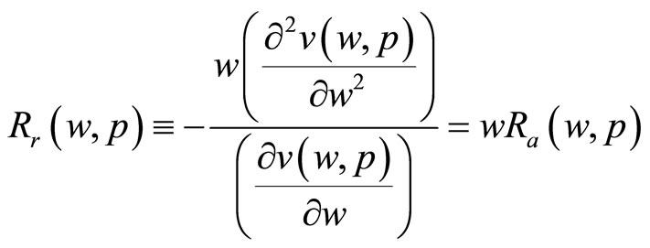
What is Behavioral Finance?
1912
G.C. Selden
Psychology of the Stock Market
1979
Daniel Kahneman & Amos Tversky
Prospect Theory: A Study of Decision Making Under Risk
1964
John Pratt & KJ Arrow
Defining Risk
Notes:
There are a lot of places we could begin our historical journey – as with most histories, but I think starting with the work of GC Selden is a good starting point. GC Selden became internationally known for his keen and thorough analyses of the effects of economic factors on business and investments.
In 1912, he wrote a book called “Psychology of the Stock Market” – this book predominantly focused on the human aspect of the market, and was a breakthrough in the finance sector.
To give a glimpse into this, consider the following excerpt from the introduction: “This book is based upon the belief that the movements of prices on the changes are dependent to a very large degree on the mental attitude of the investing and trading public.”
Definitely NOT a piece on finance, but a piece on ourselves.
This idea that financial choices, specific to investing, are much more human than they are financial, really took off.
There are many who continued this work, and the next most notable following a series of excellent statisticians that began to measure these less easily quantifiable things is the work of Pratt and Arrow. These two worked in both statistics, mathematics, and finance. They already knew that investors are generally risk-averse, but they aimed to better understand what factors make one investor more or less averse to risk than another.
Before we jump into the work of Kahneman and Tversky, I want us to take a quick look at the importance of the work of Pratt and Arrow.

Slide 8
Risk & Utility
Pro Risk
Utility
Risk Neutral
Risk Averse
“Mental Wealth”
UTILITY
This dotted line represents the date of planned retirement.
WEALTH
Notes:
Arrow and Pratt calculated a way of investing that is still predominantly followed today.
The first step is to understand the utility, or usefulness of something, as it relates to the proposed risk-aversion of an investor.
To understand this graph, note that the word UTILITY representing our vertical axis is the same as usefulness, or, how much an investor thinks they will get out of an investment.
Next, the x or horizontal axis represents wealth.
So, the higher the value of UTILITY, the more useful an investment is
And the further out the value of WEALTH is, the higher the wealth.
If this graph is still a little confusing; consider the following scenario:

Slide 9
Risk & Utility
I know every syllable of their music. I have seen them over 10x in concert.
Utility
I like the band.
The band is cool, but I can listen to them on Spotify.
How much you like the band
UTILITY
This dotted line represents the date of the concert.
WEALTH
$Price of a concert ticket
Notes:
This example puts this same information into the context of a concert ticket.
We ALL know that as a show gets nearer; the prices start to climb. But at least where I am at in North Carolina – a concert in the middle of summer can mean a beautiful evening, a scorching evening, a thousand mosquito bites, or a downpour of rain. There is RISK associated w/ this purchase for me.
So here; the utility becomes HOW MUCH SOMEONE LIKES THE BAND.
UTILITY of an investment;
UTILITY OF TIME VALUE;
The WEALTH becomes THE PRICE OF THE TICKET OR THE MONETARY VALUE
We all have an expected utility when it comes to music; as we all have different tastes. We don’t all go to every concert! So this shows that we have a risk profile for each band; those we don’t like as much we are much more risk AVERSE; or less likely to pay a lot. For bands we LOVE, or have high utility; we are willing to take on that additional risk.
So back to Pratt and Arrow;
We won’t get into the statistical work that was done to come up with this graph, but it basically categorizes investors as being prone to risk, averse to risk, or neutral to it; where Risk Neutral individuals are those who believe the utility they receive from a certain amount of wealth is on par with what they expected.
Next, we will see this in a non-graph form, and review a separate example that reflects the work of Pratt and Arrow.

Slide 10
Risk & Utility
Risk
Absolute (Dollars)
Relative (% of your total current wealth)
Risk Aversion (Hesitation to risk)
Has anyone heard something similar?
As you age, it is important to reduce the risk of your investment!
CHANGE | DEFINITION
Increase in absolute or relative risk aversion | As wealth increases, less held in risky assets
No Change | Same amount held in risky assets
Decrease in absolute or relative risk aversion | Have more in risky assets
Notes:
We will now look at this chart in its narrative counterpart’s format. As in, with words and not a graph.
First, let’s define Absolute, Relative, and Risk Aversion just to recap:
Absolute is an absolute dollar value; it is the actual amount of wealth.
Relative is a percentage in relation to your total current wealth.
So, let’s say you have $5, and you find $20.
Your ABSOLUTE WEALTH increased by $20, whereas your RELATIVE WEALTH increased by 300%.
So, we see here that our RED or RISK AVERSE investor; as the UTILITY/WEALTH go UP, the amount they put into risk assets DECREASES.
THE GREEN, our RISK LOVER investor; feels totally opposite about this. The MORE WEALTH THEY HAVE, THE MORE RISK THEY WILL TAKE.
Our neutral investor remains the same; and feels that wealth and utility go up together at an equal rate over time.
To apply this to investing; I think of any time anyone starts to set up an investment account. I’ll use me as an example;
As soon as I put my age in, since I’ve still got about 20 years until I can retire; my risk goes UP! And here is why:
Time is the ultimate utility with investments.
The more time you have, the more wealth you will have from the returns you will receive on that investment or savings.
So, let’s go back to our concert-goers!

Slide 11
Risk & Utility
Risk
CHANGE | DEFINITION
Increase in absolute or relative risk aversion | As the price of the ticket goes up, the less likely I am to buy one
No Change | The price of the ticket is worth to me whatever I’m willing to pay
Decrease in absolute or relative risk aversion | As the price of the ticket goes up, I feel more pressured than ever to buy the ticket! I must go to this concert!
Notes:
So again bringing in this concept of time; as we said before; the closer you get to the show, the HIGHER THE TICKET PRICE.
The UTILITY OF TIME is recognized here; Time is precious; and the concert venue understands this.
So for our RISK AVERSE PERSON; or our person who DOES NOT LIKE THE BAND THAT MUCH; they know that if they prices goes up too much; it will quickly EXCEED THEIR EXPECTED UTILITY AND THEREFORE BECOME A BAD PURCHASE.
For our Neutral guy – a reasonable price to them is whatever they feel like paying. It isn’t an especially low or high value; and they are likely fine with the incremental increases of price leading up to the concert.
For our RISK LOVER – OUR GREEN – If they forgot to buy that ticket until the last minute; GUESS WHAT – THEY’RE GOING TO DO IT. They feel that expected utility will STILL BE WORTH THE MONEY, even if that price goes sky high.
So now that we have a better understanding of Risk, Utility, and Time; let’s get back to the history lesson!

Slide 12
And We’re Back to History!
1912
G.C. Selden
Psychology of the Stock Market
1979
Daniel Kahneman & Amos Tversky
Prospect Theory: A Study of Decision Making Under Risk
1964
John Pratt & KJ Arrow
Defining Risk
Notes:
So everyone was REALLY happy about the work of Pratt and Arrow. People felt we finally had a good way to define an investor’s risk profile – AKA how much or little risk they want to take on.
So entering now is Kahneman and Tversky; two people that have revolutionized the way we view economics and finance. They solidified this idea that these are HUMAN systems; made by and used by humans. And with that, all of our wonderful flawed logic, biases, and hesitations.
In 1979, these two would be credited with the OFFICIAL beginning of Behavioral Finance in their work
Prospect Theory: A Study of Decision Making Under Risk. They find that rather than calculating the universe of potential outcomes and selecting the optimal one, investors calculate outcomes against a subjective reference point, such as the purchase price of a stock (remember that SUBJECTIVE IDEA OF UTILITY we talked about? We’re still speaking the same language here when talking about stocks).
Moreover, investors are loss averse, which means they are willing to take on more risk in the face of losses, but become more afraid of risk when it comes to protecting their gains.
What's notable about this first behavioral finance paper is the authors' willingness to ask the question, "Is all what it seems?" with regards to traditional finance, as investment decisions in real life can drastically differ from their theories about what we SHOULD do.
More importantly, the paper posits that the notion of the rational man, or the "rational expectations wealth maximizer" -- the bedrock of traditional finance -- doesn't actually exist. If traditional finance answers the question, "How should rational decision makers act in the face of risk?", then behavioral finance answers the question, "How do real, actual humans act in the face of risk?“
So now; the exciting part.

Slide 13
SO LET’S GET ON TO THE MAIN PERFORMANCE The CONTENT Portion of this Webinar!
Notes:
That was our opening performance!
On to the main event; the content of this webinar and ways to talk about behavioral finance in the classroom.

Slide 14
Content
A few major concepts of Behavioral Finance
Binmore Continuum
Time or Future Discounting
Self-Control: How does all that work?
Buckets & Budgets – Making a plan with jars, envelopes, or apps!

Slide 15
Content
Binmore Continuum
Notes:
So to explore the Binmore Continuum; it is an idea proposed by Richard Thaler; an excellent economist who also did a lot of work in Behavioral Finance alongside Kahneman and Tversky.
Let’s look at the slide.
They are in a particular order for a reason.
The colors are irrelevant.
Do you notice anything in particular about the order of these items?
For those who may be listening as opposed to viewing; the items are in the following order:
A cup of coffee, a donut, a slice of pizza, a tank of gasoline, a vehicle, and a house.

Slide 16
Content
Binmore Continuum
Notes:
I’ll give you the answer although I’m sure some of you may have an idea!
Lots of people drink coffee every day – we make transactions with coffee regularly.
Donuts? I’ve definitely had to cut back, but we all love to treat ourselves occasionally; and too have frequent transactions with things that may be seen as a treat or, for a more justifiable term: an inexpensive item which greatly increases my quality of life.
Next up – the pizza. Since the pandemic started; my partner and I have put in a ONE TAKEOUT A WEEK RULE; so, we are having a weekly transactional experience with takeout food.
Gasoline – Idk about you but I’m not driving quite as much as I was before; and I’m filling my gas tank every 10 days or so, but generally; I do notice when this price rises or falls.
Now the big stuff! A car! How many cars have you bought? I’ve gone through 5 at this point.
And finally – the house. Most of us won’t do this transaction but a couple of times.
SO WHY DOES THIS MATTER?
Here is a question to consider: WHEN THE STAKES ARE LOW – DO WE MAKE GOOD DECISIONS? WHAT ABOUT WHEN THE STAKES ARE HIGH? AND WHAT DO EXPERTS THINK?

Slide 17
Content
Binmore Continuum Traditional Finance
When the stakes are high, people make better decisions. Do you think this is true?
Notes:
In traditional finance, the Binmore Contiuum does not exist. It is thought that rationally, people do much better in making a choice when the stakes are high for that decision.
Do you think that is true?

Slide 18
Content
Binmore Continuum – Behavioral Finance
When the stakes are high, we make less than optimal decisions. When the stakes are low, we generally get it right.
Notes:
In behavioral finance and through experimentation; studies showed that the OPPOSITE WAS TRUE;
We make BETTER CHOICES WITH PRACTICE.
So, the things we do a lot; like buy coffee, treats, takeout, or gas – we tend to understand what a BETTER DEAL looks like.
When it comes to automobiles or homes; a lot of us are kinda clueless, and we are more prone to mistakes ESPECIALLY when the stakes are high.

Slide 19
Content
Binmore Continuum – In the Classroom
For each item, have students pick a range of prices they would expect to pay for each item.
Have them calculate the RELATIVE or % difference between the lowest and highest value of the class.

Slide 20
Content
Binmore Continuum – In the Classroom
Slice of Pizza:
$0.50 to $4.00
Automobile:
$2,000 to $40,000
House:
??? to ???

Slide 21
Content
Binmore Continuum – In the Classroom
Slice of Pizza:
$0.50 to $4.00
$3.50
Automobile:
$2,000 to $40,000
$38,000
(HIGH – LOW) / LOW = % CHANGE
(NEW – OLD) / OLD = % CHANGE OVER TIME
(4.00 – 0.50) / 0.50 = % CHANGE
% CHANGE = 700%
(40 – 2) / 2 = % CHANGE
% CHANGE = 1900%
A lower % means that we collectively understand this price better.
Notes:
If you like math; this is a good way to see it in numbers. We can see here that the ABSOLUTE VALUE OF WEALTH and the RELATIVE % CHANGE both become a lot higher for the car; so we can see here the stakes are higher. That lower % difference between the lowest and highest bet shows that we are better collectively at getting the prices of little things right as we are big things. The wider that gap becomes between the lowest and highest value of a thing; the worst we get at determining if it’s a good deal.
So HOW DOES THIS ACTIVITY APPLY TO SAVINGS? WHAT CAN MY STUDENTS AND I GET FROM THIS?

Slide 22
Content
Binmore Continuum – How to make better choices?
Thaler explains that two things are needed to learn from an experience:
Frequent Practice
Immediate Feedback
We get those two things much more from low-stakes choices than we do high
Notes:
So, another form of saving is responsible financing; better interest rates and terms make for better investments.
Thaler tells us in the book that in order to learn from an experience two conditions must be met: (1) frequent practice and (2) immediate feedback. With low stakes decisions, we all get plenty of opportunities to get things right because everyone has to make minor moves on a daily basis that have a small impact on their finances. It’s those big decisions — buying a house or a car, savings for retirement, paying for your children’s college education — that we get very few chances at perfecting. Yet those decisions will have by far the biggest impact on your finances.
People focus on getting the small things right because they can see those immediate results. This is also why so much of the personal finance advice out there focuses on cutting back on lattes or bringing homemade lunches to work. These things keep people busy, but rarely make a dent in your bottom line. It sounds like good advice because it’s something you can do right away, but those moves are a drop in the bucket in the grand scheme of things.
Not only do we get very few chances to perfect the most impactful financial moves in our lives, but more often than not, you’re left to your own devices on these decisions. Buying a home is a purchase that is driven by emotions nearly every step of the way, and the feedback of our choices isn’t always clear and sometimes never becomes clear.

Slide 23
Content
Binmore Continuum – How to make better choices?
Create those conditions in the classroom:
PRACTICE the car-buying process.
EconEdLink: Car Loan Project
GIVE FEEDBACK on the process.
The Process of Buying a Car
Be asking things like: What are the payment terms? What matters to you in buying a car? What criteria do you need met? How much are you willing to spend?

Slide 24
Content
Time or Future Discounting
Would you rather have $500 today or $550 one month from today?
Notes:
Time discounting focuses on relative value of something (usually a good or reward) at different points in time.
Evidence from this research shows that present rewards, or rewards TODAY, are weighted MORE HEAVILY than ones in the future.
Once rewards are at a really far away point in time, they can lose their value completely.
Studies also reveal that this is NOT time consistent. It does not make a pretty straight slope on a graph, and it frankly makes little sense as to when some individuals prefer today’s rewards versus rewards later.

Slide 25
I AM WHY YOU DON’T THINK SAVINGS IS IMPORTANT, WHY YOU DON’T ASSESS INVESTMENT OPTIONS EARLY, AND WHY YOU WILL WAIT FOREVER TO INVEST IN YOUR RETIREMENT!!!
Putting Extra Money in Savings
The Dark Side of Discounting
Notes:
Discounting and Saving: We obviously have a problem.
You can see here that Luke Skywalker is the light side in all of us – that side that wants to secure our future with good and consistent investments.
Darth Vader is that voice in our head that tells us to “do it later”, convinces us to think our investments for later can be done later.
Also after making this slide and reading this long blurb in the voice of Darth Vader; I think I will leave script-writing to the professionals.
For young students who could be missing out on thousands of dollars of savings and investing at a younger age; this idea of discounting can be pretty costly.
So next we’re going to talk about a pretty famous experiment where some VERY young people were put under pressure to not discount a future reward.

Slide 26
Content
Time or Future Discounting – A Fun Experiment
1972 – Stanford University professor Walter Mischel
Will kids wait longer for an additional reward?
Kid given 1 Marshmallow
Told if they wait, they’ll get a 2nd one.
They found that the kids who could wait performed better academically.
At first, it was believed that this was just personality; and it was unchangeable – so What does this have to do with my students?
Notes:
Add that the longitudinal study on these kids shows higher credit scores and higher academic achievement.

Slide 27
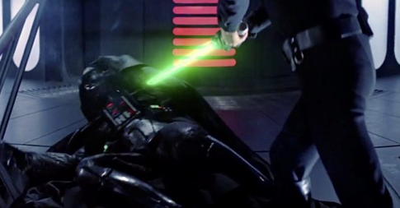
Content
Time or Future Discounting – Defeating Discounting
Reliability of Adults
Establishing group or team goals
Dollywood Foundation
Marshmallows Reimagined
Think like a FUTURIST
Imagining your future self
YouTube Video on Futurist Thinking
Notes:
Research has shown that personality is not FIXED. We are all able to grow and change and adapt to new information.
That being said; let’s talk about a few things the research shows that helps students defeat the dark side of discounting!
First, kids are better at setting future goals when their network of adults is reliable. When there is less trust in the world of a student, they are far less likely to wait for future rewards.
Another thing that helps kids set goals and stick to them is implementing times when they must cooperate to succeed.
In one example linked here – Dolly Parton promised kids in 6th and 8th grade that if they graduated high school; she would give them each $500.
On ONE CONDITION; they each pick a buddy. Now, you only got the $500 if you AND YOUR BUDDY graduated.
Drop-out rates in that district went from 35% to 6%. Cooperation works!
The next piece that shows cooperation is effective is this reimagined marshmallow experiment.
They made kids work together in order to receive rewards; and found that MORE KIDS GOT REWARDS even when the REWARD WAS LOWER;
AKA – cooperation had an additional value to the kids.
So with students; building in places where trust can be built or cooperation can be used to accomplish a financial decision simulation in the classroom can help students begin to see the value of diminishing their dark side of discounting.
Next is this idea of thinking like a futurist. We are taught a lot about history and how to think about things that have already happened, but we do not always get the same training on how to think about the future. I have linked a nice white paper that goes through many different ways to think about the future.
A good exercise to do with students regarding futures is to have them imagine their desired self later in life; what is their desired state? Once they have that in mind; talk about the steps needed to get there!

Slide 28
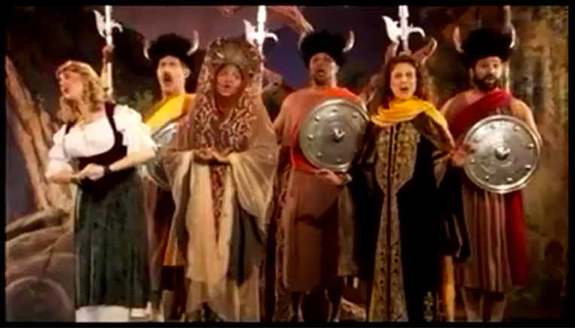
Content
Self Control
Investing in the future is not a long-term decision, it is thousands of smaller decisions made quickly and in the short-term.
Notes:
Self Control is a tricky thing; and most of us aren’t extremely good at it.
When it comes to financial choices – it comes down to making sure we have the short-term discipline needed to make good decisions in the long term.
Investing in the future is not a long-term decision; it’s a thousand small decisions we make in the short-term.
This image here is a great tune that I think of a lot when I think about how self-control bias effects money.
Generally; those with self control bias have issues putting aside money. This isn’t people who don’t have enough to save; it’s people who do and spend it elsewhere.
They typically put fewer dollars in savings, yet expect higher returns. These same investors with a prevalence of this bias also tend to want higher returns; and are also less likely to invest in places where their money may be locked in for longer EVEN WHEN THE INVESTMENT WOULD BE BETTER.
This image shows a commercial that really plays into our self-control bias of short-term spending; remember those JG WENTWORTH COMMERCIALS? It’s my money, and I want it now!
So, how can we relate this to students?

Slide 29
Content
Self Control
Since we all must accept that we are not always the most perfect decision-makers, we must learn to deal with this imperfection.
One of the most effective ways is using this principle called
FUNGIBILITY
So what is fungibility?

Slide 30
Content
Self Control
Fungibility is the ability of a good or asset to be interchangeable with other goods or assets of the same type. It implies equal value between the assets.
When an asset is fungible, it’s a chameleon, it can change and become equal to the other assets around it.

Slide 31
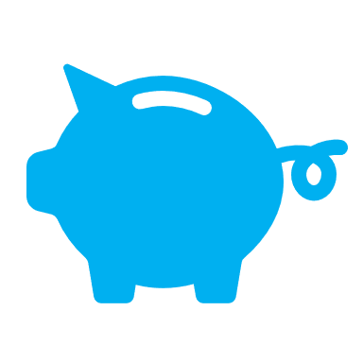
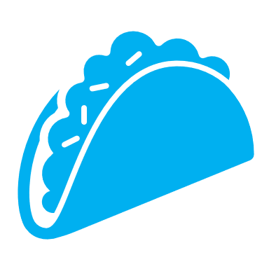
Content
Self Control
So how do we use this concept of Fungibility to our advantage?

Slide 32
Content
Self Control
Take Away the Fungibility!
Buckets & Budgets
Budgeting for Income and Expenses
Creating a Budget
Basics of Savings and Budgeting
Notes:
By assigning your money you are reducing this fungibility or change-ability. It is a clear, concise, and easy way that anyone can begin to save.
It can be in different accounts; auto-drafting money into savings on a recurring basis; or literally having money in separate envelopes/jars.

Slide 33
Want to dive in more?
Books
Misbehaving – Richard Thaler
Thinking Fast & Slow – Daniel Kahneman
The Undoing Project: A Friendship that Changed Our Minds
Kahneman & Tversky
Websites
Behavioral Finance
Video by Kahneman
Overconfidence
Ted Talk: Dan Ariely
How to change behavior.
Articles
Dave Ramsey on Saving Money

Slide 34
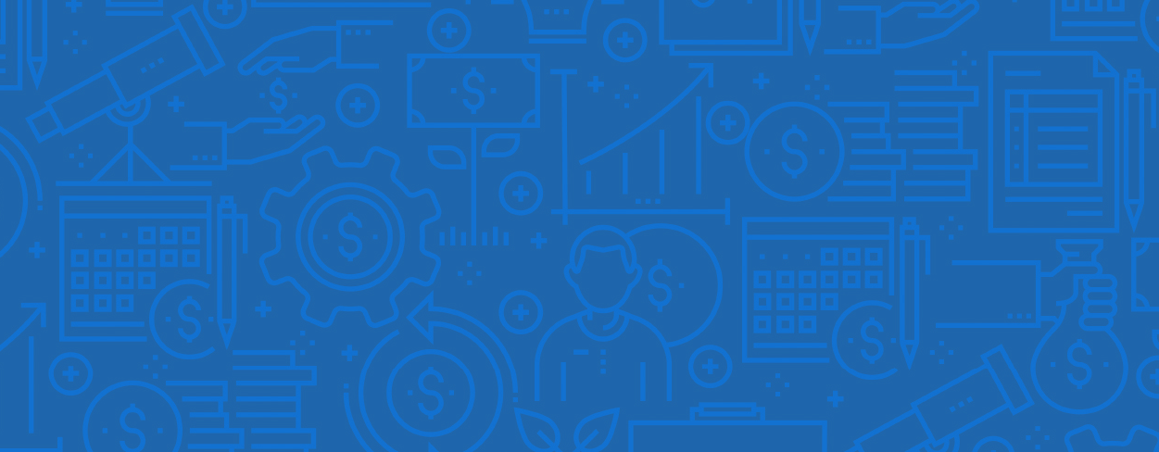
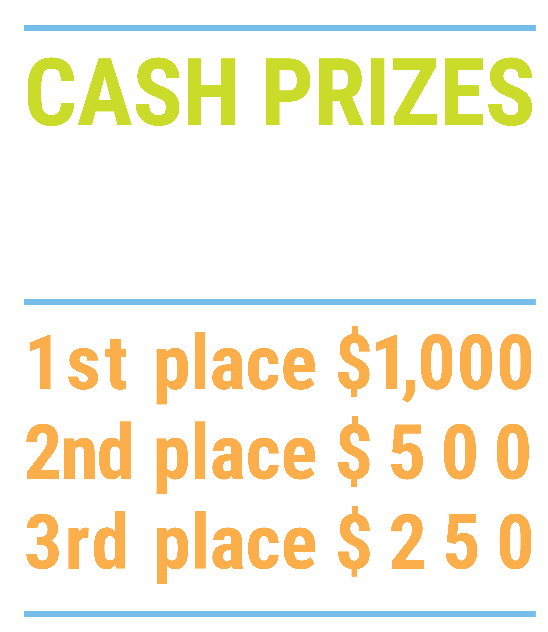
We’ve gone Virtual!
Teach Economics?
Your students may have what it takes to compete in the nation’s only high school economics competition!
Why Play?
• Fun team learning experience
• Great for college applications
• No other challenge like this
• Online participation makes access easy
• Chance for cash prizes
How it Works
Teams register
Teachers enroll team(s) of 3- 4 high school students from the same school. Multiple teams allowed.
Teams compete within their state
Compete to win your state competition for a chance to advance to the National Semi-Finals.
National Semi-Finals: May 3-20, 2021
Teams answer multiple-choice questions on macroeconomics, microeconomics, and international & current events.
National Finals: May 22-24, 2021
Teams analyze an economic issue and present their solution. Top teams engage in the Finals Quiz Bowl where they face-off answering questions to claim the National Title.
Two divisions based on experience level
David Ricardo for first-time competitors who have taken no more than one economics course.
Adam Smith for returning competitors, AP, International Baccalaureate, and honors students.
Register Today at NationalEconomicsChallenge.org

Slide 35
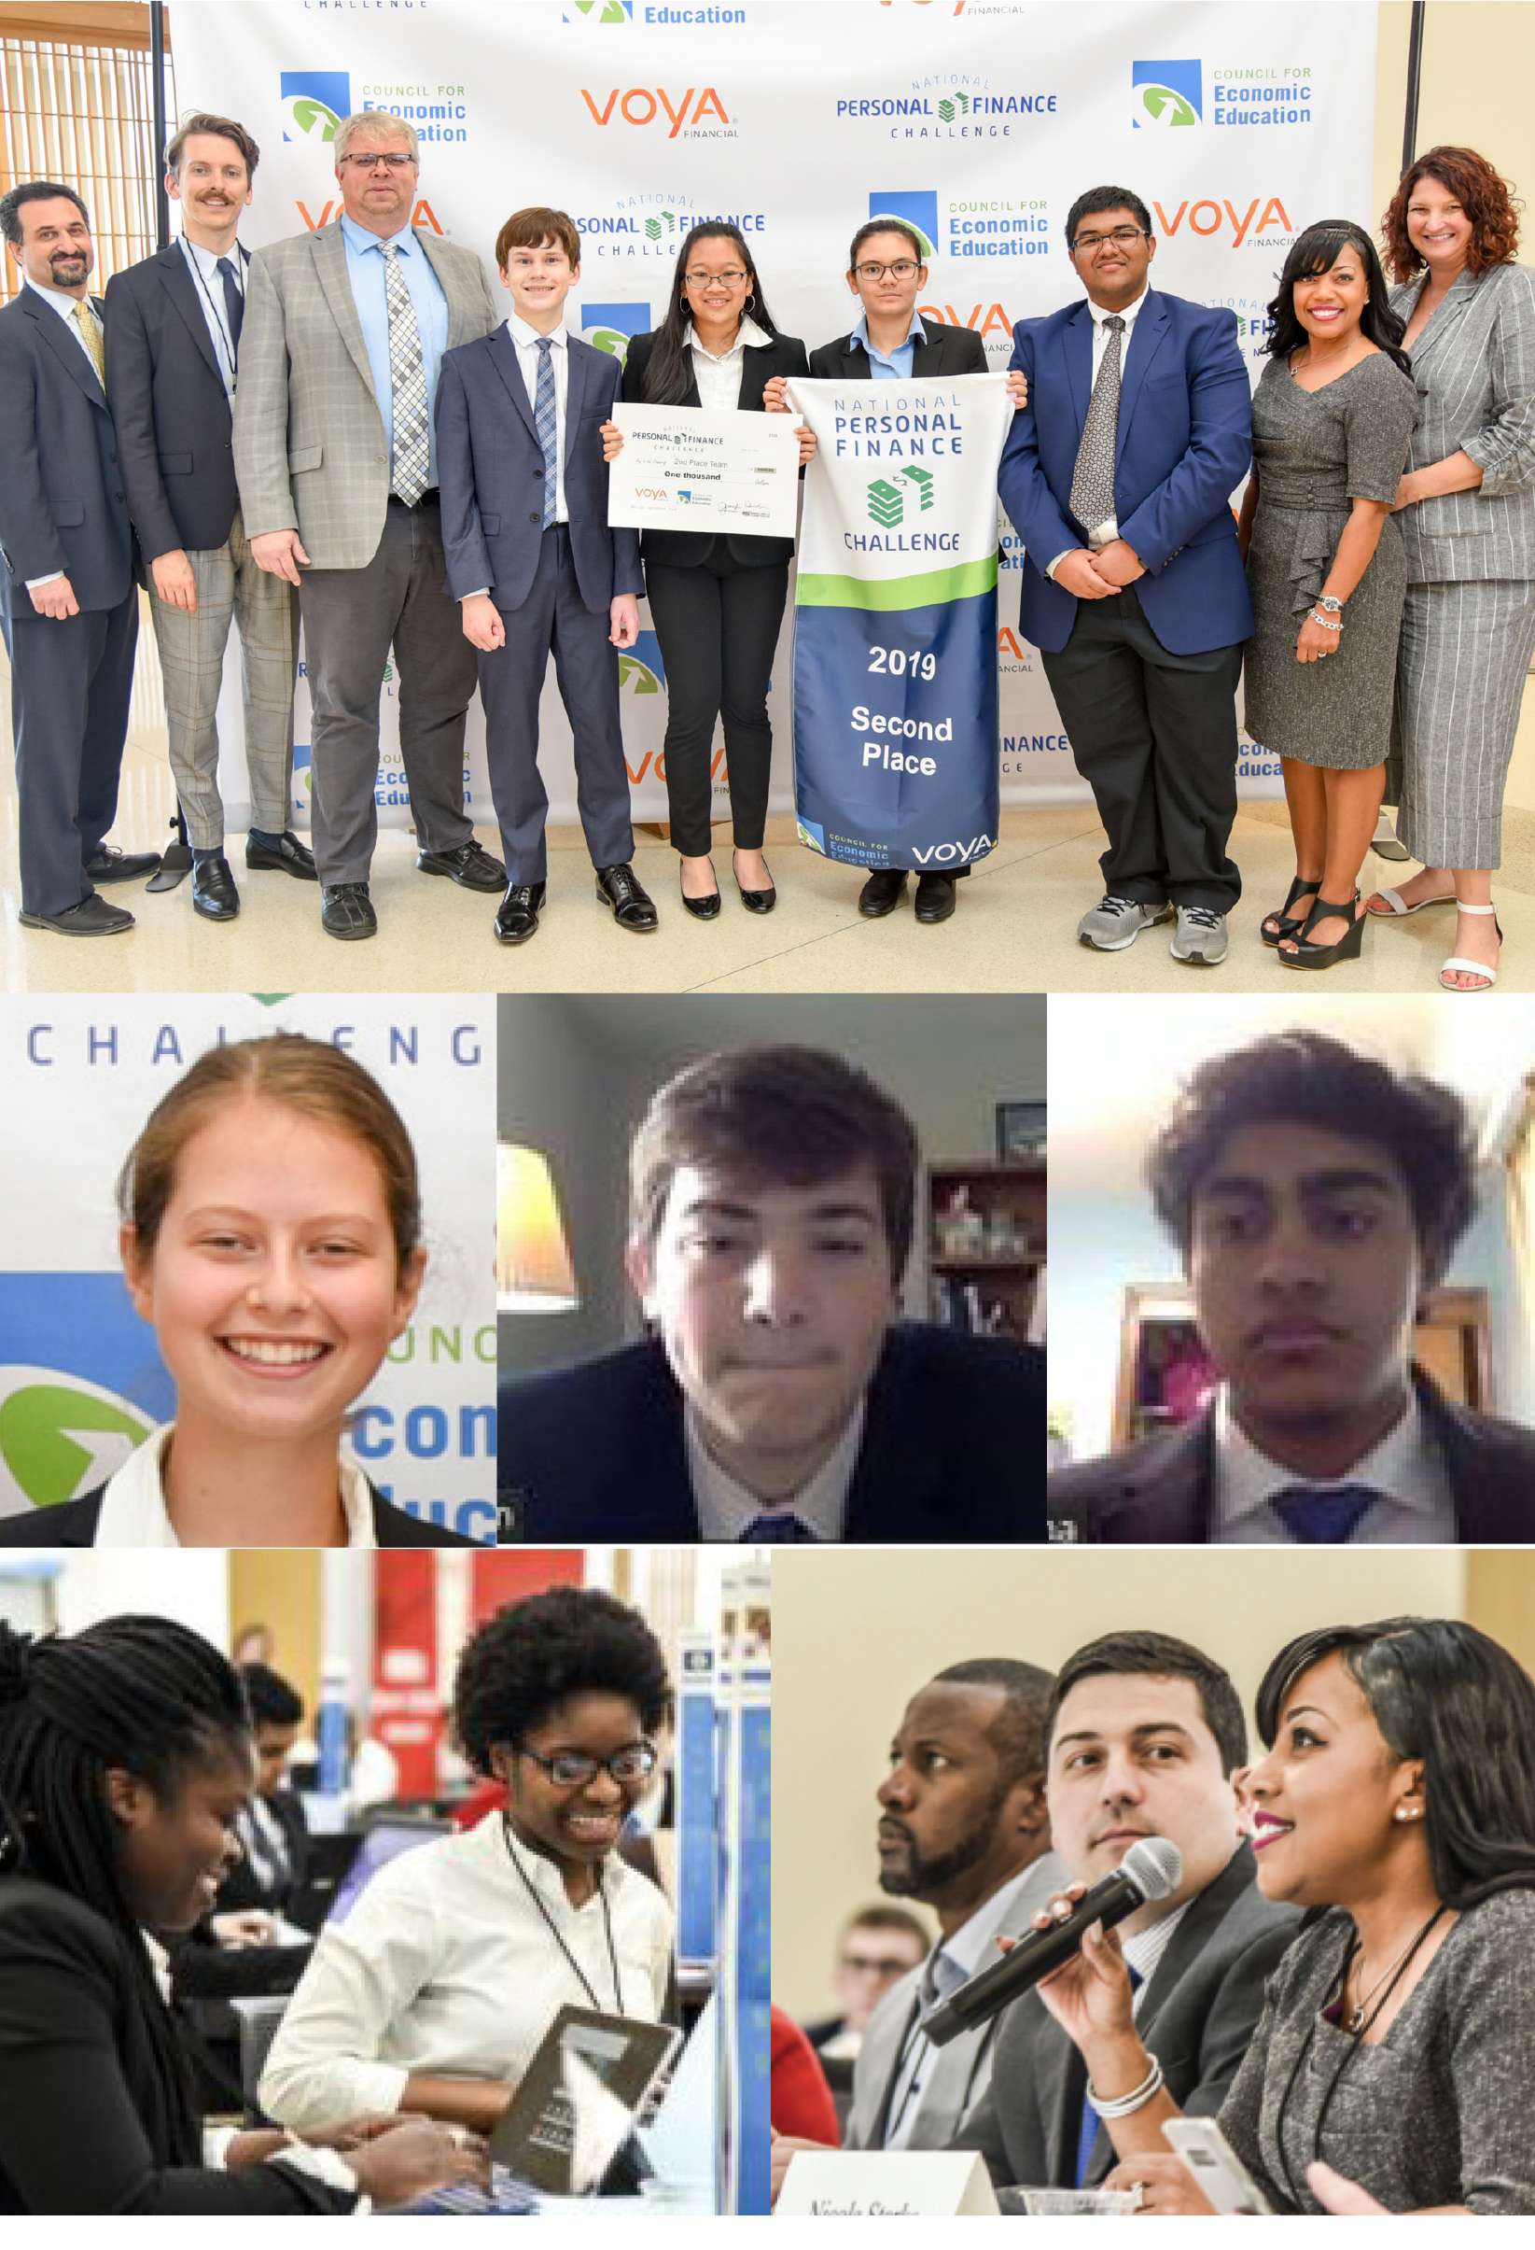
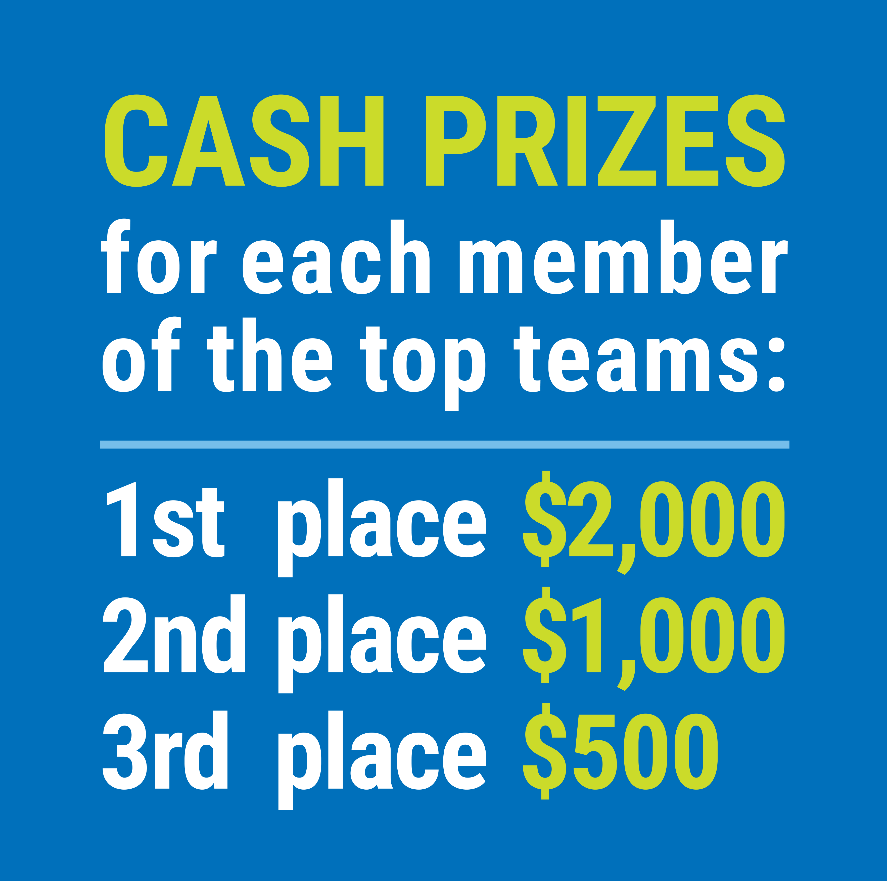
FIND YOUR LOCAL COMPETITION AND REGISTER TODAY!
The National Personal Finance Challenge is a competition that provides high school students with an exciting and motivating opportunity to build, apply, and demonstrate their knowledge of money management.
Through online exams and a personal finance simulation, teams showcase their expertise in earning income, buying goods and services, saving, using credit, investing, as well as protecting and insuring.
Teams of up to four students, with one teacher/coach, can qualify to represent their state at the National Personal Finance Challenge by winning their local competition.
NATIONALS
Semi-Finals: First round elimination via online multiple-choice questions.
Finals: Case study round virtually co-hosted by the Cleveland Fed on June 3.
personalfinancechallenge.org

Slide 36
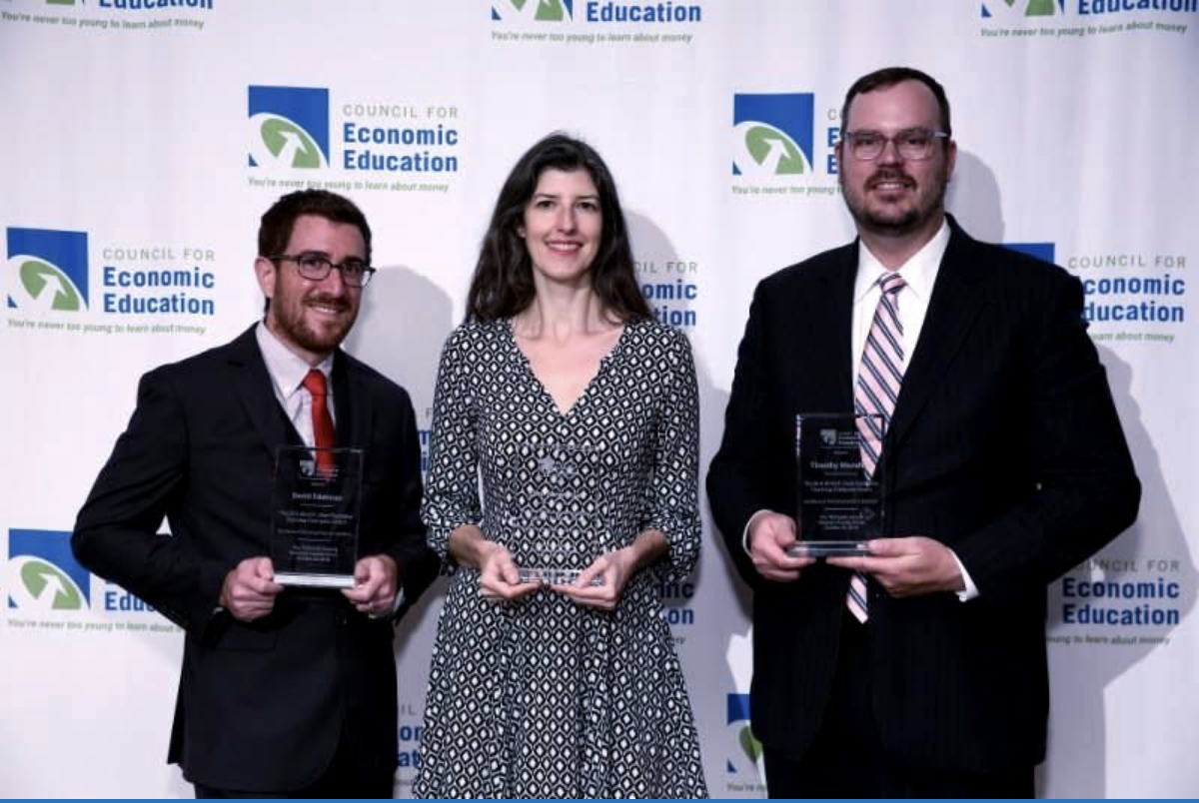
The 2021 Sloan Teaching Champion Award
Winners receive:
A cash award of $5,000
A cash award of $2,500 for their school to support economic education
Recognition at our annual Visionary Awards convening.
This award promotes economic education by honoring three outstanding teachers who incorporate exemplary teaching techniques that improve their students’ economic understanding in and out of the classroom.
This award is open to New York metropolitan area high school teachers of all subjects, not just teachers of economics. Applicants must demonstrate how they integrate economics into their teaching.
Sound like you or someone you know?
Applicants must teach in one of the
Twelve New York state counties (New York, Kings, Bronx, Richmond, Queens, Nassau, Suffolk, Westchester, Putnam, Rockland, Orange and Dutchess)
Eight New Jersey counties (Bergen, Passaic, Essex, Hudson, Middlesex, Union, Morris, Monmouth), or the
Two Connecticut counties (Fairfield and New Haven)
Application will be launched on Friday February 19th 2021
You can access the application here.
CONTACT
Please feel free to e-mail us at rrivera@councilforeconed.org
with any questions you have.

