Slide 1
Economics of Latin America
Jay LeBlanc (with thanks to Dr. Neal Rappaport from UCCS)
Economic Literacy Colorado
March 24, 2021
jay.leblanc@econlitco.org

Slide 2
EconEdLink Membership
You can now access CEE’s professional development webinars directly on EconEdLink.org! To receive these new professional development benefits, become an EconEdLink member. As a member, you will now be able to:
Automatically receive a professional development certificate via e-mail within 24 hours after viewing any webinar for a minimum of 45 minutes
Register for upcoming webinars with a simple one-click process
Easily download presentations, lesson plan materials and activities for each webinar
Search and view all webinars at your convenience
Save webinars to your EconEdLink dashboard for easy access to the event
You may access our new Professional Development page here

Slide 3
Professional Development Certificate
To earn your professional development certificate for this webinar, you must:
Watch a minimum of 45-minutes and you will automatically receive a professional development certificate via e-mail within 24 hours.
Accessing resources:
You can now easily download presentations, lesson plan materials, and activities for each webinar from EconEdLink.org/professional-development/

Slide 4
Agenda for Today’s Session
Overview of Latin America – geography, culture, etc..
“Why Are Some Nations Wealthy?” revised lesson
Overview of Immigration/Emigration issues in the region
“Why Do People Move?” lesson (only slightly revised)

Slide 5
Objectives
Teachers will learn about current economic and social issues within Latin America.
Teachers will study some of the current immigration and emigration issues related to Latin America and the economic impacts of those issues on Latin American countries.
Teachers will examine economics lessons connected to economic development and the trade-offs faced by Latin American countries.

Slide 6
Colorado State Standards
6th Grade, Standard 2 Geography, “Examine the characteristics of places and regions, and how regional differences and perspectives in the Western Hemisphere impact human and environmental interactions;
6th Grade, Standard 3 Economics, “Investigate how societies create different economic systems in the Western Hemisphere”, specifically describe how economic systems in the Western Hemisphere (such as traditional, command, market, and mixed) allocate resources; plan and evaluate complex solutions to global economic system challenges; and use economic reasoning to explain how specialization of production can result in more interdependence (like international trade patterns).
6th Grade, Standard 3 Economics, “Investigate the role of consumers within the Western Hemisphere” – specifically explain how different societies in the Western Hemisphere define the roles of buyers and sellers in product, labor, and financial markets; identify what role competition and wages have played in different cultures; and analyze how external factors might influence spending decisions for different individuals.
High School, Standard 3 Economics, “Economic systems, market structures, competition, and government policies affect market outcomes” – specifically explore the role of government in addressing market failures

Slide 7
Colorado State Standards (con’t)
High School, Standard 2 Geography, “Examine the interconnected nature of the world, its people and places” – specifically how the uneven distribution of resources in the world can lead to conflict, cooperation, or competition among nations, regions, and cultural groups; and explain how migration of people and movement of goods and ideas can enrich cultures but also create tensions.
High School, Standard 3 Economics, “Productive resources (natural, human, capital) are scarce; therefore, choices are made about how individuals, businesses, governments, and nonprofits allocate these resources – specifically what incentives influence choices and analyze how these groups deal with the challenges of scarcity.
High School Standard 3 Economics, “Globalization and international trade affect the allocation of goods, services, and resources” – specifically recognize how exchange rates affect economic activity; explain how trade policies affect international trade and domestic markets; and explore the effects of current globalization trends and policies
High School, Standard 4 Civics, “Analyze the origins, structures, and functions of governments to evaluate the impact on citizens and the global society” – specifically analyze how current global issues impact American foreign policy, for example: foreign trade agreements.

Slide 8
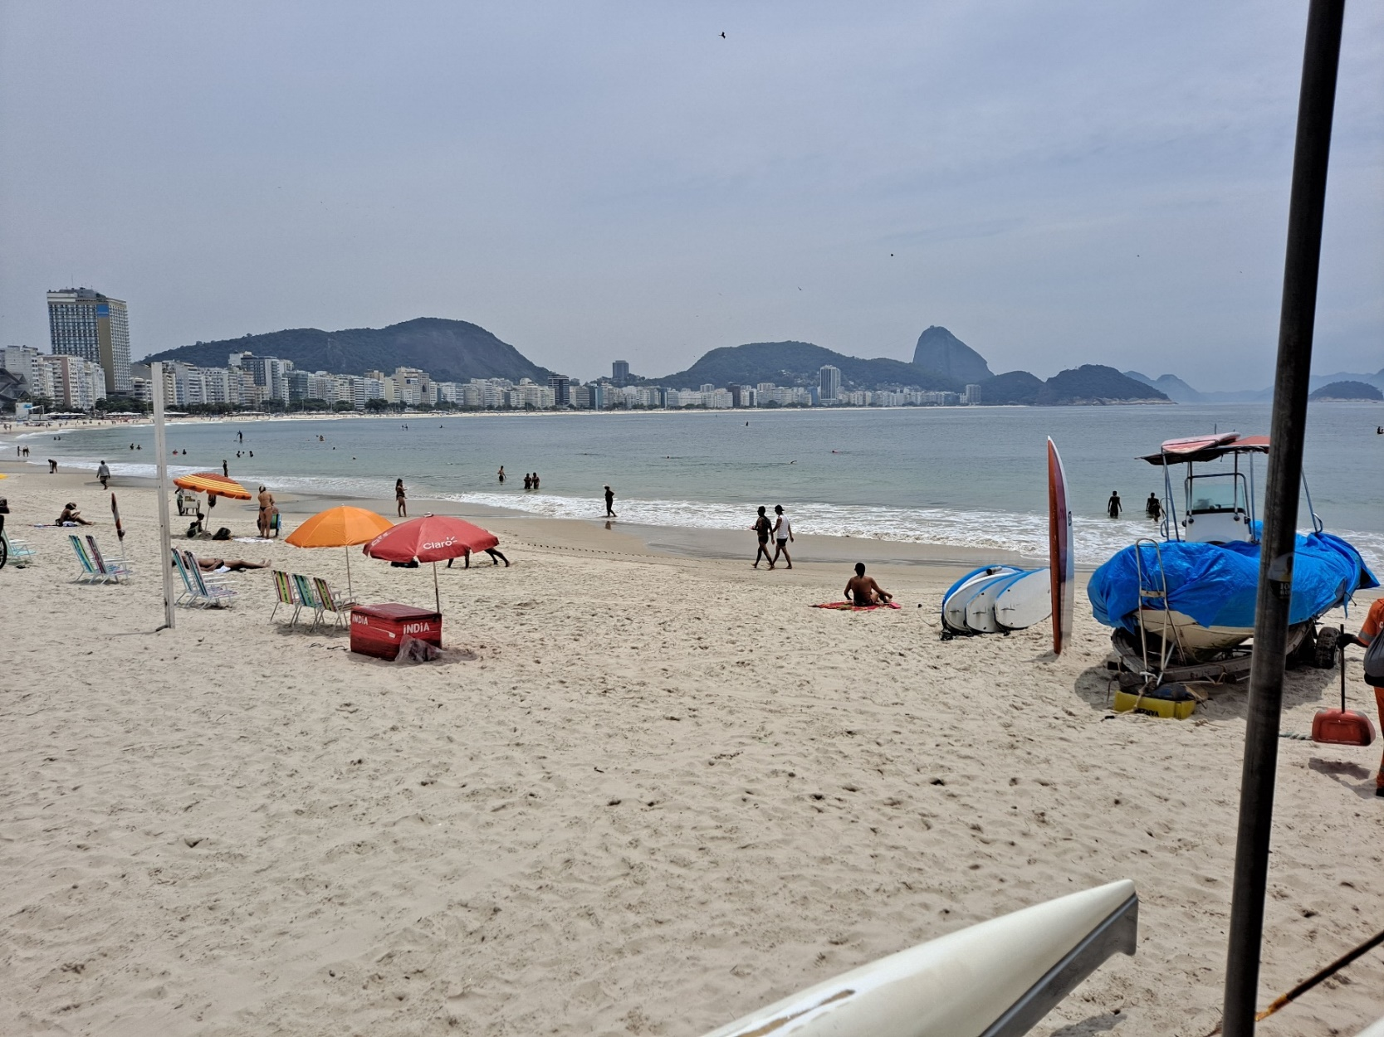
Overview of Latin America
Copacabana Beach, Rio de Janeiro, Brazil - November 2020

Slide 9
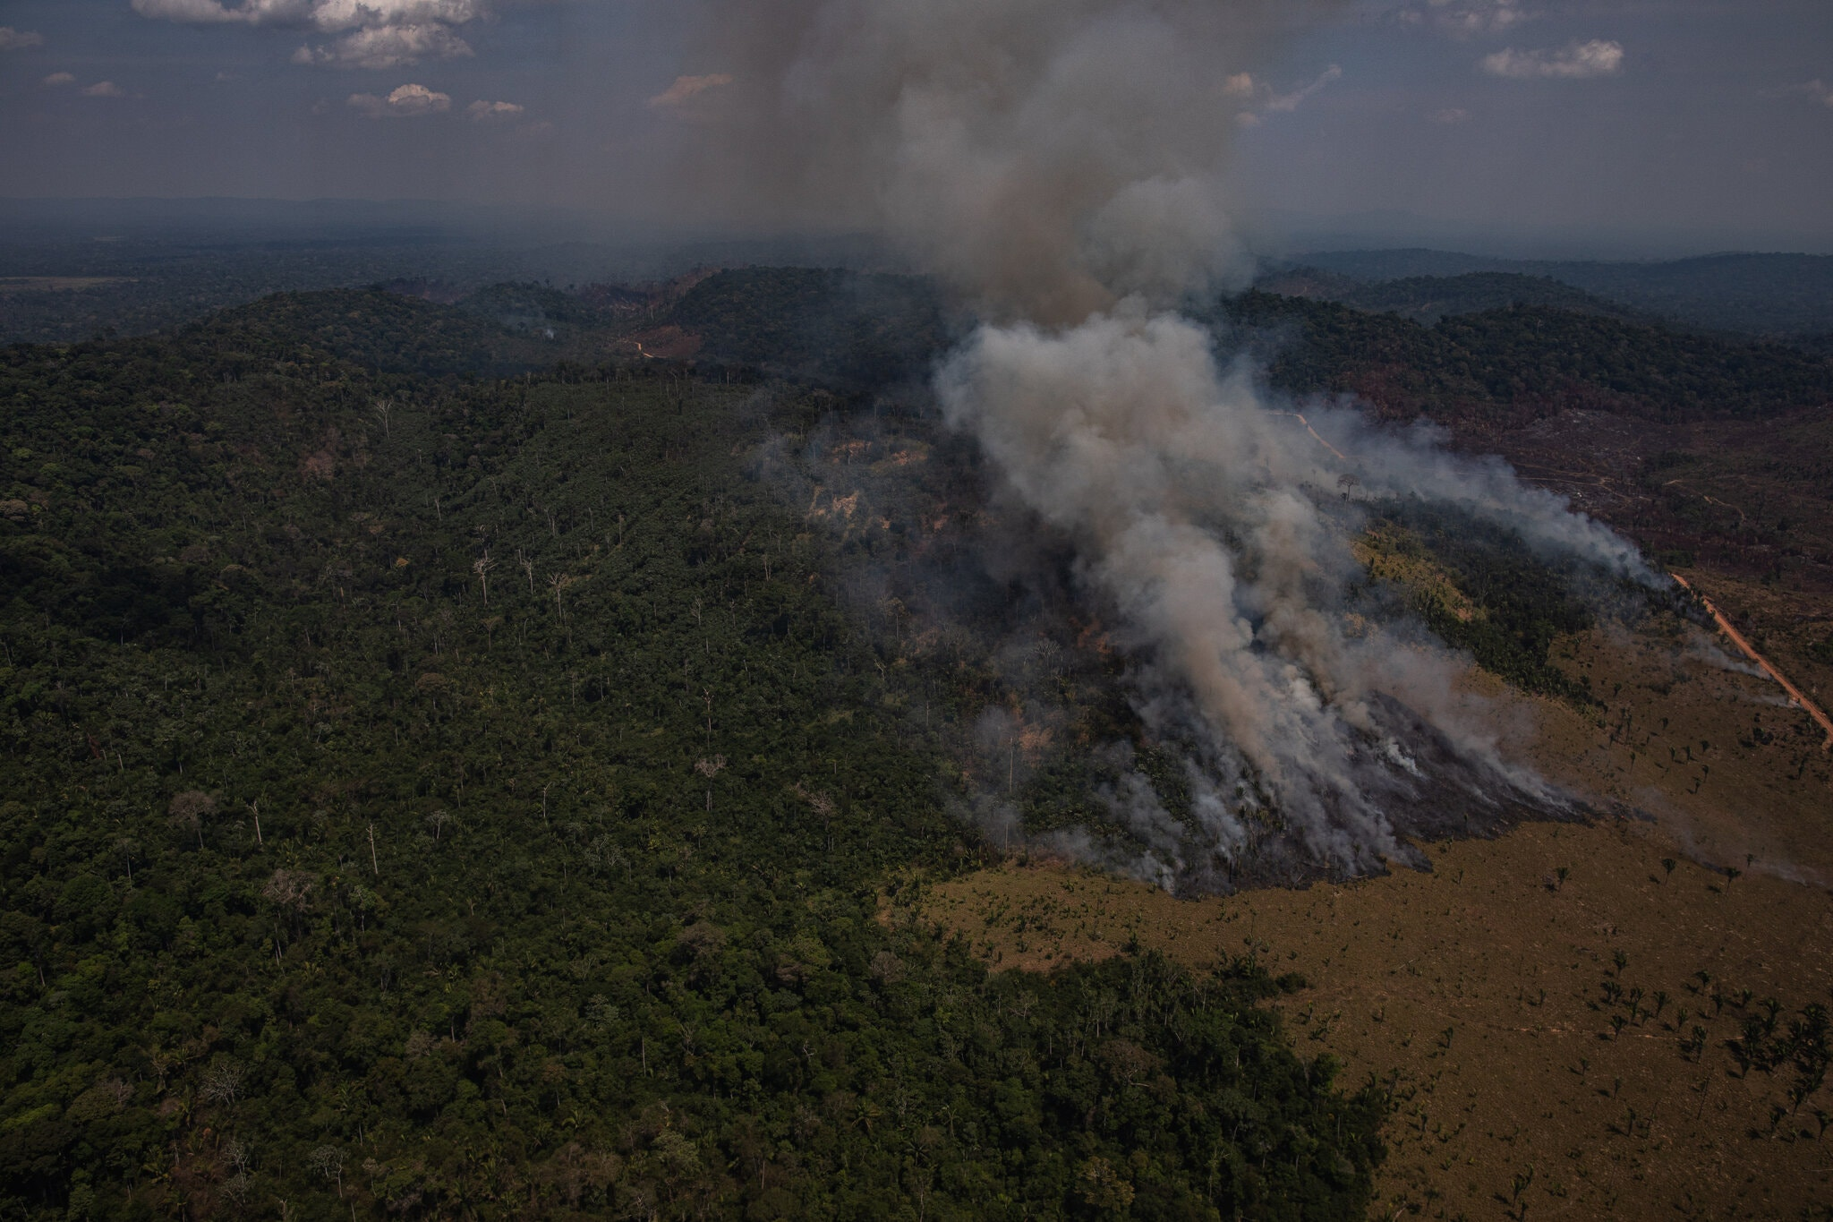
Overview of Latin America
Brazil Amazon Deforestation Hits 12-Year High Under Bolsonaro
NY Times, 30 November 2020

Slide 10

Overview of Latin America
Embraer 390, Made in Brazil (the world's 3rd largest plane manufacturer)

Slide 11
Short video clip on Embraer

Slide 12
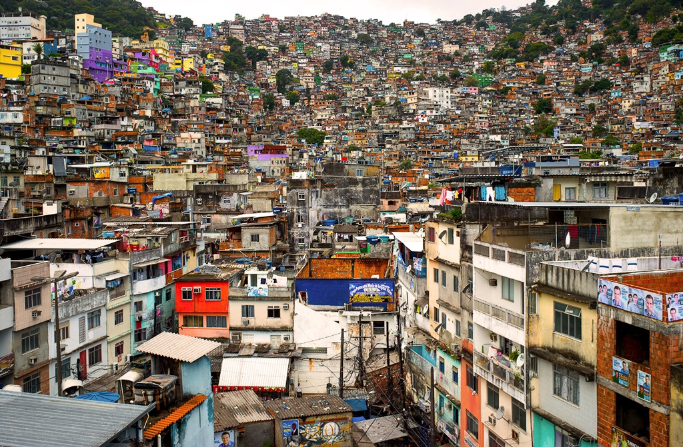
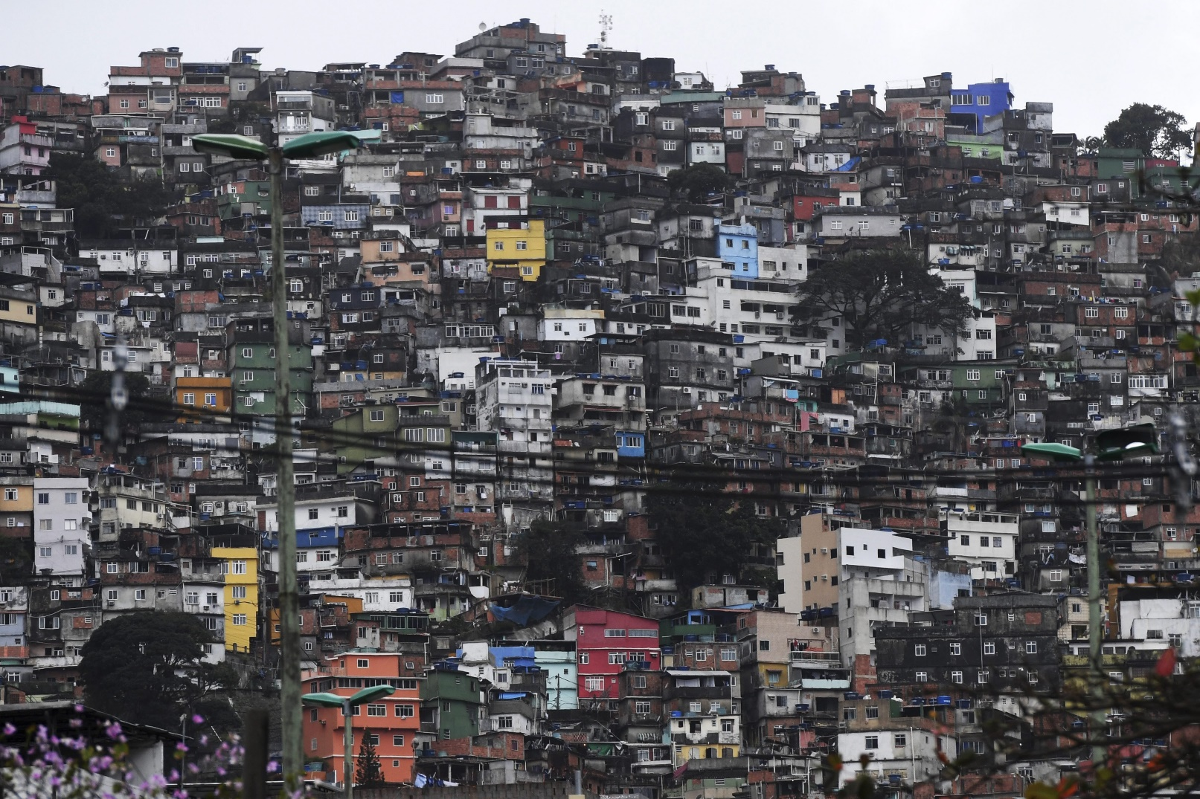
Overview of Latin America

Slide 13
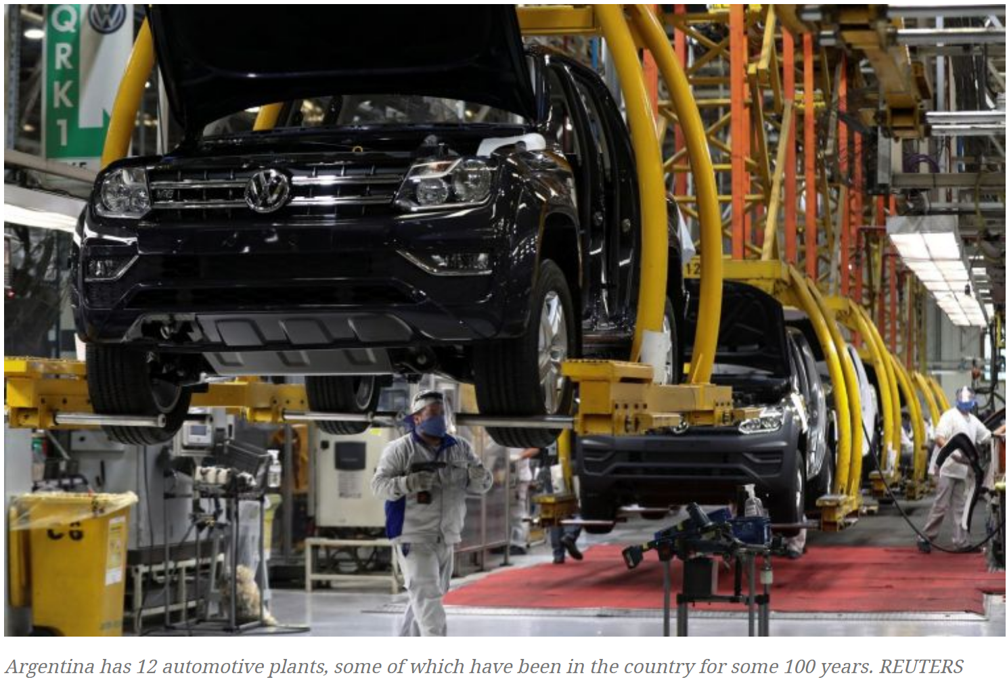
Overview of Latin America

Slide 14
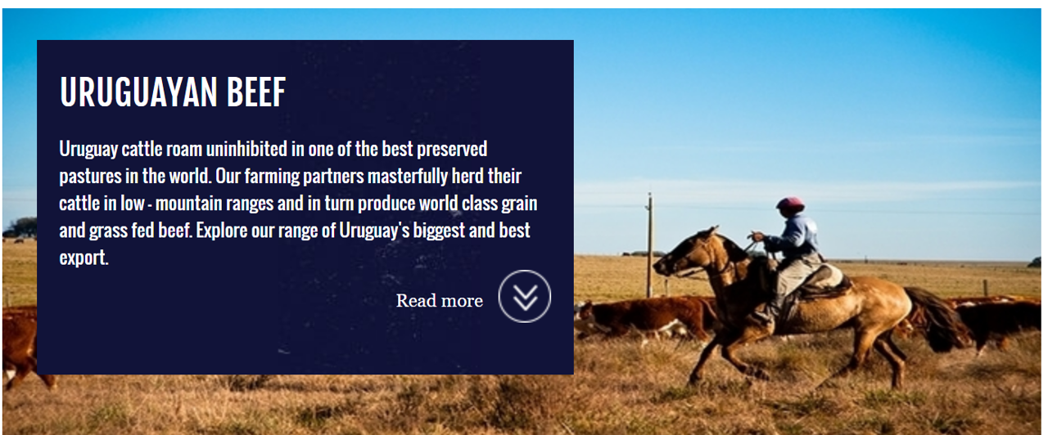
Overview of Latin America

Slide 15

Overview of Latin America

Slide 16


Overview of Latin America

Slide 17

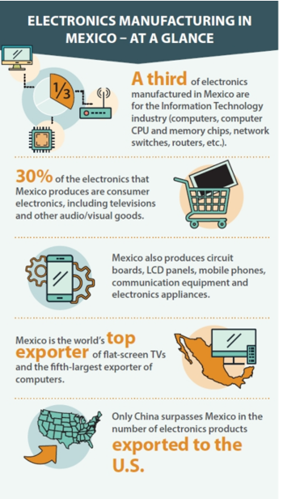
Overview of Latin America

Slide 18
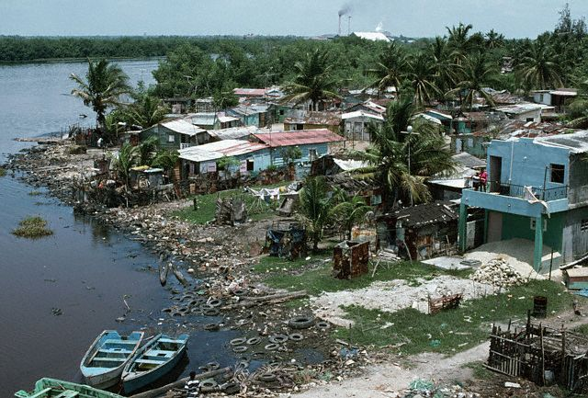
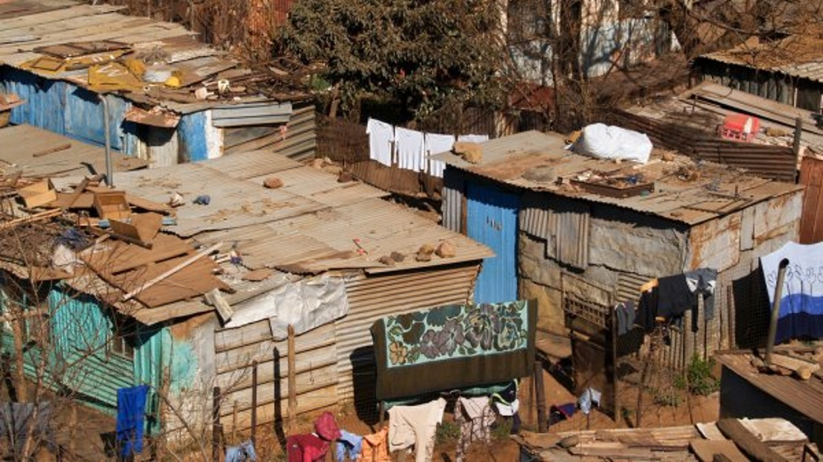
Overview of Latin America

Slide 19
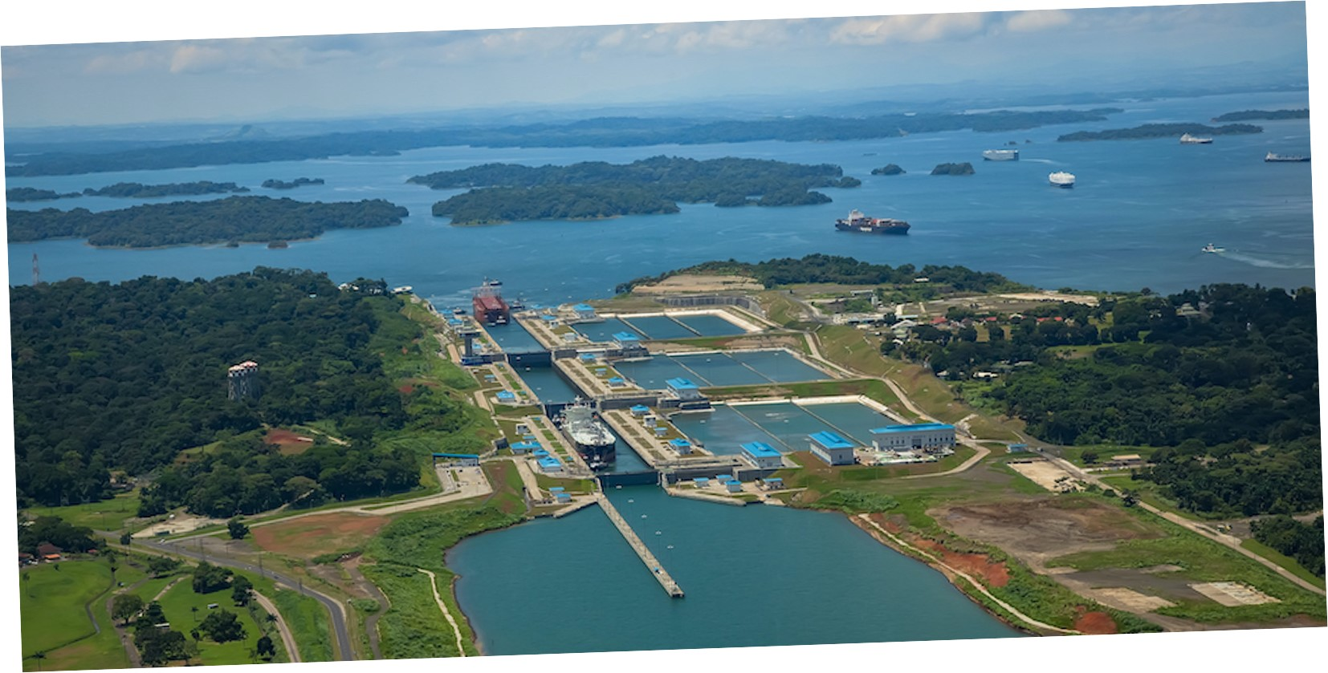
Overview of Latin America

Slide 20
Survey #1 – Which image do YOU think of first when you think of
Latin America?

Slide 21
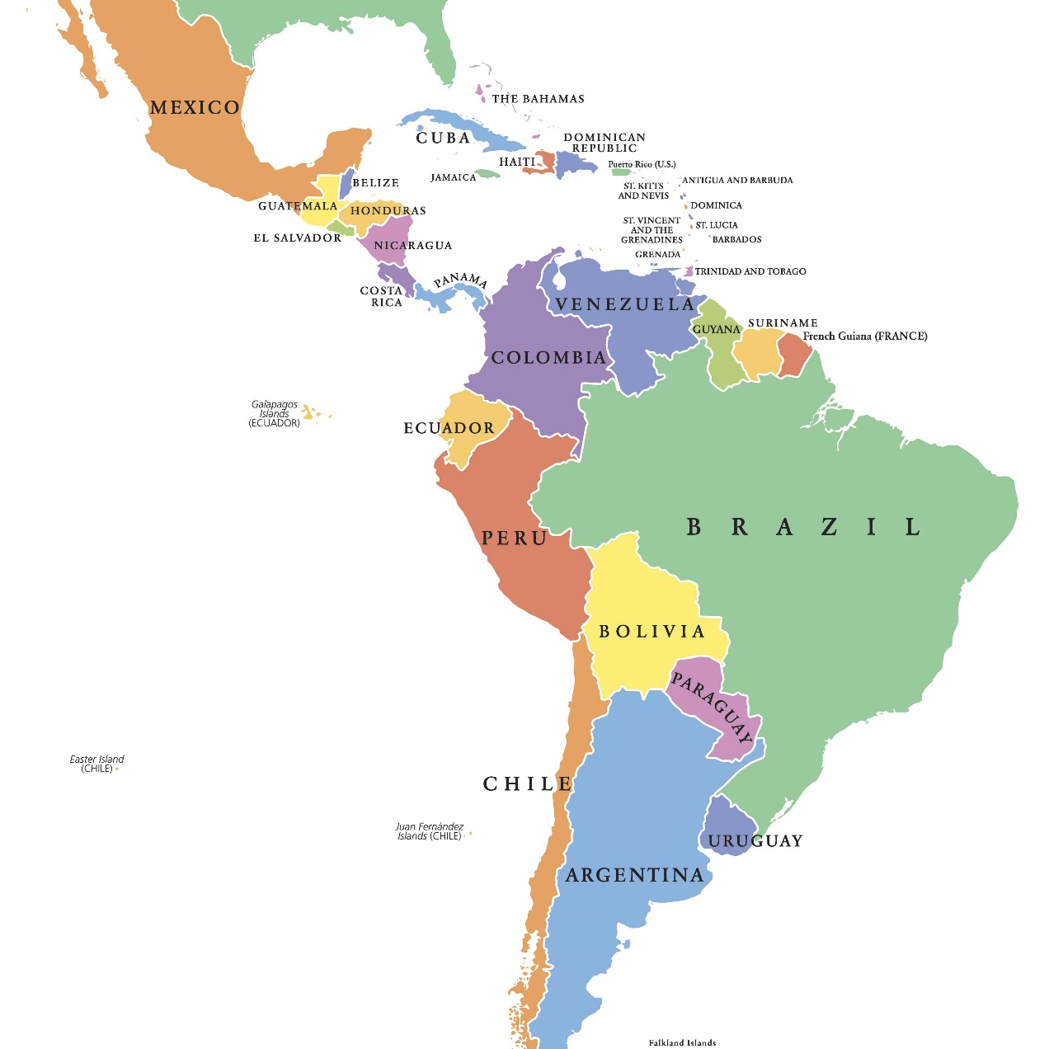
Overview of Latin America
What is Latin America?
Latin America is not the same as South America
  South America is a continent; Latin America is (typically) defined as cultural
    Latin America generally refers to the area where languages spoken are Latin-based
      Spanish, Portuguese, French
So, Latin America includes countries/areas in:
  North America – Mexico
  Caribbean – e.g. – Cuba
  Central America – e.g. Panama
  South America – e.g. Brazil

Slide 22
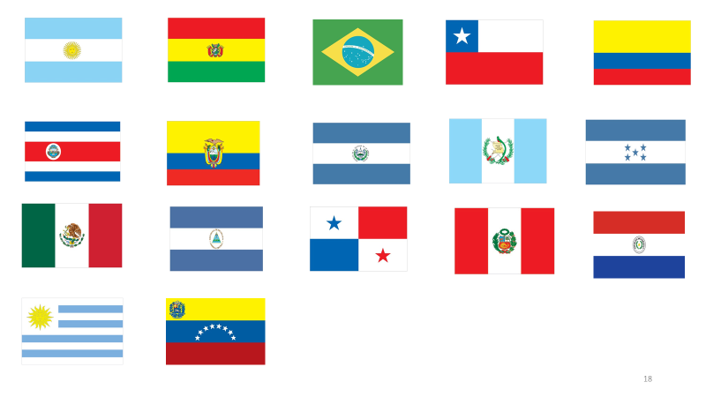
Overview of Latin America
33 countries:
12 in South America
7 in Central America (8 if including Mexico)
13 in the Caribbean
Also 15 dependency territories (including Puerto Rico, the Virgin Islands, French Guiana, Curacao, Aruba, etc..)

Slide 23
Some Facts & Figures

Slide 24
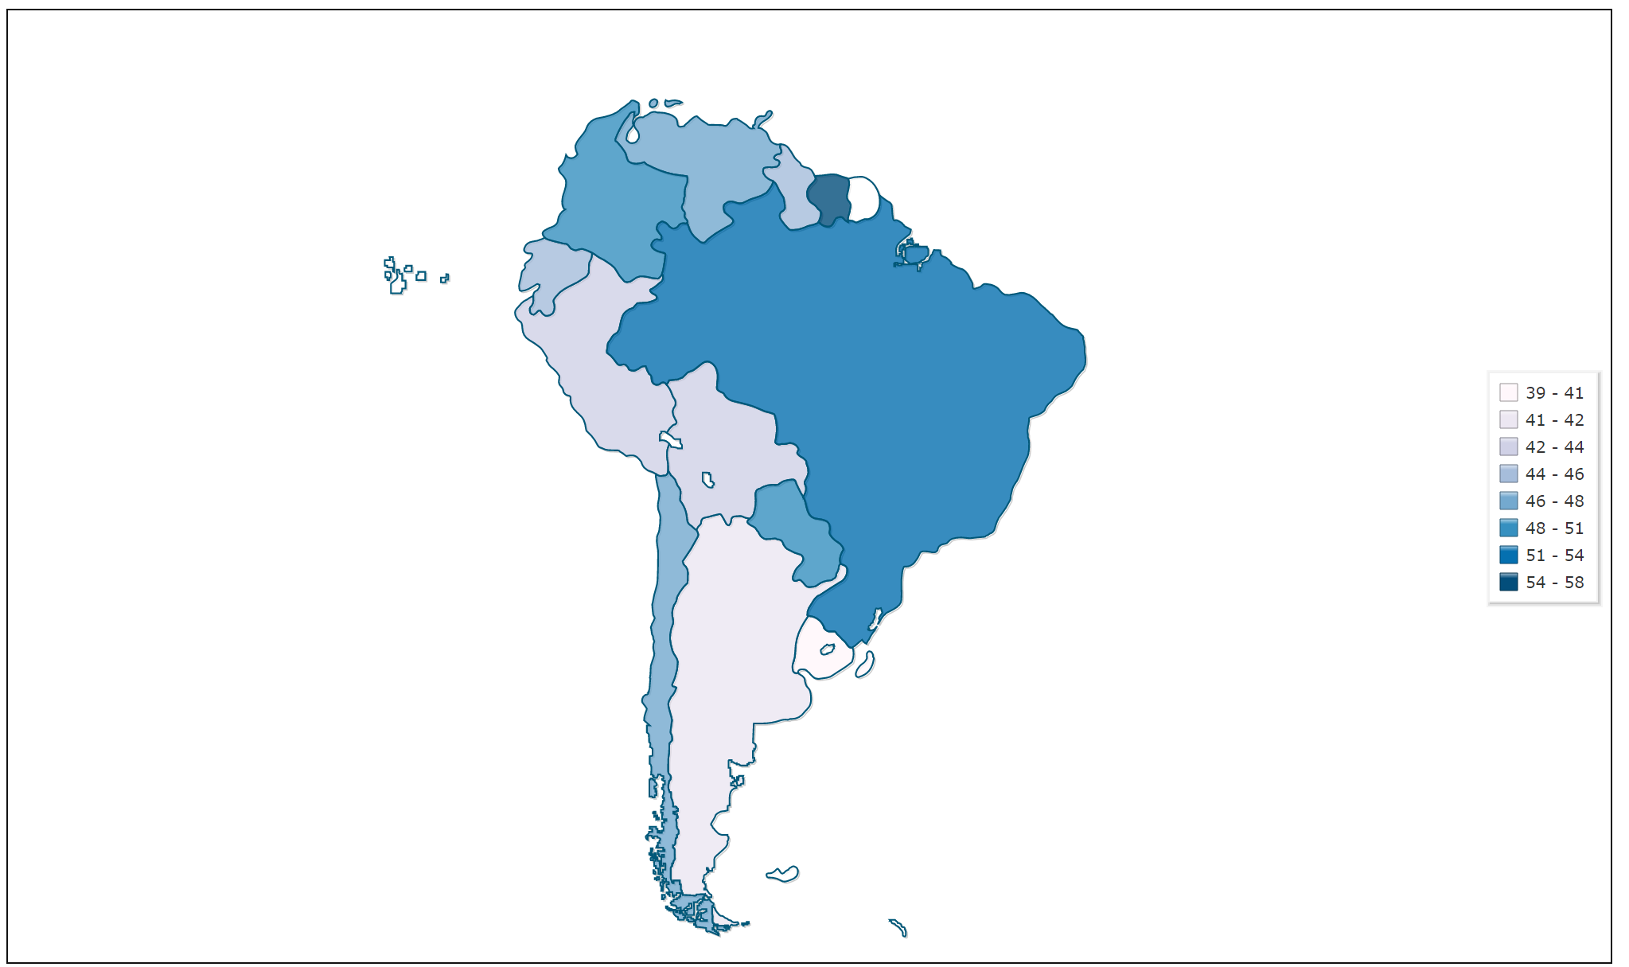
Overview of Latin America
Gini Coefficient (0 = total equality; 100 = total inequality)
(Source: World Bank)
FYI: US ~ 41

Slide 25
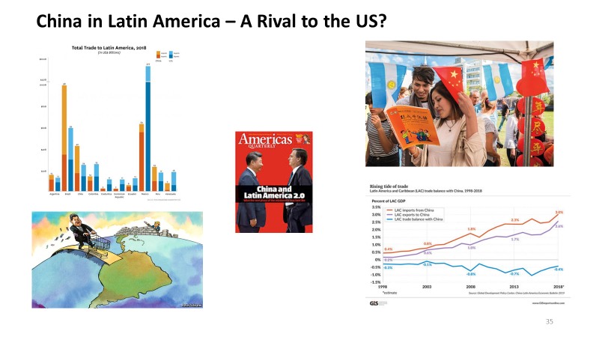
Overview of Latin America

Slide 26
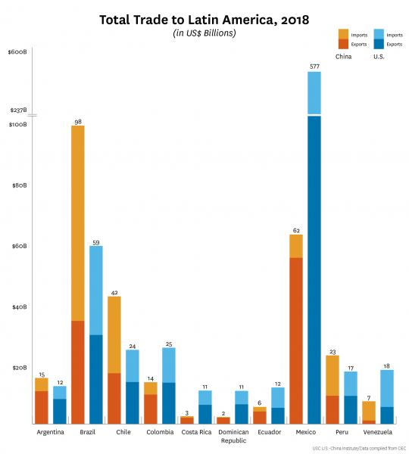
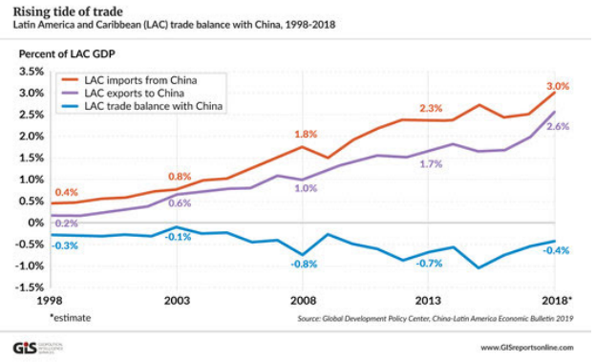
Overview of Latin America

Slide 27
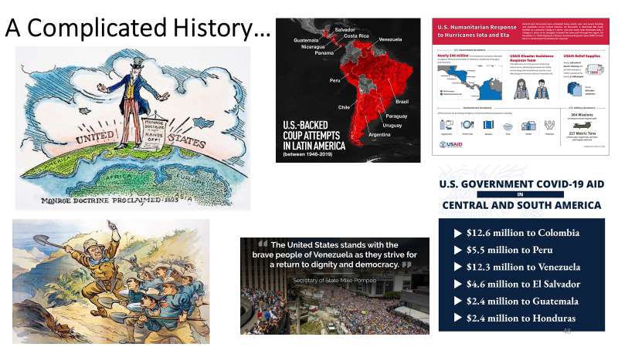
Overview of Latin America

Slide 28
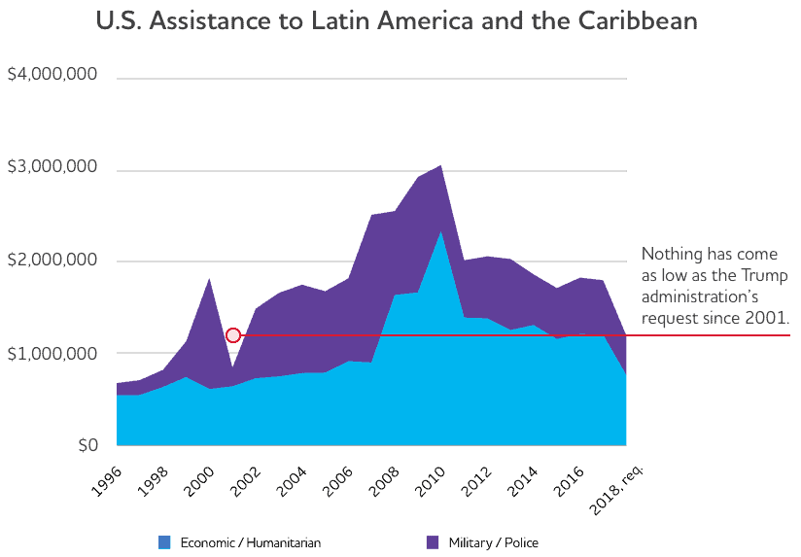
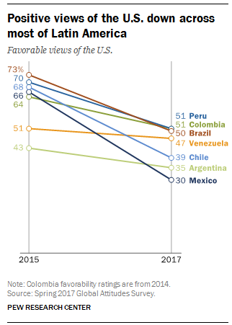
Overview of Latin America

Slide 29
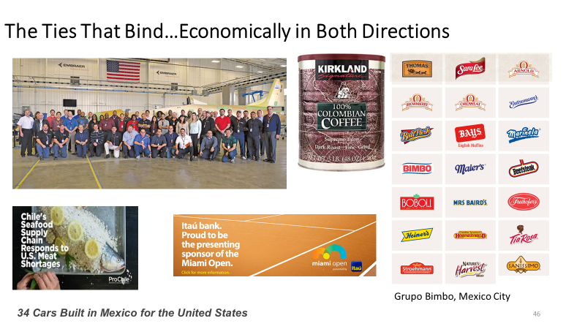
Overview of Latin America

Slide 30
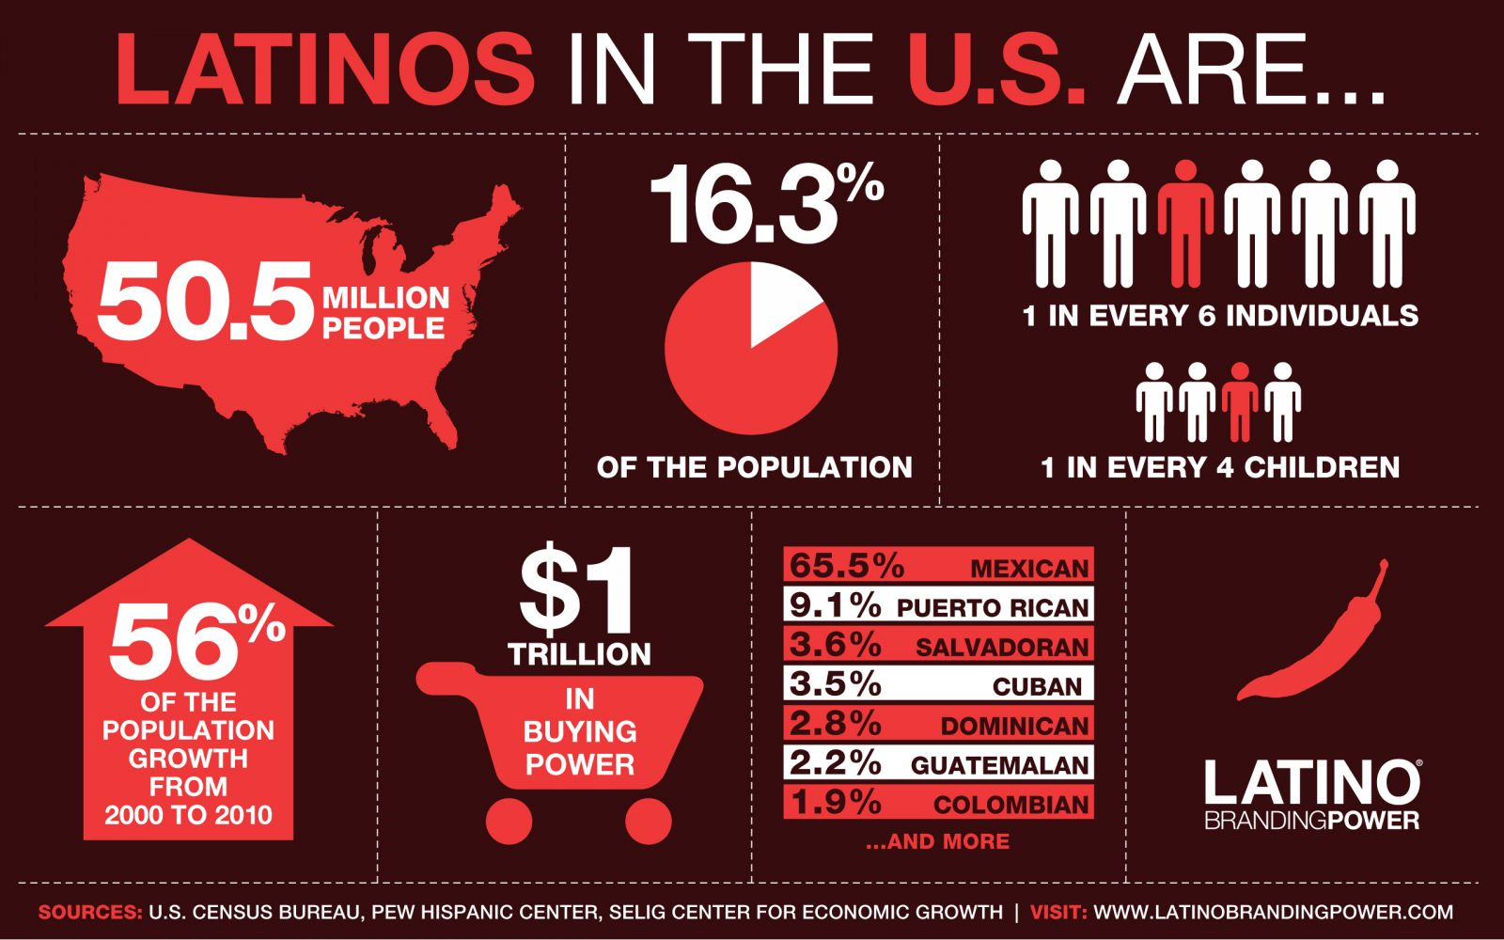
Overview of Latin America
Advantage: US…even in the modern world

Slide 31
Survey #2 – Which do YOU think should be Latin America’s chief trading partner (China, US, or EU)?

Slide 32
PDF of the “Why Are Some Nations Wealthy” lesson (shared on other window)

Slide 33

Mystery Country A
Area: 744,000 sq km. A little larger than Texas
Major Exports: Copper, lithium, fish, fruit, paper and pulp, chemicals
Internet Access: 82% of population
Life Expectancy: 79.4 years
Population: 18.2 million (2020 est.)
Biggest Trade Partner: China
Mystery Country B
Area: 882,000 sq km. Twice the size of California
Major Exports: Petroleum, bauxite and aluminum, steel, chemicals, agricultural products
Internet Access: 72% of population
Life Expectancy: 71.1 years
Population: 28.6 million (2020 est.)
Biggest Trade Partner: United States
Mystery Country C
Area: 1,285,000 sq km. Size of AZ, NM, and TX combined
Major Exports: Fish and fish products, copper, zinc, gold, lead, coffee, sugar, cotton, crude petroleum
Internet Access: 53% of population
Life Expectancy: 74.8 years
Population: 31.9 million (2020 est.)
Biggest Trade Partner: China
Mystery Country D
Area: 1,100,000 sq km. Size of NM, TX and LA combined
Major Exports: Soybeans, natural gas, zinc, gold, silver, lead, tin, wood, sugar
Internet Access: 44% of population
Life Expectancy: 70.5 years
Population: 11.7 million (2020 est.)
Biggest Trade Partner: China/Brazil

Slide 34
Mystery Nations Revealed
Mystery Nation A – Chile Per Capita Income - $23,500
Mystery Nation B – Venezuela Per Capita Income – $3,000
Mystery Nation C – Peru Per Capita Income - $11,500
Mystery Nation D – Bolivia Per Capita Income - $8,300
NOTE – World GDP per capita: $18,381 (Source: International Monetary Fund)

Slide 35
Mystery Country E1
Area: 48,300 sq km. New Hampshire/Vermont combined
Major Exports: Cocoa, tobacco, sugarcane, coffee, cotton, sugar, gold mining
Internet Access: 75% of population
Life Expectancy: 72.1 years
Population: 10.5 million (2020 est.)
Biggest Trade Partner: United States
Per Capita GDP: $8,300
Mystery Country E2
Area: 27,750 sq km. About the size of Massachusetts
Major Exports: Light manufactures, coffee, oils, mangoes
Internet Access: 33% of population
Life Expectancy: 65.3 years
Population: 11.1 million (2020 est.)
Biggest Trade Partner: United States/China
Per Capita GDP: $1,700
Final Mystery “Country”
Area: 9,100 sq km. Size of Denver-Boulder metro area
Major Exports: Chemicals, pharmaceuticals, electronic goods, rum, beverage concentrates, canned tuna
Internet Access: 85% of population
Life Expectancy: 80.2 years
Population: 3.2 million (2020 est.)
Biggest Trade Partner: United States
Per Capita GDP: $35,000

Slide 36
Mystery Nations Revealed
Possible Follow-up Questions for Discussion
How can some nations with few natural resources, such as the Bahamas, Panama and Uruguay, be relatively wealthy?
How can other nations with vast amounts of natural resources, such as Peru, Brazil and Venezuela, be so relatively poor (per person)?
How could two countries that share the same island, Haiti and the Dominican Republic, have such different outcomes?
Why does a relatively poor portion of the United States (like Puerto Rico) still have so much more wealth than its’ neighbors in the Caribbean?

Slide 37
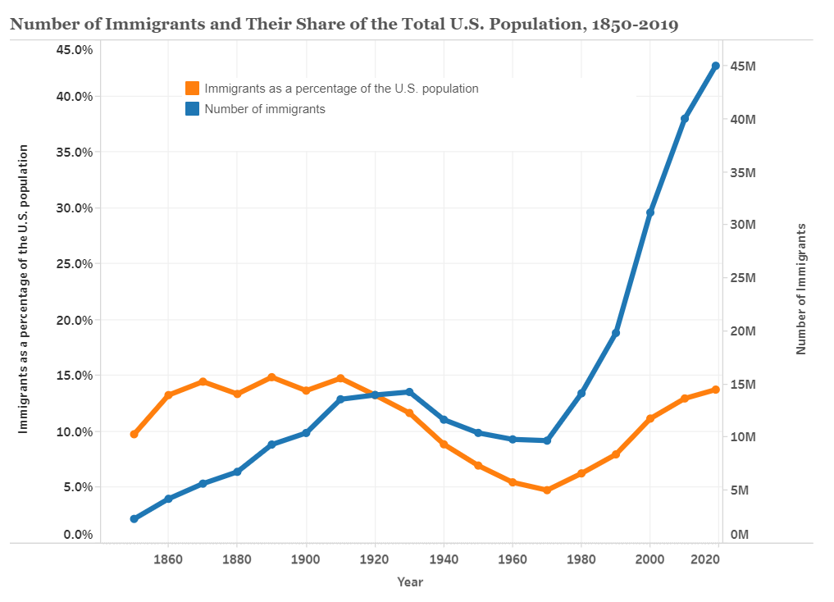
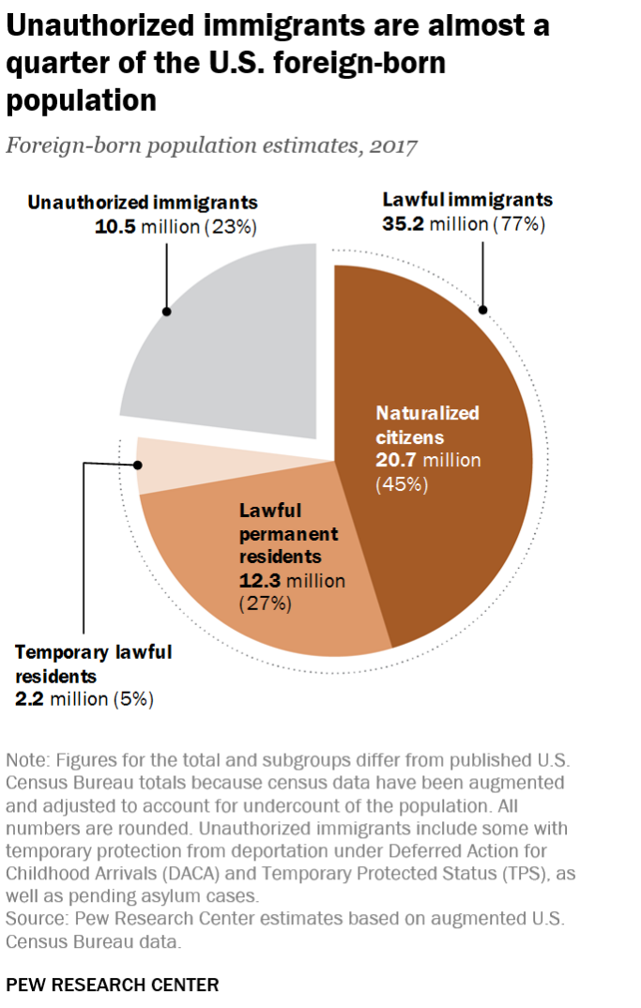
Immigration and Emigration Issues

Slide 38
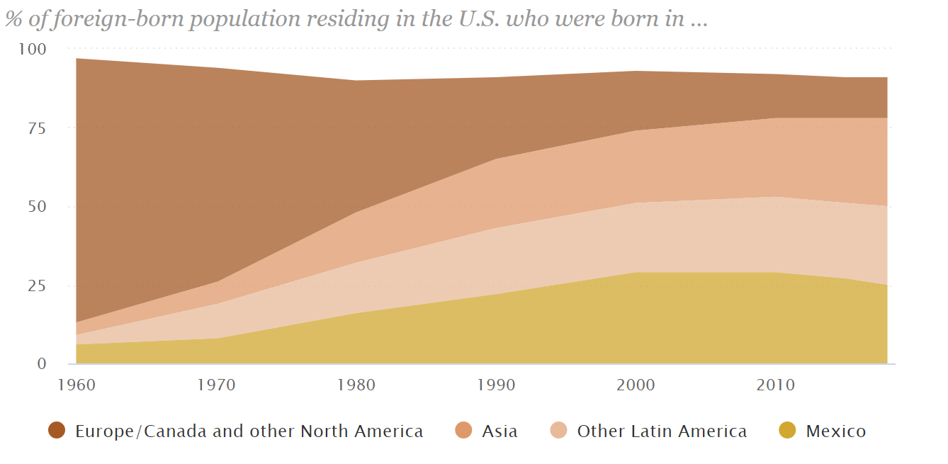
Immigration and Emigration Issues

Slide 39
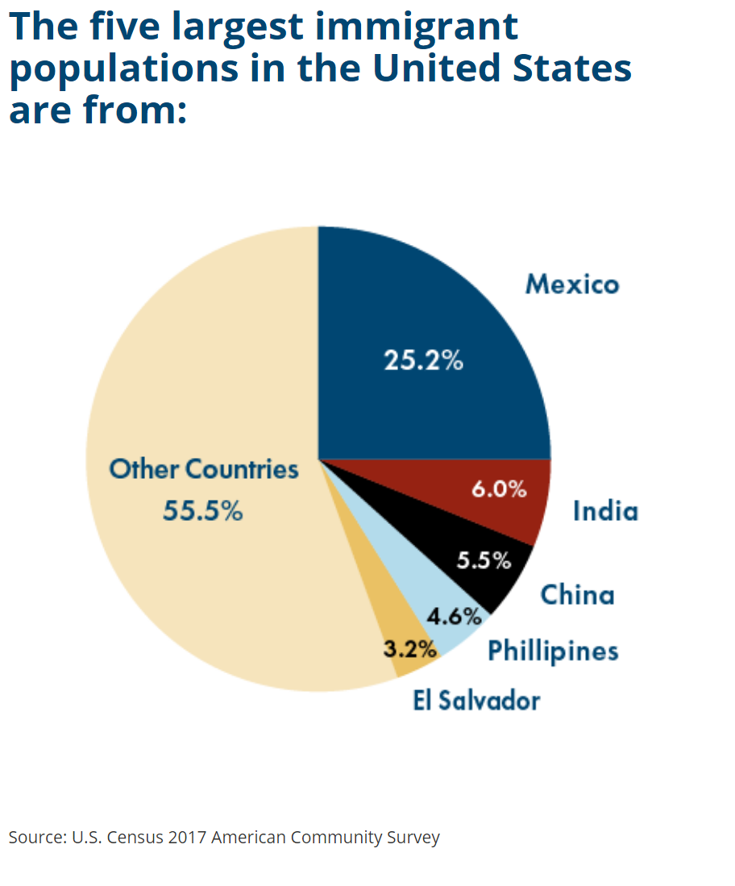
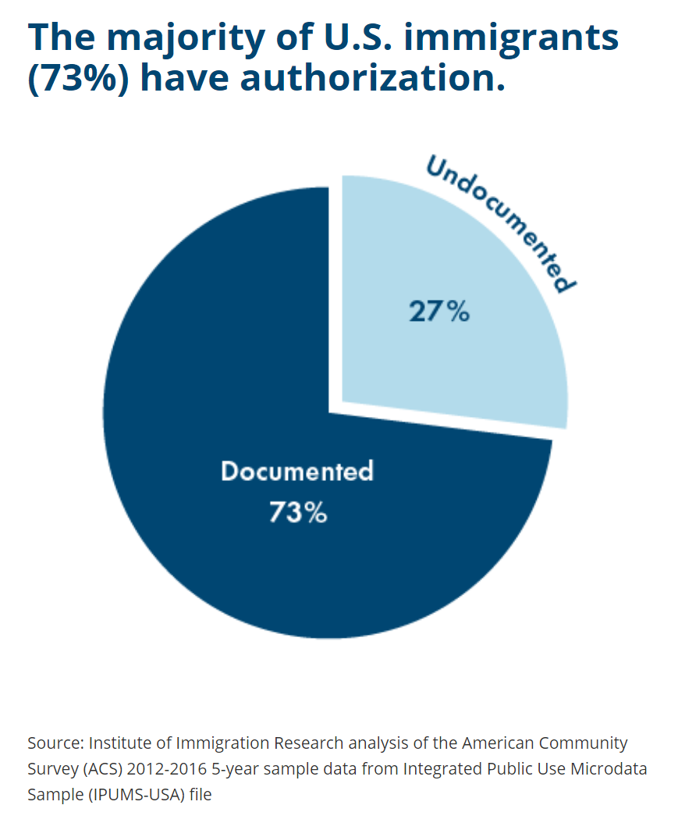

Slide 40
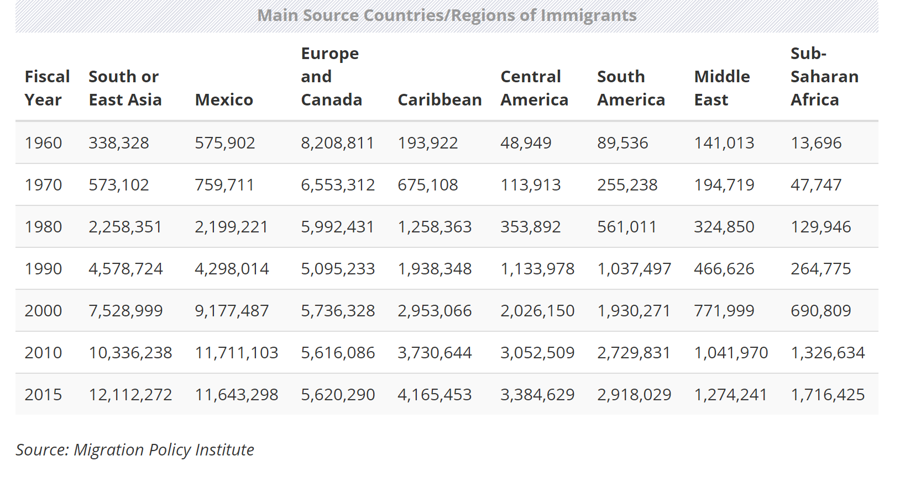

Slide 41
Immigration and Emigration Issues
Immigration as a Share of Overall Regional Population (2019)
Foreign-Born to US Total Population %
South or East Asia 14,100,000 4,175,000,000 0.34
Middle East 1,540,000 457,000,000 0.33
Sub-Saharan Africa 1,973,000 1,107,000,000 0.17
Europe and Canada 5,465,000 784,000,000 0.69
Mexico 10,932,000 127,600,000 8.56
Central America 3,783,000 44,500,000 8.50
Caribbean 4,495,000 44,400,000 10.12
South America 3,380,000 422,500,000 0.80

Slide 42
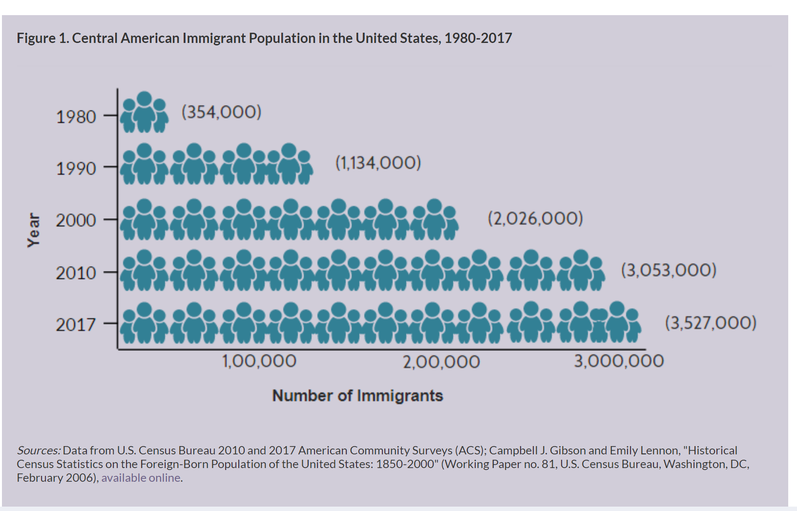
Immigration and Emigration Issues

Slide 43
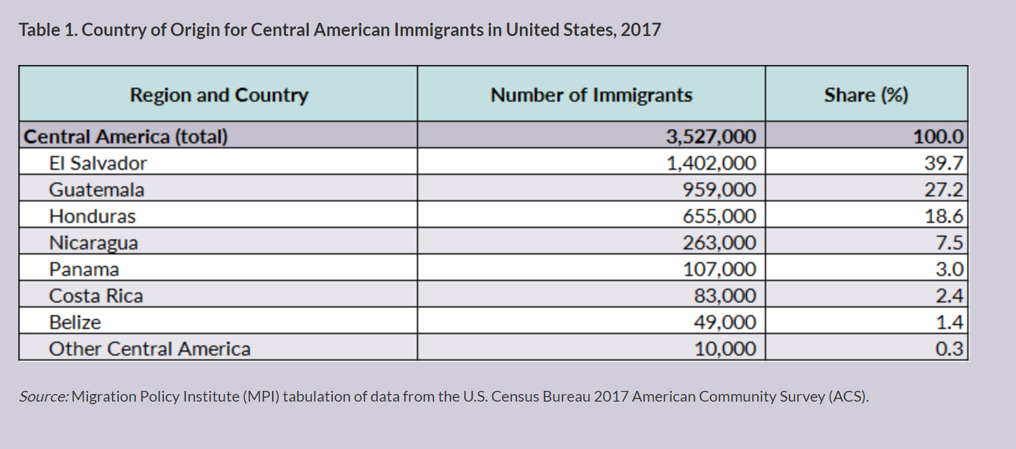
Immigration and Emigration Issues

Slide 44
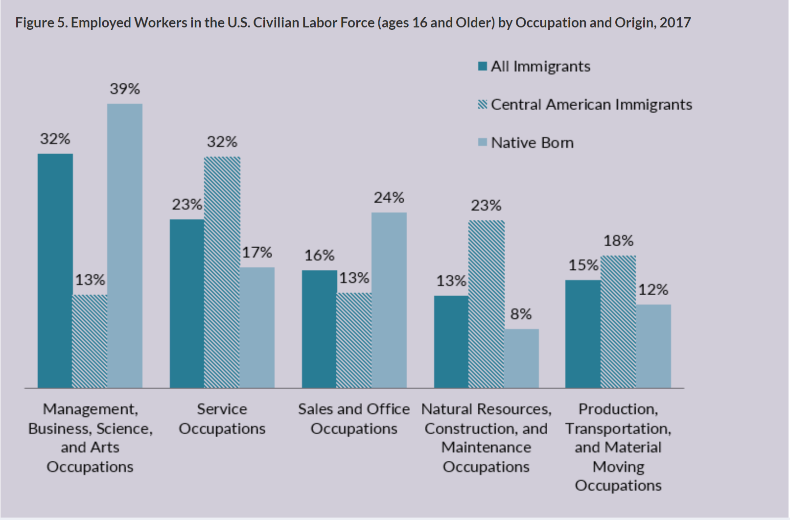
Immigration and Emigration Issues

Slide 45

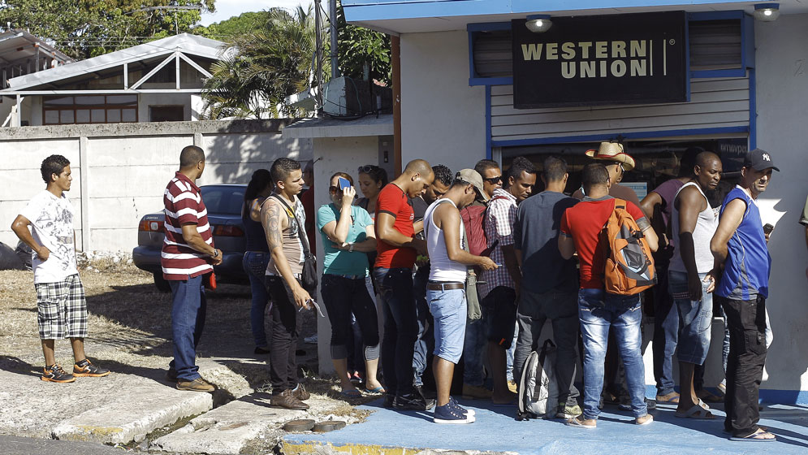
Immigration and Emigration Issues

Slide 46
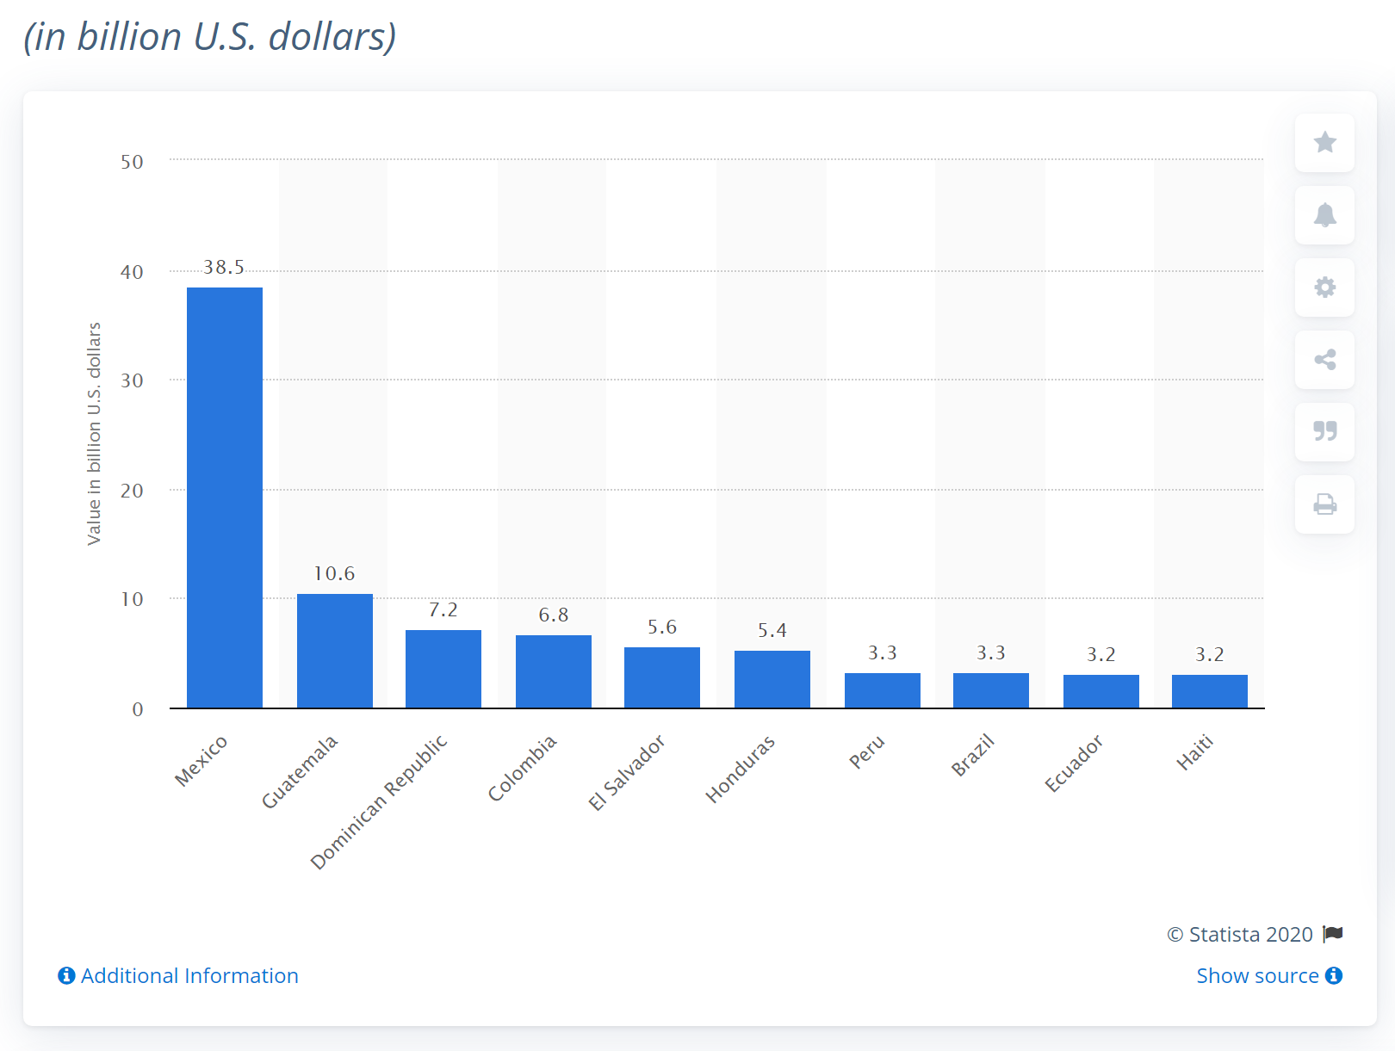
Immigration and Emigration Issues
Countries with the highest migrant remittance inflows
in Latin America and the Caribbean, 2019

Slide 47
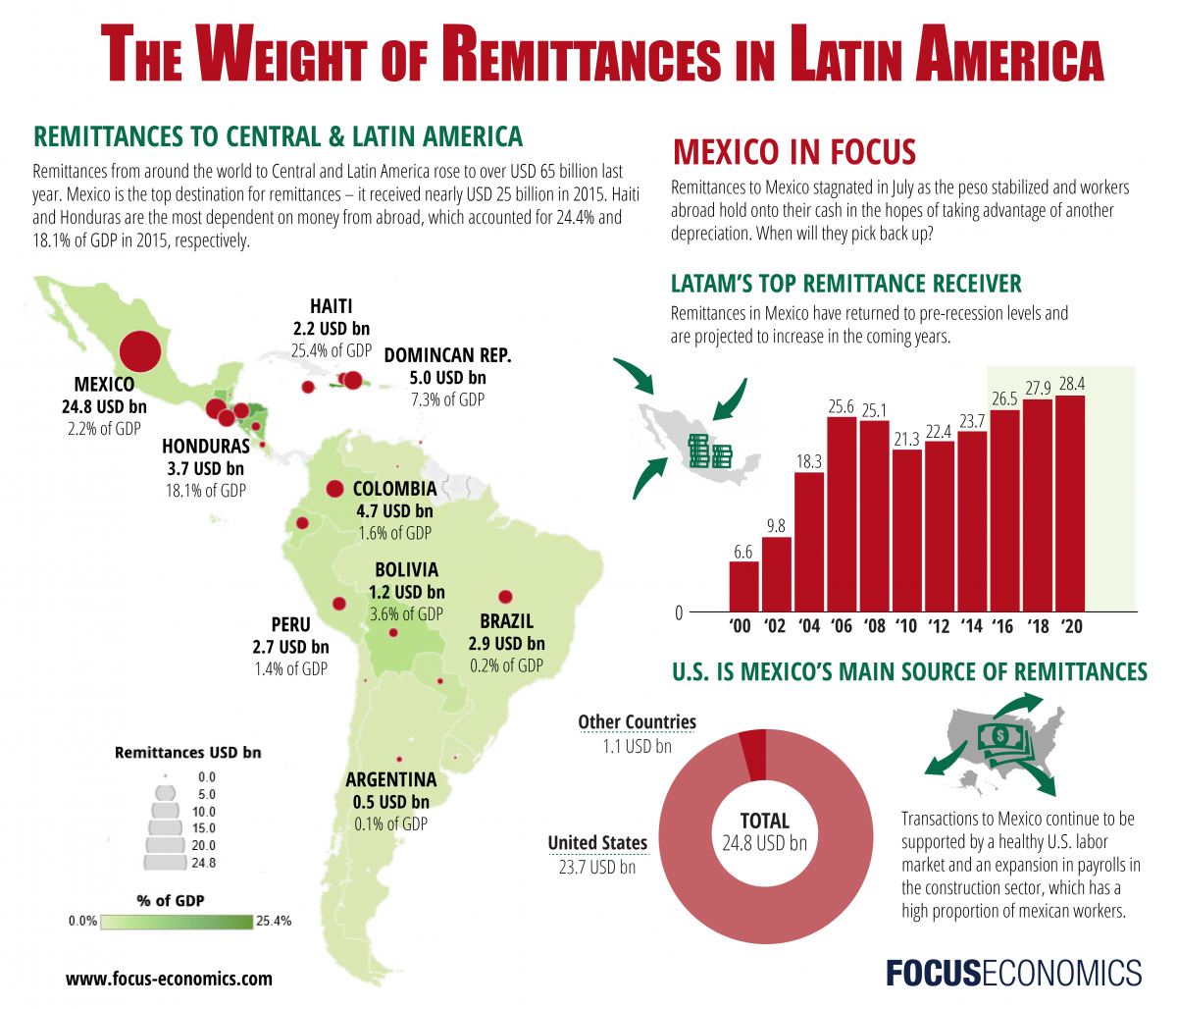
Immigration and Emigration Issues
Remittances as total $ amount (2019)
Mexico $36.5 billion
Guatemala $10.6 billion
Dominican Republic $7.10 billion
Columbia $6.75 billion
Brazil $3.00 billion
Remittances as a share of GDP (2019)
Haiti 23.2%
Honduras 21.5%
El Salvador 20.9%
Jamaica 15.7%
Guatemala 13.9%
https://data.worldbank.org/indicator/BX.TRF.PWKR.DT.GD.ZS?end=2019&locations=ZJ&start=1979&view=chart

Slide 48
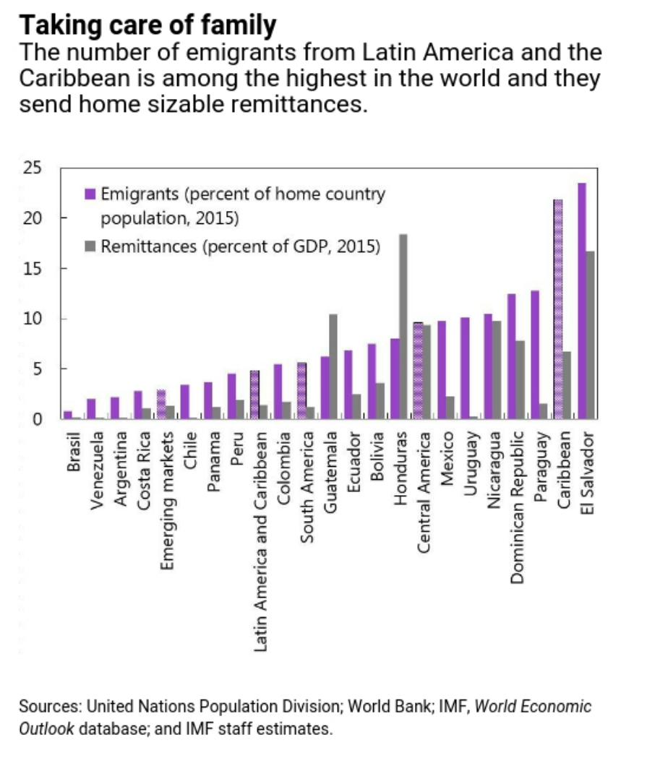
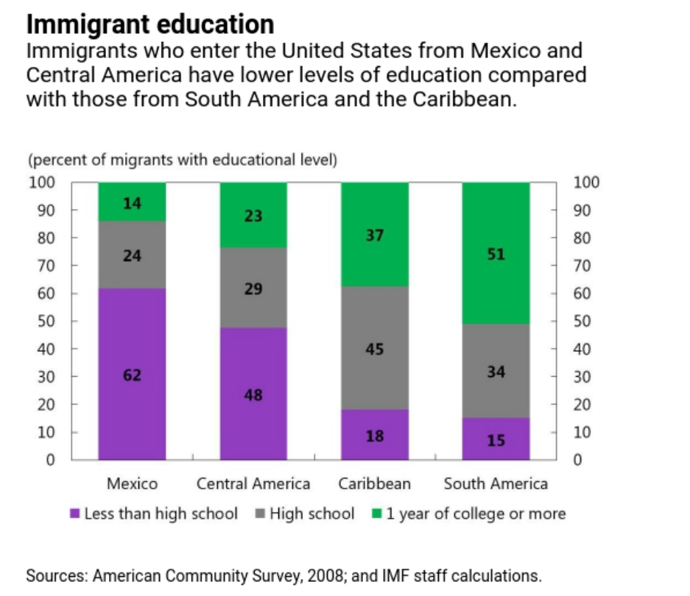
Immigration and Emigration Issues

Slide 49
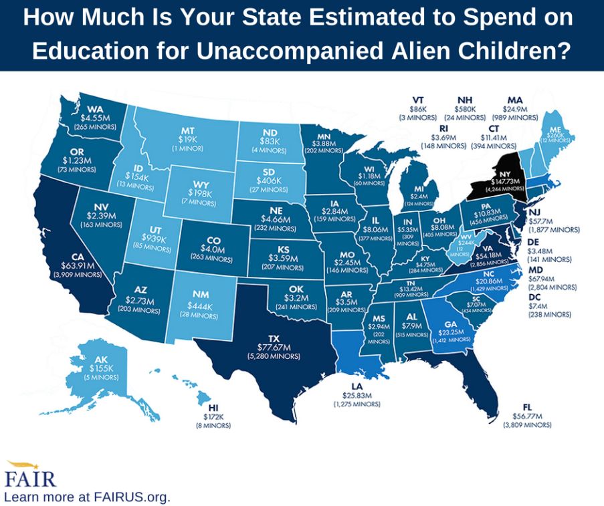
Immigration and Emigration Issues
Trade-Offs – For the Country having Immigration
From the Point of View of the country receiving immigrants
  Plus: Additional labor
    Economic Growth (Economic Growth ~ Growth in Labor Force + Growth in Productivity)
    Tax revenue – Immigrants tend to be young and energetic
  Plus: Cultural diversity
  Negative: Strains on social services / schools if new immigrants “cluster” in relatively small areas

Slide 50
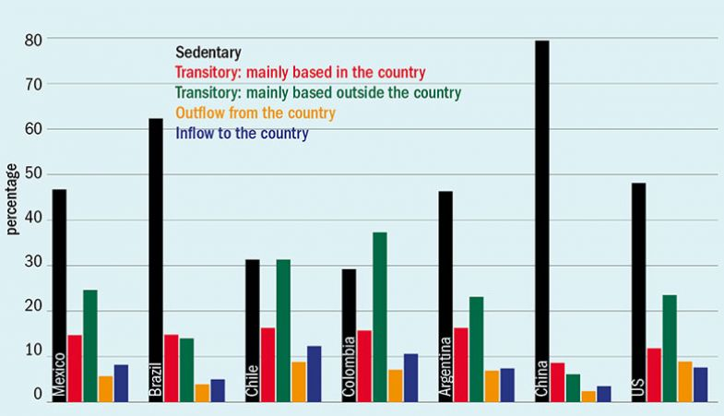
Immigration and Emigration Issues
Trade-Offs – For the Country having Emigration
From the Point of View of the country having emigrants
  Plus: Remittances (as described earlier)
  Plus: Relief of population pressures
  Negative: Loss of population
  Negative: “Brain Drain” in some cases
  Negative: “Ambition Drain” since it takes effort to emigrate.

Slide 51
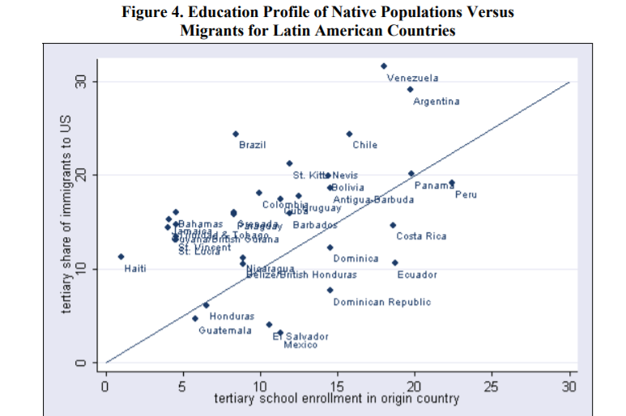
Immigration and Emigration Issues
According to the World Bank:
More than 80 percent of college-educated people born in Haiti, Jamaica, Grenada, or Guyana live abroad, most in the U.S.
Fewer than 10 percent of college graduates from South America have migrated, but that is a large portion of the overall migrant population
Mexican and Central American migrants tend to come from the lower end of the education spectrum, probably because the cost/benefit analysis is easier than a similar person living farther away

Slide 52
Survey #3 – Does the reliance on remittances help more than it hurts, or hurt more than it helps in Latin America?

Slide 53
PDF of the “Why Do People Move?” lesson (shared on other window)

Slide 54
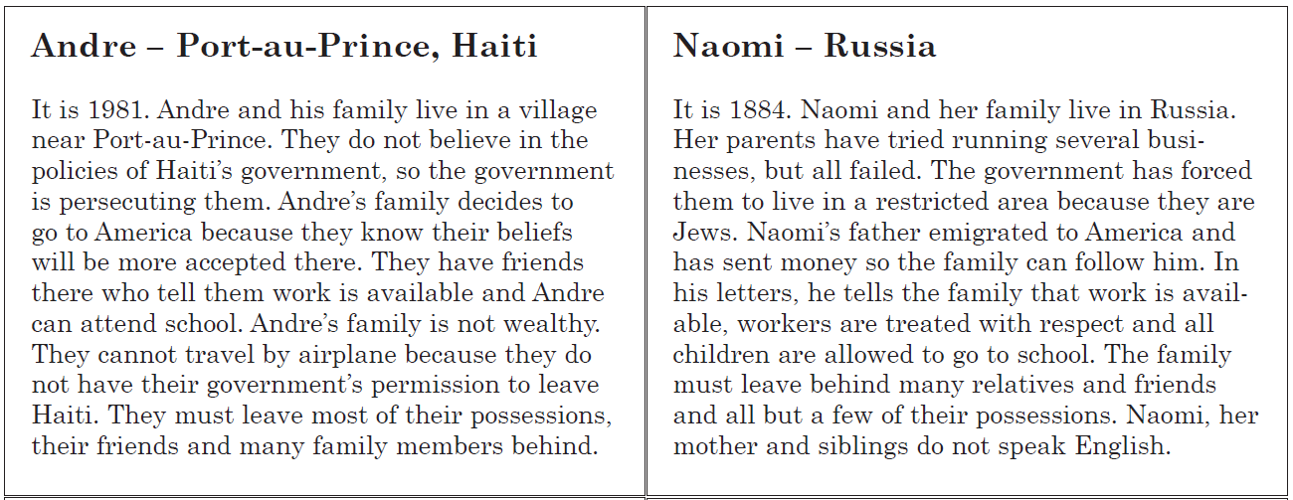
Immigration and Emigration Issues

Slide 55
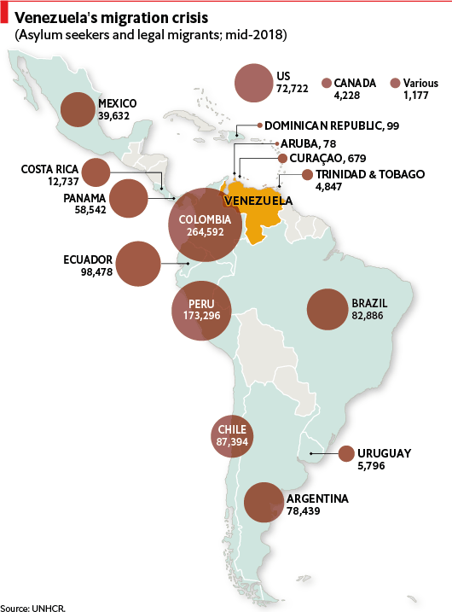
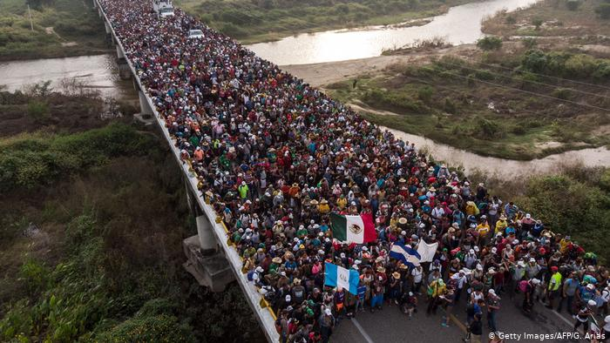
Immigration and Emigration Issues
Immigration is not just a US issue in the 21st Century
Significant immigration (or migration or asylum seeking or refugee status) within Latin America—especially from Venezuela
Central Americans to Mexico

Slide 56
Short video clips on intra-South America immigration
(as time allows)

Slide 57
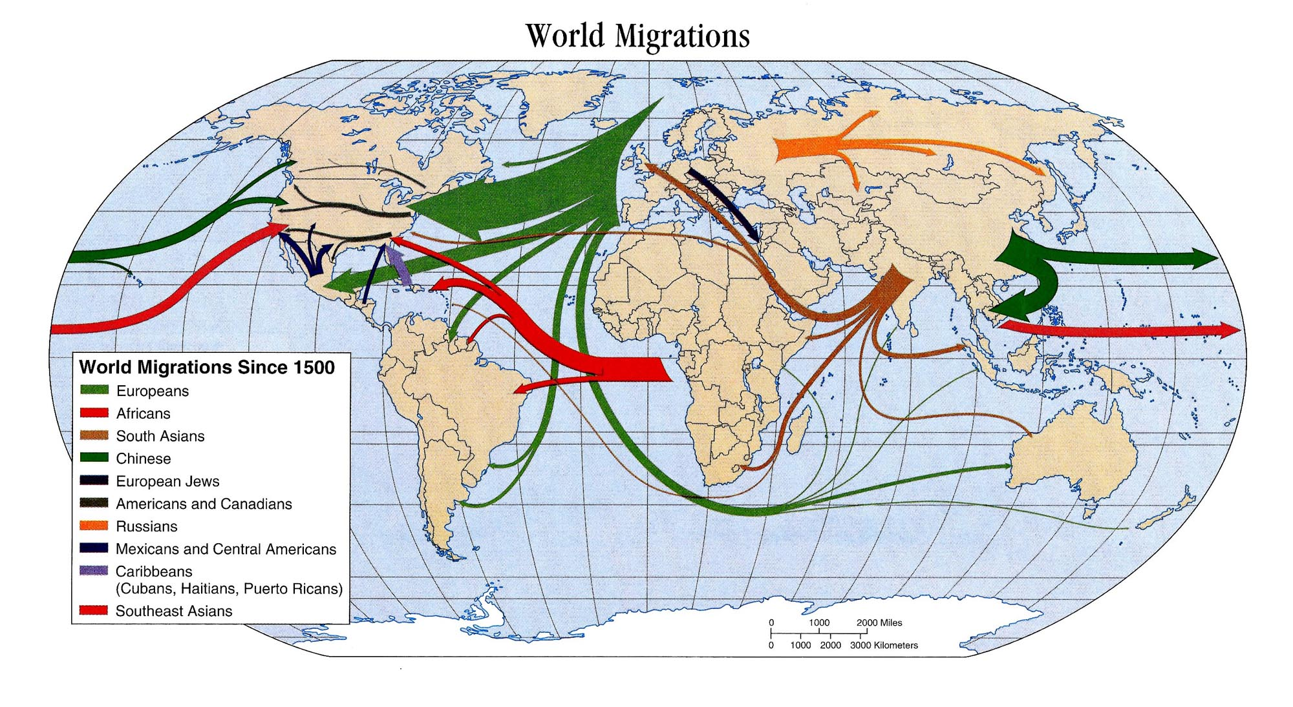
Immigration and Emigration Issues

Slide 58
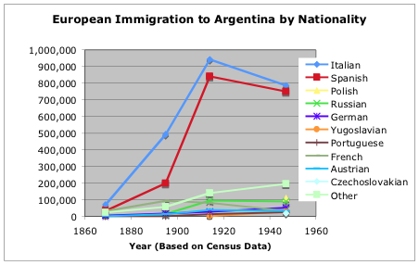
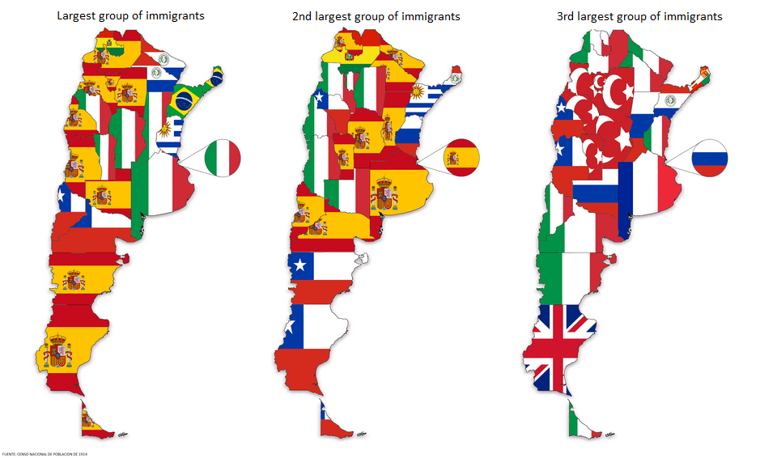
Immigration and Emigration Issues

Slide 59
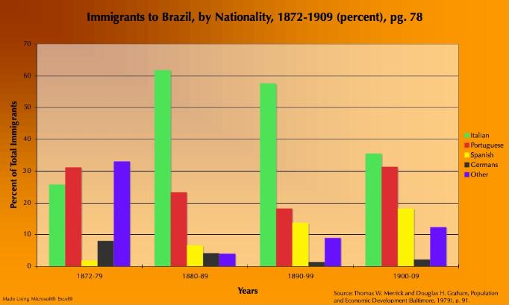
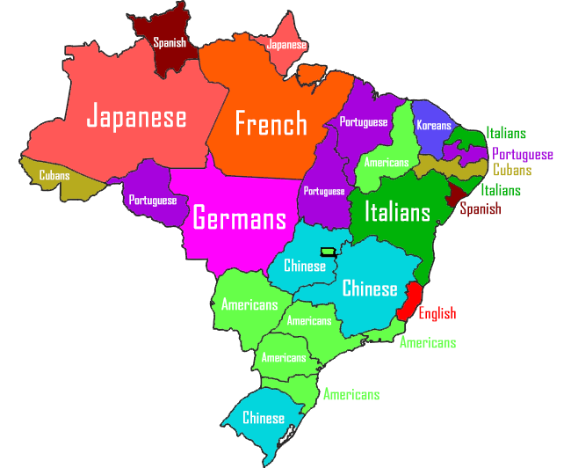


Immigration and Emigration Issues

Slide 60

Immigration and Emigration Issues
And Emigration from the US to Latin America
About 1,200,000 US citizens live in Mexico (US Embassy, Mexico City)
Over 250,000 in Brazil (US Embassy, Brasilia)
About 3,000 in Uruguay (US Embassy, Montevideo)

Slide 61
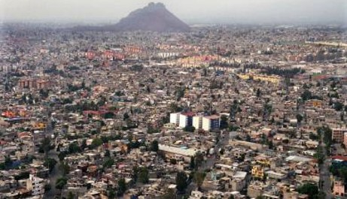
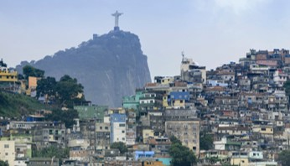
Immigration and Emigration Issues
Migration from Rural Areas to Urban Areas
Similar to other parts of the world, migration to urban areas in Central and South America has created “mega-cities”
  Sao Paulo Metro Area – 22.2 million
  Mexico City Metro Area – 21.9 million
  Buenos Aires Metro Area – 15.3 million
  Rio De Janerio Metro Area – 13.5 million
  Bogota Metro Area – 11.2 million
  Lima Metro Area – 10.9 million
For perspective – Latin America has 44 cities with a population over 2 million (the U.S. has 4)

Slide 62
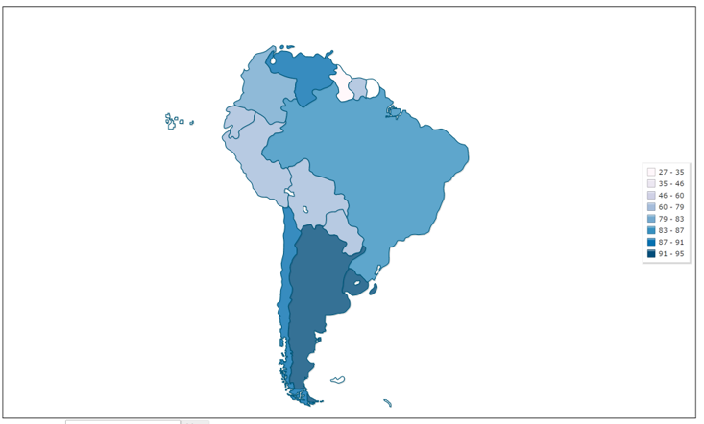
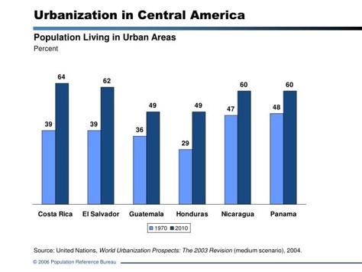
Immigration and Emigration Issues
Urbanization in Latin America

Slide 63
Immigration and Emigration Issues
Conclusions
Latin America has a lot of successful companies and a wealth of natural resources to work with
Governmental issues and debates about centralized power and nationalized industries have traditionally hurt development
The trade war between China and the U.S. could provide more price competition, but mostly for natural resources rather than industry
Emigration from poor to rich regions (both within Latin America and out to the U.S./Europe) threatens to “drain” the region (especially Central America and the Caribbean) of educated leaders

Slide 64
Survey #4 – What do YOU think is Latin America’s biggest economic challenge moving forward past COVID?

Slide 65
Parting Shots
Future Professional Development Sessions with CEE:
Wed, April 21st – K-8 Essential Concepts, 6-7pm ET
Wed, May 5th – Personal and Corporate Debt, 6-7pm ET

Slide 66
Parting Shots
Future College Classes with Economic Literacy Colorado:
Sat, April 10th – Capitalism vs Socialism: Comparing Economic Systems
Sat, April 24th – Implications of COVID for the U.S. and Developing World Economies
All classes are virtual from 8am to 4pm MT – sessions typically alternate between professors and mentor teachers. $25 class fee and you can also sign up for 0.5 graduate credit hours from Univ of Colorado-Colorado Springs for $51

Slide 67


Slide 68


Slide 69





We’ve gone Virtual!
Teach Economics?
Your students may have what it takes to compete in the nation’s only high school economics competition!
Why Play?
• Fun team learning experience
• Great for college applications
• No other challenge like this
• Online participation makes access easy
• Chance for cash prizes
How it Works
Teams register
Teachers enroll team(s) of 3- 4 high school students from the same school. Multiple teams allowed.
Teams compete within their state
Compete to win your state competition for a
chance to advance to the National Semi-Finals.
National Semi-Finals: May 3-20, 2021
Teams answer multiple-choice questions on macroeconomics, microeconomics, and international & current events.
National Finals: May 22-24, 2021
Teams analyze an economic issue and present their solution. Top teams engage in the Finals Quiz Bowl where they face-off answering questions to claim the National Title.
Two divisions based on experience level
David Ricardo for first-time competitors who have taken no more than one economics course.
Adam Smith for returning competitors, AP, International Baccalaureate, and honors students.
Register Today at NationalEconomicsChallenge.org

Slide 70





FIND YOUR LOCAL COMPETITION
AND REGISTER TODAY!
The National Personal Finance Challenge is a competition that provides high school students with an exciting and motivating opportunity to build, apply, and demonstrate their knowledge of money management.
Through online exams and a personal finance simulation, teams showcase their expertise in earning income, buying goods and services, saving, using credit, investing, as well as protecting and insuring.
Teams of up to four students, with one teacher/coach, can qualify to represent their state at the National Personal Finance Challenge by winning their local competition.
NATIONALS
Semi-Finals: First round elimination via online multiple-choice questions.
Finals: Case study round virtually co-hosted by the Cleveland Fed on June 3.
personalfinancechallenge.org

Slide 71

The 2021 Sloan Teaching Champion Award
Winners receive:
A cash award of $5,000
A cash award of $2,500 for their school to support economic education
Recognition at our annual Visionary Awards convening
This award promotes economic education by honoring three outstanding teachers who incorporate exemplary teaching techniques that improve their students’ economic understanding in and out of the classroom.
This award is open to New York metropolitan area high school teachers of all subjects, not just teachers of economics. Applicants must demonstrate how they integrate economics into their teaching.
Sound like you or someone you know?
Applicants must teach in one of the
Twelve New York state counties (New York, Kings, Bronx, Richmond, Queens, Nassau, Suffolk, Westchester, Putnam, Rockland, Orange and Duchess)
Eight New Jersey counties (Bergen, Passaic, Essex, Hudson, Middlesex, Union, Morris, Monmouth), or the
Two Connecticut counties (Fairfield and New Haven)
Application will be launched on Friday February 19th 2021
You can access the application here.
CONTACT
Please feel free to e-mail us at rrivera@councilforeconed.org
with any questions you have.

