Slide 1
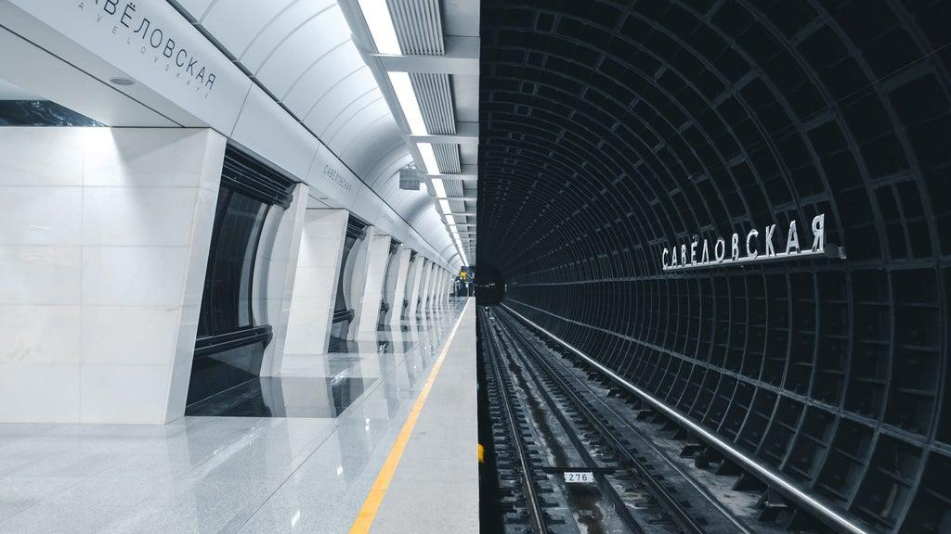

Economics
Bootcamp
Alex Lamon
CEE Master Teacher
2. 16. 21: Topics in Microeconomics.
lamonteach@gmail.com
Twitter: @AlexMLamon
Notes:
5 min break

Slide 2
EconEdLink Membership
You can now access CEE’s professional development webinars directly on EconEdLink.org! To receive these new professional development benefits, become an EconEdLink member. As a member, you will now be able to:
Automatically receive a professional development certificate via e-mail within 24 hours after viewing any webinar for a minimum of 45 minutes
Register for upcoming webinars with a simple one-click process
Easily download presentations, lesson plan materials and activities for each webinar
Search and view all webinars at your convenience
Save webinars to your EconEdLink dashboard for easy access to the event
You may access our new Professional Development page here

Slide 3
Professional Development Certificate
To earn your professional development certificate for this webinar, you must:
Watch a minimum of 45-minutes and you will automatically receive a professional development certificate via e-mail within 24 hours.
Accessing resources:
You can now easily download presentations, lesson plan materials, and activities for each webinar from EconEdLink.org/professional-development/

Slide 4

My teaching context
Who do I teach?
What do I teach them?
And how...in a pandemic?!
Notes:
Mine and guests

Slide 5
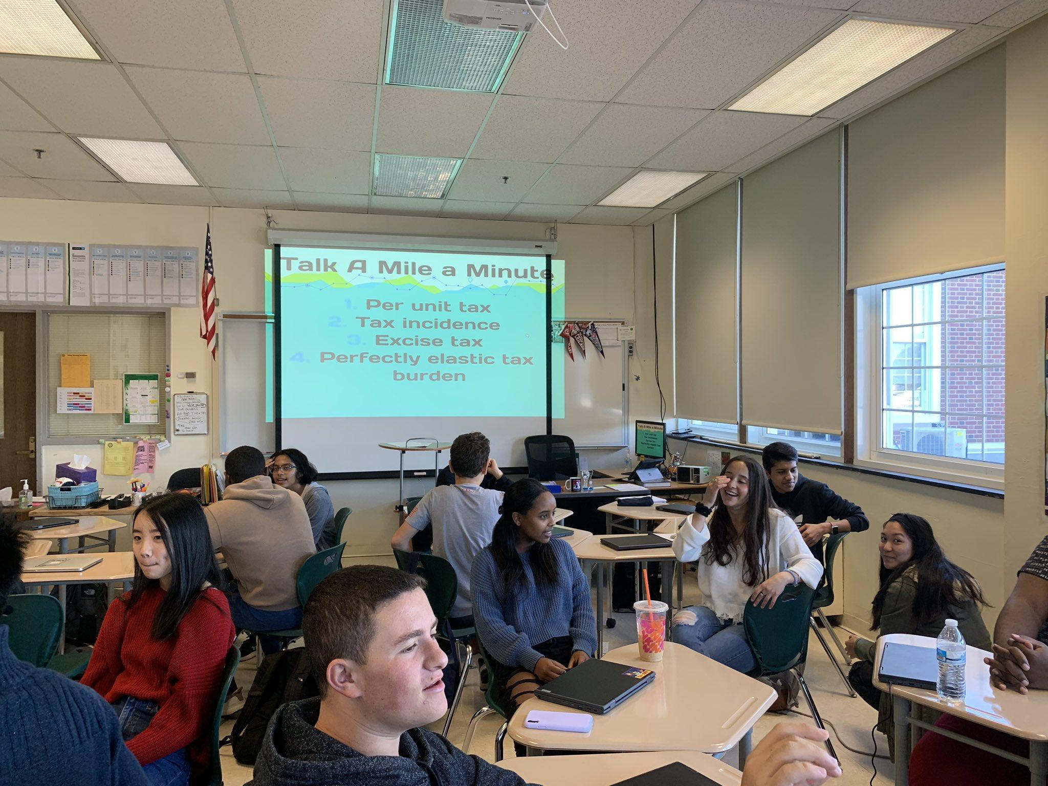
The good old days

Slide 6
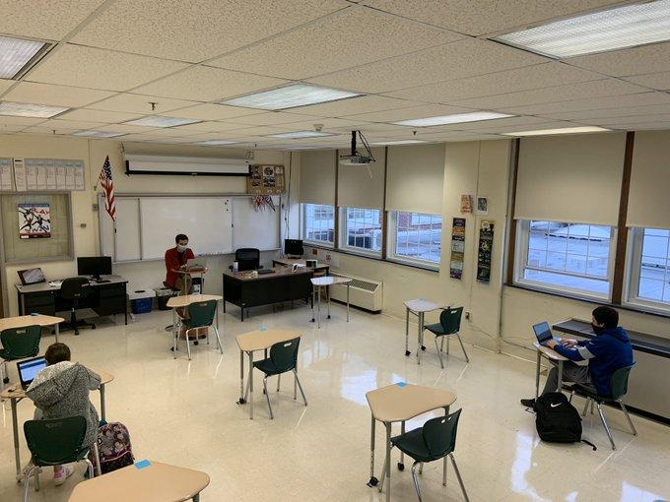
My pandemic teaching

Slide 7

Our job is so hard
Better days are ahead
Notes:
Our subway theme, liminal, resources for hybrid, in person, remote revisions

Slide 8

Please go to: bit.ly/3jOGMf8
Who do you teach?
What do you teach them?
And how...in a pandemic?!
Notes:
Mine and guests

Slide 9

Where are we going?
Stop 1: Production
Stop 2: Market Structures
Stop 3: Labor Markets

Slide 10

Before we depart…
Flipped class videos
Class time = practice and application
AP style tests vs. projects
Reassessments
Exam corrections
Notes:
Chat: Do you use any of these strategies? Is there another one you use that you found success with? Do you have a question about any of their usages?

Slide 11
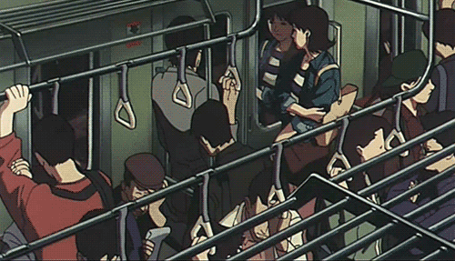
Hang on tight!
We’ve got 2.5 hours together - time for breaks!
Toolbox session!
Interact during the session: bit.ly/3jOGMf8
Notes:
Share your context

Slide 12

First stop!
Production Decisions
Production simulation
Cost curve matching
Cost curves market day
  Profit Record
  Adapted

Slide 13
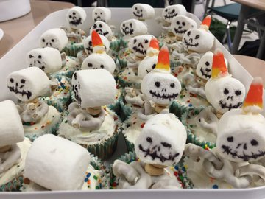
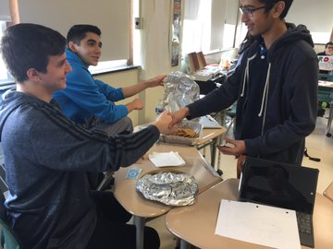
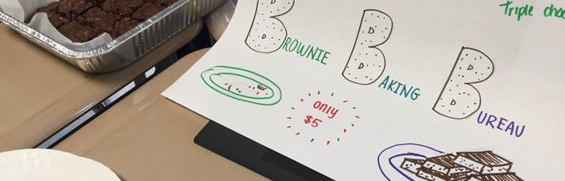
Notes:
Chat: What do you wonder about the activities? Best practices? Something to share? Would you use any? Suggestions for hybrid?

Slide 14

Pit Stop!
Memes
Notes:
5 break after memes

Slide 15
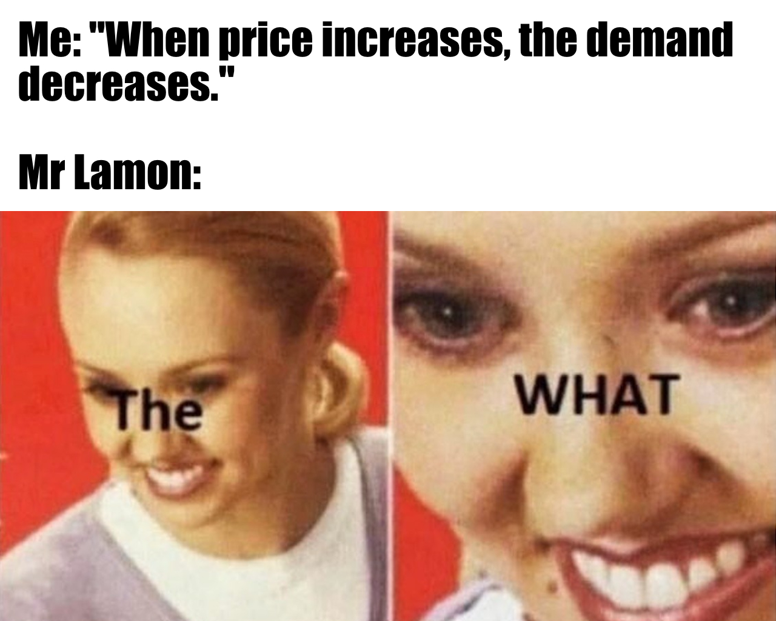
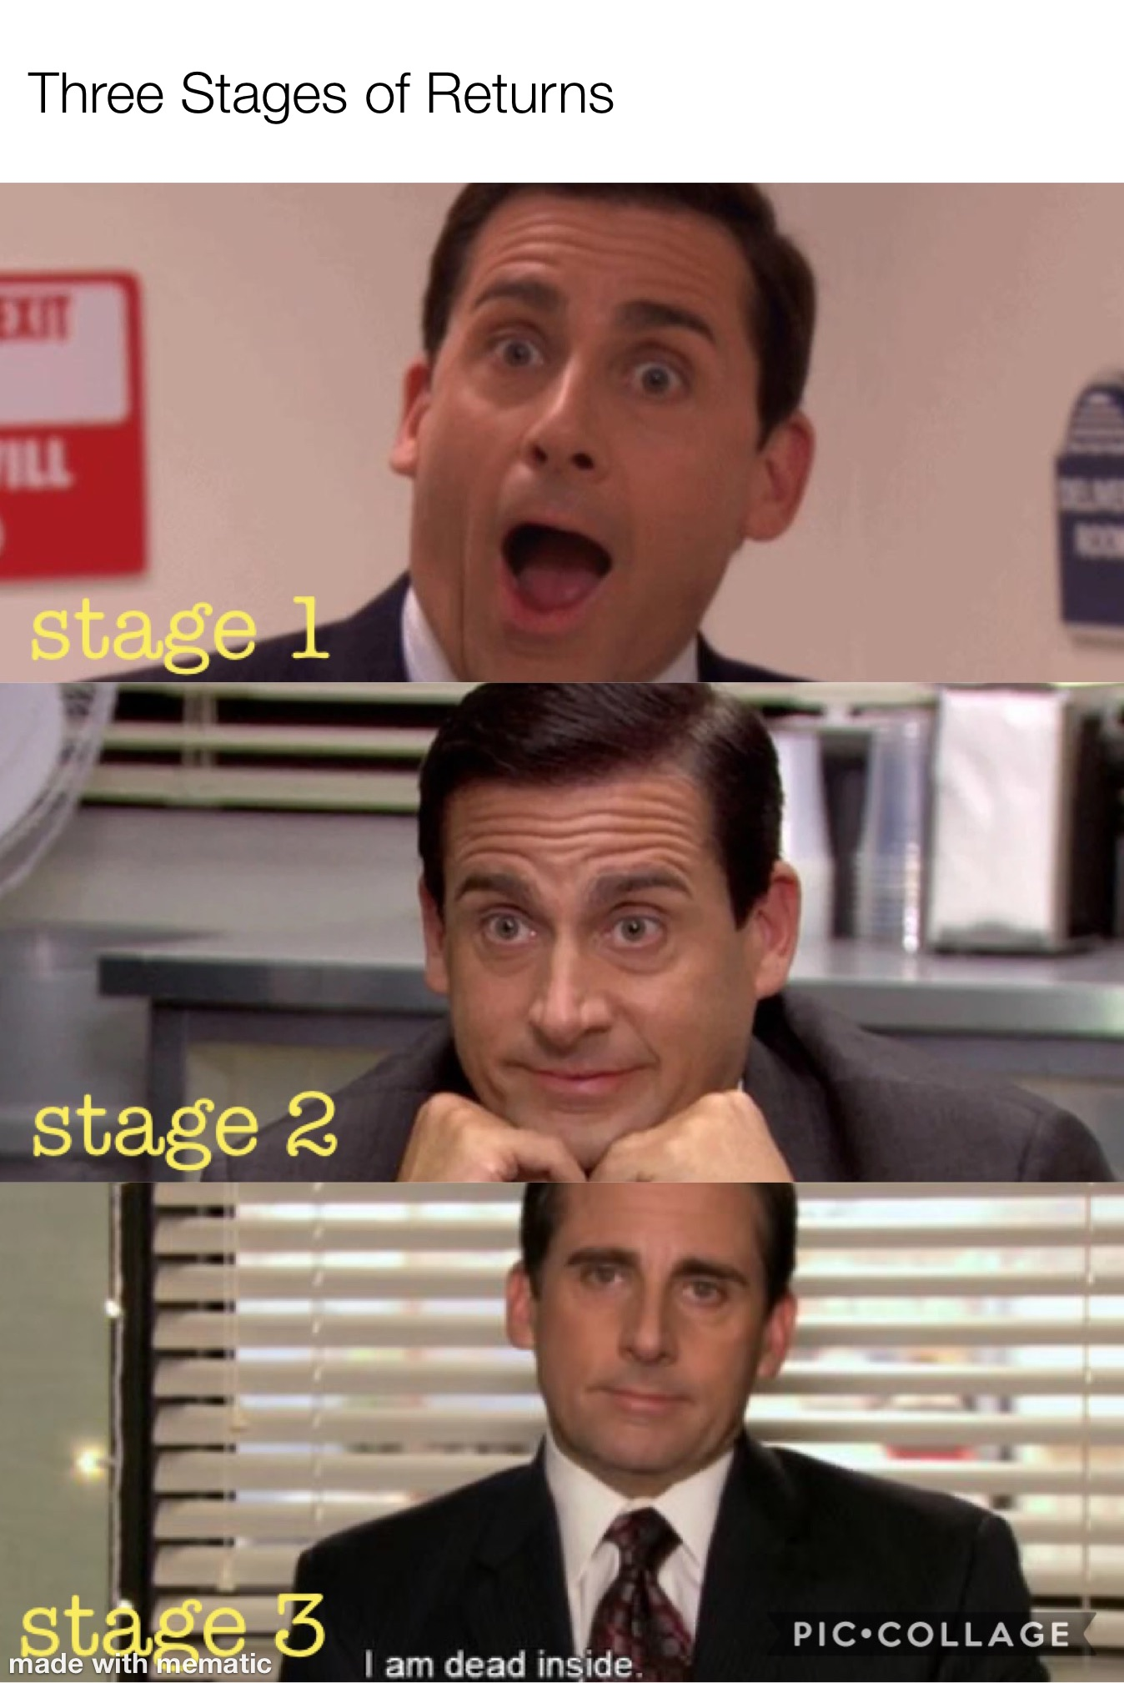
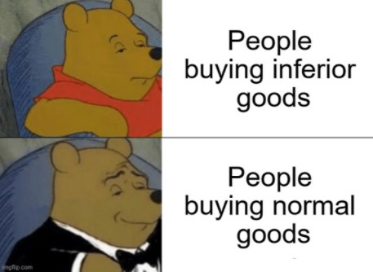

Slide 16

Second stop!
Market Structures
Candy simulation
Perfect Comp Graphing
Monopoly resources
Oligopoly simulation
  Videos: 1, 2, 3
  Family Feud
Mono Comp activity

Slide 17

Last stop!
Labor Markets
Job jungle
  Marginal Product
  Employer Profits
  Reflection ?s
Minimum wage
  Follow up video

Slide 18

Safe
Travels
Thank you for learning with me today
lamonteach@gmail.com
@AlexMLamon

Slide 19

CEE Affiliates
https://www.councilforeconed.org/resources/local-affiliates/

Slide 20




Thank You to Our Sponsors!

Slide 21



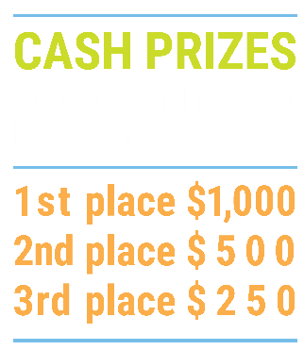

We’ve gone Virtual!
Teach Economics?
Your students may have what it takes to compete in the nation’s only high school economics competition!
Why Play?
• Fun team learning experience
• Great for college applications
• No other challenge like this
• Online participation makes access easy
• Chance for cash prizes
How it Works
Teams register
Teachers enroll team(s) of 3- 4 high school students from the same school. Multiple teams allowed.
Teams compete within their state
Compete to win your state competition for a
chance to advance to the National Semi-Finals.
National Semi-Finals: May 3-20, 2021
Teams answer multiple-choice questions on macroeconomics, microeconomics, and international & current events.
National Finals: May 22-24, 2021
Teams analyze an economic issue and present their solution. Top teams engage in the Finals Quiz Bowl where they face-off answering questions to claim the National Title.
Two divisions based on experience level
David Ricardo for first-time competitors who have taken no more than one economics course.
Adam Smith for returning competitors, AP, International Baccalaureate, and honors students.
Register Today at NationalEconomicsChallenge.org

Slide 22



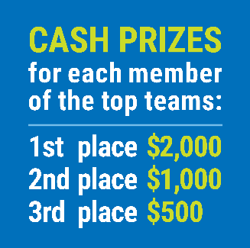

FIND YOUR LOCAL COMPETITION
AND REGISTER TODAY!
The National Personal Finance Challenge is a competition that provides high school students with an exciting and motivating opportunity to build, apply, and demonstrate their knowledge of money management.
Through online exams and a personal finance simulation, teams showcase their expertise in earning income, buying goods and services, saving, using credit, investing, as well as protecting and insuring.
Teams of up to four students, with one teacher/coach, can qualify to represent their state at the National Personal Finance Challenge by winning their local competition.
NATIONALS
Semi-Finals: First round elimination via online multiple-choice questions.
Finals: Case study round virtually co-hosted by the Cleveland Fed on June 3.
personalfinancechallenge.org

