Slide 1
Teaching Fiscal Policy in the COVID Era: Who Gets Bailed Out and Why Dr. Chris Cannon, Georgia Council on Economic Education 2/2/2021 ccannon11@gsu.edu

Slide 2
EconEdLink Membership
You can now access CEE’s professional development webinars directly on EconEdLink.org! To receive these new professional development benefits, become an EconEdLink member. As a member, you will now be able to:
Automatically receive a professional development certificate via e-mail within 24 hours after viewing any webinar for a minimum of 45 minutes
Register for upcoming webinars with a simple one-click process
Easily download presentations, lesson plan materials and activities for each webinar
Search and view all webinars at your convenience
Save webinars to your EconEdLink dashboard for easy access to the event
You may access our new Professional Development page here

Slide 3
Professional Development Certificate
To earn your professional development certificate for this webinar, you must:
Watch a minimum of 45-minutes and you will automatically receive a professional development certificate via e-mail within 24 hours.
Accessing resources:
You can now easily download presentations, lesson plan materials, and activities for each webinar from EconEdLink.org/professional-development/

Slide 4
Agenda
New Fiscal Lessons Overview
Lesson Demo
Questions/Wrap- Up

Slide 5
Objectives
Understand overview and purpose of the new COVID lessons
Participate in and feel comfortable using the “Who Gets Bailed out and Why” lesson

Slide 6
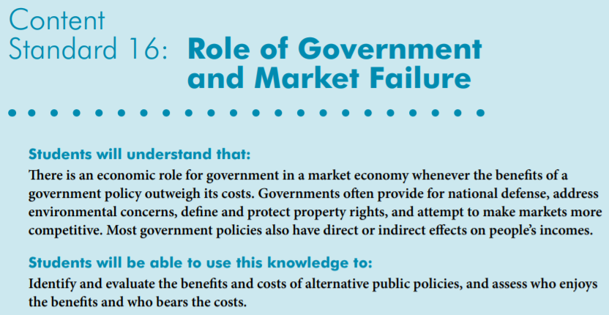
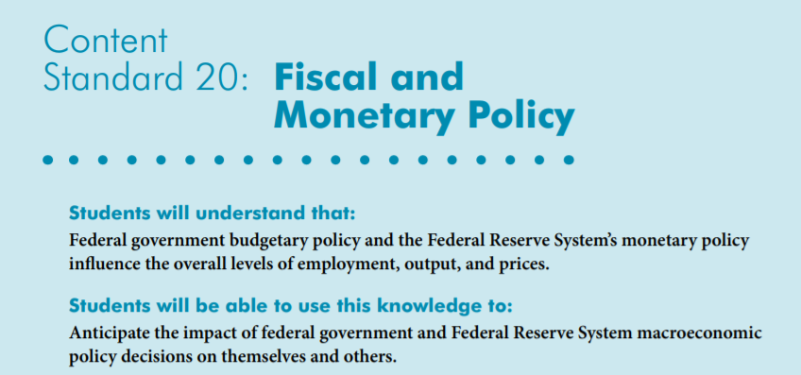
National Standards

Slide 7
Bailout:
When a business, individual or government provides money and/or resources to a business in danger of failing
Notes:
Explain that for this lesson you are going to primarily focus on government bailouts. Sometimes these come in the form of direct payments by the government to companies or entire industries and other times the government receives a stake in the companies or the money comes in the form of a loan.

Slide 8
Bailouts...
Sometimes referred to as government assistance, government loans or capital injections
Controversial because they use taxpayer dollars to support specific companies or industries
Some loans become profitable over time
Government may get shares of companies or fees in return
U.S. has a long history of bailouts
Notes:
To some, the word “bailout” has a negative connotation. Sometimes phrases like “government assistance” or “capital injections” are used to make them seem more palatable to voters. Students should also understand that most bailouts are not direct payments from the government. They are usually structured as loans or shares of a company. Several big bailouts have turned profitable for the government as seen here: https://www.saturdayeveningpost.com/2020/01/the-5-biggest-bailouts-ever/ and here https://projects.propublica.org/bailout/list

Slide 9
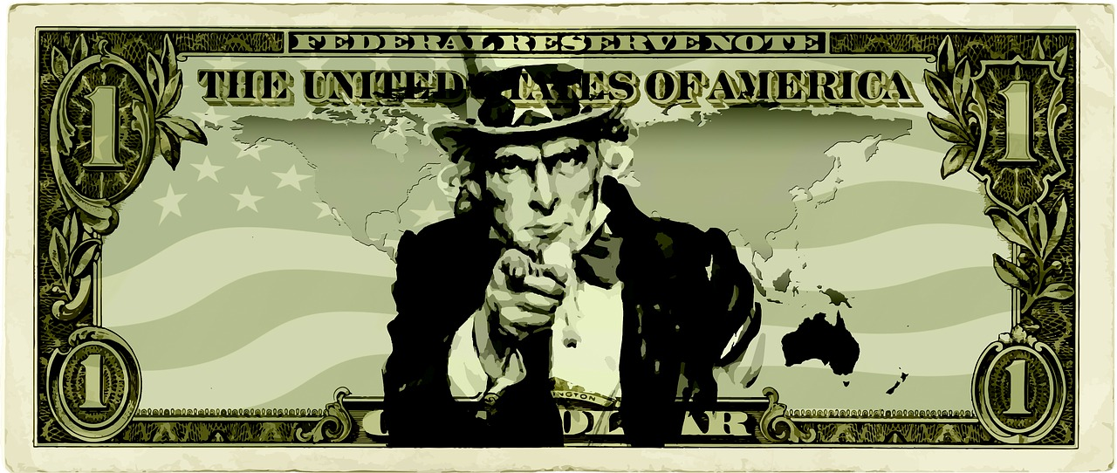
U.S. Bailouts in History
A google doc version of the article is available here: https://docs.google.com/document/d/1q2hdyBWf2aLrFvnG-Cl4AETCaZnYAWGF/copy
Notes:
Distribute the printed reading or have students use the link found on this page to read about historic U.S. bailouts. Royalty free image from Pixabay https://pixabay.com/images/id-1935750/

Slide 10
Scenario Time!
You are a member of the U.S. Congress, about to vote on a bill that can provide government money to specific industries.
In each round, you may choose up to 3 industries to receive money…
Notes:
Students may choose 0, 1, 2, or 3 industries ot bail out. Remember, the amount of the bailout and other similar specifics are not up for debate. They are only to focus their energies on WHO (if anyone) should receive the money, not how much.

Slide 11
A few rules…
You may not add new industries or individuals
The amount of money will be significant to the industry (think billions)
I expect to hear reasons for your answers
Notes:
Students may choose 0, 1, 2, or 3 industries ot bail out. Remember, the amount of the bailout and other similar specifics are not up for debate. They are only to focus their energies on WHO (if anyone) should receive the money. Students should discuss, but do not have to agree as a group.

Slide 12
The Candidates are...
Agriculture
Airlines
Automotive
Construction
Healthcare
Retail
Entertainment/
Performing Arts
Professional Sports
Notes:
Agriculture - includes farming, livestock, and timber, support staff, corporate jobs, etc
Airlines - includes all major airlines, pilots, flight attendants, mechanics, tech support, marketing, etc
Automotive - includes only manufacturing for all companies located in U.S.
Construction - includes all types of construction companies, support staff,
Healthcare - includes all levels of healthcare, doctors, nurses, assisstants, pharmacists, etc. DOES NOT include drug companies
Retail - includes staff for brick and mortar stores, managerial positions, etc. DOES NOT include online component and DOES NOT include food service industry
Entertainment/Performing Arts - includes actors, writers, directors, technical staff, marketing, stagehands, etc
Professional Sports - includes athletes, corporate jobs, and venue-level support from MLB, MLS (men and women) NBA, NFL, NHL, NASCAR, U.S. Olympic Team, and WNBA

Slide 13
Socrative.com
Login AS A STUDENT
Room code: CHRISCANNON

Slide 14
Tallies for Round 1
Agriculture |  | Entertainment
Airlines |  | Healthcare
Automotive |  | Pro Sports
Construction |  | Retail
Notes:
Use this slide to tally individual votes. Remember, each student could get up to 3 votes so your total numbers may be wildly different. No one industry should have more than the total number of students in the class however. If you have a socrative.com account, you can get a ready-made version of this tally here: https://b.socrative.com/teacher/#import-quiz/51932104

Slide 15
Round 2: Now with More Economic Data!
Number of employees - Consider the economic impact of layoffs that happen during recessions and the number of jobs you might support with a bailout.
Economic impact - Includes things like overall sales, tickets to events, the relationships with associated industries like catering, business travel, etc.
EPI Employment Multiplier - When one job is created, other jobs are needed to support it. In some industries, this matters more than others, so the multiplier is variable.
Notes:
Students need to consider how these industries differ in some of these areas. Pro sports has fewer overall employees, but when a sports team is not playing, it affects MANY other jobs like vendors, parking lot owners, hotels and restaurants in the city, Uber and Lyft drivers etc. While many more people work in retail, their multiplier is less as one retail job doesn’t have much impact on others. In fact, if we can replace that retail worker with a machine that lets customers order or check out and pay on their own, the impact of that retail job is even less. Students may be surprised by the manufacturing number. An assembly line worker needs someone to repair the assembly line, deliver materials, provide uniforms and safety equipment, etc so this multiplier is often larger than others. You may also want to point out that these multipliers are estimates and not absolute values.

Slide 16
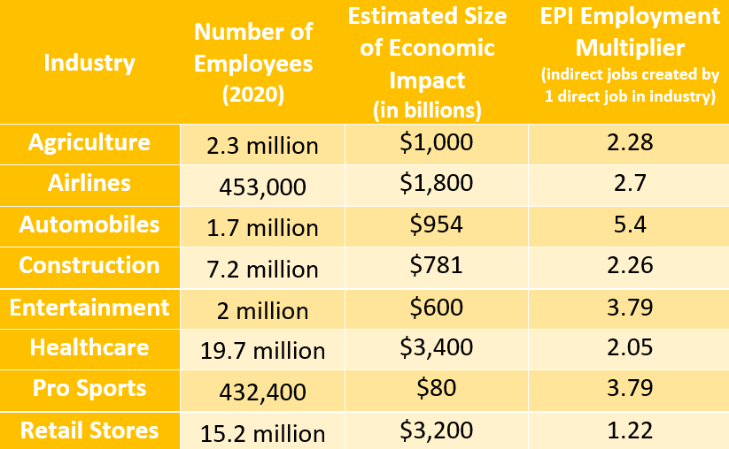

Slide 17
Socrative.com
Login AS A STUDENT
Room code: CHRISCANNON

Slide 18
Tallies for Round 2
Agriculture |  | Entertainment
Airlines |  | Healthcare
Automotive |  | Pro Sports
Construction |  | Retail
Notes:
Use this slide to tally individual votes for round 2. Remember, each student could get up to 3 votes so your total numbers may be wildly different. No one industry should have more than the total number of students in the class however. If you have a socrative.com account, you can get a ready-made version of this tally here: https://b.socrative.com/teacher/#import-quiz/51932104

Slide 19
Round 3: Elected Official Variables
constituents
What do the people who elected you want?
What industries to they work in?
What would MOST help the people in your state/district?
lobbyists
Which experts should you seek out and listen to?
Who donates to your campaign?
promises
What statements did you make when you were running for office?
What does your political party want you to do?
Is there pressure from a governor or president to act a certain way?
Notes:
These types of decisions often cause conflicts for elected officials between their personal views and the views of others. Additionally, members of congress may get pressure from lobbyists or campaign donors who are looking for some help during economic downturns.

Slide 20
Tallies for Round 3
Agriculture |  | Entertainment
Airlines |  | Healthcare
Automotive |  | Pro Sports
Construction |  | Retail
Notes:
Use this slide to tally individual votes for round 3. Remember, each student could get up to 3 votes so your total numbers may be different between rounds. No one industry should have more than the total number of students in the class, however. If you have a socrative.com account, you can get a ready-made version of this tally here: https://b.socrative.com/teacher/#import-quiz/51932104

Slide 21
Debrief and Discussion
If this class was Congress, who would get bailed out?
Would your decisions change if you found out the recession had been “caused” by one of the industries?
What other industries should we have considered?
What other variables could play role in this process?
Did the process get easier or harder as we added more information and more variables? Why?
Notes:
Answers will depend on tally marks from slide 11.
Answers will vary, but for some students the answer will be yes. For example, many people felt the financial industry was at fault for the 2008 recession and should not be bailed out. The phrase “moral hazard” is often used by economists to refer to a situation where a business or industry is willing to undertake risky behaviors if they feel the government will be there to support them.
Answers will vary but some obvious ones not included here are the restaurant industry, hotel industry, individuals in the “gig” economy (1099 workers or Uber/Lyft Drivers,) etc. Also not present are government workers and educators.
Public sentiment, political party in charge, how recently the industry had been bailed out, reason for the economic downturn, etc could all factor in to this decision.
Answers will vary, but students taking the simulation seriously should answer harder. As you get more information, the cost/benefit structure changes and your decision-making might change. This is true for most economic decisions - the more information you have leads to better decisions, but tougher ones as well.

Slide 22
References
Socrative share code: SOC-51932104
Bailout history reading: https://docs.google.com/document/d/1q2hdyBWf2aLrFvnG-Cl4AETCaZnYAWGF/copy
Lesson will be posted on Econ Ed link: https://econedlink.org/resources/who-gets-bailed-out-and-why/

Slide 23
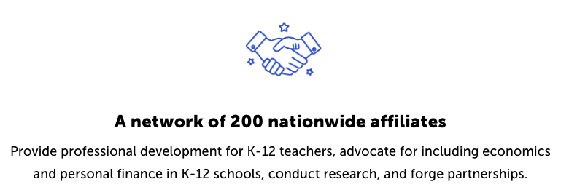
CEE Affiliates
https://www.councilforeconed.org/resources/local-affiliates/

Slide 24
Thank You to Our Sponsors!

