Slide 1
WELCOME
to
Culturally Relevant Personal Finance
Housekeeping Items
Please use the chat function to ask questions or to notify moderator of issues
Session will be recorded and emailed to participants following the webinar
Attendance certificates can be accessed following webinar
The webinar will begin shortly

Slide 2
Culturally Relevant
Personal Finance
Facilitated By: Joel Coleman & Jamie Shaw
Live Webinar: February 10, 2021

Slide 3
MINNESOTA COUNCIL ON ECONOMIC EDUCATION (MCEE)
Our Vision
To equip all Minnesotans with the economic and personal financial understanding needed to succeed in today's complex economy.
Teaching Teachers, Engaging Students, and Reaching Communities
mcee.umn.edu | mcee@umn.edu | 612.625.3727

Slide 4
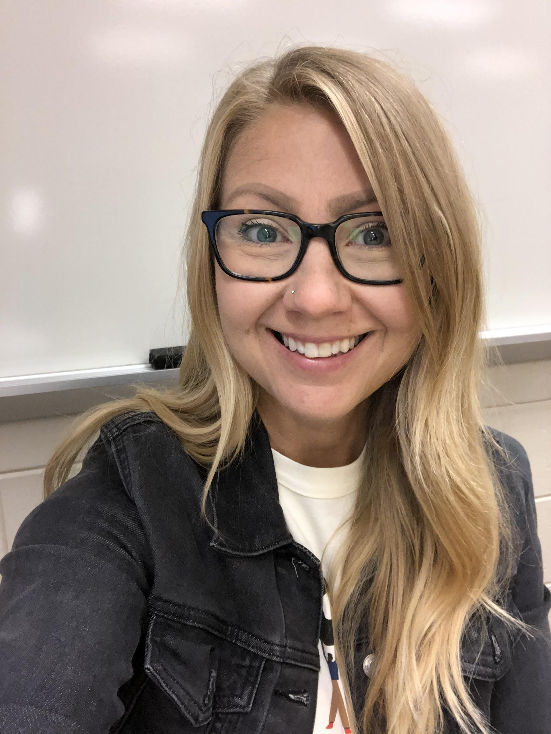
Jamie Shaw
Married with 2 kids: Jude (9), Lennon (6 1/2)
Teacher at Champlin Park High School (21 yrs)
  Economics (CIS and core)
  US Gov & Politics
  Geography
MCEE Master Teacher

Slide 5
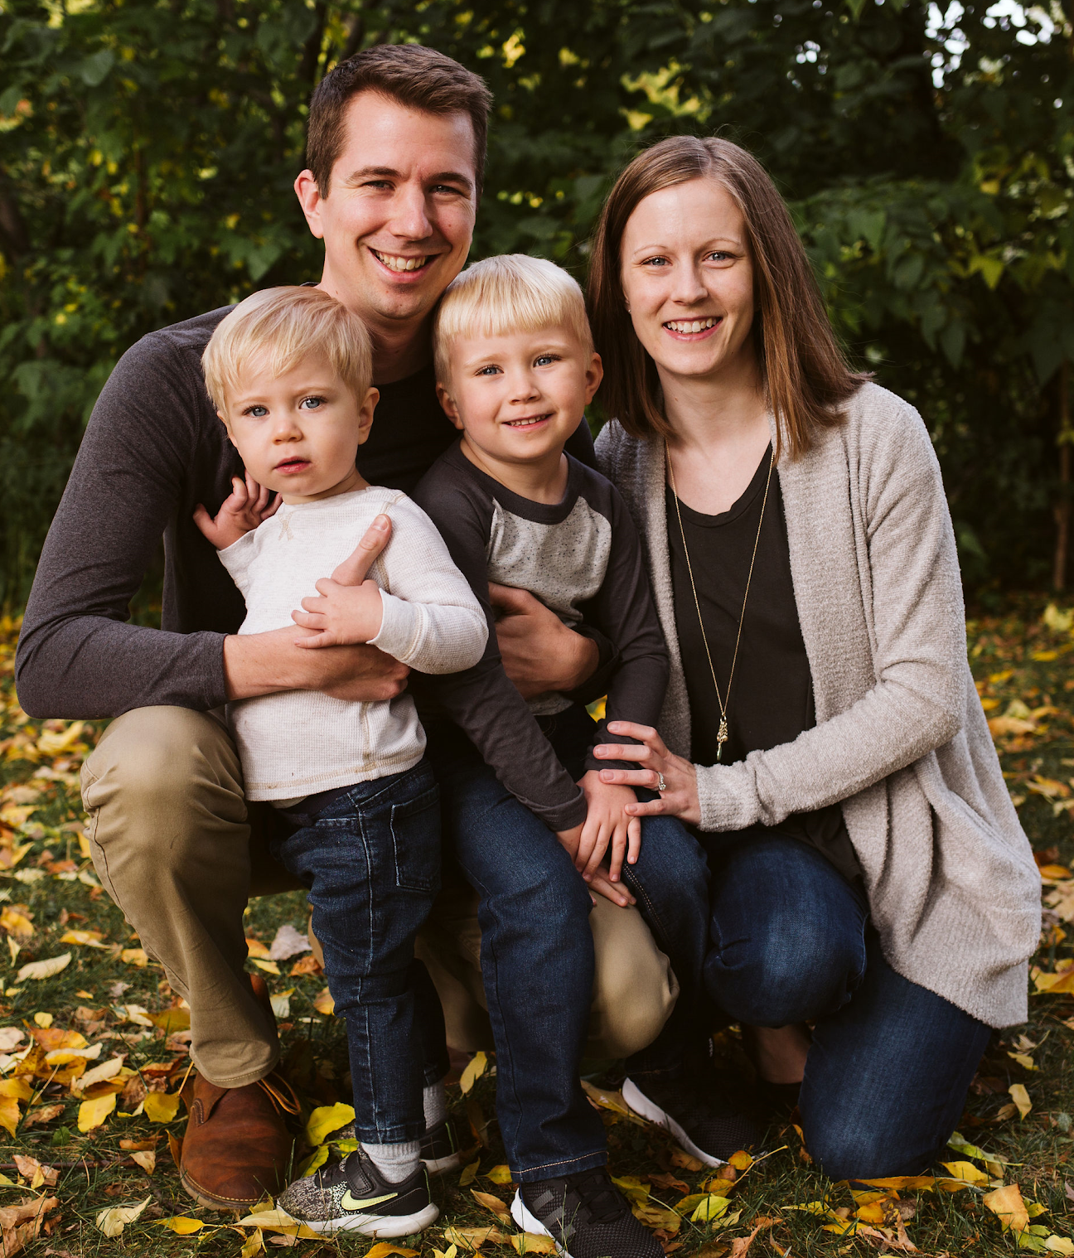
Joel Coleman
Picture if you want
Married with 2 kids: Noah(2) and Henry (4)
Teacher at Ubah Medical Academy in Hopkins, MN (10 years)
Subjects include:
  CIS Economics, CIS Education, Economics, Personal Finance, US History, Psychology, Citizenship
MCEE Master Teacher

Slide 6
★Webinar Objectives
Educators will be able to identify ways in which they can apply cultural knowledge and prior experiences of diverse students to make learning more appropriate and effective.

Slide 7
☆Jamboard
https://rb.gy/h4tghy

Slide 8
★The Checklist
MAKE FINANCE PERSONAL
KNOW YOUR STUDENTS
STUDENT CENTERED INSTRUCTION
TEACHER AS FACILITATOR

Slide 9

☆Make Finance Personal
Include issues and topics related to the students' background and culture and relevant to their needs
What is your
first memory of money?

Slide 10
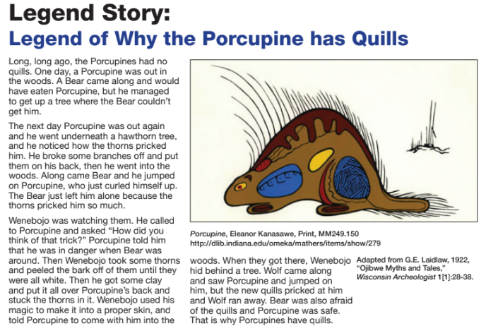
☆Make Finance Personal
Storytelling/ student narratives: Booshke Giin

Slide 11
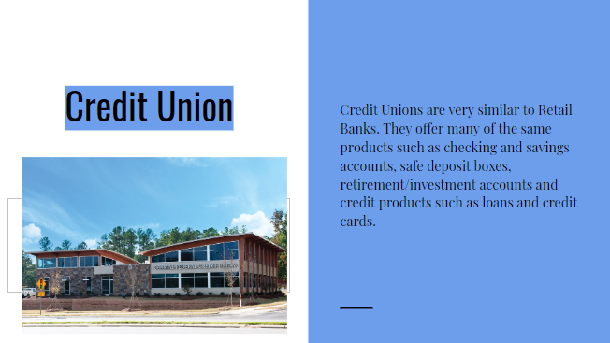
☆Make Finance Personal
Banks and Lending Options

Slide 12
★Know Your Students
In the chat:
What is something you have learned from your students?
Ask questions you are curious about to your students!
Unique things I have learned:
No interest (Paying for college is hard)
Kids take care of parents in old age
Identity theft a big problem
Remittances

Slide 13
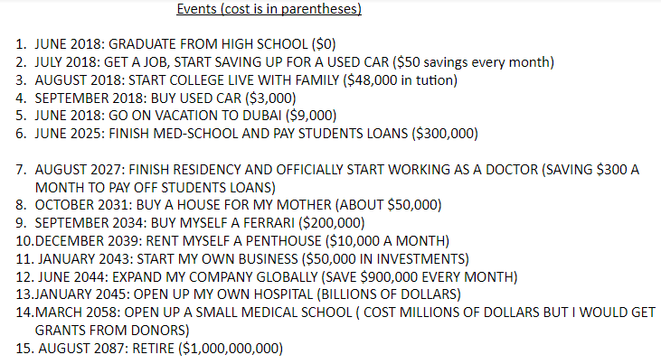
★Student Centered Instruction
Personal Financial Timeline

Slide 14
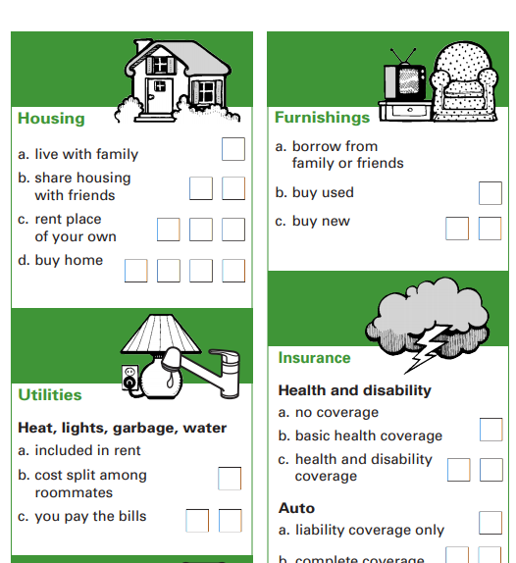
★Student Centered Instruction
Budget Game: Kami
Congratulations! You just got a new job offer! You will get paid 5 more pieces, BUT, you must purchase your own car to get to your new job. Your choice!
Oh no! You have broken your leg while playing sports and need medical attention. Take away 3 pieces if you only had partial medical coverage and 1 if you had full.
Feel free to make up any event--possibly one you encountered yourself!

Slide 15
☆Teacher As Facilitator
Teacher acts as guide: question, listen
Your opinion should be one of many
Bring in community experts

Slide 16
☆Teacher As Facilitator
Values Based Scenarios
Personal finance choices are not one size fits all
Individual choices but also collective decision-making
Students guide discussion and answers

Slide 17
☆Fatima and Banking
In the chat:
What issues does Fatima and/or her family have to consider when making decisions about money?
Fatima is 17 years old, a junior in high school, and is a new immigrant to Minnesota. Currently she lives with her Mom, uncle, and two brothers in an apartment. She recently obtained a job at a local retail shop as a store clerk and will be working after school and on weekends. This is her first job and she is really excited! Fatima and her uncle are the only ones currently working in the household. Before her first paycheck, she understands that a portion of it will be used for her family's living costs. In addition, she wants to save a portion in a savings account for college, she would like to study design and fashion. Her Mom and uncle support her decision to attend college and would like to help her open a savings account. The family is not very familiar with income taxes or navigating financial institutions (banks and credit unions) and are feeling uneasy about seeking information because they are still learning English, although Fatima has reassured them that she will serve as their translator.

Slide 18
☆Fatima and Banking
Who should Fatima and her family talk with about how income taxes work in the United States?
How should Fatima and her family find a bank or credit union?
What might be a key factor in deciding where to open a savings account?
What percentages would you recommend that Fatima put into a college savings account? And why?

Slide 19
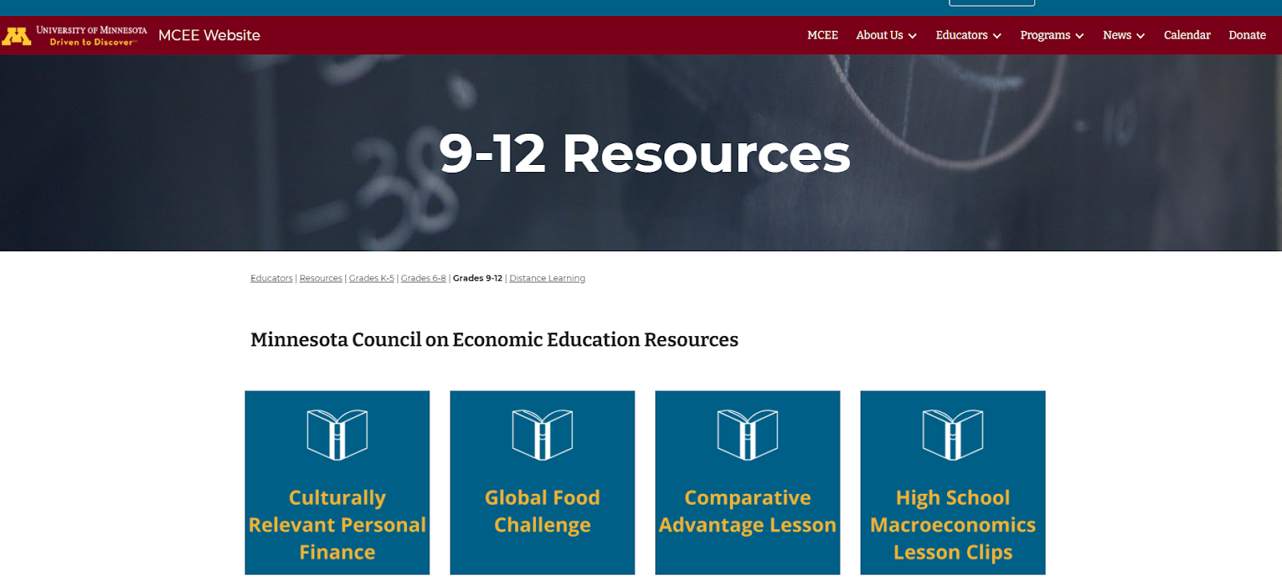
CRPF curriculum
https://mcee.umn.edu/educators/resources/9-12-resources
★

Slide 20
★Additional Resources
Additional K-12 Resources: z.umn.edu/TeacherResources

Slide 21
Thank You
Jamie Shaw | jamie.shaw@ahschools.us
Joel Coleman | joel.coleman@ubahstudents.org
mcee.umn.edu | mcee@umn.edu | 612.625.3727

