Slide 1
NCCEE
Presents
“The Growing Number of Women in Finance” Amber Thomas, North Carolina Council acthomas@nccee.org

Slide 2
NCCEE
Who We Are

Slide 3
Objectives
Teachers will be able to:
Examine why there is a growing number of women with careers in finance.
Explain to students why they may want to pursue the field of finance.

Slide 4
Agenda
Facts
Why do we need women in Finance?
How to we get women in Finance?
Educate
Inspire
Empower
Financial Lessons we must teach women
Podcasts and Articles
Lesson Plans

Slide 5
What are some reasons you think explain such few women in the finance industry?

Slide 7
What do you think can explain the growth of women in finance?

Slide 9
Facts about Women in Finance
Women in Finance Are Rising -- At Last
Slow to adjust
Women = 22% of corporate boards
Twice the figure from 2000
Women = 30% (31,000) Senior Officials and Managers in the finance and insurance industry
29% five years ago

Slide 10
Facts about Women in Finance
Women in Finance Are Rising -- At Last
We have more women, but what roles are they filling?
Human Resources
General Counsel
Investor Relations
Non-revenue generating roles that lead to CEO and Money Managers

Slide 11
Facts about Women in Finance
Women in Finance Are Rising -- At Last
5 of the highest paid positions in the Russell 3000 index
Financial Services sector
10% women in roles
3rd worst after energy and communication services

Slide 12
Facts about Women in Finance
Women in Finance Are Rising -- At Last
Within the Finance Sector…..
BANKING WINS!
26% of top five highest-paid positions
Up from 11% in 2010
5% of S&P 500 companies have women leading them

Slide 13
Facts about Women in Finance
Women in Finance Are Rising -- At Last
Women start ups attracted 2.7% of venture capital
This means money left on the table
Women
Minority-owned businesses

Slide 14
Facts about Women in Finance
Women in Finance Are Rising -- At Last
Women manage only 1.6% of mutual fund assets
Performance is similar
Research paper out of Northwestern University stated that “hedge funds that were still open and had at least one female manager outpaced male-managed funds”
….Why?

Slide 15
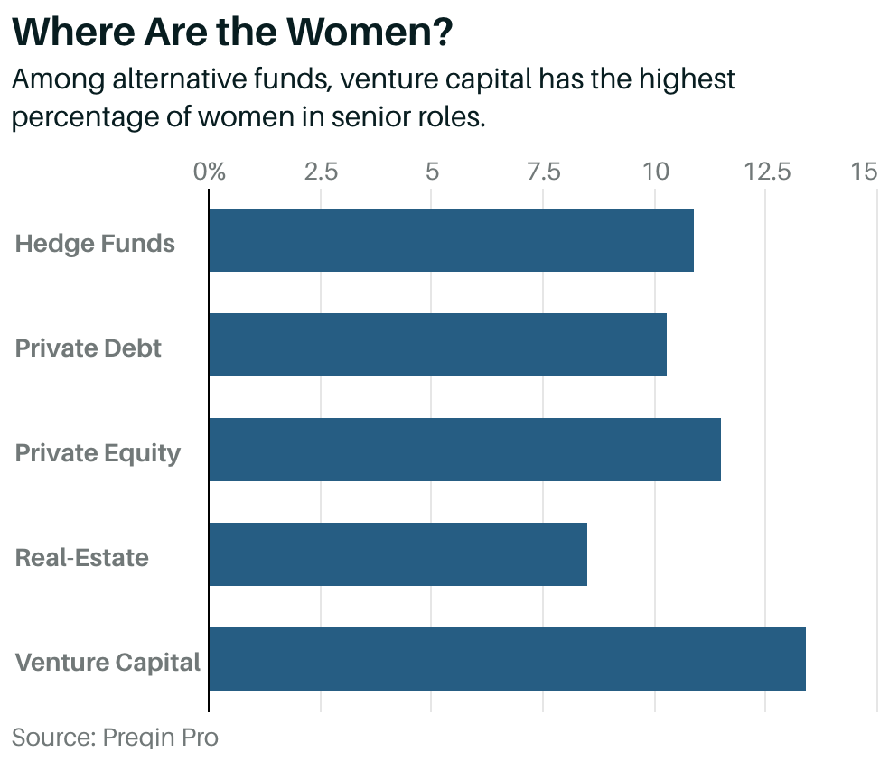
Facts about Women in Finance
Women in Finance Are Rising -- At Last

Slide 16
Facts about Women in Finance
Women in Finance Are Rising -- At Last
Optimism!
Institutional investors, such as foundations and endowments, women win!
42.2% mid level roles
41.6% junior roles
28.2% senior roles

Slide 17
Fast Facts
In 2016, median salary for female full-time worker was $8,632 lower
Women earn less but women products are 7% more
American women are 11 percentage points more likely to be fragile than men

Slide 18
Why do we need women in finance?

Slide 20
Why do we need women in finance?
Approach to Management
Story by World Economic Forum in 2018
Depositors and borrowers, leadership on the firm side
Banking industry more stable
Greater resistance to stress
Higher capital cushion
Lower proportion of nonperforming loans

Slide 21
Why do we need women in finance?
Risk Management
Studies have shown…
Women in leadership = less risks for banks
Women make different (better) financial decision based on risk

Slide 22
Why do we need women in finance?
Relationships
Women love people!
Help build better relationships with clientele
More than half of investors are women
More representation = better picture
In 2020, women are expected to hold more than 32% of global wealth
Women are master relationship builders
Female-led teams weather the storm!

Slide 23
Why do we need women in finance?
Better Investments
Slightly better than men
Less emotional moves
Less risky
Trade less frequently
Study by Warwick Business School
Women outperform men by 1.8%

Slide 24
Why do we need women in finance?
Socially conscious investing
Interest are different
Companies that do good in the world
Green
Give Back
Clean technology
Social justice
These areas are BOOMING!
¼ assets managed, up 40% year over year
73% of women prefer companies that effect social change vs. those that do not

Slide 25
Why do we need women in finance?
More Diversity
Thought
Approaches
Creative
Employee engagement increases

Slide 26
How do we get women to pursue careers, or an interest, in Finance?

Slide 28
Educate!
Lower levels of financial literacy
Less girls getting an education
Missed opportunities
Economically vulnerable
Spend fewer years in workforce
Live longer
Divorce is a flip of the coin

Slide 29
Inspire!
Barron’s 100 Most Influential Women in U.S. Finance
First Woman to Lead a Big Wall Street Bank
8 Popular Financial Experts that are women

Slide 31
Empower!
Take an active role in finances
Talk the “talk”
It’s cool now!
Demand what you deserve AND SPEAK UP!

Slide 32
Financial Lessons We MUST Teach Girls and Women
It’s Personal...and emotional
Prioritize!
Budgeting Skills
Invest in Retirement
Protect yourself!
Get financially savvy
Review your plan once a year
Always ask for more money!
You must be your strongest advocate!

Slide 34
Resources to Help!
Girl Rises Curriculum
Clever Girl Finance

Slide 36
Lesson Plan Ideas
Mini Project: Women in Finance
Create a PowerPoint/Google Slideshow focusing one of Barron’s 100 Most Influential Women
Why is important to be in this industry?
What path did she take?
Research the career path she took
Job Outlook
What do you need to do if you want to achieve this?

Slide 37
Closing and Questions

Slide 38
Sources
https://www.barrons.com/articles/women-are-advancing-to-senior-roles-in-u-s-financeslowly-51583436329
https://thriveglobal.com/stories/this-is-why-female-representation-in-finance-is-so-important/
https://www.weforum.org/agenda/2018/09/women-in-finance-an-economic-case-for-gender-equality
https://gflec.org/wp-content/uploads/2017/12/CitixGirlRising-WomenMoneyFactSheet.pdf?x27564
https://www.cnbc.com/2018/04/30/women-need-to-take-an-active-role-in-their-financial-lives.html
https://www.clevergirlfinance.com/blog/financial-experts-that-are-women/
https://www.kiplinger.com/article/retirement/t047-c032-s014-5-money-lessons-women-must-learn.html
https://hermoney.com/earn/entrepreneurship/female-entrepreneurs-on-their-greatest-financial-lesson/
https://gflec.org/education/girl-rising-financial-literacy-curriculum/

Slide 39
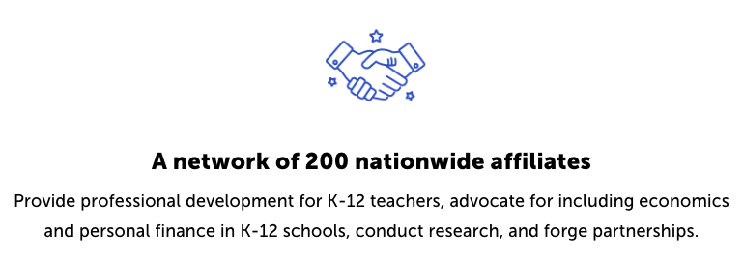
CEE Affiliates
https://www.councilforeconed.org/resources/local-affiliates/

Slide 40
Thank You to Our Sponsors!

Slide 41
We’ve gone Virtual!
Teach Economics?
Your students may have what it takes to compete in the nation’s only high school economics competition!
Why Play?
• Fun team learning experience
• Great for college applications
• No other challenge like this
• Online participation makes access easy
• Chance for cash prizes
How it Works
Teams register
Teachers enroll team(s) of 3- 4 high school students from the same school. Multiple teams allowed.
Teams compete within their state
Compete to win your state competition for a chance to advance to the National Semi-Finals.
National Semi-Finals: May 3-20, 2021
Teams answer multiple-choice questions on macroeconomics, microeconomics, and international & current events.
National Finals: May 22-24, 2021
Teams analyze an economic issue and present their solution. Top teams engage in the Finals Quiz Bowl where they face-off answering questions to claim the National Title.
Two divisions based on experience level
David Ricardo for first-time competitors who have taken no more than one economics course.
Adam Smith for returning competitors, AP, International Baccalaureate, and honors students.
Register Today at NationalEconomicsChallenge.org

Slide 42
FIND YOUR LOCAL COMPETITION AND REGISTER TODAY!
The National Personal Finance Challenge is a competition that provides high school students with an exciting and motivating opportunity to build, apply, and demonstrate their knowledge of money management.
Through online exams and a personal finance simulation, teams showcase their expertise in earning income, buying goods and services, saving, using credit, investing, as well as protecting and insuring.
Teams of up to four students, with one teacher/coach, can qualify to represent their state at the National Personal Finance Challenge by winning their local competition.
NATIONALS
Semi-Finals: First round elimination via online multiple-choice questions.
Finals: Case study round virtually co-hosted by the Cleveland Fed on June 3.
personalfinancechallenge.org

Slide 43
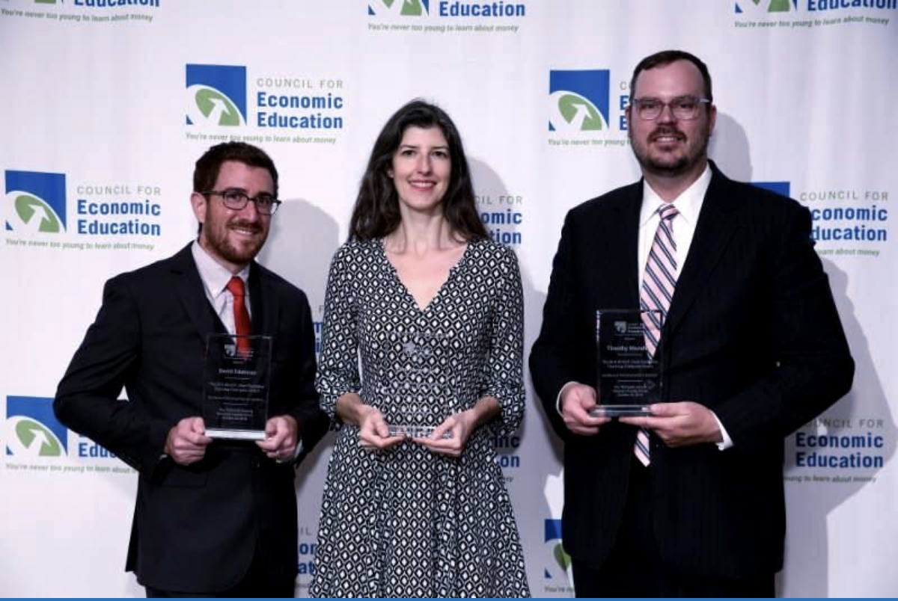
The 2021 Sloan Teaching Champion Award
Winners receive:
A cash award of $5,000
A cash award of $2,500 for their school to support economic education
Recognition at our annual Visionary Awards convening
This award promotes economic education by honoring three outstanding teachers who incorporate exemplary teaching techniques that improve their students’ economic understanding in and out of the classroom.
This award is open to New York metropolitan area high school teachers of all subjects, not just teachers of economics. Applicants must demonstrate how they integrate economics into their teaching.
Sound like you or someone you know?
Applicants must teach in one of the
Twelve New York state counties (New York, Kings, Bronx, Richmond, Queens, Nassau, Suffolk, Westchester, Putnam, Rockland, Orange and Dutchess)
Eight New Jersey counties (Bergen, Passaic, Essex, Hudson, Middlesex, Union, Morris, Monmouth), or these
Two Connecticut counties (Fairfield and New Haven)
Application will be launched on Friday February 19th 2021
You can access the application here.
CONTACT
Please feel free to e-mail us at rrivera@councilforeconed.org
with any questions you have.

