Slide 1



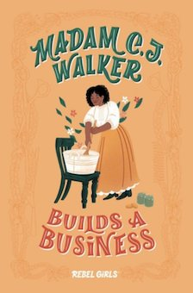

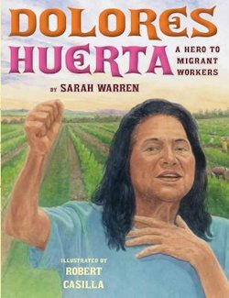
Enterprising Women:
Using Children’s Literature to Teach Economics
Presented by
Lynne Farrell Stover
Date March 16, 2021
stoverlf@jmu.edu

Slide 2
Professional Development Certificate
To earn your professional development certificate for this webinar, you must:
Watch a minimum of 45-minutes and you will automatically receive a professional development certificate via e-mail within 24 hours.
Accessing resources:
You can now easily download presentations, lesson plan materials, and activities for each webinar from EconEdLink.org/professional-development/

Slide 3
EconEdLink Membership
You can now access CEE’s professional development webinars directly on EconEdLink.org! To receive these new professional development benefits, become an EconEdLink member. As a member, you will now be able to:
Automatically receive a professional development certificate via e-mail within 24 hours after viewing any webinar for a minimum of 45 minutes
Register for upcoming webinars with a simple one-click process
Easily download presentations, lesson plan materials and activities for each webinar
Search and view all webinars at your convenience
Save webinars to your EconEdLink dashboard for easy access to the event
You may access our new Professional Development page here

Slide 4
Agenda
In this webinar we will:
Examine National and State Standards & review economic concepts.
Discuss books based on the lives of six enterprising women.
Focus on the economic decision-making made by the featured women.
Review lessons and activities that can be applied to women’s biographies in general.

Slide 5
Objectives
Teachers will be able to:
Prepare for Woman’s History Month by learning about the lives of some enterprising women.
Investigate how the decisions made by these women effected society for the greater good.
Use the presented lessons and activities immediately in their classroom instruction.

Slide 6
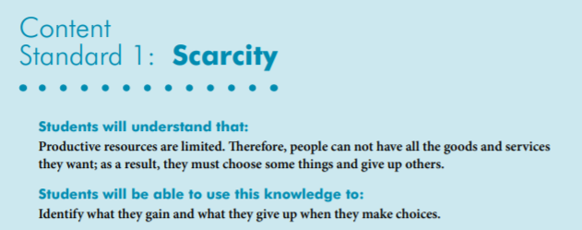
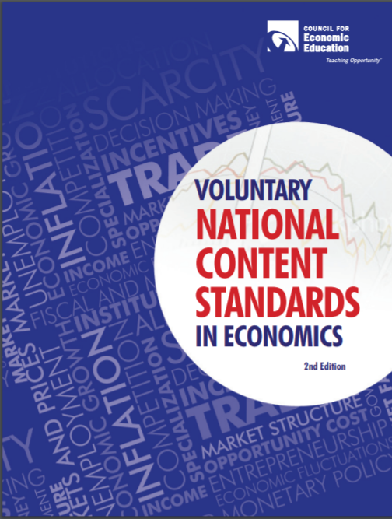
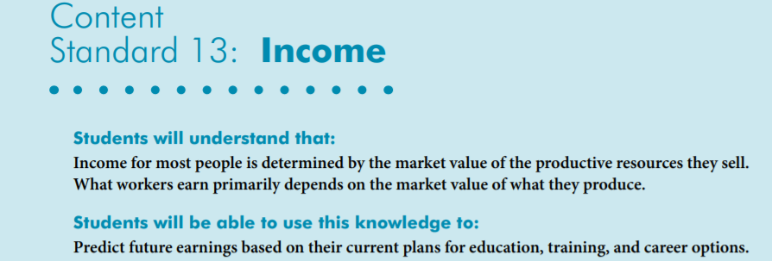
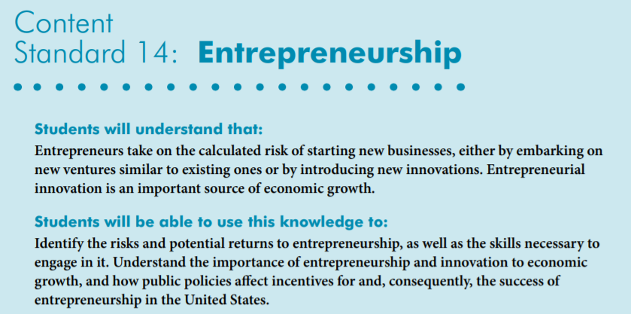
National Standards
https://www.councilforeconed.org/wp-content/uploads/2012/03/voluntary-national-content-standards-2010.pdf

Slide 7

Virginia HISTORY & SOCIAL SCIENCE Standards of Learning
K.9 The student will
a) recognize that people make choices because they cannot have everything they want; and
explain that people work to earn money to buy the things they want.
CE.11 The student will apply social science skills to understand how economic decisions are made in the marketplace by
a) explaining that because of scarcity, consumers, producers, and governments must make choices, understanding that everyone’s choice has an opportunity cost; and
EPF. 4 The student will demonstrate knowledge that many factors affect income by
a) examining the market value of a worker’s skills and knowledge;
c) explaining the relationship between a person’s own human capital and the resulting income potential;

Slide 8
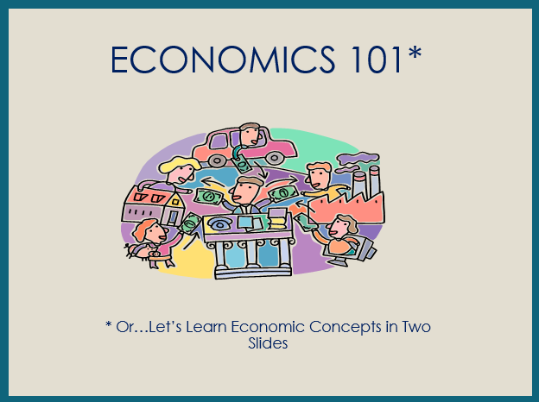

Slide 9
ECONOMICS 101
Economics is the study of _________
(as they pertain to _________, _________, and the _________).
choices
consumers
producers
government
Every nation has productive resources
__________________
Resources from the earth, unaltered by man
__________________
People’s effort, skills, and knowledge
__________________
Man-made resources
used over and over
natural
human
capital
__________________
Goods used in production to become part of a product
intermediate
which are used to produce
goods
and
services
to be __________________ or __________________ with money (savings).
bartered
purchased

Slide 10
however
Productive resources, and therefore, goods and services, are limited
Human wants (needs)
are basically unlimited
resulting in
SCARCITY
Consequently, buyers (consumers) and sellers (producers) have to make
economic __________________ (resulting in
__________________ __________________)
choices
opportunity
cost
when answering
three basic economic questions
__________ ___________
Buyers and sellers answer ?’s
___________ goods and
services will be produced?
___________ will the goods and services be produced?
___ _______ will the goods and services be distributed?
___________ ___________
Government answers ?’s
What
How
To whom
command economy
market economy
Answering these questions most efficiently creates the need for
___________________ and ___________________ resulting in trade.
specialization
interdependence
decision
making
scarcity
Economics: ___________ - __________ under ___________.

Slide 11

Women’s History Month was first celebrated in the United States in March, 1981. For educators and students, the month provides a wonderful opportunity to explore and study women’s contributions, struggles, and triumphs throughout history. This month honors women who come from all walks of life, races, ages and religions and often had to overcome major obstacles to achieve their goals.

Slide 12
Match Game
Journalist, industrialist, inventor and charity worker who went around the world in 72 days.
Songwriter, actress, pianist and civil rights activist.
Architect and sculptor.
Author, disability rights advocate, political activist and lecturer.
Activist and lifelong crusade to correct economic injustice.
Entrepreneur, philanthropist, and social activist. She is recorded as the first female self-made millionaire.
Aretha Franklin
Maya Lin
Nellie Bly
Hellen Keller
Madam C.J Walker
Dolores Huerta

Slide 13
The Daring Nellie Bly: America’s Star Reporter by Bonnie Christensen
Publisher: Dragonfly Books
Copyright Date: 2003
Reading Level: 6.0
Interest Level: K-3
May 5, 1864- June 27, 1922

Slide 14
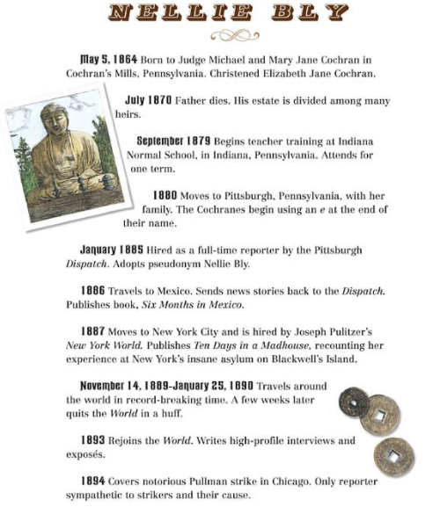
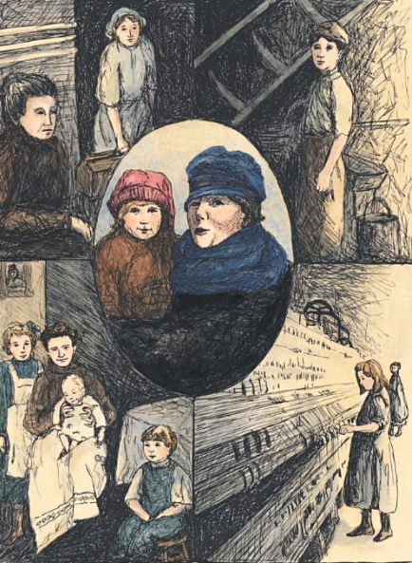
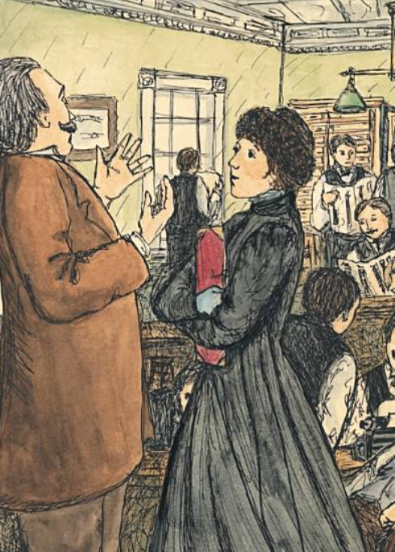
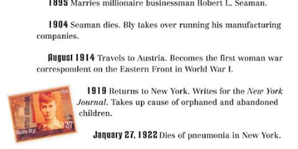
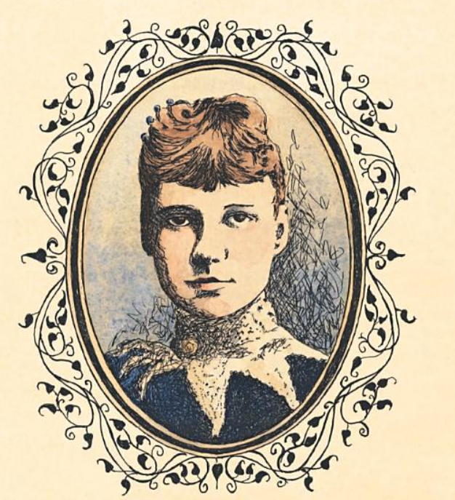

Slide 15
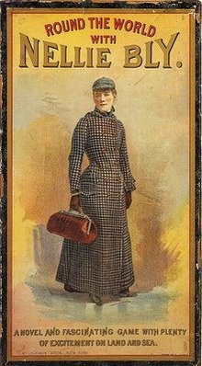
Nellie Bly
Newspaper journalist Elizabeth Jane Cochran is best known by the name Nellie Bly. That was the name she used as a newspaper reporter. She once went under cover to learn and write about the terrible conditions in which many poor people lived in New York City. She even went on a trip around the world trying to beat the record of Phineas Fogg, a character in the Jules Verne book Around the World in Eighty Days.

Slide 16
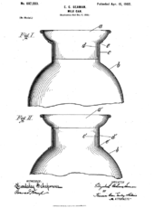
Enterprising Facts
Nellie received patents for several inventions including a stacking garbage can and an innovative lid for a milk can.
Nellie married Robert Seaman in 1895. When he died, she took over his business, Iron Clad Manufacturing.
During WWI she was the first woman to report from overseas.

Slide 17
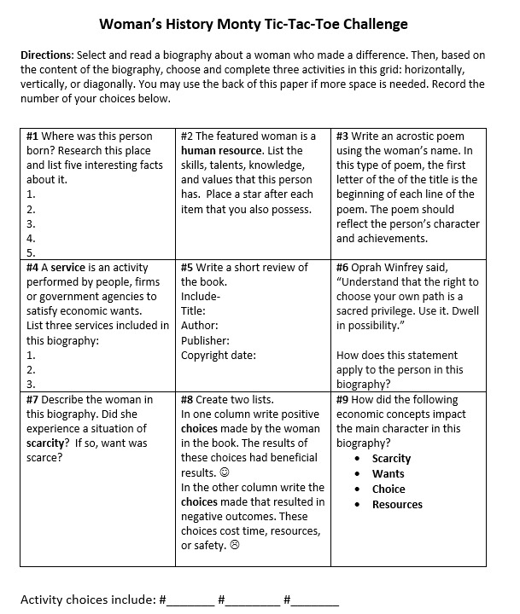


Slide 18
Madam C.J. Walker Builds a Business by Rebel Girls
Publisher: Simon & Schuster
Copyright Date: 2019
Reading Level: 2.0
Interest Level: 1-4
December 23, 1867- May 25, 1919

Slide 19

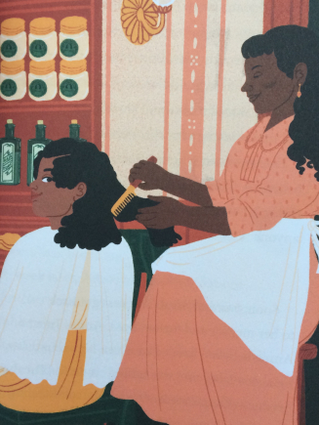
Madam C.J. Walker
Madam C.J. Walker, born Sarah Breedlove, created specialized products for African American hair care and was one of the first American women to become a self-made millionaire.
She promoted her products by traveling around the country giving lecture-demonstrations and eventually established Madame C.J. Walker Laboratories to manufacture cosmetics and train sales beauticians.
Her business acumen led her to be one of the first American women to become a self-made millionaire. She was also known for her philanthropic endeavors, including a donation toward the construction of an Indianapolis YMCA in 1913.

Slide 20
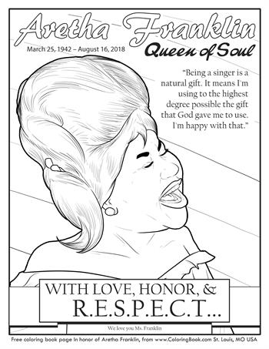
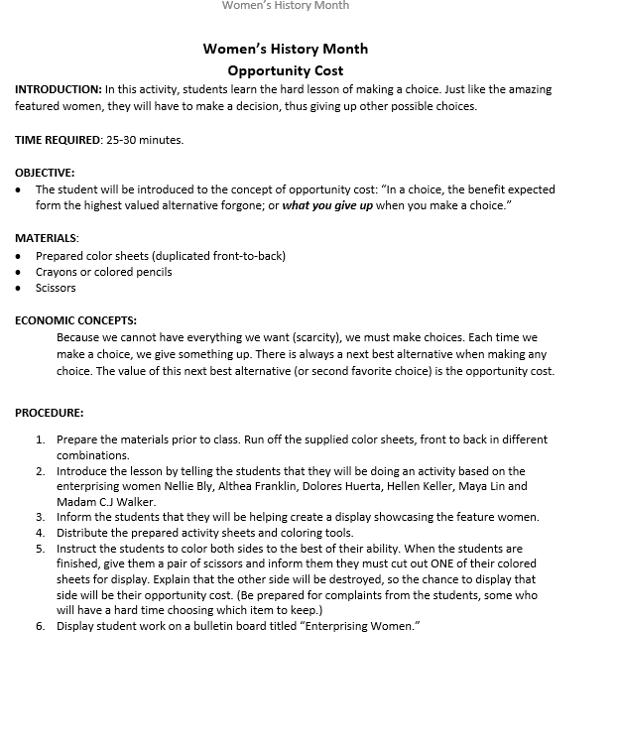
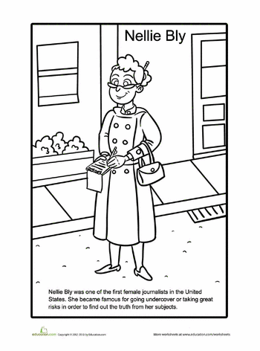
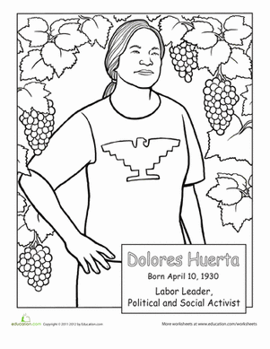
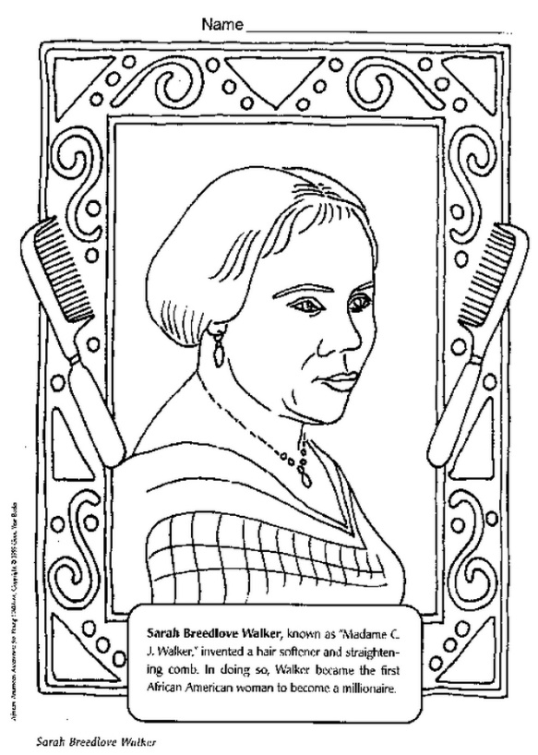

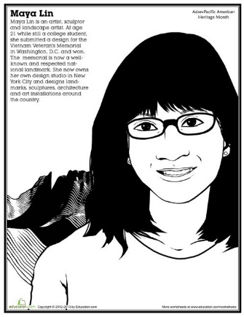
Opportunity Cost Lesson

Slide 21
Helen's Big World: The Life of Helen Keller by Doreen Rappaport
Braille
Publisher: Hyperion
Copyright Date: 2017
Reading Level: 4.9
Interest Level: 1-4
June 27, 1880- June 1, 1968

Slide 22
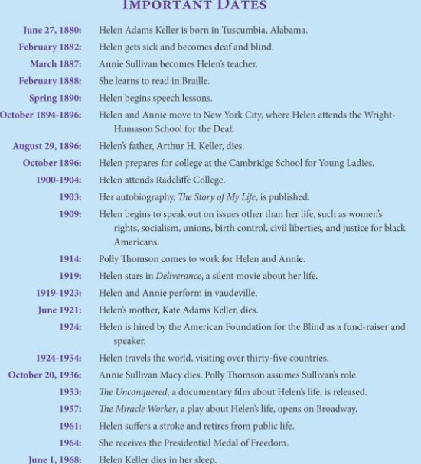
Helen Keller
Helen Keller was an American educator, advocate for the blind and deaf and co-founder of the ACLU. Stricken by an illness when she was two-years-old, Keller was left blind and deaf. Beginning in 1887, Keller's teacher, Anne Sullivan, helped her make tremendous progress with her ability to communicate, and Keller went on to college, graduating in 1904. During her lifetime, she received many honors in recognition of her accomplishments.

Slide 23
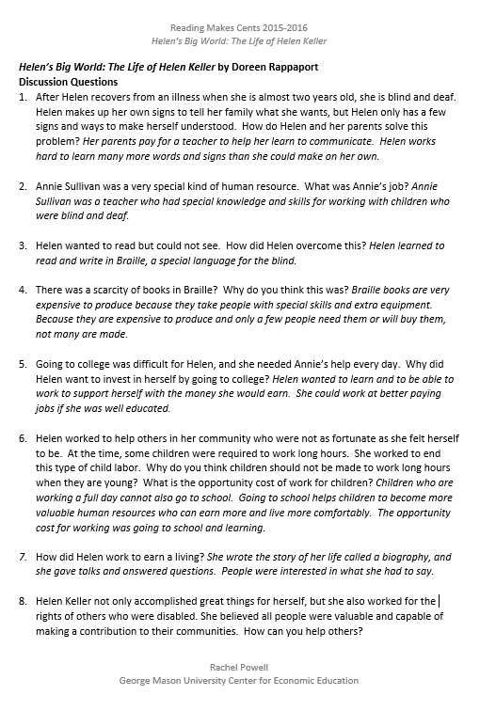
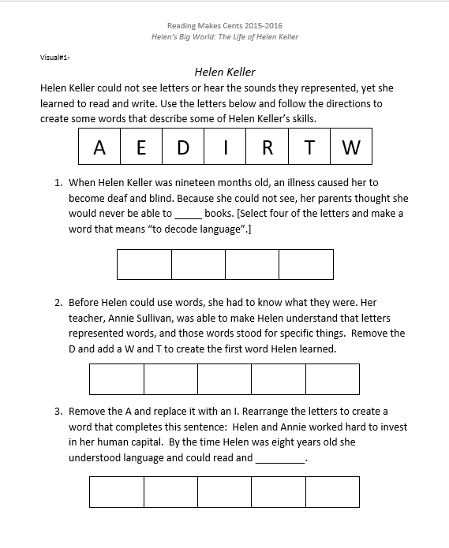
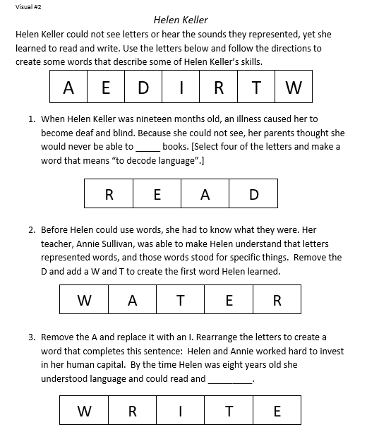
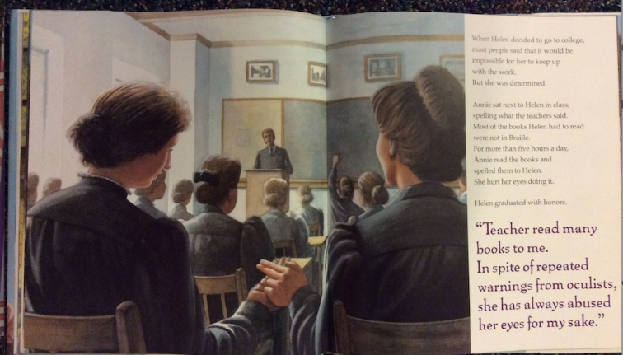
Discussion Questions & Lesson

Slide 24
Dolores Huerta: A Hero to Migrant Workers by Sarah Warren
Publisher: Marshall Cavendish
Copyright Date: 2012
Reading Level: 3.0
Interest Level: 2-5
April 10, 1930

Slide 25
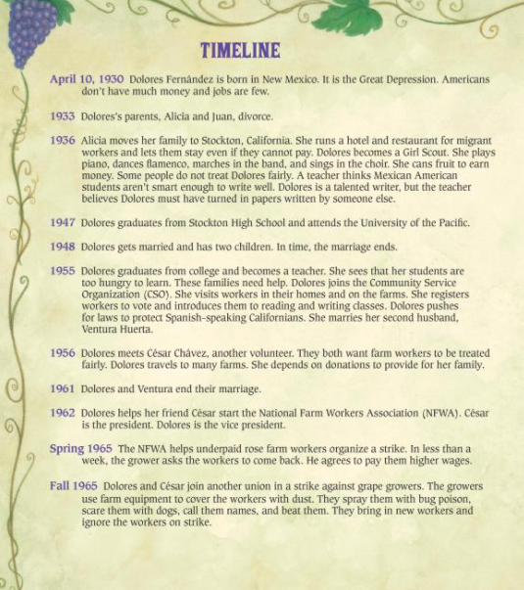
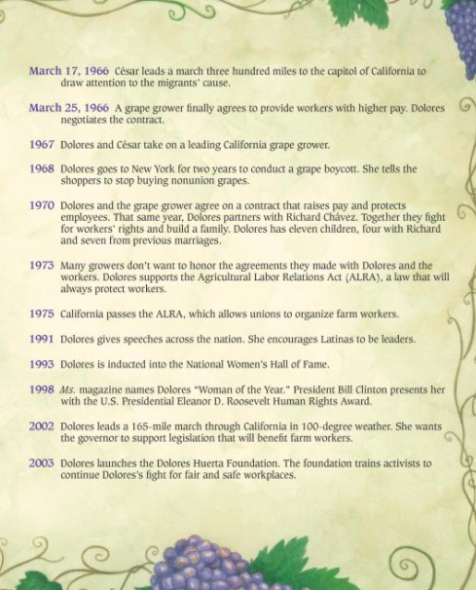
What Do You Think They Meant?
Dolores Huerta defines a feminist as someone "who supports a woman's reproductive rights, who supports a woman's right to an abortion, who supports LGBT rights, who supports workers and labor unions, somebody who cares about the environment, who cares about civil rights and equality and equity in terms of our economic system.”
She is the mother of nine children!

Slide 26
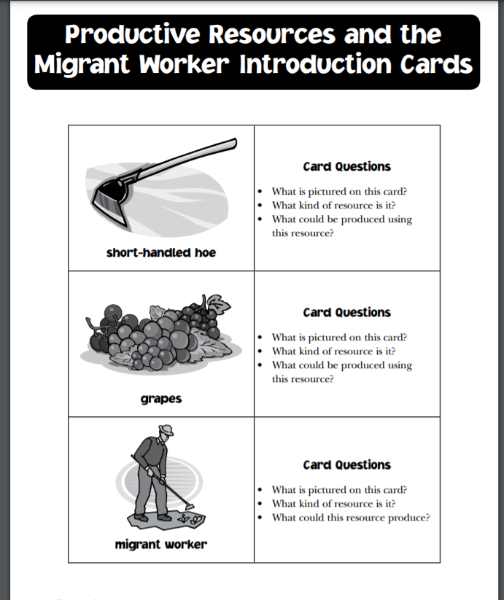
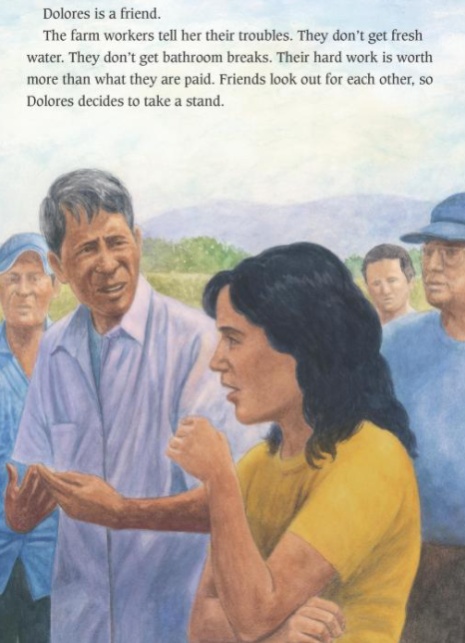
What Do You Think?
Migrant farm workers had to use the short-handled hoe for thinning and weeding crops. Because it required them to stoop during long hours in the fields, the hoe became a symbol of the exploitive working conditions. Campaigns by the United Farm Workers and others helped outlaw use of the hoe in 1975.
What was the reasoning behind the mandatory use of the short-handled hoe…?

Slide 27
R-E-S-P-E-C-T: Aretha Franklin, the Queen of Soul by Carole Boston Weatherford
Publisher: Simon & Schuster
Copyright Date: 2020
Reading Level: 2.0
Interest Level: K-3
March 25, 1942- August 16,2018

Slide 28
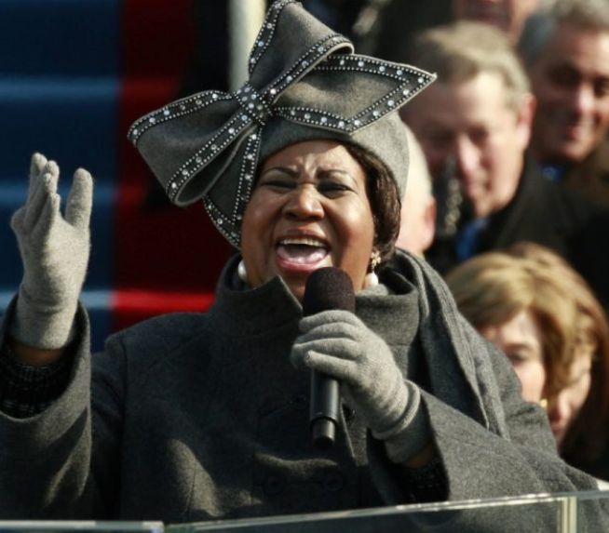
Aretha Franklin
Aretha Franklin’s musical talent was clear from her earliest days when singing in her father’s Detroit church.
Later, her hit songs earned her the title “the Queen of Soul,” multiple Grammy Awards, and a place in the Rock & Roll Hall of Fame. But Aretha didn’t just raise her voice in song; she also spoke out against injustice and fought for civil rights.

Slide 29
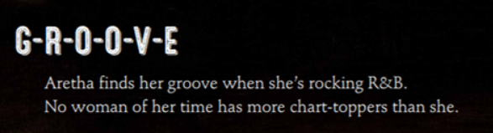
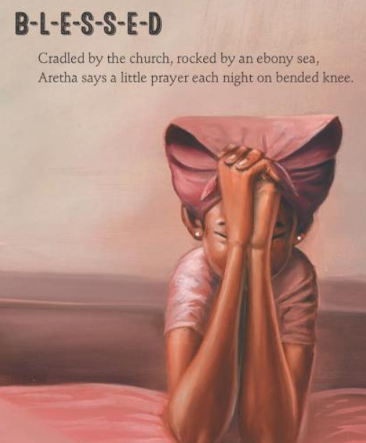
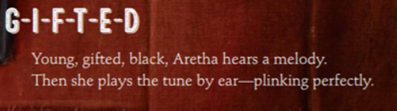
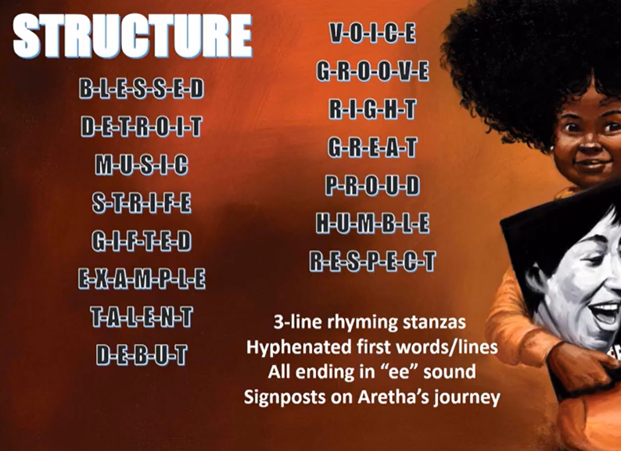

Slide 30
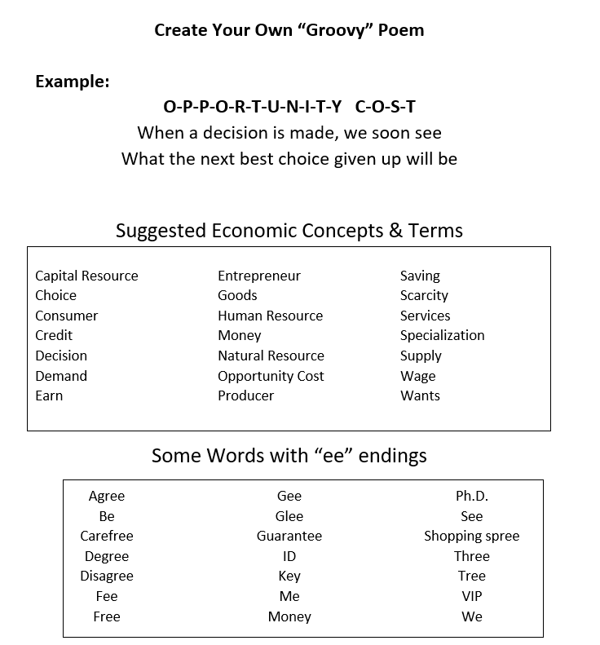

Slide 31
Maya Lin: Artist-Architect of Light and Lines by Jeanne Walker Harvey
Publisher: Henry Holt & Co.
Copyright Date: 2017
Reading Level: 4.2
Interest Level: K-3
https://www.youtube.com/watch?v=ro7ylpGt5gQ
Reading Time: 5:05 minutes
October 5, 1959

Slide 32

Fascinating Fact
Maya Lin’s design for the Vietnam Veteran’s Memorial only earned a B in her class at Yale, so Lin was shocked when competition officials came to her dormitory room in May 1981 and informed the 21-year-old that she had won the design and the $20,000 first prize.

Slide 33
What Do You Think They Meant?
“Energy rightly applied can accomplish anything.” -Nellie Bly
“Don’t sit down and wait for the opportunities to come. Get up and make them.” -Madam C.J. Walker
“Knowledge is love and light and vision.” -Helen Keller
“I love Wal-Mart, and not just because my record is there. You can get some things there that you cannot get at Saks’ of Bergdorf’s or other upscale stores.” -Aretha Franklin
“Every moment is an organizing opportunity, every person a potential activist, every minute a chance to change the world.” -Dolores Huerta
“To me, the American Dream is being able to follow your own personal calling. To be able to do what you want to do is incredible freedom.” - Maya Lin

Slide 34
Assessment Questions
How do you think these statements affect our nation’s economic future…?
When more women work, economies grow.
Increasing women’s and girls’ educational attainment contributes to women’s economic empowerment and more inclusive economic growth.
Women’s economic equality is good for business.
Based on 2018 U.S. Census Bureau data, women working full time, year-round earn an average of 82 cents for every $1 earned by their male counterparts.
What lessons can our students learn when they study the lives of enterprising women?

Slide 35
Comments?
Questions?
Concerns?

Slide 36
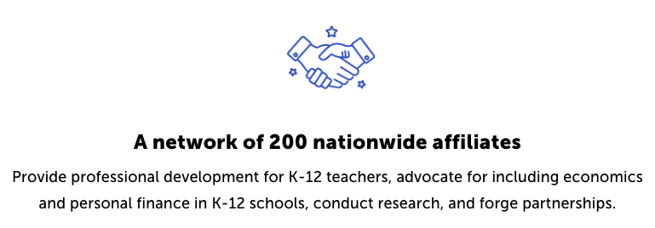
CEE Affiliates
https://www.councilforeconed.org/resources/local-affiliates/

Slide 37




Thank You to Our Sponsors!

Slide 38



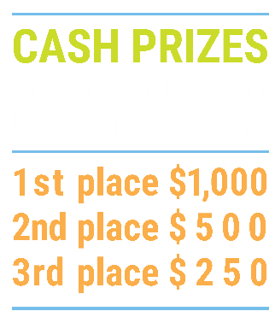

We’ve gone Virtual!
Teach Economics?
Your students may have what it takes to compete in the nation’s only high school economics competition!
Why Play?
• Fun team learning experience
• Great for college applications
• No other challenge like this
• Online participation makes access easy
• Chance for cash prizes
How it Works
Teams register
Teachers enroll team(s) of 3- 4 high school students from the same school. Multiple teams allowed.
Teams compete within their state
Compete to win your state competition for a
chance to advance to the National Semi-Finals.
National Semi-Finals: May 3-20, 2021
Teams answer multiple-choice questions on macroeconomics, microeconomics, and international & current events.
National Finals: May 22-24, 2021
Teams analyze an economic issue and present their solution. Top teams engage in the Finals Quiz Bowl where they face-off answering questions to claim the National Title.
Two divisions based on experience level
David Ricardo for first-time competitors who have taken no more than one economics course.
Adam Smith for returning competitors, AP, International Baccalaureate, and honors students.
Register Today at NationalEconomicsChallenge.org

Slide 39



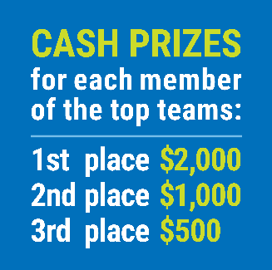

FIND YOUR LOCAL COMPETITION
AND REGISTER TODAY!
The National Personal Finance Challenge is a competition that provides high school students with an exciting and motivating opportunity to build, apply, and demonstrate their knowledge of money management.
Through online exams and a personal finance simulation, teams showcase their expertise in earning income, buying goods and services, saving, using credit, investing, as well as protecting and insuring.
Teams of up to four students, with one teacher/coach, can qualify to represent their state at the National Personal Finance Challenge by winning their local competition.
NATIONALS
Semi-Finals: First round elimination via online multiple-choice questions.
Finals: Case study round virtually co-hosted by the Cleveland Fed on June 3.
personalfinancechallenge.org

Slide 40
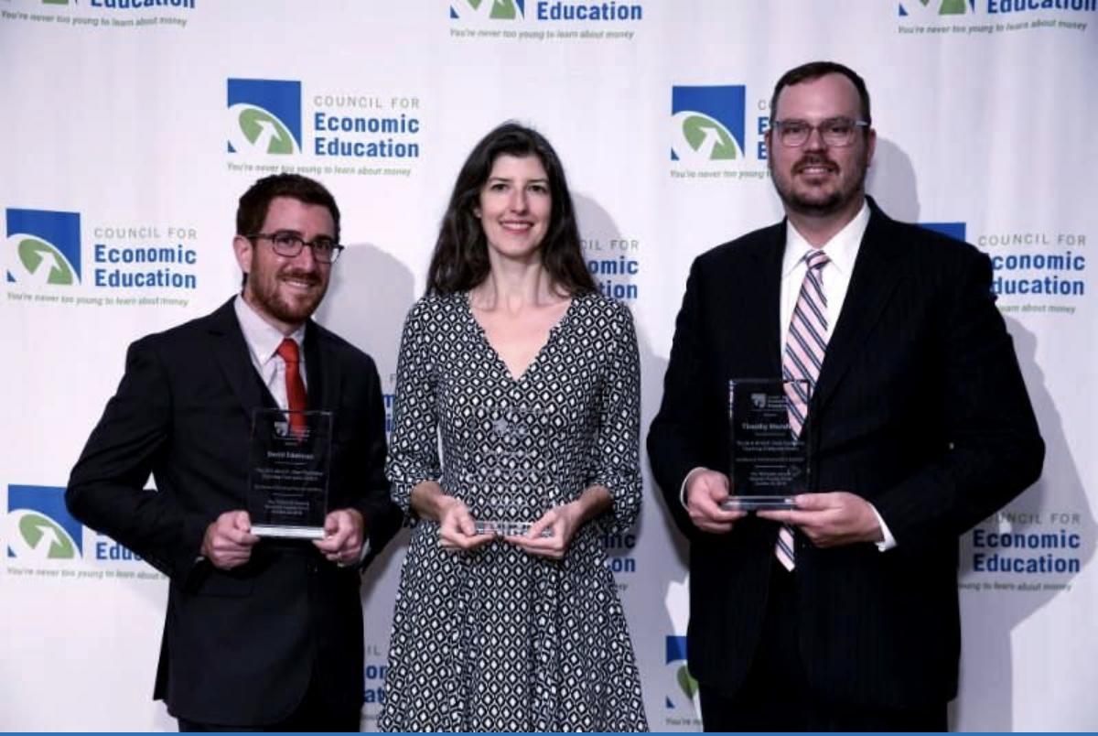
The 2021 Sloan Teaching Champion Award
Winners receive:
A cash award of $5,000
A cash award of $2,500 for their school to support economic education
Recognition at our annual Visionary Awards convening.
This award promotes economic education by honoring three outstanding teachers who incorporate exemplary teaching techniques that improve their students’ economic understanding in and out of the classroom.
This award is open to New York metropolitan area high school teachers of all subjects, not just teachers of economics. Applicants must demonstrate how they integrate economics into their teaching.
Sound like you or someone you know?
Applicants must teach in one of the
Twelve New York state counties (New York, Kings, Bronx, Richmond, Queens, Nassau, Suffolk, Westchester, Putnam, Rockland, Orange and Dutchess)
Eight New Jersey counties (Bergen, Passaic, Essex, Hudson, Middlesex, Union, Morris, Monmouth), or the
Two Connecticut counties (Fairfield and New Haven)
Application will be launched on Friday February 19th 2021
You can access the application here.
CONTACT
Please feel free to e-mail us at rrivera@councilforeconed.org
with any questions you have.

