Slide 1
Teaching Fiscal Policy in the COVID Era: The Economic Impact of the Crisis & Why It Doesn’t Affect Everyone Equally Presented by Brett Burkey, Education Director @ FCEE February 18, 2021 5:30-6:30 pm bburkey@fcee.org

Slide 2
EconEdLink Membership
You can now access CEE’s professional development webinars directly on EconEdLink.org! To receive these new professional development benefits, become an EconEdLink member. As a member, you will now be able to:
Automatically receive a professional development certificate via e-mail within 24 hours after viewing any webinar for a minimum of 45 minutes
Register for upcoming webinars with a simple one-click process
Easily download presentations, lesson plan materials and activities for each webinar
Search and view all webinars at your convenience
Save webinars to your EconEdLink dashboard for easy access to the event
You may access our new Professional Development page here

Slide 3
Professional Development Certificate
To earn your professional development certificate for this webinar, you must:
Watch a minimum of 45-minutes and you will automatically receive a professional development certificate via e-mail within 24 hours.
Accessing resources:
You can now easily download presentations, lesson plan materials, and activities for each webinar from EconEdLink.org/professional-development/

Slide 4
Agenda
5:30-5:35, Welcome and Preview
5:35-5:50, Review Bell- Ringer and Hyperdoc
5:50-6:15, Work Through Economic Impact Nearpod
6:15-6:25, Explore Kahoot
6:25-6:30, Questions and Wrap- Up

Slide 5
Objectives
Participants will be able to explain the immediate universal impact the virus had on our economy and way of life.
Participants will be able to understand that a significant number of American households were distressed financially before the pandemic.
Participants will recognize that the recovery from the pandemic has been very disparate, creating different experiences along multiple demographic and economic lines.

Slide 6
National Standards
Standard: 18
Students will understand that: Fluctuations in a nation's overall levels of income, employment, and prices are determined by the interaction of spending and production decisions made by all households, firms, government agencies, and others in the economy. Recessions occur when overall levels of income and employment decline.
Standard: 13
Students will understand that: Income for most people is determined by the market value of the productive resources they sell. What workers earn primarily depends on the market value of what they produce.

Slide 7
Assessment Questions
Kahoot:
https://create.kahoot.it/share/the-economic-impact-of-covid-19/25620652-4f97-4930-b158-fdd52ab8fa03

Slide 8
Google Slides
https://share.nearpod.com/e/aI08LMFN5db
https://docs.google.com/presentation/d/1GwtUgf1RRBSkDOrNNqqk7QSjrhFETPEtpUpQzKSYit0/edit?usp=sharing

Slide 9
References
What is a K-shaped Recovery: https://youtu.be/0ws7WrNyQGs
Jerome Powell on the Recovery: https://youtu.be/4NRjGY154qM

Slide 10
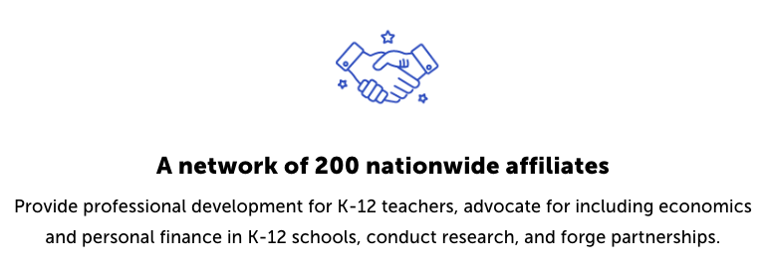
CEE Affiliates
https://www.councilforeconed.org/resources/local-affiliates/

Slide 11
Thank You to Our Sponsors!

