Slide 1
The New Silk Road:
African Development and China’s Belt & Road Initiative
Jay LeBlanc
Economic Literacy Colorado
February 24, 2021
https://econlitco.org/

Slide 2
EconEdLink Membership
You can now access CEE’s professional development webinars directly on EconEdLink.org! To receive these new professional development benefits, become an EconEdLink member. As a member, you will now be able to:
Automatically receive a professional development certificate via e-mail within 24 hours after viewing any webinar for a minimum of 45 minutes
Register for upcoming webinars with a simple one-click process
Easily download presentations, lesson plan materials and activities for each webinar
Search and view all webinars at your convenience
Save webinars to your EconEdLink dashboard for easy access to the event
You may access our new Professional Development page here

Slide 3
Professional Development Certificate
To earn your professional development certificate for this webinar, you must:
Watch a minimum of 45-minutes and you will automatically receive a professional development certificate via e-mail within 24 hours.
Accessing resources:
You can now easily download presentations, lesson plan materials, and activities for each webinar from EconEdLink.org/professional-development/

Slide 4
Agenda for Today’s Session
Overview of Africa – geography, culture, etc..
“Why Are Some Nations Wealthy” revised lesson
Overview of China’s Belt and Road Initiative in Africa
What Does the Future Hold? COVID-19 and others
Lesson connections built in – Resource List available

Slide 5
Objectives
1) Teachers will learn details about the Belt and Road Initiative: what it is, where it is and how specifically it is impacting African development.
2) Teachers will examine economics lessons connected to economic development and the trade-offs faced by developing African countries.

Slide 6
Colorado State Standards
7th Grade, Standard 3 Economics, “Investigate how societies create different economic systems in the Eastern Hemisphere”, specifically plan and evaluate complex solutions to global economic system challenges; look for and find value in different economic perspectives expressed in the Eastern Hemisphere; and discuss how different economies distribute scarce resources, control the means of production, and distribute goods and services.
7th Grade, Standard 3 Economics, “Investigate the role of consumers within the Eastern Hemisphere” – specifically identify and explain multiple perspectives (cultural and global) when exploring economic events and issues within the Eastern Hemisphere; and discuss why it is important to analyze the various levels of a culture before understanding how individuals in that culture would make financial decisions.
High School, Standard 2 Geography, “Examine the interconnected nature of the world, its people and places” – specifically how the uneven distribution of resources in the world can lead to conflict, cooperation, or competition among nations, regions, and cultural groups; and explain how migration of people and movement of goods and ideas can enrich cultures but also create tensions.

Slide 7
Colorado State Standards (con’t)
High School, Standard 3 Economics, “Economic systems, market structures, competition, and government policies affect market outcomes” – specifically explore the role of government in addressing market failures
High School, Standard 3 Economics, “Productive resources (natural, human, capital) are scarce; therefore, choices are made about how individuals, businesses, governments, and nonprofits allocate these resources – specifically what incentives influence choices and analyze how these groups deal with the challenges of scarcity.
High School Standard 3 Economics, “Globalization and international trade affect the allocation of goods, services, and resources” – specifically recognize how exchange rates affect economic activity; explain how trade policies affect international trade and domestic markets; and explore the effects of current globalization trends and policies
High School, Standard 4 Civics, “Analyze the origins, structures, and functions of governments to evaluate the impact on citizens and the global society” – specifically analyze how current global issues impact American foreign policy, for example: foreign trade agreements.

Slide 8
Play Time To Climb on Nearpod https://share.nearpod.com/vPFZCSy3kdb

Slide 9
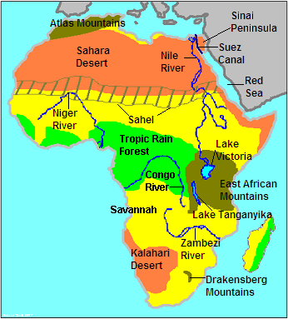
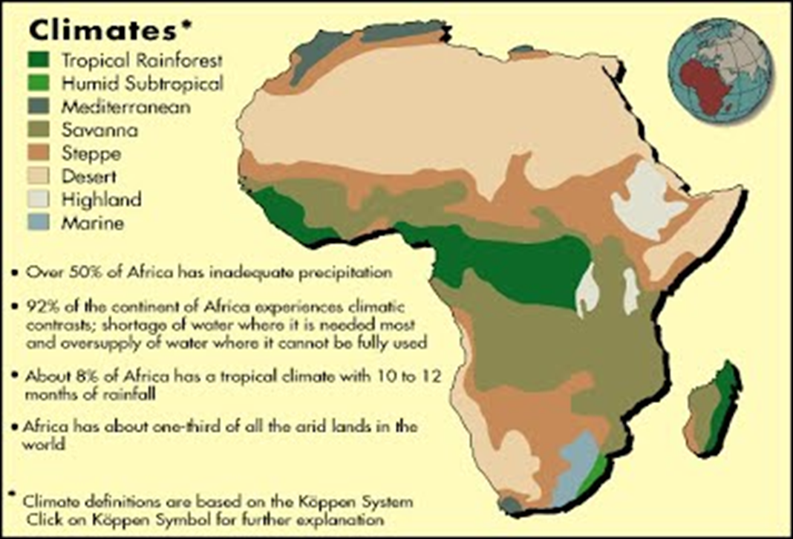
Overview of Africa

Slide 10
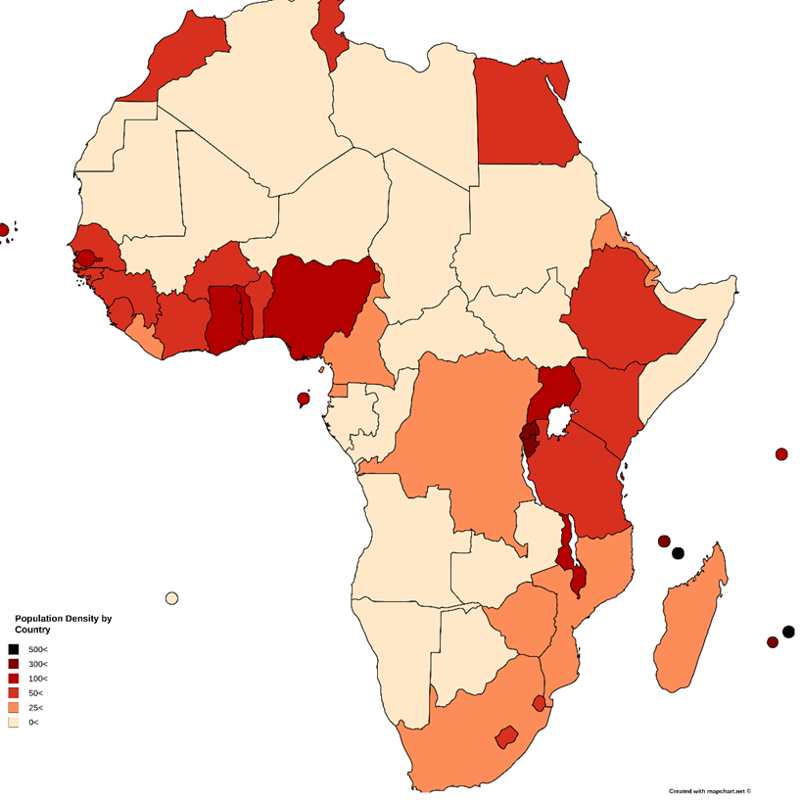
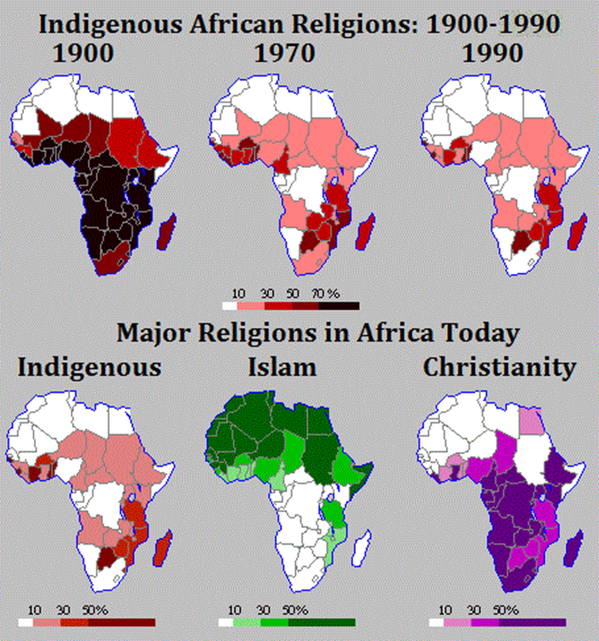
Overview of Africa

Slide 11
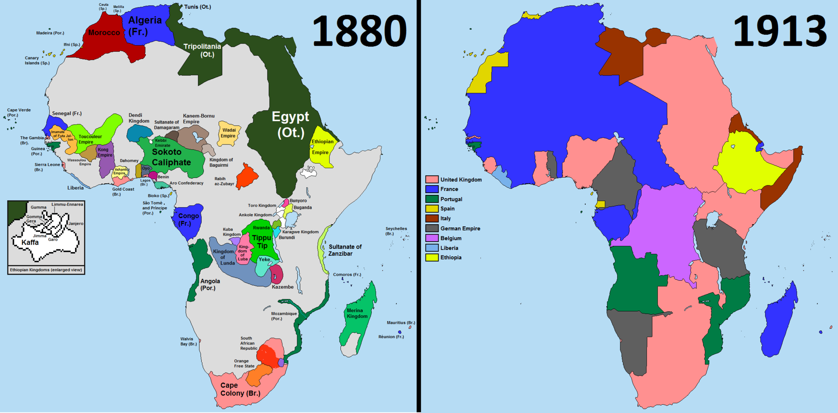
Overview of Africa

Slide 12
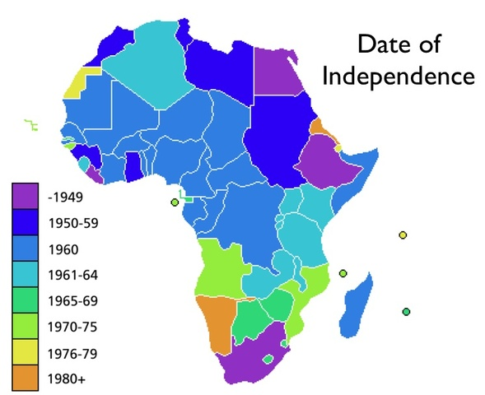

Overview of Africa

Slide 13
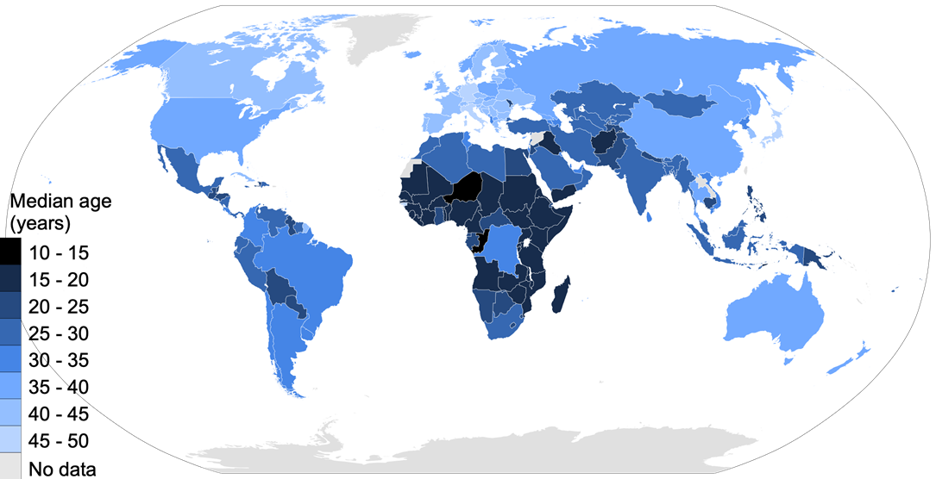
Overview of Africa

Slide 14
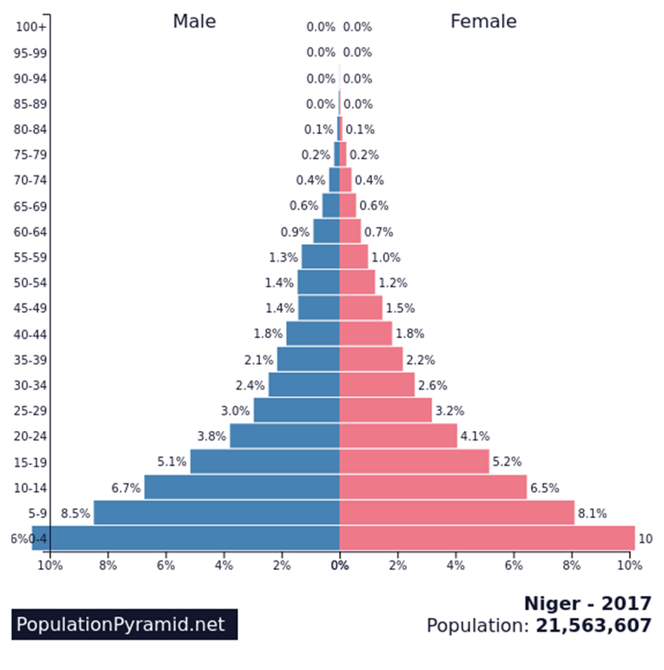
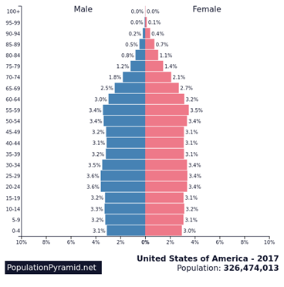
Overview of Africa

Slide 15
Collaboration Board #1 on Nearpod – What do YOU think is Africa’s biggest challenge?

Slide 16
PDF of the “Why Are Some Nations Wealthy” lesson on Nearpod

Slide 17

Mystery Country A
Area: 924,000 sq km. Texas and New Mexico together
Major Exports: Petroleum, petroleum products, cocoa, rubber
Internet Access: 42% of population
Life Expectancy: 60.4 years
Population: 214 million (2020 est.)
Biggest Trade Partner: China/India
Mystery Country B
Area: 1,220,000 sq km. 20% smaller than Alaska
Major Exports: Gold, diamonds, metals and minerals, cars, machinery
Internet Access: 56% of population
Life Expectancy: 64.8 years
Population: 56.5 million (2020 est.)
Biggest Trade Partner: China
Mystery Country C
Area: 455 sq km. The size of the Denver metro area
Major Exports: Fish, cinnamon bark, copra, petroleum products (re-exports)
Internet Access: 59% of population
Life Expectancy: 75.7 years
Population: 100,000 (2020 est.)
Biggest Trade Partner: United Arab Emirates
Mystery Country D
Area: 580,000 sq km. Montana and Idaho together
Major Exports: Tea, coffee, horticultural products, petroleum products
Internet Access: 18% of population
Life Expectancy: 69.0 years
Population: 53.5 million (2020 est.)
Biggest Trade Partner: China/Uganda

Slide 18
Mystery Nations Revealed
Mystery Nation A – Nigeria Per Capita Income - $5,350
Mystery Nation B – South Africa Per Capita Income – $13,000
Mystery Nation C – Seychelles Per Capita Income - $30,300
Mystery Nation D – Kenya Per Capita Income - $4,500

Slide 19
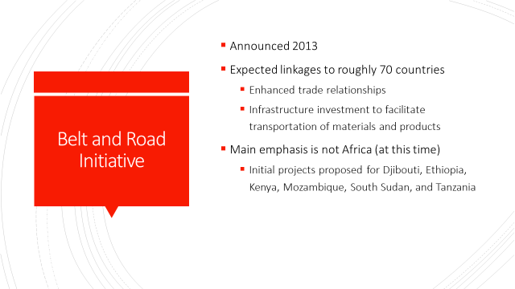
Belt and Road Initiative

Slide 20
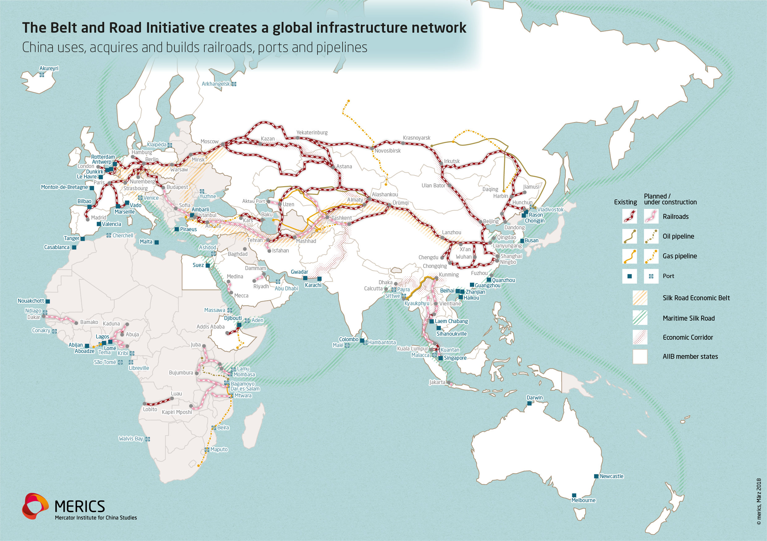
Belt and Road Initiative

Slide 21
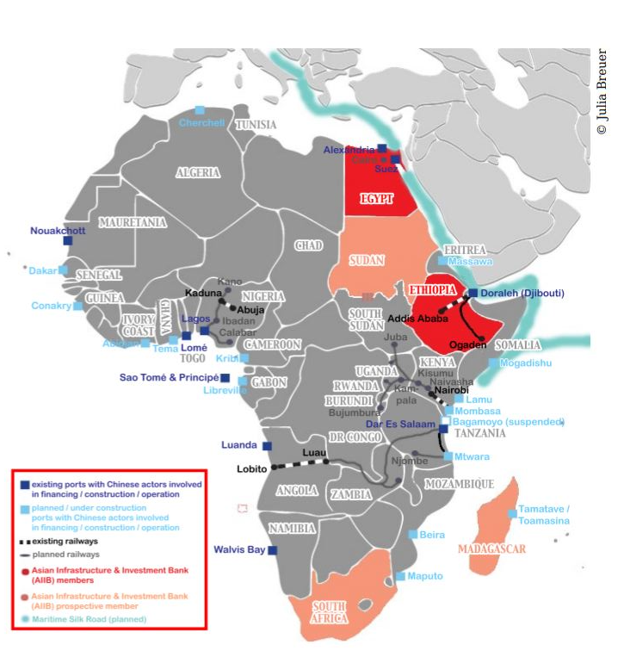
A Closer Look –
Existing and Planned
B.R.I. Projects in Africa
Dark Blue – Existing ports financed
by China
Light Blue – Planned ports with
Chinese involvement
Lines – Existing and planned railways

Slide 22
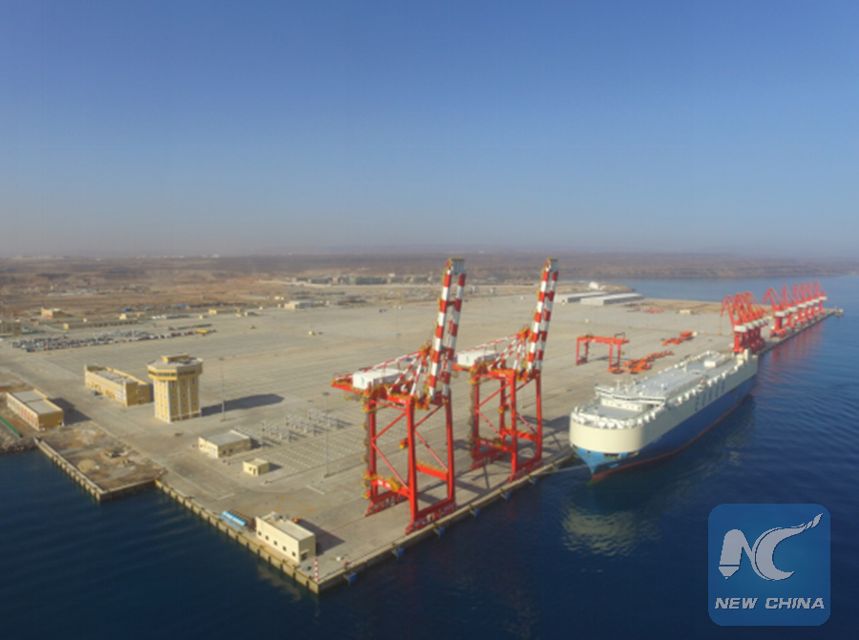
Belt and Road Initiative
Port of Djibouti
First major Belt and Road Initiative project in Africa
Constructed 2013-2016
In return, Djibouti gave China its first overseas base (right next to a major U.S. naval base)
China and Djibouti companies now arguing over who should control day-to-day operations because of past-due loans

Slide 23
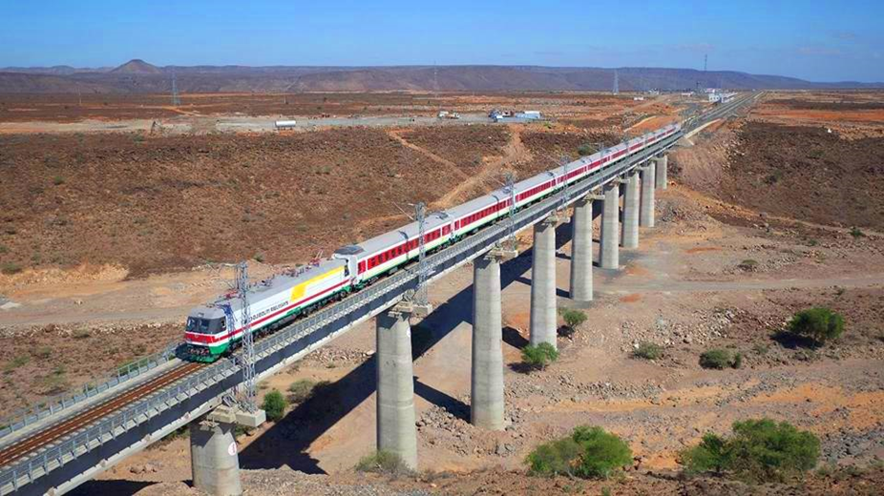
Belt and Road Initiative
Addis Ababa (Ethiopia) to Djibouti railway modernization project
First modern electrified railway line in East Africa
Constructed 2011-2018
Operated by China through 2023
Gives Ethiopia (3rd most populous country in Africa) access to the sea

Slide 24
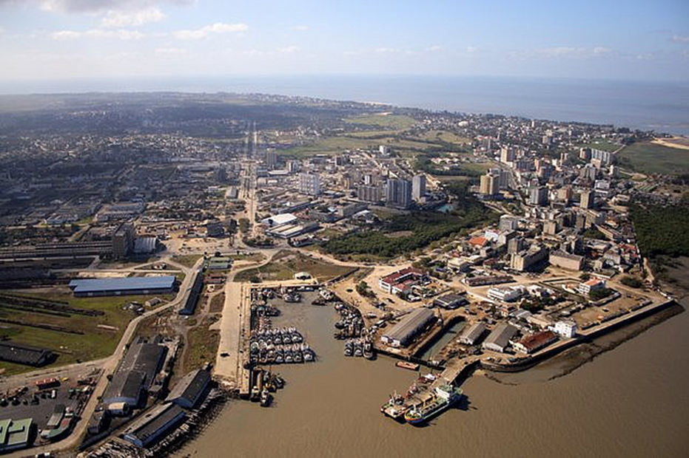
Belt and Road Initiative
Beira Port in Mozambique
Provides rail and pipeline access to Zimbabwe, and road and rail access to Botswana, Zambia, DR Congo, and Malawi
Expanded 2018, dredging operations ongoing 2020-2021

Slide 25
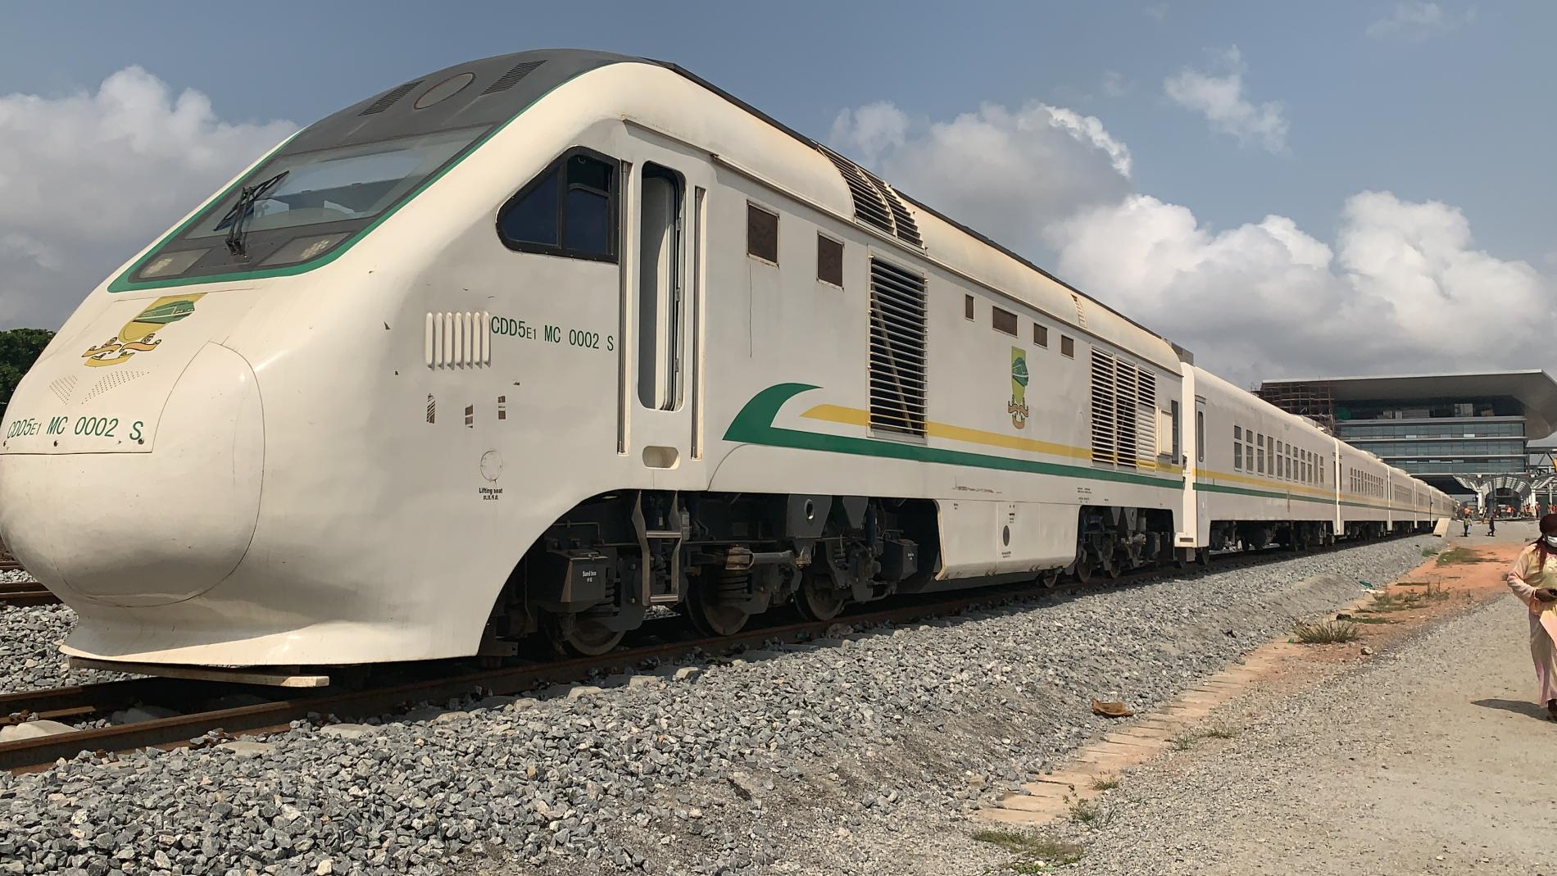
Belt and Road Initiative
Lagos to Kano (Nigeria) North-South Railway
Two sections of the railway completed and in use
Two other sections under construction by Chinese companies
Eventually will connect all major Nigerian cities by rail, but government having trouble financing the rest

Slide 26
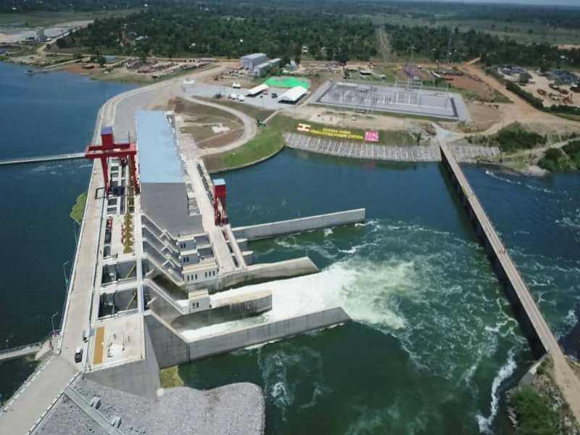
Belt and Road Initiative
Isimba (Uganda) Hydroelectric Power Station
Located about 50km downstream from the source of the Nile River
Planned to produce the cheapest hydroelectric power in East Africa
Constructed 2015-2019; in operation for two years

Slide 27
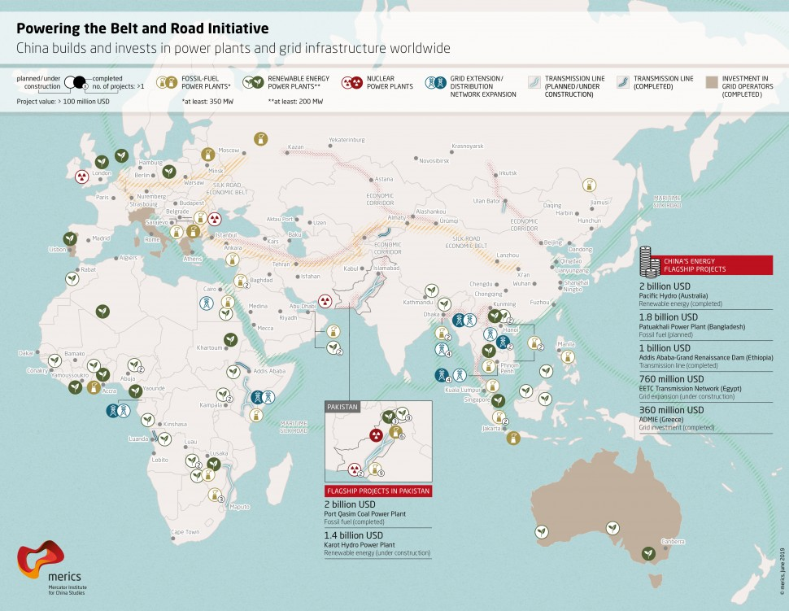
Belt and Road Initiative

Slide 28
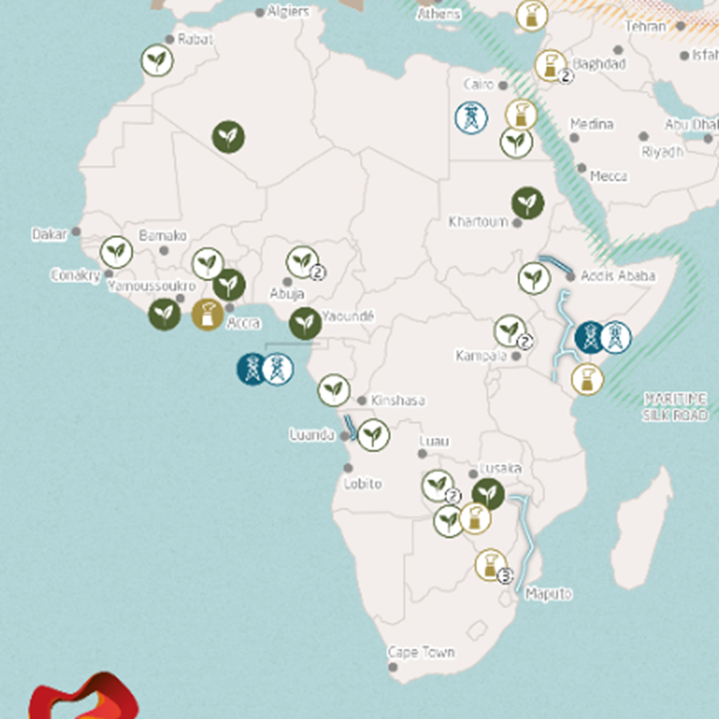
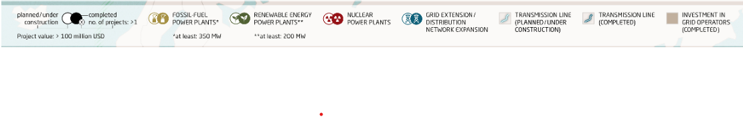
A Closer Look –
African Energy Projects

Slide 29
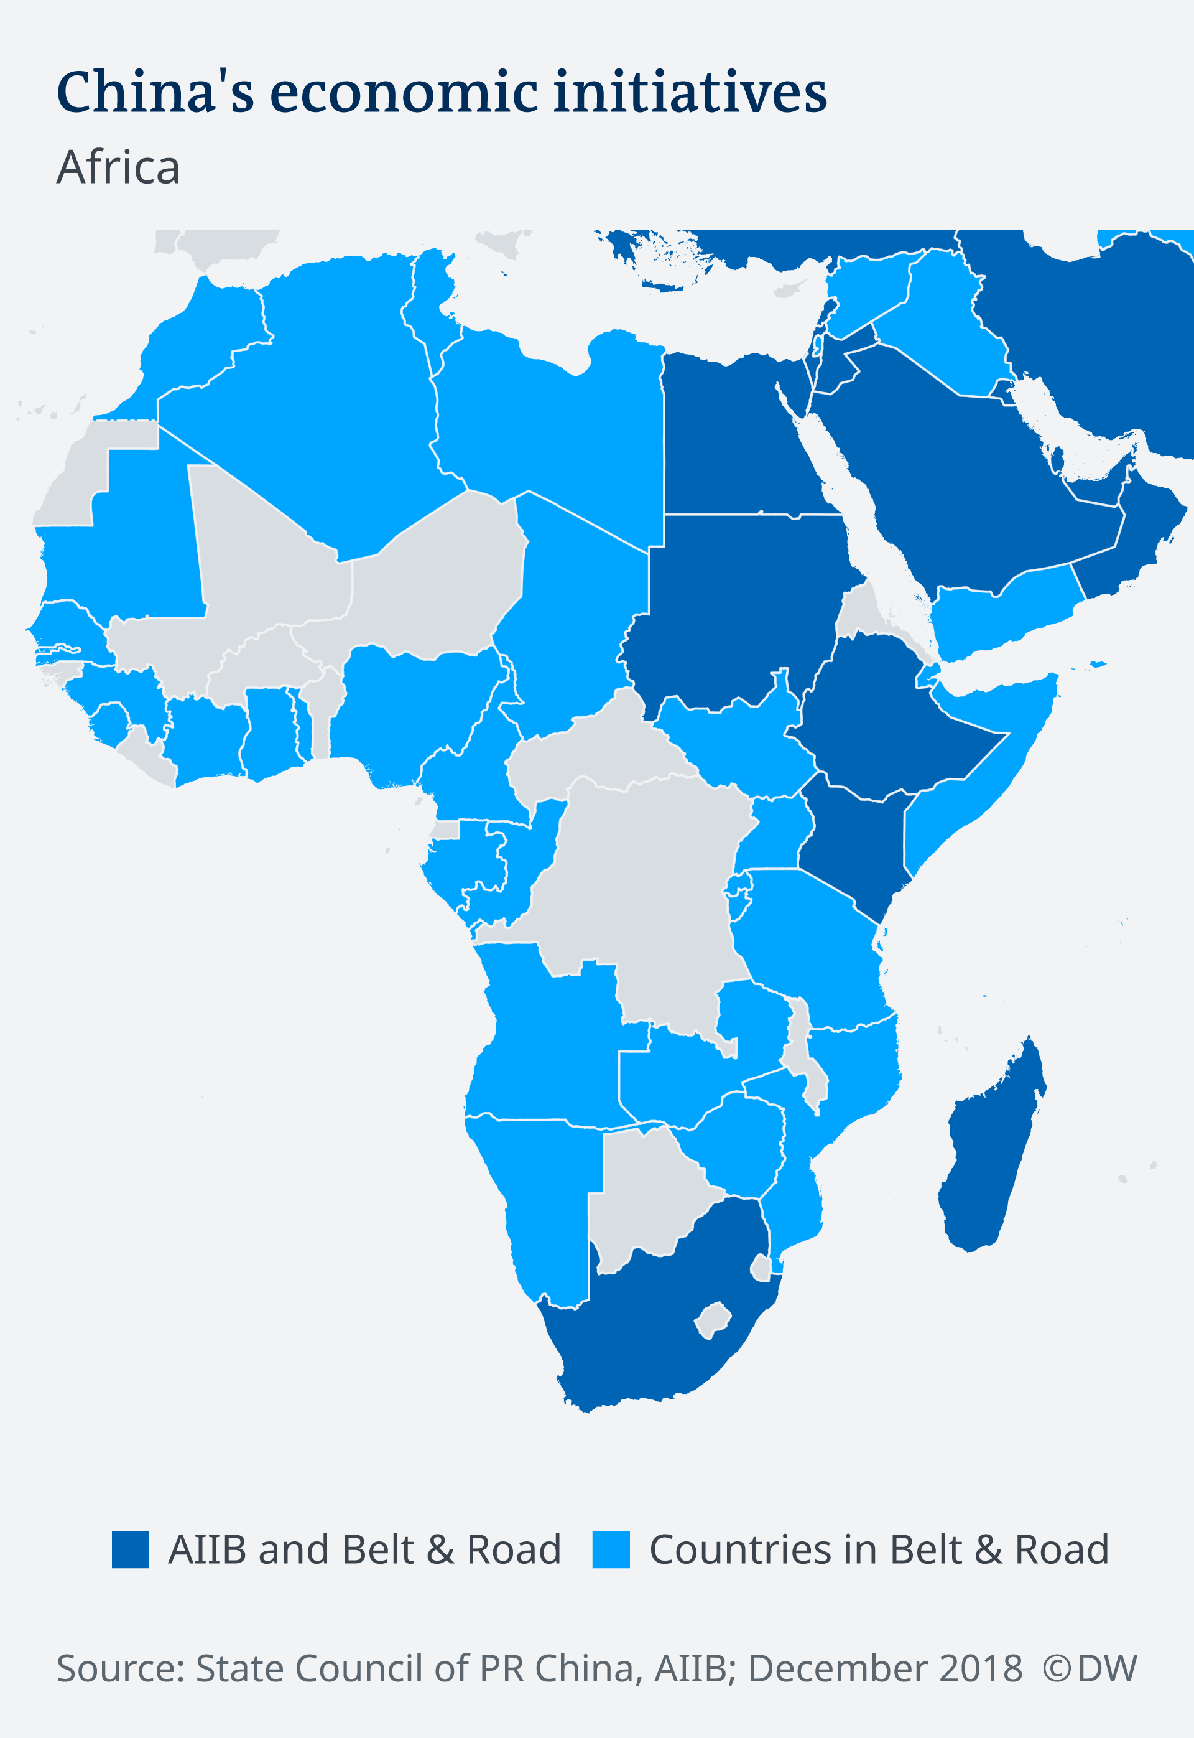
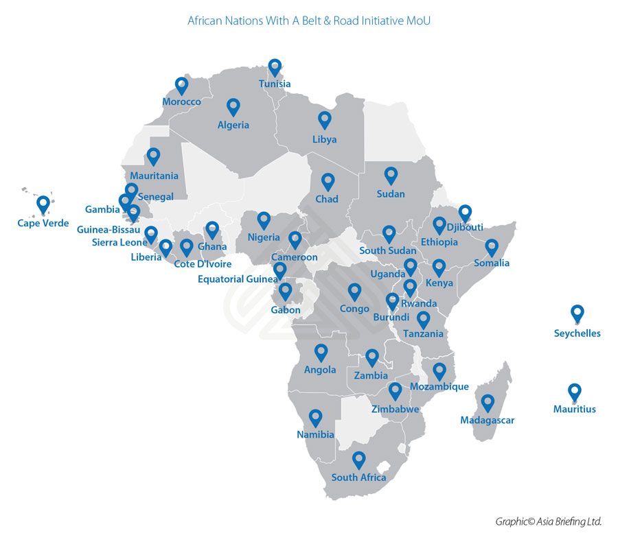
Belt and Road Initiative

Slide 30
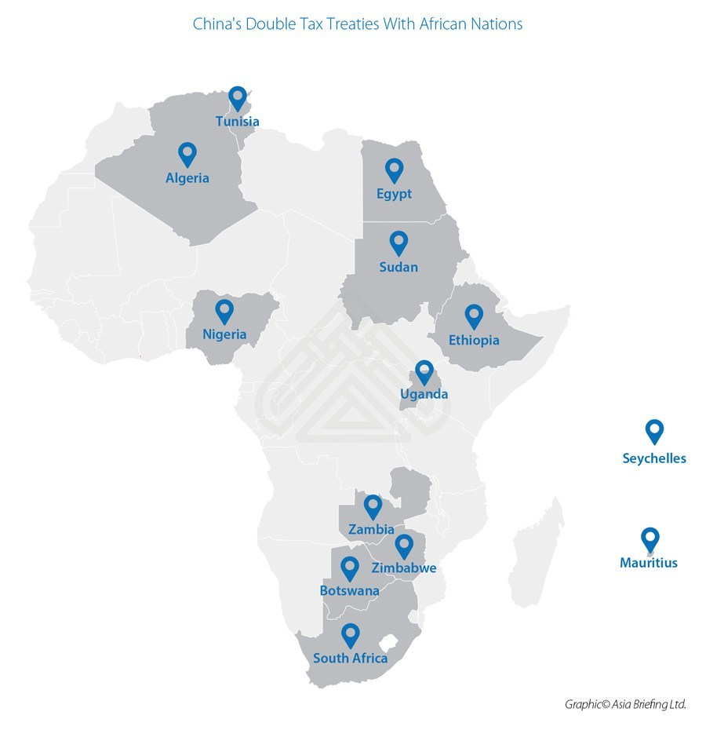
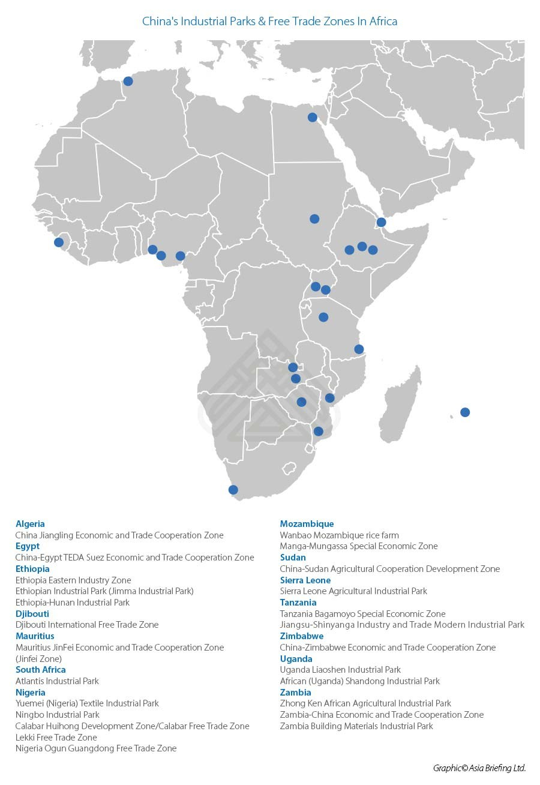
Belt and Road Initiative

Slide 31
Belt and Road Initiative
Potential Positives:
Infrastructure available from nowhere else – historically have tried IMF, World Bank, Western governments and private industry
Chinese more willing (thus far) to advance large sums without collateral (since they can afford a long-term investment)
Connects Africa into a much larger Eurasian Belt and Road system with potential entrée into European markets
If projections for future economic growth play out, the loans could be paid off easily from earnings

Slide 32
Belt and Road Initiative
Potential Negatives:
China is helping to develop transportation and power production capabilities, but not a lot of business or manufacturing
China is also importing a lot of natural resources (from Africa and other places) but not many finished products
With the economic slowdown related to COVID, the loans from China are harder to get and payments are coming due
What no one knows . . . is the collateral on these loans in the form of potentially losing control of resources (neo-colonialism)?

Slide 33
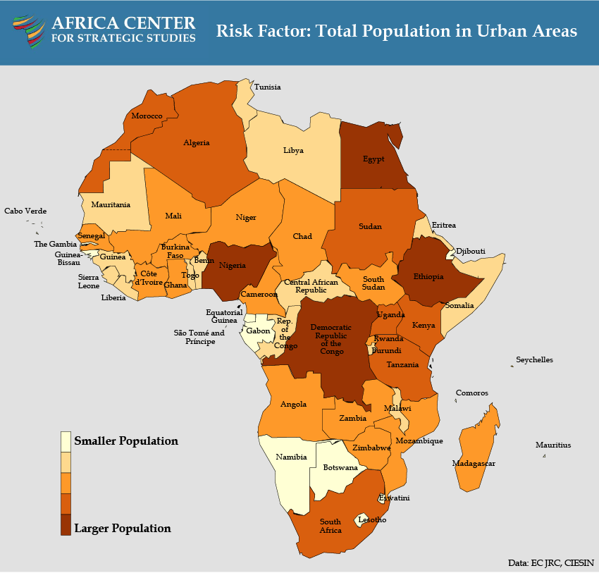
What Does the Future Hold?
Challenge #1 –
COVID-19

Slide 34
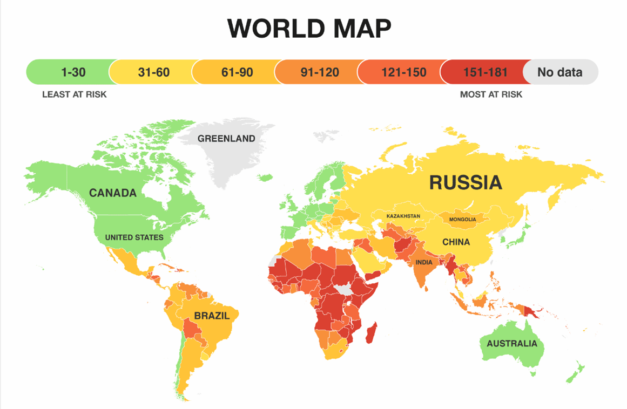
What Does the Future Hold?
Challenge #2 –
Climate Change

Slide 35
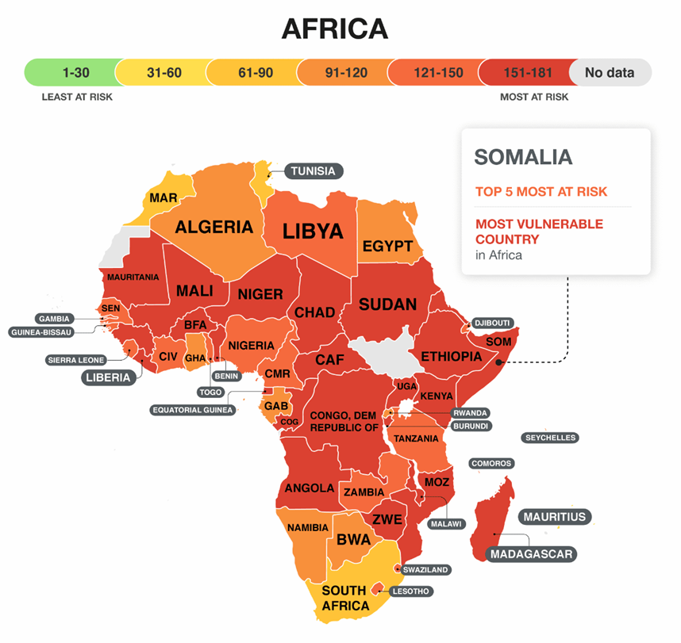
What Does the Future Hold?

Slide 36
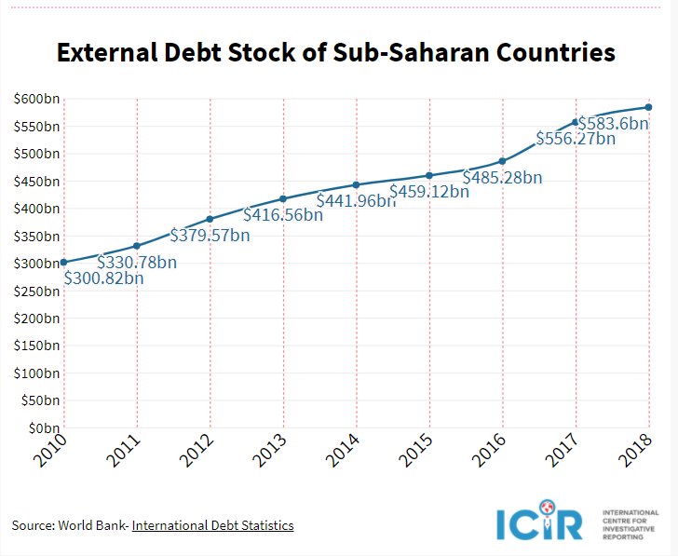
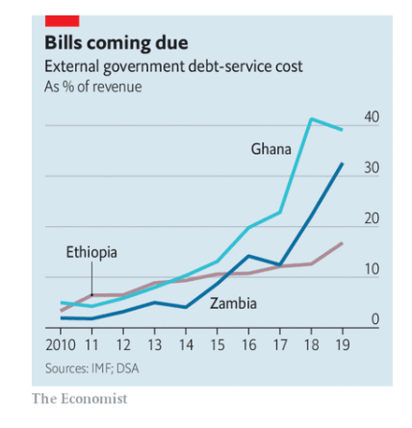
What Does the Future Hold?
Challenge #3 – Debt Coming Due

Slide 37
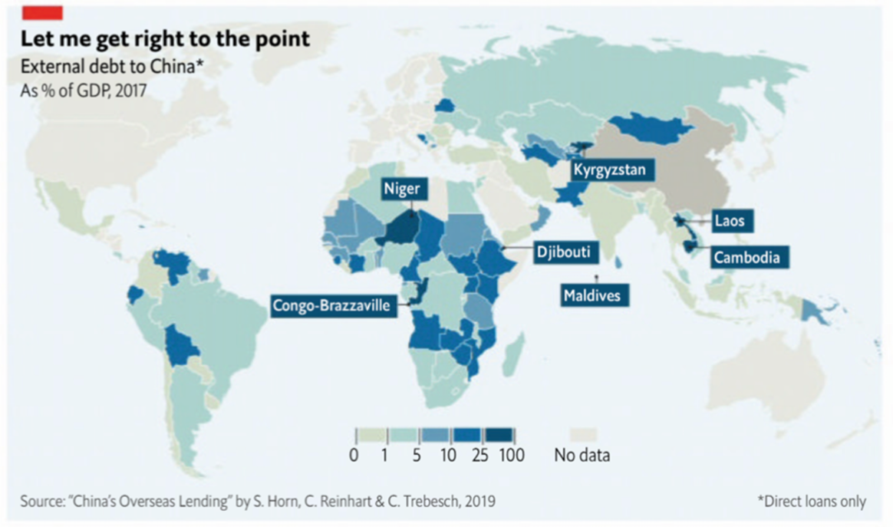
What Does the Future Hold?

Slide 38
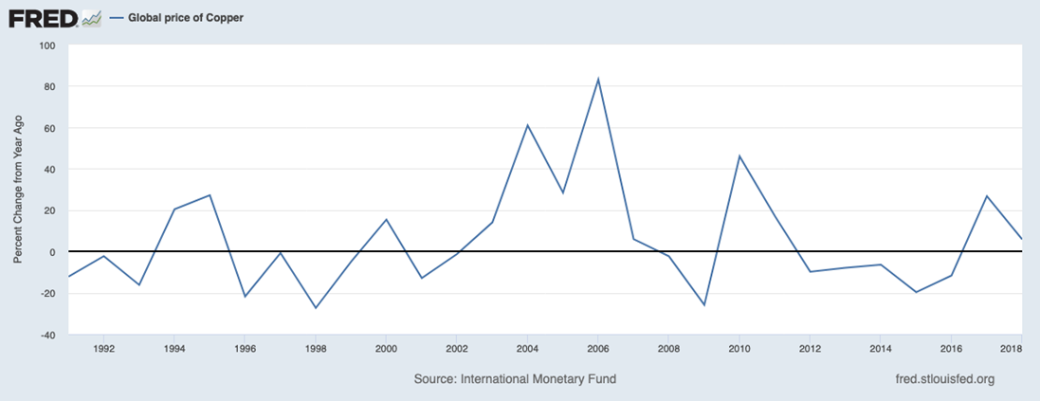
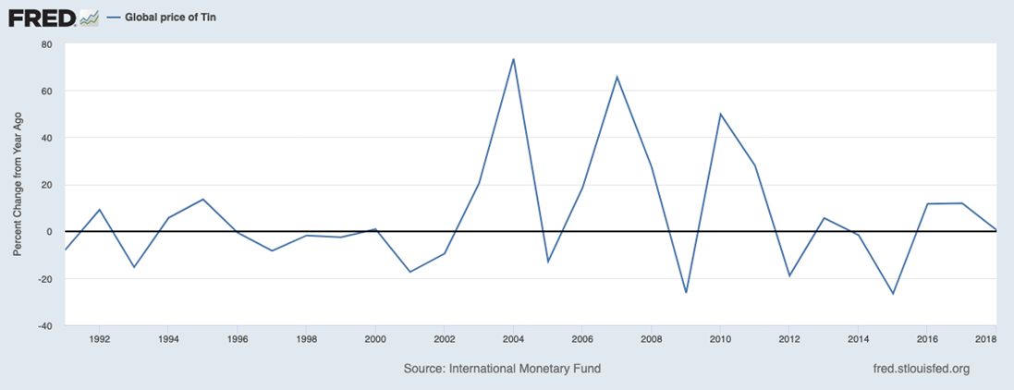
What Does the Future Hold?
Challenge #4 –
Inconsistent Prices for
Natural Resources

Slide 39
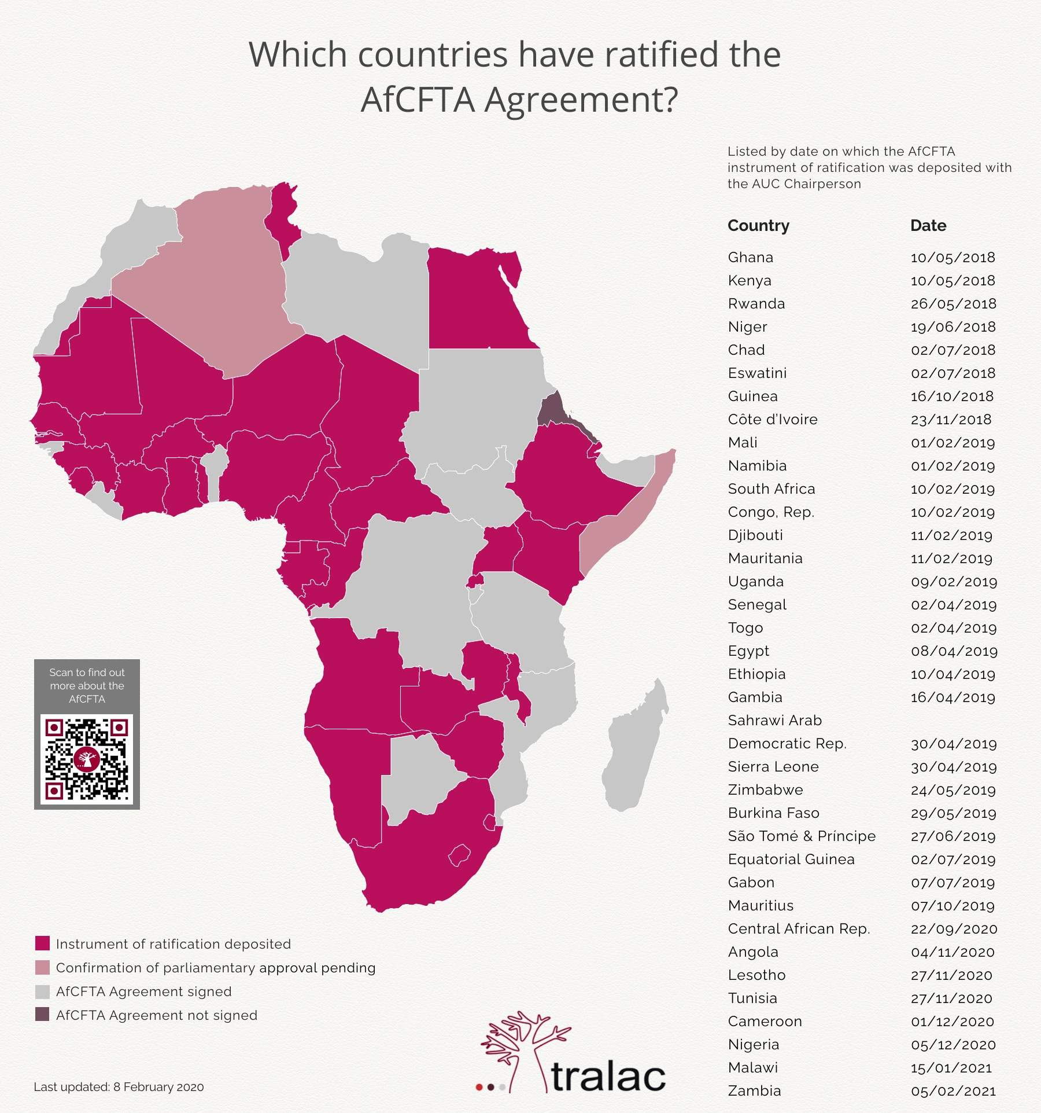
Challenge (or Opportunity) #5 –
African Continental Free Trade Agreement

Slide 40
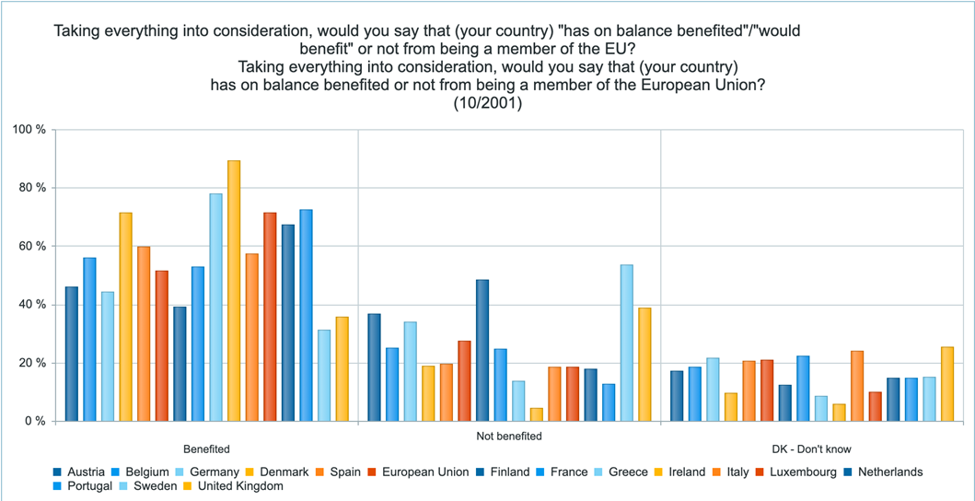
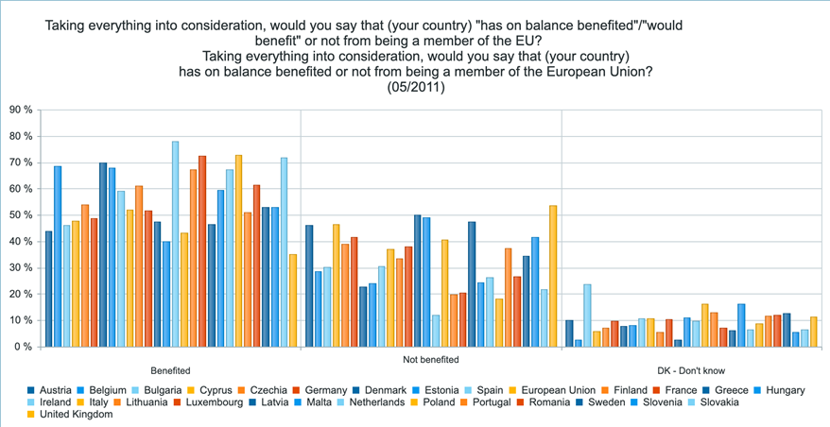
What Does the Future Hold?
Can African nations cooperate long enough to see the potential benefits of an EU-style free trade zone, or will it last . . . ?

Slide 41
Collaboration Board #2 – What do YOU think?

Slide 42
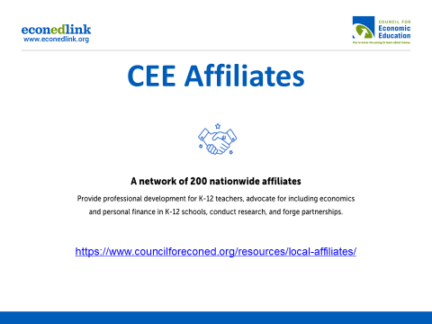

Slide 43
Parting Shots
Future Professional Development Sessions with CEE & ELC:
Wed, March 24th – Economics of Latin America, 6-7pm ET
Wed, April 21st – K-8 Essential Concepts, 6-7pm ET
Wed, May 5th – Personal and Corporate Debt, 6-7pm ET

Slide 44
Parting Shots
Future College Classes with Economic Literacy Colorado:
Sat, April 10th – Capitalism vs Socialism: Comparing Economic Systems
Sat, April 24th – Implications of COVID for the U.S. and Developing World Economies
All classes are virtual from 8am to 4pm MT – sessions typically alternate between professors and mentor teachers. $25 class fee, and you can also sign up for 0.5 graduate credit hours from Univ of Colorado-Colorado Springs for $51

Slide 45


Slide 46





We’ve gone Virtual!
Teach Economics?
Your students may have what it takes to compete in the nation’s only high school economics competition!
Why Play?
• Fun team learning experience
• Great for college applications
• No other challenge like this
• Online participation makes access easy
• Chance for cash prizes
How it Works
Teams register
Teachers enroll team(s) of 3- 4 high school students from the same school. Multiple teams allowed.
Teams compete within their state
Compete to win your state competition for a
chance to advance to the National Semi-Finals.
National Semi-Finals: May 3-20, 2021
Teams answer multiple-choice questions on macroeconomics, microeconomics, and international & current events.
National Finals: May 22-24, 2021
Teams analyze an economic issue and present their solution. Top teams engage in the Finals Quiz Bowl where they face-off answering questions to claim the National Title.
Two divisions based on experience level
David Ricardo for first-time competitors who have taken no more than one economics course.
Adam Smith for returning competitors, AP, International Baccalaureate, and honors students.
Register Today at NationalEconomicsChallenge.org

Slide 47





FIND YOUR LOCAL COMPETITION
AND REGISTER TODAY!
The National Personal Finance Challenge is a competition that provides high school students with an exciting and motivating opportunity to build, apply, and demonstrate their knowledge of money management.
Through online exams and a personal finance simulation, teams showcase their expertise in earning income, buying goods and services, saving, using credit, investing, as well as protecting and insuring.
Teams of up to four students, with one teacher/coach, can qualify to represent their state at the National Personal Finance Challenge by winning their local competition.
NATIONALS
Semi-Finals: First round elimination via online multiple-choice questions.
Finals: Case study round virtually co-hosted by the Cleveland Fed on June 3.
personalfinancechallenge.org

Slide 48
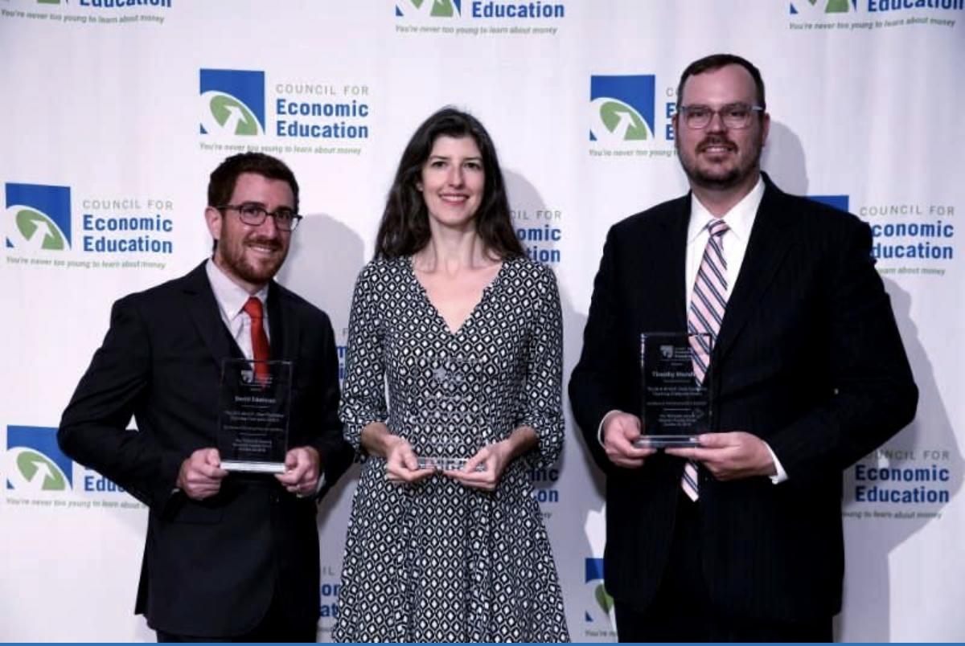
The 2021 Sloan Teaching Champion Award
Winners receive:
A cash award of $5,000
A cash award of $2,500 for their school to support economic education
Recognition at our annual Visionary Awards convening
This award promotes economic education by honoring three outstanding teachers who incorporate exemplary teaching techniques that improve their students’ economic understanding in and out of the classroom.
This award is open to New York metropolitan area high school teachers of all subjects, not just teachers of economics. Applicants must demonstrate how they integrate economics into their teaching.
Sound like you or someone you know?
Applicants must teach in one of the
Twelve New York state counties (New York, Kings, Bronx, Richmond, Queens, Nassau, Suffolk, Westchester, Putnam, Rockland, Orange and Duchess)
Eight New Jersey counties (Bergen, Passaic, Essex, Hudson, Middlesex, Union, Morris, Monmouth), or the
Two Connecticut counties (Fairfield and New Haven)
Application will be launched on Friday February 19th 2021
You can access the application here.
CONTACT
Please feel free to e-mail us at rrivera@councilforeconed.org
with any questions you have.

