Slide 1
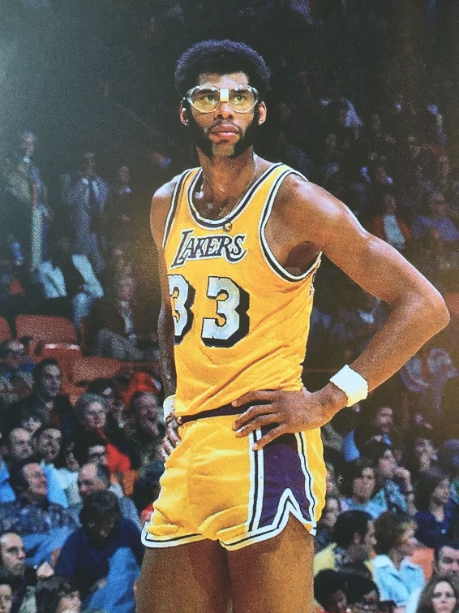
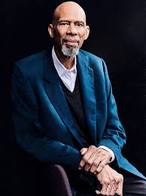
Kareem Abdul-Jabbar
A Pedagogy of Preparation
Presented by Dr. Jonathan T. Wolf
Wednesday, February 17, 2021 jowolfwriter@gmail.com

Slide 2
EconEdLink Membership
You can now access CEE’s professional development webinars directly on EconEdLink.org! To receive these new professional development benefits, become an EconEdLink member. As a member, you will now be able to:
Automatically receive a professional development certificate via e-mail within 24 hours after viewing any webinar for a minimum of 45 minutes
Register for upcoming webinars with a simple one-click process
Easily download presentations, lesson plan materials and activities for each webinar
Search and view all webinars at your convenience
Save webinars to your EconEdLink dashboard for easy access to the event
You may access our new Professional Development page here

Slide 3
Professional Development Certificate
To earn your professional development certificate for this webinar, you must:
Watch a minimum of 45-minutes and you will automatically receive a professional development certificate via e-mail within 24 hours.
Accessing resources:
You can now easily download presentations, lesson plan materials, and activities for each webinar from EconEdLink.org/professional-development/

Slide 4
Instructor Biography
Dr. Jonathan T. Wolf
BA and MA from The City College of New York
PhD from Fordham University
Taught Composition and Rhetoric / American Literature for 13 years

Slide 5
Agenda
Review objectives of webinar
Review Kareem Abdul-Jabbar’s biography
Preparing for Success / Identifying Essential Skills
Envisioning Your Future / What Success Means (to You)
Conclusion
Other resources

Slide 6
Objectives
Over the course of this webinar, I will introduce an idea that I call the pedagogy of preparation. In the context of Kareem Abdul-Jabbar’s life and his staunch allegiance to the work ethics instilled in him through his personal experiences and his work with Coach John Wooden, the pedagogy of preparation refers to an educational philosophy in which ethics is the foundational organizing principle upon which financial, spiritual and political success rests.
There is a thin line between teaching ethics and teaching morality. Indeed, much of the discussion in this webinar, and those that you will have with you students, utilize my proposed assignments and verge into whether things are moral or immoral. What must be kept in mind is that objective of the pedagogy of preparation is NOT to teach students what in particular is moral or immoral, but to give students the resources to empower them to think of “success,” in some part, ethically. In this sense, it is enough for us to proclaim the existence and importance of a moral world, without explicitly defining it for them.

Slide 7
Objectives, Cont’d
Here we can trace our primary axiom: success. In some way, it is always shaped in accordance with some moral/ ethical principle. For instance, we might ask students “Who is more of a winner: the person who follows the rules of a sport and loses, or the person who wins but cheats?” Lance Armstrong comes to mind here; once a champion, his lack of ethics has turned him into a pariah.
Moreover, how we define success also suggests a praxis in how we should attain success. It becomes part of the imaginative process, depicting not just what we want, but who we want to be in or through its attainment. Returning to Mr. Armstrong, one might wonder how his vision of being a champion diverged (consciously or unconsciously) with his unethical actions.
Thus, a pedagogy of preparation asks us to define, analyze and refine that praxis in our everyday lives by creating a groundwork for success. It’s not just about what we do the moment before the “big game,” but what we do in the months and years before it.

Slide 8
Objectives, Cont’d
Abdul-Jabbar’s biography is a perfect example of this idea because of how he links his success to his work ethic. He is successful not because he hit one basket in a big game, but because he shot 100,000 baskets in practice for years. For him, it takes those 100,000 baskets just to make one game-winning shot. Likewise, many of his other successes, from acting to writing, emerge from his making ethical decisions around curiosity and education. Cultivating curiosity about the world enabled him to be introduced to other diverse arenas in which to succeed, ones he never would have known about if had been averse to exploring new ideas.

Slide 9
Biography- The Early Years
Kareem Abdul-Jabbar was born Ferdinand Lewis Alcindor Jr. on April 16, 1947, in New York City.
Best known as a basketball player, Abdul-Jabbar has been an actor, martial artist, writer, scholar and activist.
His eclectic interests arise from his lineage. His father, employed for most of his life as a transit police officer, was also an accomplished jazz musician who graduated from Julliard. As such, Kareem’s childhood granted him a love of jazz and R&B, cultivated with exposure to New York’s bohemian Greenwich Village.
Moreover, as someone growing up in the middle of the Civil Rights movement, Lew Alcindor identified himself within the growing struggle for racial equality, leading him eventually to convert to Islam and rename himself Kareem Abdul-Jabbar.

Slide 10
Biography- High School & College
Unusually tall, Kareem seemed destined for basketball greatness. While living in the Dyckman Public Housing Complex in Inwood, Manhattan, he became All-American high school player.
He went on to play with the UCLA Bruins under the tutelage of Coach John Wooden, who would play a fundamental role in shaping and refining his work ethic not only in the NBA, but throughout all his professional ventures and personal successes.
After leaving the Bruins, Abdul-Jabbar went on to play, at the time a record, 20 consecutive seasons in the NBA, first with the Milwaukee Bucks and then the Los Angeles Lakers.
The list of accolades and records Kareem amassed in his basketball career are too numerous to mention, but a few should go to prove why he is still known as one of the greatest to ever play the game…

Slide 11
NBA Highlights
Rookie of the Year
Six NBA MVP Awards
Two NBA Finals MVP Awards
Six NBA Championships
Most points scored (Career)
Fourth all time Rebound Leader
Third all time in Blocks
Most minutes played (Career)

Slide 12

Biography- Martial Arts & Acting
He also worked notably as an actor and martial artist. During college he’d begun to study Jeet Kune Do with Bruce Lee, and in 1972 made his movie debut in Lee’s Game of Death

Slide 13

Abdul-Jabbar would go on to act in a multitude of supporting and cameo roles over the years, staring in a bevy of comedies, dramas, and commercials.
And then there was his most memorable turn as co-pilot Roger Murdoch in 1980s classic comedy, Airplane!

Slide 14
Biography- Writer
Wanting to know more about his religion, Kareem studied Arabic at Harvard.
He also wrote numerous books on African-American history, including On the Shoulders of Giants: My Journey Through the Harlem Renaissance, co-written with Raymond Obstfeld, and Brothers in Arms: The Epic Story of the 761st Tank Battalion- World War II's Forgotten Heroes co-written with Anthony Walton, a history of an all-Black armored unit that served with distinction in Europe. On the Shoulders of Giants went on to become an award winning documentary.
All of this while also taking on numerous roles in government and public service, and essay writing for major media publications. Abdul-Jabbar’s retirement from the NBA only began his incredible role as author- activist and public advocate, culminating in his receiving the Presidential Medal of Freedom from President Barack Obama in 2016.

Slide 15
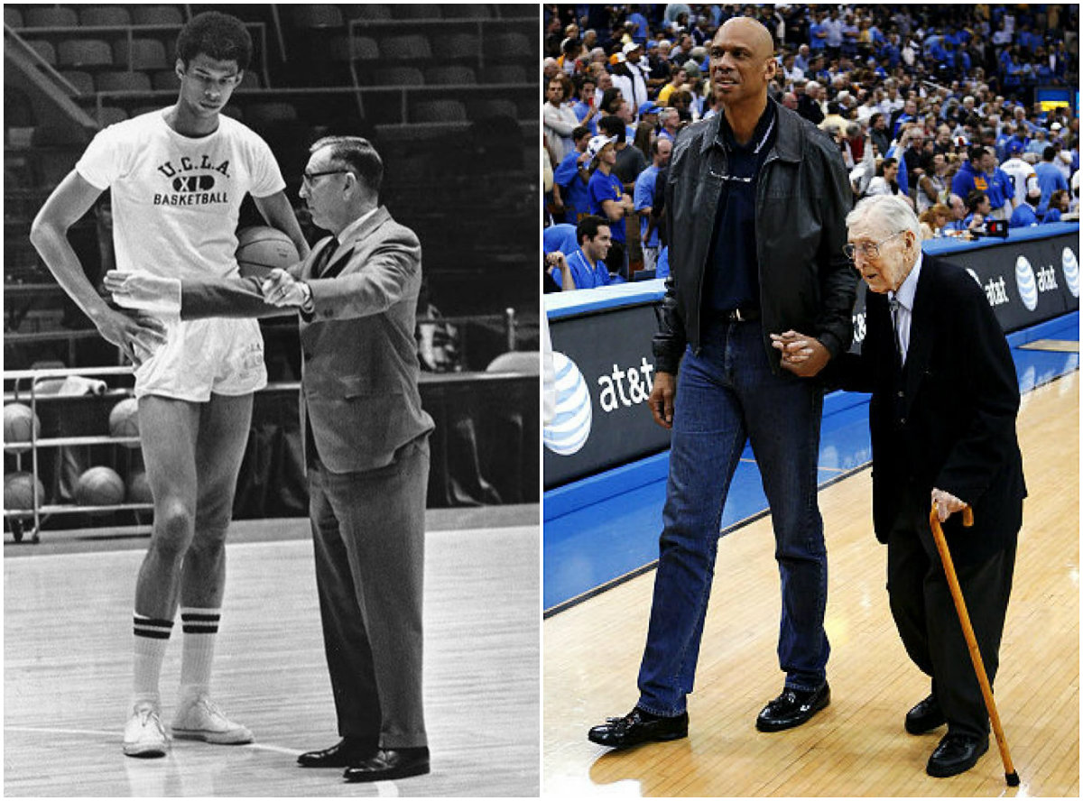
Preparing for Success:
Identifying Essential Skills

Slide 16
Preparing for Success:
Identifying Essential Skills
Suggested Reading:
Coach Wooden and Me, Chapter 2; Giant Steps, Chapter 7
Key Quotes:
“Mr. Wooden believed in supreme conditioning and unwavering fundamentals: not only knowing which plays to run and how to run them, but being capable of calling up the physical stamina at the precise time you need it to win,” (Chapter 2, Giant Steps).
“Today, we are going to learn how to put on our sneakers and socks correctly,” (Chapter 7, Coach Wooden and Me).

Slide 17
Preparing for Success:
Identifying Essential Skills
The story of Abdul-Jabbar’s first team practice with Coach Wooden provides an excellent introduction both to his biography and the pedagogy of preparation, for as it began Kareem’s legendary basketball career so did the particular lesson Wooden departed onto his team, focusing on the importance of an iron-clad work ethic.
As Kareem narrates, in their first practice, Coach Wooden sat them down and taught them how to put on their socks, in what he called the “snug-and-tug.” Pull your socks on snugly around your feet, and tug them tightly up your calf. Seeing the looks of confusion on his players’ faces, he quoted a poem by Benjamin Franklin:
“For the want of a nail the shoe was lost/ For the want of a shoe the horse was lost/ For the want of a horse the rider was lost/ For the want of a rider the battle was lost/ For the want of a battle the kingdom was lost/ And all for the want of a horseshoe-nail”

Slide 18
Preparing for Success:
Identifying Essential Skills
Wooden introduced to his team this most foundational skill: “If you do not pull your socks on tightly…you’re likely to get wrinkles in them. Wrinkles cause blisters. Blisters force players to sit on the sideline. And players sitting on the sideline lose games” (Coach Wooden and Me, Chapter 2).
Abdul-Jabbar calls this idea “essential” and these skills, for him, encompass the foundation of greatness: “All the most effective basketball strategists and players have kept their technique honed to its most lean and essential parts. John Wooden did it in his coaching; Bill Russell did it in his playing, and Oscar Robertson was the same way…He didn’t have blazing speed, and he didn’t do a whole lot of pirouettes, all he did was score, rebound, and dish the ball off…If you were going to stop him, you were just going to stop the basics, and you would have to do it perfectly because he could take advantage of any miscue you might make” (Giant Steps, Chapter 11).

Slide 19
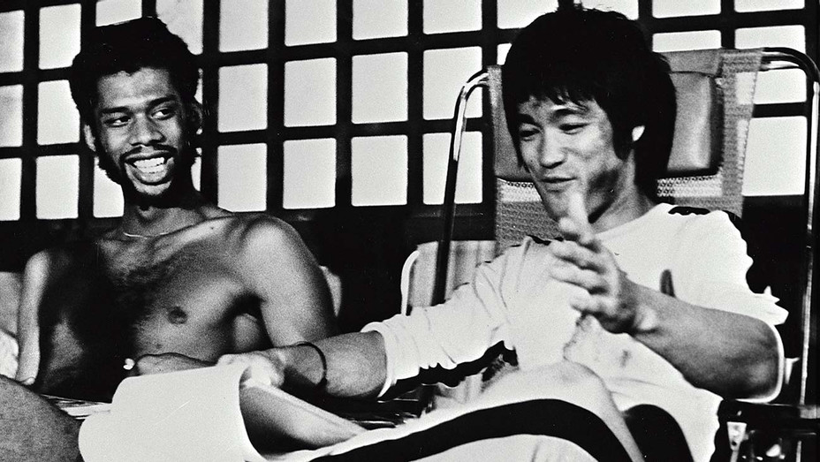
Preparing for Success:
Identifying Essential Skills
It is not too surprising then, that as a student of Bruce Lee, Abdul-Jabbar emphasizes Lee’s focus on fundamentals as well: “(Lee) pared down what he saw as the cute, inessential mannerisms that had crept into the teachings (of martial arts); techniques that did not give you any real advantage in a fight” (Giant Steps, Chapter 9).

Slide 20
Preparing for Success:
Identifying Essential Skills
Assignment:
Rhetorical & Compositional Concepts
  Identifying & Describing
  Defining
  Categorizing
These assignments work to get your students thinking about their own particular interests, identifying and describing possible career paths, defining what skills relate to those paths, and categorizing them in a hierarchy.
What for them is the “nail,” or essential skill, that will make them successful in their field? How do other skills relate to that essential skill?

Slide 21
Preparing for Success:
Identifying Essential Skills
Assignment #1: Your Hook Shot
In Chapter 2 of Giant Steps, Abdul-Jabbar describes how he first discovered what would become his signature move: the hook shot. Interestingly, the first two times he tried it he did not make the basket. However, he saw that “it felt right.” With that in mind respond to the following prompts:
What would you consider to be your “hook shot?” That is, what strategy or technique do you employ in your everyday work that you most identify with? Remember, it does not necessarily mean that it is the most effective, only that it feels right for you. This can be anything from a way that you study, to a strategy you use in a video game, to a technique you have for folding clothes.
As best as you can, break down that “hook shot” into its component parts. For instance, if your study technique is to listen to music while you study, then describe the kinds of music you play or type of headphones you use. Even volume is a component part of that technique.
Finally, explain how those components can affect your “hook shot.” If you change one of those components, do you think you could make your “hook shot” more effective or feel better? How so? (Extra credit: Try one of those changes in the real world. Did that change have the intended effect?)

Slide 22
Preparing for Success:
Identifying Essential Skills
Assignment #2: Essential Differences
This assignment is intended to get students thinking about the skills they’ll need to cultivate for future careers, and for exploring their feelings about achieving proficiency in those areas. There is a slight Internet research requirement, but it can be changed to a print requirement if desired.
1) Choose a career path that you might be interested in following, and generate a list of the top five skills (in order) you think one might need to succeed in that endeavor.
2) Go online to discover what people in that industry believe are the top five skills necessary for success in that field. (Hint: there are many, many results in Google if you type in “top skills in ______”.) Try to use those you believe to be the most authoritative, but also realize that this question is quite subjective. Use your own discretion in choosing who you believe has the knowledge and experience to best list those skills.
3) Compare your list with the one by professionals. Is there any overlap? Difference? Has seeing what the professionals said changed your feelings? Would you want to become proficient in these skills? Why or why not?

Slide 23
Preparing for Success:
Identifying Essential Skills
Assignment #3: Perfect Skill
This assignment is aimed in inspiring students to think about the relationship between habits, interests and work ethics to generate an understanding about interdisciplinary studies and careers.
What is something you enjoy doing? This can be anything from watching TV, video gaming, reading, or eating. Describe this activity in depth.
Generate a list of at least three skills involved in these activities. Be imaginative and far reaching as you imagine what skills are involved in these activities. Perhaps, for instance, going to parties is your activity; some skills you might have cultivated are a fashion sense, dance moves or DJ’ing. For each of these skills, tell us a little about the knowledge behind these skills. Where does one go to find this knowledge? Where did you go?
Finally, think of some classes, internships or another experience that could help in adding to knowledge or skill cultivation. Check online and see what employers, schools or programs offer in helping students perfect these skills.

Slide 24
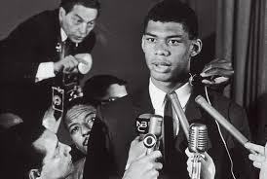
Envisioning Your Future /
What Success Means (to You)

Slide 25
Envisioning Your Future /
What Success Means (to You)
Suggested Reading:
Coach Wooden and Me, Chapter 1; Giant Steps, Chapter 1
Key Quotes:
“My homework got done because my mother made me do it, and after she’d drilled it into me how important it was, I did it for myself,” (Chapter 1, Giant Steps).
“Don’t hope. Hope is for people who aren’t prepared. My mother always emphasized that hard work was necessary to achieve your goals, while my father proved the value of repetition in mastering a skill,” (Chapter 1, Coach Wooden and Me).

Slide 26
Envisioning Your Future /
What Success Means (to You)
The previous quotes clearly demonstrate how Abdul-Jabbar understood his success as attributable to the efficacy of his essential skills: hard work and repetition. What is less clear, if perhaps more obvious, is if these skills are not simply praised for efficacy but also for virtuousness. Indeed, one would be hard pressed to find anyone who does not think these are “good” values.
At the same time, we have to realize that the “goodness” of these values (and perhaps any value system) cannot be divorced from the context and the intentions of those values. It’s not just hard work and resolve that are good but that those virtues serve good ends.
In part, we study Abdul-Jabbar not just for bringing those values to his basketball career but to also in his work as an activist for racial equality and religious understanding.

Slide 27
Envisioning Your Future /
What Success Means (to You)
His story is further inspiring when we study the consequences of his socially conscious ventures, those points in his life when his steadfastness of his convictions worked against his financial interests…
Here, the sections on his boycott of the 1968 Olympics (Coach Wooden and Me, Chapter 3 and Giant Steps, Chapter 8) and his conversion to Islam (Giant Steps, Chapter 6 and Coach Wooden and Me, Chapter 3) demonstrate how, ironically, many of those same values that brought him success in basketball also endangered his career, as many White coaches, team owners and media figures disagreed with his decisions.
In reviewing these sections with your students, you should encourage them to think about how the essential skills discussed in “Preparing for Success” are interlinked with moral questions that can come into conflict with certain industries. What does it mean, for instance, for a “good” lawyer to defend a “bad” person? How do we rectify those conflicts?

Slide 28
Envisioning Your Future /
What Success Means (to You)
Assignments:
Rhetorical & Compositional Concepts
  Identifying & Describing
  Comparing & Contrasting
  Defining
These assignments work to get your students thinking about the ethics related to their own particular interests: identifying and describing them, comparing and contrasting the ethical values of industry standards with some famous individuals working in those industries, and developing some definitions of their stances on ethics. Is there an “essential” ethic? How do those ethics intersect with our understandings of “essential skills?”

Slide 29
Envisioning Your Future /
What Success Means (to You)
Assignment #1: Your (Ethical) Boundary
We all know ethics are important, but what are ethics? This assignment should create a groundwork for your class to further investigate important ethical questions.
In a paragraph, describe ethics. What is the importance of ethics to you? What does it mean to be an ethical person?
Look up the word “ethics” in the dictionary, and write out the definition here.
Compare your description of ethics to the dictionary definition. What ideas do you and the dictionary share and what differ? What did the dictionary add to your idea of ethics that you think you should incorporate, and what ideas do you have that you think the dictionary missed?

Slide 30
Envisioning Your Future /
What Success Means (to You)
Assignment #2: Working Ethics
We will look at the ethical standards of particular careers and industries, and think about the challenges people within those careers and industries may face in adhering to those ethical standards.
Choose a career or industry that interests you, then do a bit of research to discover some of the ethical standards, policies or considerations practiced within that career or industry. Many companies will have information about this on their webpage, while other industries may require a bit more in depth investigation.
Then, using your research, discuss a bit about the ethical challenges one might face when working within that industry. What may tempt a lawyer to, for instance, encourage a witness to lie on the stand, an athlete to cheat or a politician to take a bribe? Try not to think just of sheer greed and malfeasance, but consider some alternate ideas.
Finally, give some concluding thoughts on how one may overcome those ethical challenges. Are there support systems to help people in these industries work though those issues? What skills could one cultivate in aiding people in these industries make better ethical choices?

Slide 31
Envisioning Your Future /
What Success Means (to You)
Assignment #3: Our Ethical World
We will look at Kareem Abdul-Jabbar’s stances on racial equality and his life long work in activism to try to inspire students to think about how they would like to make our world more ethical and just.
As we have seen, Kareem Abdul-Jabbar was inspired to work as an activist for racial equality and social justice because of his experiences being Black in America. Choose a cause you feel strongly about and describe it. Why is it important to you?
Imagine you are a tremendous success in your field: how would you use that success to advance your cause? What might be the repercussions of that action? What would you stand to lose for standing up for what you believe in? Be specific.
Finally, suggest three things you can do now to prepare yourself for ethical success. To help, you might want to look at the previous assignment and reflect on what policies and departments industries have for maintaining ethical standards for their employees. How can some of those ideas shape your work ethic? What places can you turn to for help?

Slide 32
Conclusion
There is a phrase in basketball: learning to play without the ball. This phrase is a catch-all term for actions a player can make when they do not have the literal ball that prepares them, or another player, to score. Coaches often find this very hard because players typically think about their performance in the moment. They focus on making the basket, rather than how to get to the basket. We educators face a similar challenge: Students want to do well, but often they forget or never learn about the work ethics that can prepare them to do well on a test.
Kareem Abdul-Jabbar’s biography can help display the importance of establishing a strong work ethic. The assignments and discussion prompts I have outlined in this presentation provide not just exercises in key rhetorical and compositional concepts but also introduce and encourage them to develop their own work ethic that is so fundamental to academic, professional, and personal achievement. In reviewing Abdul-Jabbar’s biography along with the pedagogy of preparation, it is my hope that we may inspire students to become not only good scholars but better people.

Slide 33
References
Abdul-Jabbar, Kareem & Peter Knobler. Giant Steps: The Autobiography of Kareem Abdul-Jabbar. Amazon. 2017 (Kindle Edition).
Abdul-Jabbar, Kareem. Coach Wooden and Me: Our 50-Year Friendship. Hachette Book Group, 2017 (Kindle Edition).

Slide 34

CEE Affiliates
https://www.councilforeconed.org/resources/local-affiliates/

Slide 35




Thank You to Our Sponsors!

