Slide 1

Behavioral Economics: Irrationality
Don’t Let Good Decisions Work Against You
Presented by: Tori Yauch
April 12, 2021
tyauch@nccee.org
Notes:
Welcome to this webinar. I am your host, Tori Yauch, from the North Carolina Council on Economic Education.

Slide 2
Standards
National Standard 2: Decision Making
Effective decision making requires comparing the additional costs of alternatives with the additional benefits. Many choices involve doing a little more or a little less of something: few choices are “all or nothing.”
Notes:
Today’s webinar is all about decision-making.

Slide 3
What is Today’s Goal?
By the end of today’s webinar, I want you to be able to do two things:
Describe and explain concepts that make us less-than-perfect economic decision-makers.
Explain how these concepts impact our economic choices.

Slide 4
Agenda
What is Behavioral Economics?
Definition
History
The Relevance of Behavioral Economics
We will never be the “Economic Man”
Understanding our biases can make for
making better choices
A few concepts of Behavioral Economics
The Overconfidence Effect
Anchoring & Framing
Loss Aversion
Acquisition & Transaction Utilities
Narrow Framing & Investments
Want to Dive in More?
Resources
Notes:
Here is the agenda we will cover on today’s webinar. First, we will define this field that has gained a lot of recent popularity. I am a huge fan of history, and feel understanding where we’ve been is one of the best ways to see where we’re going. So, we will take a few minutes and learn about the short yet exciting history of this field. We will see how its history influences its relevance in the field of economics today, and then we will dive into the content portion. At the end, there will be a slide giving you book recommendations, websites, articles, and other resources you can use to learn more about this subject.

Slide 5

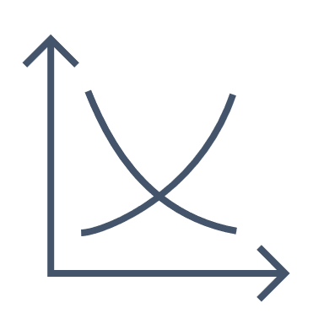
What is Behavioral Economics? Definition
Economics is the science of economies. It studies how people and societies produce and consume goods and services.
Behavioral science aims to understand human behavior and motivations through experiments.
Notes:
To understand this discipline, I feel it is helpful to first define Economics and Behavioral Science separately.

Slide 6

What is Behavioral Economics? Definition
Behavioral Economics combines these two disciplines by studying human behaviors relating to economic decisions.
Notes:
So how did we get here? Next, we will look at a brief history of the emergence and soaring popularity of this discipline.

Slide 7
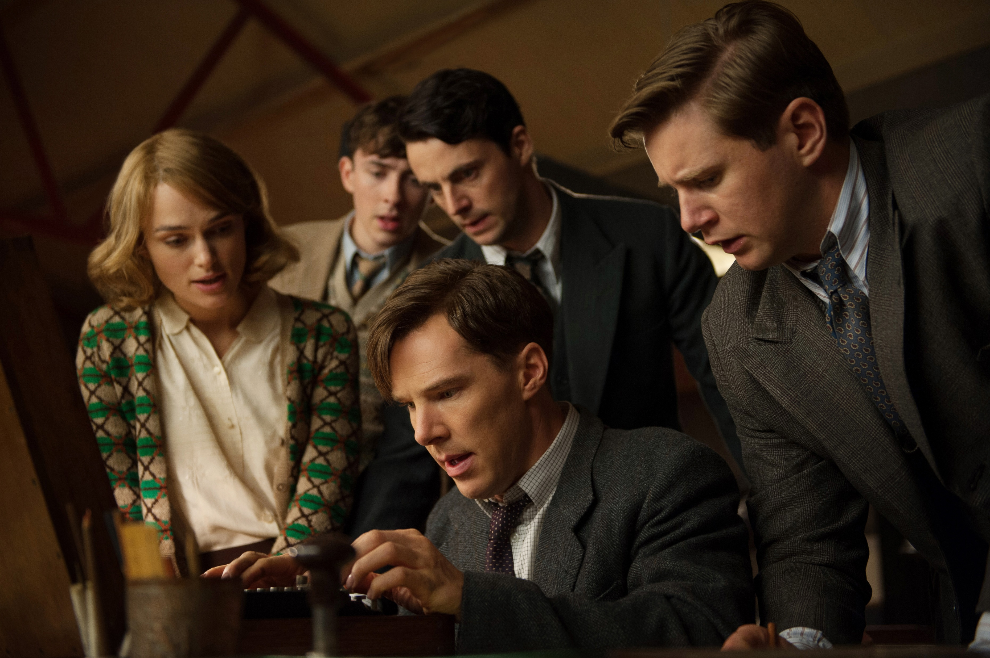
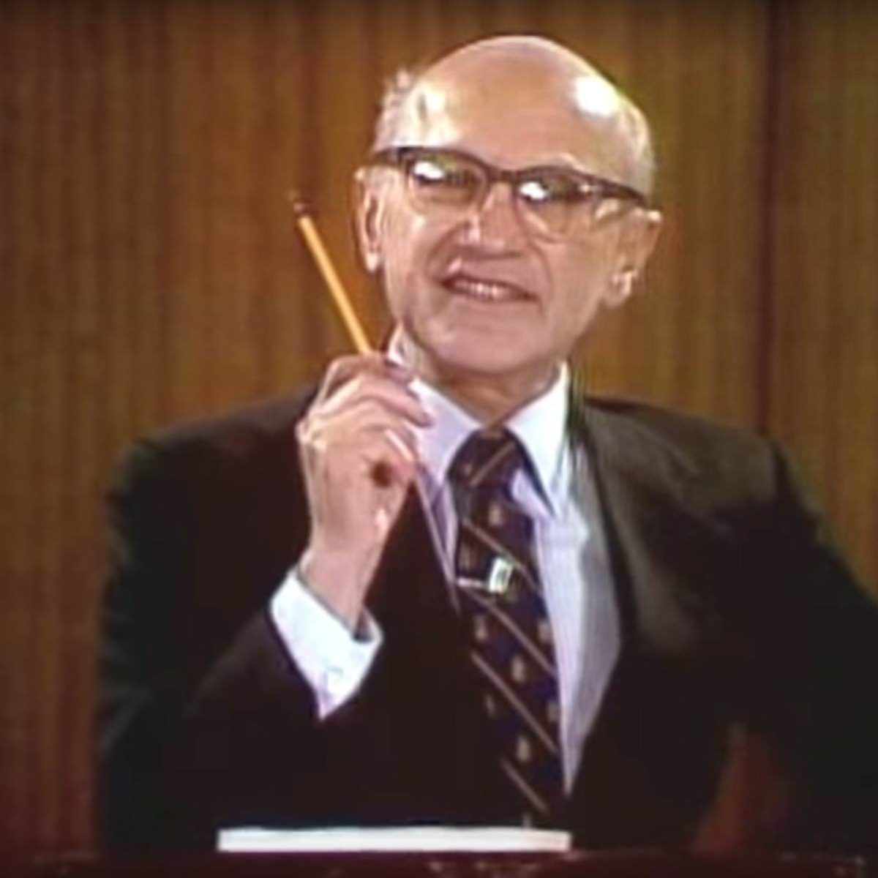
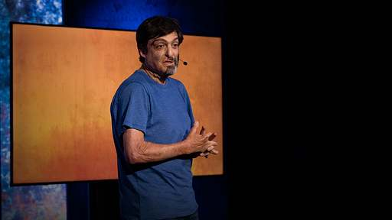
What is Behavioral Economics? History
The Rational Tidal Wave
(1940’s)
Decision Analysis
Rational Heuristics
(They work if we’re perfect!)
(1948)
Heuristics & Biases
(AKA: Behavioral Economics)
(1970’s – Present)
Notes:
Any mathematician, economist, or statistician from the 1940s would promise you that math and analytics is what allowed the Allied effort to defeat the Axis Powers in World War II. And they’d probably be telling the truth. It was during this war that we saw a global push for mathematics and analytics, used in what was then called ‘Operations Research’, to improve quality control in manufacturing, route ships more safely across oceans, and crack the Germans’ communication codes. It was believed that these logical advancements would transform many disciplines.
We will see this rational approach spill into Economics in the form of Rational Heuristics; which assumes that we are all very logical creatures that always make the most optimal decision. The creation of this perfectly economic decision-maker will not be challenged until the late 1960s and 70s with the emergence of the field of Heuristics & Biases (also known as Behavioral Economics) which continues to gather momentum to this day.

Slide 8
What is Behavioral Economics? History
The Rational Tidal Wave – “Decision Analysis”
Jon von Neumann
“expected utility” 1944 – Theory of Games and Economic Behavior
Likelihood of Result * Potential Gains = “Expected Utility”
This “expected utility” did not account for taking in new information!
Pierre-Simon Laplace, Thomas Bayes, Jimmie Savage, et al
“Bayesian statistics” 1954 – The Foundations of Statistics
This statistical approach still guides portfolio selection and management!
Howard Raiffa & Ronald Howard – Founding Fathers of “Decision Analysis”
Notes:
Mathematics and logic was credited to the Allies’ victory and the desire to apply this success to other disciplines was very energetic. In the same way that numbers were used to optimize code cracking and global ship routes, so too was it hopeful in transforming the free market.
In 1944, a mathematician named Jon von Neumann would write a book on “expected utility” – this wonderfully simple idea that if you multiply the likelihood of something by the potential gains of it, you get a predictable amount of utility out of that transaction.
If this theory seems a bit rigid or simple to you, that’s because it was.
It was based on Poker; which can be fun because it is relatively simple, but awful because we can’t always know this “expected utility” when dealt a random hand.
In real-life decisions, we often don’t know for certain any 1 of those 3 parts of the von Neumann formula for a “perfect” Poker game (or even a decent one!)
This expected utility did not account for new information, which led a large gap that we would soon see filled by a series of scholarly statisticians; they calculated how to revise probabilities based on new information.
This mathematic application still heavily influences the theory of portfolio selection; where the expected return and likelihood of being incorrect are both accounted for.
The official name of this discipline would not be officially called “Decision Analysis” until the 1960’s when mathematician Howard Raiffa and Ronald Howard would combine the works of von Neumann with Bayesian statistics; creating a full-blown discipline all about the logical analysis of decisions.

Slide 9
What is Behavioral Economics? History
Heuristics – They work if we’re perfect!
“Economic Man”
Because we all aced Statistics.
“Economic Billiards Player”
Milton Friedman – 1948
Because we make all decisions the way expert billiard players play billiards.
Notes:
This idea that decisions could be analyzed spilled over into the assessment of how people actually make decisions, and the era of the “Economic Man” was born.
This “economic man” was a rational creature; who could account for the ever-changing probabilities, perfectly, every time.
Already feeling skeptical that humans are completely rational? This analogy should clear things up:
Milton Friedman would make the analogy that the “economic man” acts as an expert billiards player – who does not need to know the mathematical formulas governing how one ball may ricochet off another but made his shots as if he knew the formulas!
Because we all make every decision the way expert billiard players play billiards. If you aren’t convinced, that’s good! You shouldn’t be.
This idea of a perfectly rational thinker was very flattering, as it was this theory that would go unchallenged until the emergence of our topic today over thirty years later, excluding one slight challenge to this by a psychologist named Ward Edwards.

Slide 10
What is Behavioral Economics? History
Heuristics – They work if we’re [almost] perfect!
“Economic Man” became the psychologists’ burden.
1956
Ward Edwards would put us to the test, and we would pass with dull yet acceptable colors.
Notes:
The existence of this “Economic Man” was left up to psychologists. Economists had their decision-maker, and were not keen on giving him up for a less perfect decider. A psychologist who was learnt in Statistics would challenge this “Economic Man” with an experiment in 1956.

Slide 11

What is Behavioral Economics? History
Heuristics – They work if we’re [almost] perfect!
BAG B
Ward’s Experiment:
There are two bags,
each with 1000 tokens.
You draw 12 tokens from a bag.
700
300
700
300
What’s the likelihood you drew from BAG B?
Notes:
Ward’s experiment is as follows: There are two bags, each containing 1000 tokens. One bag has 700 blue and 300 green tokens; and the other bag, bag B, has the opposite.
You draw 12 tokens; 8 are green, and 4 are blue.
Ward asked participants what they believed the chance was that they drew their tokens out of Bag B?
What do you think people said? Feel free to put a guesstimate in the chat.

Slide 12
What is Behavioral Economics? History
Heuristics – They work if we’re [almost] perfect!
The answer Ward got:
70% - 80%

Slide 13
What is Behavioral Economics? History
Heuristics – They work if we’re [almost] perfect!
The correct answer:
97%
Ward and his colleagues concluded that normal individuals scored close enough to their “Economic Man,” and left it at that.
Notes:
Hardly opposed, our “Economic Man” would live on unchallenged for another decade.

Slide 14
What is Behavioral Economics? History
Behavioral Economics
We’ve FINALLY Made it!

Slide 15
What is Behavioral Economics? History
Heuristics & Biases
(AKA: Behavioral Economics)
1969
Enter Daniel Kahneman & Amos Tversky
“In making predictions and judgments under uncertainty, people do not appear to follow the calculus of change or the statistical theory of prediction.” (1973)
Heuristics are shortcuts or rules of thumb, and sometimes they work great, and other times, not so much.
Behavioral Economics focuses on the Heuristics that lead us astray.
Notes:
In 1969 – Daniel Kahneman and Amos Tversky would begin to poke holes in the story of our “Economic Man” and would accompany these findings with almost apologetic notes like the one on this slide. Economists were so set in the ways of our perfectly rational decision-making, that any findings to the contrary warranted an apology.
But for reasons unknown to even the “Economic Man”, the work of Kahneman and Tversky took off. Namely, their work on Heuristics and Biases:
Basically put – Heuristics are mental shortcuts we take to reach reasonable conclusions. Biases are the ways in which our personal lived experiences can change the shortcuts we make to reach these conclusions. And Kahneman and Tversky were the first to experiment on when our biases tug us away from these more reasonable conclusions.

Slide 16
What is Behavioral Economics? History
Heuristics & Biases
(AKA: Behavioral Economics)
1980’s - Present
Enter Richard Thaler, Dan Ariely, & Everyone Else
The academic movement we recognize today was born.
This study of Heuristics & Biases studies as it relates to money became known as Behavioral Economics.
Notes:
The work of identifying these less-than-perfect Heuristics and our accompanying biases present took on a world of their own in the field of Economics.
The 70s, 80s, and 90s would bring in legions of followers from the disciplines of psychology, economics, and statistics.
Another pioneer to this field, Richard Thaler, was brought in and the work continued to boom. Unfortunately, Tversky passed in 1996. In 2002, Kahneman would be honored with the Nobel Prize for his and Tversky’s work in this field.

Slide 17
What is Behavioral Economics? What’s the Point?
Behavioral Economists aim to answer two big questions:
Are economists’ assumptions of utility or profit maximization good ways to predict real people’s behavior?
Do the old-school, rational theories work?
  AKA: Are our Heuristics on point or leading us astray?
Do individuals maximize subjective expected utility? As in, when we make seemingly irrational decisions, what is motivating our irrationality? How do we keep score when we make irrational choices?
    When the old theories don’t work, why not?
    AKA: When our Heuristics lead us astray, why? & How do we course-correct?
Notes:
So now we’ve got a decent historical context of how Behavioral Economics came to be; but what is the goal of this field?

Slide 18
The Relevance of Behavioral Economics
We will never be the “Economic Man”
and that’s OK!
Notes:
We are not, nor can we ever be, the “Economic Man.” It’s as simple as that.
And to better understand a few of these instances where Heuristics lead us astray, or where our biases get in the way, can help us all to make smarter choices.

Slide 19
A Few Concepts of Behavioral Economics
The Overconfidence Effect
Anchoring & Framing
Loss Aversion
Acquisition & Transaction Utilities
Narrow Framing & Investments
For each concept, we will:
Define it, Explain it, and Offer an idea of bringing the concept into the classroom.

Slide 20
The Overconfidence Effect
Define It:
The overconfidence effect is observed when a person’s subjective (perceived) confidence in their own ability is greater than their objective (actual) performance (Pallier et al., 2002).
Notes:
This effect is also called Optimism Bias – we are VERY optimistic creatures! Next, we’ll see an example of this optimism in the workplace.

Slide 21
The Overconfidence Effect
Explain It:
In one study,
Each employee at a company was asked:
Do you believe you are performing in the top 5% of the company?

Slide 22
The Overconfidence Effect
How many employees do you think answered that they are performing in the top 5%?
Notes:
Keep in mind, that in a world full of Economic thinkers – we would expect about 5% of respondents to feel this way.

Slide 23
The Overconfidence Effect
42%
Notes:
I like this question and its subsequent answer for a few reasons. The first is that it shows that we are a VERY optimistic species when it comes to assessing our own behavior.
The second: I bet many of you were thinking figures near or even higher than this! Which shows us that we have a baseline idea about some of these faults in our own rationality.
And lastly, understanding that we’re all a little too optimistic can help us to better understand our own beliefs as well as the beliefs of others.

Slide 24

The Overconfidence Effect
Use it in the Classroom:
From the Decision Lab: Everything You Want to Know About Optimism/Overconfidence Bias
Now, presenting: The best shirt that you will definitely wear enough to justify the price.
Notes:
This link comes from the Decision Lab – a socially conscious applied research firm. They study all things relating to behavior, and are a great resource to learn more about some of these topics.
There are many ways to relate to students when talking about overconfidence.
Have you ever said you’re going to get a project done way ahead of schedule, yet you find yourself pulling an all nighter to meet the deadline? THAT’S optimism bias – the difference between what you believed you would do and what you actually did.
In economics; a simple experiment in the classroom may look like this:
You go online or into a store and see the best shirt.
You want pockets? It’s got pockets.
You need it to wear to work? It’s perfect for that.
You have a hard time finding things that fit, and this fits perfect.
I mean, look at how excited we are to try this shirt on! The guy in the picture definitely wants you to buy this shirt.
But WOW, it’s fifty bucks – far more than you’d usually spend on a top.
But we want the shirt; so what might we tell ourselves to justify this purchase?

Slide 25
The Overconfidence Effect
Use it in the Classroom:
How do we justify the purchase?
I will wear this ALL THE TIME.
It goes with everything.
It’s usually $75 and I’m getting it for $50 – what a deal!
How do these justifications stack up to our expected utility? AKA: that “rational” voice in our head?
Notes:
Congratulations! You are now down fifty dollars but the proud owner of the best shirt, possibly ever.

Slide 26
The Overconfidence Effect
7 Times
Notes:
According to a study of over 2000 women in 2015, it was found that an article of clothing is worn a mere 7 times before being tossed or donated.
Does wearing this new shirt 7 times justify the cost? In other words – would you have bought the shirt knowing there is a high chance it may only be worn 7 times?
This gap between feeling so certain that we will wear something enough to justify the price and the number of times we actually wear it; this gap is our optimism.

Slide 27
Anchoring & Framing
Define It:
Anchoring is a number we associate with a certain thing; and Framing is how that number is displayed to us.
These two are frequently used together to influence consumer behavior.

Slide 28
Anchoring & Framing
Explain It:
Consumers with less knowledge about a product are more greatly influenced by Anchoring & Framing.
Anchoring sets the tone and Framing makes the sale.
Notes:
Consumers with less knowledge about a product or service are more greatly influenced by Anchoring and Framing – so we can already see how being aware of these might make us better decision-makers.
Anchoring sets the tone and Framing makes the sale.

Slide 29
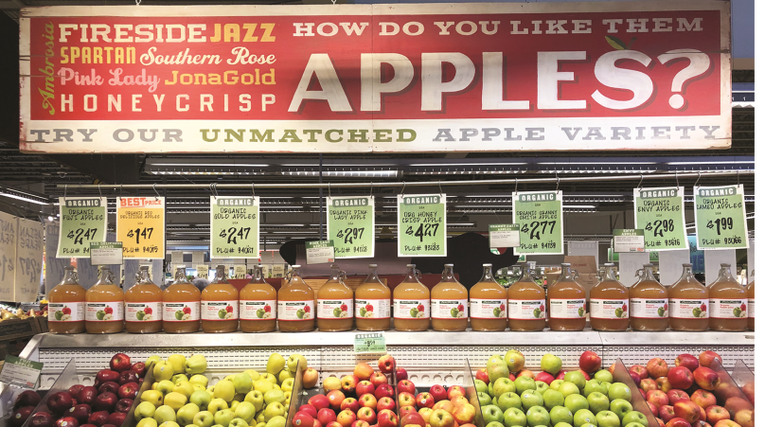
Anchoring & Framing
Explain It:
The prices of all the apples is the Anchor.
Notice the cheapest apple’s signage? That’s Framing. They want the consumer to buy more of the “Best Price” apple for $1.47/lb.

Slide 30
Anchoring & Framing
In the classroom…
Make students pick between two options
We have 600 people who need treatment:
OPTION A:
This treatment will save 200 lives.
OPTION B:
This treatment has a 33% chance of saving everyone or a 66% chance of saving no one.
Which option would you choose?
Notes:
The following experiment is a very famous one conducted by Kahneman and Tversky, and can be proposed to a variety of groups of individuals.
When framed positively, as is here, 72% of people chose Option A.

Slide 31
Anchoring & Framing
In the classroom…
Make students pick between two options
We have 600 people who need treatment:
OPTION A:
This treatment will let 400 people die.
OPTION B:
This treatment has a 33% chance of no one dying and a 66% chance of everyone dying.
Which option would you choose?
Notes:
When negatively framed, Option A was only chosen 22% of the time.
This framing impacted how participants viewed the answer, despite the answer yielding the same result in both scenarios.
The assumed anchor in this experiment is that participants would want the solution where the least number of people died, and the greatest number of people could be treated.
When making economic decisions, it can be good to take a step back from the context of the deal to assess whether or not it is actually a good value. Although most economics choices aren’t life or death, this example shows the drastic difference in results given the same information framed in two different ways.

Slide 32
Loss Aversion
Define It:
A loss hurts us about twice as much as a gain gives us.
Loss
Gain
Notes:
We have all felt an example of loss aversion in our lives.
It is this principle that we generally disdain a loss a lot more than we appreciate a gain.

Slide 33
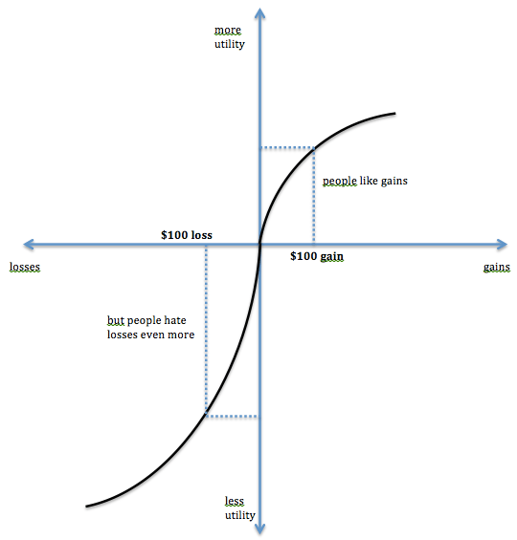
Loss Aversion
Explain It:
Notice how much steeper the Loss curve is when compared to the Gain curve.
Notes:
This curve was first charted by Kahneman and Tversky. But what can we learn from this curve?

Slide 34
Loss Aversion
Explain It:
We don’t experience life in numbers or charts, but in changes. And this graph shows that the changes we experience sting more when it’s perceived to be a negative change.
Notes:
Although there are many experiments that yielded numerical equivalencies to this graph, I feel Loss Aversion is a great place to talk more about our behavior than the numbers we produce in experiments.

Slide 35
Loss Aversion
In the classroom…
Appreciate the gains in life and roll with the losses.
If you want more, EconEdLink has a great lesson on Loss Aversion here.
Loss
Gain
Notes:
We will all face loss and gains in our lives, and especially students who are learning to navigate the world around them.
Students who understand the anticipated sting of a loss and the less significant celebration of a gain can begin to manage these emotions in real-time.

Slide 36
Acquisition & Transactional Utility
Define It:
Utility of Thing – Cost of Thing = Acquisition Utility
This is that “expected utility” we learned about during our history lesson.
Transactional Utility: Bringing in the idea of “a bargain” or “a rip-off” to transactions.
Notes:
Acquisition utility is the rational utility we get from a purchase or transaction.
Transactional utility introduces this idea that the context of the transaction can impact a deal’s overall utility.

Slide 37
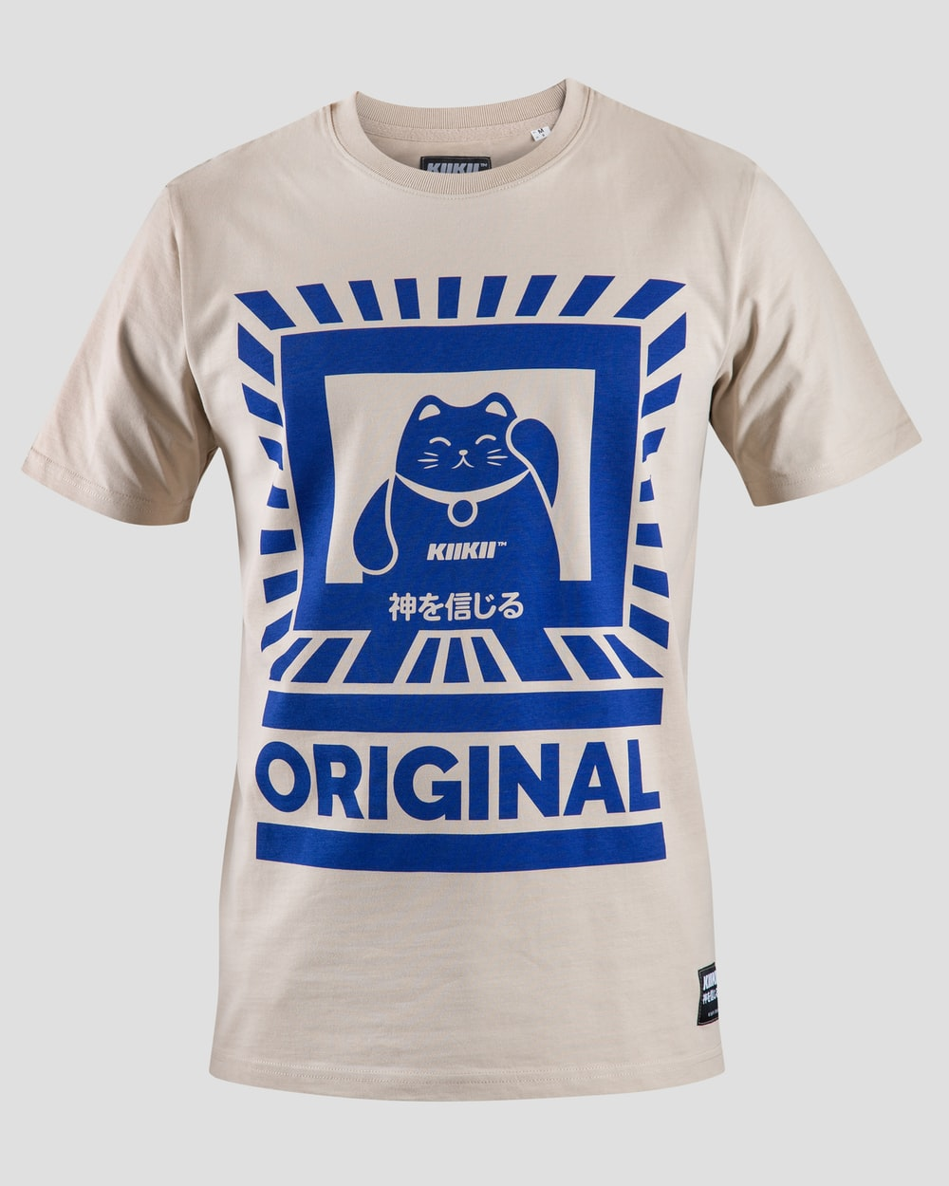
Acquisition & Transactional Utility
Explain It:
Here, we have two identical T-shirts.
Price: $45
Expected Utility: 10
Location: Your Favorite Concert
For our “Economic Man”, they would only purchase the shirt at the better price of $15.
Price: $15
Expected Utility: 10
Location: Online store

Slide 38
Acquisition & Transactional Utility
Explain It:
Here, we have two identical T-shirts.
Price: $45
Expected Utility: 10
Location: Your Favorite Concert
In experiments, it was found time and time again that people would pay a totally different price, for the same item, given a change in context AKA the transactional utility changed the price a person was willing to pay.
Price: $15
Expected Utility: 10
Location: Online store

Slide 39
Acquisition & Transactional Utility
A Question For Your Students:
What might make the shirt from the concert appear or feel more valuable than one bought online? And does this actually make it more valuable?
Notes:
If there’s any RENT fans on this call, transactional utility reminds me of the questions asked in the Seasons of Love track; which is kind of funny but it is worth asking:
How do we measure things like time and love when it comes to our transactions? And even though it goes against our “Economic Man” – is it wrong to consider these things?

Slide 40
Narrow Framing & Investments
Define It:
Narrow Framing is looking at too few factors that may affect a financial decision. Typically, this is applied to investments.

Slide 41
Narrow Framing & Investments
Explain It:
The values of January, February, and March are the same on both charts. If an investor looks at too narrow of information, they may miss out on a good opportunity.
Studies show that investors who are shown the bottom chart instead of the top chart invested more and took on more risk. Seeing the narrowly framed losses made people risk-averse.
Notes:
A paper done by Kahneman, Tversky, and Thaler in 1997 showed that viewing a portfolio more often reduced the amount of risk a person would take in the investment.
So how can we apply this to students, who, for the most part, don’t invest in the stock market?

Slide 42
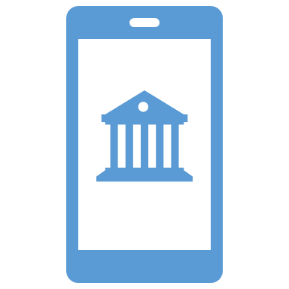


Narrow Framing & Investments
Explain It:
For students and young people in general, building good relationships with a bank can make for better financing among many other benefits down the road.
Ask students:
How many of you have an insured bank account? (Insured meaning your money is protected)
Next, ask them how much research they did to pick their first bank:
No time, a little time, a lot of time? What did you find? What influenced your decision?
Notes:
Getting banked is one of the best things a young person can do.

Slide 43

Narrow Framing & Investments
Explain It:
Factors that might influence a banking decision
Where family banks (That was me!)
Where a friend banks
A bank that comes to your classroom
A bank you see an ad for online
Notes:
Some factors can influence where someone might bank, like if a family member or friend bank there; if maybe the bank came and did an activity at your school or church; or maybe just a bank you saw an ad for online. Next, emphasize the importance of research!

Slide 44

Narrow Framing & Investments
Explain It:
Factors that might get missed
Fees & Minimum balances
Interest rates on financing common items like a car
Insurance options and retirement accounts
Ability to track account from your phone
Notes:
There are many factors that might get missed if we narrowly frame our choices based on the easiest or most immediate feedback. Much like only looking at one quarter of stock returns, only getting subjective input from friends or ads can lead to missed out on some important criteria.
Suppose Blue Bank ends up having ridiculous fees for accounts that dip below $500. Maybe their interest rates are better, but if your balance stays under $500, you’ll be drowning in fees before you ever even ask them to finance something.
After going through these additional criteria – ask students to make a list of priorities they want their bank to have. Also a great time to remind them that a lot of the newer cash apps are very different than a bank account; namely in their abilities to finance and insure your money.

Slide 45
Narrow Framing & Investments
Explain It:
Factors that might get missed
Fees & Minimum balances
Interest rates on financing common items like a car
Insurance options and retirement accounts
Ability to track account from your phone
Notes:
There are many factors that might get missed if we narrowly frame our choices based on the easiest or most immediate feedback. Much like only looking at one quarter of stock returns, only getting subjective input from friends or ads can lead to missed out on some important criteria.
Suppose Blue Bank ends up having ridiculous fees for accounts that dip below $500. Maybe their interest rates are better, but if your balance stays under $500, you’ll be drowning in fees before you ever even ask them to finance something.
After going through these additional criteria – ask students to make a list of priorities they want their bank to have. Also a great time to remind them that a lot of the newer cash apps are very different than a bank account; namely in their abilities to finance and insure your money.

Slide 46
Learning to Love Our Irrationality
Recognizing these faults in our own judgment can help us all make better economic decisions!
So, leaving here today…
  Reel in your optimism – it gets the best of us all sometimes!
  Assess whether a transaction is a bargain or a rip-off
  Don’t sweat the small losses; they sting but they too will pass!
  Sometimes, it’s OK to buy that shirt from your favorite show. It can’t always just be about money.
  Get the whole picture before committing to a bank, a car, or an investment account!

Slide 47
Want to dive in more?
Books
Misbehaving
– Richard Thaler
Predictably Irrational
– Dan Ariely
Thinking Fast & Slow
– Daniel Kahneman
Websites
EconEssentials Online Lessons
EconEdLink Behavioral Economics
Articles
Harvard Business Review: History of Behavioral Economics
Behavioral Economics: An Introduction
This presentation is also a bit heavy on the text. This is intentional, as you will be getting a copy of the slides and searching any of the names mentioned here will yield a lot of excellent reading and materials on these subjects.

Slide 48
Thank you!
Q&A

Slide 49
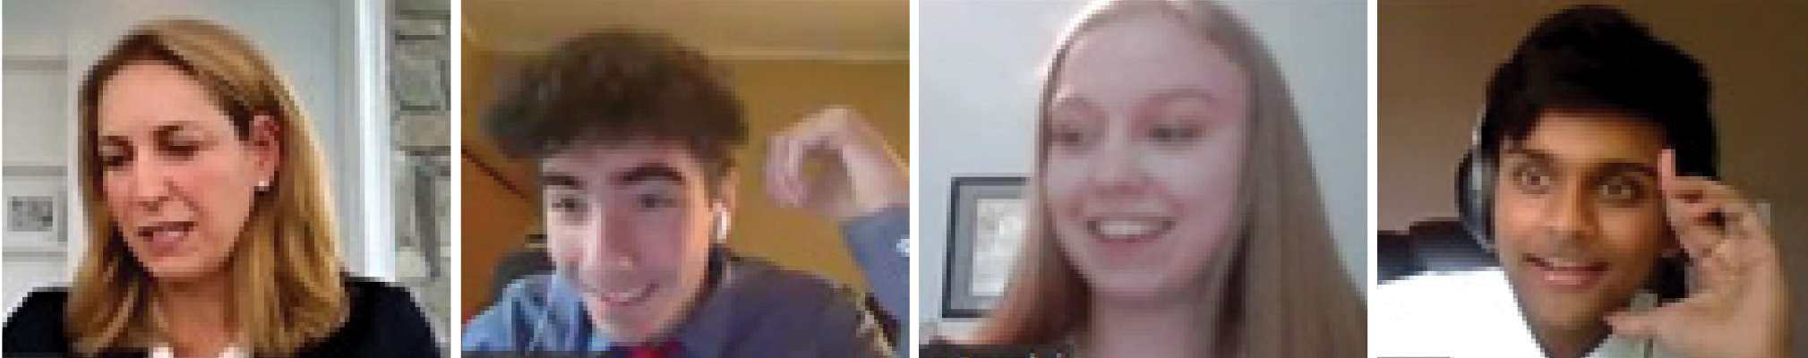

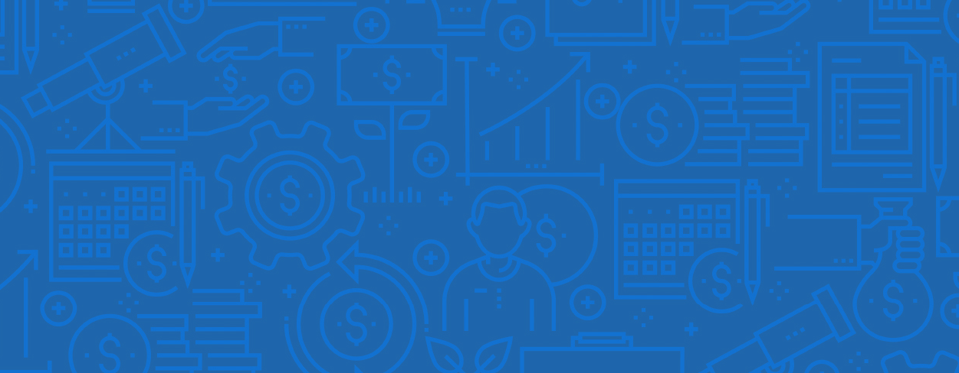
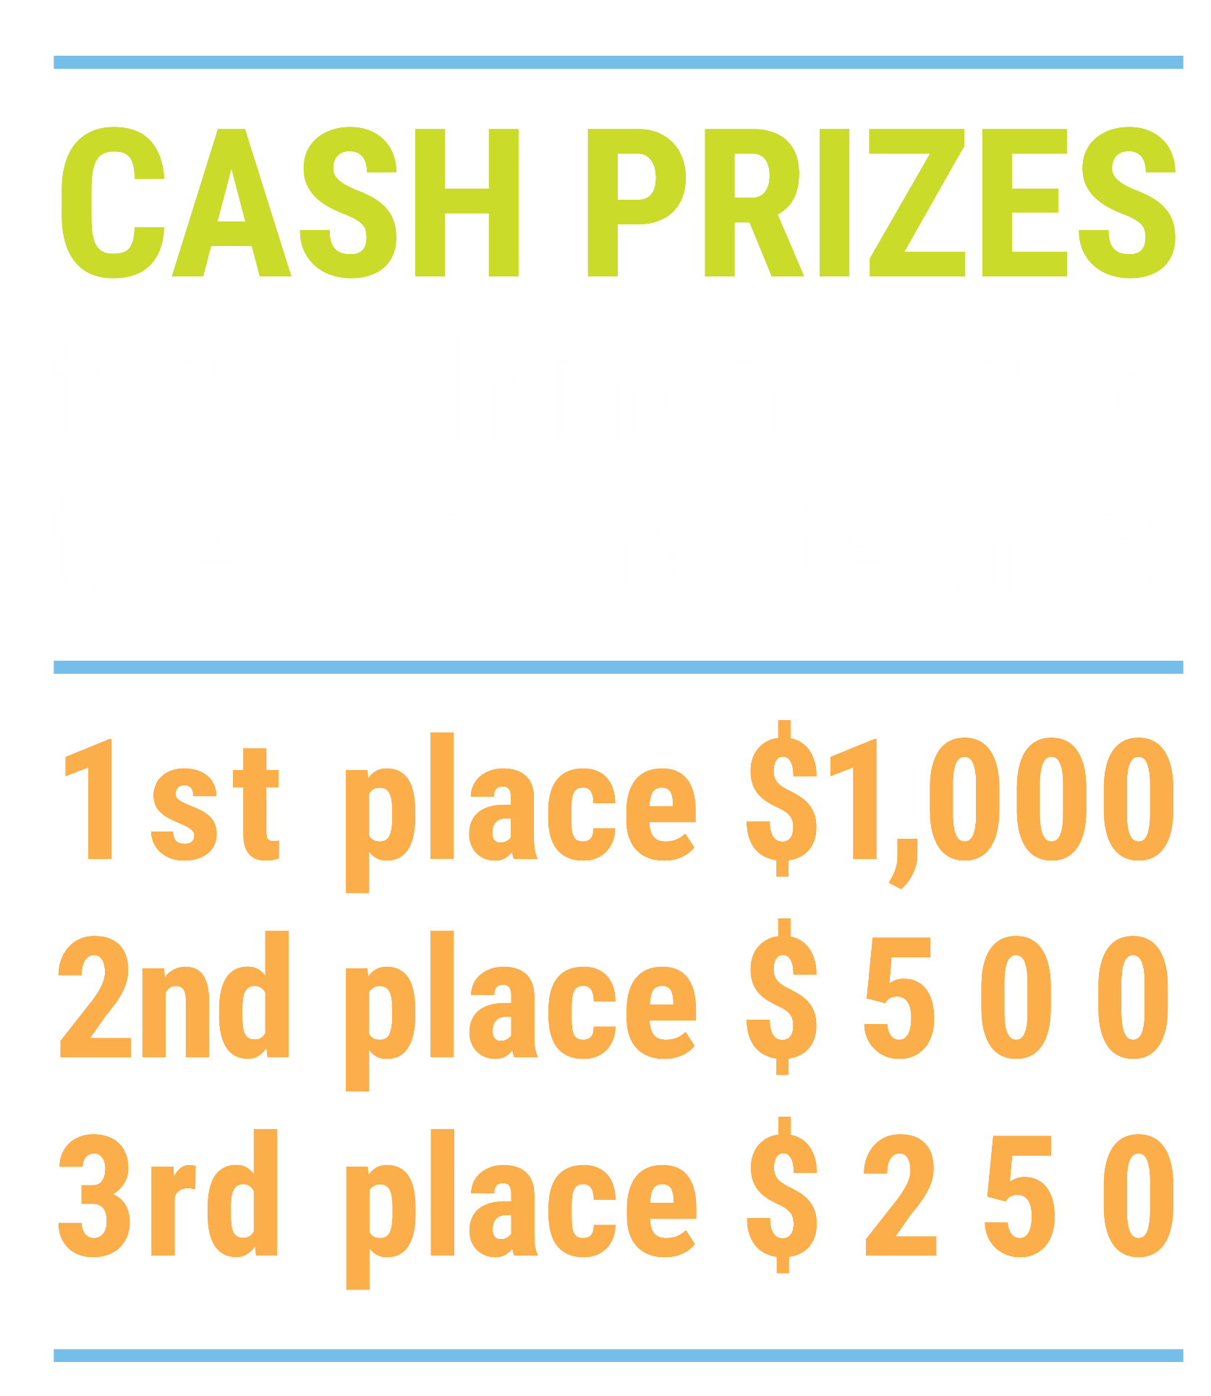

We’ve gone Virtual!
Teach Economics?
Your students may have what it takes to compete in the nation’s only high school economics competition!
Why Play?
• Fun team learning experience
• Great for college applications
• No other challenge like this
• Online participation makes access easy
• Chance for cash prizes
How it Works
Teams register
Teachers enroll team(s) of 3- 4 high school students from the same school. Multiple teams allowed.
Teams compete within their state
Compete to win your state competition for a
chance to advance to the National Semi-Finals.
National Semi-Finals: May 3-20, 2021
Teams answer multiple-choice questions on macroeconomics, microeconomics, and international & current events.
National Finals: May 22-24, 2021
Teams analyze an economic issue and present their solution. Top teams engage in the Finals Quiz Bowl where they face-off answering questions to claim the National Title.
Two divisions based on experience level
David Ricardo for first-time competitors who have taken no more than one economics course.
Adam Smith for returning competitors, AP, International Baccalaureate, and honors students.
Register Today at NationalEconomicsChallenge.org

Slide 50

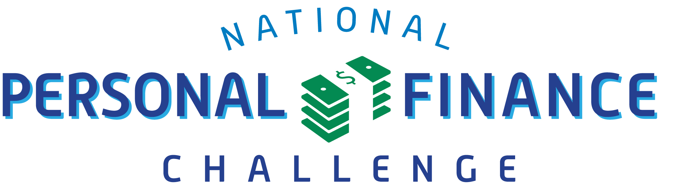

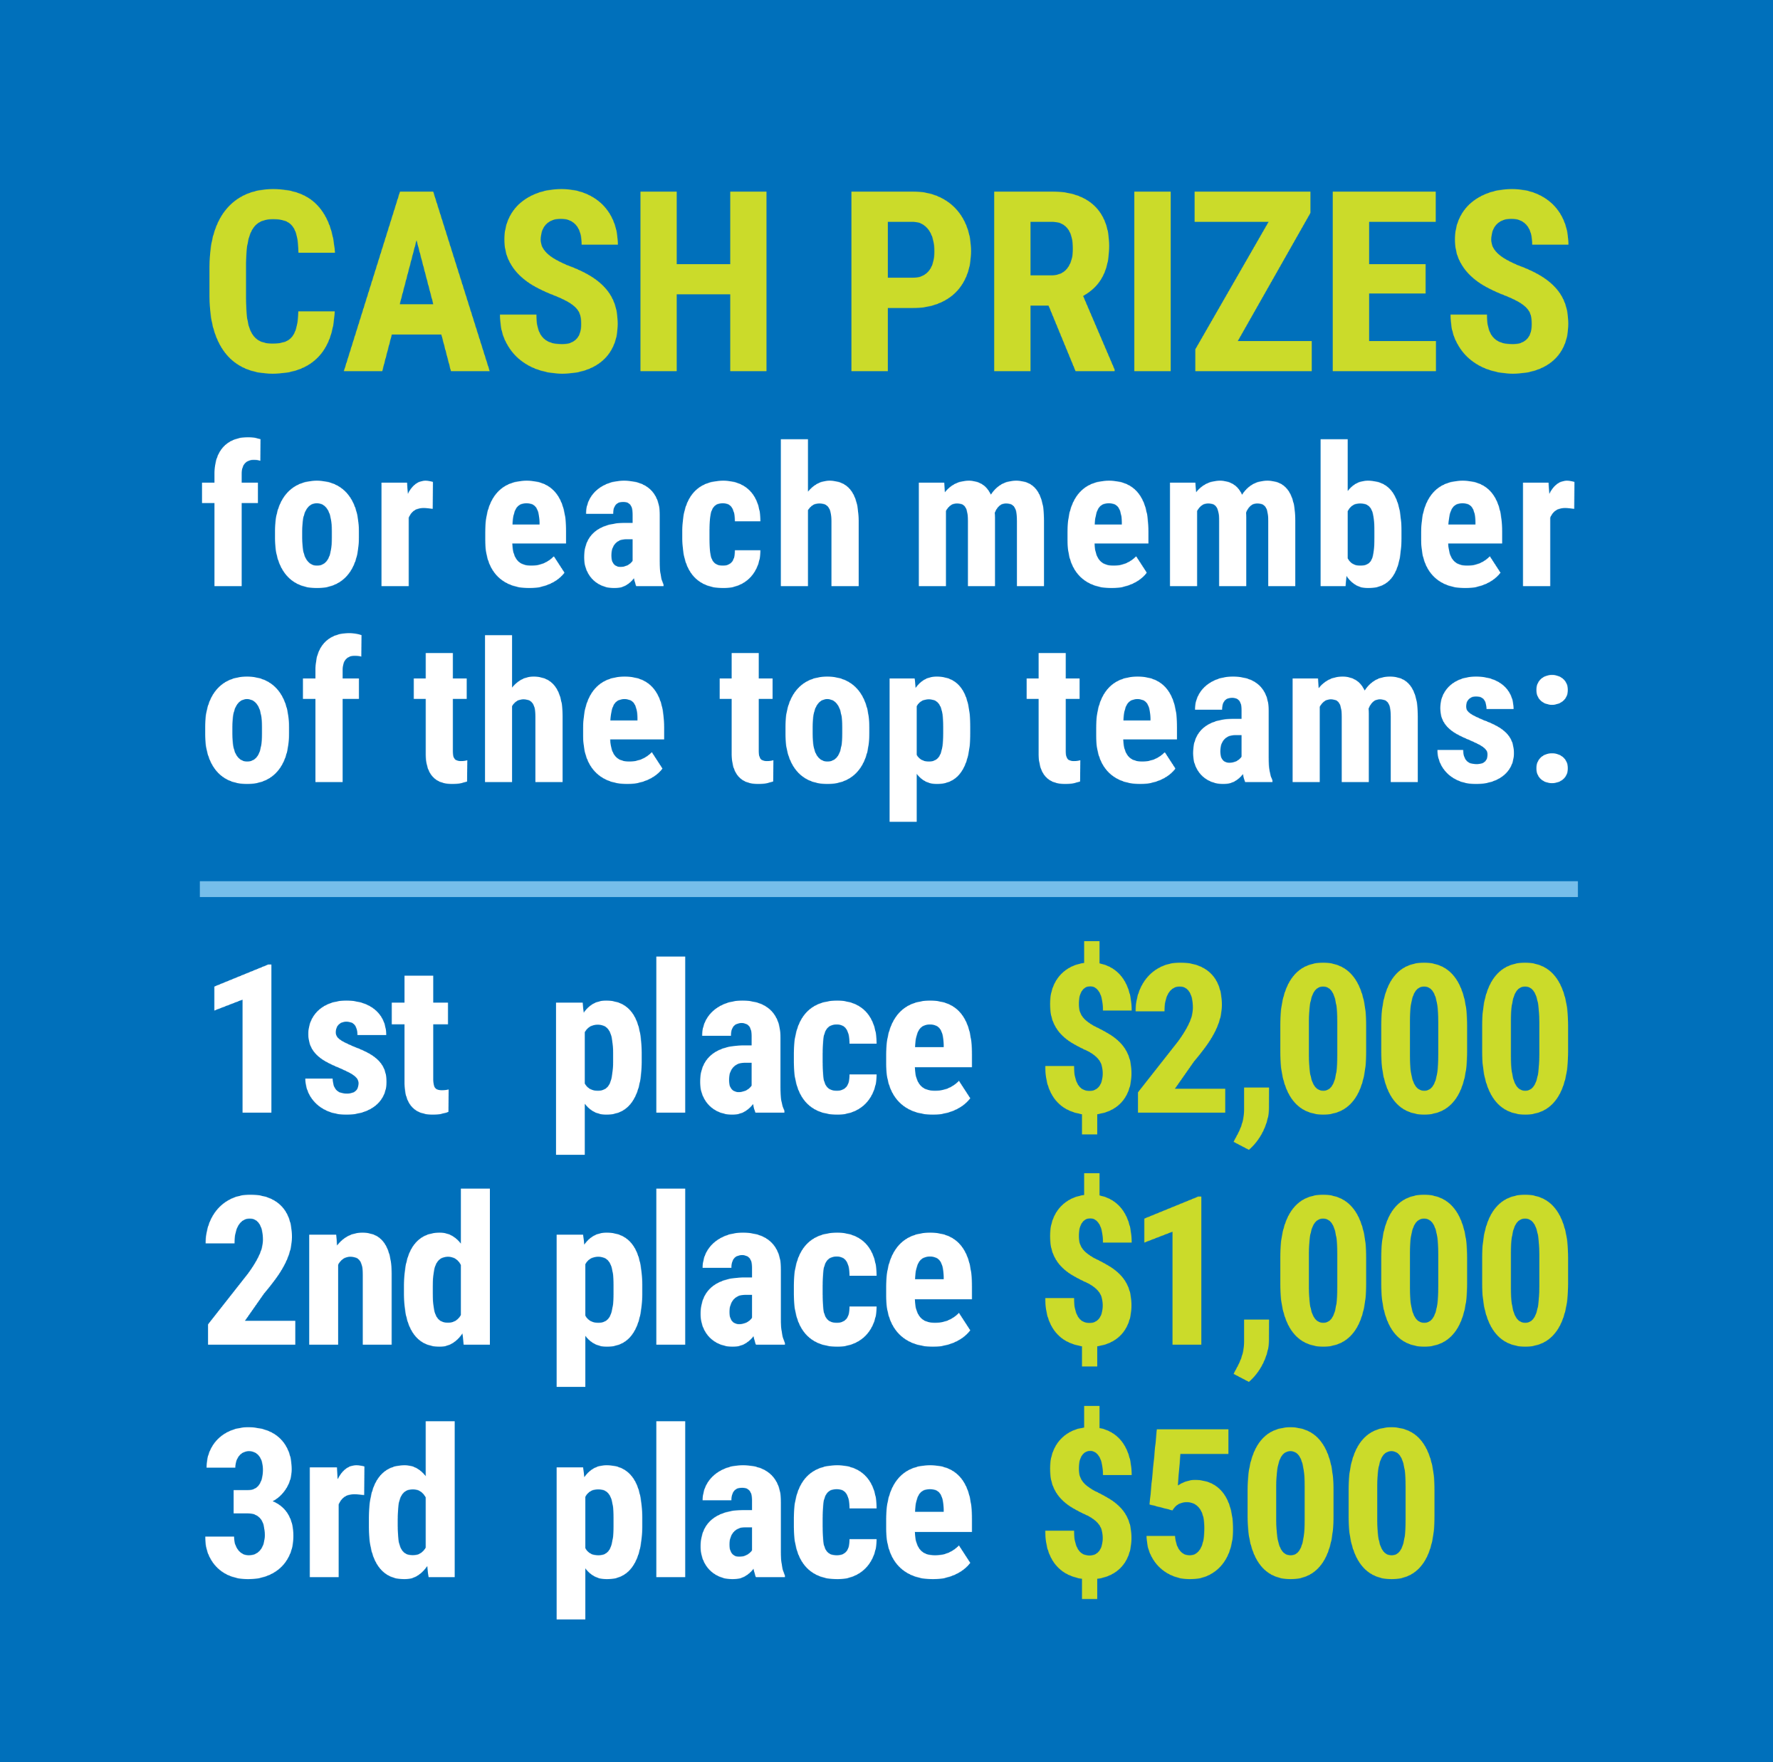

FIND YOUR LOCAL COMPETITION
AND REGISTER TODAY!
The National Personal Finance Challenge is a competition that provides high school students with an exciting and motivating opportunity to build, apply, and demonstrate their knowledge of money management.
Through online exams and a personal finance simulation, teams showcase their expertise in earning income, buying goods and services, saving, using credit, investing, as well as protecting and insuring.
Teams of up to four students, with one teacher/coach, can qualify to represent their state at the National Personal Finance Challenge by winning their local competition.
NATIONALS
Semi-Finals: First round elimination via online multiple-choice questions.
Finals: Case study round virtually co-hosted by the Cleveland Fed on June 3.
personalfinancechallenge.org

Slide 51
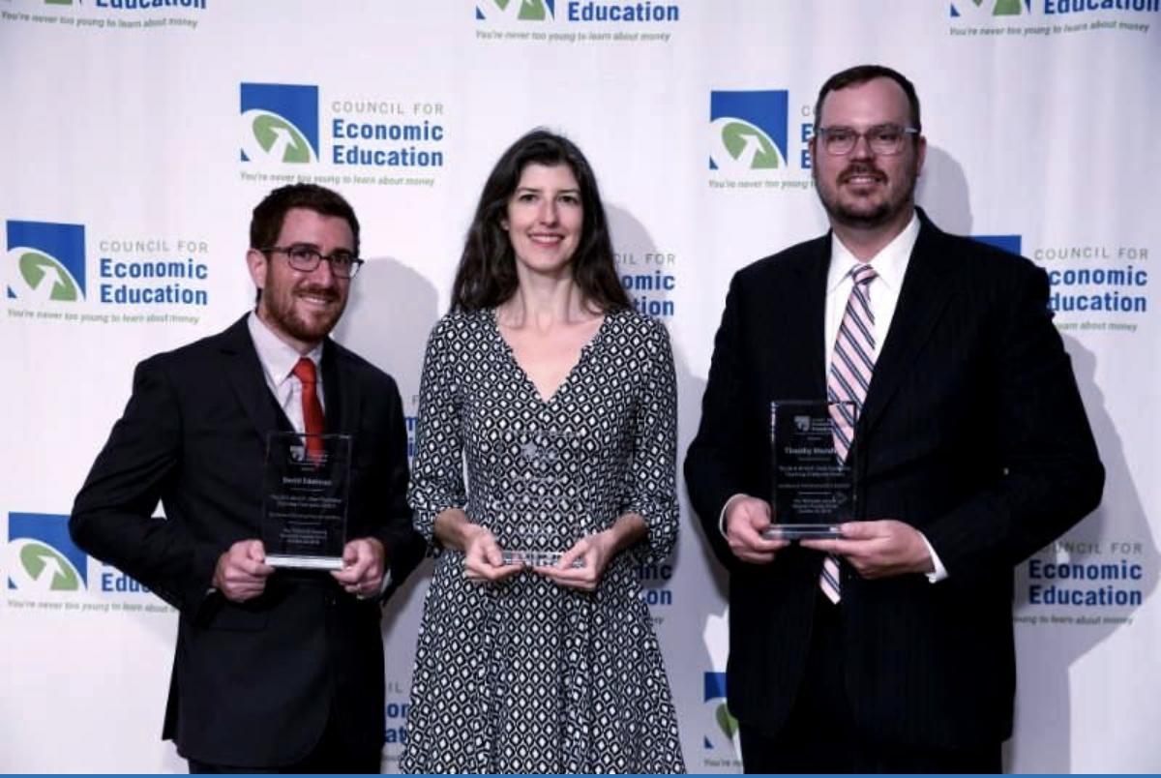
The 2021 Sloan Teaching Champion Award
Winners receive:
A cash award of $5,000
A cash award of $2,500 for their school to support economic education
Recognition at our annual Visionary Awards convening.
This award promotes economic education by honoring three outstanding teachers who incorporate exemplary teaching techniques that improve their students’ economic understanding in and out of the classroom.
This award is open to New York metropolitan area high school teachers of all subjects, not just teachers of economics. Applicants must demonstrate how they integrate economics into their teaching.
Sound like you or someone you know?
Applicants must teach in one of the
Twelve New York state counties (New York, Kings, Bronx, Richmond, Queens, Nassau, Suffolk, Westchester, Putnam, Rockland, Orange and Dutchess)
Eight New Jersey counties (Bergen, Passaic, Essex, Hudson, Middlesex, Union, Morris, Monmouth), or the
Two Connecticut counties (Fairfield and New Haven)
Application will be launched on Friday February 19th 2021
You can access the application here.
CONTACT
Please feel free to e-mail us at rrivera@councilforeconed.org
with any questions you have.

