Slide 1
NCCEE
Presents: “Using Podcasts to Teach Personal Finance” Stephanie Cales stephanie.cales@nccee.org

Slide 2
NCCEE
Who We Are

Slide 3
Objectives
Teachers will be able to:
Identify podcasts with economics themed content.
Design unique learning opportunitites using podcasts in the classroom.

Slide 4
Agenda
Why should I use podcasts in the classroom?
How to tell a “good” podcast from a “bad” podcast
How to use podcasts in the classroom
Economics podcasts to explore
Standards

Slide 5
What kind of podcasts do you already listen to?

Slide 6
How NCCEE has used podcasts

Slide 7
Why should I use podcasts in the classroom?

Slide 8
Why should I use podcasts in the classroom?
Listening Skills
Active listening skills
Reflective thinking

Slide 9
Why should I use podcasts in the classroom?
Variety
Current statistics show there are more than 1 million active podcasts and more than 30 million podcast episodes
Students learn differently

Slide 10
Why should I use podcasts in the classroom?
Student independence
Choice in podcasts
Choice in when/where/how to listen

Slide 11
Why should I use podcasts in the classroom?
Accessibility
Free to you and your students
Almost everyone has access to them already

Slide 12
How to tell a “good” podcast from a “bad” podcast

Slide 13
“Good” vs “bad” podcast
Focus on topic
Episode description
Do I have to spend 30 minutes waiting to get to the point?

Slide 14
“Good” vs “bad” podcast
Show structure
Is it short enough to use with students?
OR can it be clipped to only use the segment I want?

Slide 15
“Good” vs “bad” podcast
Quality of content
Who is producing it?
Who is speaking on the topics?

Slide 16
“Good” vs “bad” podcast
Political neutrality
Either presents information in an unbiased manner OR presents both sides equally

Slide 17
How to use podcasts in the classroom

Slide 18
How to use podcasts in the classroom
4 main avenues
Individual/independent listening
Group discussions/listen in small groups
Whole class
Projects

Slide 19
How to use podcasts in the classroom
Bellringers/discussion
Podcasts shorter than 10 minutes
Clips from longer podcasts
Homework
Projects

Slide 20
Personal Finance podcasts to explore

Slide 21
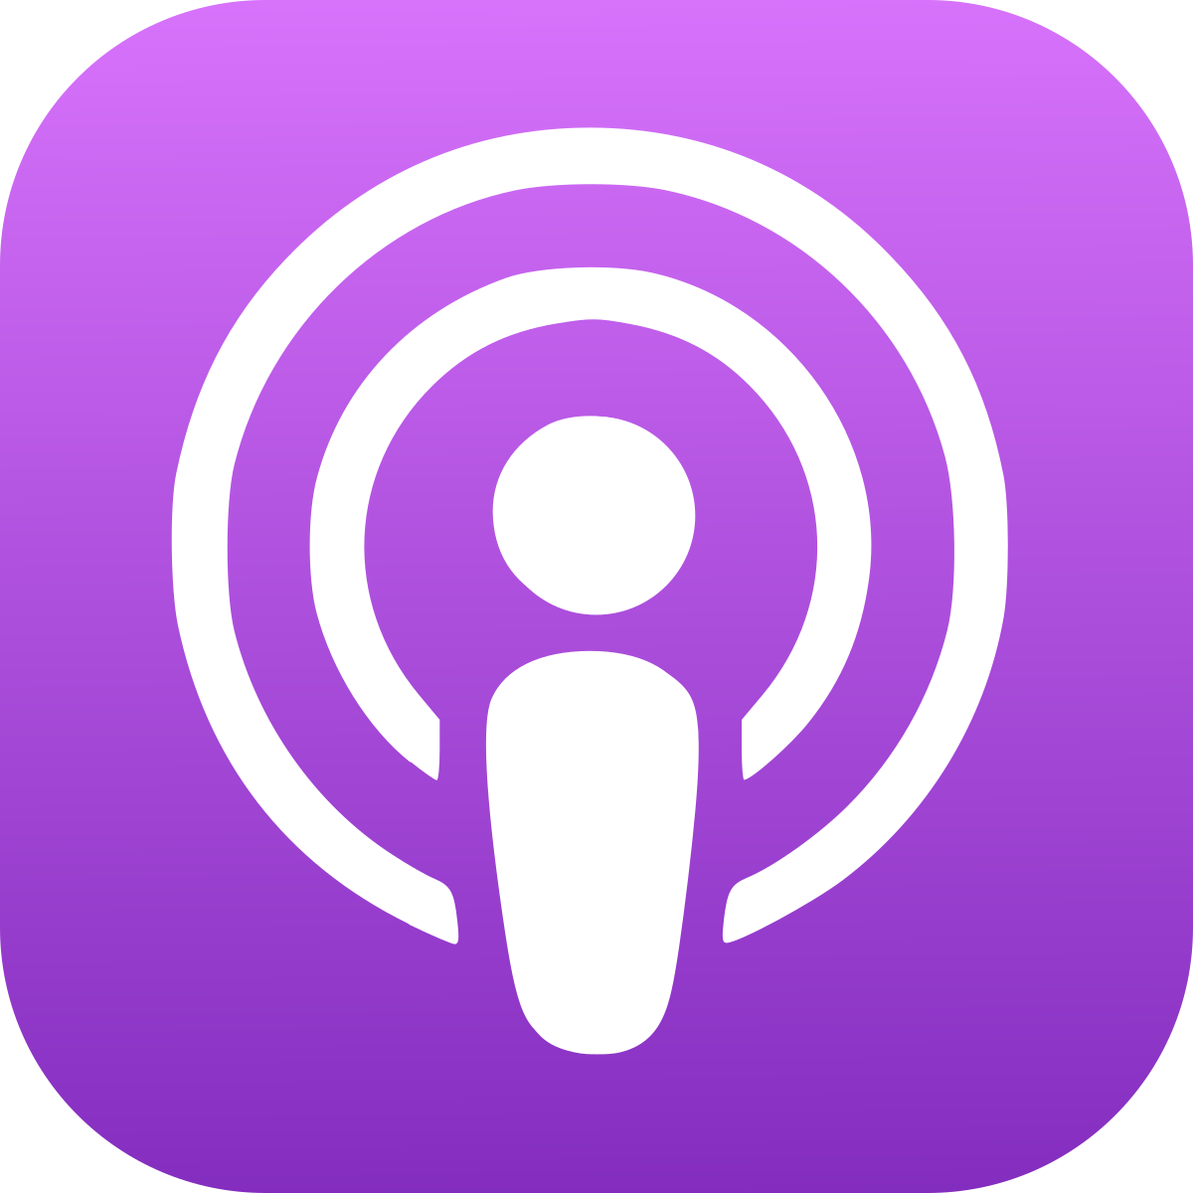
How/where to find podcasts
Apple podcasts
Google podcasts
Spotify
Web presence

Slide 22
Daily updates
WSJ Your Money Briefing
Weekdays
New York Times’ The Daily
20 minute episodes
NPR’s Up First
3 stories in 10 minutes

Slide 23
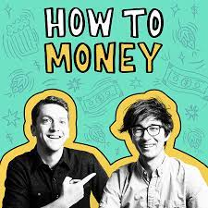
1. How to Money
2 best friends, Joel and Matt
Episodes twice weekly
40-minute episodes

Slide 24
1. How to Money
Episode highlight
“Debunking Common Tax Misconceptions”
National standard 1: Earning Income
Taxes

Slide 25
2. Suze Orman’s Women & Money
Suze Orman
Financial advisor, author, podcast host

Slide 26
2. Women & Money
Episode Highlight
“Ask Suze Anything” episodes
National standard 3: Saving
National standard 5: Financial Investing

Slide 27
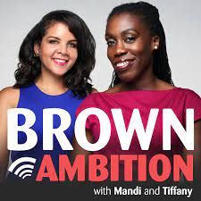
3. Brown Ambition
Personal finance journalist Mandi Woodruff, now Chief Consumer Advocate for Ally Bank
Tiffany Aliche, an award-winning financial educator and best-selling author

Slide 28
3. Brown Ambition
Episode features
Overall topics
Answering listener questions
Timestamps
National standard 3: Saving
National standard 4: Using Credit
National standard 5: Financial Investing

Slide 29
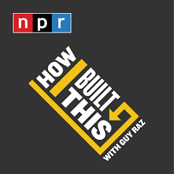
4. How I Built This
Guy Raz- journalist, correspondent, radio host
Longer episodes that could be used for a project or discussion based assignment
Companies your students will know

Slide 30
4. How I Built This
Episode highlight
“Hinge: Justin McLeod”
Standard 1: Earning Income
Standard 2: Buying Goods and Services
Standard 5: Financial Investing

Slide 31
And more!
She Did It Her Way from She Podcast
More Money Podcast
The Dave Ramsey Show
BiggerPockets Money
Afford Anything with Paula Pant
Money With Mak & G

Slide 32
Closing and Questions

Slide 33
Sources
https://www.businessinsider.com/personal-finance/best-personal-finance-podcasts
https://time.com/nextadvisor/in-the-news/ten-best-money-podcasts/
https://www.realsimple.com/work-life/money/best-finance-podcasts
https://www.councilforeconed.org/wp-content/uploads/2013/02/national-standards-for-financial-literacy.pdf
https://www.teachcreatemotivate.com/using-podcasts-in-the-classroom/
https://blog.edpuzzle.com/edtech/podcasts-in-the-classroom/
https://artsintegration.com/2019/05/31/podcasting-in-the-classroom/
https://www.readingrockets.org/article/benefits-using-podcasts-classroom
https://www.npr.org/2020/02/26/809352282/teachers-are-you-using-podcasts-in-your-classroom

