Slide 1
Economics Bootcamp 2021:
Key Concepts in Microeconomics
Presented by Theodore Opderbeck
February 16, 2021 opderbeckt@waldwickschools.org

Slide 2
EconEdLink Membership
You can now access CEE’s professional development webinars directly on EconEdLink.org! To receive these new professional development benefits, become an EconEdLink member. As a member, you will now be able to:
Automatically receive a professional development certificate via e-mail within 24 hours after viewing any webinar for a minimum of 45 minutes
Register for upcoming webinars with a simple one-click process
Easily download presentations, lesson plan materials and activities for each webinar
Search and view all webinars at your convenience
Save webinars to your EconEdLink dashboard for easy access to the event
You may access our new Professional Development page here

Slide 3
Professional Development Certificate
To earn your professional development certificate for this webinar, you must:
Watch a minimum of 45-minutes and you will automatically receive a professional development certificate via e-mail within 24 hours.
Accessing resources:
You can now easily download presentations, lesson plan materials, and activities for each webinar from EconEdLink.org/professional-development/

Slide 4
Agenda
Supply and Demand
Elasticity
Government Price Controls
Externalities
Consumer Theory

Slide 5
Objectives
To discuss how buyers and sellers interact in a free market to determine price signals that are influenced by supply and demand.
To explore how elasticity affects consumption and production decisions.
To analyze the impact of government intervention/ price controls in a market.
To introduce dynamic learning activities and lesson plans to bring content alive for students.
To model digital formative assessment tools to use with your students in order to maximize learning.

Slide 6
National Standards
NCEE Standard 7: Markets and Prices. A market exists when buyers and sellers interact. This interaction determines market prices and thereby allocates scarce goods and services.
NCEE Standard 8: Role of Prices. Prices send signals and provide incentives to buyers and sellers. When supply or demand changes, market prices adjust, affecting incentives
https://www.councilforeconed.org/wp-content/uploads/2012/03/voluntary-national-content-standards-2010.pdf

Slide 7
State Standards
NY State Common Core Social Studies Standard 12.E2b: The choices of buyers and sellers in the marketplace determine supply and demand, market prices, allocation of scarce resources, and the goods and services that are produced. In a perfect world, consumers influence product availability and price through their purchasing
http://www.nysed.gov/curriculum-instruction

Slide 8
State Standards
NY State Common Core Social Studies Standard 12.E2c Businesses choose what to supply in the product market, based on product market prices, available technology, and prices of factors of production. The prices of those factors are determined based on supply and demand in the factor market. The supply and demand of each factor market is directly related to employment. Debates surround various ways to minimize unemployment (frictional, structural, cyclical).
http://www.nysed.gov/curriculum-instruction

Slide 9
Question of the Day
Which “Shark Tank” featured product has been the most successful in terms of sales revenue?
Squatty Potty
Wicked Good Cupcakes
Scrub Daddy
Bombas Socks

Slide 10
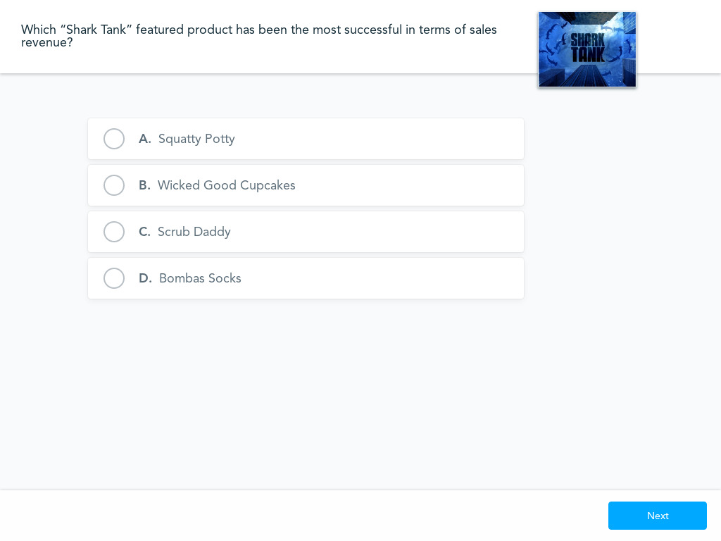
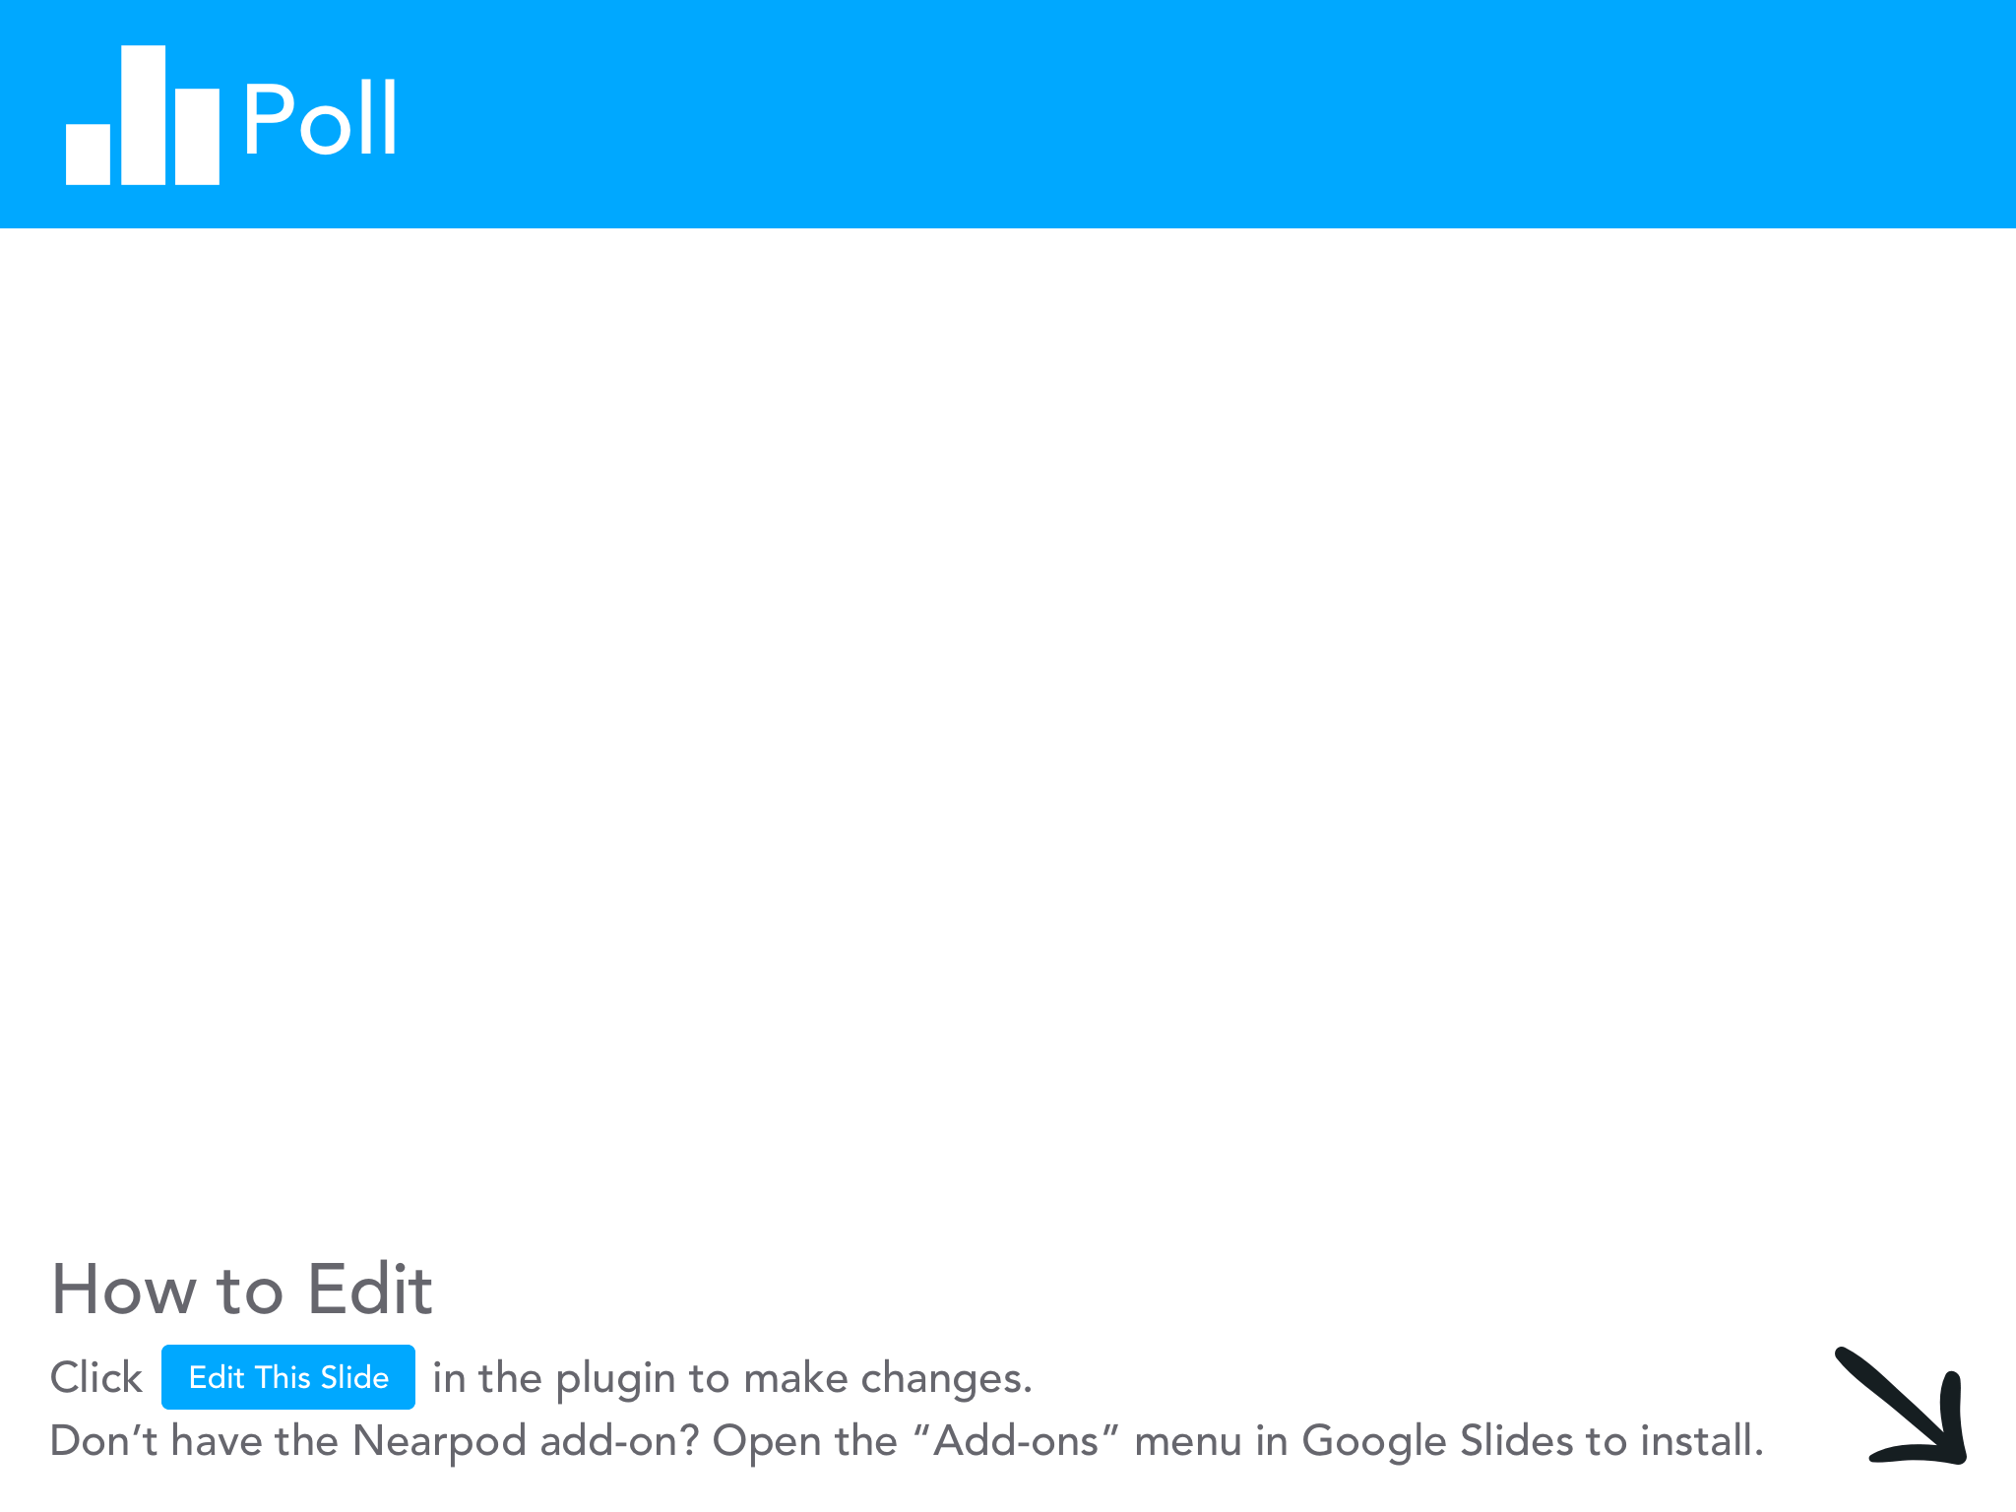

Slide 11

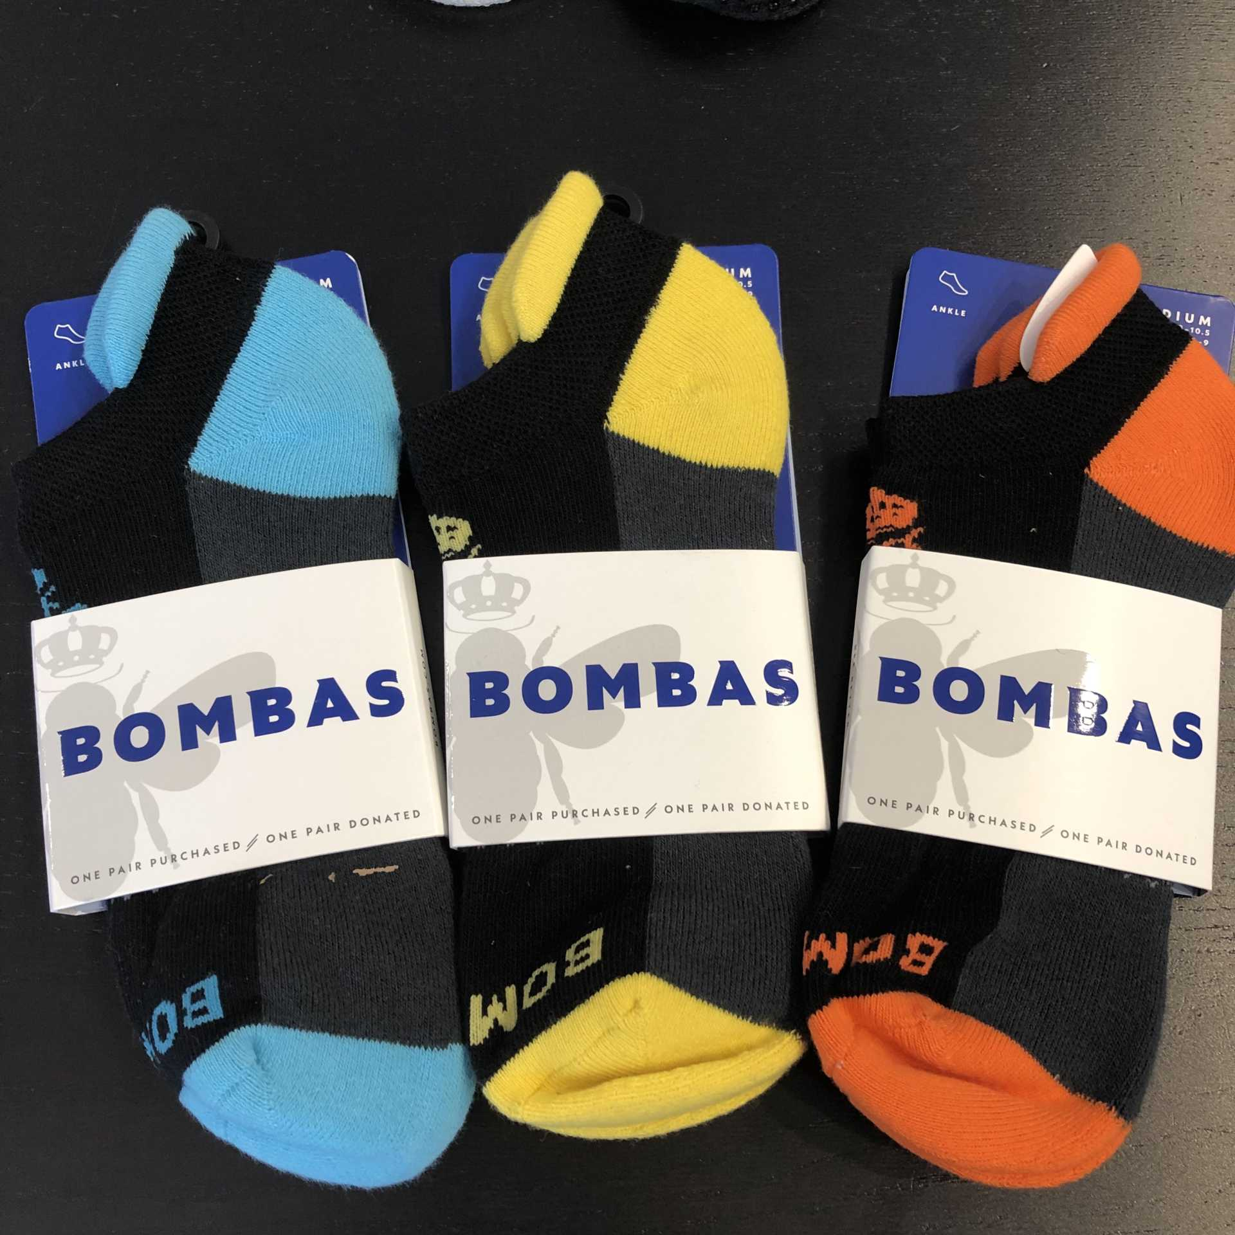

$225 million in sales since Shark Tank!

Slide 12
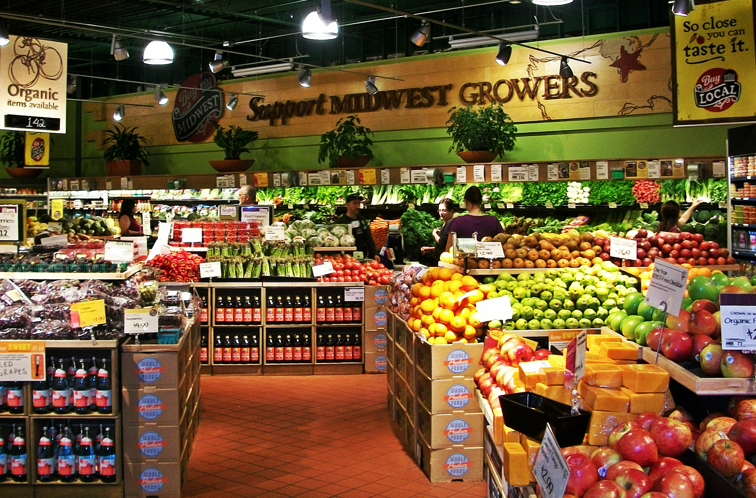

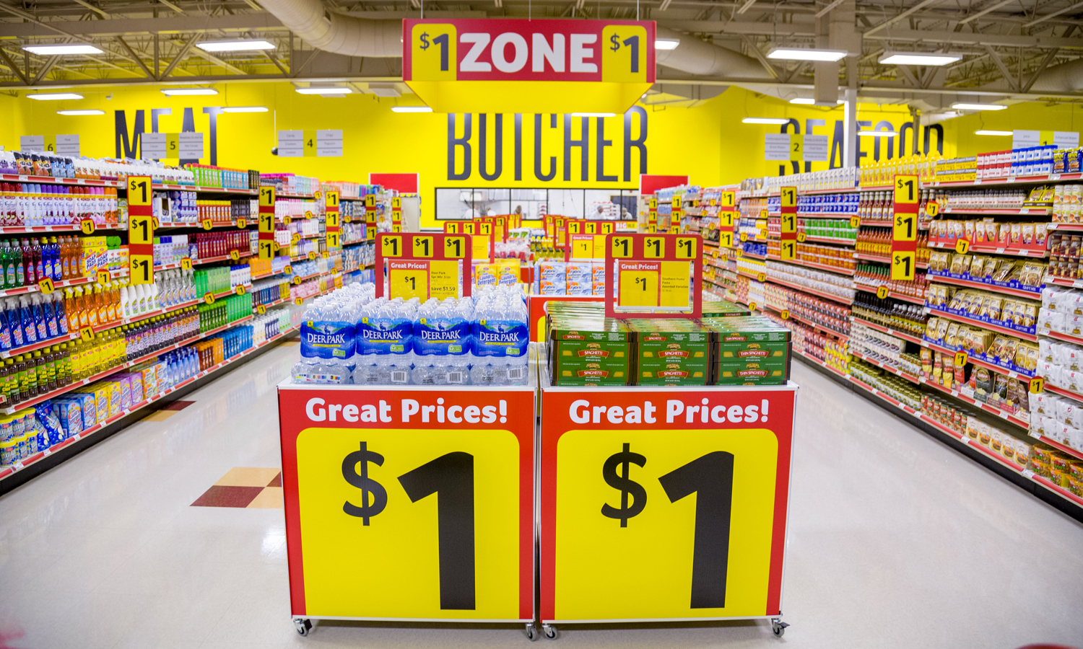



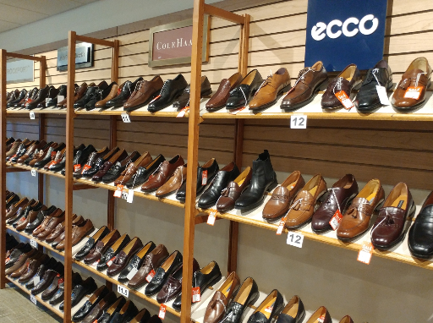



Supply and Demand
Notes:
Get kids atttention - mention iPhones

Slide 13
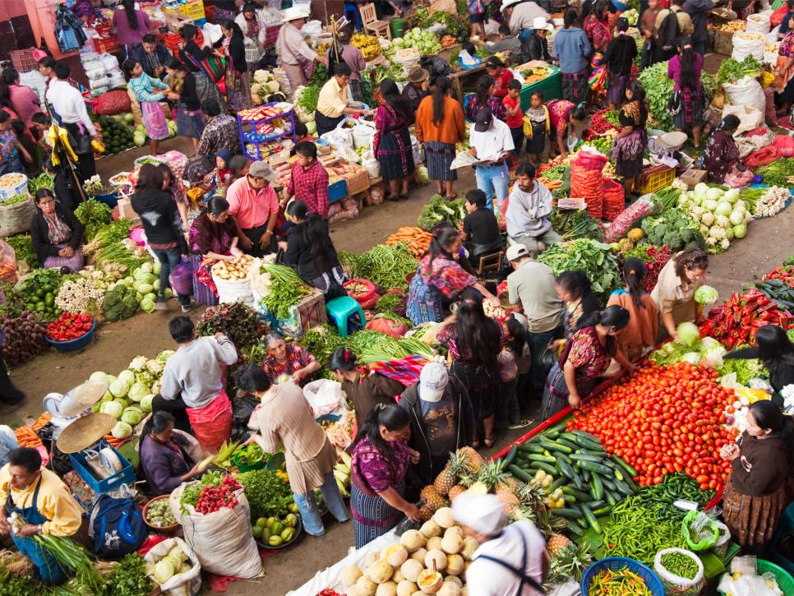
Market Economy
MARKET: Any arrangement that brings buyers and sellers together to exchange goods and services for money.
FREE MARKET: Little to no government interference or involvement. The forces of supply and demand determine output levels and prices.

Slide 14
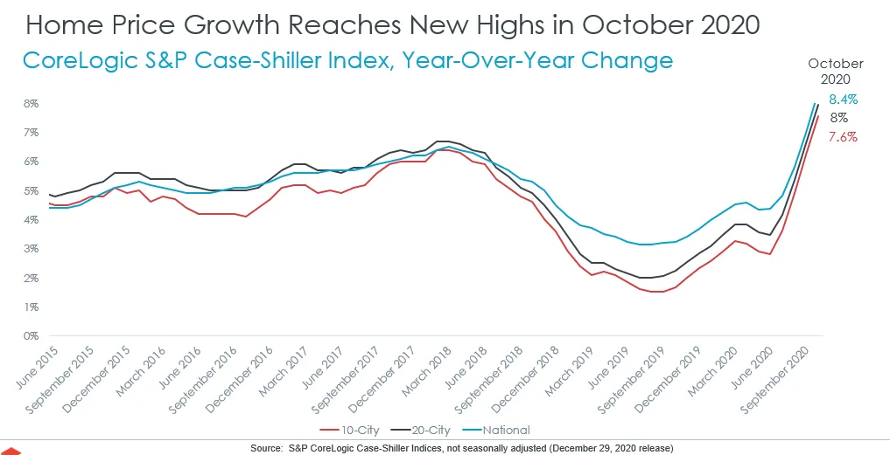
Why do you think home prices have risen so rapidly in the past year?
Do you think prices will level off, or will they continue to increase at the current pace? Why?
https://www.financialsamurai.com/housing-market-predictions-2021/

Slide 15
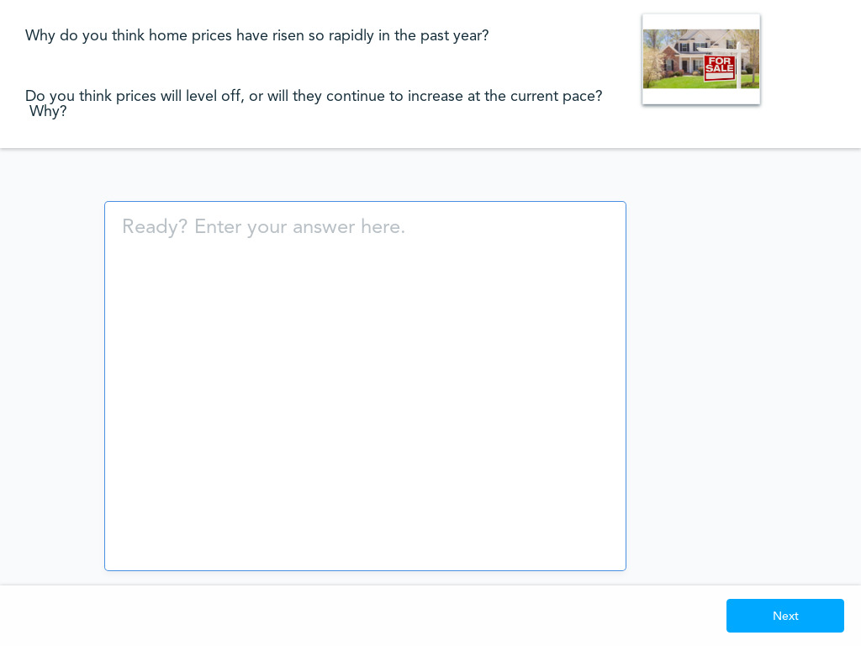
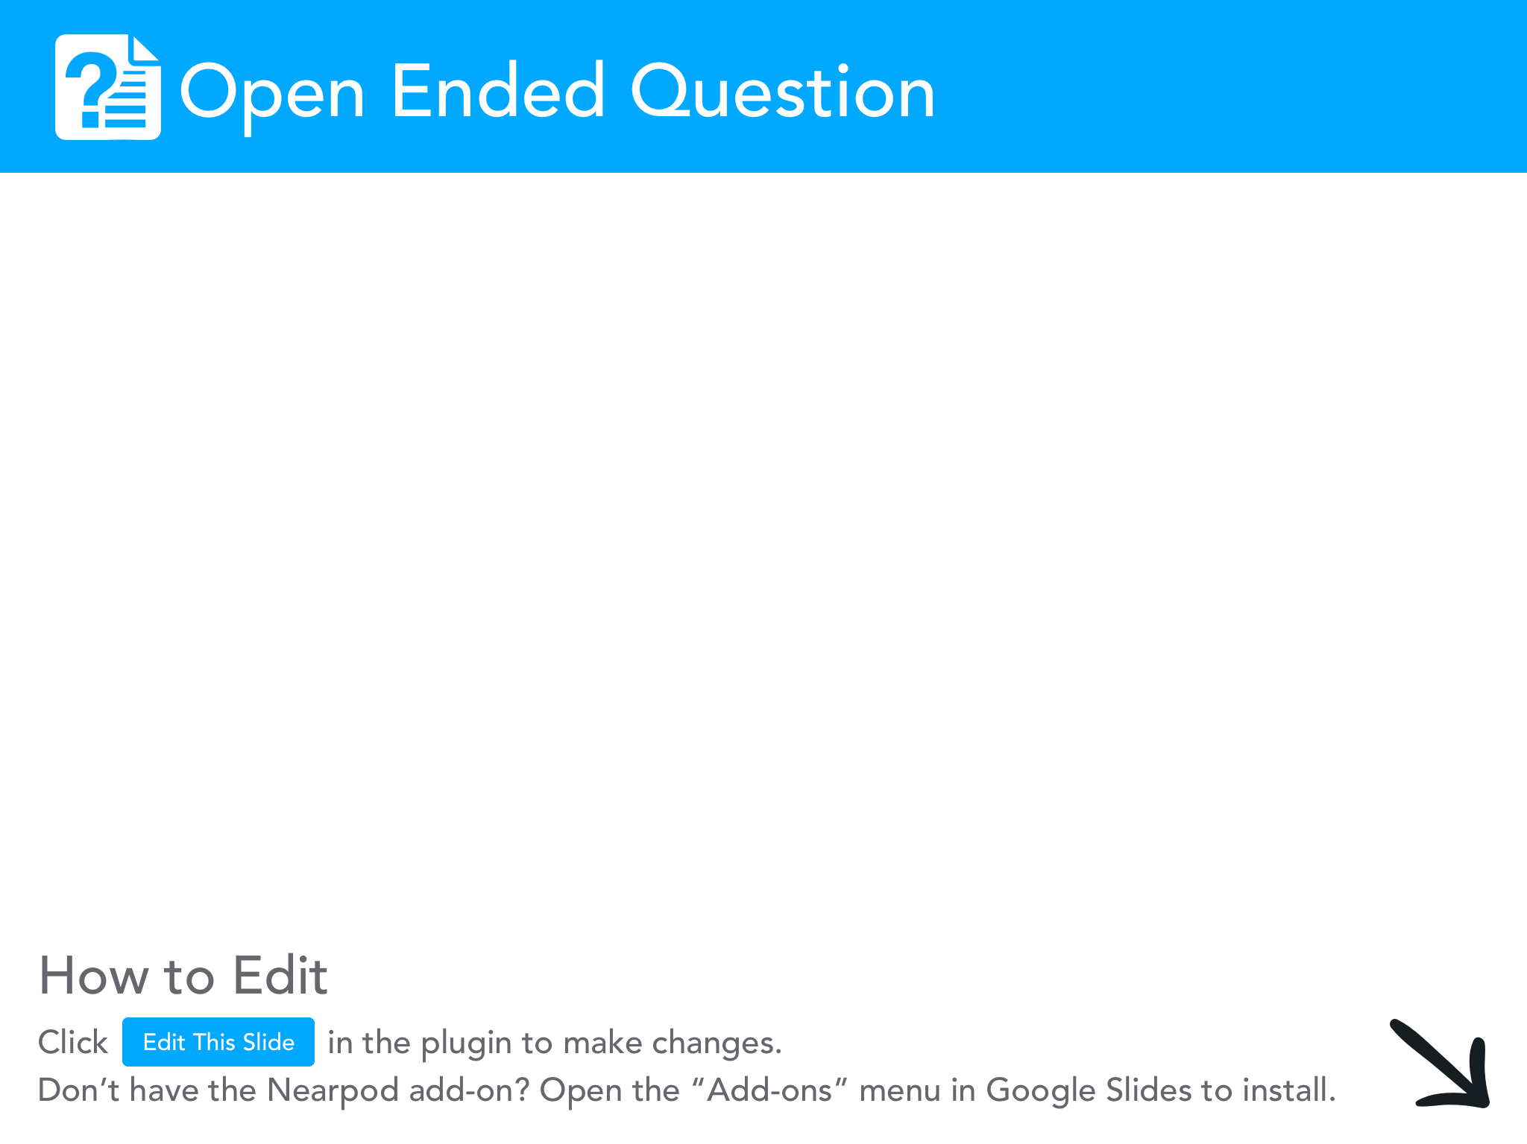

Slide 16
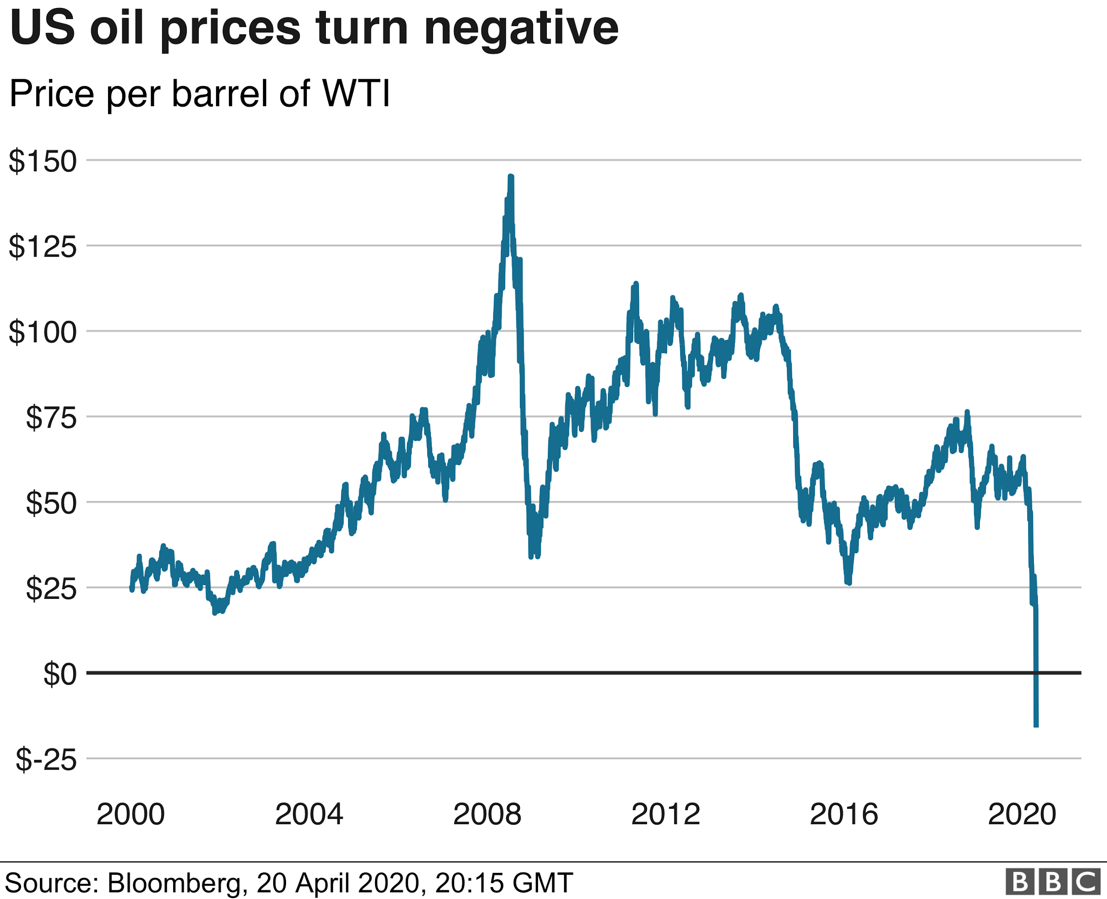

Choose a time period of a few years on the graph above regarding oil prices.
Explain, to the best of your ability, why oil prices may have risen, fallen or stayed constant during that period.

Slide 17
Introductory Teaching Activity
Hang various items (10) around the room with incorrect prices.
Students examine a total of five items and record whether they think the price is lower or higher than the listed price. They list one reason for their response.
Display the actual prices. Hold brief discussions introducing “supply and demand” concepts. For every correct response, students get two fictional dollars for an auction.
Auction (non-allergenic) food items to the class. Construct supply and demand tables to display and discuss for selected items. Discuss how supply and demand influence the prices of the items you auctioned.

Slide 18

Snuggie Fleece Blanket with Sleeves Zebra
$30

Slide 19
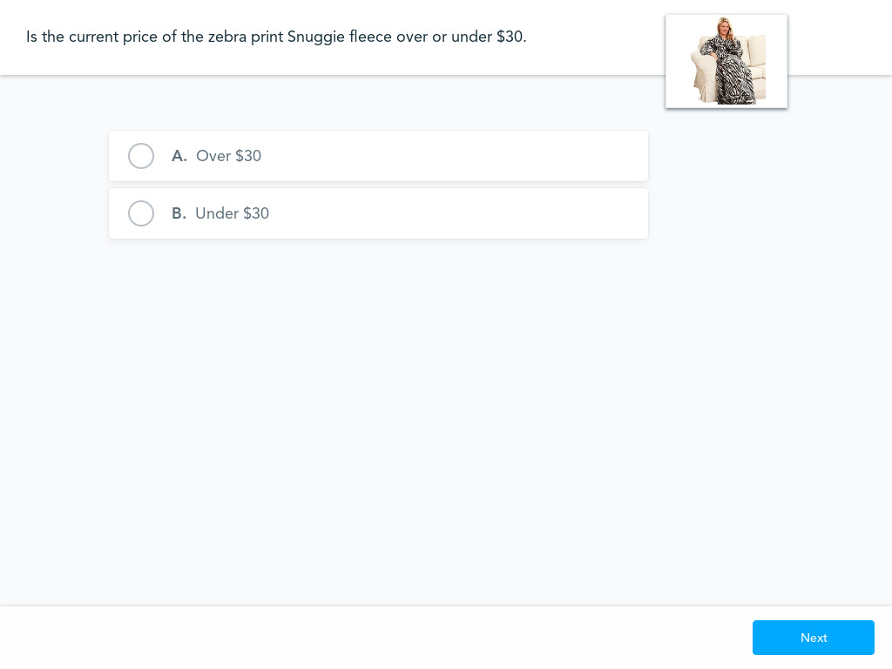

Slide 20
Supply/Demand
Law of Demand
CETERIS PARIBUS (“holding all other things constant”)
As prices rise, quantity demanded will fall; as prices fall, quantity demanded will rise.
WHY?
Income Effect - when price rises for a good or service, purchasing it takes up a greater share of your discretionary income.
Substitution Effect - when price rises for a good or service, consumers will purchase the good or service’s substitute

Slide 21
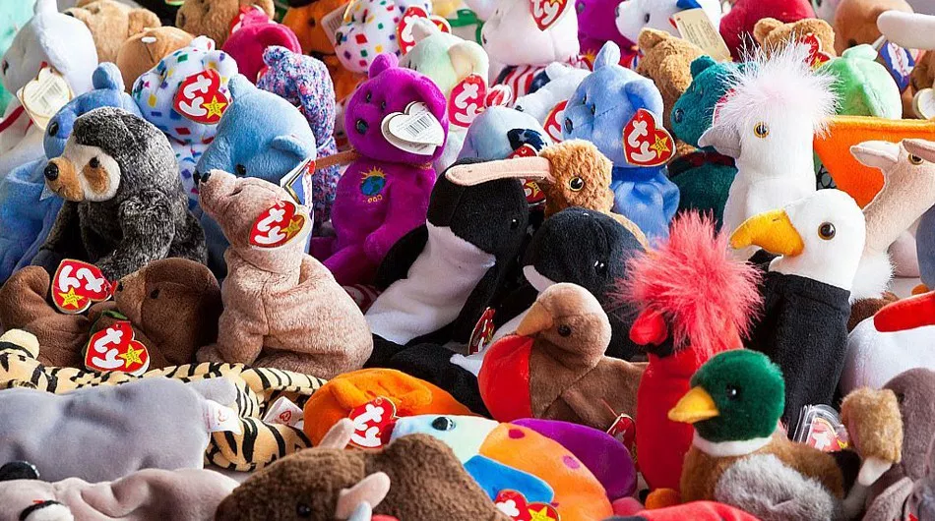

Supply/Demand

Slide 22
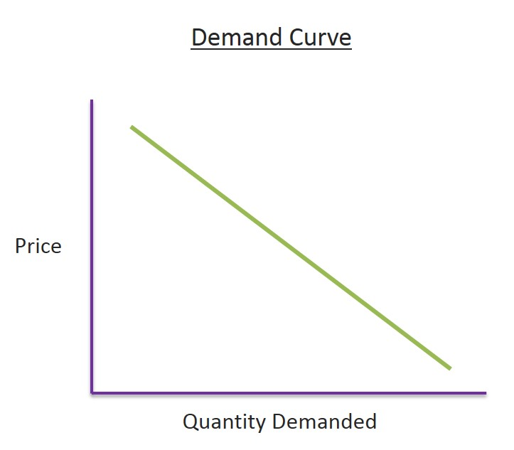
Supply/Demand

Slide 23
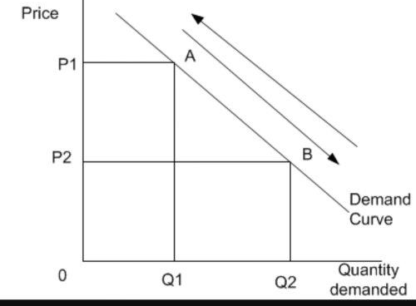
Supply/Demand
Change in Quantity Demanded

Slide 24
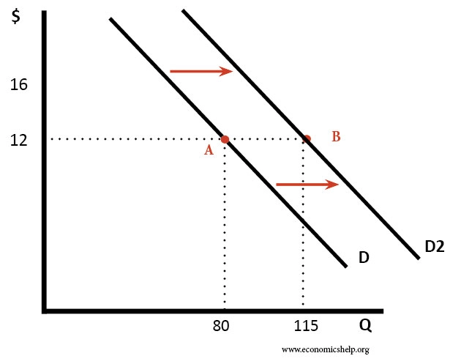
Supply/Demand
Shift in Demand

Slide 25
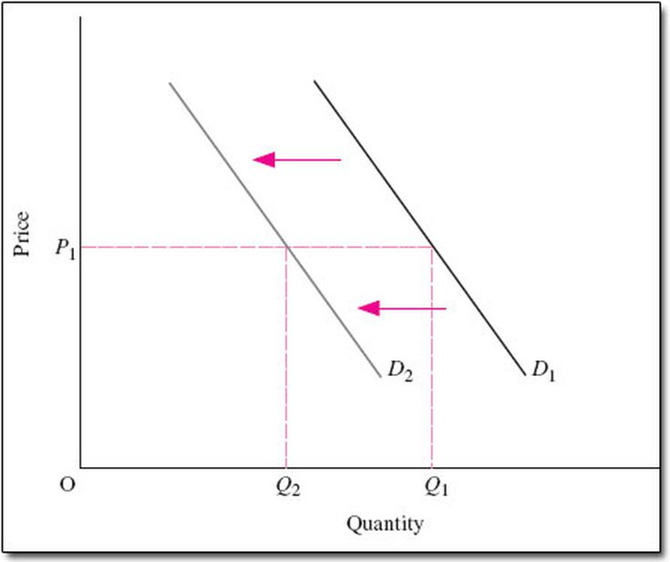
Supply/Demand

Slide 26
Supply/Demand
Factors that Cause a Shift in Demand (Increase or Decrease in Demand)
Consumer Preferences
Advertising/Marketing
Population Level
Income Level
  Normal Good: income increases, demand increases; income decreases, demand decreases
    Examples:
  Inferior Good: income increases, demand decreases; income decreases, demand increases
    Examples:

Slide 27





Supply/Demand
Normal or Inferior?
https://forms.gle/sKgLWXco6ZEtGAW18

Slide 28
Supply/Demand
Factors that Cause a Shift in Demand (Increase or Decrease in Demand) Cont’d
Prices of Related Goods:
  Complementary goods - goods that are bought and used together.
    Assume that pancakes and maple syrup are complementary goods. If the price of pancakes increases, the quantity demanded for pancakes decreases; therefore the demand for syrup (pancake’s complement) decreases.
  Substitute goods - goods that are used in place of one another.
    Assume that pizza and hamburgers are substitute goods. If the price of pizza increases the quantity demanded for pizza decreases; therefore the demand for hamburgers (pizza’s substitute) increases.

Slide 29
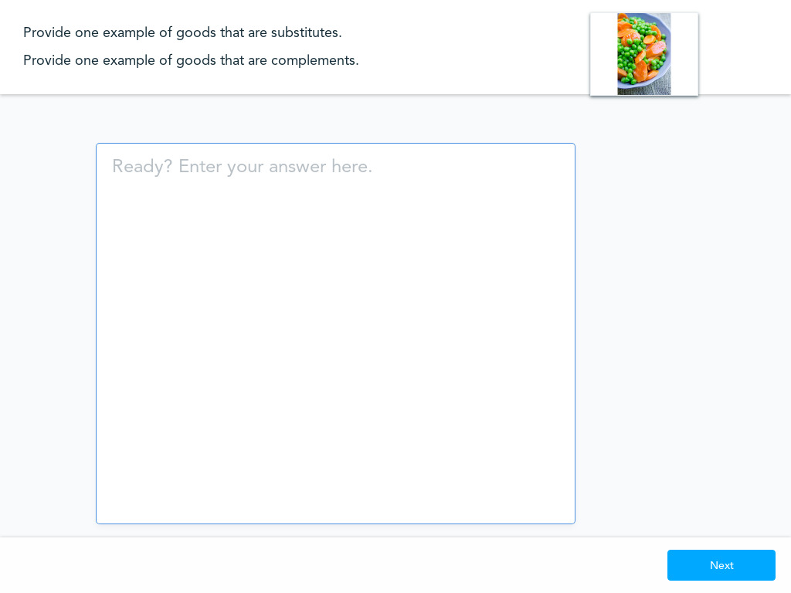

Slide 30
Supply/Demand
Law of Supply
CETERIS PARIBUS . . .
As prices rise, the quantity supplied increases; as prices fall, the quantity supplied decreases
WHY?
At higher prices, suppliers make a larger profit so they have an incentive to produce/supply more of the good or service.
At lower prices, suppliers make a smaller profit so there is a disincentive to produce/supply more of the good or service.

Slide 31
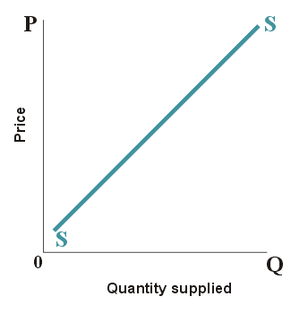

Slide 32
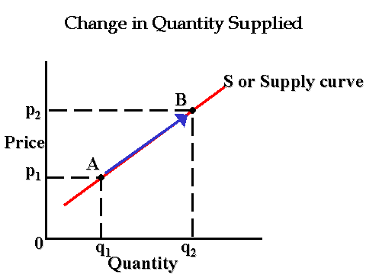

Slide 33
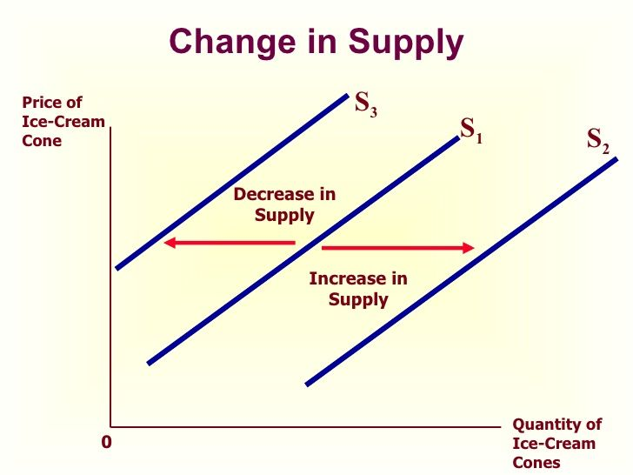

Slide 34
What factors cause a change in Supply (shift of the supply curve)?
Changes in the price of inputs/resources used in production
Changes in the number of competitors in the market
Changes in technology/productivity

Slide 35
DEMAND / SUPPLY FOR PIZZAS
PRICE | QUANTITY DEMANDED | QUANTITY SUPPLIED
$8 | 100 | 20
10 | 80 | 40
12 | 60 | 60
14 | 40 | 80
16 | 20 | 100

Slide 36
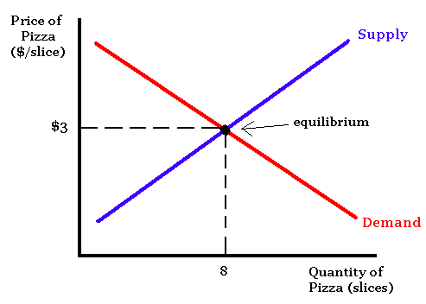

Slide 37
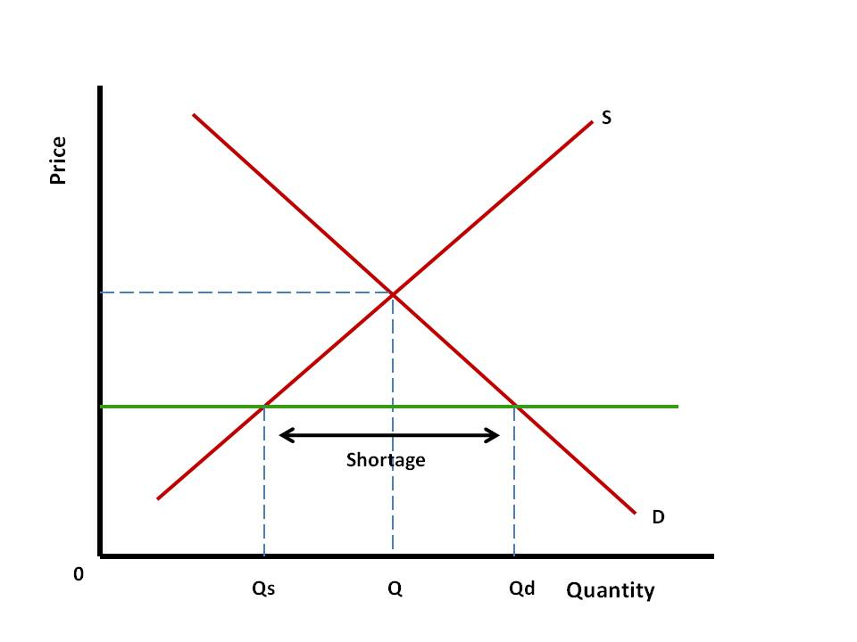

Slide 38
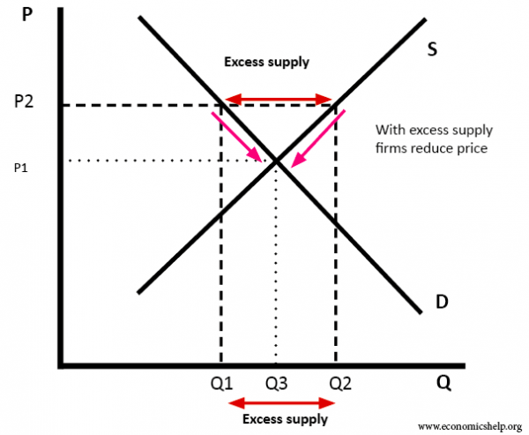

Slide 39
Graphing Example:
*The equilibrium price for Uggs is $150. Draw a correctly labeled graph showing this. Now assume that there is an increase in the price of materials used to produce Uggs. Draw a new curve (supply or demand) that reflects this change.

Slide 40
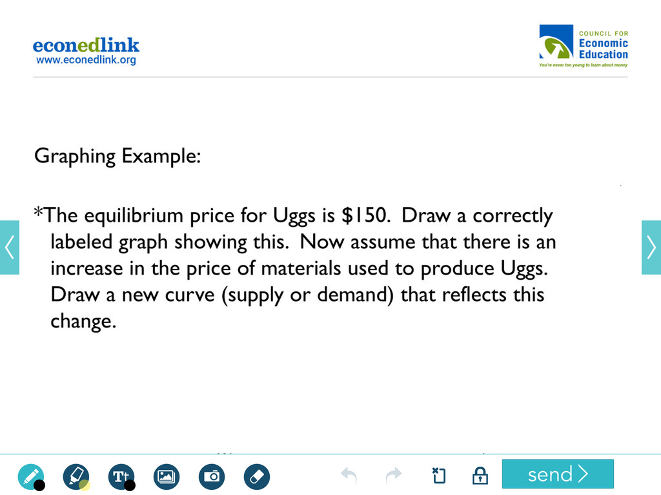
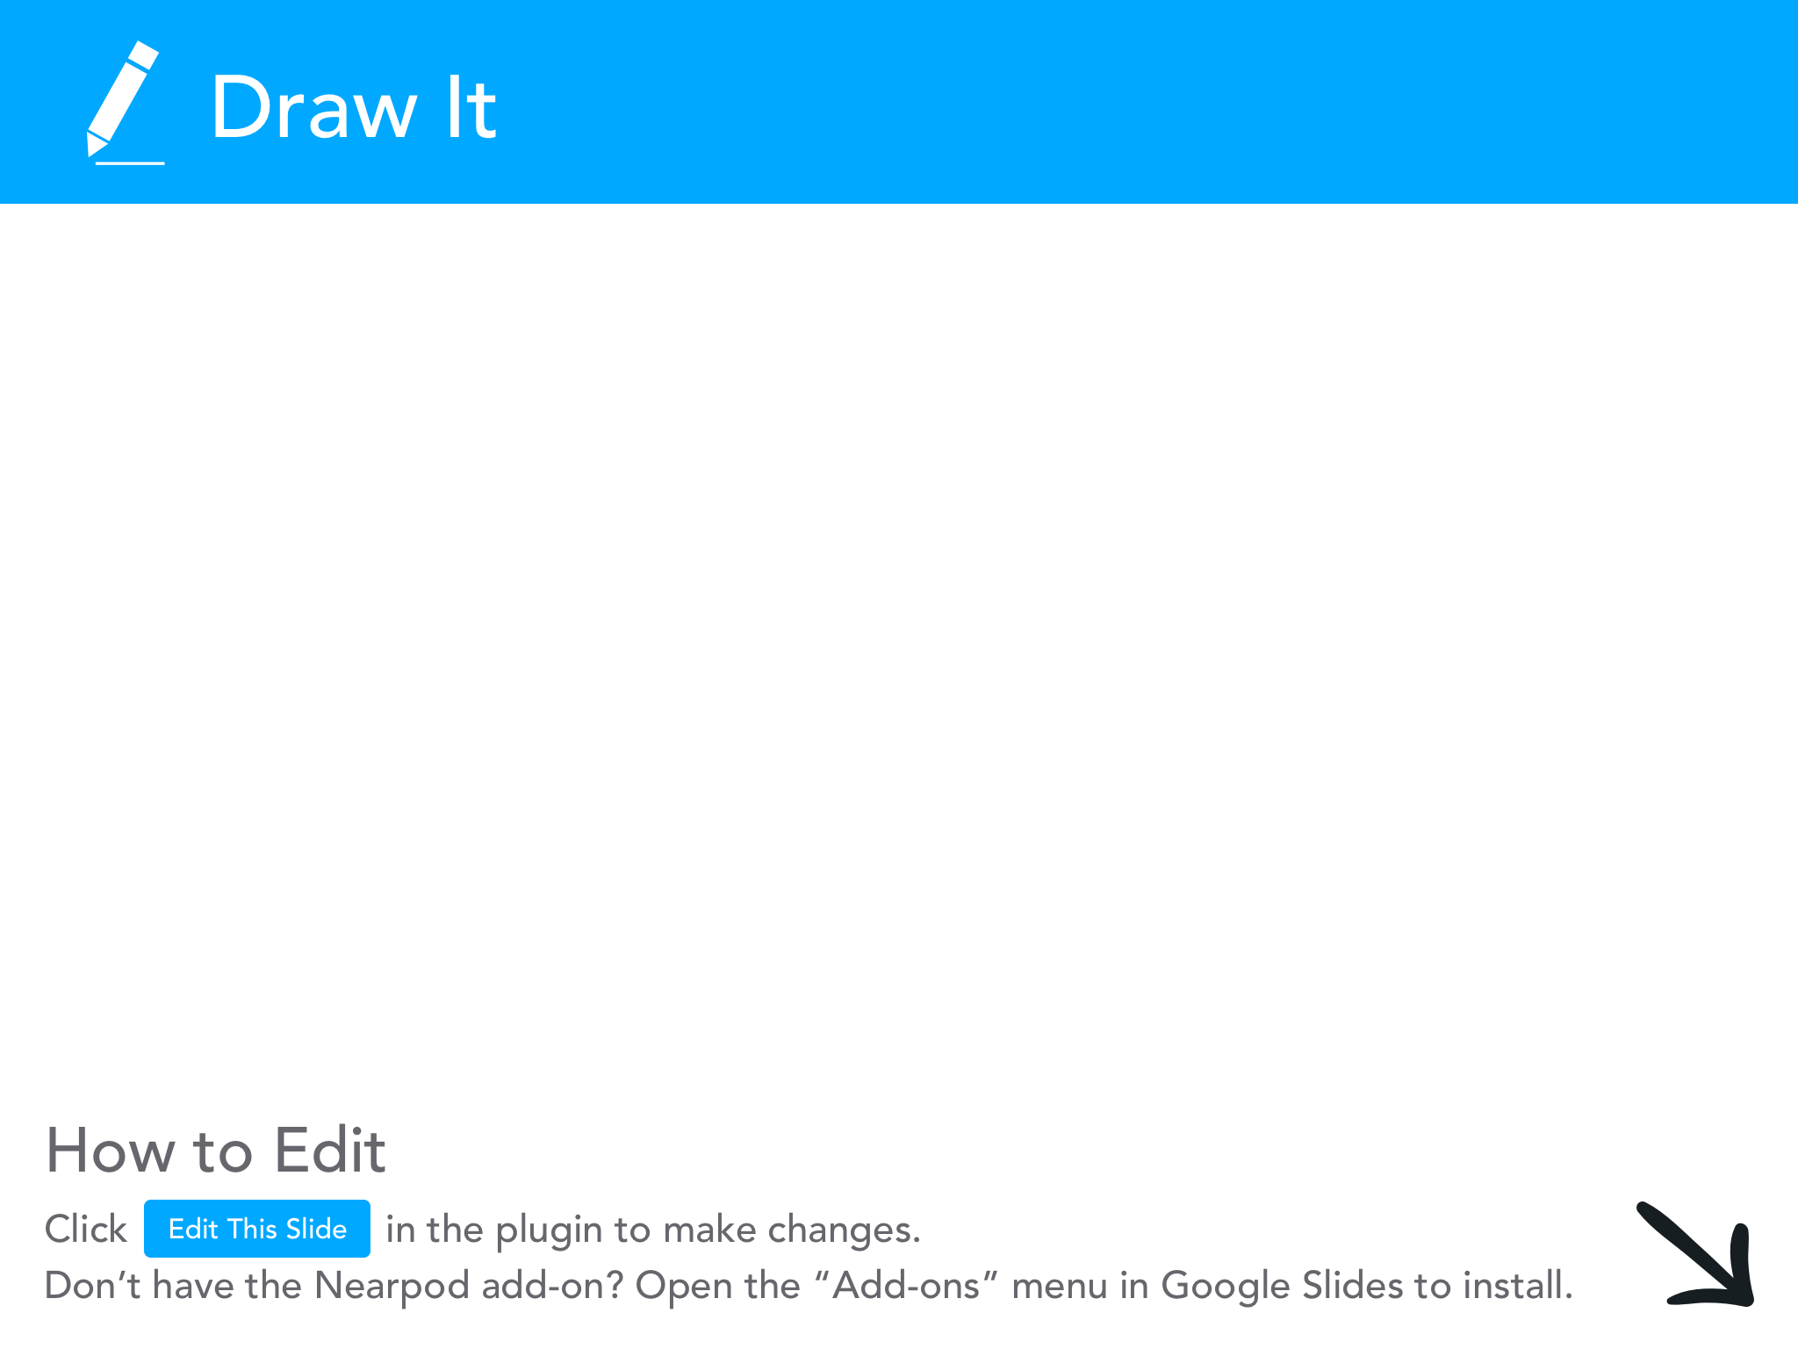

Slide 41
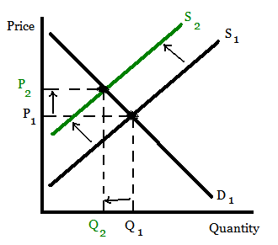

Slide 42
Graphing Example:
*The equilibrium price for Caribbean cruises is $2,000. There is a general increase in the national income level. Assuming that cruises are a normal good, show this change on a supply and demand graph.

Slide 43


Slide 44
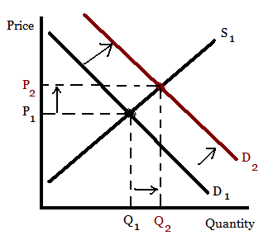

Slide 45
Graphing Examples:
*The equilibrium price for M&M’s is $1.50. Draw a correctly labeled graph to depict this. Now assume that skittles are a substitute of M&M’s. The price of skittles decreases. On a graph show how this might affect the supply or demand of M&M’s.

Slide 46
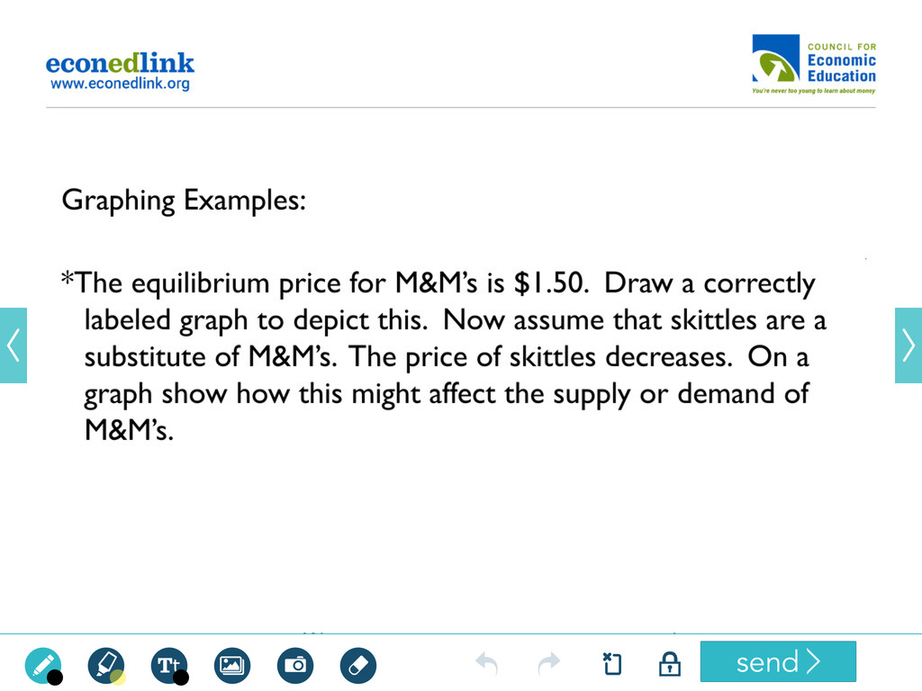

Slide 47
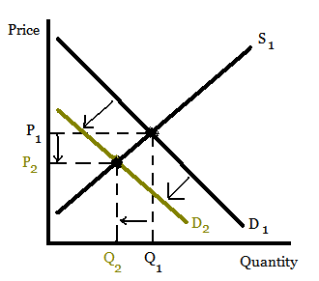

Slide 48
Sample Project:
Choose up to ten products.
Create a slide for each that includes the following:
Current market price
An analysis of the price - is it higher; lower; is the price influenced by high or low supply or demand.
Is it a normal or inferior good?
Include one substitute good and one complementary good
Is there a lot of competition and how might this influence supply?
Are there any increases in technology or productivity that might influence the future supply?
Where do you think the price of the product is heading?

Slide 49
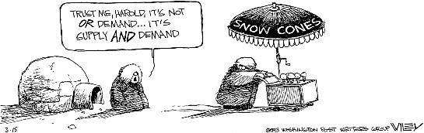

Slide 50
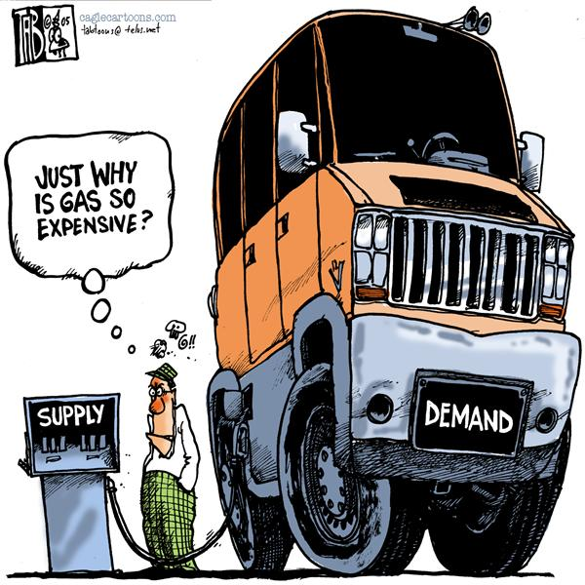

Slide 51
Why is supply/demand important in the “real world?”

Slide 52
Supply and Demand
Resources…
EconEdLink Lesson: Supply and Demand at the Gold Rush https://www.econedlink.org/resources/economic-spotter-supply-and-demand-at-the-gold-rush/
EconEdLink Lesson: Who Determines Wages?
https://www.econedlink.org/resources/who-decides-wage-rates/
EconEdLink Activity: Why Does Eli Manning Make $24 million a Year? https://www.econedlink.org/teacher-lesson/650/Why-does-Eli-Manning-Make-$24-million-per-year
EconEdLink Lesson: Where Does the Price of Pizza Come From?
https://www.econedlink.org/resources/where-does-the-price-of-pizza-come-from/

Slide 53
Formative Assessment Option:
Kahoot
Go to kahoot.it

Slide 54

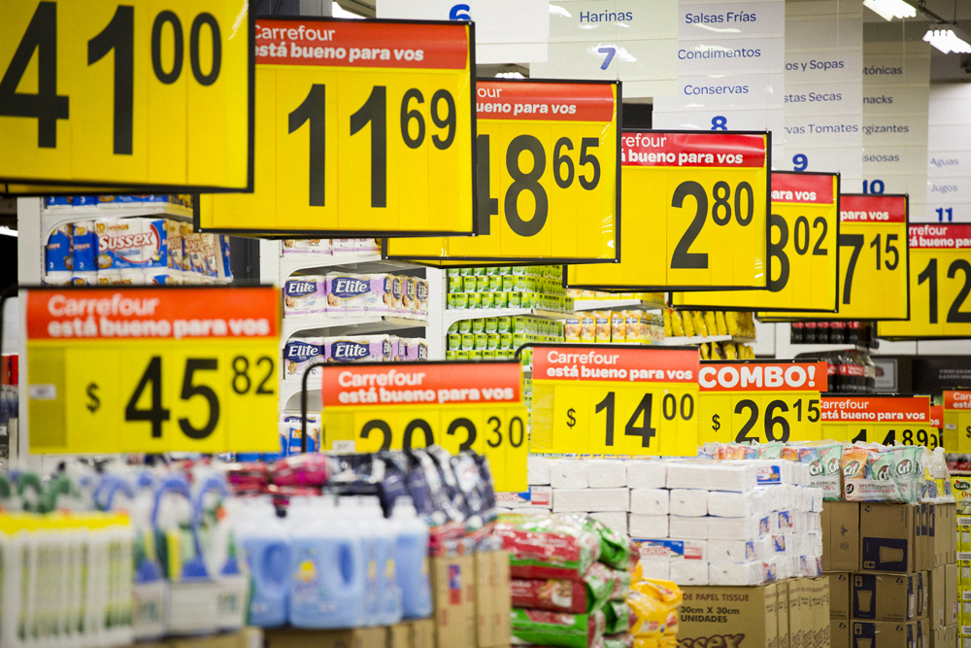


Elasticity

Slide 55
Elasticity
How responsive are consumers to changes in price?
To what extent will the quantity demanded change when the price of a good or service changes?

Slide 56

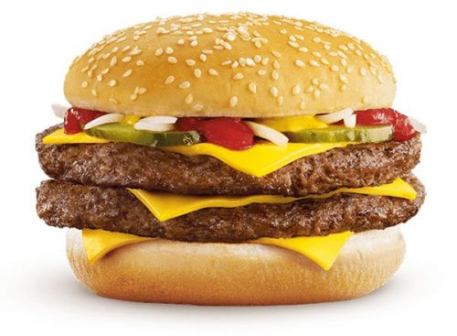




Elasticity

Slide 57
Elasticity
If the percentage change in quantity demanded is greater than the percentage change in price, demand is considered to be elastic.
If the percentage change in quantity demanded is less than the percentage change in price, demand is considered to be inelastic.
If the percentage change in quantity demanded is the same as the percentage change in price, demand is considered to be unit elastic.

Slide 58
Elasticity
Elastic: Consumers are highly responsive to price changes.
Inelastic: Consumers are relatively less responsive to price changes.
Examples of elastic goods?
Examples of inelastic goods?

Slide 59
Elasticity
What factors influence the elasticity of demand for specific goods and services?
How many close substitutes are there for a good/service?
How much of a typical consumer’s budget does the good or service take up?
How much time do consumers have to make a decision?

Slide 60


Slide 61
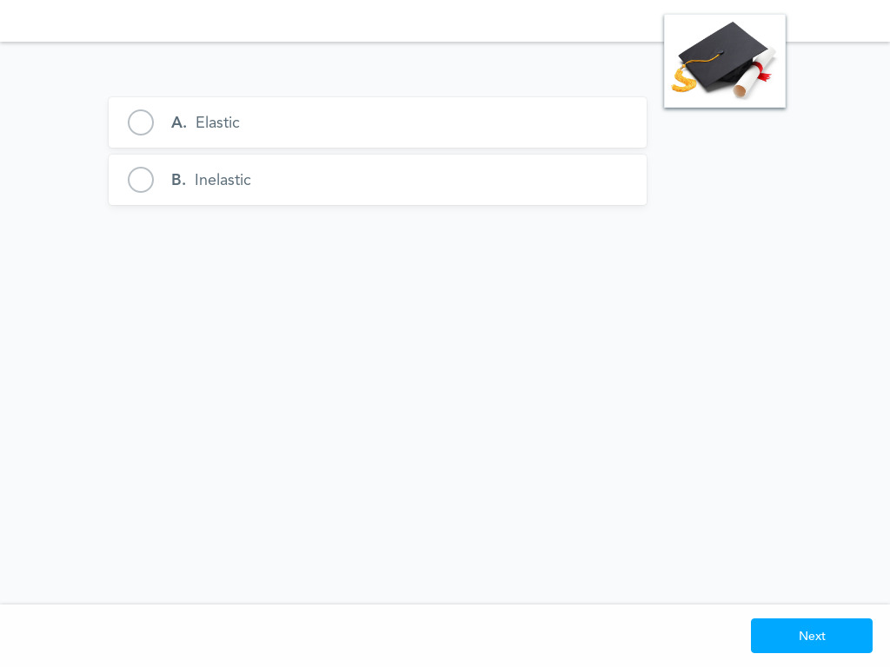

Slide 62


Slide 63
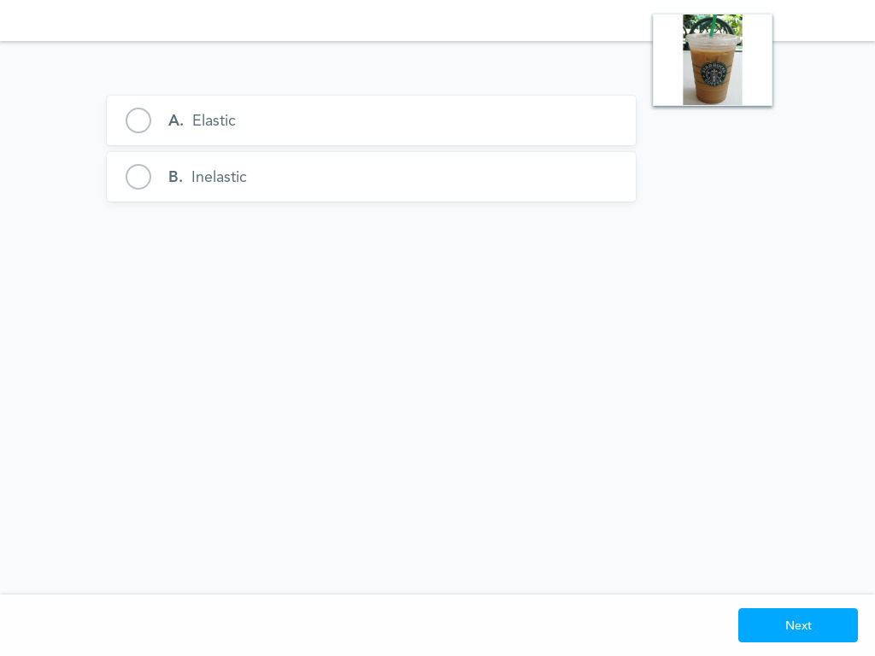

Slide 64
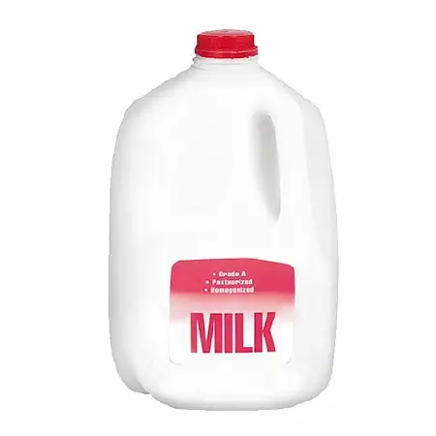

Slide 65


Slide 66


Slide 67


Slide 68
If the absolute value of the answer is greater than 1, demand is elastic
If the absolute value of the answer is less than 1, demand is inelastic
If the answer is equal to 1, demand is unit elastic
Calculating Elasticity:
Q2 - Q1
_______
Q1
____________
P2 - P1
______
P1
% change in quantity demanded / % change in price

Slide 69
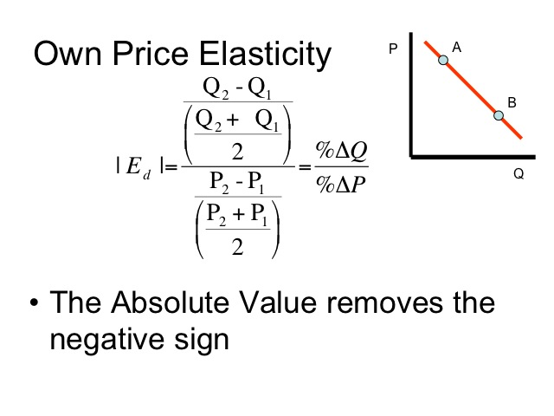

Slide 70
Example:
The price of a subway fare is $3. At this price, the quantity demanded is 100.
The price increases to $4, and the quantity demanded drops to 80.
Is demand for subway fares elastic or inelastic?

Slide 71
80 - 100 -20
_______ /2 = ___ /2 = -.056
80 + 100 180
__________ ____ ___ = [-.8] = 0.8
4 - 3 1
____ /2 = __ /2 = .07
4 + 3 7

Slide 72

Elasticity
Total Revenue Test
Total Revenue = Price x Quantity Sold
Demand is elastic if:
Price increases, total revenue decreases
Price decreases, total revenue increases
Demand is inelastic if:
Price increases, total revenue increases
Price decreases, total revenue decreases

Slide 73
Elasticity
Total Revenue Example:
The price of a subway fare is $3. At this price the quantity demanded is 100.
The price increases to $4 and the quantity demanded drops to 80.
Total Revenue 1 = $3 x 100 = $300
Total Revenue 2 = $4 x 80 = $320
Price increased and total revenue increased = _____________

Slide 74
Elasticity
Why is the concept of elasticity so important in the “real world”, especially for business firms?

Slide 75
Elasticity
Activities:
Students create a tutorial video on the issue of elasticity. In the video, they must teach the concept and interview at least two small business owners regarding their pricing decisions.
Students create an original skit centered on the concept of elasticity in which they portray consumers’ and producers’ reactions to pricing decisions.
Students choose a product and survey consumers regarding their reactions to various prices. The students then compile a table of data and corresponding graphs and conclude whether the product’s demand is elastic or inelastic.
Students create an original rap (can use a released song as a base) about the concept of elasticity.

Slide 76
EdTech Tool
b.socrative.com
Room: Opderbeck

Slide 77



Government Price Controls

Slide 78
Government Price Supports
In certain situations, the government intervenes in a market to establish minimum or maximum prices.
Price Floor - minimum price set by the government
Price Ceiling - maximum price set by the government

Slide 79
Government Price Controls
Price Floors - Minimum Wage
Minimum price that employers must pay employees.
http://playspent.org/

Slide 80
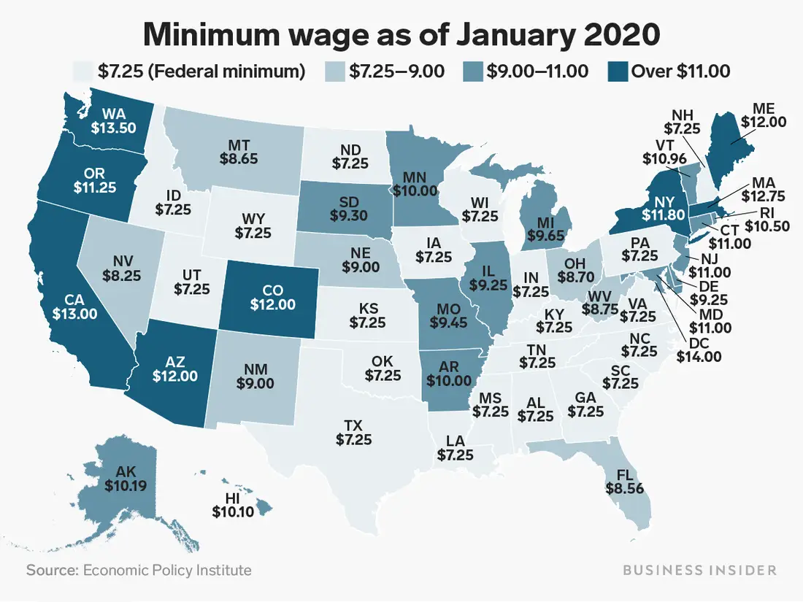

Slide 81
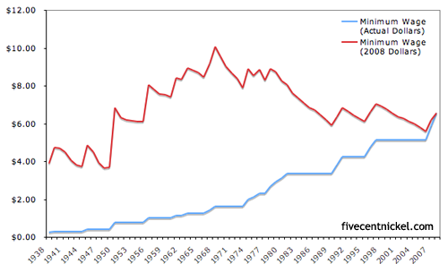

Slide 82
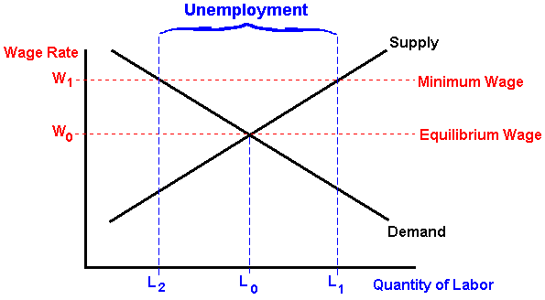

Slide 83
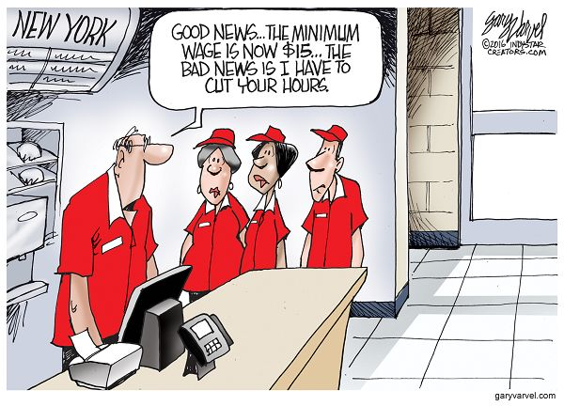
Is minimum wage fair?
Is minimum wage efficient?

Slide 84
Minimum Wage Survey
https://forms.gle/xciT3hGatt1naQcf7

Slide 85
Minimum Wage Simulation:
Round One:
A few students are solicited to be “managers” of a business that rearranges classroom furniture.
The rest of the class are workers seeking money to earn and spend for some incentive (a lollipop, extra points, etc)
Students are hired in a free market with no minimum wage. They rearrange the room furniture as to the managers directions.
An equilibrium wage rate is established and a graph is drawn on the board.
Round Two:
Same as round one, but the teacher now introduces and enforces a minimum wage. There should be a surplus of workers and some unemployment.

Slide 86
Background Information
Minimum Wage: Background, Arguments For/Against
https://drive.google.com/file/d/1Gll26pbBcmwfwfmLKBO0dKF_q33YqVDr/view?usp=sharing
Minimum Wage Webquest
https://docs.google.com/document/d/1_PjMfYPSSd2_GAEWz3J7dGSmuVEpRy8oLC8109oxagQ/edit?usp=sharing

Slide 87
Mock Congressional Hearing
Objective: Stage a mock Congressional hearing on whether the U.S. should enact a $15 minimum wage in the U.S. Students will be assigned or choose a role which they will fill during the hearing.
Procedure:
Teacher introduces the topic and provides some historical context.
Students are assigned roles. Here are some roles to use as examples.
Students research their roles and prepare for discussion. Here is a sample graphic organizer to help them prepare.
Stage a mock “Congressional Hearing” style meeting where students present in their roles and openly discuss the issue of agricultural price supports and their impact on the economy
Debrief with a formative assessment.

Slide 88
Price Floors - Agricultural Price Supports
-Minimum prices set by the government for farm produce
-Introduced in the 1930’s as farm prices dropped dramatically
Implementation:
*Isolate the domestic market through quotas and tariffs
*Introduce a price floor above equilibrium
*The government offers a subsidy to farmers in exchange for the surplus
*The government distributes surplus in foreign markets or offers as direct aid

Slide 89
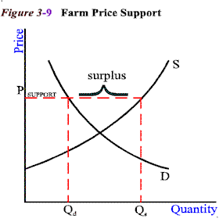

Slide 90
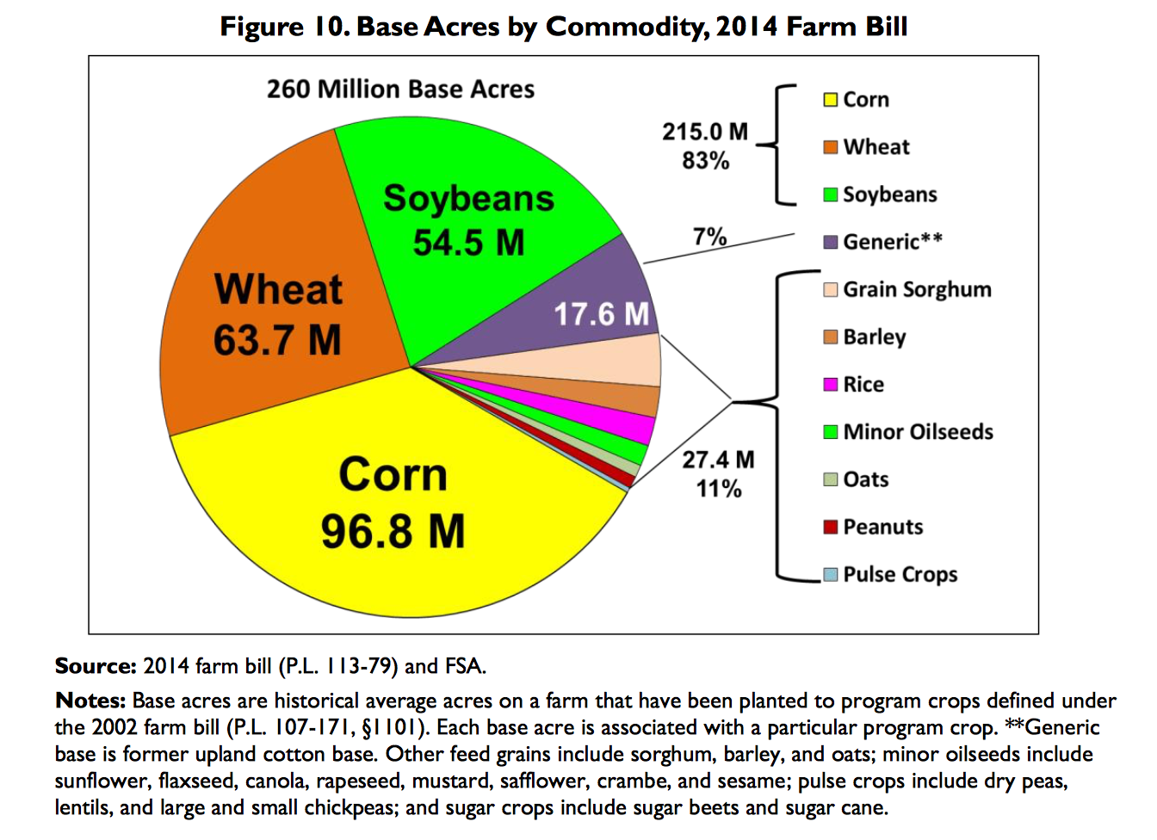

Slide 91
Consequences of Agricultural Price Controls:
-Artificially high agricultural commodity prices
-Arbitrary enforcement of which products are supported
-Subsidies go to corporate “farmers” who donate to politicians
-Over production of cheap processed food
-Environmental consequences
-Depressed prices in less developed foreign markets

Slide 92
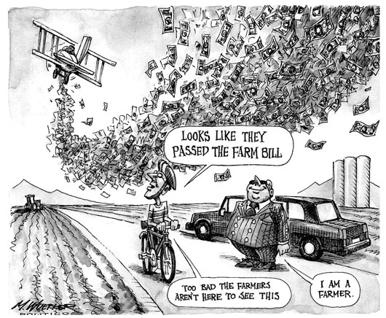

Slide 93
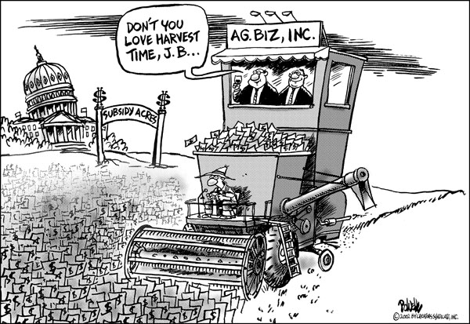

Slide 94
Agricultural Price Support Simulation:
Round 1: Three students represent “farmers” from the U.S. and two other nations. Rest of class is given fake money. The farmers sell a product (pretzels, M&M’s, etc.). An equilibrium price is established and a graph is drawn on the board.
Round 2: The teacher removes the two foreign farmers and explains that quotas and tariffs are introduced.
The teacher introduces a price support (price floor)
Students purchase the produce at the new higher price. There should be a surplus.
The teacher then buys the surplus and pays the U.S. farmer a subsidy.
The teacher sells the surplus in the foreign markets.

Slide 95
Mock Congressional Hearing
Objective: Stage a mock Congressional hearing on the economic impact of Farm Subsidies in the U.S. Students will be assigned or choose a role which they will fill during the hearing.
Procedure:
Teacher introduces the topic and provides some historical context.
Students are assigned roles. Here are some roles to use as examples.
Students research their roles and prepare for discussion. Here is a sample graphic organizer to help them prepare.
Stage a mock “town hall” style meeting where students present in their roles and openly discuss the issue of agricultural price supports and their impact on the economy
Debrief with a formative assessment.

Slide 96
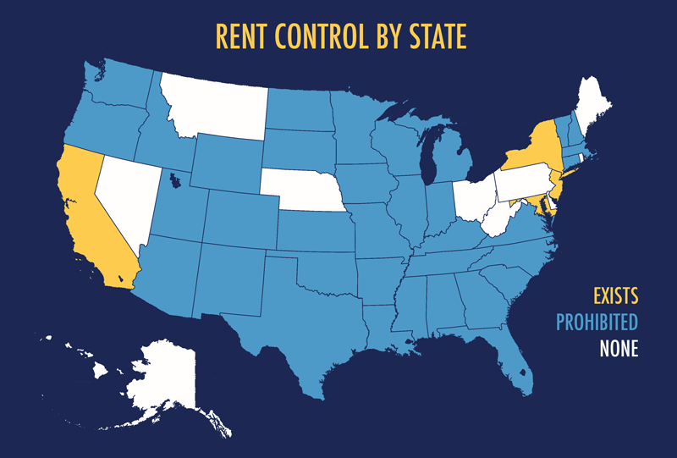
Price Ceilings - Rent Control
-Maximum prices allowed to be charged in housing rental markets.
-Designed to help the working class afford housing in urban locations.

Slide 97
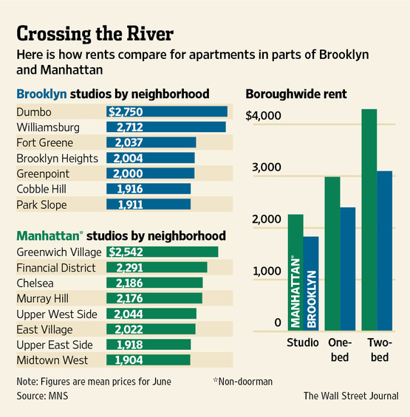

Slide 98
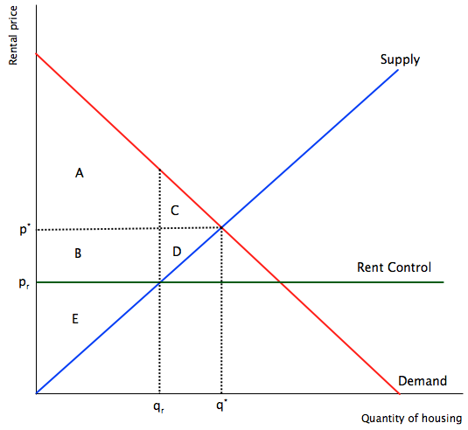
Rent Control

Slide 99
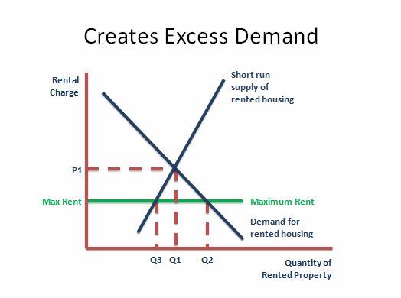

Slide 100


Consequences of Rent Control:
Positive:
Helps tenants afford rent
Prevents mass displacement
Allows tenants to invest in their communities
Negative:
Blocks voluntary exchange
Promotes black market activity (ex: “key fees”)
Could lead to poor housing quality
Lost resources - increased search activity

Slide 101


Slide 102
Rent Control Activity
Divide room into four corners/quarters. Each quarter is a model “apartment” owned by a selected “landlord.”
Each landlord delivers a sales pitch to the “tenants” (rest of class).
Teacher gives varying fake money amounts to tenants…
Round 1: Tenants rent apartments from landlords in a free market. Establish a city wide equilibrium price.
Round 2: Teacher establishes a rent control in one of the quarters. Tenants rent apartments again. There should be excess demand in the rent controlled area.

Slide 103
Government Price Controls
Price Controls Activity
Debate: Assign students a role. They research the role and formulate arguments supporting their position. The teacher sets up a “town meeting” in which students voice their opinions on the various types of rent control.
Examples of roles:
https://docs.google.com/document/d/1LzJx-dM_juGiy7udK5ziNczCfFqZQmseq3SqF281wuc/edit?usp=sharing

Slide 104
Resources
EconEdLink Rent Control Lesson: https://www.econedlink.org/teacher-lesson/47/Who-Knows-What-Inefficiencies-Lurk-Hearts-Rent-Controlled-Housing-Markets-Shadow-Market-Knows
EconEdLink Minimum Wage Lesson:
https://www.econedlink.org/resources/minimum-wage-the-challenge-of-living-on-it/
EconEdLink Agriculture Lesson:
https://www.econedlink.org/resources/the-economics-of-the-family-farm/

Slide 105
More EdTech Tools
Blooket.com
Quizlet Live

Slide 106




Externalities

Slide 107
Externalities
Externality: a consequence of an economic transaction/activity experienced by an unrelated third party.
Positive externality: a positive consequence that falls on a third party unrelated to the original economic transaction.
Negative externality: a negative consequence that falls on a third party unrelated to the original economic transaction.

Slide 108
Externalities
Examples:
A factory opens that dumps industrial waste into nearby waterways.
A consumer purchases fair trade coffee from a retailer.
An energy company fracks for natural gas. Several earthquakes result that cause property damage.
A college student gains a degree in social work.
A solar power farm opens in a desert.
A Wal-Mart opens in a small town.

Slide 109


Government Intervention
Negative Externalities:
Tax on production
Emission Charges
Marketable Permits
Positive Externalities:
Subsidies
Vouchers
Provide as a public good

Slide 110





Consumer Theory

Slide 111
Consumer Theory
Consumer theory studies how individuals make choices, given restraints, such as their income and the prices of goods and services.
The decisions that consumers make about what and how much to consume shape the evolution of the overall economy (60 - 70% of GDP).
It is assumed that consumers act in rational ways that can be observed and quantified.

Slide 112
Consumer Theory
Utility: The satisfaction one receives from consuming a good or service
Marginal utility: The satisfaction one receives from consuming one additional unit of a good or service.
Total utility: The total amount of satisfaction one receives from consuming a good or service in its entirety.
Law of Diminishing Marginal Utility: (ceteris paribus) As a person consumes more of a good or service, his/her marginal utility (satisfaction) will diminish with each unit consumed.
Examples?

Slide 113



Slide 114

Consumer Theory

Slide 115


Slide 116
Budget Constraints and Indifference Curves
Budget Line: Shows the combination of goods/services that can be purchased given a consumer’s budgetary constraints.
Ex: Sam’s income = $80. She wishes to purchases swimsuits and flip flops for the summer.
-Swimsuits cost $20
-Flip flops cost $10
If Sam purchases only swimsuits, she can buy 4. ($80 / $20 (swimsuit cost)
If Sam purchases only flip flops, she can buy 8. ($80 / $10 (flip flop cost)
There are several possible combinations of swimsuits and flip flops given her budget.
Ex: 2 swimsuits and 4 flip flops

Slide 117


Slide 118
Indifference Curve: Shows all the combinations of two goods/services that give the consumer equal amounts of utility (satisfaction). The consumer is indifferent to the various combinations because they give equal amounts of utility.
Any of the following combinations provide 50 utils to Sam:
Swimsuits | FlipFlops
6 | 1
3 | 3
2 | 4
1 | 7

Slide 119


Slide 120
Consumer’s Goal: To make decisions that attain the highest possible utility given the constraints of his/her budget.
The consumer will maximize his/her utility and be within his/her budget where the indifference curve is tangent to the budget line – “Consumer Equilibrium”

Slide 121


Slide 122
Consumer Theory
Have students keep a “Utility Log” where they measure their levels of satisfaction while consuming different types of goods or services. Students then construct individual utility graphs that demonstrate the Law of Diminishing Marginal Utility.
Students reflect on a decision they made between consuming two different goods or services. They calculate their budgetary constraint and construct a budget line. Students then add indifference curves and find the optimal point of consumption.

Slide 123


Slide 124
Assessment Questions
In what ways do supply and demand determine market prices?
Why is the concept of elasticity such an important determinant of setting prices for business firms?
Are price controls necessary in a free market economy? Do they do more harm than good?
How can the government respond in light of negative and positive externalities?
Is consumer behavior generally rational and predictable?

Slide 125
References
Khan Academy: https://www.khanacademy.org/economics-finance-domain/microeconomics
Mr. Clifford EconMovies: https://www.youtube.com/channel/UCCQEbqDL8i40d83Au55lYMQ
Investopedia: https://www.investopedia.com/terms/l/law-of-supply-demand.asp

Slide 126

CEE Affiliates
https://www.councilforeconed.org/resources/local-affiliates/

Slide 127




Thank You to Our Sponsors!

Slide 128





We’ve gone Virtual!
Teach Economics?
Your students may have what it takes to compete in the nation’s only high school economics competition!
Why Play?
• Fun team learning experience
• Great for college applications
• No other challenge like this
• Online participation makes access easy
• Chance for cash prizes
How it Works
Teams register
Teachers enroll team(s) of 3- 4 high school students from the same school. Multiple teams allowed.
Teams compete within their state
Compete to win your state competition for a
chance to advance to the National Semi-Finals.
National Semi-Finals: May 3-20, 2021
Teams answer multiple-choice questions on macroeconomics, microeconomics, and international & current events.
National Finals: May 22-24, 2021
Teams analyze an economic issue and present their solution. Top teams engage in the Finals Quiz Bowl where they face-off answering questions to claim the National Title.
Two divisions based on experience level
David Ricardo for first-time competitors who have taken no more than one economics course.
Adam Smith for returning competitors, AP, International Baccalaureate, and honors students.
Register Today at NationalEconomicsChallenge.org

Slide 129





FIND YOUR LOCAL COMPETITION
AND REGISTER TODAY!
The National Personal Finance Challenge is a competition that provides high school students with an exciting and motivating opportunity to build, apply, and demonstrate their knowledge of money management.
Through online exams and a personal finance simulation, teams showcase their expertise in earning income, buying goods and services, saving, using credit, investing, as well as protecting and insuring.
Teams of up to four students, with one teacher/coach, can qualify to represent their state at the National Personal Finance Challenge by winning their local competition.
NATIONALS
Semi-Finals: First round elimination via online multiple-choice questions.
Finals: Case study round virtually co-hosted by the Cleveland Fed on June 3.
personalfinancechallenge.org

