Slide 1
Black Wall St. and the Threat of Black Financial Stability
William Anderson 2/25/2021 Love1stedcon@gmail.com

Slide 2
EconEdLink Membership
You can now access CEE’s professional development webinars directly on EconEdLink.org! To receive these new professional development benefits, become an EconEdLink member. As a member, you will now be able to:
Automatically receive a professional development certificate via e-mail within 24 hours after viewing any webinar for a minimum of 45 minutes
Register for upcoming webinars with a simple one-click process
Easily download presentations, lesson plan materials and activities for each webinar
Search and view all webinars at your convenience
Save webinars to your EconEdLink dashboard for easy access to the event
You may access our new Professional Development page here

Slide 3
Professional Development Certificate
To earn your professional development certificate for this webinar, you must:
Watch a minimum of 45-minutes and you will automatically receive a professional development certificate via e-mail within 24 hours.
Accessing resources:
You can now easily download presentations, lesson plan materials, and activities for each webinar from EconEdLink.org/professional-development/

Slide 4
Norms
•It’s all LOVE.
•Things may get uncomfortable…That’s okay.
•Just consider it.
•Chances are we will not solve all the problems here today.
•DO NOT let the work stop here.

Slide 5
Objectives
Describe the historical significance of ”Black Wall St.” in Tulsa, Oklahoma in the early 1900s
Discuss the pushback against the success of Tulsa’s Black section at the time
Analyze our country’s current circumstances in an effort to understand if the financial stability of minority groups is still a threat to power, and if so, how and why?

Slide 6
National Standards
CCSS.ELA-LITERACY.RH.11-12.3
Evaluate various explanations for actions or events and determine which explanation best accords with textual evidence, acknowledging where the text leaves matters uncertain.
CCSS.ELA-LITERACY.RH.11-12.7
Integrate and evaluate multiple sources of information presented in diverse formats and media (e.g., visually, quantitatively, as well as in words) in order to address a question or solve a problem.
CCSS.ELA-LITERACY.RH.11-12.9
Integrate information from diverse sources, both primary and secondary, into a coherent understanding of an idea or event, noting discrepancies among sources.

Slide 7
The Devastation of Black Wall Street: Tulsa, Oklahoma. 1921. A wave of racial violence destroys an affluent African-American community, seen as a threat to White-dominated American capitalism. By: Kimberly Fain

Slide 8
History of Tulsa, Oklahoma
https://www.tulsahistory.org/exhibit/1921-tulsa-race-massacre/photos/

Slide 9
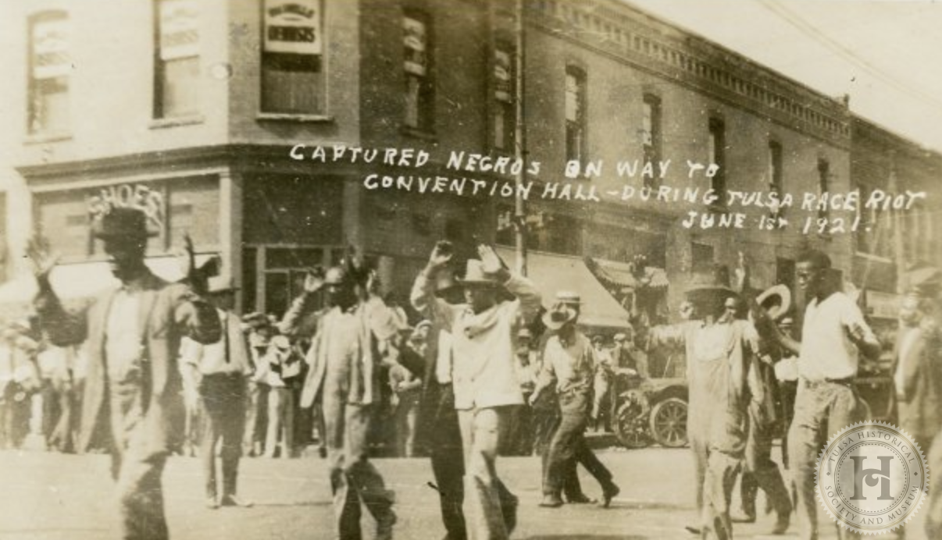
Let’s Think About It...
On May 31 of that year, the Tulsa Tribune reported that a Black man, Dick Rowland, attempted to rape a White woman, Sarah Page. Whites in the area refused to wait for the investigative process to play out, sparking two days of unprecedented racial violence.
What specific event led up to the Tulsa race riots? How has this trope impacted the experience of Black people historically?

Slide 10
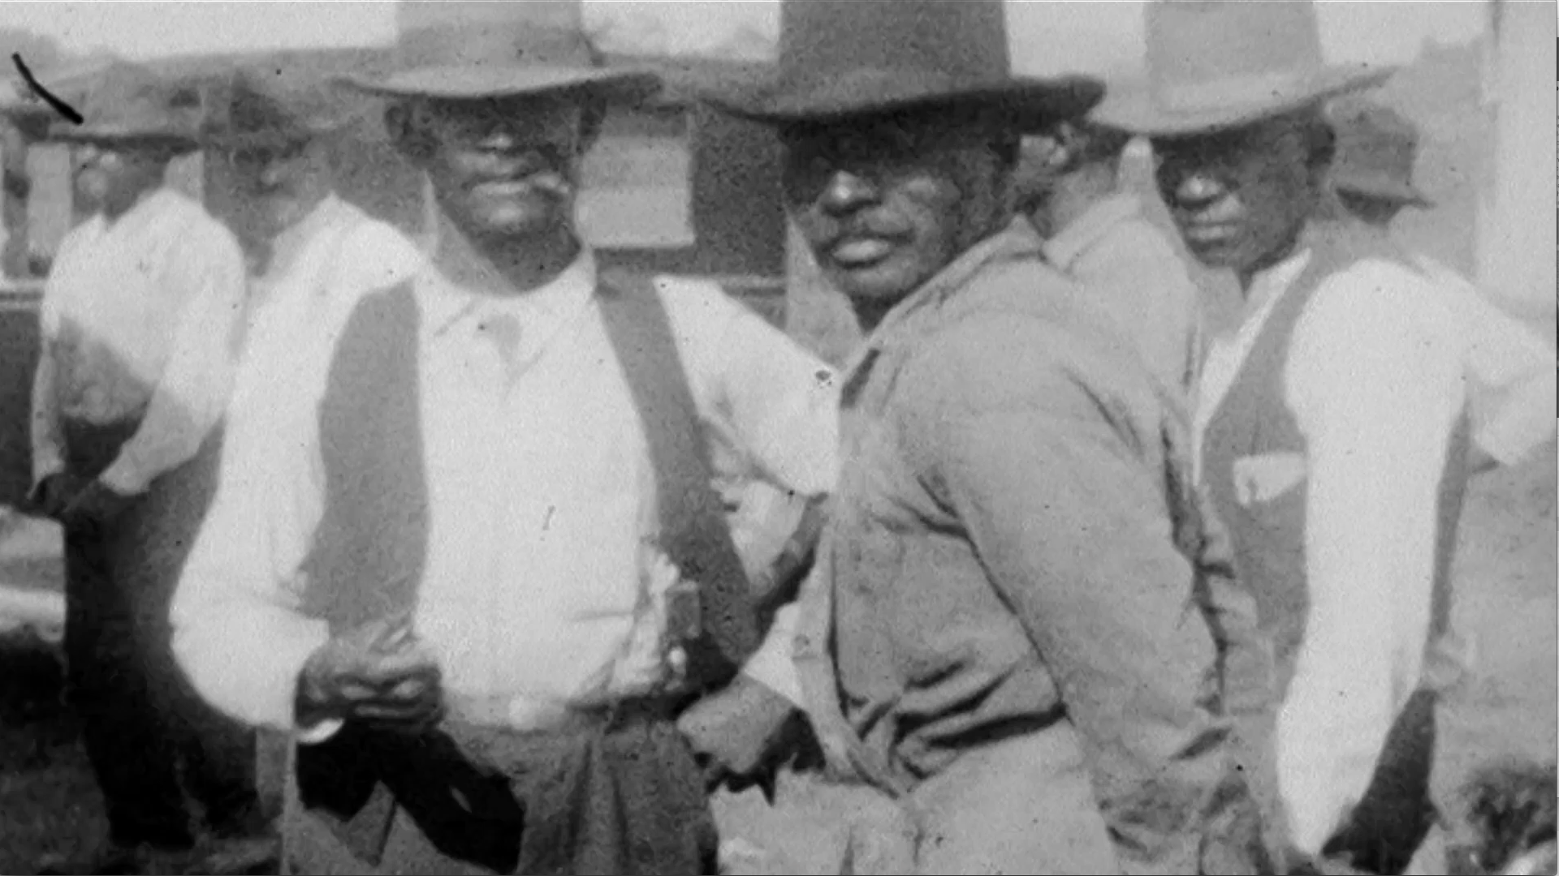
Let’s Think About It...
“In 1906, O.W. Gurley, a wealthy African-American from Arkansas, moved to Tulsa and purchased over 40 acres of land that he made sure was only sold to other African-Americans,” writes Christina Montford in the Atlanta Black Star. Gurley provided an opportunity for those migrating “from the harsh oppression of Mississippi.” The average income of Black families in the area exceeded “what minimum wage is today.” As a result of segregation, a “dollar circulated 36 to 100 times” and remained in Greenwood “almost a year before leaving.”
What factors contributed to the rise of Black Wall St. (Greenwood)? How is financial stability different now than it was in this time? Are marginalized groups better or worse off financially now than they were in the past? Why or why not?

Slide 11
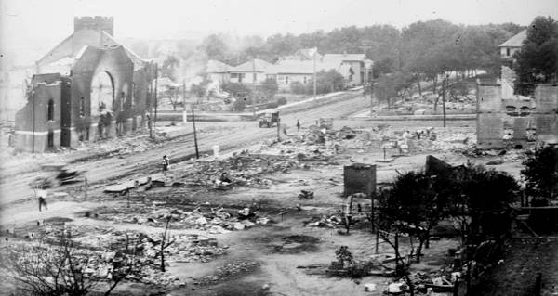
Let’s Think About It...
The massacre of Black Wall Street primarily occurred due to Whites’ “generalized perception that African-Americans were ‘out of line’” and needed to be put “back in their place….The destruction of this successful African-American community was no accident. Messer asserts that “[t]he destruction of the community was rationalized as a necessary and natural response to put them back in their place.” Evidently, private industry and the state stood to benefit economically from the destruction.
How did the government support the undercutting of Greenwood’s Black families following the race riot?

Slide 12
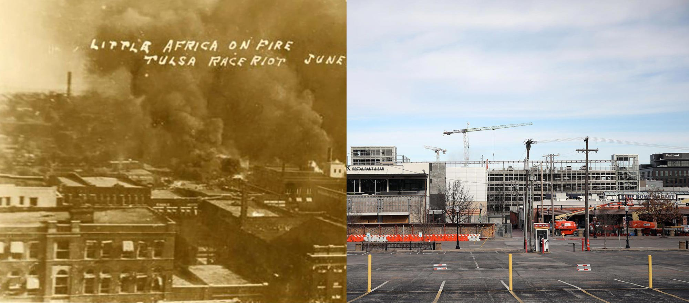
Let’s Think About It...
How do we see similar actions taken being taken against Black financial upliftment today?

Slide 13
Assessment Questions
What specific event led up to the Tulsa race riots? How has this trope impacted the experience of Black people historically?
What factors contributed to the rise of Black Wall St. (Greenwood)? How is financial stability different now than it was in this time?
What were the financial realities of the Tulsa White population that lead them to resent the Greenwood community?
How did the government support the undercutting of Greenwood's Black families following the race riot?
How do we see similar actions taken being taken against Black financial upliftment today?

Slide 14
Thank you
Twitter: @Mizter_A
Email: william_anderson@dpsk12.org

Slide 15
Thank You to Our Sponsors!

Slide 16
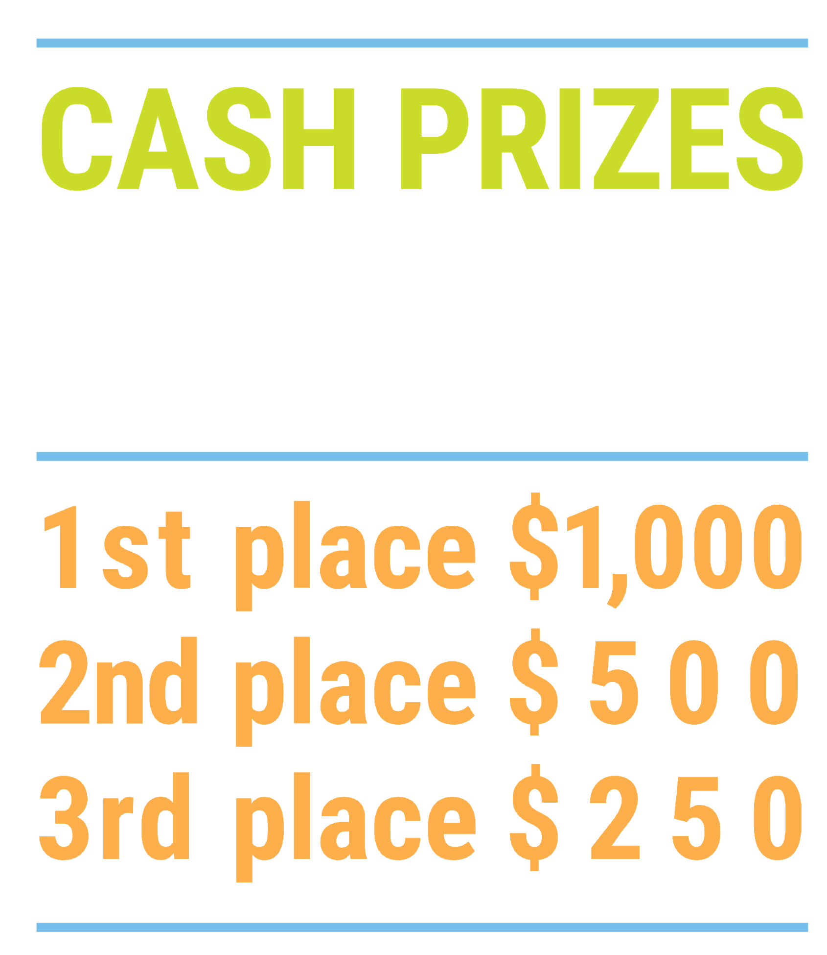
We’ve gone Virtual!
Teach Economics?
Your students may have what it takes to compete in the nation’s only high school economics competition!
Why Play?
• Fun team learning experience
• Great for college applications
• No other challenge like this
• Online participation makes access easy
• Chance for cash prizes
How it Works
Teams register
Teachers enroll team(s) of 3- 4 high school students from the same school. Multiple teams allowed.
Teams compete within their state
Compete to win your state competition for a chance to advance to the National Semi-Finals.
National Semi-Finals: May 3-20, 2021
Teams answer multiple-choice questions on macroeconomics, microeconomics, and international & current events.
National Finals: May 22-24, 2021
Teams analyze an economic issue and present their solution. Top teams engage in the Finals Quiz Bowl where they face-off answering questions to claim the National Title.
Two divisions based on experience level
David Ricardo for first-time competitors who have taken no more than one economics course.
Adam Smith for returning competitors, AP, International Baccalaureate, and honors students.
Register Today at NationalEconomicsChallenge.org

Slide 17
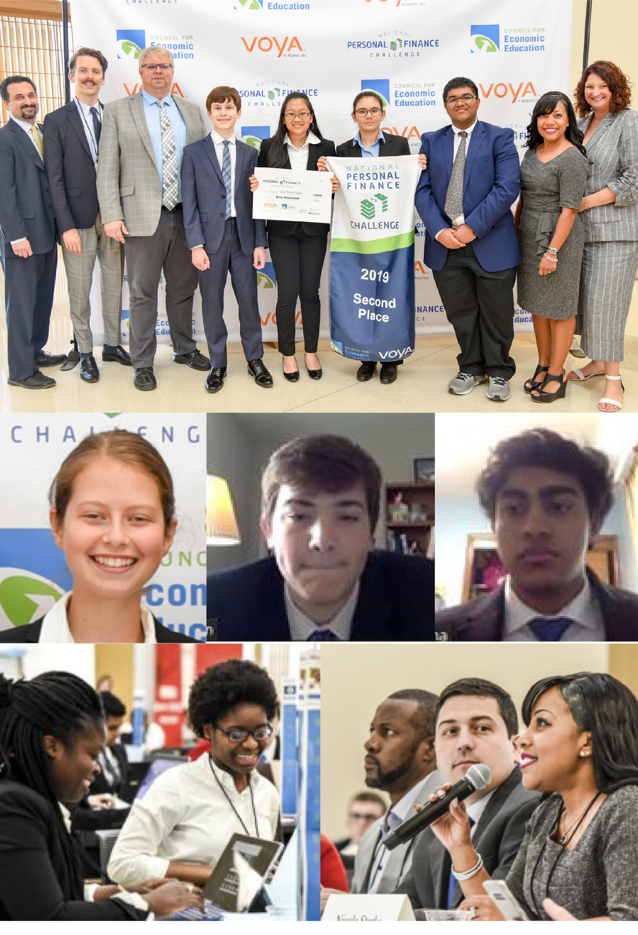
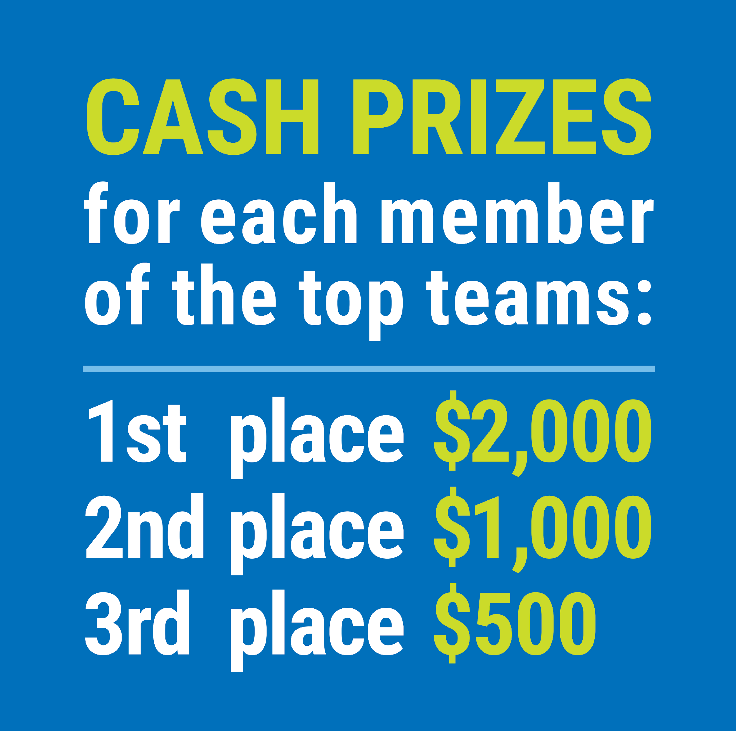
FIND YOUR LOCAL COMPETITION AND REGISTER TODAY!
The National Personal Finance Challenge is a competition that provides high school students with an exciting and motivating opportunity to build, apply, and demonstrate their knowledge of money management.
Through online exams and a personal finance simulation, teams showcase their expertise in earning income, buying goods and services, saving, using credit, investing, as well as protecting and insuring.
Teams of up to four students, with one teacher/coach, can qualify to represent their state at the National Personal Finance Challenge by winning their local competition.
NATIONALS
Semi-Finals: First round elimination via online multiple-choice questions.
Finals: Case study round virtually co-hosted by the Cleveland Fed on June 3.
personalfinancechallenge.org

Slide 18
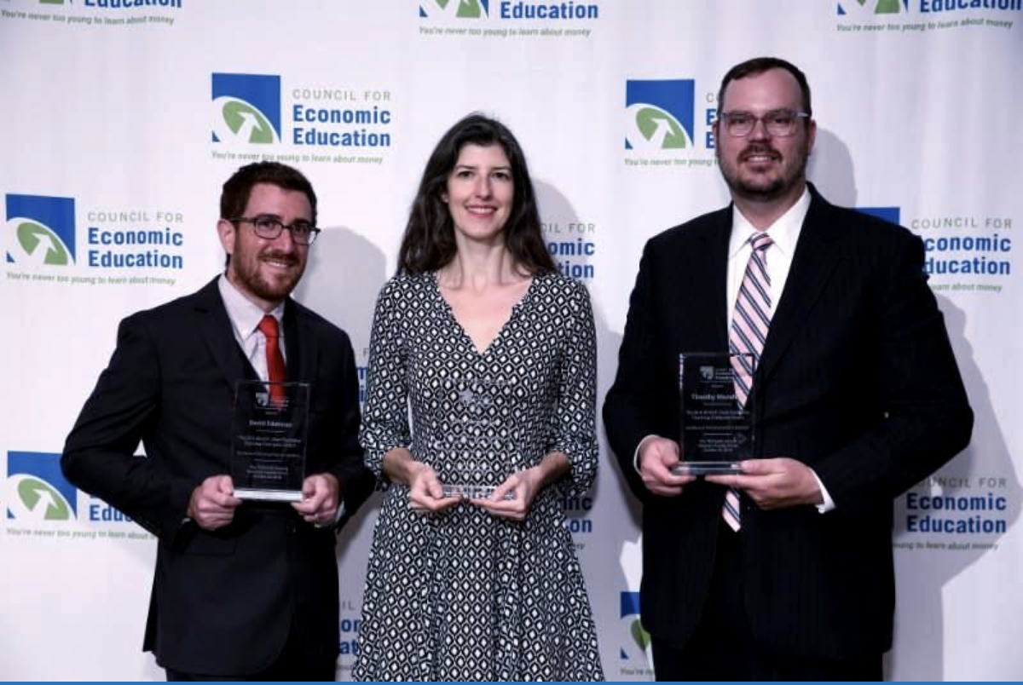
The 2021 Sloan Teaching Champion Award
Winners receive:
A cash award of $5,000
A cash award of $2,500 for their school to support economic education
Recognition at our annual Visionary Awards convening.
This award promotes economic education by honoring three outstanding teachers who incorporate exemplary teaching techniques that improve their students’ economic understanding in and out of the classroom.
This award is open to New York metropolitan area high school teachers of all subjects, not just teachers of economics. Applicants must demonstrate how they integrate economics into their teaching.
Sound like you or someone you know?
Applicants must teach in one of the
Twelve New York state counties (New York, Kings, Bronx, Richmond, Queens, Nassau, Suffolk, Westchester, Putnam, Rockland, Orange and Dutchess)
Eight New Jersey counties (Bergen, Passaic, Essex, Hudson, Middlesex, Union, Morris, Monmouth), or the
Two Connecticut counties (Fairfield and New Haven)
Application will be launched on Friday February 19th 2021
You can access the application here.
CONTACT
Please feel free to e-mail us at rrivera@councilforeconed.org
with any questions you have.

