Slide 1

Wells Fargo Personal Finance for Educators, Pt.4:
Maximizing Your Classroom Expenses and Resources
Tuesday, December 15th 2020
Ruben A. Rivera, PhD
Director of Professional Development
Mia Russell, PhD
Content Strategy & Integration, Wells Fargo

Slide 2
EconEdLink Membership
You can now access CEE’s professional development webinars directly on EconEdLink.org! To receive these new professional development benefits, become an EconEdLink member. As a member, you will now be able to:
Automatically receive a professional development certificate via e-mail within 24 hours after viewing any webinar for a minimum of 45 minutes
Register for upcoming webinars with a simple one-click process
Easily download presentations, lesson plan materials, and activities for each webinar
Search and view all webinars at your convenience
Save webinars to your EconEdLink dashboard for easy access to the event
You may access our new Professional Development page here

Slide 3
Professional Development Certificate
To earn your professional development certificate for this webinar, you must:
Watch a minimum of 45-minutes and you will automatically receive a professional development certificate via e-mail within 24 hours.
Accessing resources:
You can now easily download presentations, lesson plan materials, and activities for each webinar from EconEdLink.org/professional-development/

Slide 4
Objectives
Learn about various online resources to maximize your budget and classroom budgets.
Understand how your educator expenses can lead to tax credits.
Develop strategies to generate financial resources to increase your classroom budget.
Evaluate Wells Fargo’s online personal finance assessment through the Hands On Banking Program.

Slide 5
Online Resources to Maximize your Personal and Classroom Budgets
Free resources and materials through Wells Fargo:
Youth page - Educator Resources
https://youth.handsonbanking.org/educators/
Educator Assessments -
https://handsonbanking.org/assessment/
Notes:
Take Two - minutes: To complete the Survey
https://handsonbanking.org/assessment/ Share with the audience.

Slide 6

Take the Survey
Notes:
https://handsonbanking.org/assessment/

Slide 7
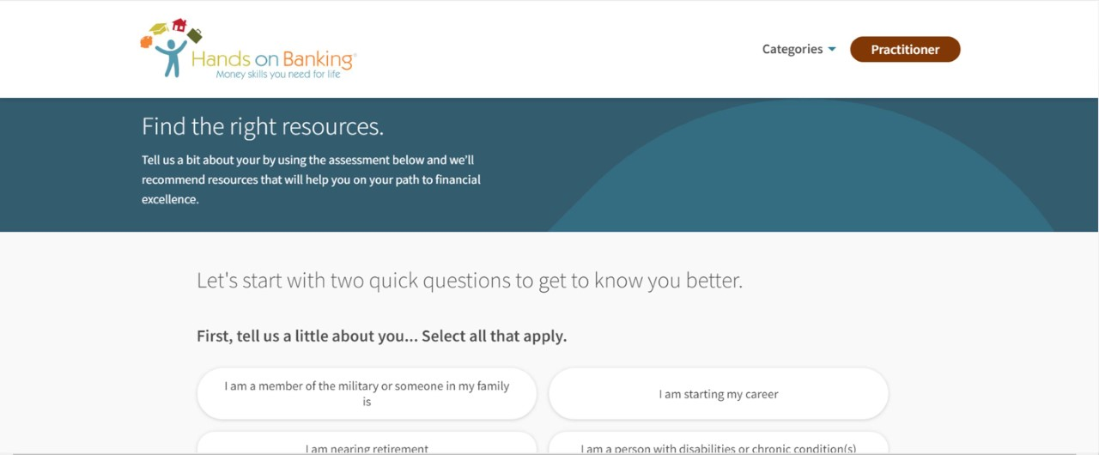
Notes:
https://handsonbanking.org/assessment/

Slide 8
Online Resources to Maximize your Personal and Classroom Budgets
Classroom Spending During the 2019/2020 School Year
Teachers spent an average of $745 on school supplies during the 2019/2020 school year.
Most teachers spend their own money on distance learning materials. On average, teachers spent $252 during the 2020 spring year.
45% of teachers said their spending has increased since distance learning began.
Student Engagement with Distance Learning
Teachers estimate that 43% of students were disengaged (missing class activities or assignments 50% or more of the time) during distance learning this spring.
70% of teachers said they have dropped off or mailed items to their students’ homes for distance learning to keep them engaged.
55% of teachers said students who were disengaged during distance learning didn’t have a stable home environment, housing, or food.
53% of teachers said students who were disengaged during distance learning didn’t have access to the internet at home.
Source: 2020 Teacher Spending Survey AdoptAClassroom.org
Notes:
Devon Karbowski, Marketing Manager AdoptAClassroom.org
Received over 3900 surveys
AdoptAClassroom.org received 3,938 unique, completed surveys from PreK-12 teachers at public, private, and charter schools nationwide. The survey found that during the 2019/2020 school year teachers are spending more than ever before.

Slide 9
Online Resources to Maximize your Personal and Classroom Budget
Additional expenses as a result of Distance Learning:
Technology/Hardware (New computer or laptop, printer, tablet, etc.)
New Software (EdTech memberships, Office Suite)
Pens, supplies, and additional materials
Postage and mailing
Increased home bills such as electricity, internet, etc.
Workstation supplies and materials
Cost of remote learning varies by city, state, and Zip code

Slide 10
Online Resources to Maximize your Personal and Classroom Budget
Online Resource Strategy #1
Explore Google Extensions when Shopping for your personal items or classroom supplies.
Example:
Honey Coupons and Savings
Popcart
Coupon Cabin
CamelCamelCamel

Slide 11




Honey Coupons and Savings

Slide 12





Popcart

Slide 13




Coupon Cabin

Slide 14
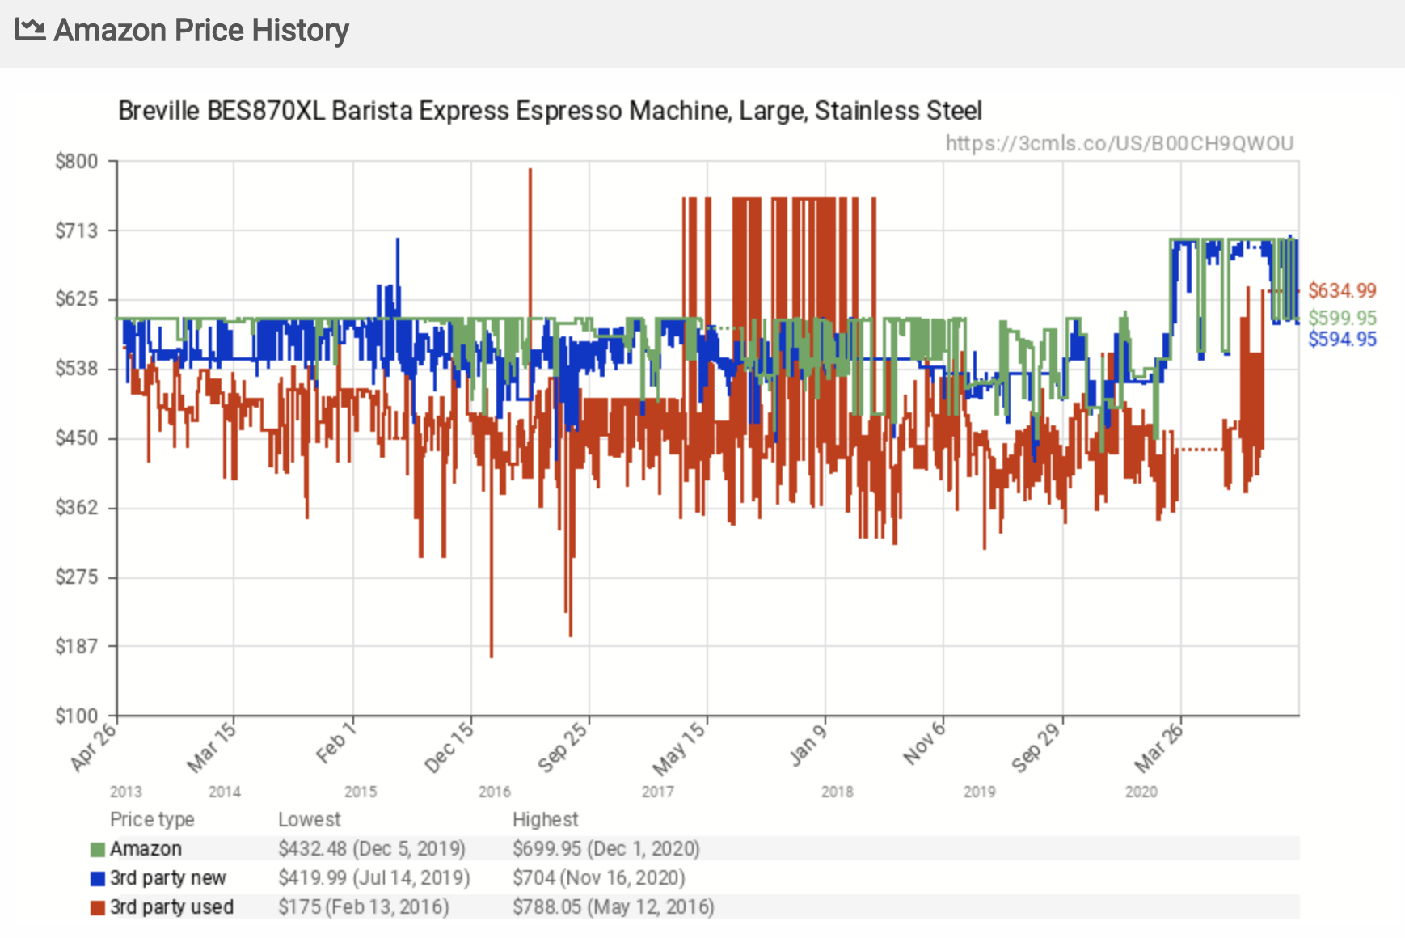
CamelCamelCamel

Slide 15
Online Resources to Maximize your Personal and Classroom Budgets
Online Resource Strategy #2
Fundraising is now easier than ever!
Example:
DonorsChoose.org
GoFundMe.org
Create your own budget for expenses or “Wish List”

Slide 16


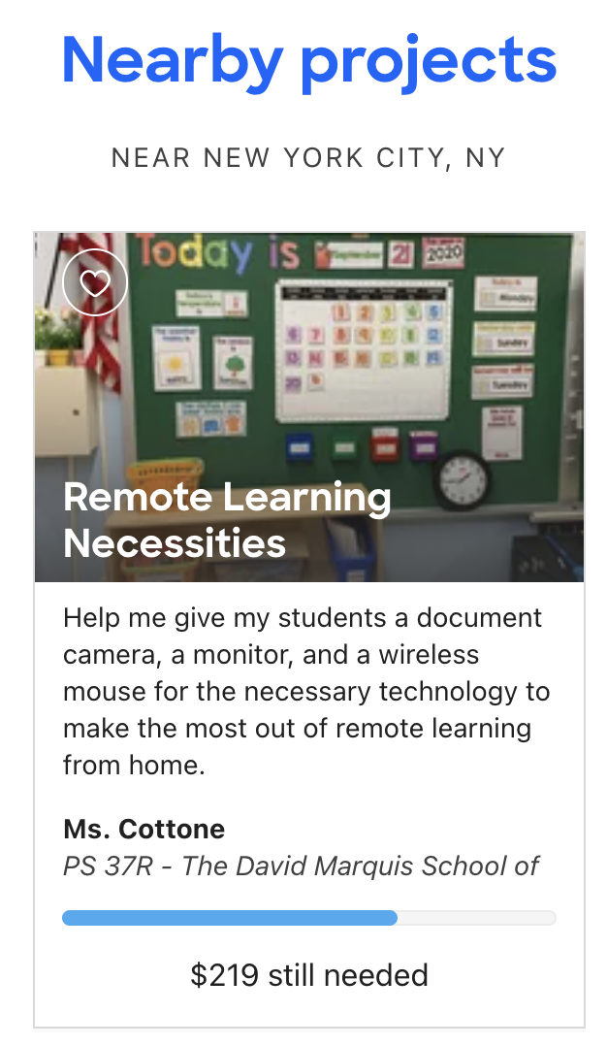

DonorsChoose.org

Slide 17


GoFundMe.org

Slide 18
Create your own proposal and submit it to your administrator
Include the following:
A quick summary of your intended project.
A list of resources needed to fulfill the project.
A sample lesson plan attached to your project.
A timeline for the academic school year.
How many students will this project serve? Is it sustainable?
A budget.
See Sample Budget Proposals

Slide 19
Online Resources to Maximize your Personal and Classroom Budgets
Online Resource Strategy #3
You have made purchases for education purposes. Put some of those expenses towards your taxes!
Tax Credits and Benefits for Educators
Example:
Education Credits
American Opportunity Credit and Lifetime Learning Credit
Education Deductions
Student Loan Interest
Work-Related Educational Expenses
Teacher Educational Expenses

Slide 20
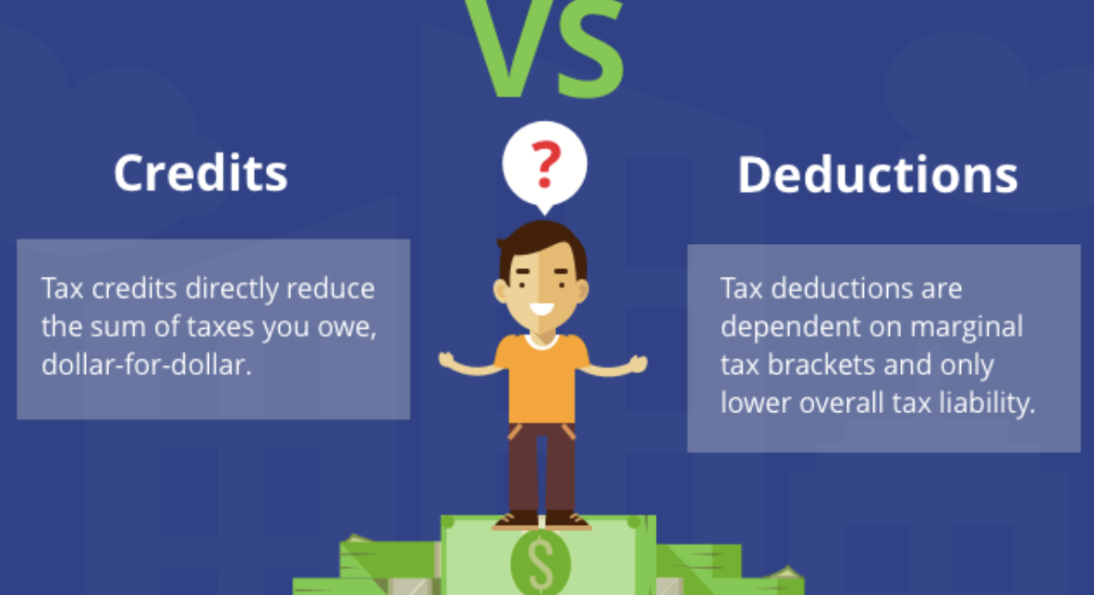

Slide 21
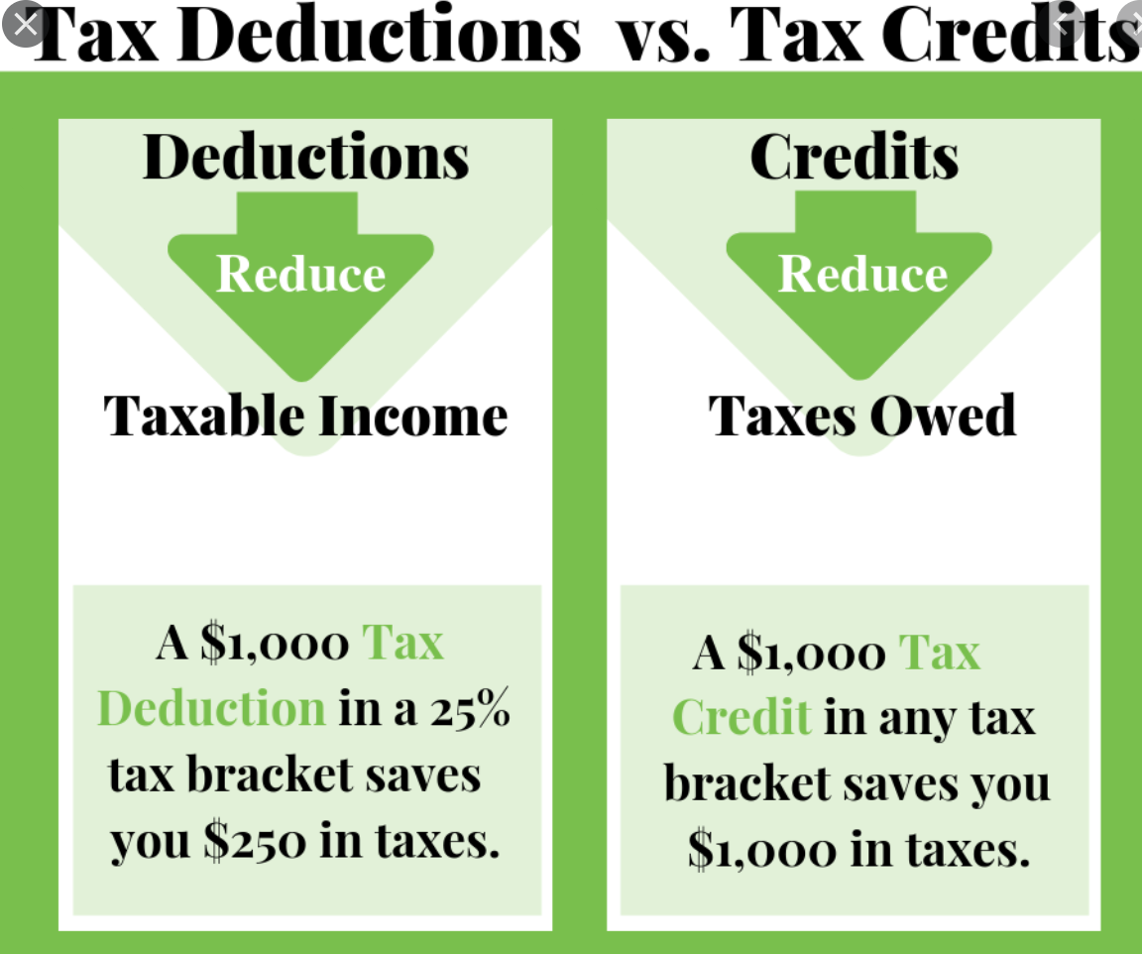

Slide 22
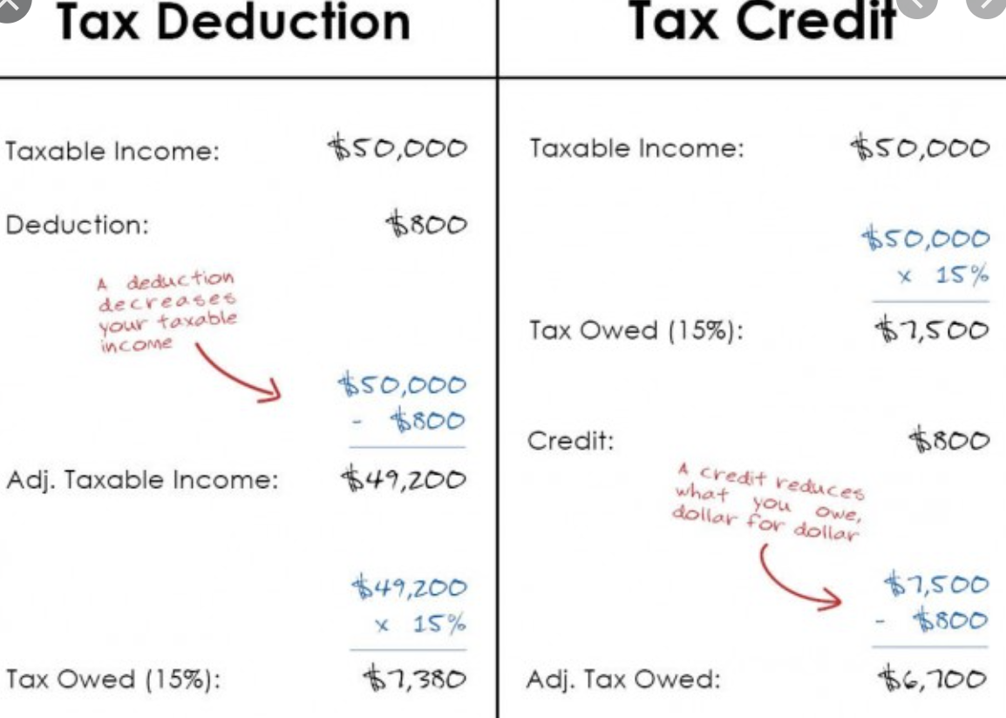

Slide 23
Online Resources to Maximize your Personal and Classroom Budgets
Education Deductions
Teacher Educational Expenses
An eligible educator can deduct up to $250 of any unreimbursed business expenses for classroom materials, such as books, supplies, computers including related software and services or other equipment that the eligible educator uses in the classroom. Supplies for courses on health and physical education qualify only if they are related to athletics.
-IRS.GOV

Slide 24
Online Resources to Maximize your Personal and Classroom Budgets
Additional Tax Tips
1098-E - Student Loans and Interest
The student loan interest deduction is a federal income tax deduction that allows you to subtract up to $2,500 of the interest you paid on qualified student loans from your taxable income. It is one of several tax breaks available to students and their parents to help pay for higher education
Check here

Slide 25
Online Resources to Maximize your Personal and Classroom Budgets
Additional Tax Tips
1098-T - Tuition Statement
A form 1098-T, Tuition Statement, is used to help figure education credits (and potentially, the tuition and fees deduction) for qualified tuition and related expenses paid during the tax year. ... The tuition and fees deduction can reduce the amount of your income subject to tax by up to $4,000.
NO LONGER AVAILABLE

Slide 26
Online Resources to Maximize your Personal and Classroom Budgets
Additional Tax Tips
The Lifetime Learning Credit offers up to $2,000 for qualified education expenses paid for all eligible students per return. The amount of the credit is figured by calculating 20% of the first $10,000 of qualified education expenses – up to that maximum of $2,000 per taxpayer.
You can claim the $2,500 American Opportunity Credit for each qualifying student on your federal income tax return. Unlike the American Opportunity Credit, the Lifetime Learning Credit is not refundable which means that if your credit exceeds your tax, you won’t receive a refund of the difference.

Slide 27
Online Resources to Maximize your Personal and Classroom Budgets
Online Resource Strategy #4
Combine your Teacher and Student expenses
Teacher expenses = $250
Student expenses = $3500
Teacher/student materials (new laptop, or hardware) = $1000
= $4750 in tax deductions and credits

Slide 28
Catch our previous webinars on building your personal finance
Part 1: Budgeting and Debt Management
https://www.econedlink.org/resources/personal-finance-for-educators-pt-1/
Part 2: Asset Building for Wealth
https://www.econedlink.org/resources/personal-finance-for-educators-pt-2/
Part 3: Protecting Your Assets
https://www.econedlink.org/resources/personal-finance-for-educators-pt-3/
Notes:
Take Two - minutes: To complete the Survey
https://handsonbanking.org/assessment/ Share with the audience.

Slide 29

Ruben A Rivera
rrivera@councilforeconed.org
The Council for Economic Education

Slide 30

CEE Affiliates
https://www.councilforeconed.org/resources/local-affiliates/

Slide 31




Thank You to Our Sponsors!

