Slide 1
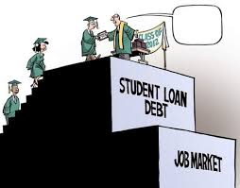
Financial Fitness for Life, Chapter 16:
Paying for Postsecondary Education
Doug Young
CEO - Financial Coach
doug.n.young@gmail.com
March 18, 2021

Slide 2
EconEdLink Membership
You can now access CEE’s professional development webinars directly on EconEdLink.org! To receive these new professional development benefits, become an EconEdLink member. As a member, you will now be able to:
Automatically receive a professional development certificate via e-mail within 24 hours after viewing any webinar for a minimum of 45 minutes
Register for upcoming webinars with a simple one-click process
Easily download presentations, lesson plan materials and activities for each webinar
Search and view all webinars at your convenience
Save webinars to your EconEdLink dashboard for easy access to the event
You may access our new Professional Development page here

Slide 3
Professional Development Certificate
To earn your professional development certificate for this webinar, you must:
Watch a minimum of 45-minutes and you will automatically receive a professional development certificate via e-mail within 24 hours.
Accessing resources:
You can now easily download presentations, lesson plan materials, and activities for each webinar from EconEdLink.org/professional-development/

Slide 4

https://www.econedlink.org/resources/collection/fffl-9-12/

Slide 5
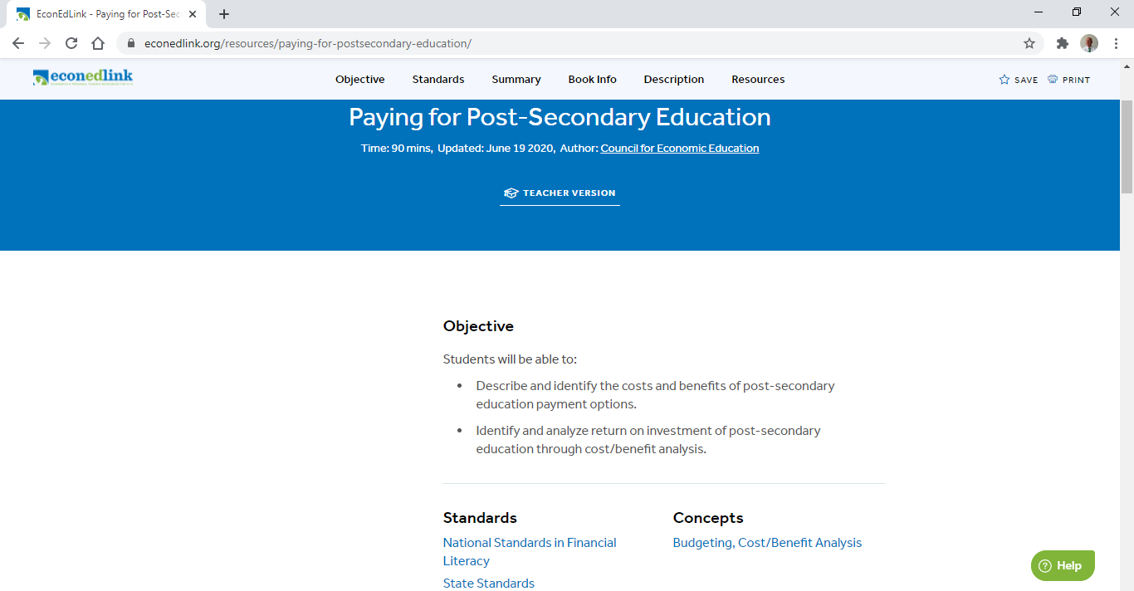
Chapter 16: Paying for Secondary Education
https://www.econedlink.org/resources/paying-for-postsecondary-education/

Slide 6
National Standards
Standard 4 Using Credit, Grade 8,Benchmark 8
People can use credit to finance investments in education and housing. The benefits of using credit in this way are spread out over a period of time and may be large. The large costs of acquiring the education or housing are spread out over time as well. The benefits of using credit to make daily purchases of food or clothing are short-lived
and do not accumulate over time.
Standard 1 Earning Income Grade 12, Benchmarks 3
People vary in their willingness to obtain more education or training because these decisions involve incurring immediate costs to obtain possible future benefits. Discounting the future benefits of education and training may lead some people to pass up potentially high rates of
return that more education and training may offer.
Standard 1 Earning Income Grade 12, Benchmark 4
People can make more informed education, job, or career decisions by evaluating the benefits and costs of different choices.

Slide 7
Florida State Standards
Standard: SS.912.E.2.2 -
Understand the fundamental concepts relevant to the institutions, structure, and functions of a national economy.
Standard: SS.912.E.2.6 -
Understand the fundamental concepts relevant to the institutions, structure, and functions of a national economy.

Slide 8
Objectives
The student will:
Describe and identify the costs and benefits of post-secondary education payment options.
Identify and analyze return on investment of post-secondary education through cost/benefit analysis.
Utilize an abundance of websites which are available to navigate ways to help fund their investment in college.
Provide resources to help students make smart decisions in their choice of college, limiting incurred costs (debt) and opportunities available for the future after college.

Slide 9
Agenda
National and State Standards
Lesson Objectives
Vocabulary
Costs and Benefits of Payment Options for College Costs - Ex. 16.1 & Quizlet
Return on Investment Scenarios – Exercise 16.2
Is it Worth It? – Ex. 16.3
Activities and Assessments
References

Slide 10
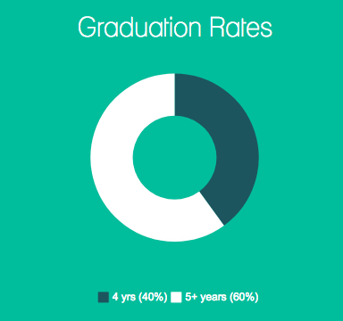
Student Debt and the Class of 2019
More than six in ten (62%) college seniors who graduated from public and private nonprofit colleges in 2019 had student loan debt
(https://ticas.org/our-work/student-debt/)

Slide 11
Vocabulary
Human Capital - An asset or quality that can be classified as the economic value of a worker's experience and skills. This includes assets like education, training, intelligence, skills, health, etc.
Cost/Benefit Analysis - A process businesses use to analyze decisions. One sums the benefits of a situation or action and then subtracts the costs associated with taking that action.
Loan - A loan is money you borrow and must pay back with interest. Understand who is making the loan and the terms and conditions of the loan (i.e. Stafford, Perkins, Parent Plus, Private).
Scholarship - Financial support awarded to a student, based on academic achievement or other criteria that may include financial need for schooling. There are various types of scholarships – the three most common are merit-based, athletic and need-based.
Grant - A need-based financial aid given to college students to help pay for their expenses. This money that does not have to be paid back.
Return on Investment - ROI tries to directly measure the amount of return on a your education, relative to the investment’s cost. (Higher earnings, promotion opportunities, more career options, etc.)

Slide 12
COA Comparison
College | Florida State University | Miami University | Palm Beach State
Tuition/Fees | $6,517 | $53,682 | $3,030
Room/Board | $11,088 | $15,470 (On-Campus) | $9,450 (Home)
Books | $1,000 | $1,000 | $1,800
Transportation | $1,400 | $1,400 | $5,400
Personal | $3,982 | $2,160 | $1,000
Total | $23,987 | $ 73,712 | $20,680
https://bigfuture.collegeboard.org/

Slide 13
Pre-Discussion Questions
“Education costs money, but then so does ignorance” (Claus Moser)
How does a post-secondary education improve your human capital?
How can you personally invest in yourself after high school?
Why do people choose to invest in themselves?
How would you plan to finance your postsecondary college education?
Let’s look at Exercise 16.1

Slide 14
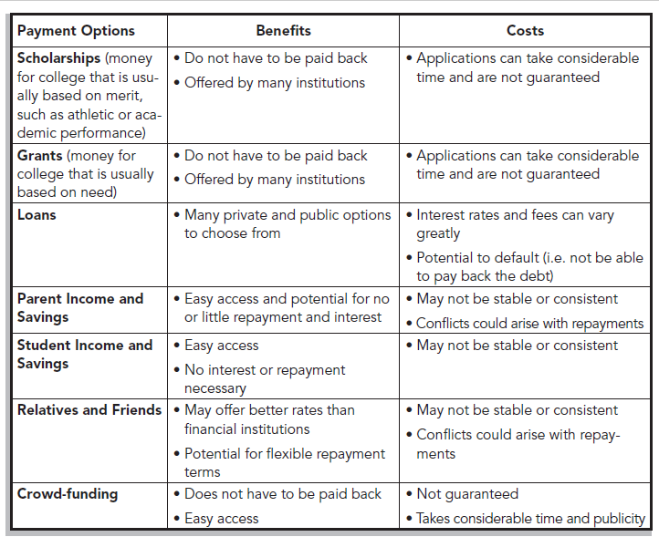
Exercise 16.1 - Costs and Benefits

Slide 15
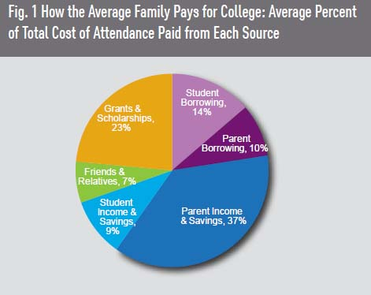
Notes:
BRIAN

Slide 16
Merit Aid – Free Money
Money a college is willing to give based on grades, academic achievement, leadership skills, zip codes (signaling affluence) or response to text from a school.
Colleges do not reveal how they determine their criteria for these awards.
Not always guaranteed after the first year.
“Caveat Emptor”: Some schools artificially raise their costs, knowing people can pay.
A scholarship can always make a more expensive choice a better deal.
Families with money have a better opportunity to get this type of free money.
Colleges who have trouble getting students are using this technique to fill slots.
Both private and public institutions are playing this game.
https://www.nytimes.com/2021/01/23/business/financial-aid-college-merit-aid.html

Slide 17
Merit Based System
Tangibles
  GPA
  Standardized test scores
  Strength of your high school curriculum ( based on previous students from that school)
Intangibles (not all schools)
  For candidates that go to financial aid office and negotiate ($0-$3,000)
  The further your residence from the school, the greater the contribution ($0-$2,000)
  Each “A” on the report card ($50-$60 each)
  AP, IB and honors courses taken at high school ($400 per course)
  Recommendations ($0-$1800)
  Each 10 point improvement in the SAT score above the freshmen classes average ($0-$115)
  Observing deadlines such as application, mid-year grades, etc. ($0-$400)
  Deduction in aid for every student that gets admitted with the same major
  Merit money if FAFSA is filled out on time and correct. ($0-$1,700)

Slide 18
Ex. 16.1 - Questions
What are the benefits of scholarships?
Scholarships do not have to be paid back.
What is the cost of using loans to pay for postsecondary education?
You need to pay for any associated interest and/or fees, plus the principal repayment.
Besides the cost of postsecondary education, what is a non-monetary factor to consider when borrowing from friends and family members?
Your relationship with them because of potential conflicts over repayment plans.
What might be the best option or options for you and why? Answers will vary.
https://quizlet.com/396696351/flashcards

Slide 19
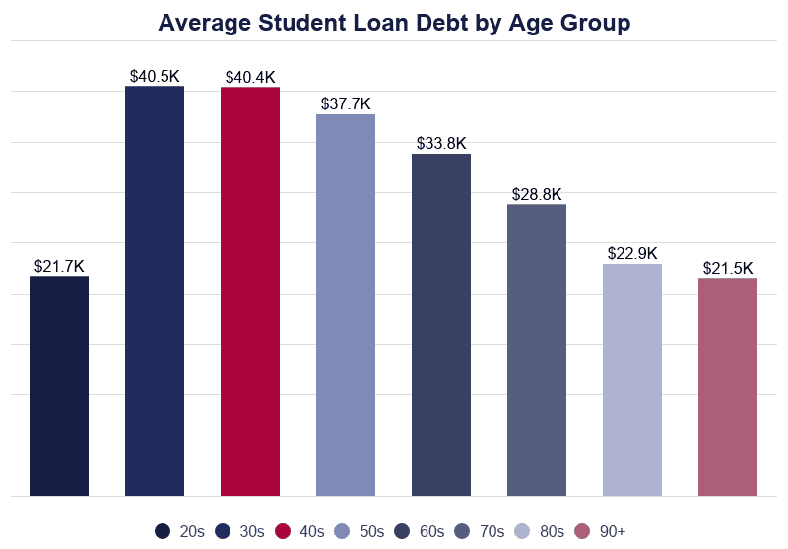

Slide 20
Exercise 16.2 - Directions
When you attend postsecondary schooling or complete training, you are investing in yourself. This investment, through formal or informal ways, helps boost your human capital. However, you must know the costs and benefits of your choices. One way to do this is to determine your return on investment. In this activity, you will act as an advisor and make a recommendation to others who are deciding on their postsecondary option. Read each scenario below. Determine the monthly student loan payment, monthly entry level income, and the employment outlook.
a. MONTHLY LOAN PAYMENT: For each scenario, use the interest repayment estimator to determine the monthly student loan payment. Select “direct unsubsidized loan” and use 4.29% as the interest https://studentloans.gov/myDirectLoan/repaymentEstimator.action.
b. ANTICIPATED MONTHLY INCOME: For each scenario, use the Bureau of Labor Statistics (BLS) Occupational Outlook Handbook (OOH), located at the website https://www.bls.gov/ooh/ to determine the ”entry-level” salary of the occupation being considered. An entry-level salary is what is paid for the first few years of a person’s first job and likely falls into the low end of the pay scale. Click on the Occupation Group search bar on left side of the webpage. Click on the name of the Occupation described in the scenario. Click on "Pay" in the top search bar. Find the annual entry-level pay for this occupation by locating what the lowest 10% make in this occupation. Divide the annual entry level pay by 12 to determine the anticipated monthly income. Remember, it is recommended by personal finance experts to keep your debt payments less than 40% of your gross monthly income.
c. EMPLOYMENT OUTLOOK: Use the OOH data at https://www.bls.gov/ooh/ to determine whether employment in this occupation is projected to grow or decline over the 10-year projection period. Click on “Job Outlook” in the top search bar. Compare the rate of growth or decline for the occupation covered in the profile to the rate for all occupations. What major factors are expected to affect the outlook for employment in the occupation? Some are changes in technology, in business practices, and in demographics. For each scenario below, make a recommendation about whether this student should or should not choose the option they are considering and explain why. Base your answer on their loan payment compared to their monthly income and the employment outlook for their occupation.

Slide 21
Scenario #1, Easton
Easton’s dream is to become a 3rd grade teacher. He wants to attend the same private university his mother did. He will have to borrow $211,394 to finance his four-year education.
Monthly Loan Payment ___________ Anticipated Monthly Income______________
Employment Outlook: __________________
______________________________________________________________________
Should this student choose the postsecondary option he is considering? Why or why not?
Response:
Monthly Loan Payment: $2,171 Anticipated Gross Monthly Income: $3,111
His monthly loan payment would consume more than the recommended 40% of his monthly income, so he should look for a less expensive school or reduce his costs by applying for scholarships or going to a community college for his first two years.

Slide 22
Scenario #2, Rory
Rory wants to become a paramedic. She can complete a one-year program at a local community college and borrow $12,938.
Monthly Loan Payment ____________ Anticipated Monthly Income___________
Employment Outlook: __________________
_____________________________________________________________________
Should this student choose the postsecondary option she is considering? Why or why not?
Response:
Monthly Loan Payment: $133 Anticipated Gross Monthly Income: $1,823
Her monthly loan payment would consume less than 8% of her monthly income, so it is a reasonable debt load.

Slide 23
Scenario #3, Carly
Carly took several college courses during her senior year of high school and she will be able to graduate one year early from college. She plans to start a career as an architect. It costs her $15,693 a year to attend college.
Monthly Loan Payment ___________ Anticipated Monthly Income______________
Employment Outlook: _____________
_________________________________________________________________________
Should this student choose the postsecondary option he is considering? Why or why not?
Response:
Monthly Loan Payment: $483 Anticipated Gross Monthly Income: $3,956
Carly will save a total of $19,336 (principal and interest) by having one year of college complete during high school. She is able to graduate one year earlier and start earning an income. She made a good return on her time and money.

Slide 24
Scenario #4, Leo
Leo spent his first year of college partying and not caring about his grades. As a result, he now has to attend a fifth year to get his degree as a financial planner. He will now have to borrow a total of $134,993 for five years of college.
Monthly Loan Payment __________ Anticipated Monthly Income____________
Employment Outlook: ________________
________________________________________________________________________
Should this student choose the postsecondary option he is considering? Why or why not?
Response:
Monthly Loan Payment: $1,386 Anticipated Gross Monthly Income: $3,400
Leo will have to pay an additional year of tuition to complete his degree. It is costing him additional time and money, because he is missing out on the opportunity of making $40,000 a year. He did not make a good decision to extend his schooling. However, it is still beneficial for him to complete his degree in the long-run.

Slide 25
Direct Consolidation Loan Summary Sheet
Repayment Plan | Loan Amount | # of Payments | Interest Rate | lnitial Payment | Max Payment | Total Interest | Total Repaid
STANDARD | $18,104.72 | 180 | 6.750% | $160.21 | $160.21 | $10,731.64 | $28,836.36
GRADUATED | $18,104.72 | 180 | 6.750% | $101.83 | $240.32 | $11,581.29 | $29,686.01
(2) EXTENDED | $.00 | 0 | 0.0000% | $.00 | $.00 | $.00 | $.00
FIXED OPTION | $.00 | 0 | 0.0000% | $.00 | $.00 | $.00 | $.00
GRADUATED OPTION | $.00 | 0 | 0.0000% | $.00 | $.00 | $.00 | $.00
To qualify !or the Extended Plan - Fixed and Graduated Monthly Payment Options. the sum ol your estimated new Direct Consolidation Loan and other Direct Loan must be greater than $30,000.

Slide 26
Direct Consolidation Loan Summary Sheet
i
SECTION 1 - LOANS ELIGIBLE FOR THIS CONSOLIDATIO'N
I
i
Current Interest Rate
Loan Holder Name
Loan Type
Current Balance
U.S. DEPARTMENT OF EDUCATION | Unsub | $8,132.66 | 6.80%
U.S. DEPARTMENT OF EDUCATION | Sub | $2,780.62 | 6.00%
SLMA/LOAN SERVICING CENTER/FLORIDA (SALLIE MAE) | Sub | $4,541.96 | 6.80%
SLMA/LOAN SERVICING CENTER/FLORIDA (SALLIE MAE) | Sub | $2,649.48 | 6.80%
Your Total Education Loan Indebtedness Summarv
Total Included In This Consolidation Total Not Included In This Consolidation Grand Total All Loans | $18,104.72 $.00
 | $18,104.72

Slide 27
Strategy Suggestions
Estimate your full cost of college.
Take only what you need.
  Maximize federal loans before private
  Estimate compounding of your debt when you graduate
  Research your earning potential for when you graduate.
  Loans should not exceed first year’s salary
  If you don’t know what you want to do, be even more cautious
Think long term.
  Calculate your total loan debt for 4 ½ - 5 years of loans
  Set up a proposed budget including debt obligations (Balance Pro)
Weigh loan options.
  Federal (subsidized or unsubsidized) versus private loans
  Fixed versus variable rates
Keep a healthy mindset about debt.
  People drowning in student debt is somewhat overblown
  Average student debt (2019) is $30,000+. Is that manageable?

Slide 28
Do You Have a Strategy?
Graduate in 3 years. Earn AP, Community College, SUPA credits.
2% of students earn a bachelor's in 3 years.
Parents often assume that all elements in a financial aid award letter are free money, which rarely, if ever is the case.
Need to distinguish between a gift — such as scholarships or grants — and “loans" that need to be paid back, which includes loans and work-study.
  About 82% of all first-year students receive some type of financial aid.
1/3 of students transfer before earning a degree.
  Increased costs as colleges don't like to accept credits from other schools
  Cuts into a college’s profits

Slide 29
Ways to Help Pay for That Future
Enroll in a 529 College Savings Plan ASAP.
Take as many A.P., IB courses for college credit, if accepted.
Enroll in SUPA courses if offered at your high school for college credit.
Take a community college course during high school or summer.
Study hard to qualify for merit based scholarships.
Get a summer or after school job and start saving (CD’s).
Take an on-line course at a community college during a semester.
Live at home and save on room and board.
Line up a paid Internship.

Slide 30
Lessen College Debt!
Choose a debt-trimming package.
  Some colleges offer reduced or free tuition based on families’ income
  Some colleges are limiting student loans in financial aid packages (GW, UVA, W&M)
Pick an inexpensive school.
  Low sticker price public college versus big loan for a private college
  Education degree at Syracuse for $220,000 or $80,000 at SUNY- Binghamton
Maximize your money.
  Keep college savings in parents name for 1-2 years prior to FAFSA
  Fin. aid formulas “tax” student assets much more heavily than parents’ assets
  Spend down your child’s assets. Gifts from relatives should used for FAFSA in Junior year
Consider public service.
  Loan forgiveness after 20 years
  .Public service now includes local, state and federal workers along with nurses and teachers
  Know the six repayment options
If you must borrow, borrow smart.
  Use Stafford and Perkins loans (subsidized is better than unsubsidized)
  Don’t take on more debt than you expect to earn in your first year of work
Think outside the box.
  Tuition free schools (Cooper Union, Webb Institute, Berea College, Curtis Institute for Music)
  GoFundMe.com!
  Two years at a community college, then transfer for last 2 years
  Graduate in three years

Slide 31
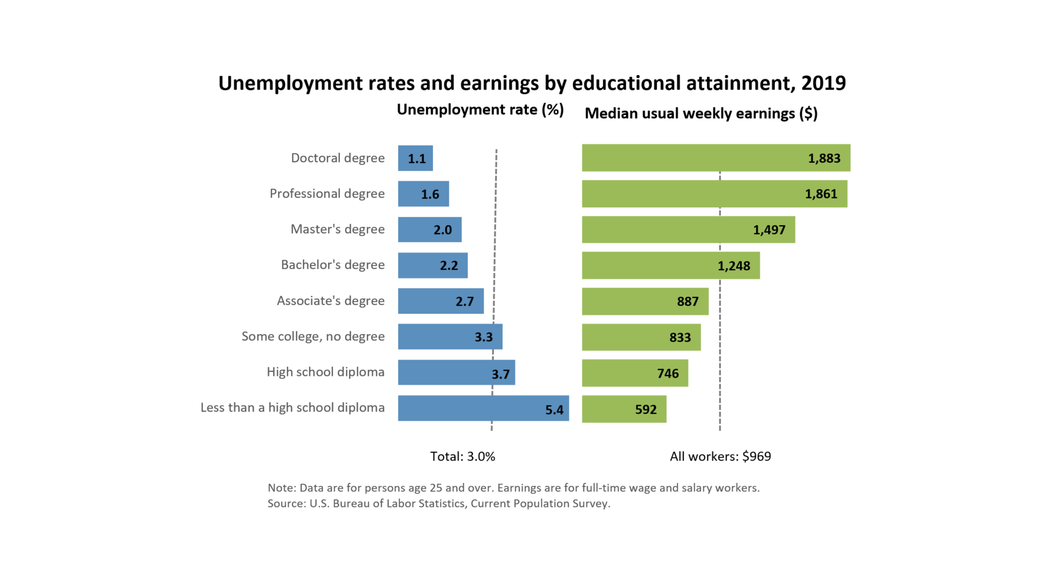

Slide 32
Assessment – Ex. 16.3
Finally, using the Career Outlook information at https://bls.gov/ooh/ , what is the Employment Outlook for your future occupation?
Now that you have an idea of what your future salary and employment outlook will be, write a one-page essay that answers these questions:
Given the monthly student loan repayment, projected salary and employment outlook, is this college a smart financial choice? Why or why not.
Explain three specific actions (such as apply for scholarships, borrow from parents, or go to a less expensive college) you could take to reduce the amount of student loans required to finish the college education or training. Calculate with the reduced costs. How does that change your initial answer?

Slide 33
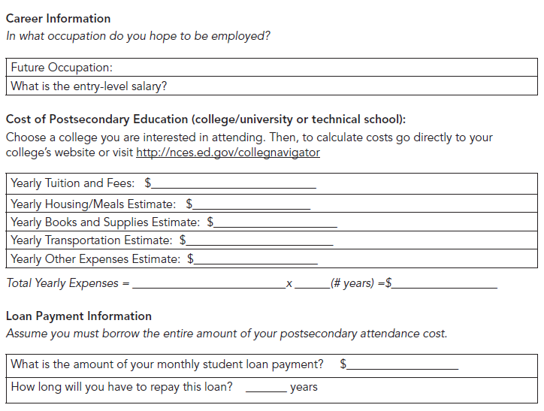
Exercise 16.3: Is It Worth It?

Slide 34
Unit Closure
Reiterate to students that it is important to identify the costs and benefits of postsecondary payment options in order to make an informed decision. As a class, discuss the following,
What are some costs of investing in your human capital at the postsecondary level?
  Cost of education and your time to complete the applications.
What are some benefits of investing in your human capital at the postsecondary level?
Increased income potential, learning new things, obtaining the career or job you desire.
How can you determine if you are making a good return on your investment?
By analyzing the costs and benefits in terms of anticipated monthly income and the monthly loan payment.

Slide 35
Consequences of Defaulting on a Federal Student Loan
1. Bankruptcy for 99% is not an option to rid the debt.
2. Government can seize your income tax refunds and garnish your wages
3. Entire unpaid balance of your loan and interest is immediately due and payable.
4. You lose eligibility for deferment, forbearance, repayment plan options and eligibility for additional federal student aid.
5. Your loan account is assigned to a collection agency and reported as delinquent to credit bureaus, damaging your credit rating.
6. Loan debt will increase: late fees, additional interest, court costs, collection fees, attorney’s fees and other costs associated with the collection process will be added.
Affects ability to buy a car or house, open utilities account, obtain homeowner’s insurance, get a cellphone plan, get a credit card.
Hard to rent an apartment or get a job as employers may pull your credit report.
Loan holder takes legal action: assets (i.e. real estate) and large purchases frozen.
It will take years to reestablish your credit and recover from default.

Slide 36
Resources
www.nslp.org - Assists students and families with loan related services.
www.studentaid.ed.gov - Federal financial assistance - grants, loans and work-study.
www.financialaidnews.com - Newsletters and blogs from around the Internet, dedicated to bringing you the best, most up to date financial aid information.
www.fastaid.com - Free data base of private-sector, graduate, worldwide scholarships, fellowships, grants and free undergraduate college scholarships.
www.scholarshipexperts.com - Free database of college and grad school scholarships.
http://www.stlouisfed.org/education_resources/personal-finance-101-conversations/ - St Louis Fed.
EconEdLink
  College: Where am I going to go? https://www.econedlink.org/resources/college-where-am-i-going-to-go/
  You’re Going to College - https://www.econedlink.org/resources/youre-going-to-college/
  The 411 on College Education - https://www.econedlink.org/resources/the-411-on-college-education/

Slide 37

Questions & Answers
Notes:
BRIAN
Let’s open the floor to questions

Slide 38

CEE Affiliates
https://www.councilforeconed.org/resources/local-affiliates/

Slide 39




Thank You to Our Sponsors!

Slide 40





We’ve gone Virtual!
Teach Economics?
Your students may have what it takes to compete in the nation’s only high school economics competition!
Why Play?
• Fun team learning experience
• Great for college applications
• No other challenge like this
• Online participation makes access easy
• Chance for cash prizes
How it Works
Teams register
Teachers enroll team(s) of 3- 4 high school students from the same school. Multiple teams allowed.
Teams compete within their state
Compete to win your state competition for a
chance to advance to the National Semi-Finals.
National Semi-Finals: May 3-20, 2021
Teams answer multiple-choice questions on macroeconomics, microeconomics, and international & current events.
National Finals: May 22-24, 2021
Teams analyze an economic issue and present their solution. Top teams engage in the Finals Quiz Bowl where they face-off answering questions to claim the National Title.
Two divisions based on experience level
David Ricardo for first-time competitors who have taken no more than one economics course.
Adam Smith for returning competitors, AP, International Baccalaureate, and honors students.
Register Today at NationalEconomicsChallenge.org

Slide 41



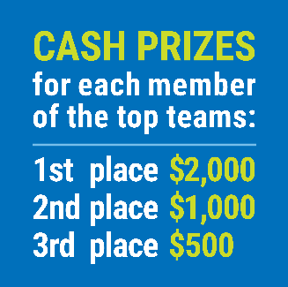

FIND YOUR LOCAL COMPETITION
AND REGISTER TODAY!
The National Personal Finance Challenge is a competition that provides high school students with an exciting and motivating opportunity to build, apply, and demonstrate their knowledge of money management.
Through online exams and a personal finance simulation, teams showcase their expertise in earning income, buying goods and services, saving, using credit, investing, as well as protecting and insuring.
Teams of up to four students, with one teacher/coach, can qualify to represent their state at the National Personal Finance Challenge by winning their local competition.
NATIONALS
Semi-Finals: First round elimination via online multiple-choice questions.
Finals: Case study round virtually co-hosted by the Cleveland Fed on June 3.
personalfinancechallenge.org

Slide 42
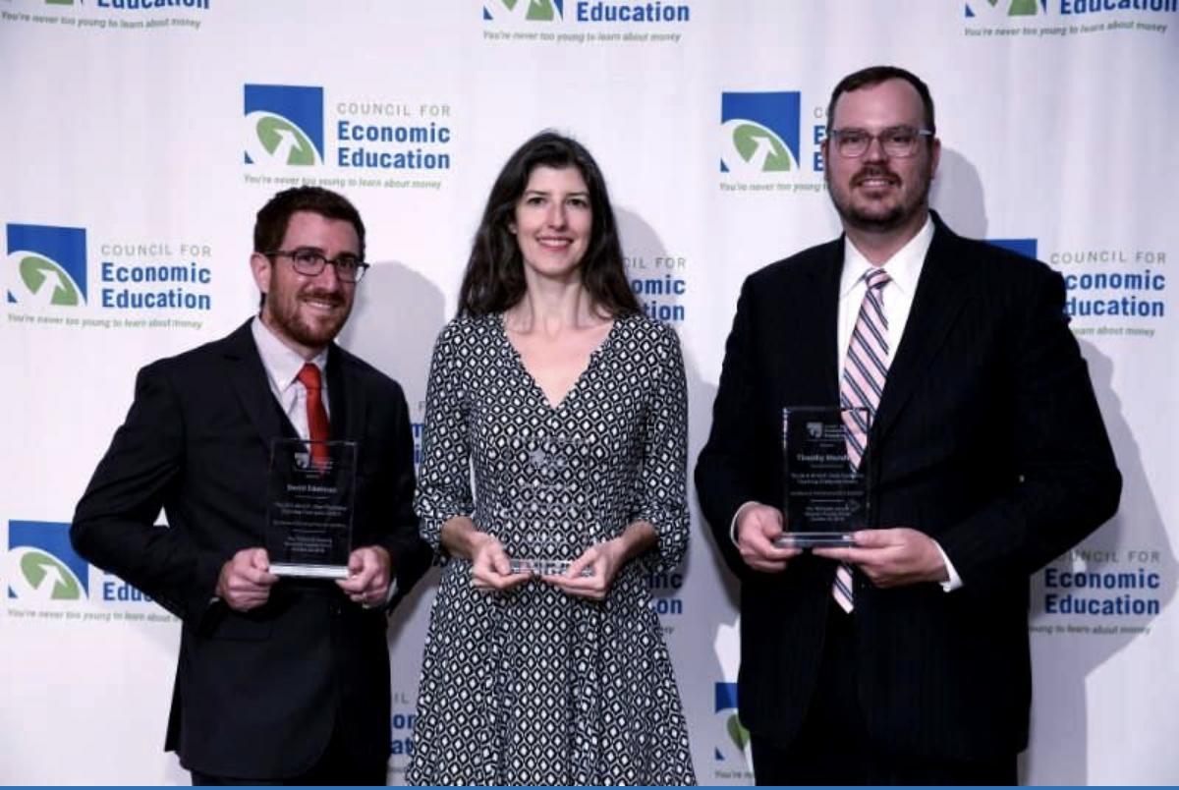
The 2021 Sloan Teaching Champion Award
Winners receive:
A cash award of $5,000
A cash award of $2,500 for their school to support economic education
Recognition at our annual Visionary Awards convening.
This award promotes economic education by honoring three outstanding teachers who incorporate exemplary teaching techniques that improve their students’ economic understanding in and out of the classroom.
This award is open to New York metropolitan area high school teachers of all subjects, not just teachers of economics. Applicants must demonstrate how they integrate economics into their teaching.
Sound like you or someone you know?
Applicants must teach in one of the
Twelve New York state counties (New York, Kings, Bronx, Richmond, Queens, Nassau, Suffolk, Westchester, Putnam, Rockland, Orange and Dutchess)
Eight New Jersey counties (Bergen, Passaic, Essex, Hudson, Middlesex, Union, Morris, Monmouth), or the
Two Connecticut counties (Fairfield and New Haven)
Application will be launched on Friday February 19th 2021
You can access the application here.
CONTACT
Please feel free to e-mail us at rrivera@councilforeconed.org
with any questions you have.

