Slide 1
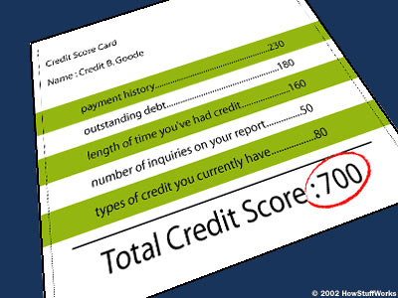
Financial Fitness for Life, Chapter 13:
Credit Reports and Credit Scores
Doug Young
CEO - Financial Coach
doug.n.young@gmail.com
January 28, 2021

Slide 2
EconEdLink Membership
You can now access CEE’s professional development webinars directly on EconEdLink.org! To receive these new professional development benefits, become an EconEdLink member. As a member, you will now be able to:
Automatically receive a professional development certificate via e-mail within 24 hours after viewing any webinar for a minimum of 45 minutes
Register for upcoming webinars with a simple one-click process
Easily download presentations, lesson plan materials and activities for each webinar
Search and view all webinars at your convenience
Save webinars to your EconEdLink dashboard for easy access to the event
You may access our new Professional Development page here

Slide 3
Professional Development Certificate
To earn your professional development certificate for this webinar, you must:
Watch a minimum of 45-minutes and you will automatically receive a professional development certificate via e-mail within 24 hours.
Accessing resources:
You can now easily download presentations, lesson plan materials, and activities for each webinar from EconEdLink.org/professional-development/

Slide 5
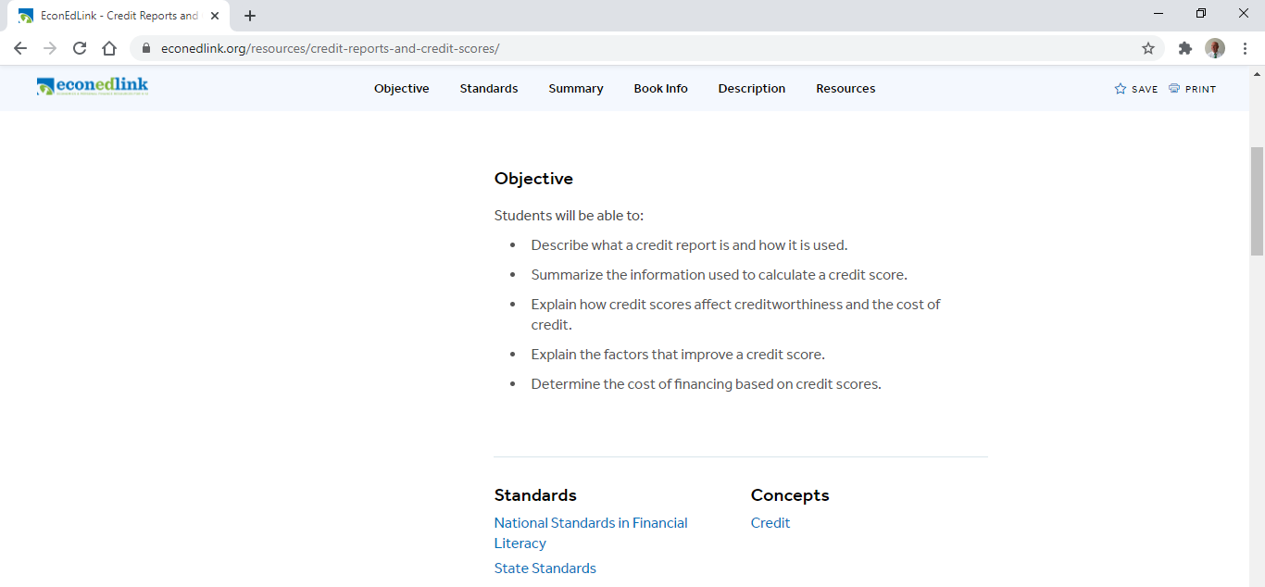
Lesson 13: Credit Reports and Scores

Slide 6
National Standards
Standard:
Students will understand that: Credit allows people to purchase goods and services that they can use today and pay for those goods and services in the future with interest. People choose among different credit options that have different costs. Lenders approve or deny applications for loans based on an evaluation of the borrower’s past credit history and expected ability to pay in the future. Higher-risk borrowers are charged higher interest rates; lower-risk borrowers are charged lower interest rates.

Slide 7
Florida State Standards
SS.912.FL.4.7
Describe that, in addition to assessing a person’s credit risk, credit reports and scores may be requested and used by employers in hiring decisions, landlords in deciding whether to rent apartments, and insurance companies in charging premiums.
SS.912.FL.4.12
Discuss that consumers who use credit should be aware of laws that are in place to protect them and that these include requirements to provide full disclosure of credit terms such as APR and fees, as well as protection against discrimination and abusive marketing or collection practices.
Explain why it is important that consumers have full information about loans. Explain the information on a credit disclosure statement.

Slide 8
Objectives
The student will:
describe what a credit report is and how it is used.
summarize the information used to calculate a credit score.
explain how credit scores affect credit worthiness and the cost of credit.
explain the factors that improve a credit score.
determine the cost of financing based on credit scores.
learn how to fix and/or improve one’s credit report and score.

Slide 9
Agenda
National and State Standards
Lesson Objectives
Bell Ringer - Pre Test
Vocabulary
5 C’s
What’s a Credit Report?
What’s a Credit Score?
Exercises, Activities and Assessments
References

Slide 10
Scenario
Imagine that a friend or family member has asked you to borrow $1,000 - $2,000 for a good sounding business, joint investment opportunity or debt obligation.
What would you want to know about this person before you determine whether or not to lend the money? Your responses, please!

Slide 11
Reading a Credit Report Prediction Guide
Exercise 13.1 (True or False)
_____ a. Your FICO score and your credit score are the same thing.
_____ b. A credit report indicates how well a person has managed credit in the past.
_____ c. Credit reports are issued monthly, so you know how much money to pay toward your credit card bill.
_____ d. A credit score of 350 is generally considered to be good.
_____ e. People with higher credit scores typically pay higher interest rates for credit.
_____ f. The Fair Credit Reporting Act allows you to receive a copy of your credit report for free.
_____ g. Potential employers and landlords may check your credit report.
_____ h. The amount of money you owe is the most important part of your credit score.
_____ i. Your income is not considered when calculating your credit score.
_____ j. A good way to improve your credit score is to apply for additional credit cards.

Slide 12
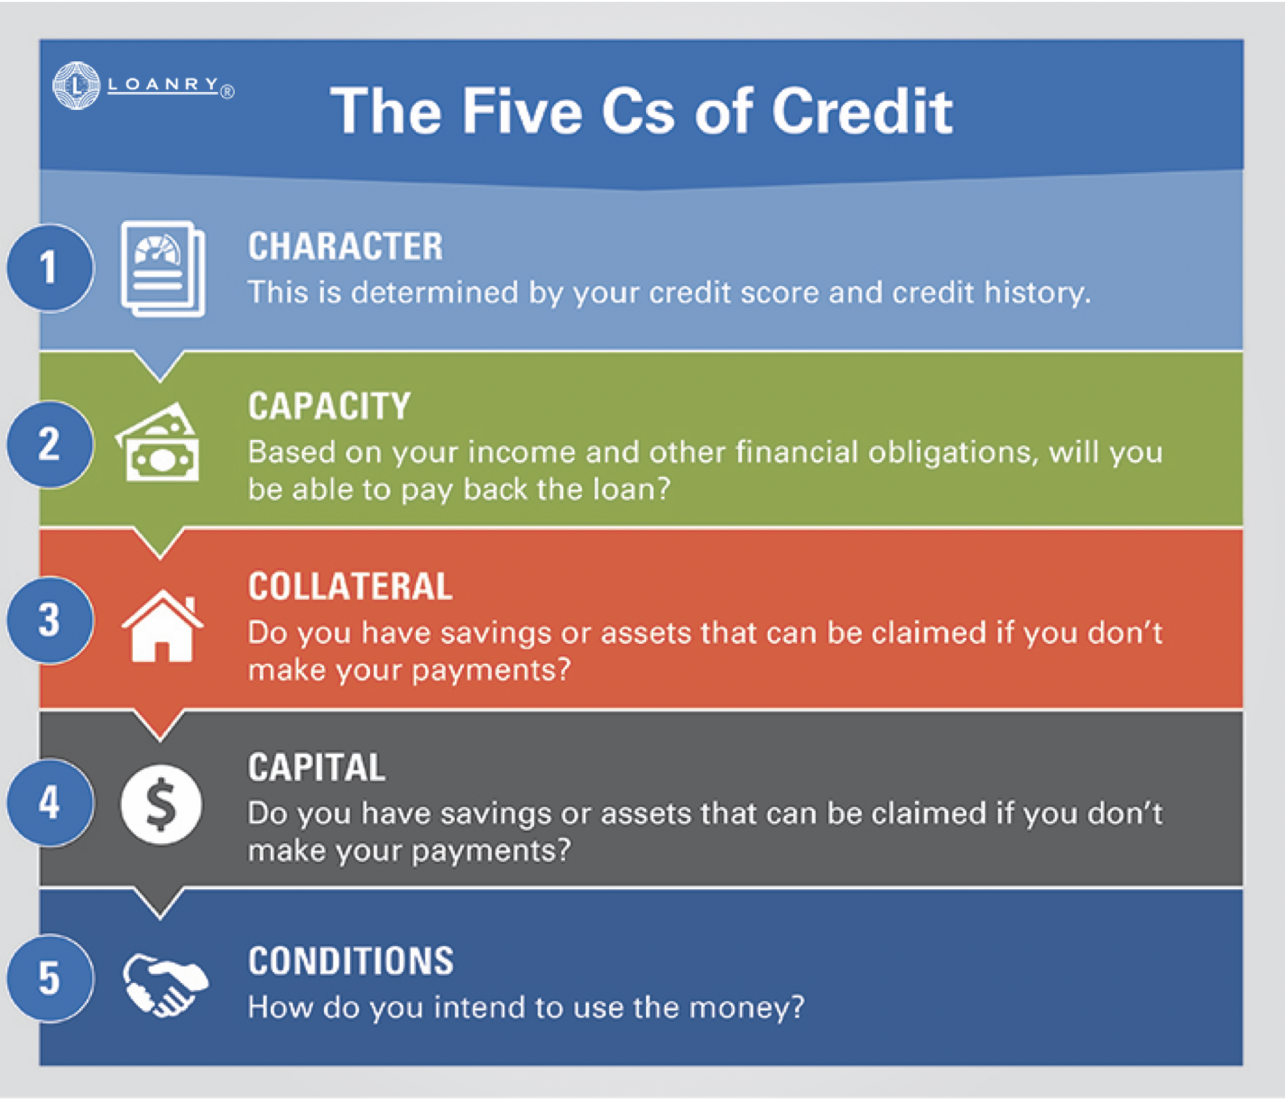
What are lenders looking for?

Slide 13
Vocabulary
Credit - Amount of money a creditor is willing to loan another to purchase goods and services, based the expectation that the money will be repaid as promised with interest.
Credit Report - A record of an individual’s credit history.
Credit Score - A measure of creditworthiness, financial history and ability to pay debts as promised as judged by character, capacity, and capital (3 C’s).
Utilization Rate - The amount of revolving credit you're currently using divided by the total amount of revolving credit you have available.
FICO – a credit score created by the Fair Isaac Corporation. Lenders use FICO scores along with details on borrowers’ credit reports to assess credit risk and determine whether to extend credit.
Fair Credit Reporting Act - a federal law that regulates the collection of consumers' credit information and access to their credit reports.

Slide 14
What’s a Credit Report?
From age 18 on, agencies collect data about your spending habits.
Monitor your ability to handle risks: installment loans and revolving credit.
Impacts: amount you can borrow and the interest rates on that loan.
Who Can Access Your Report?
Creditors
Collection agencies
Insurance companies
Employers
Landlords

Slide 15
Free Annual Credit Report
The Fair Credit Reporting Act guarantees you access to a free credit report from each of the 3 nationwide reporting agencies — Experian, Equifax, and TransUnion — every twelve months.
To get your free Credit Report
By Internet: www.annualcreditreport.com
By phone: 1-877-3222-8228
By mail: Annual Credit Report Request Service
P.O. Box 105281, Atlanta, GA 30348-5281
Note: If you contact the reporting agencies directly via e-mail or letter for your report, there may be a fee cost.
Notes:
15

Slide 16
What is in a Credit Report?
Personal Data
Employment History
Public Records (liens, judgments, secured loans, foreclosures, bankruptcies, etc.)
Collection Accounts (defaults and lateness)
Credit Information (open accounts, date account was opened, payment status)
Inquiries (approved requests and others seeking credit information)
Notes:
DOUG

Slide 17
Length of Information On A Credit Report
TYPE LIMITATION
Suits & Judgments 7 years
Tax Liens – Paid 7 years from payment
Tax Liens – Unpaid No limitation
Charged to Profit & Loss 7 years
Criminal Record Limitations No limitations
Other adverse information 7 Years
Late Payments 7 Years
Debt Collections 7 Years
Bankruptcy 10 Years
Notes:
DOUG

Slide 18
Debt and Credit Repair
Create a letter to deal with creditors, and fix errors in your credit report, as well as build and maintain good credit going forward.
Get bill collectors off your back, and finances under control.
Sample letters from NOLO for a fee (visit your library):
Request to Creditor to Remove Inaccurate Information
Offer to Settle Debt with a Reduced Lump Sum Payment
Notice to Debt Collector to Not Contact Debtor at Work
Notice to Terminate Joint Account
Offer to Pay Debt in Installments (Full or Discounted Amount)
Credit Repair Kit
Notice to Stop Payment of Check

Slide 19
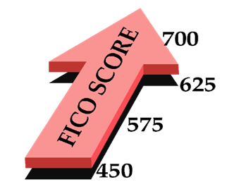
Improving Your FICO Credit Score
FICO Score Estimator: https://www.practicalmoneyskills.com/learn/life_events/going_to_college/college_resources/estimator
Notes:
BRIAN
Ever wonder why you can go online and be approved for credit with in 60 seconds? Or get pre-qualified for a car without anyone even asking you how much money you make? Or why you get one interest rate on loans, while your neighbor gets another? The answer is credit scoring.

Slide 20
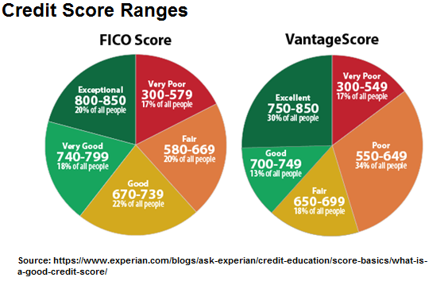
How Many Credit Scores Are There?

Slide 21
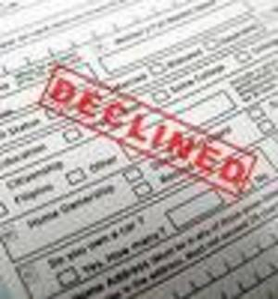
Why is a Credit Score Important?
A poor credit score can affect a person’s ability to:
Obtain credit cards, car loans and mortgages
Favorable interest rates and preferred credit limits on cars and credit cards
Qualify for utility and cell phone services with no down payment
or substantial security deposit.
Rent or lease a house or apartment.
Obtain government-sponsored student loans.
Obtain private student loans with low rates.
Get a job!!!!!!
It might also affect:
Your car insurance rate.
Life insurance rates.
Health insurance premium.
Homeowner’s policy rates.
Notes:
BRIAN

Slide 22
Most credit scoring models don't look at:
race
sex
income
education
marital status
job or length of employment at your job
whether you've been turned down for credit
length of time at your current address
whether you own a home or rent
information not contained in your credit report
age
Notes:
BRIAN
A lender may consider all those factors when deciding whether to approve a loan application, but they aren't part of how a FICO score is calculated.

Slide 23
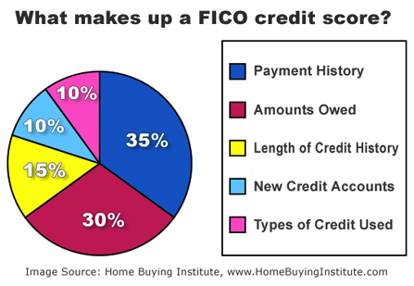
Notes:
Key factors of your score Just what goes into the score? Everything in your credit report, with different kinds of information carrying differing weights, says Fair Isaac Corp. Public Affairs Manager Craig Watts. The FICO-scoring model looks at more than 20 factors in five categories. (The VantageScore relies on slightly different factors. The Bankrate feature "New Vantage credit score now online" compares the FICO score with VantageScore. )
1. How you pay your bills (35 percent of the score) The most important factor is how you've paid your bills in the past, placing the most emphasis on recent activity. Paying all your bills on time is good. Paying them late on a consistent basis is bad. Having accounts that were sent to collections is worse. Declaring bankruptcy is worst.
2. Amount of money you owe and the amount of available credit (30 percent) The second most important area is your outstanding debt -- how much money you owe on credit cards, car loans, mortgages, home equity lines, etc. Also considered is the total amount of credit you have available. If you have 10 credit cards that each have $10,000 credit limits, that's $100,000 of available credit. Statistically, people who have a lot of credit available tend to use it, which makes them a less attractive credit risk.
"Carrying a lot of debt doesn't necessarily mean you'll have a lower score," Watts says. "It doesn't hurt as much as carrying close to the maximum. People who consistently max out their balances are perceived as riskier. People who never use their credit don't have a track history. People with the highest scores use credit sparingly and keep their balances low."
3. Length of credit history (15 percent) The third factor is the length of your credit history. The longer you've had credit -- particularly if it's with the same credit issuers -- the more points you get.
4. Mix of credit (10 percent) The best scores will have a mix of both revolving credit, such as credit cards, and installment credit, such as mortgages and car loans. "Statistically, consumers with a richer variety of experiences are better credit risks," Watts says. "They know how to handle money."
5. New credit applications (10 percent) The final category is your interest in new credit -- how many credit applications you're filling out. The model compensates for people who are rate shopping for the best mortgage or car loan rates. The only time shopping really hurts your score, Watts says, is when you have previous recent credit stumbles, such as late payments or bills sent to collections.
"Then, looking for new credit will be seen as an alarm because statistically, before people declare bankruptcy and default on everything, they look for a life preserver," Watts says. Also, if you have a very young credit file, an inquiry can count for more than if you've had credit for a long time.

Slide 24
Distribution of FICO
Fair Isaac reports that the American public's credit scores break out along these lines:
How Borrowers Rank | FICO Delinquency Rates
Up to 499 2% | Up to 499 87%
500 to 549 5% | 500 to 549 71%
550 to 599 8% | 550 to 599 51%
600 to 649 12% | 600 to 649 31%
650 to 699 15% | 650 to 699 15%
700 to 749 18% | 700 to 749 5%
750 to 799 27% | 750 to 799 2%
800+ 13% | 800+ 1%

Slide 25
Exercise 13.2 - Questions
a. Briefly explain the “3 C’s of Credit”
b. What is a credit report?
c. Why is it important to check your credit report?
d. How can you obtain your credit report for free?
e. What is the difference between a credit report and a credit score?
f. Briefly summarize the information used to calculate your credit score
g. Why is payment history the largest percentage of your credit score?
h. What are some steps you can take to improve your credit score?

Slide 26
Exercise 13.3 Your Credit Score and the Price of a Car
1. Log in to http://councilforeconed.org/earningcredit. Enter the access code you received for the.
Pre-Survey credit score _____ b. Lowest interest rate ________
2. Assume you decide to borrow $20,000 to buy a new car. Log in to https://www.bankrate.com/calculators/auto/auto-loan-calculator.aspx to calculate the monthly payment and total cost of the loan, using the interest rate from your “simulated” Pre-Survey credit score. Assume that the principal is $20,000 and the loan period is five years (60 months). Record the following information.
a. Estimated Monthly Payment ______ b. Total Principal Paid ________
c. Total Interest Paid _______ d. Total Cost of Loan _

Slide 27
Exercise 13.3 Your Credit Score and the Price of a Car
1. Log in to http://councilforeconed.org/earningcredit . Enter the access code you received for the.
Pre-Survey credit score ___695__ b. Lowest interest rate __4.5%______
2. Assume you decide to borrow $20,000 to buy a new car. Log in to https://www.bankrate.com/calculators/auto/auto-loan-calculator.aspx to calculate the monthly payment and total cost of the loan, using the interest rate from your “simulated” Pre-Survey credit score. Assume that the principal is $20,000 and the loan period is five years (60 months). Record the following information.
a. Estimated Monthly Payment __$359____ b. Total Principal Paid $20,000.00___
c. Total Interest Paid __$1,562_____ d. Total Cost of Loan _$21, 562.00_

Slide 28
What Rate Will Your Score Get You?
FICO Score | 30-year fixed-rate mortgage | 36-month new auto loan | 15-year home equity loan | Credit Card APR
740 | 5.0% | 6.4% | 8.1% | 7.3%
720 | 5.2% | 6.4% | 8.4% | 10.0%
700 | 5.2% | 7.9% | 8.9% | 15.0%
680 | 5.4% | 9.9% | 9.7% | 15.0%
660 | 5.6% | 9.9% | 11.2% | 18.0%
Notes:
DOUG

Slide 29
Group Discussion Questions
a. What was your credit score?
b. What was your interest rate?
c. How are your interest rate differences related to your credit score differences?
d. How did these differences impact the total cost of the car for individuals in your group?
e. What behaviors caused some students to have lower credit scores?
f. What behaviors caused some students to have higher credit scores?
g. What could individuals with low simulated credit scores do to improve these credit scores?
h. Now think about the categories used to calculate an actual credit score. What kinds of behaviors would result in a low score, representing a high risk?
i. What kinds of things can each individual do in the future to ensure that your real credit score is high?

Slide 30
How Can I Improve My Credit Score?
Pay bills on time.
Borrow only what you must.
Try to pay more than the monthly minimum.
Apply for and use only a few credit cards.
Report lost or stolen credit cards immediately
Stay employed.
Keep loans to a minimal percentage of your income.
Avoid bankruptcy.
Review your credit reports yearly for accuracy.
Contact lenders immediately if you have any problem.

Slide 31
Reading a Credit Report Prediction Guide
Exercise 13.1 (Answers)
___T a. Your FICO score and your credit score are the same thing.
__ T__ b. A credit report indicates how well a person has managed credit in the past.
__ F__ c. Credit reports are issued monthly, so you know how much money to pay toward your credit card bill.
__ F__ d. A credit score of 350 is generally considered to be good.
__ F__ e. People with higher credit scores typically pay higher interest rates for credit.
__ T__ f. The Fair Credit Reporting Act allows you to receive a copy of your credit report for free.
__ T _ g. Potential employers and landlords may check your credit report.
__ F _ h. The amount of money you owe is the most important part of your credit score.
__ T__ i. Your income is not considered when calculating your credit score.
___F_ j. A good way to improve your credit score is to apply for additional credit cards.

Slide 32
How Much Will My FICO Score Drop?
Current FICO Scores: Alex Blanca 680 780
Score after one of these is added to the credit report
One inquiry for a new credit card 675 (5) 775 (5)
A new charge card (additional hit) 665 (15) 760 (20)
Maxing out credit card 660 (20) 745 (35)
A 30-day delinquency 610 (70) 680 (100)
Settling a debt 625 (55) 665 (115)
Foreclosure 585 (95) 630 (150)
Bankruptcy 540 (140) 550 (230)
An $18 million Lesson in Handling Credit Report Errors by Sara Siegel Bernard
http://www.nytimes.com/2013/08/03/your-money/credit-scores/credit-bureaus-willing-to-tolerate-errors-experts-say.html?pagewanted=all&_r=0
Notes:
DOUG

Slide 33
“
Exercise 13.4 Evaluation Three Loan Applications
Janice Brown (450) – Deny. Credit score low, difficulty paying bills, 87% with similar scores have been denied.
Tito Sanders (770) – Approve. Excellent score and credit record, good history of repayments, only 2% of borrowers like this have not paid back loans. (Interest Rate – 6.098%).
Maria Martinez (620) – Not Sure. Score indicates she could difficulty with a loan, but credit record so far seems OK. Might qualify for high-Interest rate loan of 11.761%. If she improves her credit score, may qualify for a lower rate.

Slide 34
Assessments
Consumer Federation of America: The Credit Score Quiz
http://www.creditscorequiz.org/
Lesson 13 - Kahoot! – Reading a Credit Report
https://create.kahoot.it/share/reading-a-credit-report/30824e6c-f7e8-4278-9c02-f4257c27ca0f
FFFL Lesson 13 – Exercise 13.1 & 13.4
Multiple Choice Questions in packet at www.store.councilforeconed.org
FFFL - Analyzing a Credit Report and Score (Intuit Education)
https://www.econedlink.org/resources/analyzing-a-credit-report-and-score-simulation/

Slide 35
References
Experian - https://www.experian.com/
CFPB - https://www.consumerfinance.gov/consumer-tools/credit-reports-and-scores/
FICO – https://www.myfico.com/credit-education
Practical Money Skills - https://www.practicalmoneyskills.com/
Consumer Federation of America - https://consumerfed.org/

Slide 36
Questions & Answers
Notes:
BRIAN
Let’s open the floor to questions

Slide 37
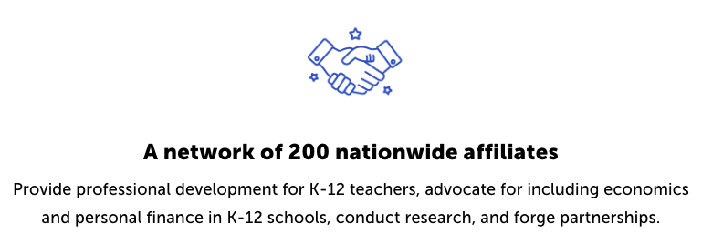
CEE Affiliates
https://www.councilforeconed.org/resources/local-affiliates/

Slide 38
Thank You to Our Sponsors!

