Slide 1
TurboTax In Virtual Classrooms
Presented by:
Jared Davidove
Sr. Manager, Strategic Education Partnerships
Ruben Rivera, Phd.
Director of Professional Development, Council for Economic Education

Slide 2



Ruben Rivera, PhD
Director of Professional Development
Council for Economic Education
Jared Davidove
Sr. Manager, Strategic Education Partnerships
Intuit
Notes:
Ryan Slide
Jared bio -
Jared leads Intuit’s Financial Readiness program aiming to empowering students to make smart money decisions and own their financial futures. As an Innovation Catalyst with deep expertise in Personal Finance Jared serves as a Board Member for the Jump$tart Coalition, a committee member for the NY State Comptroller on Personal Finance, and has been tasked with designing the Congressional Award’s first ever Personal Finance Program.”
Elaine bio -

Slide 3
Agenda Slide
Introduction Financial Fitness For Life 9-12 3rd edition
Sample lesson from FFFL on taxes
Introduction to TurboTax
Sample virtual activities
Additional activities through Google Docs
TurboTax Curriculum and Simulation for virtual learning

Slide 4
POLL ON TURBOTAX
Notes:
Ryan Slide
Jared bio -
Jared leads Intuit’s Financial Readiness program aiming to empowering students to make smart money decisions and own their financial futures. As an Innovation Catalyst with deep expertise in Personal Finance Jared serves as a Board Member for the Jump$tart Coalition, a committee member for the NY State Comptroller on Personal Finance, and has been tasked with designing the Congressional Award’s first ever Personal Finance Program.”
Elaine bio -

Slide 5


Financial Fitness For Life
Financial Fitness for Life (3rd edition) helps you prepare students for life beyond the classroom by presenting lessons and activities based on real-world economics and personal finance concepts.
Updated lesson plans with slides
1 new lesson plan for Paying Post-Secondary Education
17 ready-to-use EdTech tools
6 new activities using real-world tools in partnership with Intuit

Slide 6
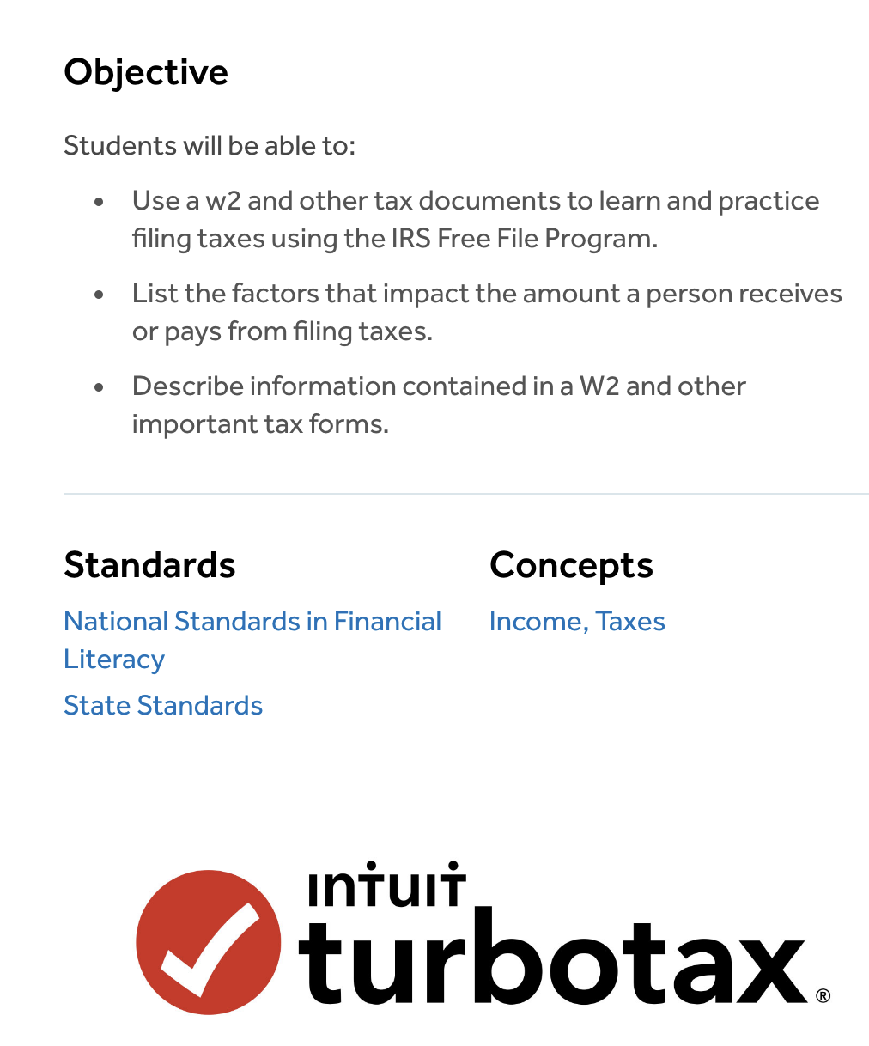
EconEdLink.org
Resource
Webinar on FFFL Ch:7 Uncle Sam Takes a Bite
W

Slide 7
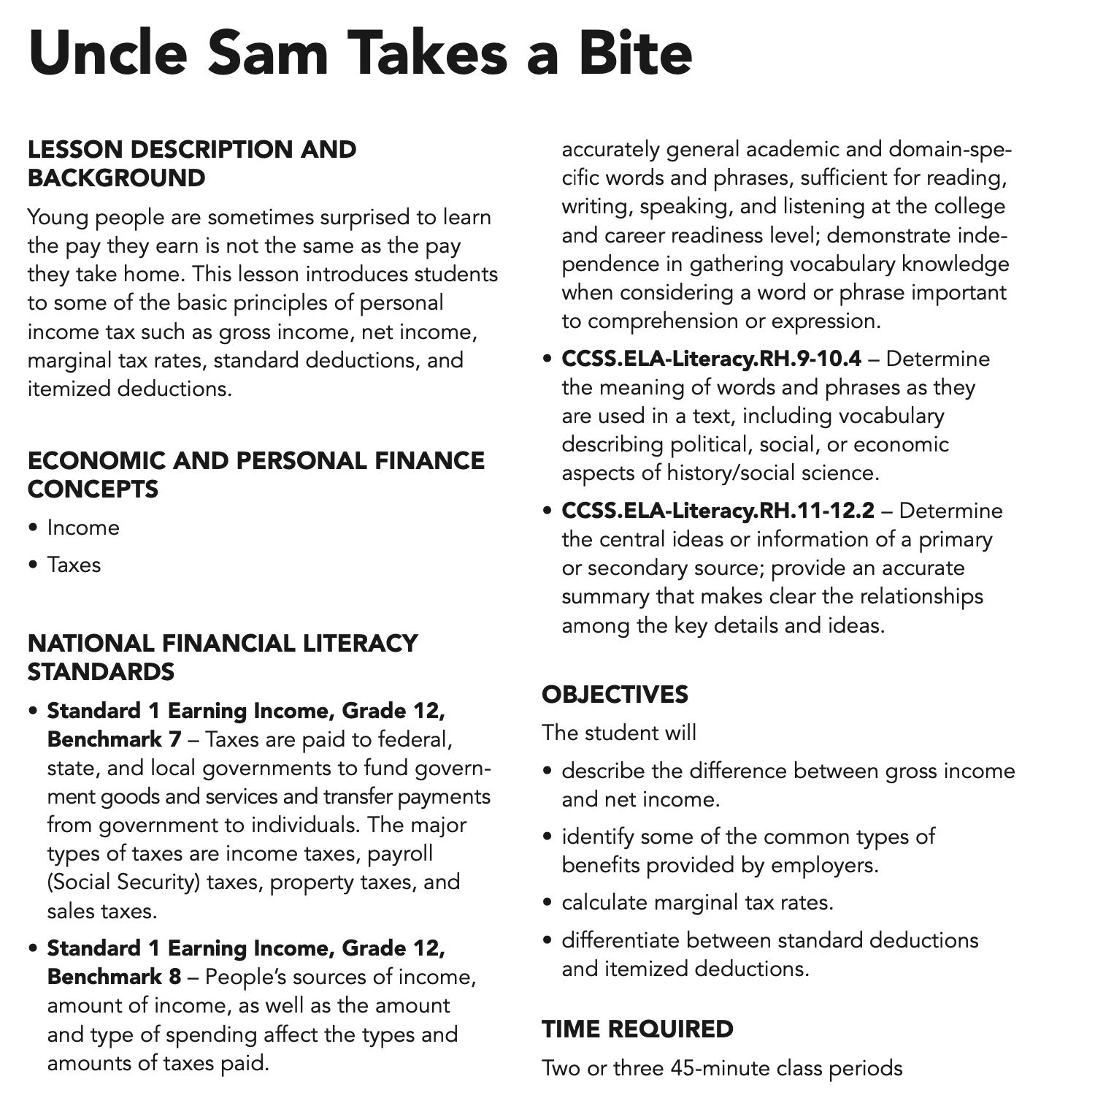
Lesson 7: Uncle Sam Takes a Bite
Includes:
3 lessons + activities using TurboTax

Slide 8
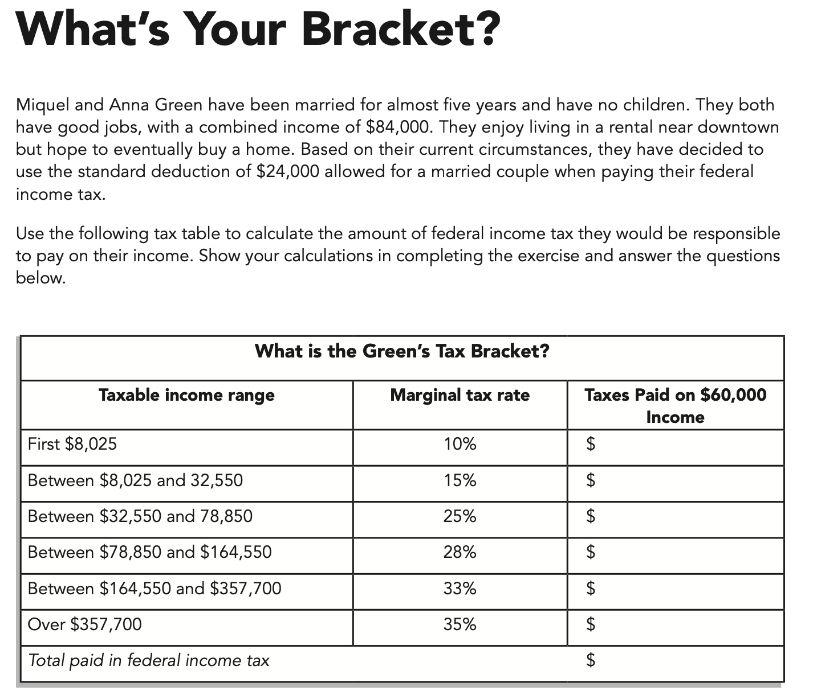
Lesson 7: Uncle Sam Takes a Bite
Sample Exercise

Slide 9
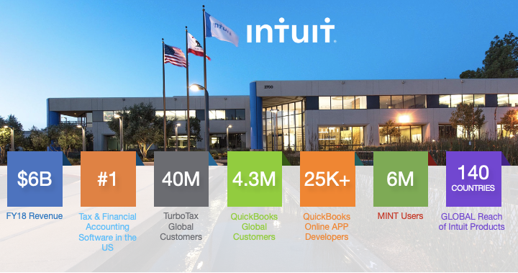


Slide 10

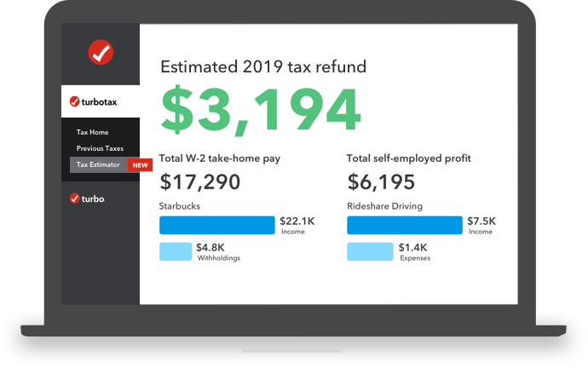
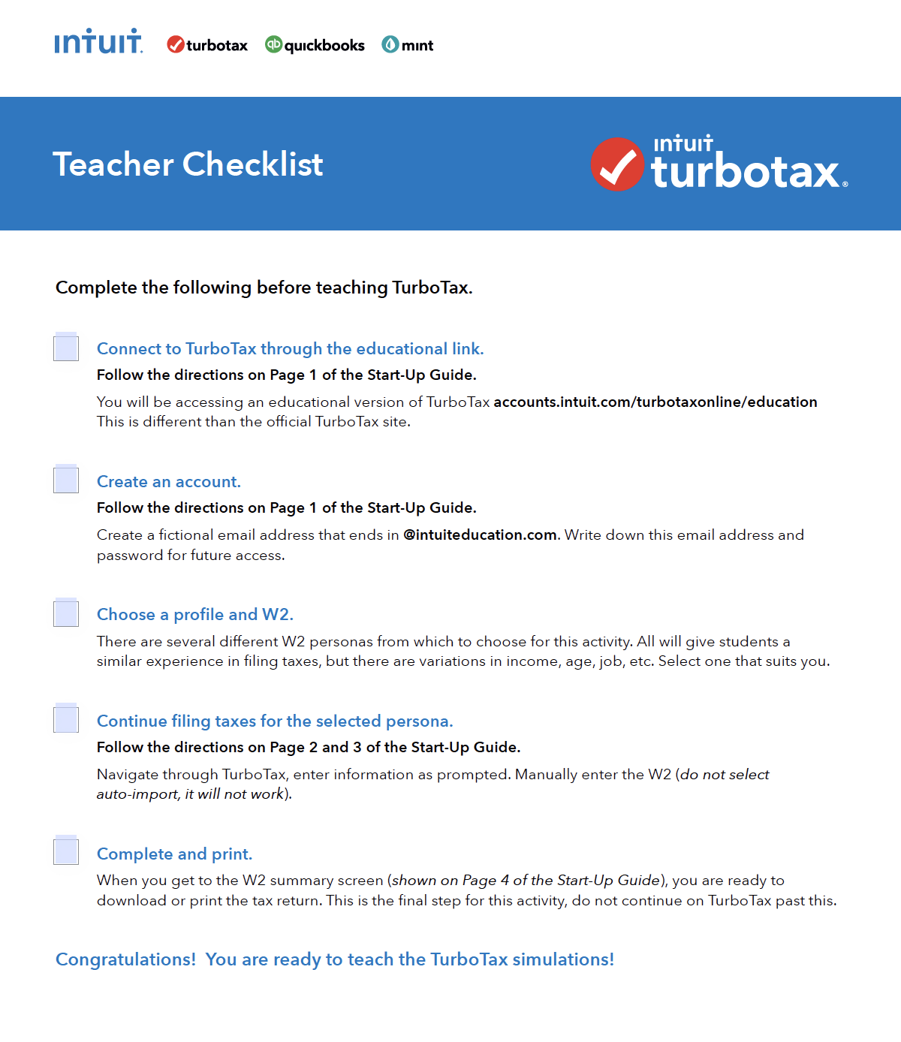
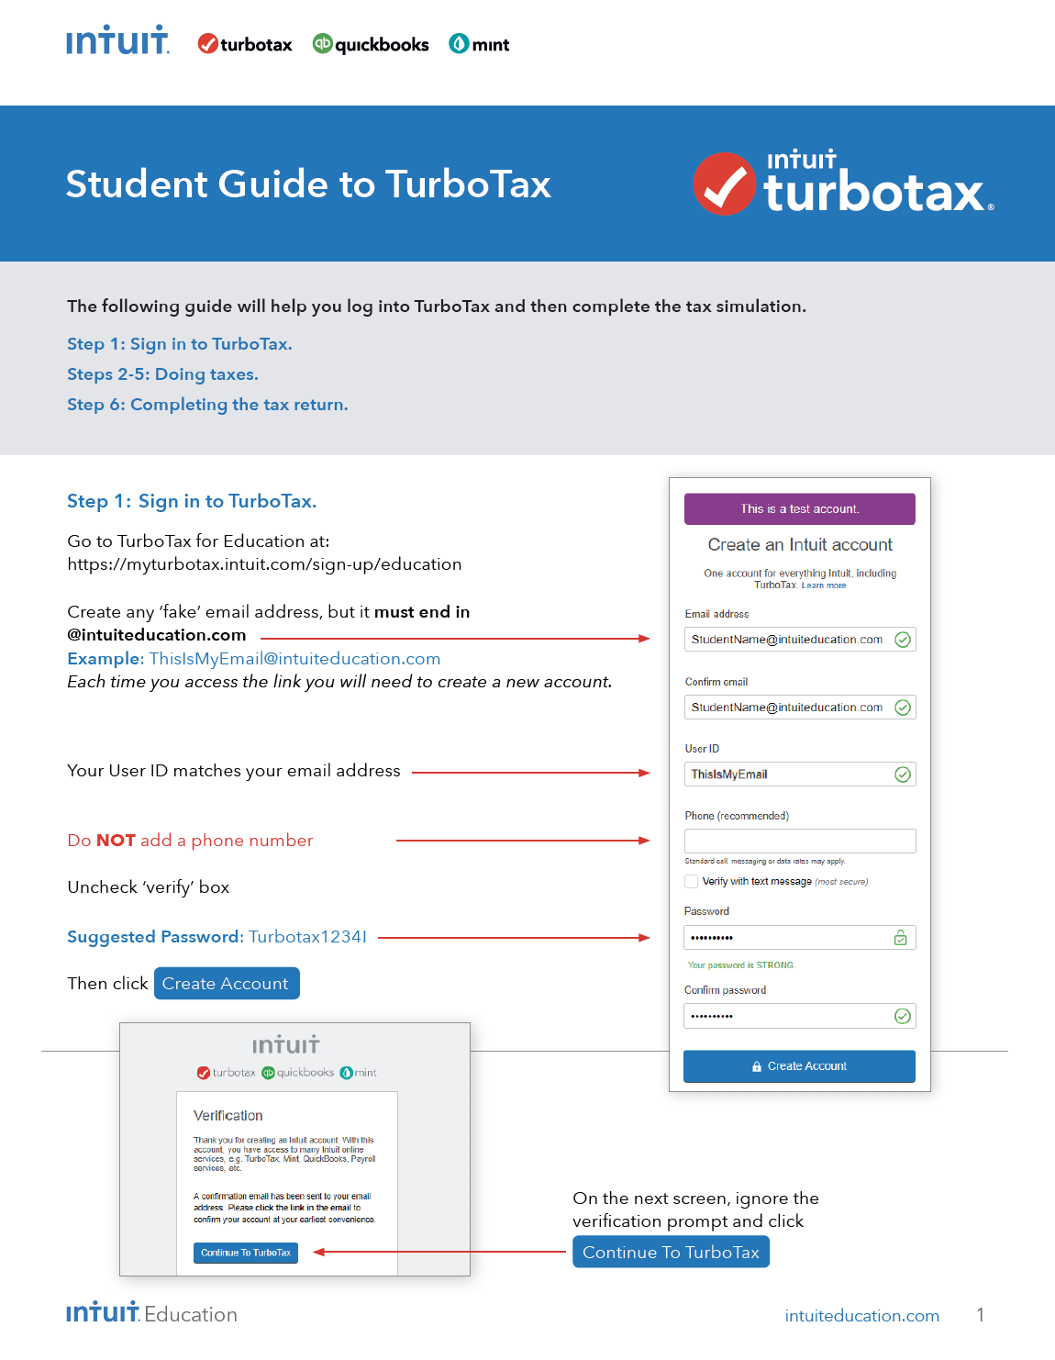
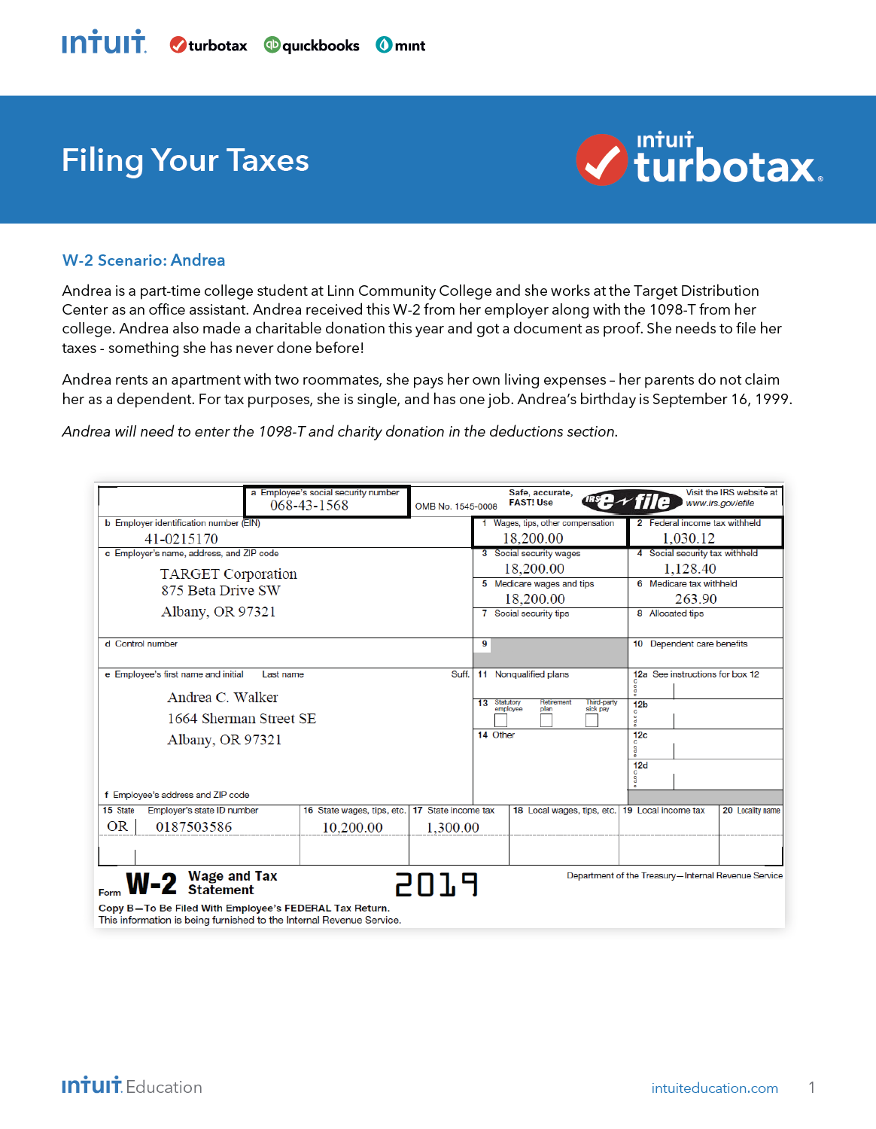
What is TurboTax?
Practice filing fictional taxes, in easy and relevant ways
Demystify Tax Day Anxiety
Uses IRS Free File Program through Freedom File Alliance
Fictional W2 Scenarios
Federal and State Returns
Notes:
Use this divider when using Title Option 2

Slide 11
Intro to Taxes
There are FOUR case studies in the Turbotax curriculum.
Case study 1 - Ezra Daniels.
(Using W2’s)
Case study 2 - Ada Singh
(Using W2’s and 1098-T)
Case study 3 - Dirk Lohanin
(Using multiple W2 forms)
Case study 4 - Karissa Rettig
(Advanced case study)
Notes:
Use this divider when using Title Option 2

Slide 12
Intro to Taxes
Time Frame: One to two class periods (depending on the number of W2s)
Purpose: Demystify Tax Day anxiety and help students understand the withholding of income taxes from pay using TurboTax.
Objectives: Students will be able to learn and practice filing taxes using the IRS Free File Program for synchronous and asynchronous learning.
Students will be able to:
Identify payroll taxes
Explain how federal income taxes are used
Describe how employers withhold and remit taxes
Explain the purpose of form W4 and W2
Use the following EconEdLink activity:
https://www.econedlink.org/resources/intro-to-turbotax-simulation/
Notes:
Use this divider when using Title Option 2

Slide 13
Intro to Taxes
Tax Activities
Three activities using the Turbotax application.
Tax word hunt
Tax due diligence and short answer
W-4 Exercise
W-2 Exercise
Notes:
Use this divider when using Title Option 2

Slide 14
Tax word hunt
Log into Turbotax. Search the following words and terms. Write down the definitions for each.
Vocabulary Words:
Intro to Taxes
Filing Status
Head of Household
Legally Blind
Married Filing Jointly
Qualifying Widow(er)
Your Marital Status
Single
EIN
W-2 Income
Notes:
Use this divider when using Title Option 2

Slide 15
Intro to Taxes
Activity #2
Tax due diligence
What personal information do you need to file your taxes? List at least 5 (five).
If you do not have a social security number to file taxes, what identity number could you legally use instead?
On a W-2, what can you find in boxes a-f and 1-6?
On a W-2, what can you find in boxes 15-20?
Notes:
Use this divider when using Title Option 2

Slide 16
Intro to Taxes
Activity # 3
Answer the following questions and complete the sample W-4 form
Complete the following W-4 form.
https://apps.irs.gov/app/understandingTaxes/hows/mod01/media/fs_mod01.pdf
Complete the following W-4 simulation.
https://apps.irs.gov/app/understandingTaxes/hows/mod01/sim_mod01_01.jsp
Notes:
Use this divider when using Title Option 2

Slide 17
Activity # 4
W-2 Exercise
Label all of the boxes from a W2. Use the Turbotax platform to help you fill these in.
Intro to Taxes
BOX A - | BOX 1 -
BOX B - | BOX 2 -
BOX C - | BOX 3 -
BOX D - | BOX 4 -
BOX E - | BOX 5 -
BOX F - | BOX 6 -
 | BOX 7 -
 | BOX 8 -
 | BOX 9 -
 | BOX 10 -
Notes:
Use this divider when using Title Option 2

Slide 18
TurboTax Simulation Demo

Slide 19
Thank You | Q&A
Next Webinar:
December 9th 2020 ,7-8 p.m. ET
Various W2 simulations and activities

