Slide 1
Fundamentals of AP Economics 404
Comparative Advantage and Trade
Presented by Theodore Opderbeck
2/22/21 opderbeckt@waldwickschools.org

Slide 2
EconEdLink Membership
You can now access CEE’s professional development webinars directly on EconEdLink.org! To receive these new professional development benefits, become an EconEdLink member. As a member, you will now be able to:
Automatically receive a professional development certificate via e-mail within 24 hours after viewing any webinar for a minimum of 45 minutes
Register for upcoming webinars with a simple one-click process
Easily download presentations, lesson plan materials and activities for each webinar
Search and view all webinars at your convenience
Save webinars to your EconEdLink dashboard for easy access to the event
You may access our new Professional Development page here

Slide 3
Professional Development Certificate
To earn your professional development certificate for this webinar, you must:
Watch a minimum of 45-minutes and you will automatically receive a professional development certificate via e-mail within 24 hours.
Accessing resources:
You can now easily download presentations, lesson plan materials, and activities for each webinar from EconEdLink.org/professional-development/

Slide 4
Agenda
Discuss the concepts of comparative advantage, absolute advantage, and terms of trade as they relate to the AP Economics Curriculum.
Explore formative and summative assessment options and EdTech resources to maximize student understanding.
Introduce dynamic learning activities and lesson plans to reinforce content.

Slide 5
Objectives
To analyze the concepts of absolute and comparative advantage and terms of trade.
To investigate resources to construct digital formative and summative assessments to reinforce learning and prepare for the AP test.
To apply the concepts of absolute and comparative advantage to real world national and international examples.
To introduce dynamic learning activities and project ideas to engage students.

Slide 6
National Standards
Council for Econ Ed Standard 5: Trade - Voluntary exchange occurs only when all participating parties expect to gain. This is true for trade among individuals or organizations within a nation, and among individuals or organizations in different nations.
Council for Econ Ed Standard 6: Specialization - When individuals, regions, and nations specialize in what they can produce at the lowest cost and then trade with others, both production and consumption increase. .https://www.councilforeconed.org/wp-content/uploads/2012/03/voluntary-national-content-standards-2010.pdf

Slide 7
State Standards
NYS Social Studies 12.E4 THE TOOLS OF ECONOMIC POLICY IN A GLOBAL ECONOMY: Globalization and increased economic interdependence affect the United States economy significantly. The tools that the policy makers have available to address these issues are fiscal policy, monetary policy, and trade policy.
http://www.nysed.gov/common/nysed/files/programs/curriculum-instruction/ss-framework-9-12.pdf

Slide 8

Question of the Day
Which nation is the leading trade partner of the U.S. (exports plus imports)?
Mexico
Japan
China
Canada

Slide 9
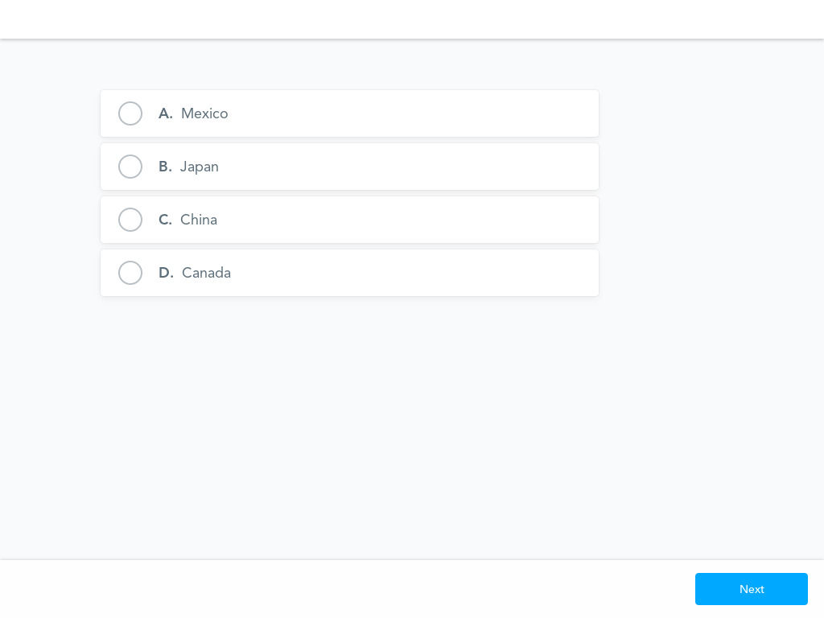


Slide 10
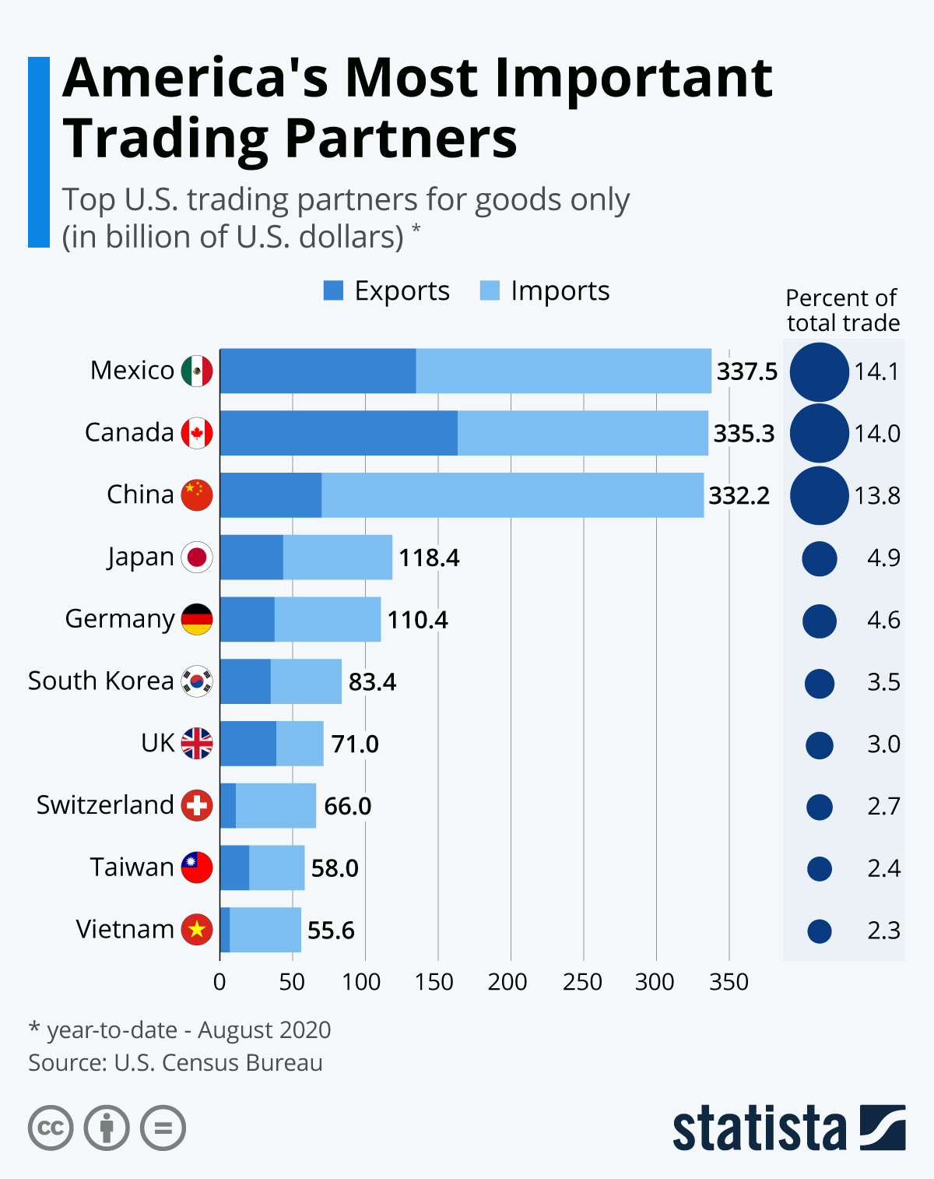

Slide 11
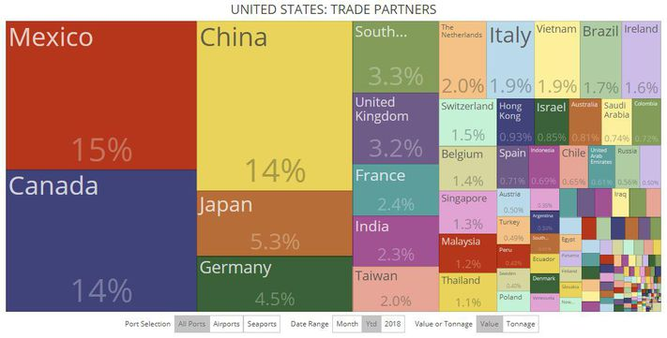

Slide 12

Question of the Day
What is currently the top export (in $) of the U.S.?
Aircraft
Motor vehicles
Oil and natural gas
Machinery, including computers

Slide 13
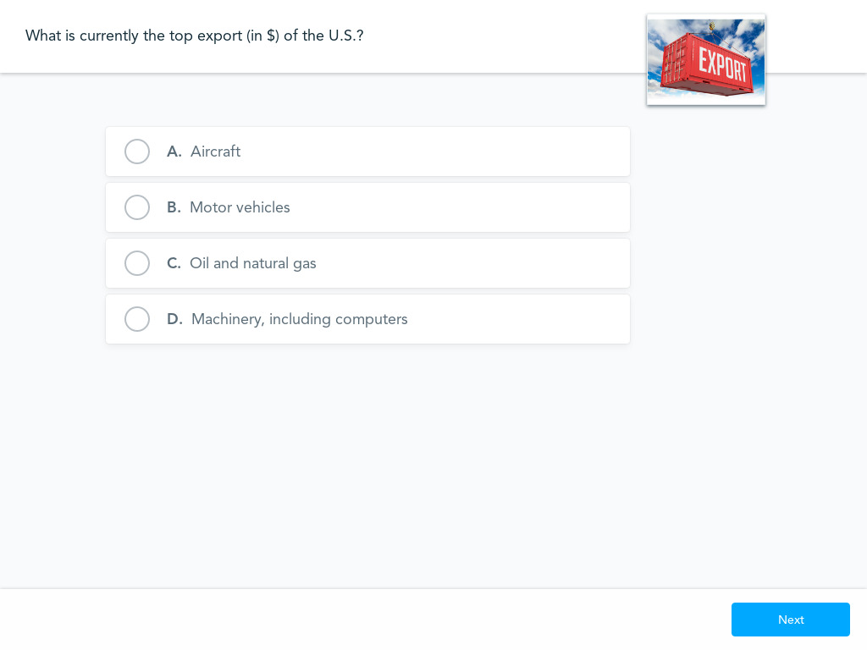

Slide 14
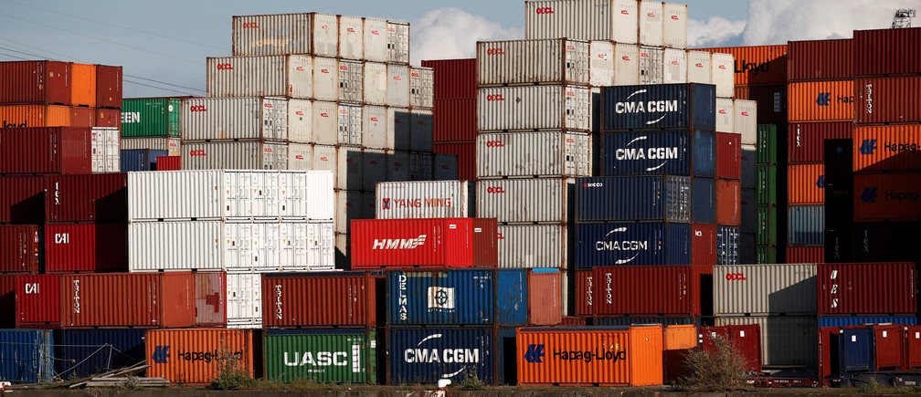
Fun Fact
Often, it costs too much to send shipping containers back and it is cheaper to purchase them.
They have been used recently in modern home construction and for charitable home building.

Slide 15





Slide 16





Slide 17
Economics and Cross Curricular Applications
Political Science
History/ Global Studies
Sociology
Science
Mathematics
Scarcity and Opportunity Cost
Comparative Economic Systems
Resource Allocation Models
Fiscal Policy

Slide 18
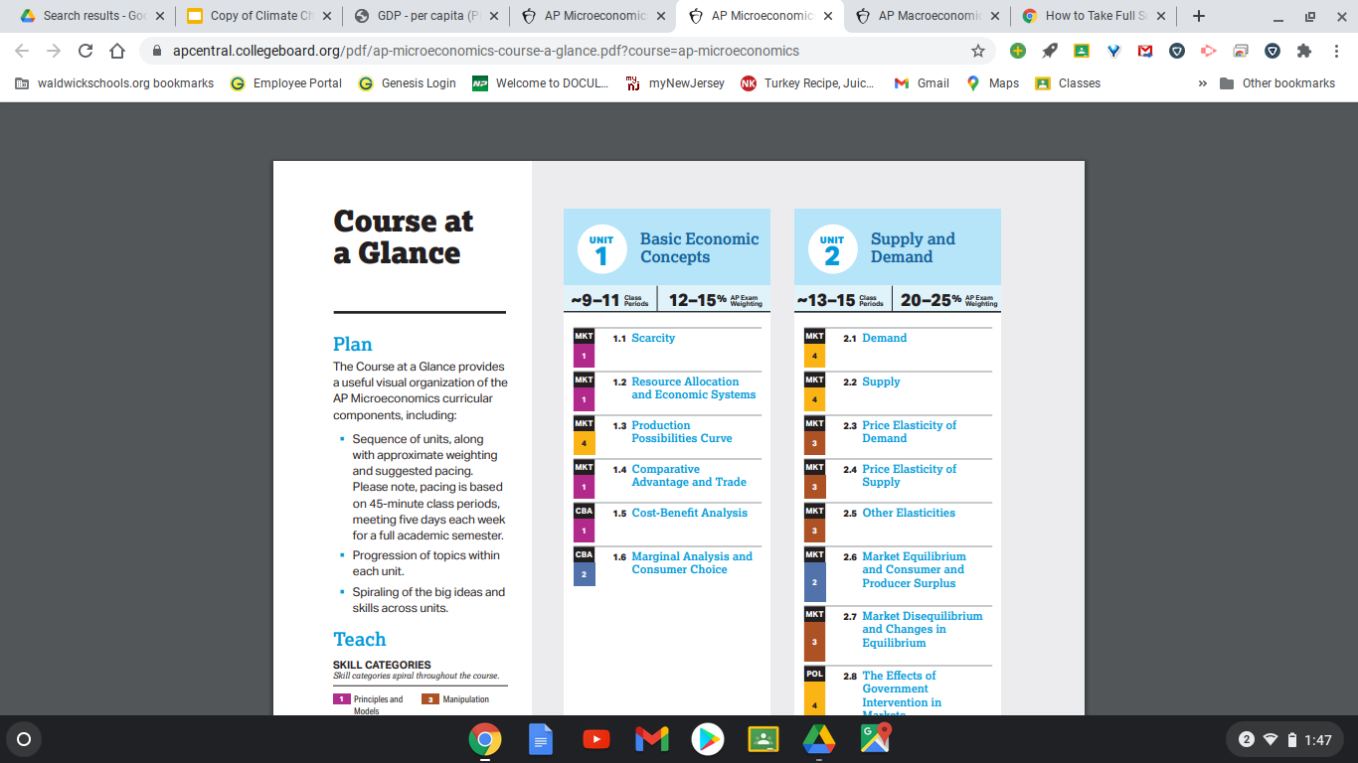
AP Economics Curriculum

Slide 19
AP Economics College Board Curriculum/ Resources
https://apcentral.collegeboard.org/courses/ap-microeconomics/course
https://apcentral.collegeboard.org/courses/ap-macroeconomics/course
https://myap.collegeboard.org/login

Slide 20





Slide 21

Important Concepts
Absolute Advantage vs. Comparative Advantage
Specialization vs. Diversification
Terms of Trade
Free Trade vs. Protectionism

Slide 22
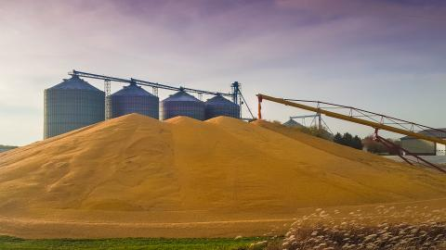

Absolute Advantage
Absolute Advantage: the ability of an economy to produce a greater quantity of goods or services for the same quantity of inputs.

Slide 23


Comparative Advantage
Comparative Advantage: the ability of an economy to produce a particular good or service at a lower opportunity cost than its trading partners.

Slide 24


Comparative Advantage - Calculating Opportunity Cost
Opportunity Cost = Foregone / Gained
Ex: Given available resources, the U.S. can produce either wheat or soybeans. If we use all resources for wheat we can produce 100 tons. If we use all resources for soybeans we can produce 80 tons. What is the opportunity cost of producing wheat?

Slide 25
Comparative Advantage - Calculating Opportunity Cost
Opportunity Cost = Foregone / Gained
We need to give up 80 tons of soybeans in order to produce 100 tons of wheat.
80 / 100 = .80
For every one unit of wheat we are giving up .8 units of soybeans.

Slide 26

Comparative Advantage - Calculating Opportunity Cost
Who uses the concept of opportunity cost to make decisions when allocating scarce resources?
Consumers
Businesses
Governments

Slide 27


Absolute and Comparative Advantage Example
With all given resources, Spain can produce either 200 million gallons of wine or 100 million gallons of olive oil.
With all available resources, Italy can produce either 400 million gallons of wine or 500 gallons of olive oil.

Slide 28
 | SPAIN | ITALY
WINE | 200 | 100
OLIVE OIL | 400 | 500
Who has absolute advantage in wine?
Who has absolute advantage in olive oil?

Slide 29
 | SPAIN | ITALY
WINE | 200 | 100
OLIVE OIL | 400 | 500
Who has comparative advantage in wine?
  Spain = 400 olive oil / 200 wine = 2
  Italy = 500 olive oil / 100 wine = 5
Who has comparative advantage in olive oil?
  Spain = 200 wine / 400 olive oil = .5
  Italy = 100 wine / 500 olive oil = .20

Slide 30
Even though Italy has absolute advantage in both wine and olive oil ……
It would benefit both countries to specialize in what they have comparative advantage in and trade with each other.
Best outcome:
Spain specializes in wine
Italy specializes in olive oil . . .
And the two nations trade with each other

Slide 31
Wine
200
France
100
Spain
400
500
Olive Oil

Slide 32

Specialization vs. Diversification
Specialization: occurs when an economy/nation concentrates its resources on producing a limited variety of goods and/or services
Diversification: occurs when an economy/nation spreads its resources on producing a large variety of goods and/or services.

Slide 33

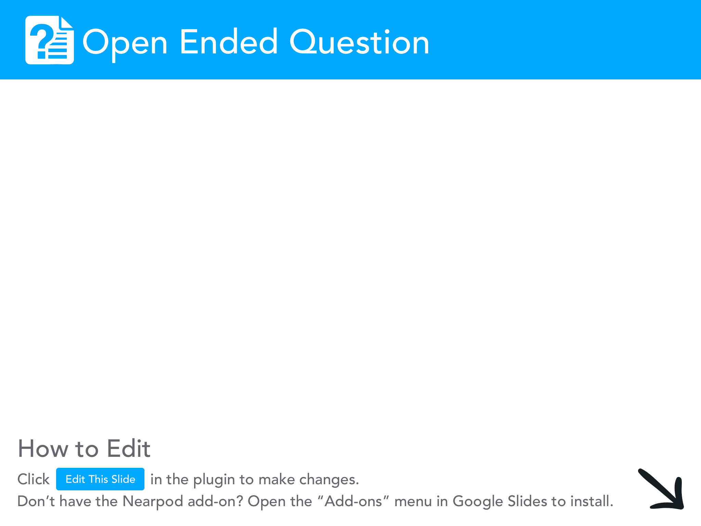

Slide 34
Predominant Theory
Economies/Nations should specialize their resources towards producing a limited amount of goods and services for which they have a comparative advantage (lowest opportunity cost)
Nations should trade with each other for the goods and services they don’t have a comparative advantage in producing.
This has led to the explosion of globalization.

Slide 35
Advantages of Specialization and Trade
Economic Gains: more efficiency, economies of scale, lower costs for consumers with increased international competition
Political Benefits: increased global connections, improved diplomacy, political leverage, free trade zones
Specialization of Labor: better labor specialization, mastery of task, concentrated human capital
Cultural Exchange: increased knowledge of other cultures and ideas

Slide 36
Disadvantages of Specialization and Trade
Susceptibility to Shocks: crop failures, diseases, natural disasters
Lack of Skill Variety: labor is over specialized, efficiency stressed over quality of life
Trade Embargoes/ Geopolitical Risks: nations could be cut out of markets and trade can suffer
Loss of Domestic Jobs/ Outsourcing/ Offshoring

Slide 37

The Prebisch-Singer Hypothesis
The price of primary commodities declines over time in relation to manufactured goods.
This leads to decreased trade prospects for poor nations which specialize in single commodities such as agricultural exports.
This relationship has been questioned recently.
Ex: 2008 coffee rust blight in Colombia

Slide 38
Student Project
Students will analyze the positive and negative consequences of specialization and diversification in an economy.
Complete a graphic organizer here
In person - role playing simulation/ model UN meeting
Virtual - break out room discussion/ jigsaw

Slide 39
Student Activities
Student research assignment on individual nations/ economies: https://docs.google.com/presentation/d/1sCX31AZpKu1viG2uQenoJzqYNB9qSFLB3WZbNwI-yhA/edit?usp=sharing
Article Review: https://docs.google.com/document/d/1psquW6RYwIn2P9M0IXn4Nz6xE30Lmq_Leea3N10uYys/edit?usp=sharing

Slide 40
Google Slides/ Notes
Slides: https://docs.google.com/presentation/d/1jYnnmq93F1q8b0OuKzxONKntqG7fZxCUhRivVnsXvN8/edit?usp=sharing
Slides: https://docs.google.com/presentation/d/1ELT8W3iezmDBU7V5UCe2mgjlCevB_lOHciYSxl4Nuug/edit?usp=sharing

Slide 41

Student Simulation
“Hands On/ Fun” Simulation: Specialization and Trade
https://docs.google.com/document/d/110BZwjqJHmfiFcowd7Uk23MdKylS5MJlOMuZgE58MOM/edit?usp=sharing

Slide 42

Terms of Trade
Def: A ratio of a nation’s export prices in relation to its import prices.
How many units of exports are required to purchase a single unit of imports?
Expressed as a ratio - Exports : Imports

Slide 43
Terms of Trade
A favorable terms of trade occurs when a nation can import relatively more in exchange for the same exports
An unfavorable terms of trade occurs when a nation receives less imports in exchange for its exports

Slide 44
An Example from Childhood
Did anyone trade baseball cards as a kid? (I know I’m dating myself :)
Good terms of trade: I trade one George Brett (Export) and get a Rickey Henderson from a friend. (Import)
Bad terms of trade: I need to trade a George Brett, Dwight Gooden and a Don Mattingly (Exports) for a Rickey Henderson (Import)

Slide 45


Slide 46
Terms of Trade
How to calculate terms of trade?
Determine which nation has comparative advantage by calculating opportunity costs
Assume that each nation will specialize in what it has a comparative advantage in
Assume that the nations will trade with each other
Determine how much of each product will be exchanged after specializing and trading. That is our terms of trade.

Slide 47
 | SPAIN | ITALY
WINE | 200 | 100
OLIVE OIL | 400 | 500
Who has comparative advantage in wine?
  Spain = 400 olive oil / 200 wine = 2
  Italy = 500 olive oil / 100 wine = 5
Who has comparative advantage in olive oil?
  Spain = 200 wine / 400 olive oil = .5
  Italy = 100 wine / 500 olive oil = .20

Slide 48
Terms of Trade
Spain specializes in wine and can produce 200 million gallons
Italy specializes in olive oil and can produce 500 million gallons
Terms of trade for Spain 200 wine : 500 olive oil
Terms of trade for Italy 500 olive oil : 200 wine

Slide 49
Terms of Trade
Terms of trade for Spain 200 wine : 500 olive oil
Terms of trade for Italy 500 olive oil : 200 wine
Suppose the terms of trade changed to 400 wine : 500 olive oil?
Would this new terms of trade be advantageous to Spain? NO - receiving same olive oil for more wine
Would this new terms of trade be advantageous to Italy? YES - receiving more wine for same olive oil

Slide 50

Why are terms of trade important in the “real world?”
We live in an increasingly globalized interconnected world.
Are nations specializing in goods and services with high value relative to what they are trading for?
What important decisions need to be made to ensure efficient specialization of productive resources?

Slide 51
Student Problem Sets
https://docs.google.com/document/d/1n7Faugeho1Mqkm8h5srmCD3va-iiYjeAxW6pBMwW_Fg/edit?usp=sharing
https://docs.google.com/document/d/1vR58I-M6Xy8RlrGa9oJh3hPq3mNTzpN1KsSdFEYs3QE/edit?usp=sharing
https://drive.google.com/file/d/0B3rkKTzIxBXEMEhEdlpWM1FXNDg/view?usp=sharing
https://docs.google.com/document/d/1uHwypiXXzNRAEQaXEaCcOzruhBHKgCVt-8DKKTSf3IE/edit?usp=sharing
https://docs.google.com/document/d/17jBDsf3NHUG0HyJKhL-CVrG-n1m340i2Ug-b5iMGNY4/edit?usp=sharing

Slide 52
Past AP Free Response Questions
https://secure-media.collegeboard.org//digitalServices/pdf/ap/ap16_frq_macroeconomics.pdf
https://secure-media.collegeboard.org//digitalServices/pdf/ap/ap15_frq_macroeconomics.pdf
https://secure-media.collegeboard.org/apc/ap08_macro_econ_frq.pdf
https://secure-media.collegeboard.org/apc/ap04_frq_macro_b_36232.pdf

Slide 53

Free Trade vs. Protectionism
Free Trade: the elimination of any barriers (quotas, tariffs, etc) between nations
Protectionism: the imposition of barriers (quotas, tariffs, etc.) between nations to protect domestic industries from foreign competition.

Slide 54

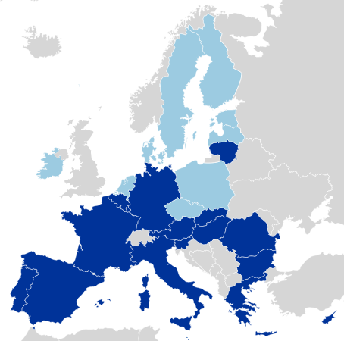

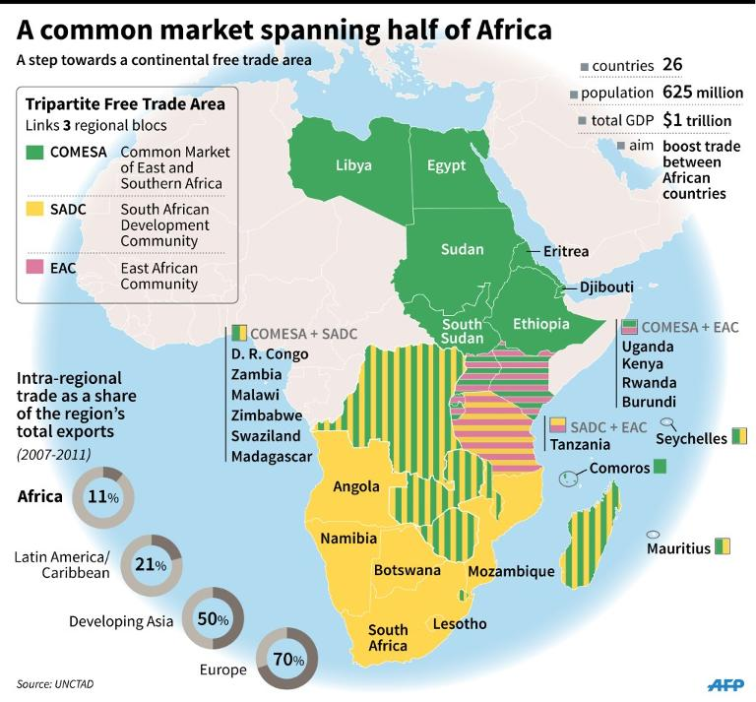
Notes:
United States Canada Mexico Agreement

Slide 55

Free Trade vs. Protectionism Research Assignment
https://docs.google.com/presentation/d/1mjdim1x96V5CjzLluT1QjEYGo4xIDjE0j43WG9b_pDQ/edit?usp=sharing

Slide 56
Formative Assessment Options
Socrative: b.socrative.com Room Name: Opderbeck
Google Forms: https://www.google.com/forms/about/
Quizlet Live: www.quizlet.com
Kahoot: www.kahoot.com
Blooket: www.blooket.com

Slide 57

Sources for Prepared Articles
Newsela:
www.newsela.com
EX: https://newsela.com/read/natgeo-impact-globalization-place/id/53351/quiz/question/0/?search_id=ee6ff03f-7852-423a-879f-b6694d985f33&collection=2000000224

Slide 58

Sources for Prepared Videos
EdPuzzle: www.edpuzzle.com
Ex: https://edpuzzle.com/search?q=comparative%20advantage

Slide 59
Some Interesting Reads in Context of Contemporary Issues. . .
https://www.nytimes.com/2020/04/16/upshot/world-economy-restructuring-coronavirus.html
https://www.forbes.com/sites/imperialinsights/2021/01/08/does-covid-19-mean-the-end-for-globalization/?sh=53cd7926671e
https://www.weforum.org/agenda/2020/12/covid-19-future-of-globalization-trade/

Slide 60
References/ Resources
https://www.khanacademy.org/economics-finance-domain/ap-macroeconomics/basic-economics-concepts-macro/scarcity-and-growth/a/lesson-summary-comparative-advantage-and-gains-from-trade
https://www.youtube.com/watch?v=HneRNVtahYw
https://www.youtube.com/watch?v=4rUfoU04QJM

Slide 61

CEE Affiliates
https://www.councilforeconed.org/resources/local-affiliates/

Slide 62




Thank You to Our Sponsors!

Slide 63

The Conference is your pathway to learn about the opportunities to incorporate personal finance and economics into your K-12 classroom and to exchange ideas with hundreds of peers.
Register by August 15, 2020 to receive the early bird special discount:
$79 Early Bird ($99 thereafter)
Register Today >>>
https://www.councilforeconed.org/events/conference

