Slide 1


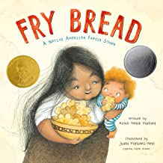

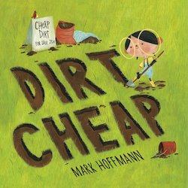
Hot off the Presses:
New Picture Books featuring Economic Concepts
Lynne Farrell Stover
January 12, 2021 stoverlf@jmu.edu

Slide 2
EconEdLink Membership
You can now access CEE’s professional development webinars directly on EconEdLink.org! To receive these new professional development benefits, become an EconEdLink member. As a member, you will now be able to:
Automatically receive a professional development certificate via e-mail within 24 hours after viewing any webinar for a minimum of 45 minutes
Register for upcoming webinars with a simple one-click process
Easily download presentations, lesson plan materials and activities for each webinar
Search and view all webinars at your convenience
Save webinars to your EconEdLink dashboard for easy access to the event
You may access our new Professional Development page here

Slide 3
Professional Development Certificate
To earn your professional development certificate for this webinar, you must:
Watch a minimum of 45-minutes and you will automatically receive a professional development certificate via e-mail within 24 hours.
Accessing resources:
You can now easily download presentations, lesson plan materials, and activities for each webinar from EconEdLink.org/professional-development/

Slide 4
Agenda
In this webinar, we will discover new picture books that engage young students as they learn about:
Opportunity Cost
Entrepreneurship
Productive Resources
Money
Choices
Human Capital
Also provided:
Hands on lessons and activities
Websites providing support materials
Related standards
Annotated bibliography
Q & A opportunities

Slide 5
Objectives
Teachers will be able to:
Review basic economic concepts.
Explore new picture books (copyrights 2017-2020) and identify the economic concepts found in them.
Learn how to use book content to teach age- appropriate lessons and activities based on the featured concepts.

Slide 6
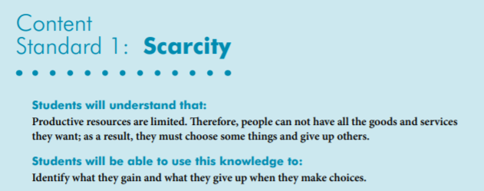
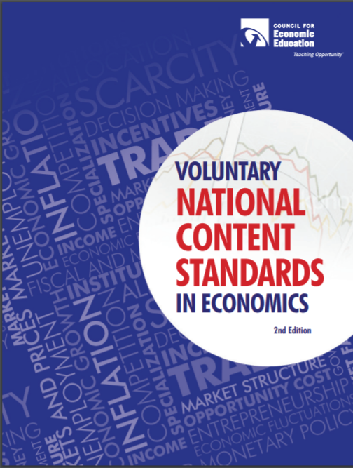
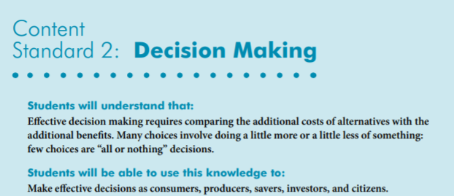
National Standards
https://www.councilforeconed.org/wp-content/uploads/2012/03/voluntary-national-content-standards-2010.pdf

Slide 7

State Standards
Virginia HISTORY & SOCIAL SCIENCE Standards of Learning
K.9 The student will
a) recognize that people make choices because they cannot have everything they want; and
explain that people work to earn money to buy the things they want.
1.9 The student will recognize that people save money for the future to purchase goods and services.
2.8 The student will describe natural resources (water, soil, wood, and coal),
human resources (people at work), and capital resources (machines, tools, and buildings).
3.10 The student will identify examples of making an economic choice and will explain the idea of
opportunity cost (what is given up when making a choice).

Slide 8
Using Children’s Literature to Teach Economics
It is to be noted that by using children’s picture books to teach in the content areas, we are providing students with engaging background information that encourages them to relate to concepts, improve vocabulary, and promote reading and writing skills.
Children’s literature offers many interdisciplinary possibilities including those of economics and personal finance.

Slide 9
Featured Economic Concepts
Choice- An act of selecting or making a decision when faced with two or more alternatives.
Entrepreneur- The person who organizes, operates, and assumes the risk for a business venture.
Human Capital- Intangible assets possessed by individuals, including knowledge, talent, skills, health, and values. (Also known as human resources)
Money – Any generally accepted medium of exchange
Opportunity Cost - The real cost of a choice. It is the next best alternative that is given up—the lost opportunity
Productive Resources- Things used in the production of goods and services including: Natural Resources (gifts of nature that are present without human intervention), Human Resources (the quantity and quality of human effort directed toward producing goods and services) and Capital Resources (manmade resources such tools, buildings, and vehicles used in production).
Wants - A desire that can be satisfied by consuming or using a good or service.
Wage- Payments for labor services that are directly tied to time worked or pieces produced.

Slide 10
Dirt Cheap by Mark Hoffmann
Copyright Date: 2020
Publisher: Alfred A. Knopf, Inc.
Reading Level: 1.0
Interest Level: P-2
Fiction

Slide 11
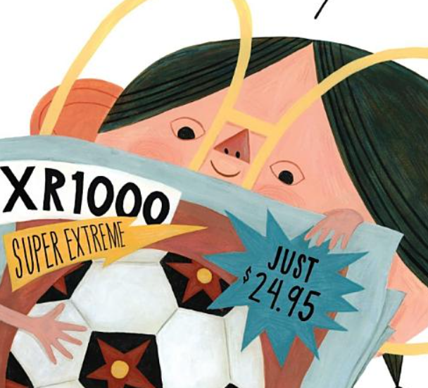
Story Synopsis: Birdie, a young entrepreneur, doesn't know much about money. She is motivated to learn so that she can purchase a new soccer ball for $24.95. When she observes her neighbors all working in their yards, she realizes that she has something that they all could use…dirt!
After digging and bagging her product she has accumulated a bag full of quarters, dimes, nickels, pennies, and even dollar bills!
However, she may not have thought through her enterprise as well as she could have.

Slide 12
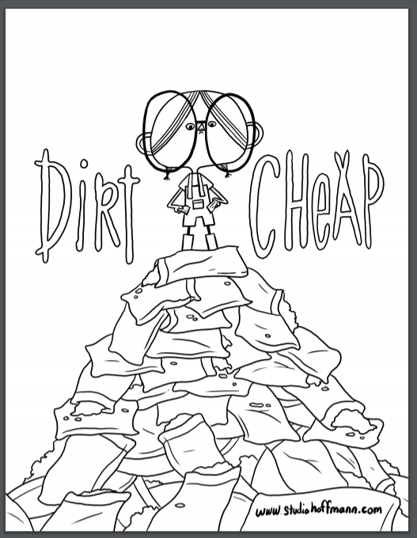
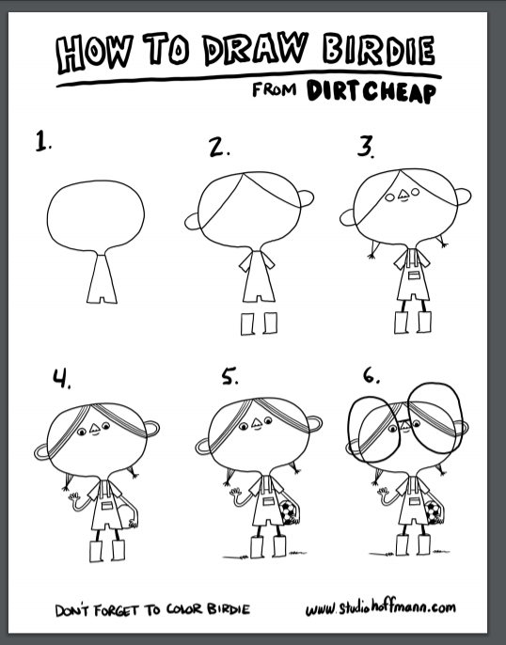
Activity Pages
https://static1.squarespace.com/static/596301cc3a0411d39d8b2f47/t/5ebf5e393072bb7b9d246b9c/1589599840669/Dirt_Cheap_1.pdf
https://static1.squarespace.com/static/596301cc3a0411d39d8b2f47/t/5ebf5e72e5e653713b79f82e/1589599926254/Dirt_Cheap_2.pdf

Slide 13
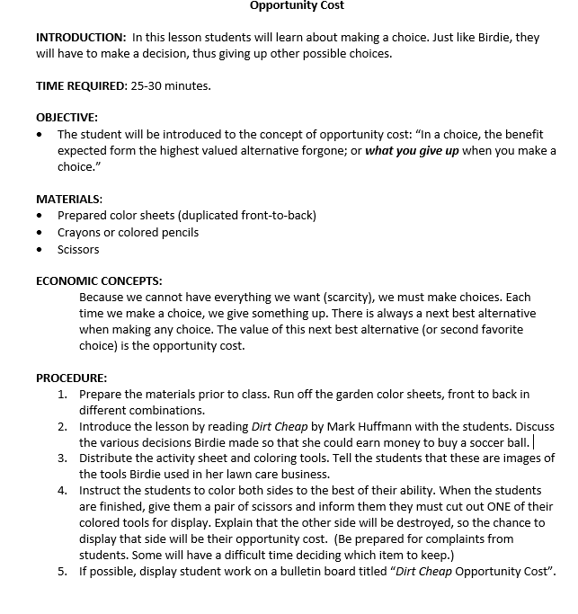
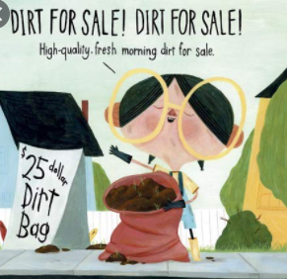
Opportunity Cost Lesson

Slide 14




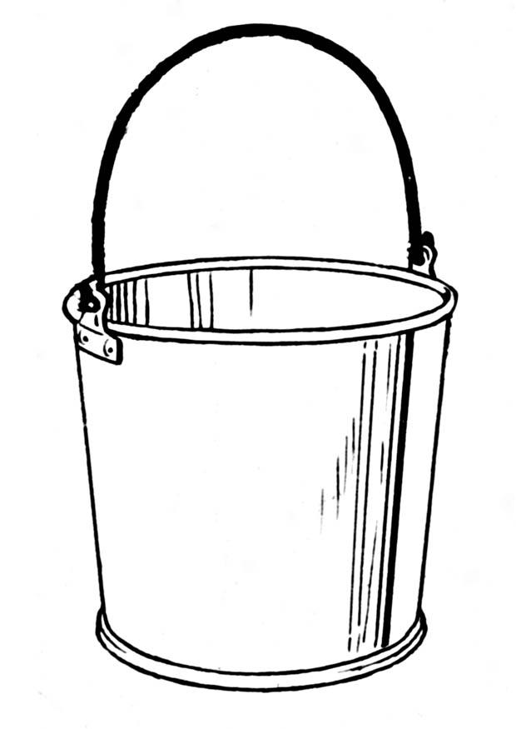


Dirt Cheap Color Sheets

Slide 15
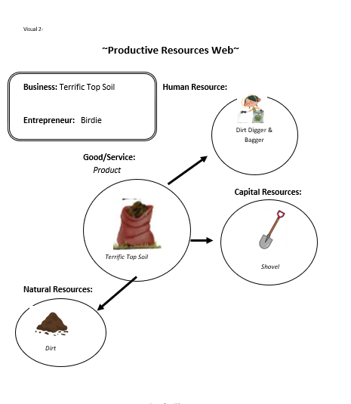
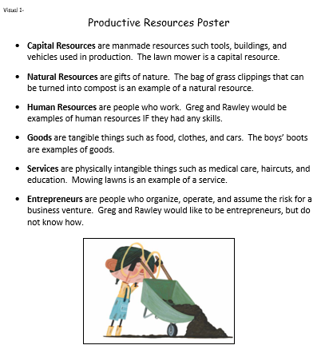
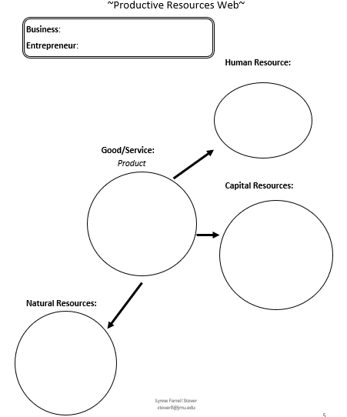
Entrepreneurship Lesson

Slide 16
Fry Bread
by Kevin Noble Maillard
Publisher: Roaring Brook Press
Copyright Date: 2019
Reading Level: 2.0
Interest Level: P-2
Realistic Fiction

Slide 17
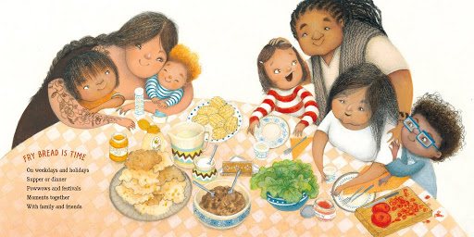
Story Synopsis: This portrayal of a modern Native American family, told in lively and powerful verse, uses fry bread as a metaphor for love, sharing, and honoring the old while embracing the new.
Connections to the making of the bread are made to sound, color, flavor, time, art, history, place and nation.

Slide 18
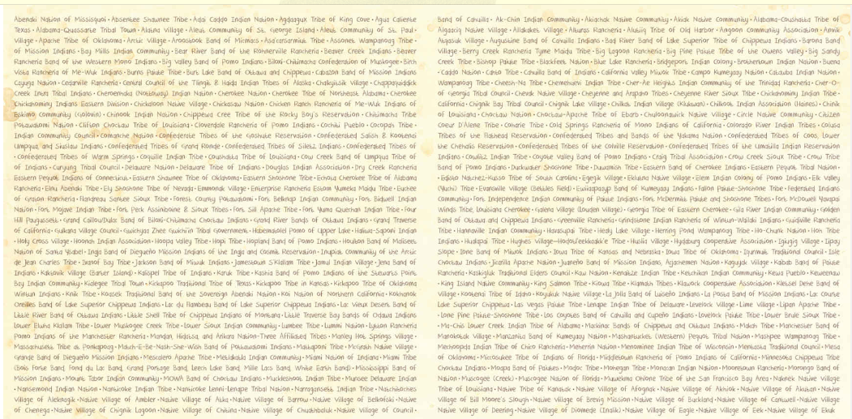
Book’s End Pages
America's 573 Recognized Tribes…

Slide 19
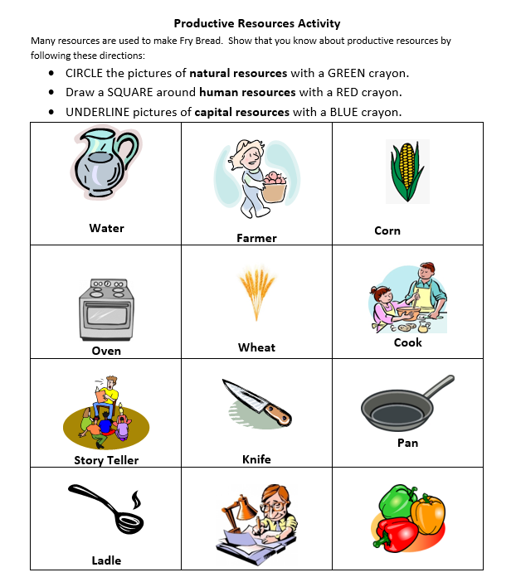

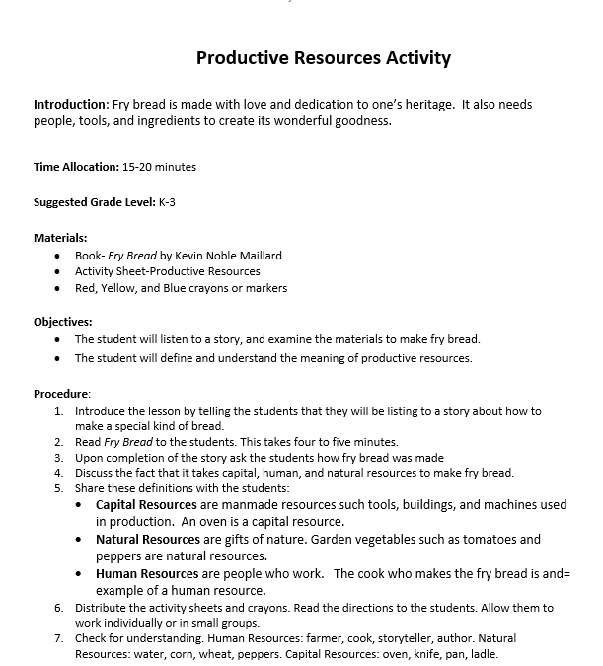
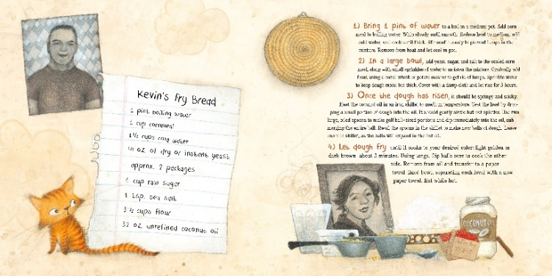
Productive Resources Lesson

Slide 20
Dreamers
by Yuyi Morales
Publisher: Holiday House
Copyright Date: 2018
Reading Level: 2.2
Interest Level: K-3
A picture book autobiography

Slide 21

Story Synopsis: Yuyi Morales brought her hopes, her passion, her strength, and her stories with her, when she came to the United States in 1994 with her infant son. She left behind nearly everything she owned, but she didn't come empty-handed. She brought her skills, determination, and work ethic with her.

Slide 22

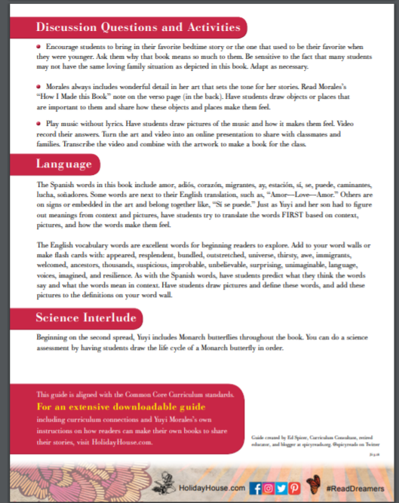
https://holidayhouse.com/wp-content/uploads/2019/01/Dreamers.pdf

Slide 23
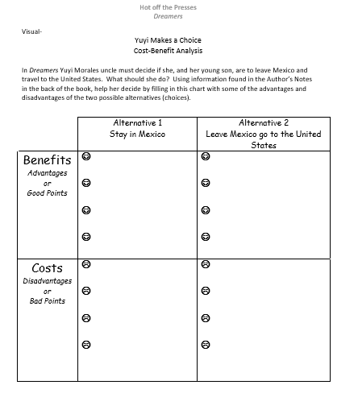
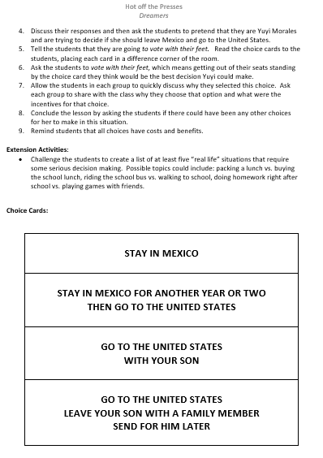
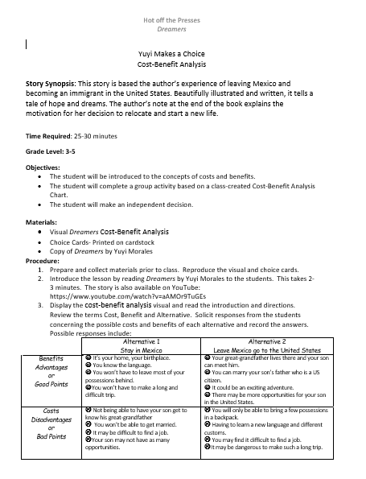
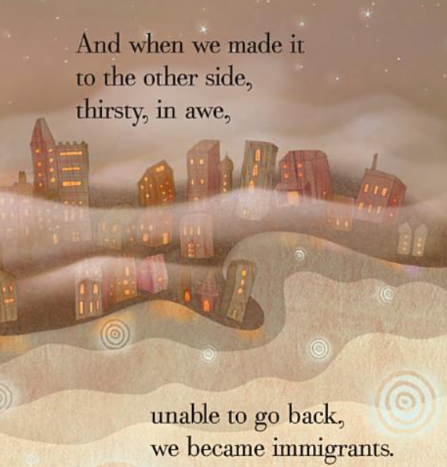
Cost-Benefit Analysis Lesson

Slide 24

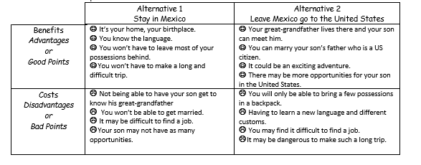

Slide 25
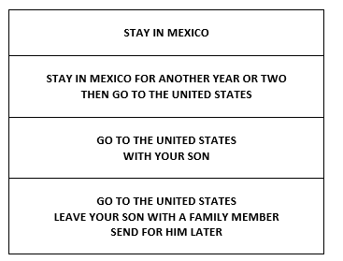


Vote With Your Feet

Slide 26
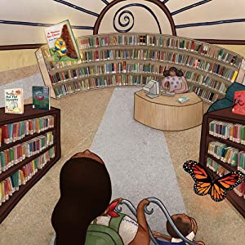
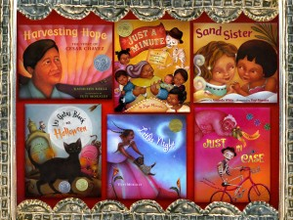
Side Note: Wonderful Libraries
For Yuyi Morales and her son, the local public library was transformative. Her visits to San Francisco Public Library, with its wealth of books, offered her an opportunity to learn about this country. Here she learns about new customs, how to speak English and also finds a new career. She and her son now call America their home.

Slide 27
A Gift from Abuela
by Cecilia Ruiz
Publisher: Candlewick Press
Copyright Date: 2018
Reading Level: 2.8
Interest Level: P-2
Realistic Fiction

Slide 28
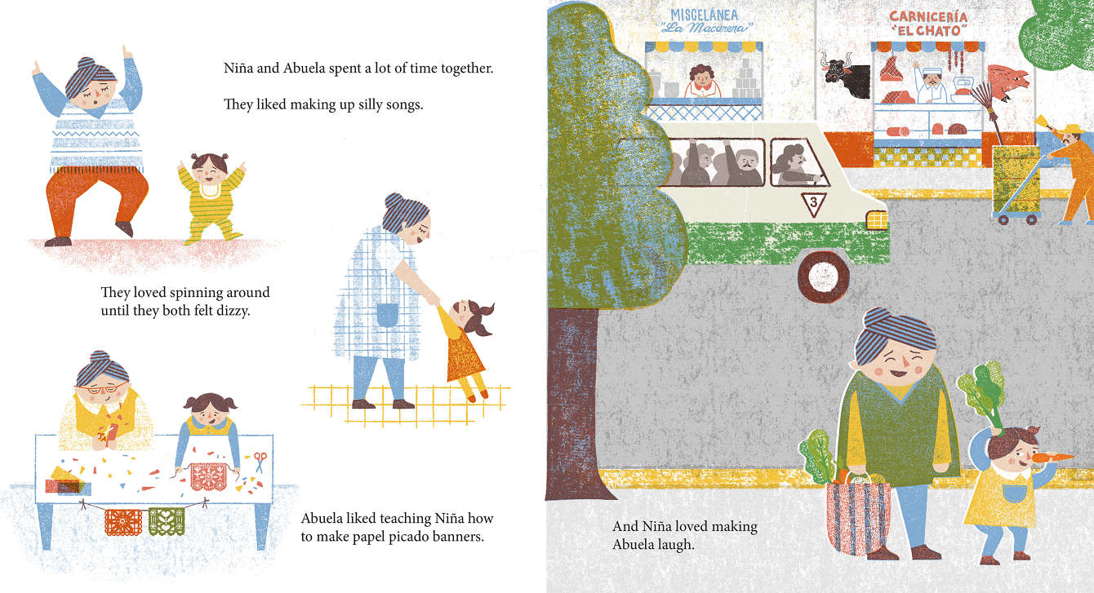
Story Synopsis: Abuela and Nina have a loving relationship, creating wonderful memories. Abuela begins to save peso notes, planning to buy something special for Nina.
However, as Nina grows up, Abuela grows older, and a newly issued currency renders the savings valueless. Luckily, time spent together — and the love Abuela and Nina have for each other — could turn out to be the very best gift of all!
.

Slide 29
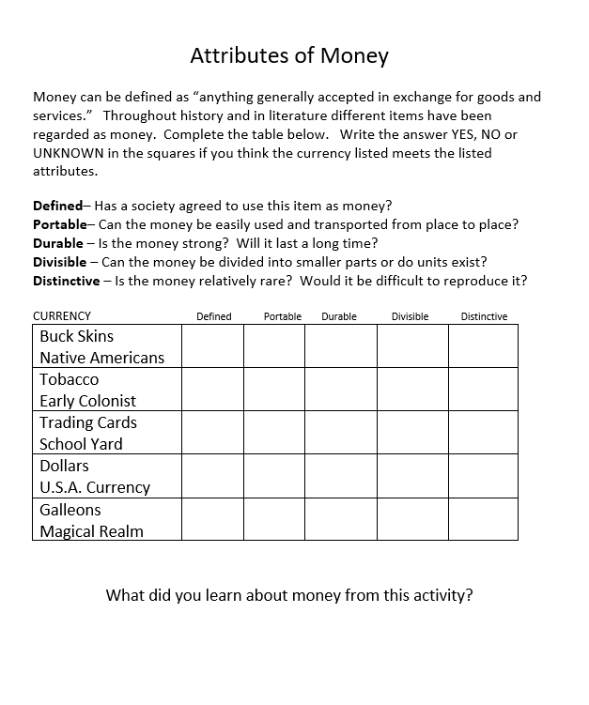
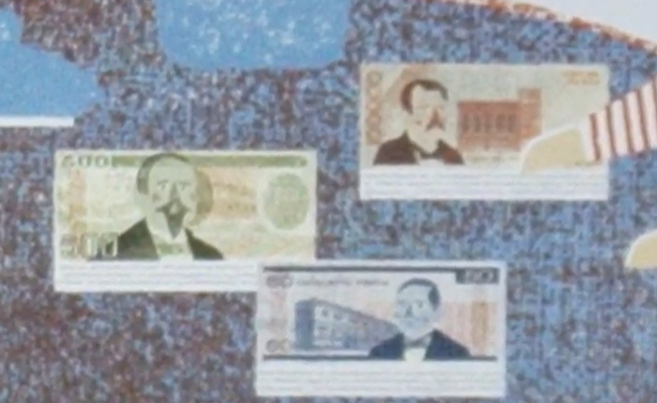
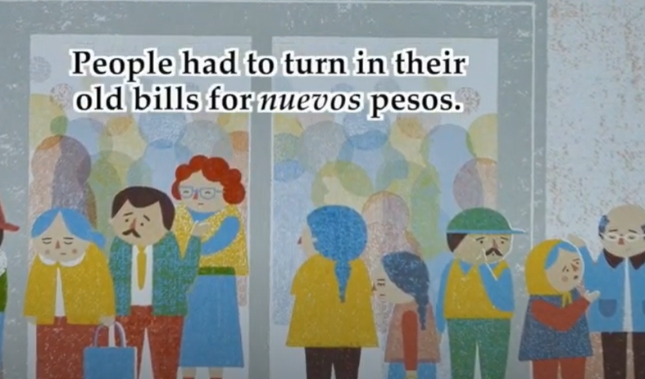

Slide 30
Resources Featuring Money Concepts

Slide 31
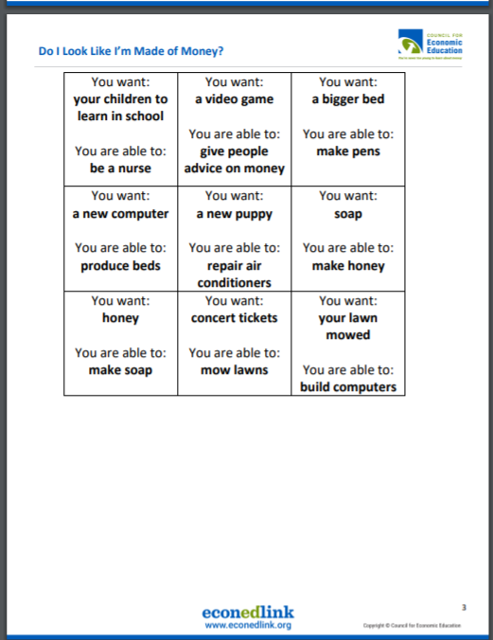
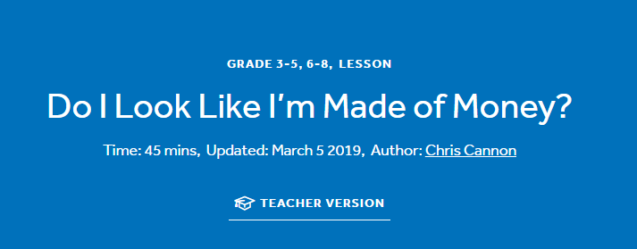
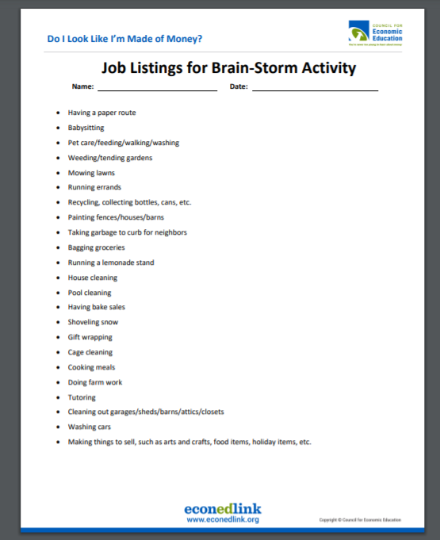
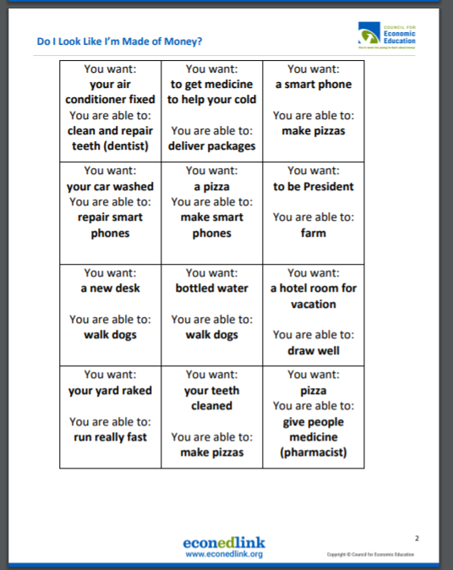
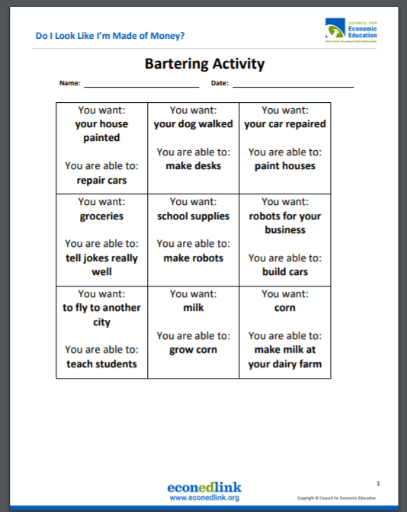
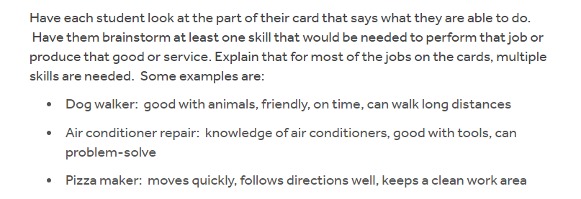
https://www.econedlink.org/resources/do-i-look-like-im-made-of-money/?view=teacher

Slide 32
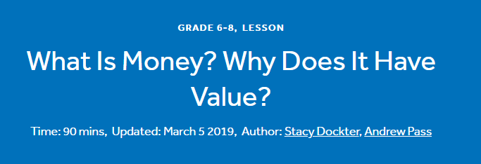
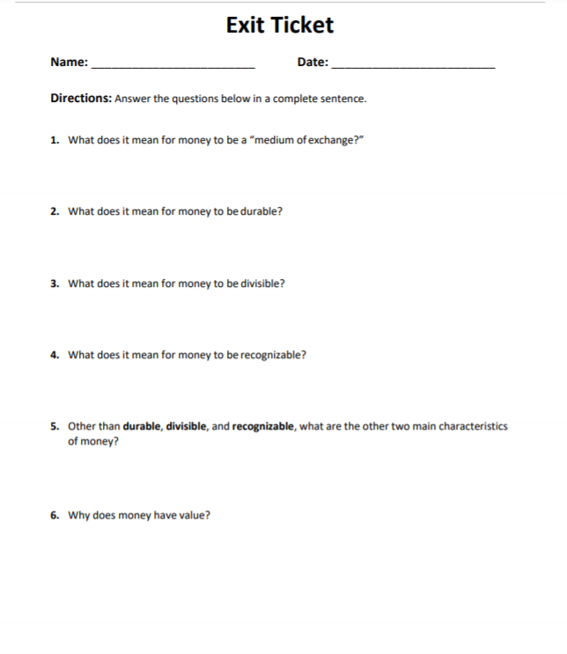
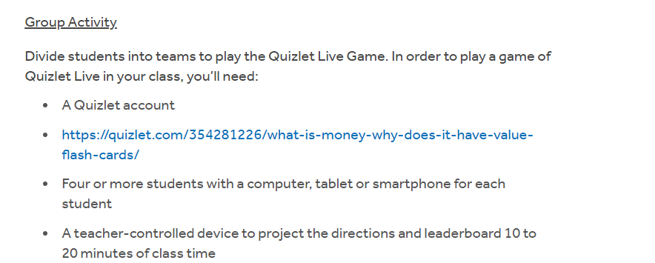
https://www.econedlink.org/resources/what-is-money-why-does-it-have-value/

Slide 33
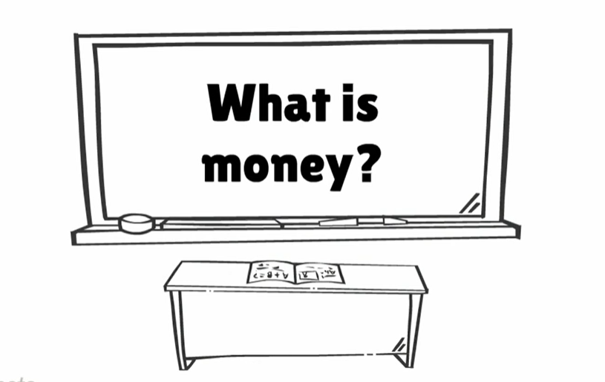
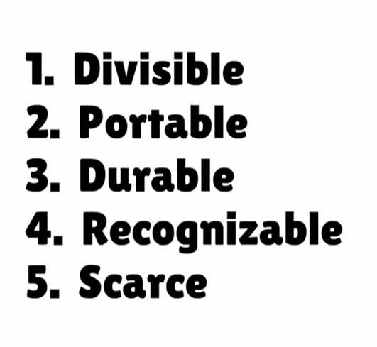
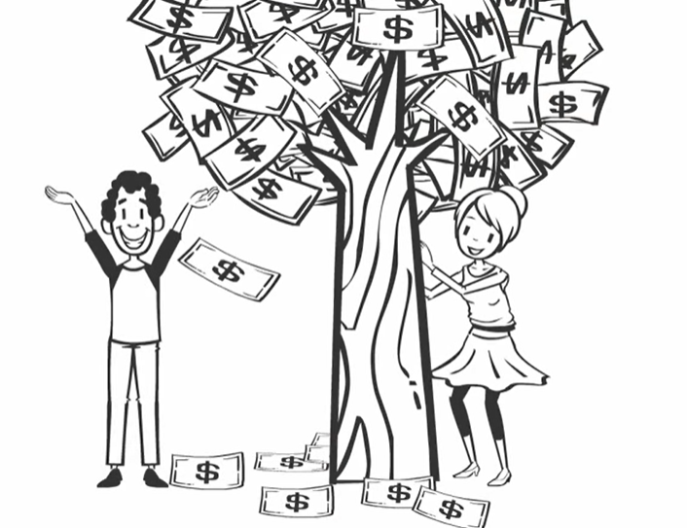
https://www.youtube.com/watch?reload=9&v=AjTwcQYgISA
We explore how money originates out of a barter system and the five characteristics of money: divisibility, portability, durability, recognizability and scarcity

Slide 34
The Oldest Student:
How Mary Walker Learned to Read
by Lorraine Hubbard
Publisher: Random House Copyright Date: 2020
Reading Level: 4.6
Interest Level: K-3
A picture book biography

Slide 35
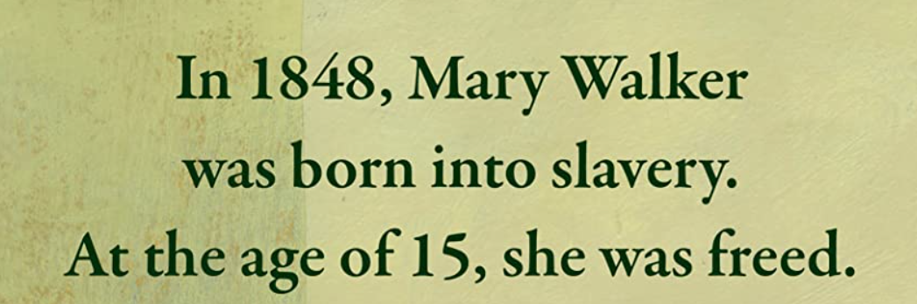
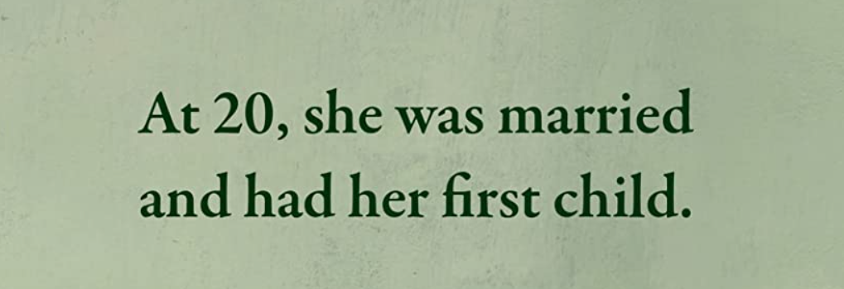

Slide 36
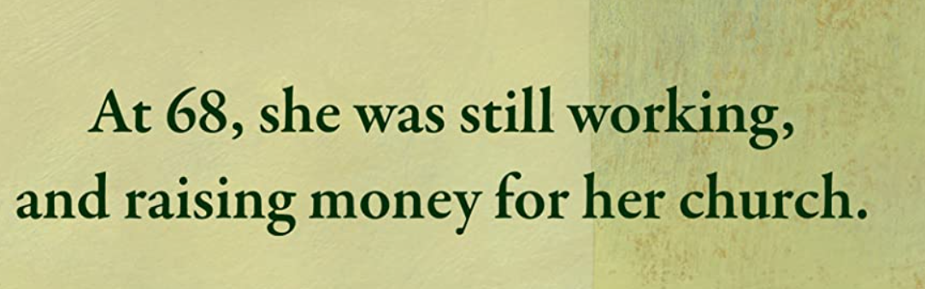
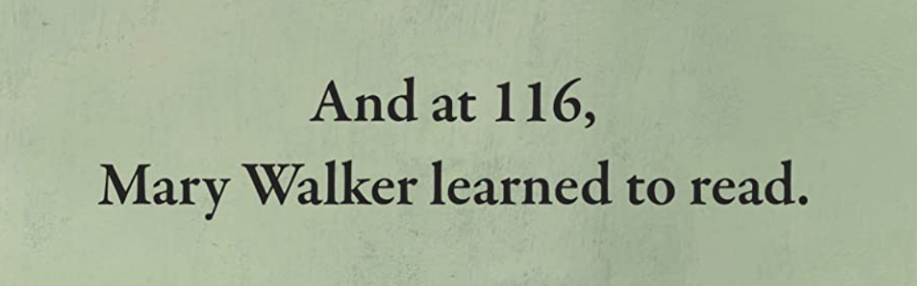

Slide 37
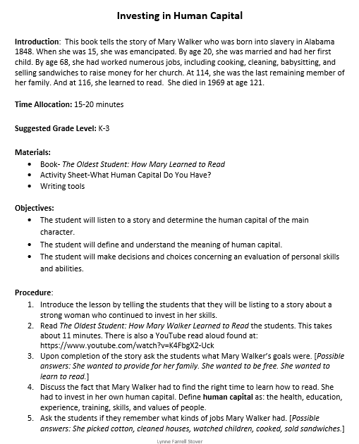
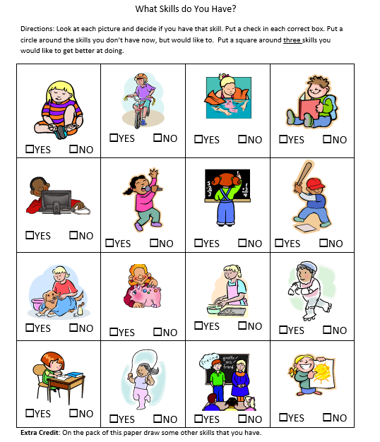

Human Capital Lesson

Slide 38


https://www.youtube.com/watch?v=K4FbgX2-Uck
The moral of the story!

Slide 39

Book’s End Pages

Slide 40







Slide 41
Assessment Framing Questions
What are the benefits of using children’s literature to teach economics and personal finance?
How can picture books be used with older students?
The book Dreamers is an immigration story. Would this require sensitivity of instruction in multi-cultural classrooms?

Slide 42
References
https://www.councilforeconed.org/wp-content/uploads/2012/03/voluntary-national-content-standards-2010.pdf
https://holidayhouse.com/wp-content/uploads/2019/01/Dreamers
df
https://www.econedlink.org/resources/do-i-look-like-im-made-of-money/?view=teacher
https://www.econedlink.org/resources/what-is-money-why-does-it-have-value/

Slide 43

CEE Affiliates
https://www.councilforeconed.org/resources/local-affiliates/

Slide 44




Thank You to Our Sponsors!

