Slide 1


Feb 2, 2021
7:00-8:00 pm ET
Presented By
Marginal Revolution University

Slide 2
EconEdLink Membership
You can now access CEE’s professional development webinars directly on EconEdLink.org! To receive these new professional development benefits, become an EconEdLink member. As a member, you will now be able to:
Automatically receive a professional development certificate via e-mail within 24 hours after viewing any webinar for a minimum of 45 minutes
Register for upcoming webinars with a simple one-click process
Easily download presentations, lesson plan materials and activities for each webinar
Search and view all webinars at your convenience
Save webinars to your EconEdLink dashboard for easy access to the event
You may access our new Professional Development page here

Slide 3
Professional Development
Certificate & Resources
To earn your professional development certificate for this webinar, you must:
Watch a minimum of 45-minutes and you will automatically receive a professional development certificate via e-mail within 24 hours.
Accessing resources:
You can now easily download presentations, lesson plan materials, and activities for each webinar from EconEdLink.org/professional-development/

Slide 4

Dr. Cheryl Ayers
Marginal Revolution University at George Mason University
Center for Economic Education at Virginia Tech
U.S. Economic Empowerment Project
Economic Education & Research Consultant

Slide 5

Webinar Objectives
Preview MRU’s Finding Equilibrium: Supply Meets Demand new curriculum unit.
Demonstrate curriculum unit’s online instructional resources.

Slide 6

About Us
Marginal Revolution University (MRU)
Online, video-based, nonprofit, economic education platform founded in 2012 by GMU professors Drs. Tyler Cowen and Alex Tabarrok for teachers, students, and lifelong learners worldwide

Slide 7
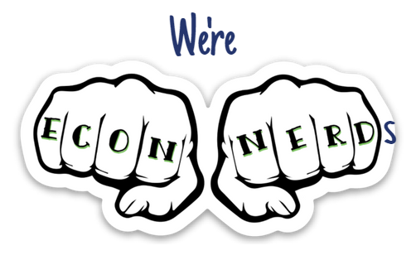
About Us
Our Vision
Economics has the power to positively change the way people view and live in the world because there’s an inner economist in all of us.
Our Mission
To provide a FREE world-class economic education to everyone, everywhere by:
Developing your inner economist with engaging, thought-provoking ways of looking at everyday problems
Entertaining you so you actually want to learn economics (no boring lectures!)
Thinking on the margin: one idea + one person at a time = “Marginal Revolution”
Notes:
Economics is the study of how to get the most out of life. We’re passionate about changing the world through economic education!

Slide 9
Poll Time!
What is your primary challenge in teaching supply, demand, and equilibrium?
student interest and engagement
student comprehension
real-world connections
finding quality resources (online or in-person)
all of the above
NO CHALLENGES – students love it and get it!

Slide 10
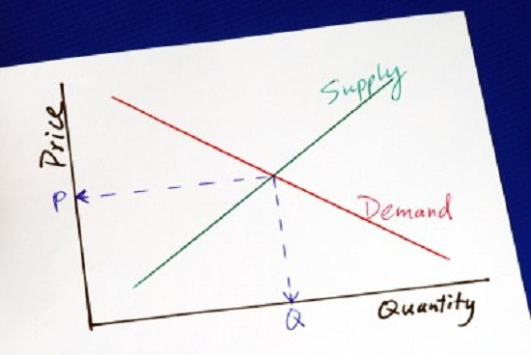
Lesson Titles
Law of Demand
Demand Curve Shifts
Law of Supply
Supply Curve Shifts
Equilibrium Price & Quantity
COMING SOON: Price Ceilings, Price Floors and Elasticity

Slide 11

Lesson Resources
Motivating bell ringers to pique interest and exit tickets to formatively assess learning
Short videos to enhance engagement and note guides to increase comprehension
Online graphing tools to predict trends and draw/shift curves
Interactive games to reinforce concepts and increase retention
Timely news articles to transfer knowledge using real world examples

Slide 12
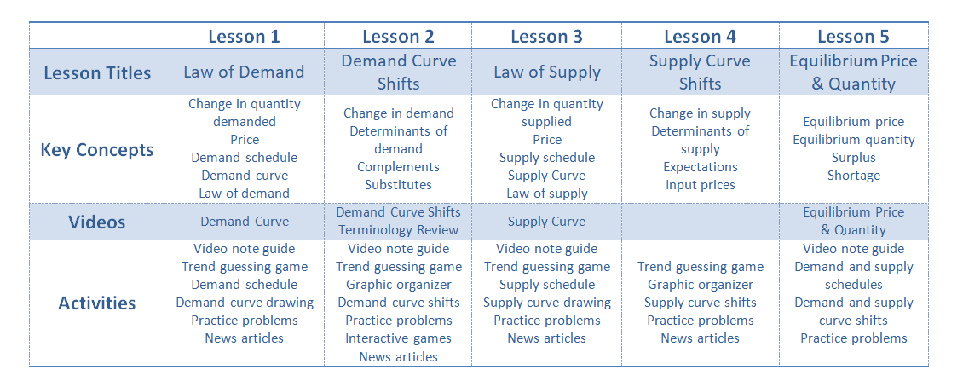
Unit Plan

Slide 13
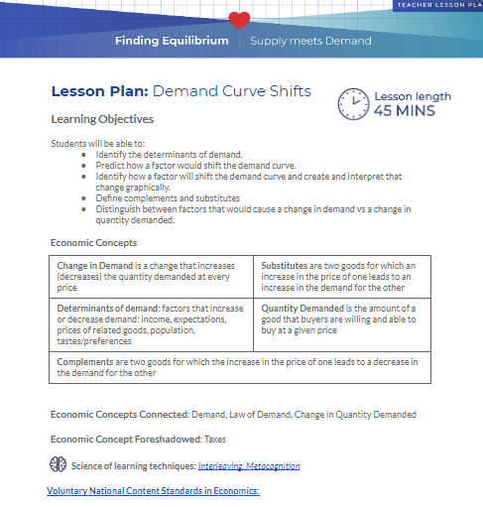
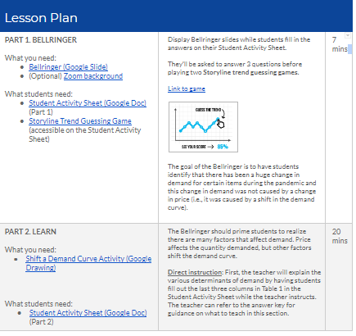
45-Minute Lessons

Slide 14
Lesson Components
PART 1. BELLRINGER
Student Activity Sheets
News Articles
Trend Guessing Tools
PART 2. LEARN
Video-integrated direct instruction
Graphing Tools
Teacher Tips
PART 3. PRACTICE
Practice Problems
Answer Keys (request)
Interactive Games
PART 4. EXIT TICKET
Learning Objectives
Economic Concepts
Economic Concepts Connected
Economic Concepts Foreshadowed
Science of Learning Best Practices
National Content Standards in Economics
Zoom Background
Enrichment
Assessment

Slide 15
Online or In-Class
Google Docs- based materials for easy editing and adaptation
Google Forms available for most Exit Tickets
Answer keys available for every assignment (verified emails)
Videos available through YouTube and Nearpod versions provided with student questions integrated

Slide 16
Lesson Demonstration
Lesson 2: Demand Curve Shifts

Slide 17

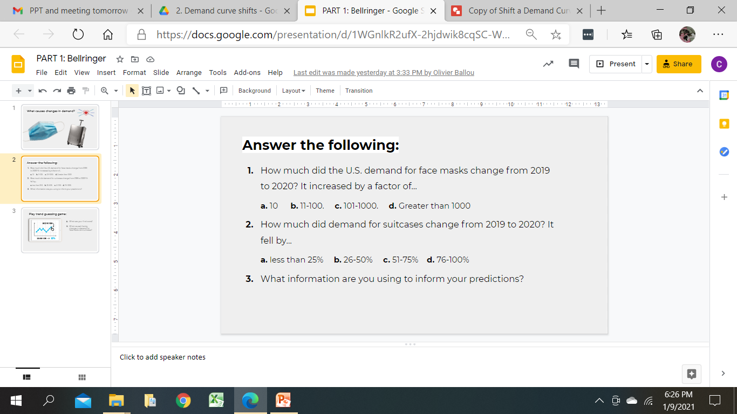
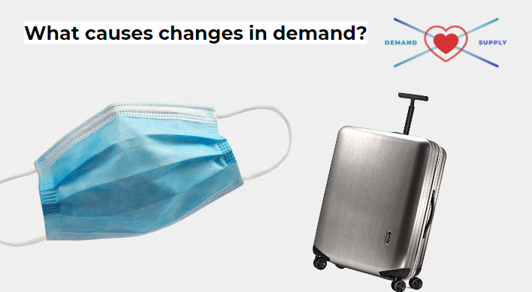
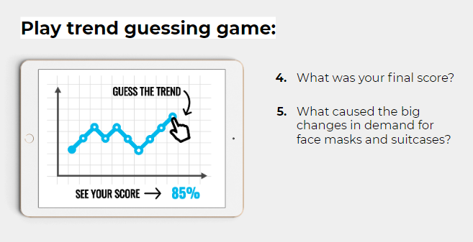
Bell Ringer

Slide 18
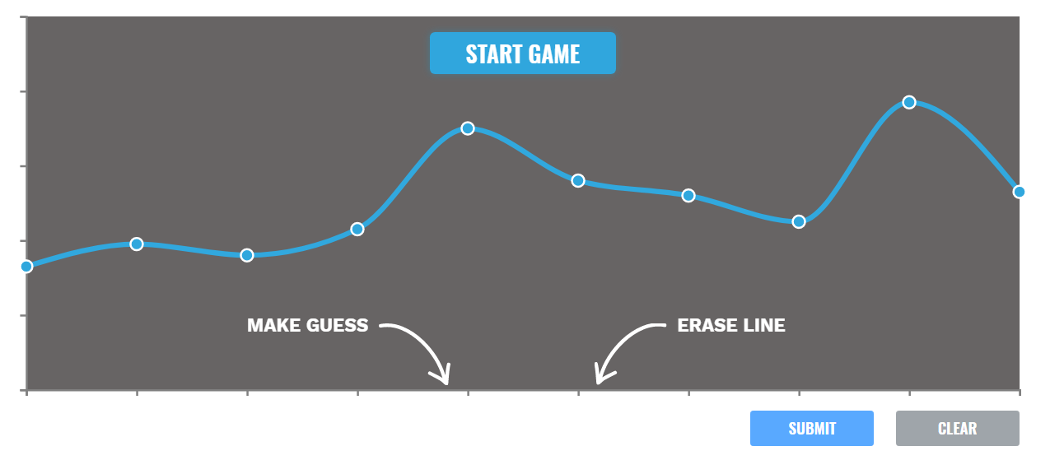
Storyline Trend Guessing Game
https://mru.io/pnn

Slide 19
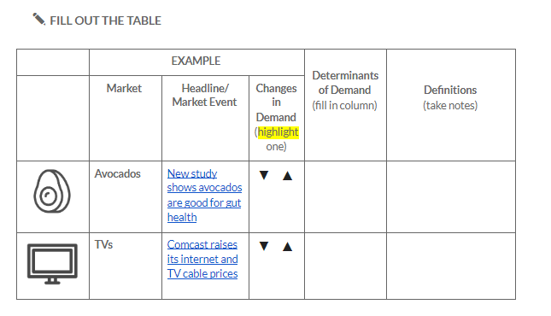
Student Activity Sheets

Slide 20
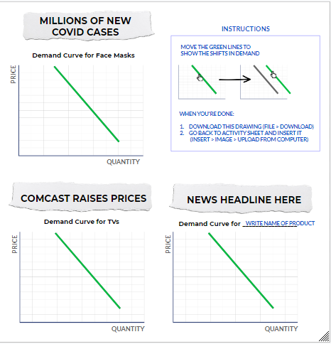
Curve Drawing Tools

Slide 21
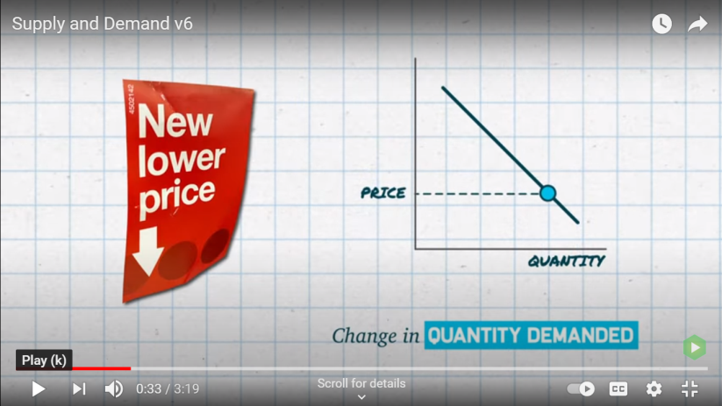
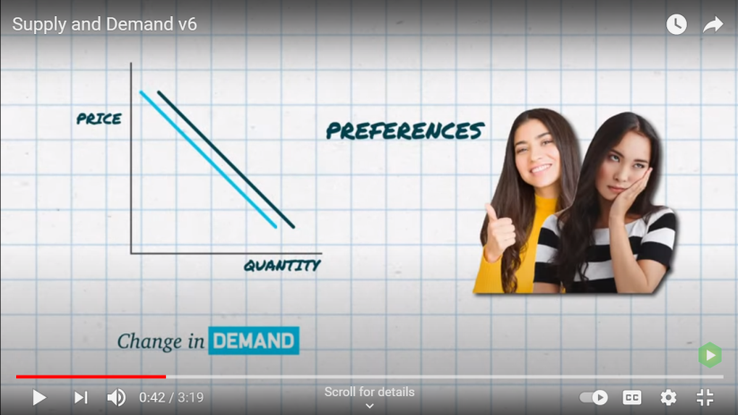
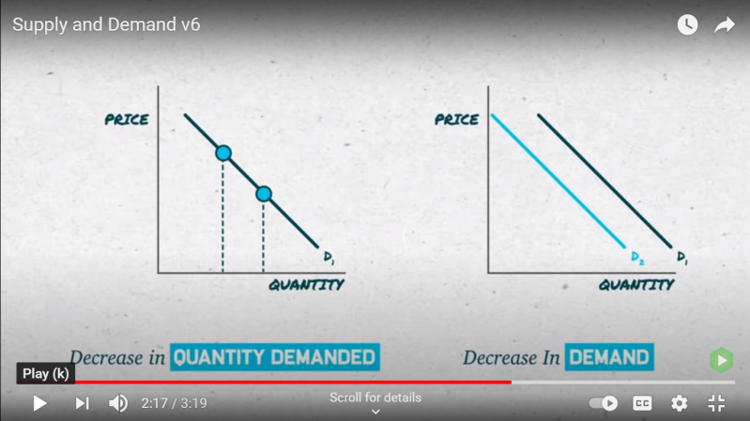
Instructional & Review Videos
https://www.youtube.com/watch?v=9jLlOPqHxLs

Slide 22
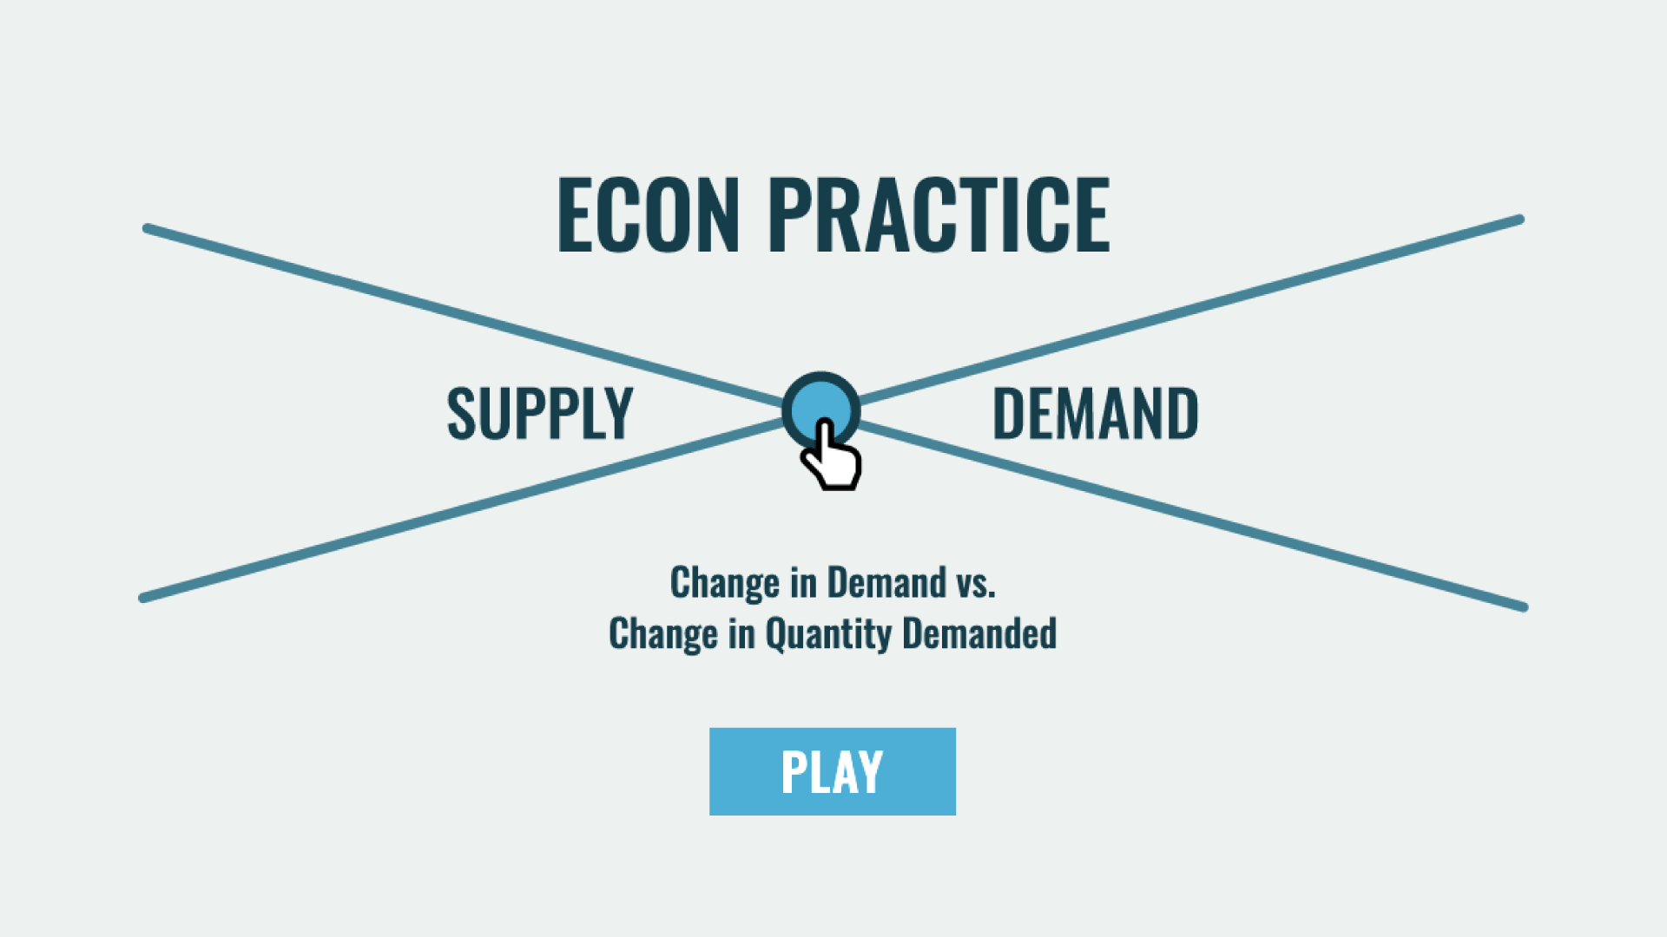
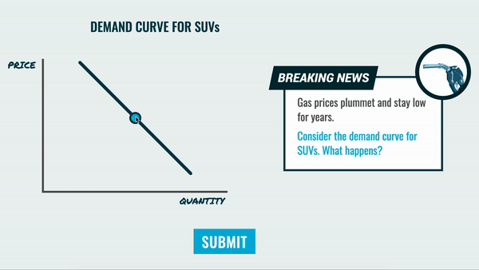
Interactive Graphing Game
http://practice.mru.org

Slide 23
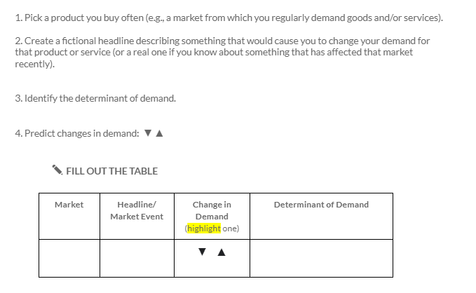
Exit Ticket

Slide 24

Other FREE MRU
Economic Resources

Slide 25
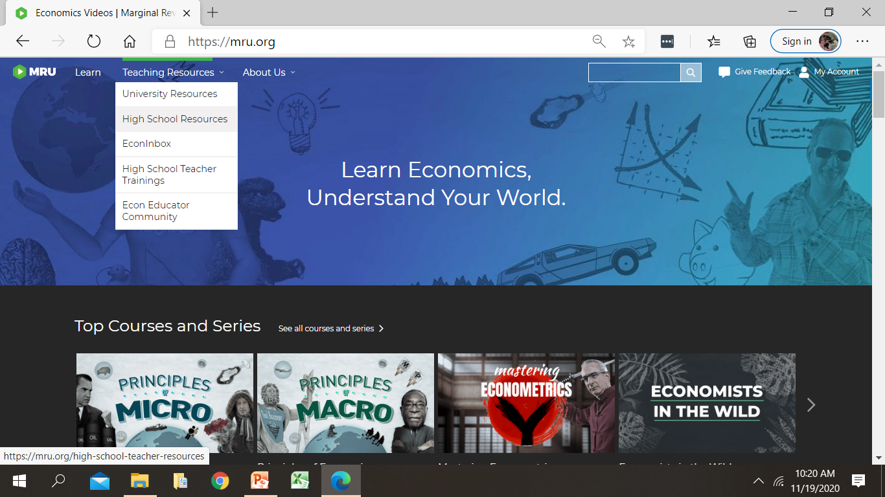
Website Exploration
https://mru.org Teaching Resources High School Resources

Slide 26
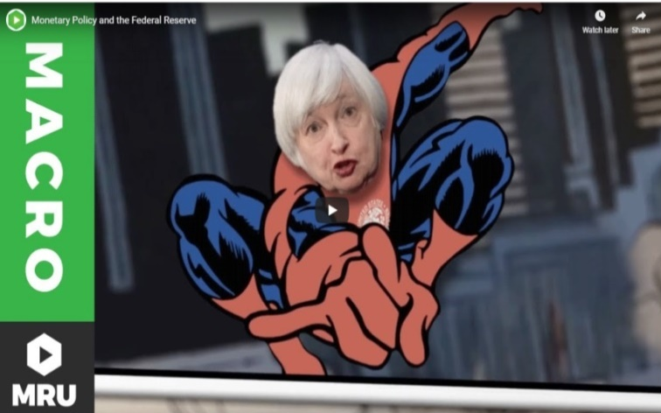
Videos
900+ Short videos with practice questions, transcripts, and subtitles
  Available at MRU.ORG and YouTube
Aligned to CEE national and select state standards
https://mru.org/resources/high-school/videos-mapped-to-standards
EdPuzzle versions
  https://edpuzzle.com/channel/5cf6f1059dc78f411126ed9f
High school topics
  Micro, macro, international economics
  Personal finance
Video dictionary of economic terms
FREE Videos for Statewide Online Courses

Slide 27


Slide 28
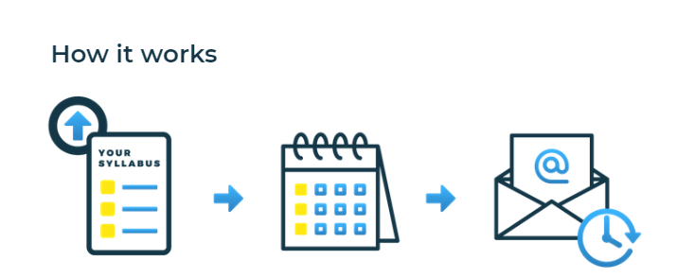
EconInBox
Curated Current Events Emails
Sign up
Send course outline
Receive
just-in-time resources
https://www.econinbox.com/
Notes:
Your weekly guide to the best online media for what you’re teaching, when you’re teaching it.
Resources are synced to your syllabus, so you get resources just-in-time, the week before you’re teaching a concept.

Slide 29
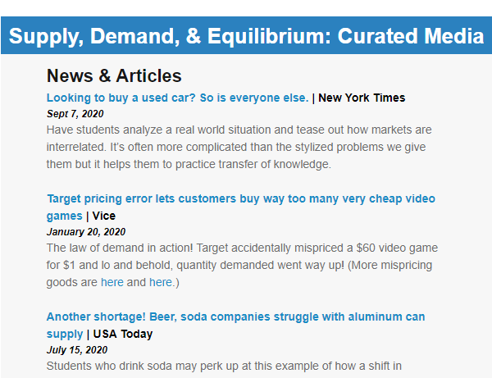
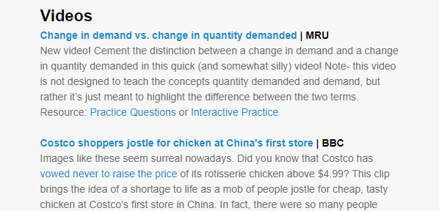
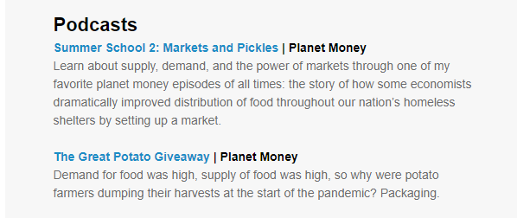
Feb. 1
Teaching Supply and Demand
Jan. 25
Receive EconInBox resources

Slide 30
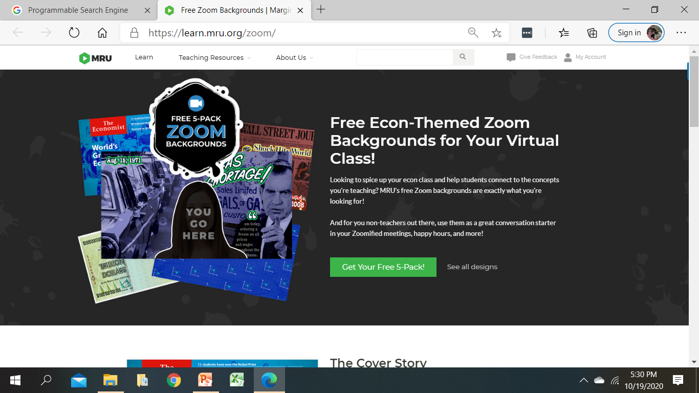





Econ Swag
Zoom Backgrounds, Tattoos & Stickers
https://learn.mru.org/zoom/

Slide 31
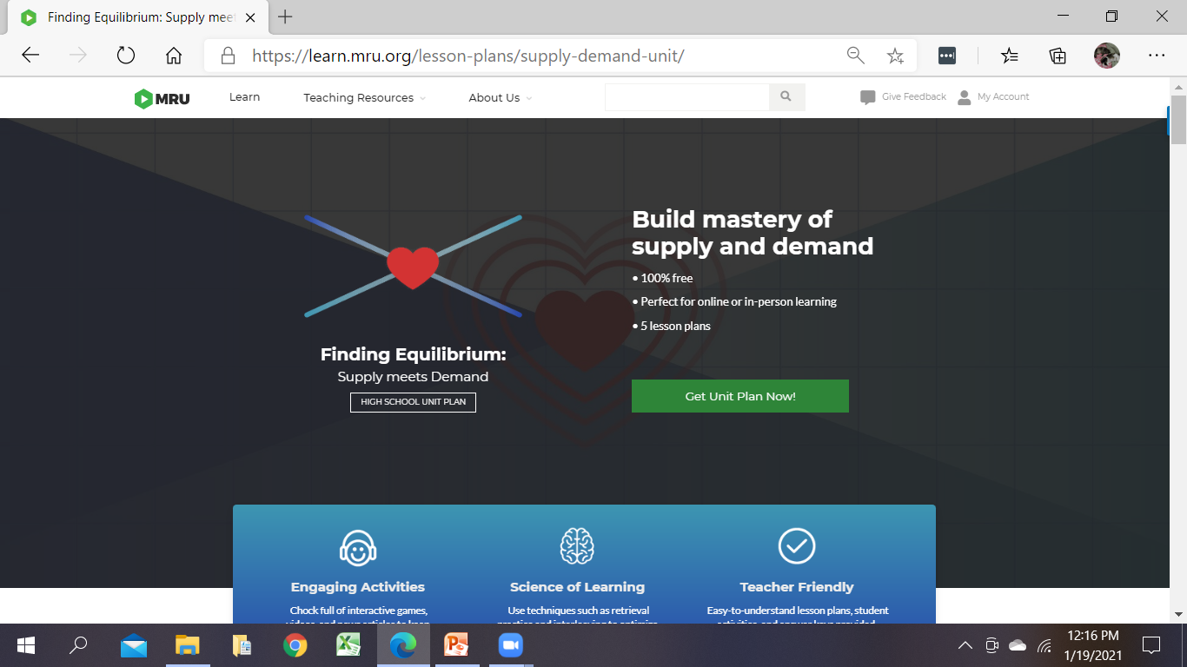
Get Your Unit Plan Now!
https://learn.mru.org/lesson-plans/supply-demand-unit

Slide 32
Questions
or Comments?

Slide 33


Thank you!
Questions/Feedback
Cheryl ♦ cheryl@mru.org
Stay Connected
@MRevUniversity
facebook.com/mrevuniversity
Join our Teaching Online Econ Facebook Community at COMMUNITY.MRU.ORG

Slide 34

CEE Affiliates
https://www.councilforeconed.org/resources/local-affiliates/

Slide 35




Thank You to Our Sponsors!

