Slide 1
Personal Finance
Fun & Games
April 9, 2019
Megan Kirts

Slide 2
Brief Bio
I’ve taught high school social studies in Arizona since 2003
I currently teach AP Macroeconomics part-time at Catalina Foothills High School in Tucson, AZ
I also serve as the director of the Office of Economic Education at the University of Arizona
James Madison Memorial Fellow (2005), Transatlantic Outreach Program Fellow (2016), admitted to the University of Delaware Master of Arts in Economics and Entrepreneurship for Educators (Class of 2021)

Slide 3
Agenda
Rationale
Overview of Materials
Credit Score Challenge
Budget Puzzle
Get a Clue (About Investing)
Coming to Terms with Risk (Insurance Vocabulary)
Occupational Uno
Resources

Slide 4
Goals (Learning Objectives)
Attendees will be able to…
  Identify the benefits of teaching personal finance concepts through hands-on activities and games.
  Effectively engage students in learning about credit scores, budgeting, investing, insurance, and occupation options.

Slide 5
Rationale
Fun (Hands-On Activities) & Games Can…
  Help learning “stick”
  Support multiple learning styles
  Engage reluctant students
  Build class camaraderie
  Reveal student misunderstanding

Slide 6
Each Lesson Includes
Relevant National Standards for Financial Literacy from CEE
Warm-up prompt(s)
Procedural instructions
Reproducible materials (in PDF and editable Word files)
Debriefing exercise
Assessment or extension suggestions
Notes:
Given time constraints, I will focus on the game or activity at the center of each lesson

Slide 7
Take Note
Using these lessons with your students will require
  Materials that may be beyond what your site provides: cardstock, dice, resealable plastic bags
  An investment of your time to create game boards, cards, etc.

Slide 8
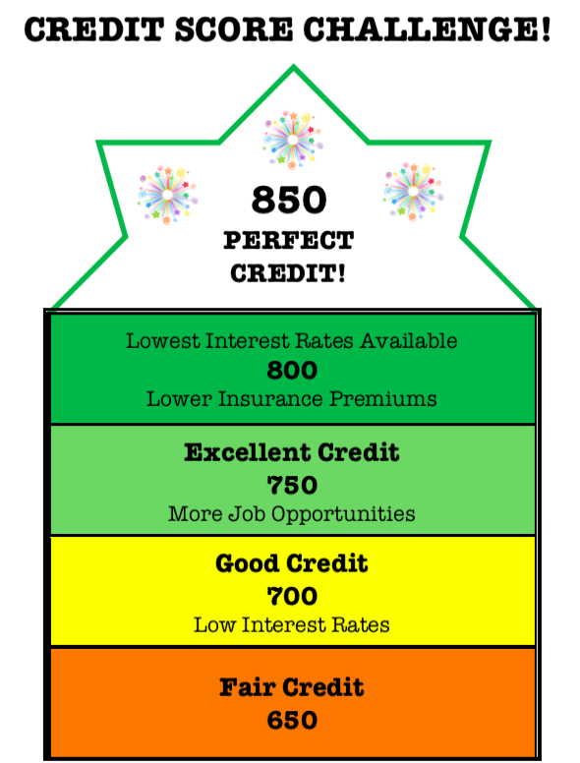
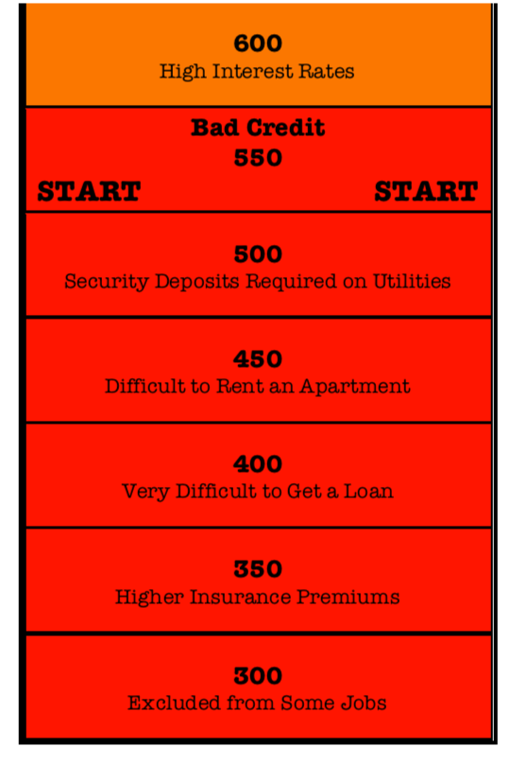
#1: Credit Score Challenge

Slide 9
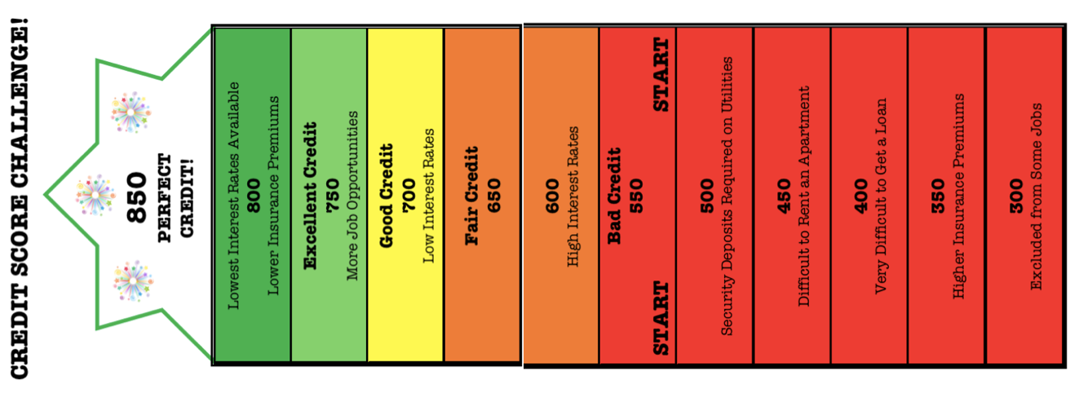
#1: Credit Score Challenge

Slide 10
#1: Credit Score Challenge
2 Players start at a credit score of 550
Players take turns drawing Impact Cards
  Players read Impact Cards aloud and move as described
  Some Impact Cards call on the player to make a decision
Winning the Game
  A player achieves a perfect score of 850
  A player has the higher score once all cards have been played
Notes:
Students respond to a warm-up about the characteristics of trustworthy person and review essential credit vocabulary before playing the game

Slide 11
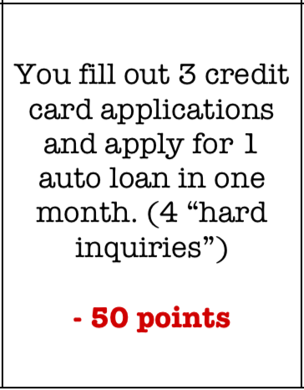
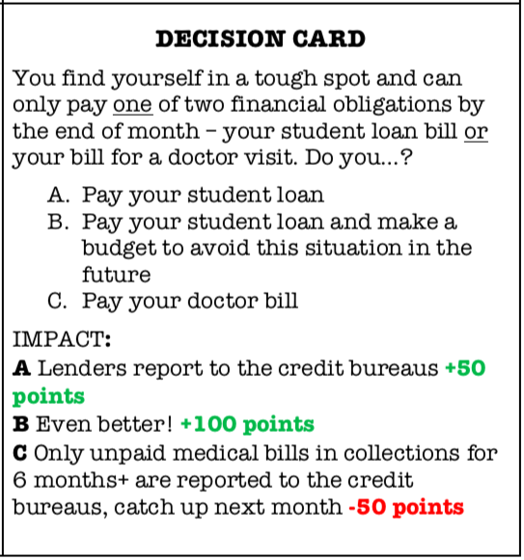
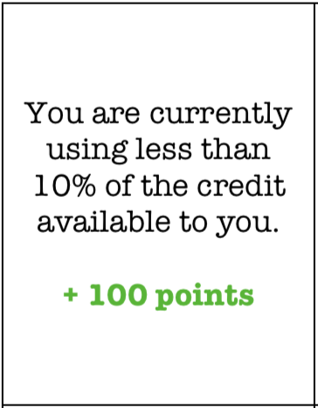
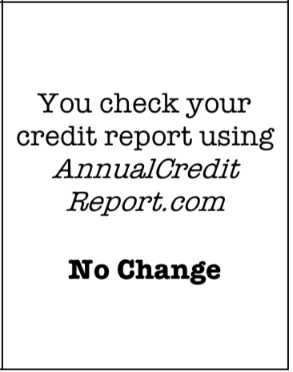
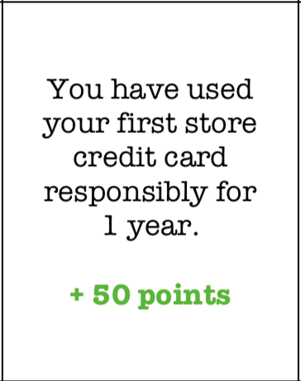

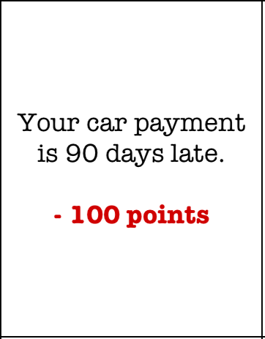
Game Cards
Notes:
All score changes will be in 50 point increments, not realistic, but the strength of each change is designed to match actual credit score calculations
Series of debrief questions at the end as well as links to NGPF lessons, good lesson on EconEdLink called Earning Credit that could be used in conjunction with this game

Slide 12
#1: Credit Score Challenge
Checking for Understanding
  Students answer a series of questions about factors that impact credit scores, the consequences of a poor credit score, and strategies to avoid credit pitfalls

Slide 13
#2: Budget Puzzle
Budget Scenario
  Single, childless individual with no debt
  Does not pay state or local income taxes
  $36,000 gross annual income (national median wage in 2017 was $37,690)
  $2,500 monthly net income
Students work in pairs to craft a budget for this person
  Must allocate net income to 8 categories in 5% ($125) increments
Notes:
Warm-up asks students to consider goals and how to achieve goals
Specific written plans help, a budget is a written plan that can help a person achieve financial goals
Can adjust budget scenario to include local taxes – use on online paystub generator for help

Slide 14
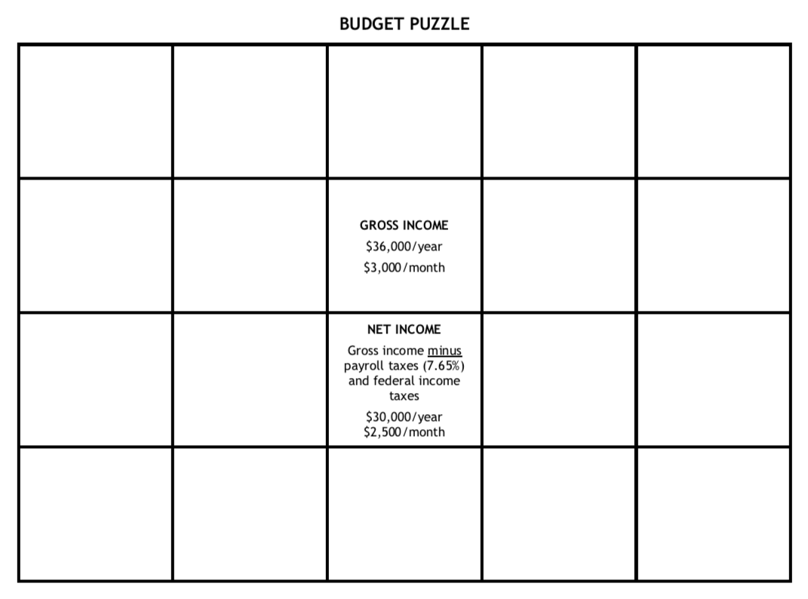
#2: Budget Puzzle

Slide 15
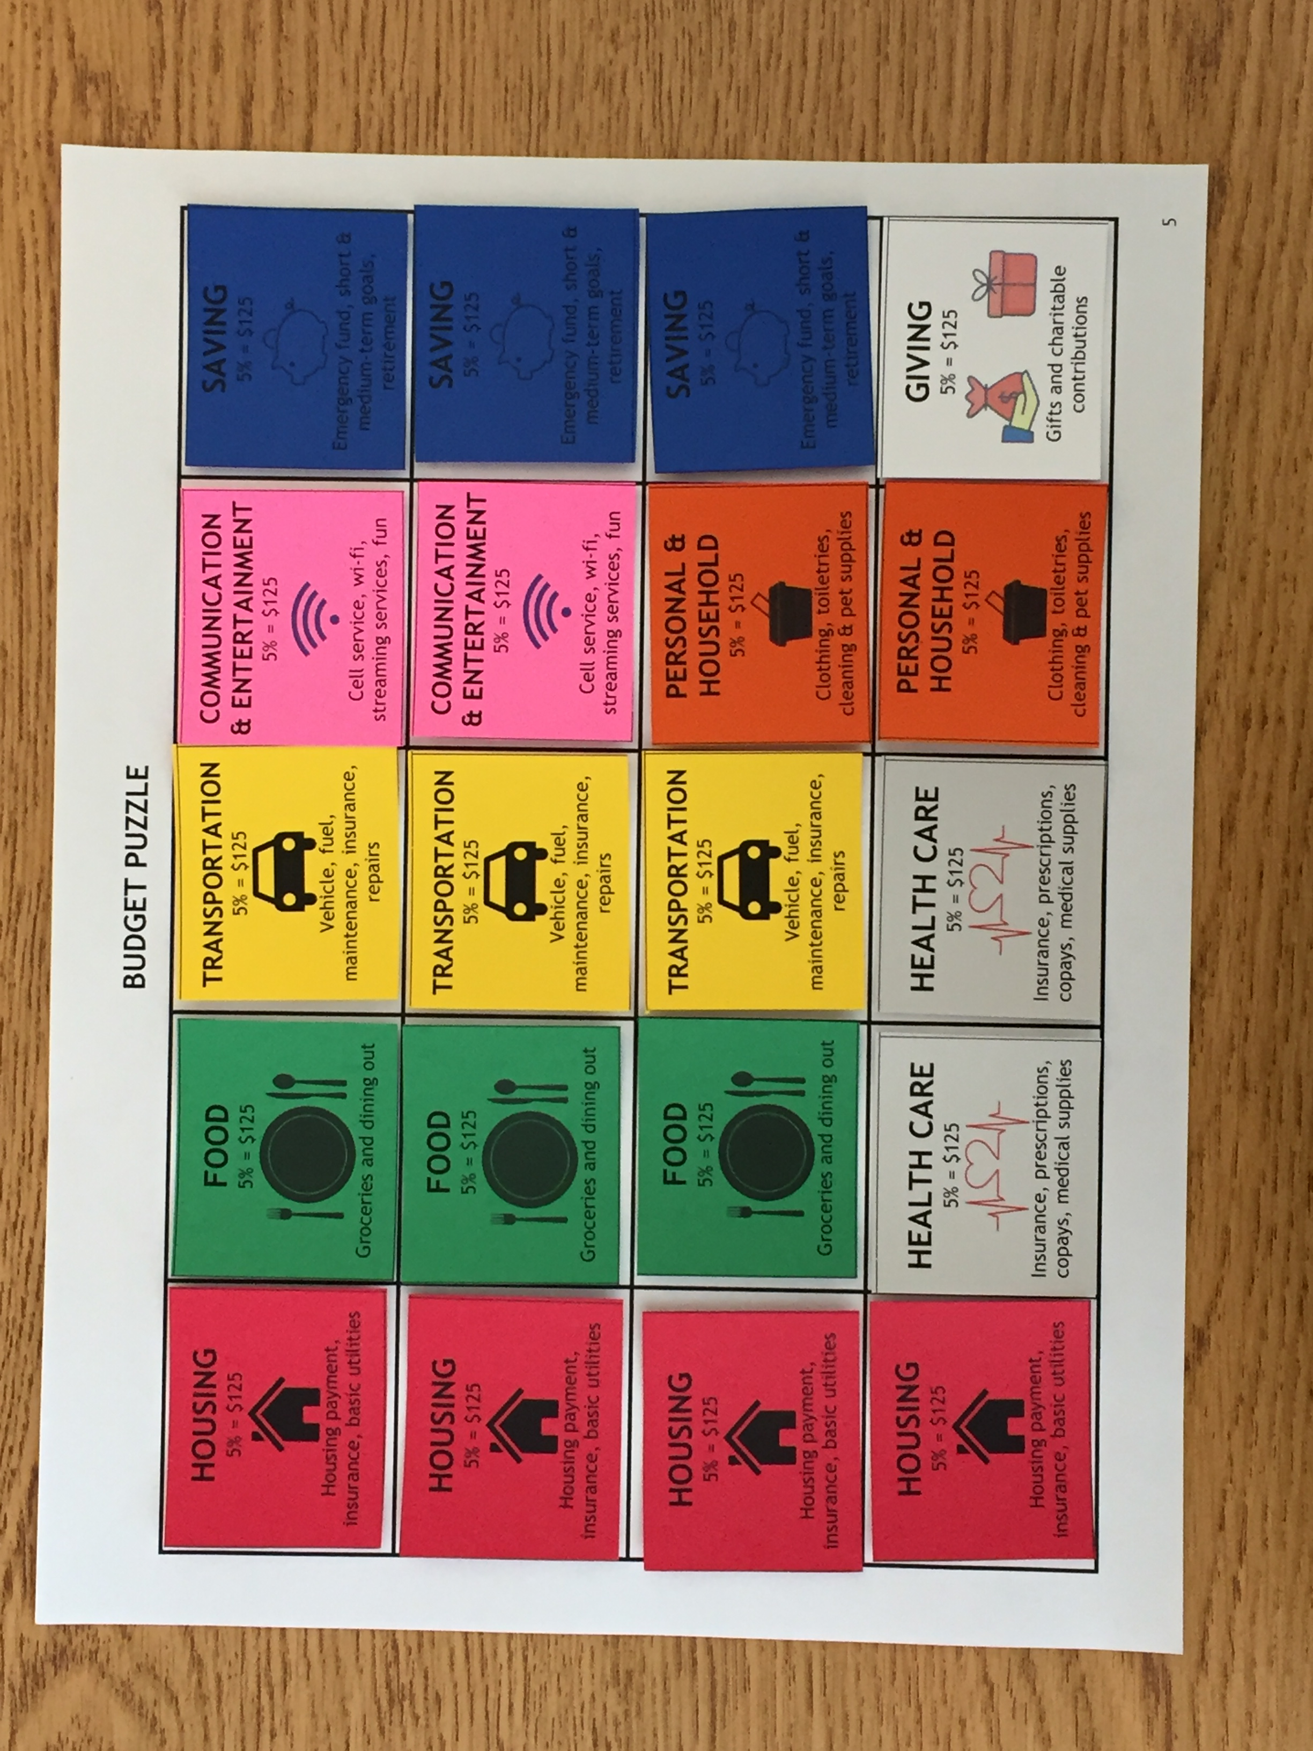
#2: Budget Puzzle

Slide 16
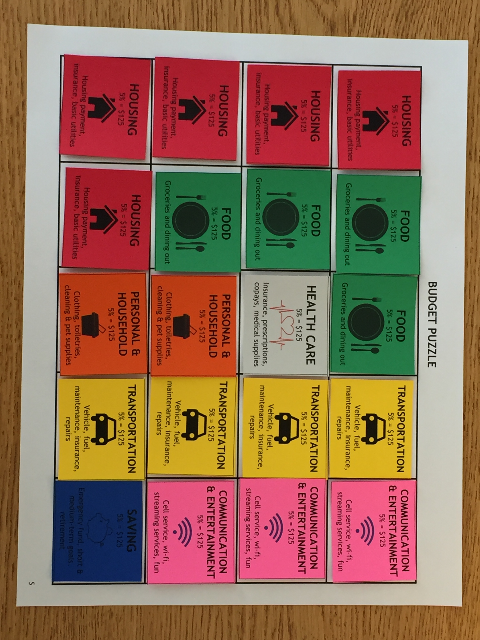
#2: Budget Puzzle

Slide 17
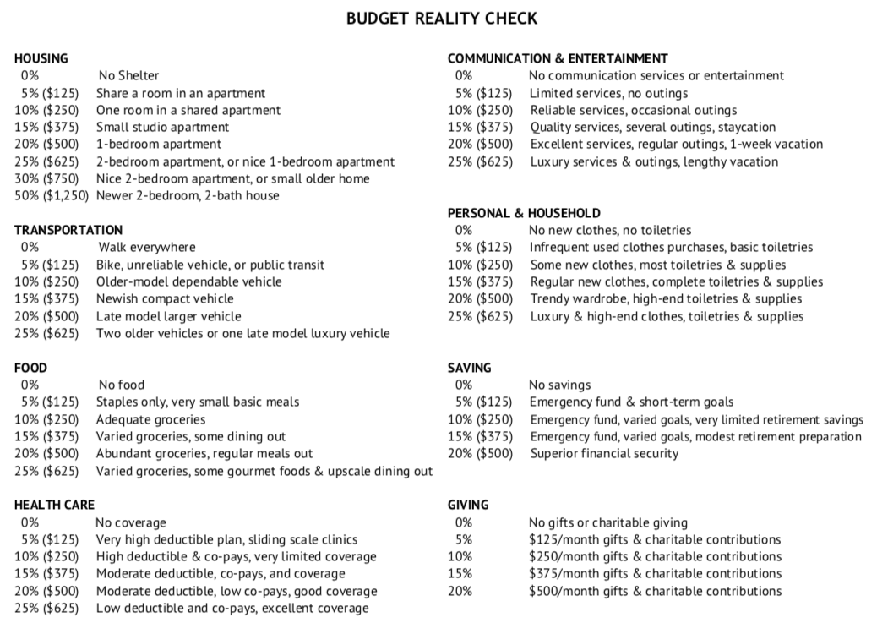
Notes:
Feel free to adjust to local cost of living
Students consider adjustments to their budget
Closure – students take on the role of a popular personal finance podcaster and must compose responses to listener tweets

Slide 18
#2: Budget Puzzle
Checking for Understanding
  Questions built into the lesson
  Once their budget is complete, students consider possible adjustments based on changing life circumstances (credit card debt, a raise, etc.)
  Students take on the role of a popular personal finance podcaster and respond to listener budget questions sent in via Twitter

Slide 19

#3: Get a Clue (About Investing)
A confidential investment transaction has occurred at Uncle Warren’s Investment Emporium
Notes:
Lesson will revolve around an investing mystery
To start students are asked how they could invest an unexpected windfall, introduced to basic investing vocabulary (bond, stock, mutual fund, etc.)

Slide 20
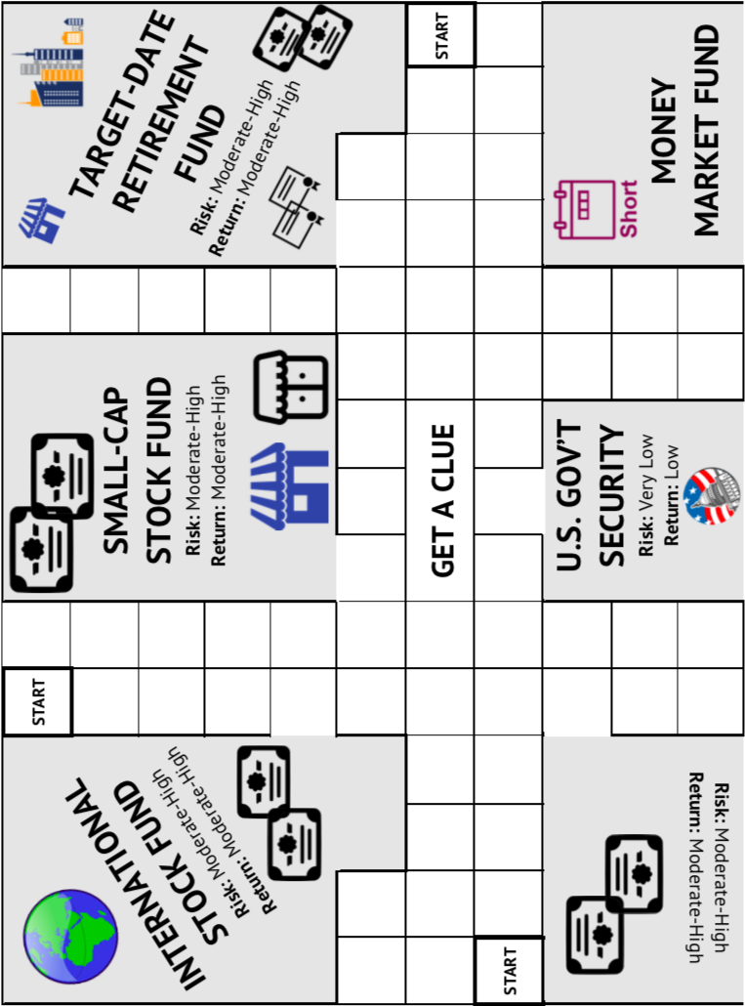
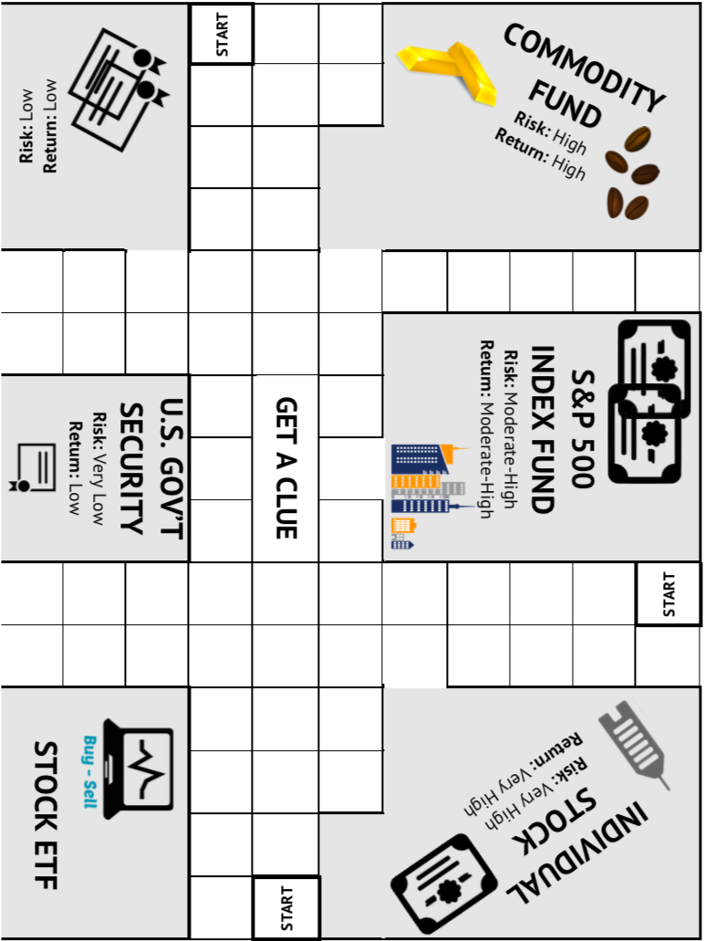
#3: Get a Clue (About Investing)
Notes:
9 stores in the emporium – each representing a different kind of asset someone might buy when investing

Slide 21
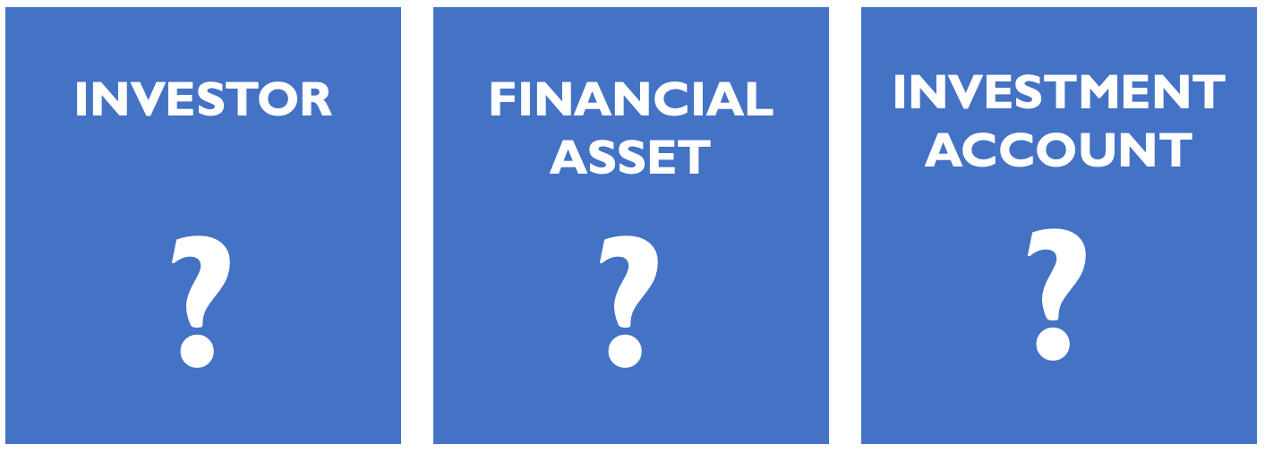
#3: Get a Clue (About Investing)
4-6 students per game board compete to solve the investing mystery
Notes:
6 investor cards
9 asset cards
6 investment account cards
Each type of card shuffled and one randomly selected for mystery transaction, remaining cards are distributed to players as evenly as possible

Slide 22
#3: Get a Clue (About Investing)
Details of the transaction are stored in a Confidential Portfolio Envelope
CONFIDENTIAL PORTFOLIO
Notes:
9 stores in the emporium – each representing a different kind of asset someone might buy when investing

Slide 23
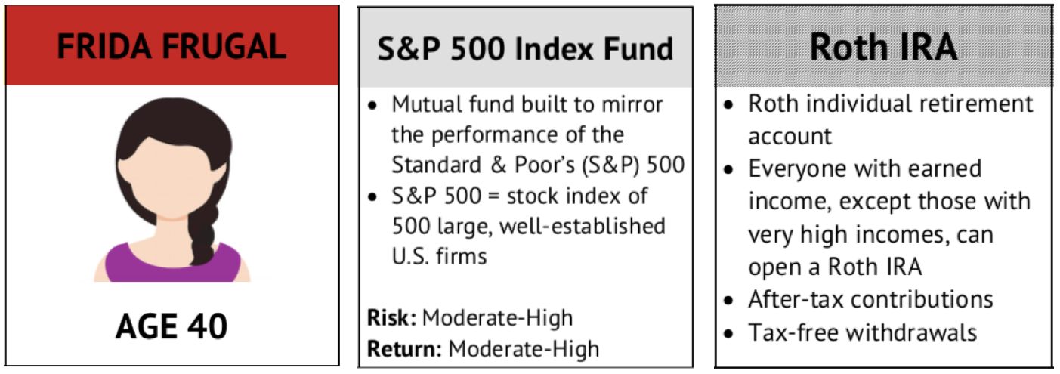
#3: Get a Clue (About Investing)
Each turn, players enter a store and make a suggestion that includes the asset sold in the store
Other players may disprove this suggestion
Notes:
A student might enter the S&P 500 Index Fund store and announce, “I suggest that Frida Frugal invested in a S&P 500 Index Fund through her Roth IRA.”

Slide 24
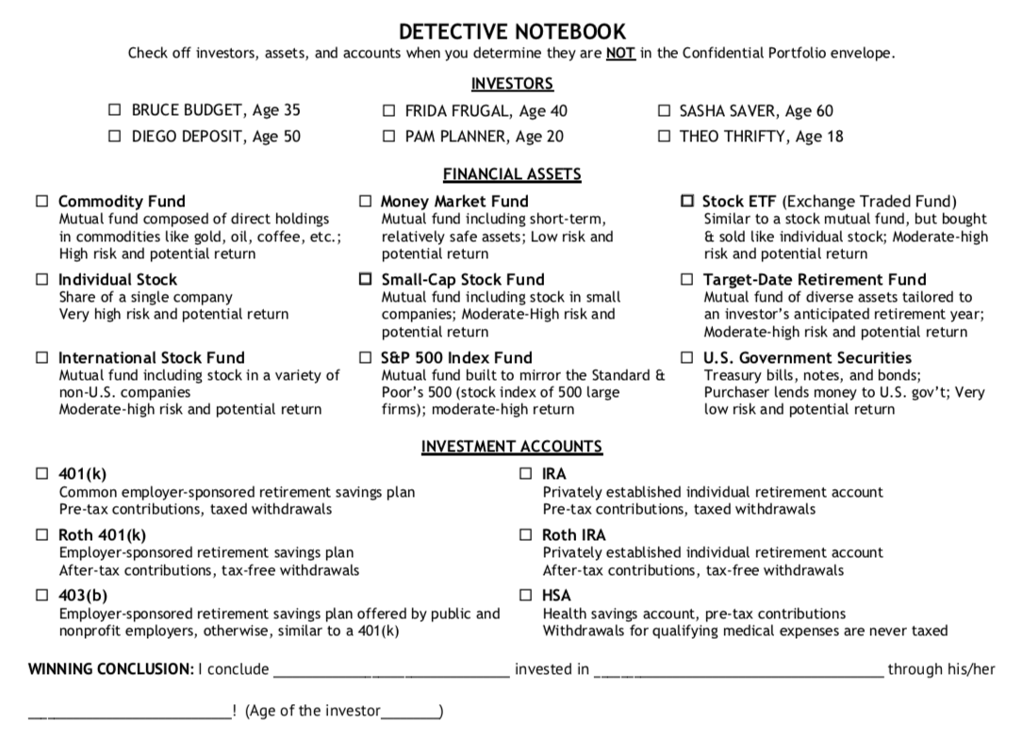
#3: Get a Clue (About Investing)
Notes:
Students use their Detective Notebook to help them make a suggestion and to keep track of clues offered along the way.

Slide 25
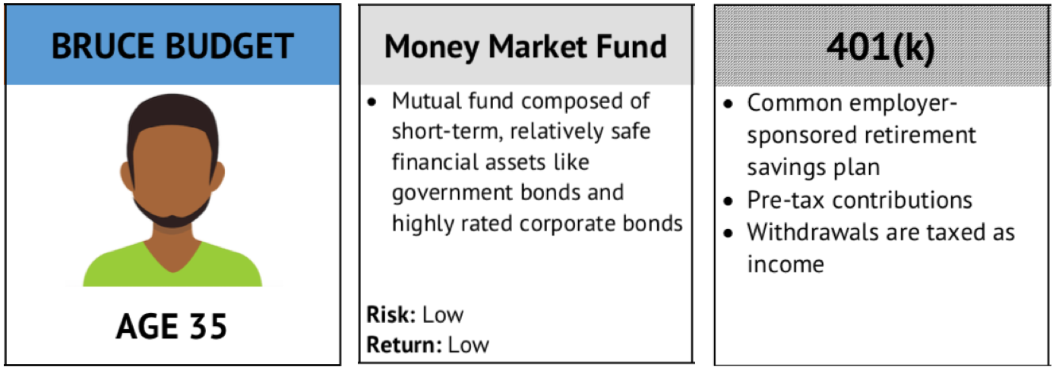
#3: Get a Clue (About Investing)
Play continues until, through a process of elimination, a player wins by stating an accurate conclusion
Notes:
“I conclude that Bruce Budget invested in a money market fund through his 401(k).”
Can start by making a suggestion. If no one disproves can state a conclusion – checks the envelope
To debrief students use their experience in the game and detective notebook to answer some questions designed to highlight the relationship between risk and return in investing as well as the different kinds of accounts one might use to save for retirement (that, for example, even if your employer does not offer a plan there are options available).

Slide 26
#3: Get a Clue (About Investing)
Checking for Understanding
  Students answer a series of questions about risk and return as well as options for retirement saving
  Students conduct research to evaluate the suitability of the mystery investment transaction

Slide 27
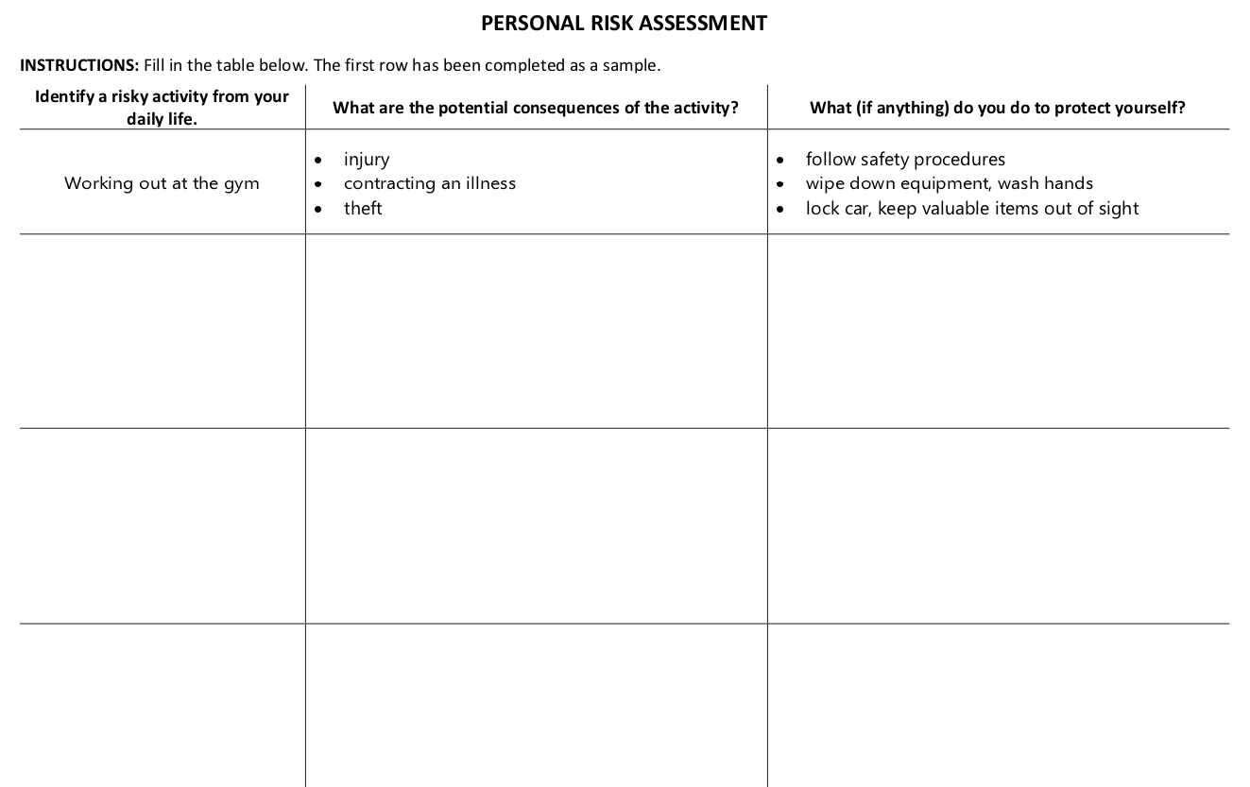
#4: Coming to Terms With Risk

Slide 28
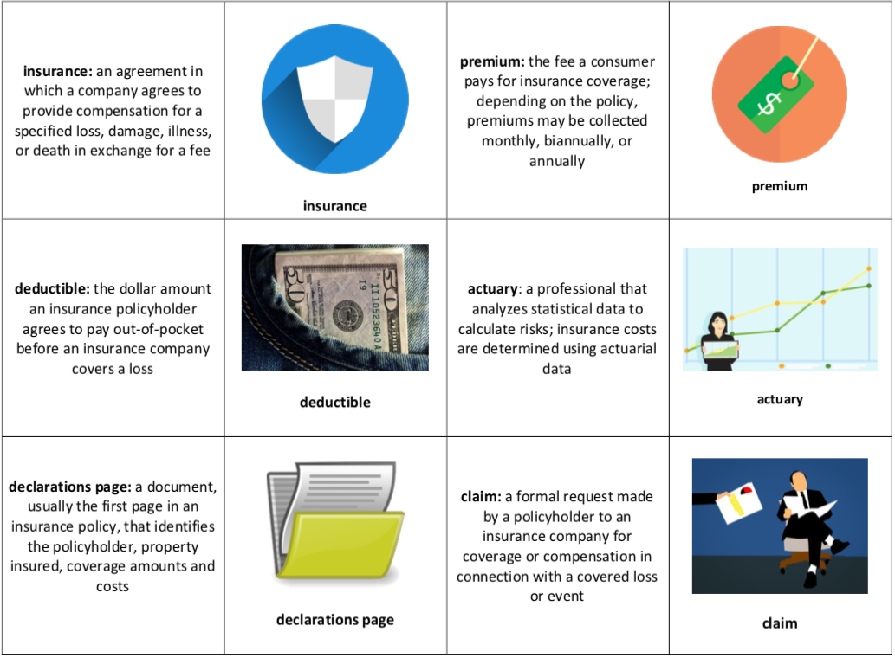
#4: Coming to Terms With Risk

Slide 29
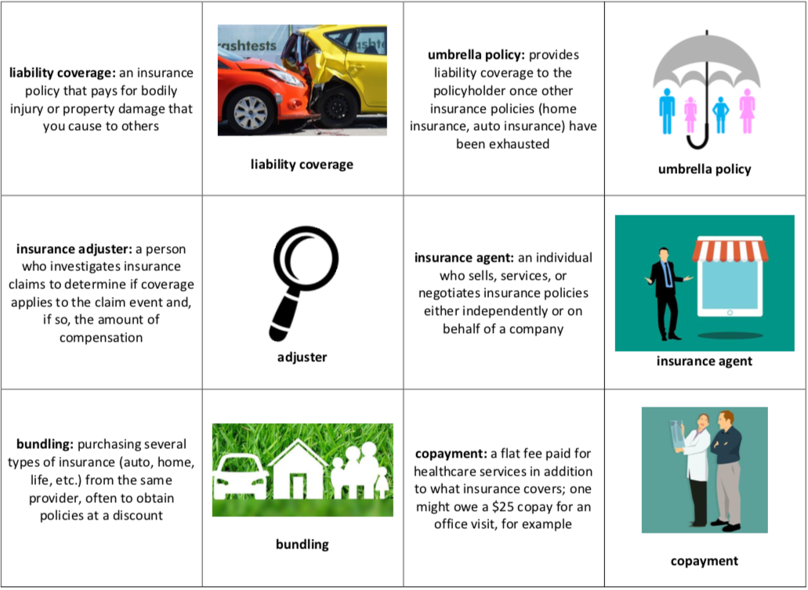
#4: Coming to Terms With Risk

Slide 30
#4: Coming to Terms With Risk
Students play in pairs
Students shuffle cards (24 cards representing 12 key terms) and lay them out facedown in a 6x4 grid
Each player takes turns flipping over two cards – if definition cards appear the player must read them aloud
The player who finds the most matches wins!

Slide 31
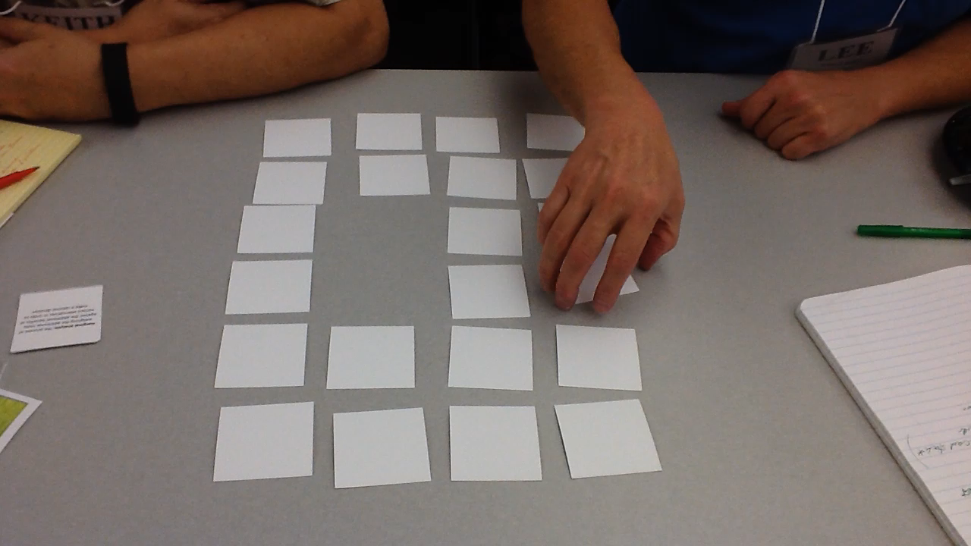

Slide 32
#4: Coming to Terms With Risk
Checking for Understanding
  Students use vocabulary from the game to complete a series of fill-in-the-blank statements

Slide 33
#5: Occupational Uno
A wage is monetary compensation paid by an employer to an employee in exchange for work completed
Estimate the typical annual wage for individuals working in the following occupations in the U.S.
  Dentist
  Dishwasher

Slide 34
#5: Occupational Uno
According the U.S. Bureau of Labor Statistics…
  In 2017 the median annual wage earned by a dentist was $151,444
  In 2017 the median annual wage earned by a dishwasher was $21,500

Slide 35
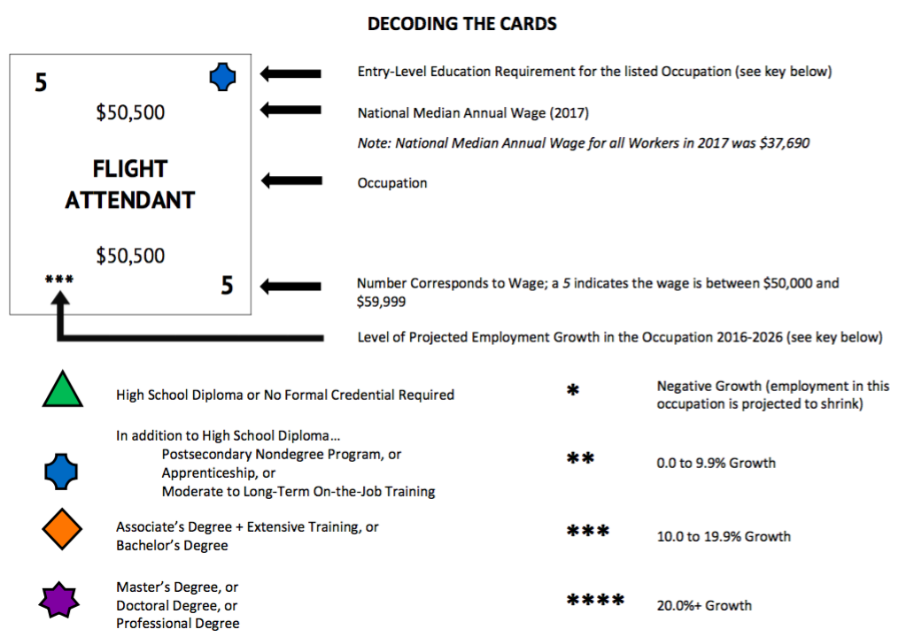
#5: Occupational Uno

Slide 36
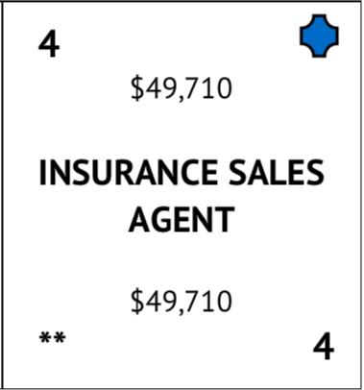
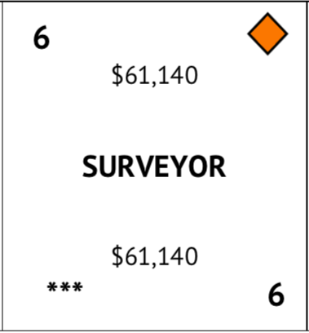
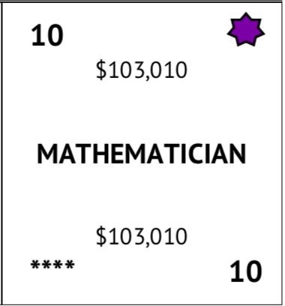

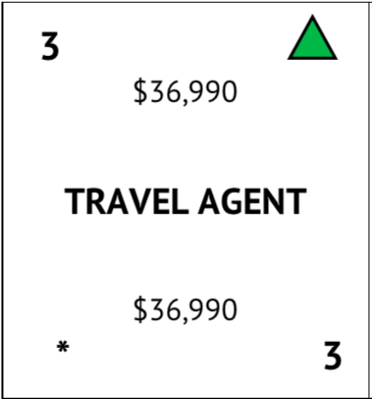
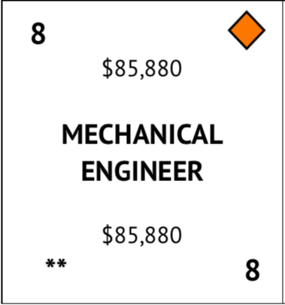
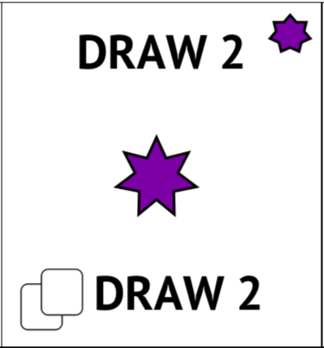
#5: Occupational Uno

Slide 37
#5: Occupational Uno
Students take turns playing cards until one player gets rid of all his or her cards
Students can play a card that matches the number (an indicator of wage range) or symbol (an indicator of the education requirement)
When playing an occupation card, the student must say the occupation aloud

Slide 38
#5: Occupational Uno
Checking for Understanding
  Students answer a series of questions about factors that shape income in various occupations
  Students conduct research using the Bureau of Labor Statistics website

Slide 39
Resources
www.econedlink.org
  Especially Better Money Habits and Financial Fitness for Life
www.ngpf.org
www.stlouisfed.org/education/
  Especially Making Personal Finance Decisions Curriculum Unit and It’s Your Paycheck Curriculum Unit
http://bit.ly/PFgames
  Google Drive folder with five lessons presented tonight; URL is case sensitive

Slide 40
Thank you!
CONTACT INFORMATION
mkirts@email.arizona.edu
520-870-6541

