Slide 1
Kahoot! Making Learning Fun
March 4th, 2020
Andrew Menfi

Slide 2

Andrew Menfi Bio
Binghamton University
-Bachelors of Arts in Social Studies
Columbia: Teacher College
-Master's of Arts in
Secondary Social Studies Education
New Visions Charter High School for Advanced Math & Science in the Bronx, New York
Subjects Taught: Economics, Government, Legal Studies, Global Studies, Independent Research, and Advanced Placement U.S. History
Independent Senior Project Project Team Leader

Slide 3


Learning Objective
How To Use Kahoot
Beginners & Advanced Guide

Slide 4
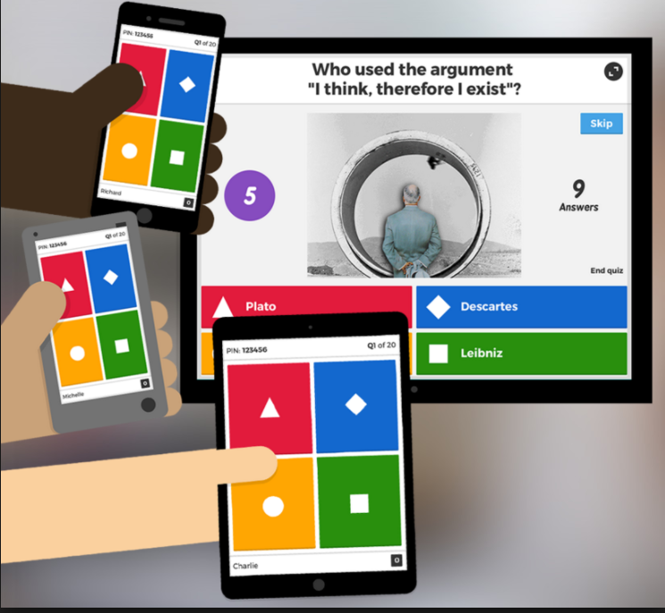
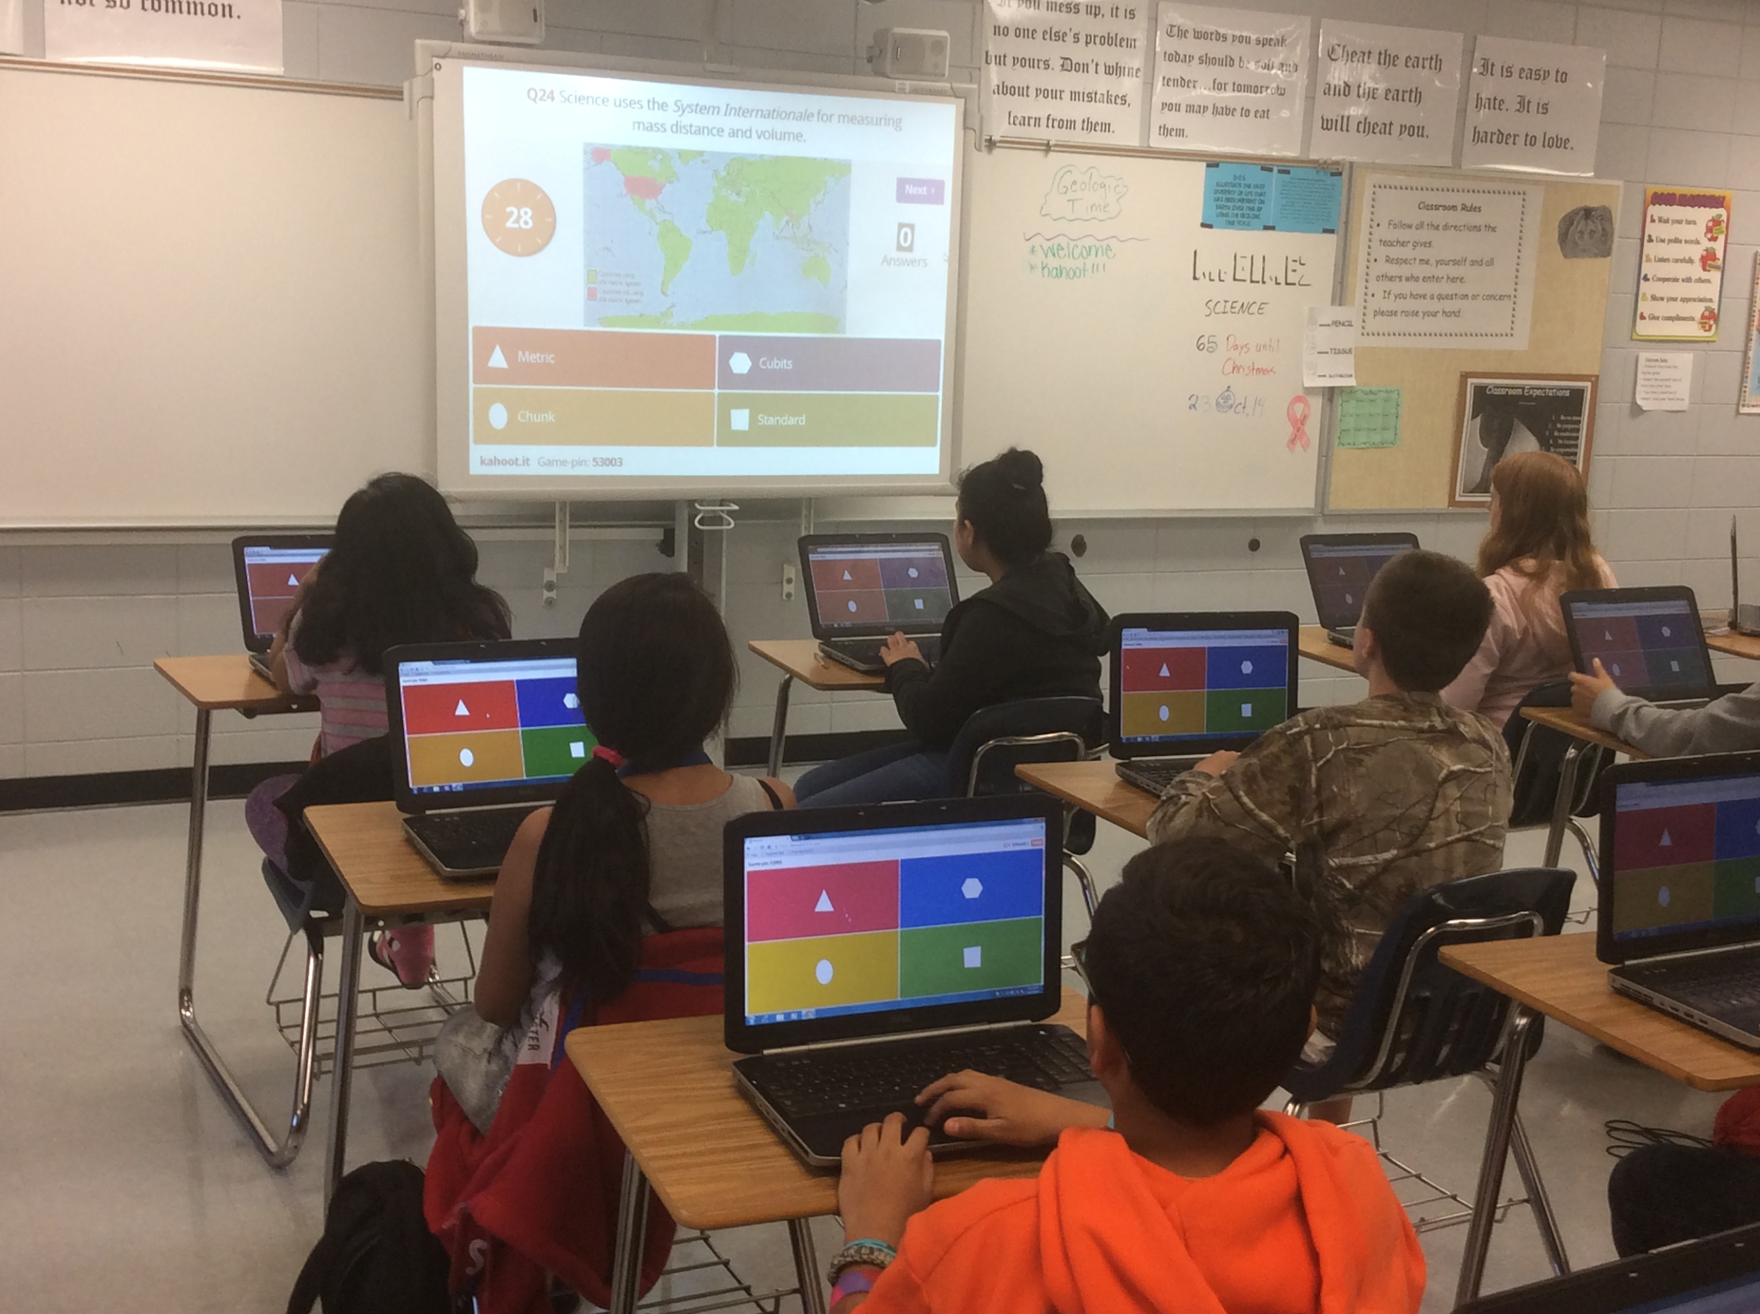
Background
What Is Kahoot?

Slide 5
Is Kahoot Worth It?
Positives | Negatives
+High Engagement +User Friendly +Customizable | -Tech Dependent

Slide 6
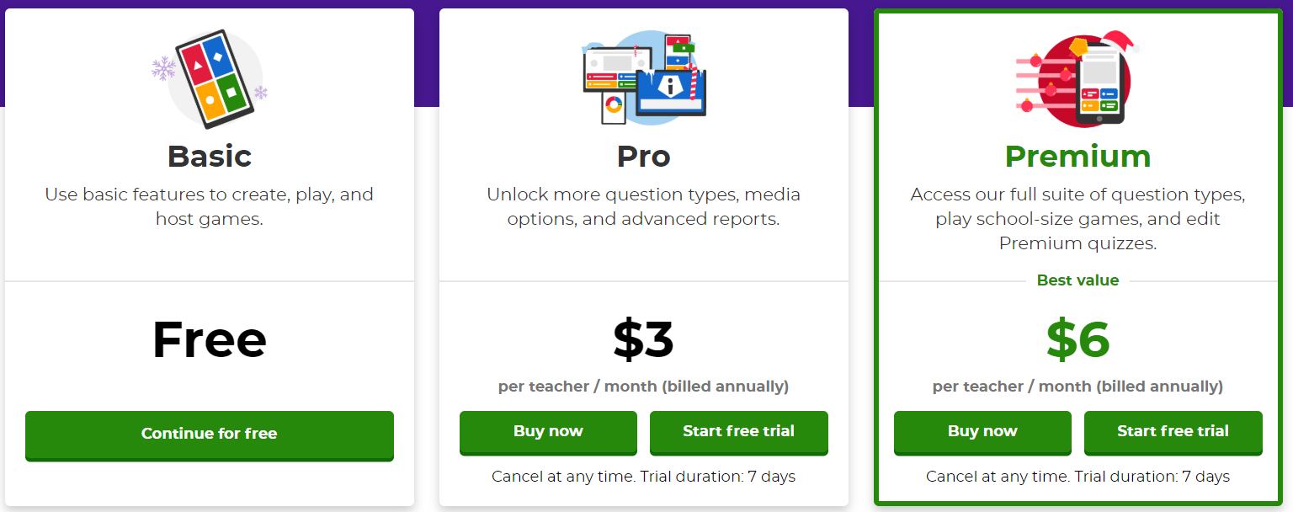
The Basics
What Does It Cost?

Slide 7

The Basics
How Does It Work?

Slide 8
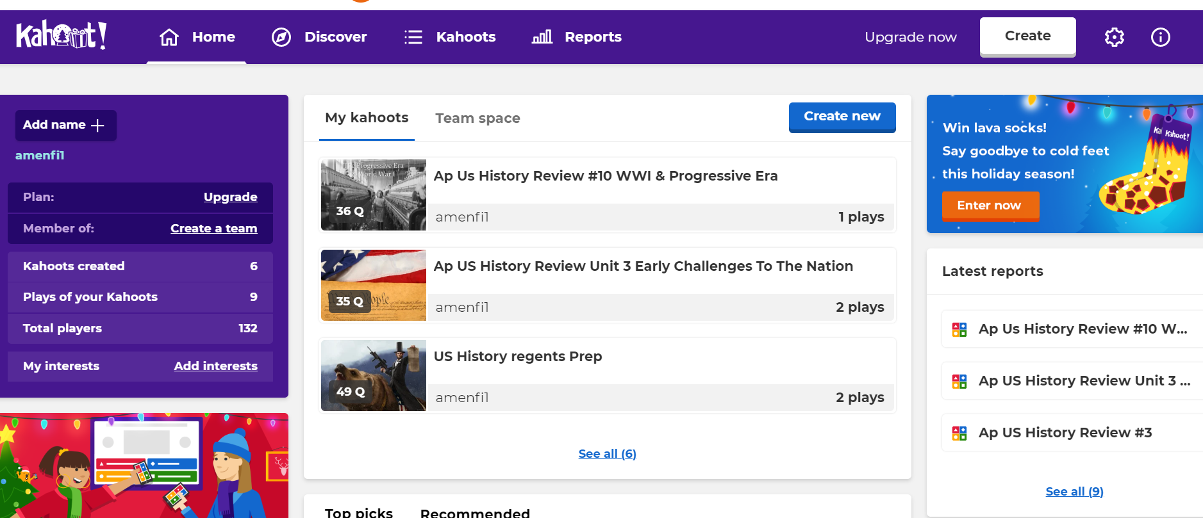
Step 1: Make Or Choose A Quiz

Slide 9
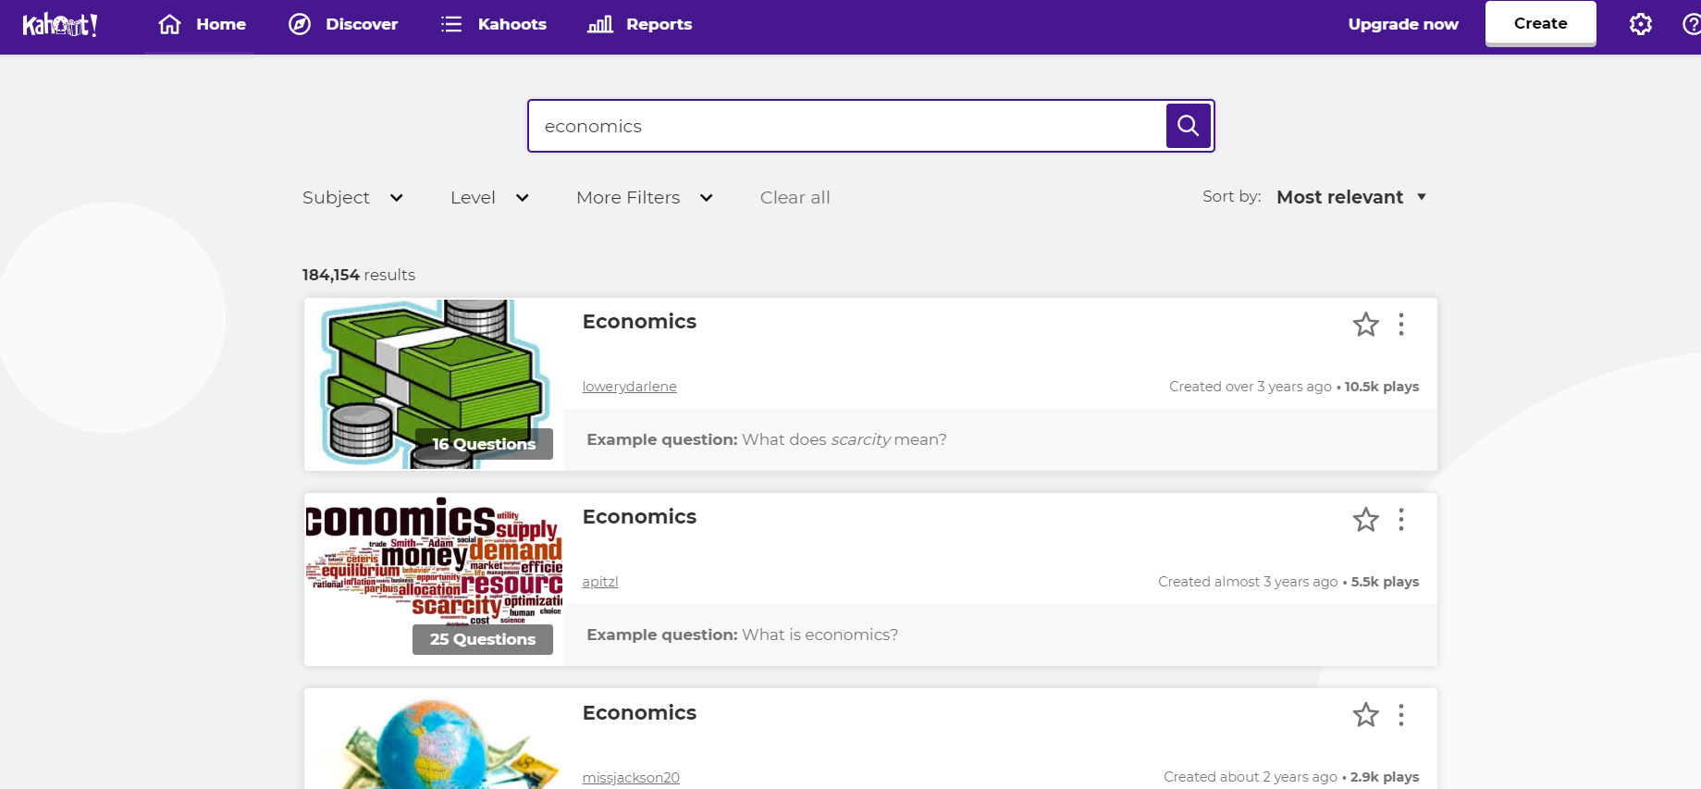
Step 1: Make Or Choose A Quiz

Slide 10
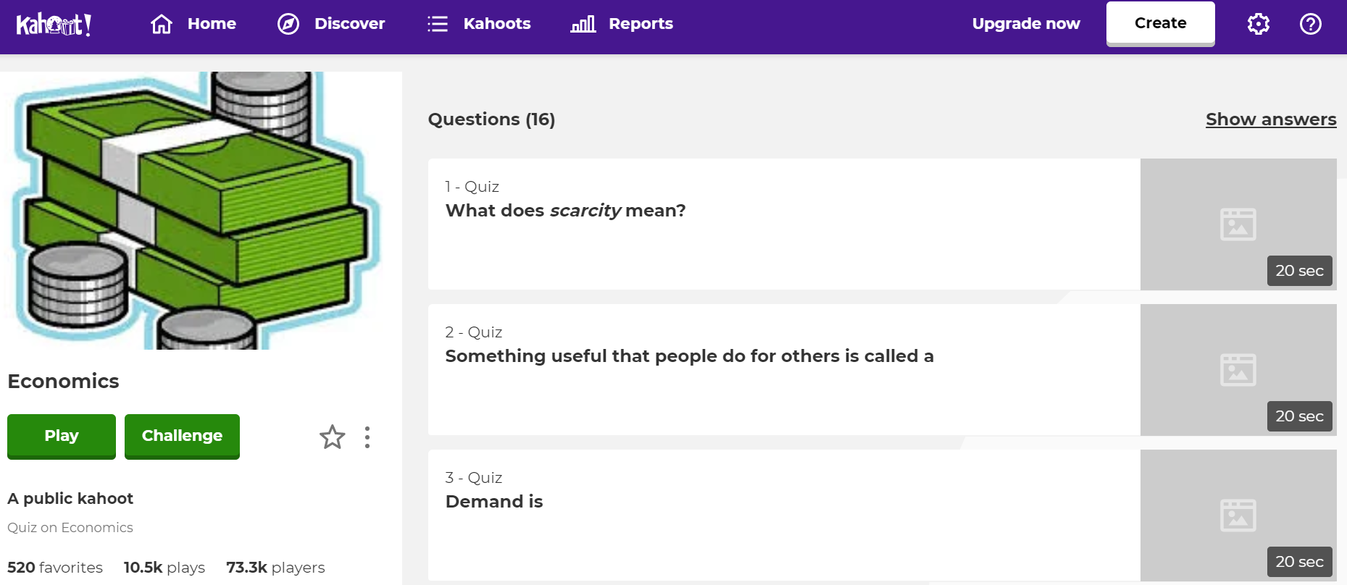
Step 1: Make Or Choose A Quiz

Slide 11
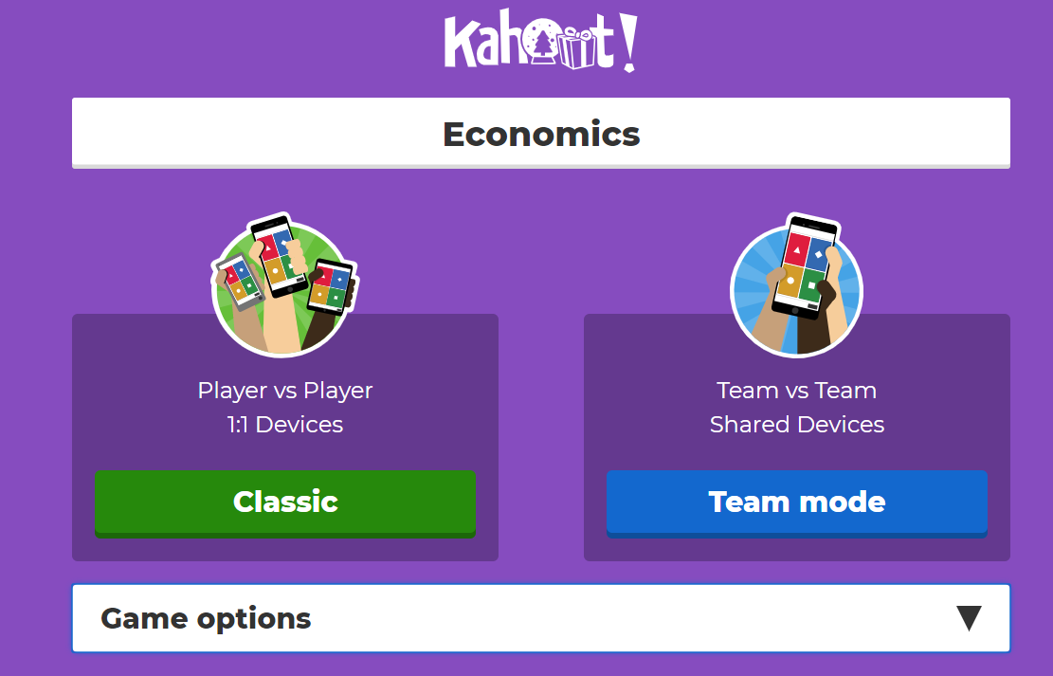
Step 2: Start Game

Slide 12
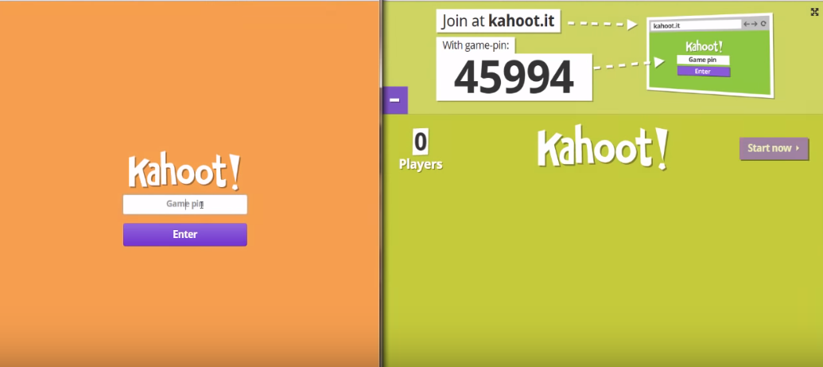
Step 2: Start Game
Students
Teacher

Slide 13
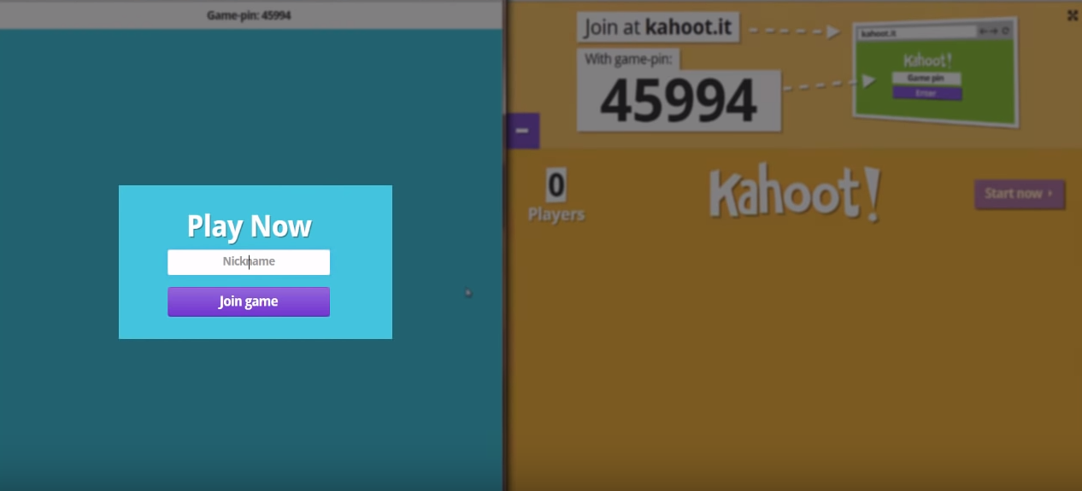
Step 2: Start Game
Students
Teacher

Slide 14
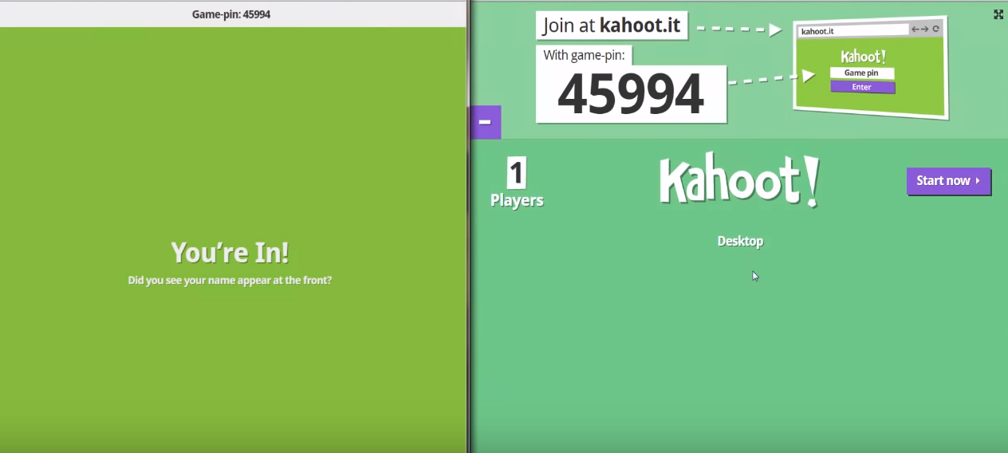
Step 2: Start Game
Students
Teacher

Slide 15
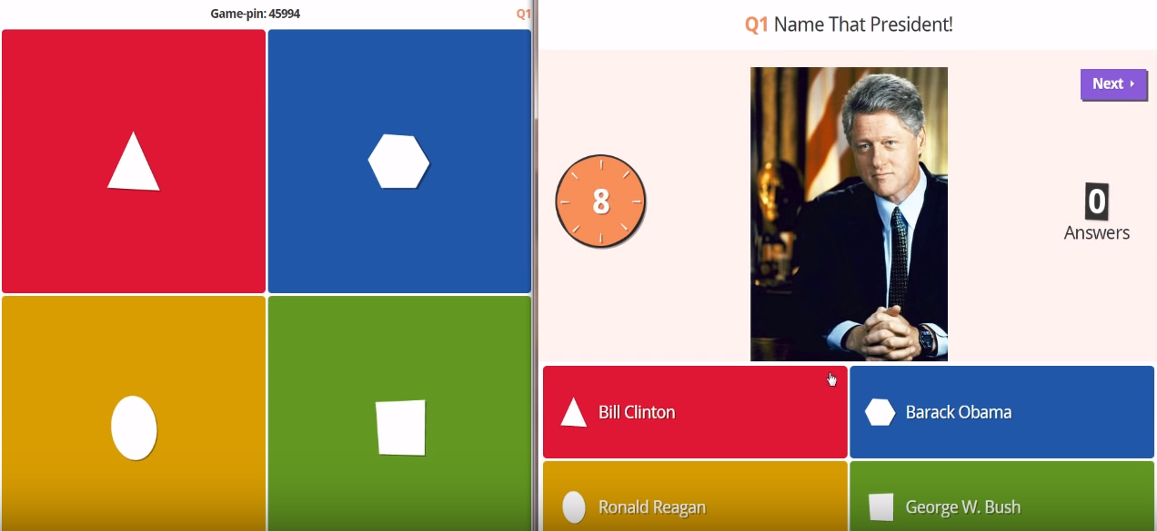
Step 3: Playing The Game
Students
Teacher

Slide 16
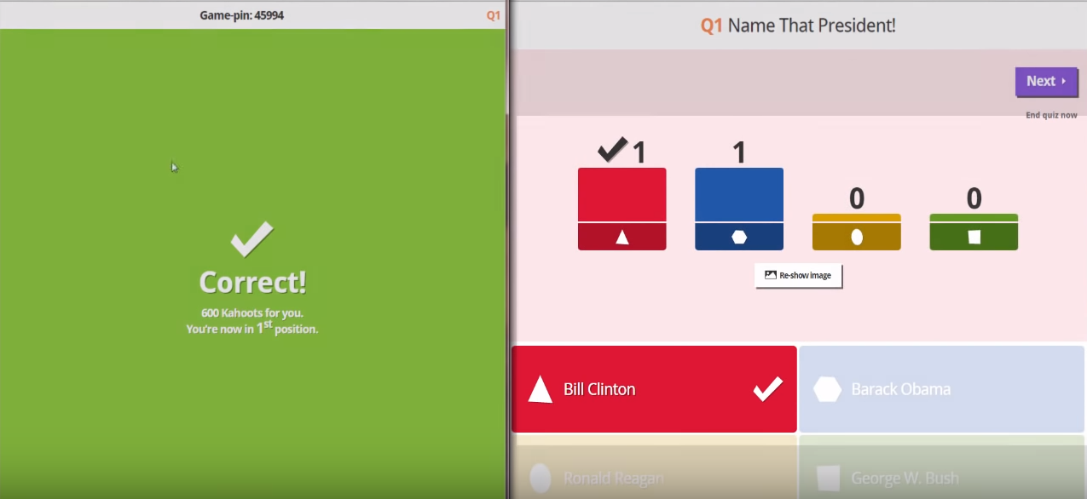
Step 3: Playing The Game
Students
Teacher

Slide 17
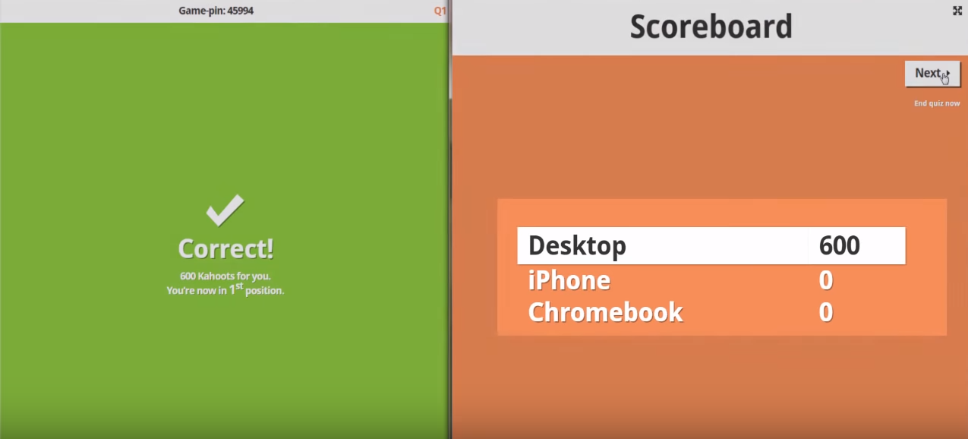
Step 3: Playing The Game
Students
Teacher

Slide 18
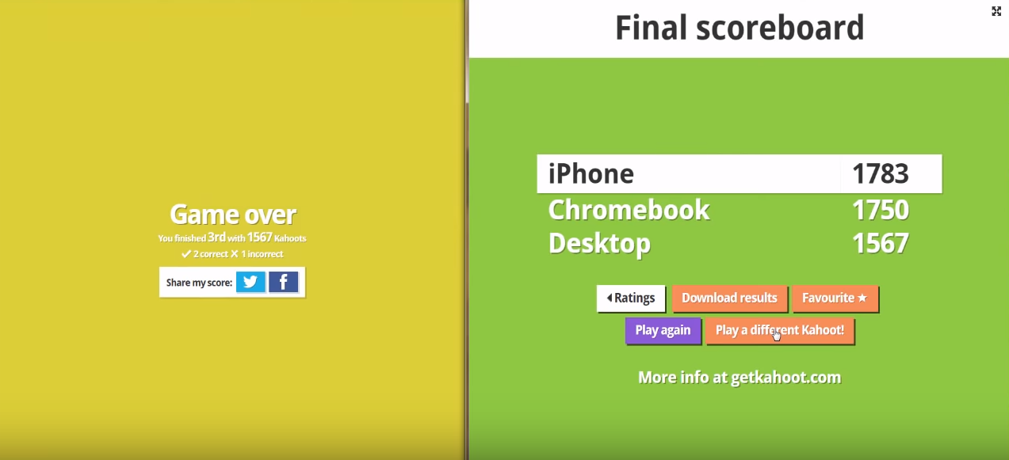
Step 3: Playing The Game
Students
Teacher

Slide 19
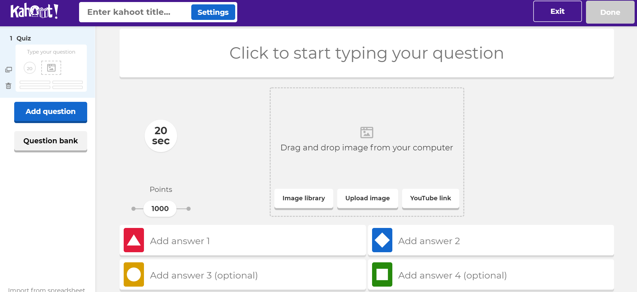
How To Make Quizzes

Slide 20
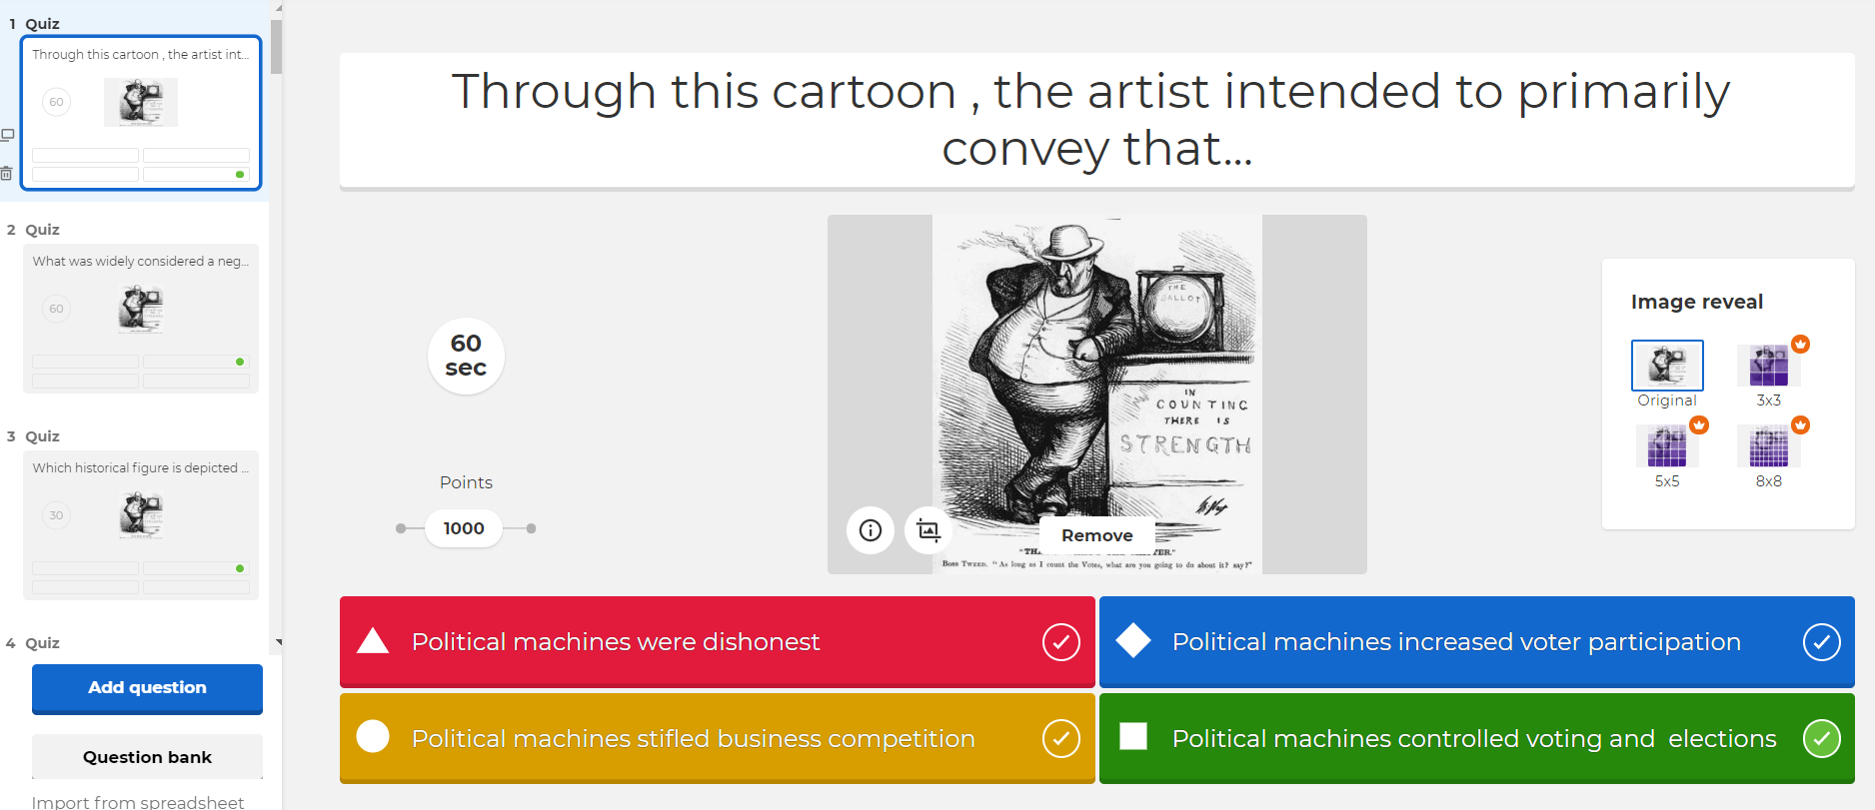
How To Make Quizzes

Slide 21

QUESTIONS?

Slide 22
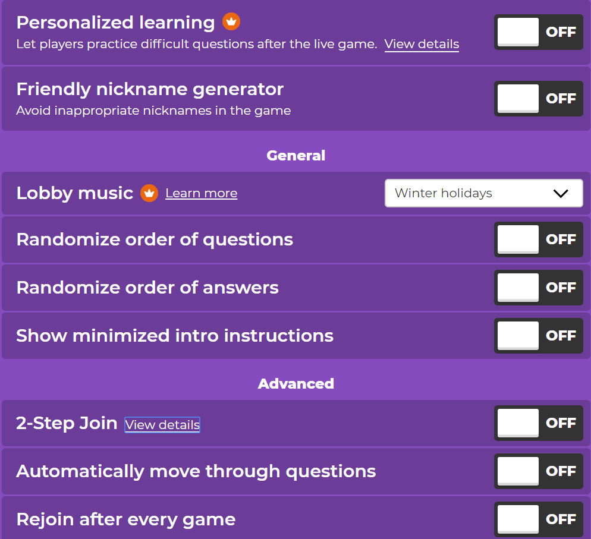
Advanced Guide: Starting Game Options
Notes:
anything with crown is premium account

Slide 23
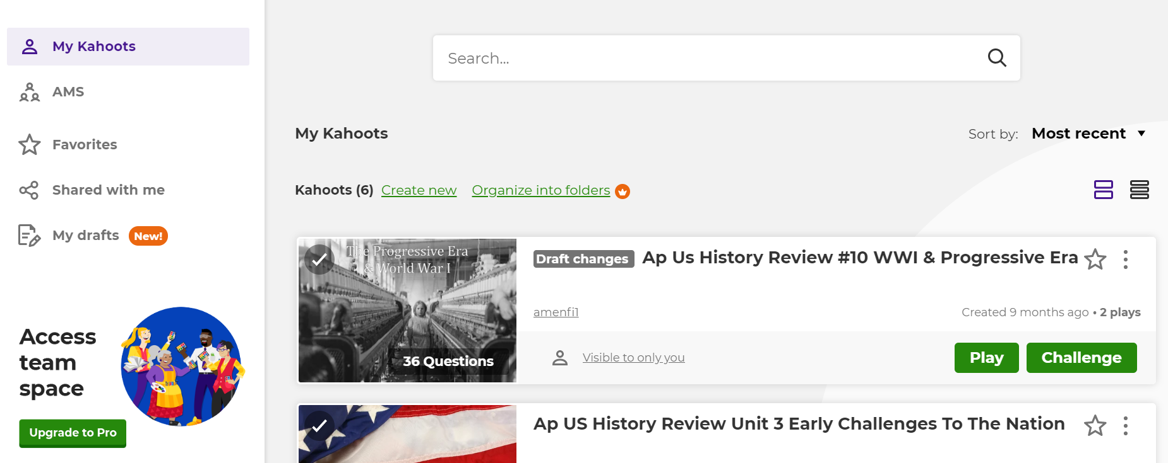
Advanced Guide: Sharing
Notes:
anything with crown is premium account

Slide 24
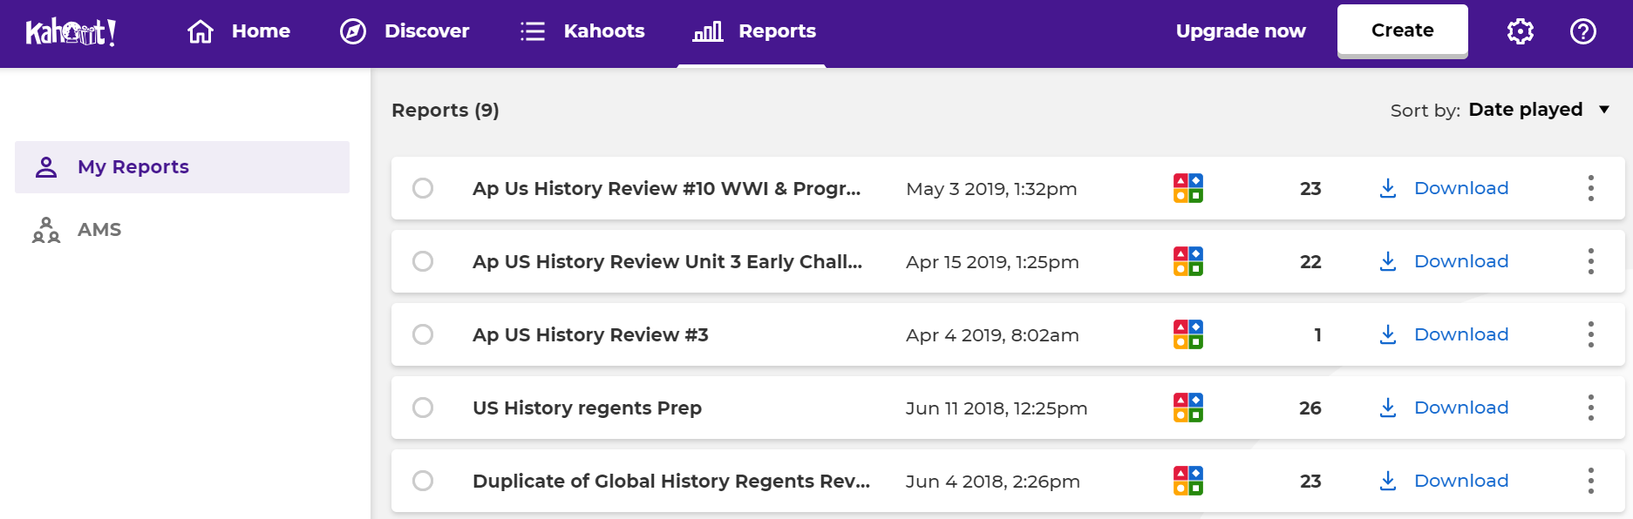
Advanced Guide: Using Reports
Notes:
anything with crown is premium account

Slide 25
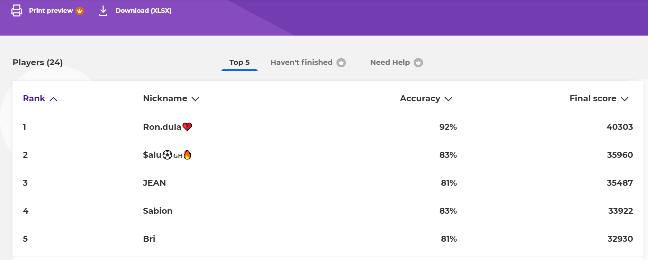
Advanced Guide: Using Reports
Notes:
anything with crown is premium account

Slide 26
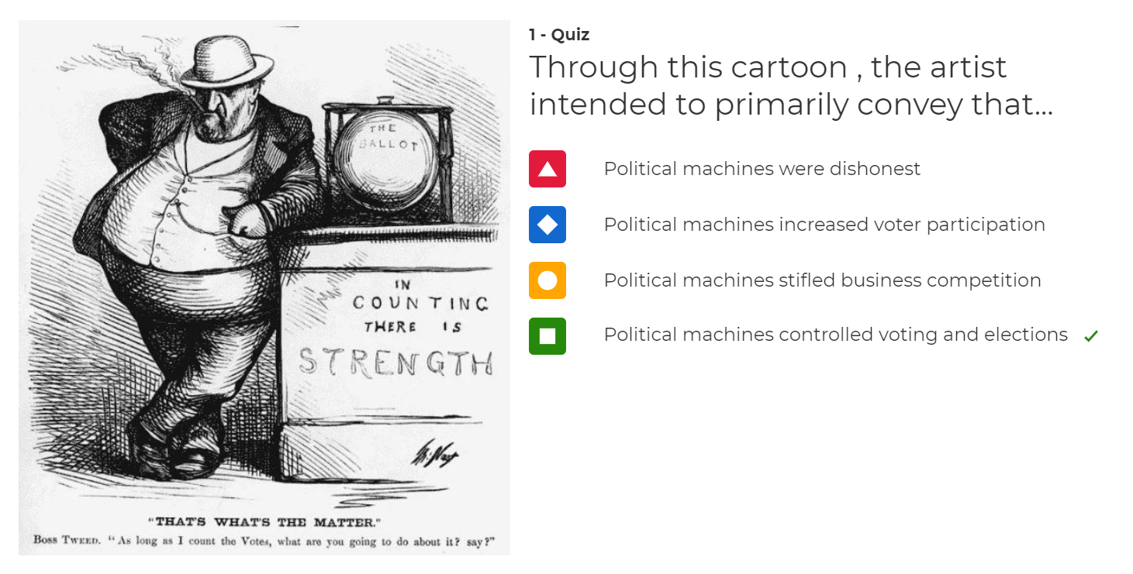
Advanced Guide: Using Reports
Notes:
anything with crown is premium account

Slide 27
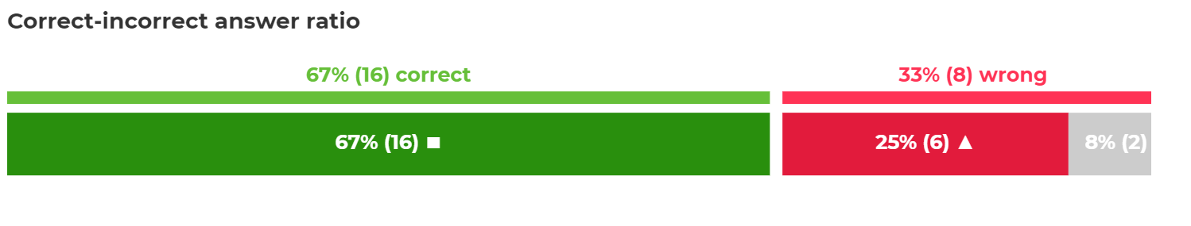
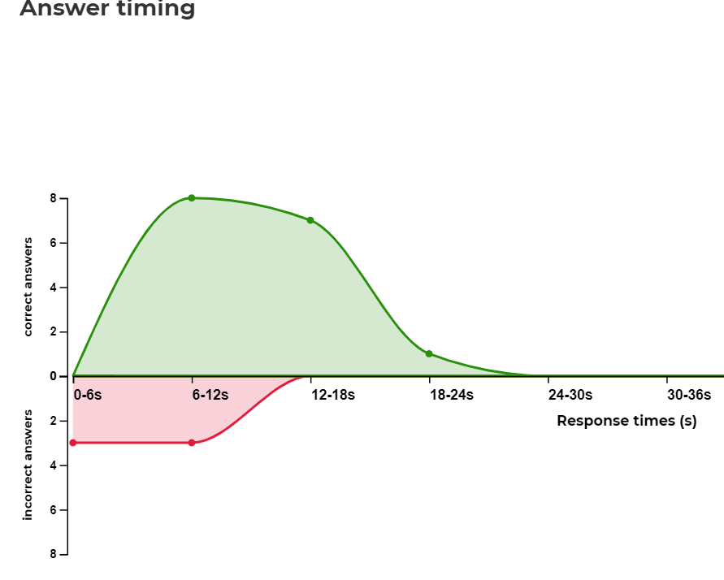
Advanced Guide: Using Reports
Notes:
premium account

Slide 28
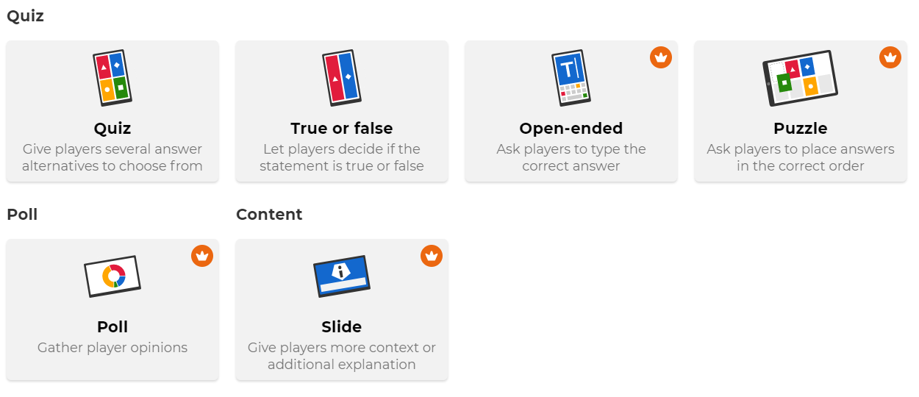
Advanced Guide: Different Question Types
Notes:
anything with crown is premium account

Slide 29
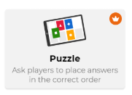
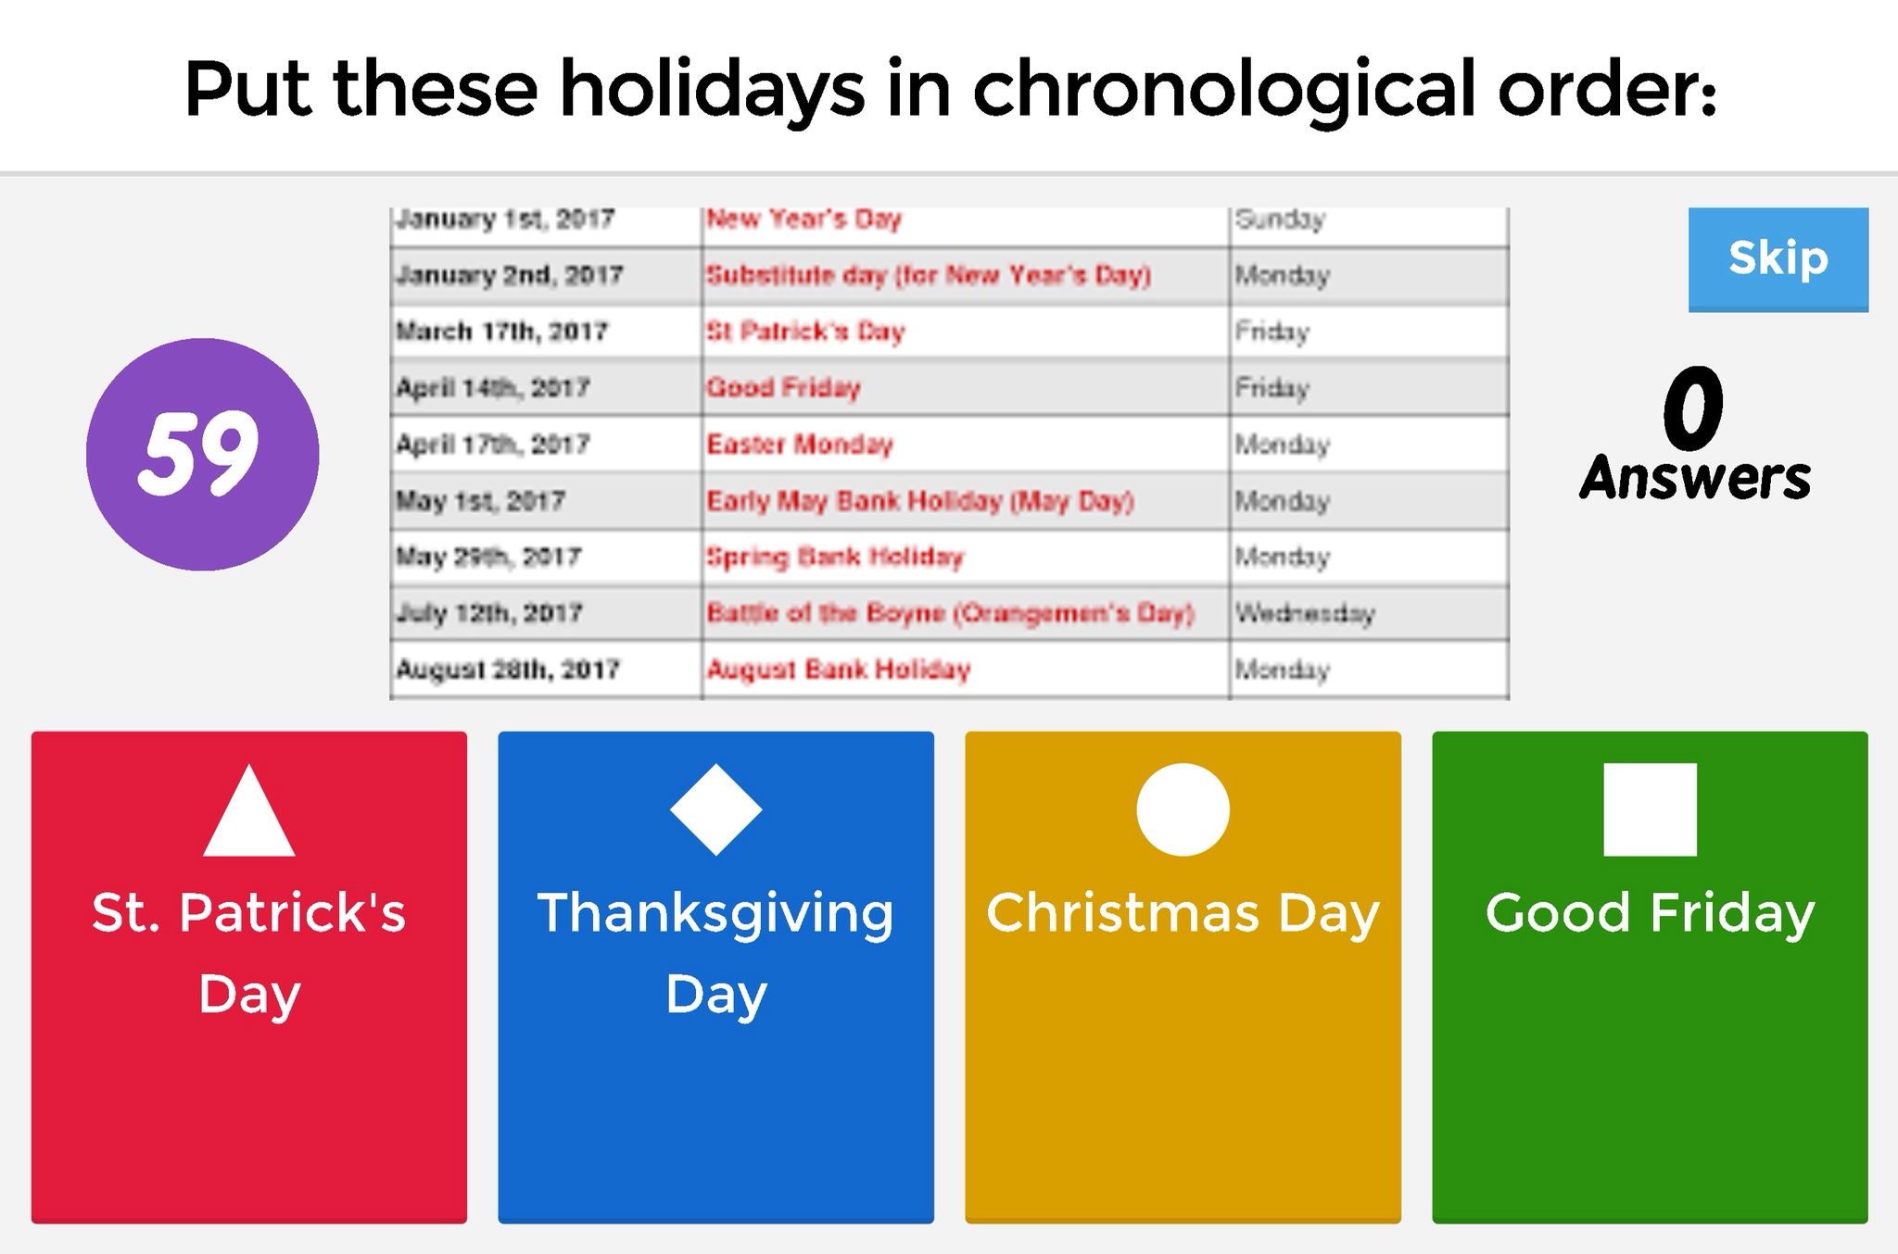
Advanced Guide: Different Question Types
Notes:
anything with crown is premium account

Slide 30
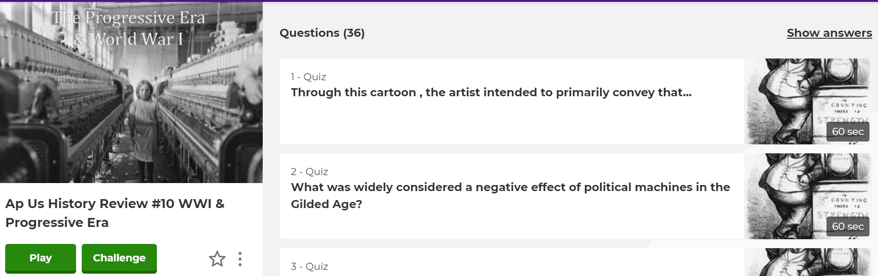
Advanced Guide: Challenge Feature
Notes:
anything with crown is premium account

Slide 31
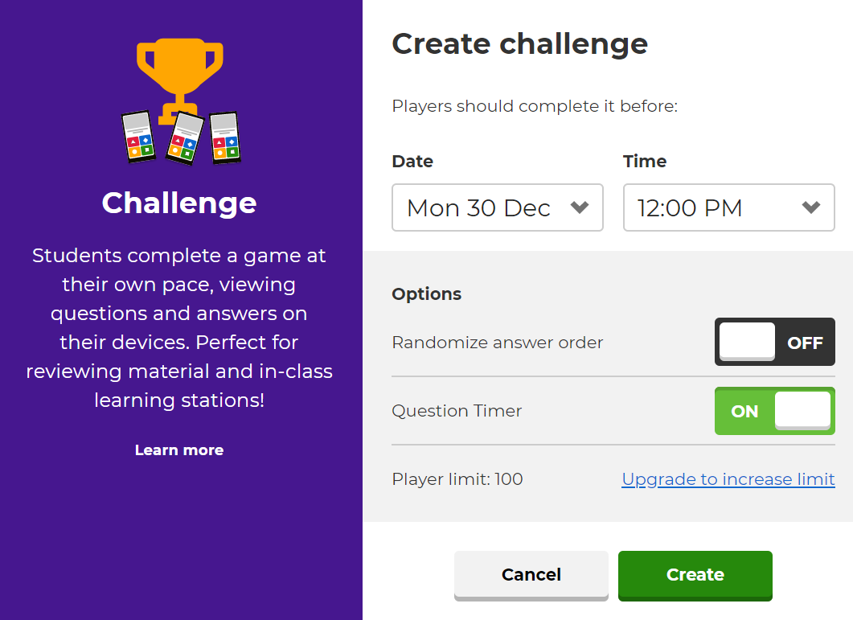
Advanced Guide: Challenge Feature
Notes:
have it count as a score, encourage them to use notes, or don’t

Slide 32
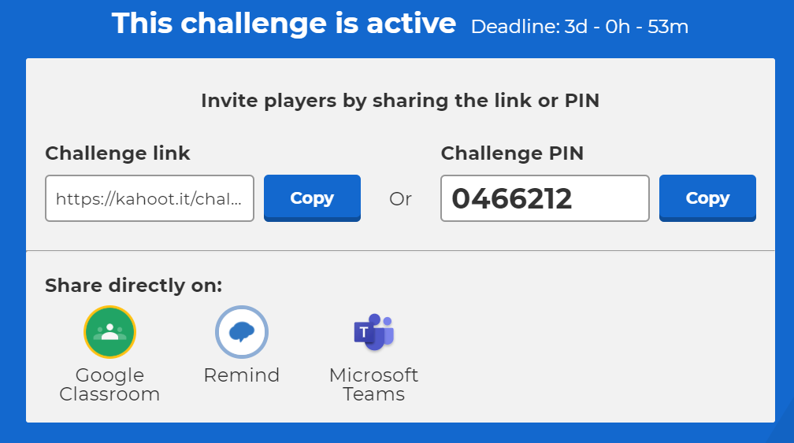
Advanced Guide: Challenge Feature
Notes:
anything with crown is premium account

Slide 33


Miscellaneous Tips
Prepare Extra Questions
  45 Min Period: 25
  60 Min Period: 35
Notes:
anything with crown is premium account

Slide 34

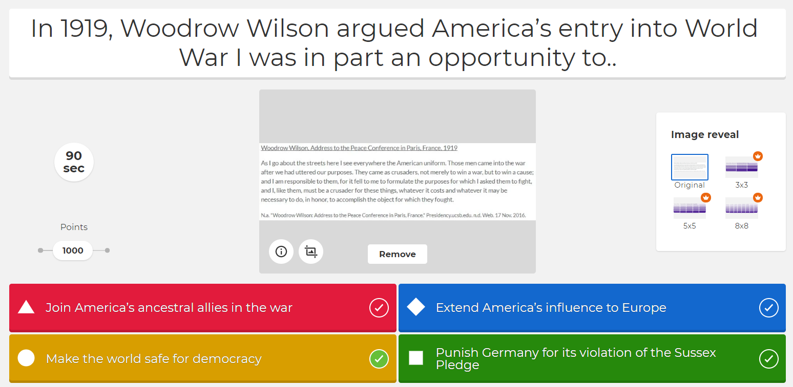
Miscellaneous Tips
Physical Copies of Documents
Notes:
anything with crown is premium account

Slide 35

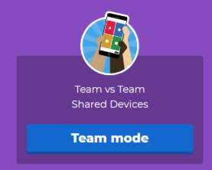
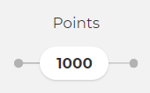
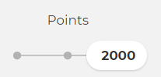
Miscellaneous Tips
Avoid Loser Check Out
  Prizes Based On Score
  Teams
  “Double Jeopardy”
  “Final Jeopardy”
Notes:
I prefer teams on different devices

Slide 36


Miscellaneous Tips
Common Tech Problems
  Disconnect
  Wrong Input
Notes:
if they disconnect, then I let them start a new one and I can combine scores

Slide 37
QUESTIONS?

Slide 38
Contact & Questions?
Andrew Menfi
Social Studies Teacher
New Visions Charter High School
for Advanced Math & Science
amenfi3@gmail.com

