Slide 1

Financial Fitness for Life, Chapter 6:
Why Do Some Jobs Pay More Than Others?
Theresa Fischer
November 2020 ecofisch@gmail.com

Slide 2
EconEdLink Membership
You can now access CEE’s professional development webinars directly on EconEdLink.org! To receive these new professional development benefits, become an EconEdLink member. As a member, you will now be able to:
Automatically receive a professional development certificate via e-mail within 24 hours after viewing any webinar for a minimum of 45 minutes
Register for upcoming webinars with a simple one-click process
Easily download presentations, lesson plan materials and activities for each webinar
Search and view all webinars at your convenience
Save webinars to your EconEdLink dashboard for easy access to the event
You may access our new Professional Development page here

Slide 3
Professional Development Certificate
To earn your professional development certificate for this webinar, you must:
Watch a minimum of 45-minutes and you will automatically receive a professional development certificate via e-mail within 24 hours.
Accessing resources:
You can now easily download presentations, lesson plan materials, and activities for each webinar from EconEdLink.org/professional-development/

Slide 4
Agenda
Why do some people earn more money than others?
What is the relationship between income and human capital?
Show how when you invest in one’s self, you will gain future earnings.
See earning potential of a high school graduate as compared to post secondary education.

Slide 5
Objectives
The importance and connection between education and human capital.
To understand the concept of derived demand, income and human capital.
To be aware of the changes in the labor market demands.
How has the pandemic created changes for the labor market of the future?

Slide 6
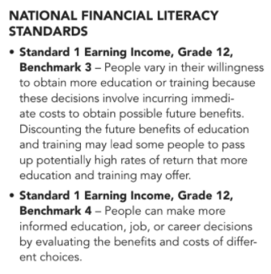
National Standards

Slide 7
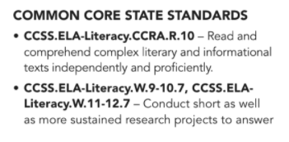
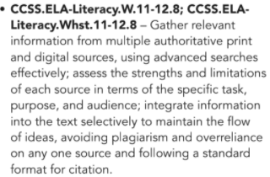
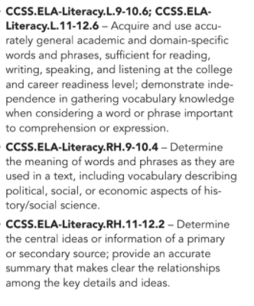
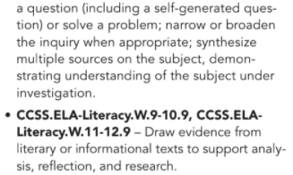
State Standards

Slide 8

https://store.councilforeconed.org/

Slide 9
References
Nearpod.com
Bureau of Labor Statistics
Federal Reserve Bank
Visit https://econedlink.org/resources/collection/fffl-9-12/ to find presentations, interactives and other great technology tools to enhance your teaching of this lesson

Slide 10
Vocabulary to Know
Derived Demand – When you demand a product, you demand its labor
Income – Wages plus other assets (interest, dividend, rent)
Wages – Salary or income
Marginal Revenue Product – Additional revenue due to an addition of one unit of resource
Marginal Resource Cost – Additional expense due to an addition of one unit of resource
Wage Differentials – Different skillsets earn different salaries
Human Capital – Knowledge, network, health, skill and talent people bring to their jobs
Ex: Hire an amount of workers so that salary MRC = MRP, to maximize profit.

Slide 11
Why Do People Earn Such Different Salaries?
Specialized set of skills and experience.
Demand for people with specific training.
People who are more productive.
People who are self disciplined and work well with others.
Varied levels of education and/or human capital

Slide 12
How Do I Find Those High Paying Jobs?
Variety of sources:
Payscale.com
National Center for Education Statistics (NCES)
Bureau of Labor Statistics
Glassdoor.com

Slide 13

Payscale Based on Education
https://study.com/articles/How_Much_More_Do_College_Graduates_Earn_Than_Non-College_Graduates.html

Slide 14
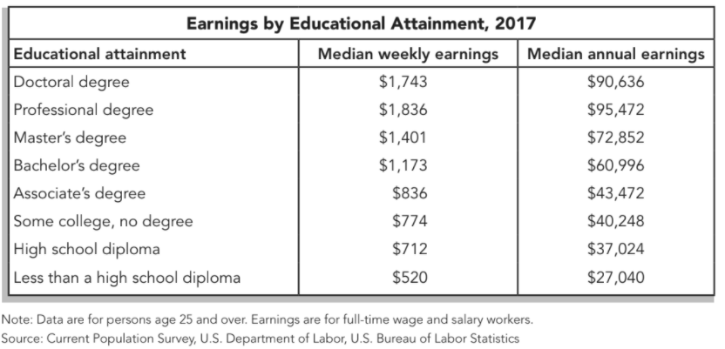

Slide 15

Benefits of a College Degree

Slide 16
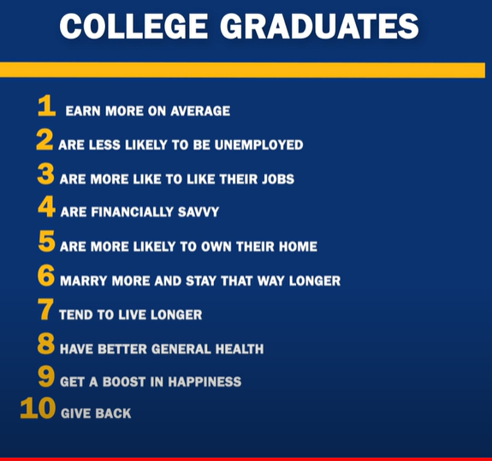

Slide 17
Job Titles Also Affect Pay
Higher paying jobs with less applicants | Lower paying jobs with more applicants
Manager | Assistant
Senior | Coordinator
Executive | Associate
Director | Accountant

Slide 18
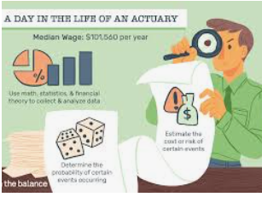

Where Are the Jobs Paying Higher?
Students can make sure they are getting the most out of their investment by choosing a major that will lead to a stable and high-paying career.
According to The Washington Post, one in five bachelor’s degrees are awarded to students who study in fields like finance, accounting and management. Actuarial mathematics can make some serious cash,
The highest-paying college major? Petroleum engineering.

Slide 19
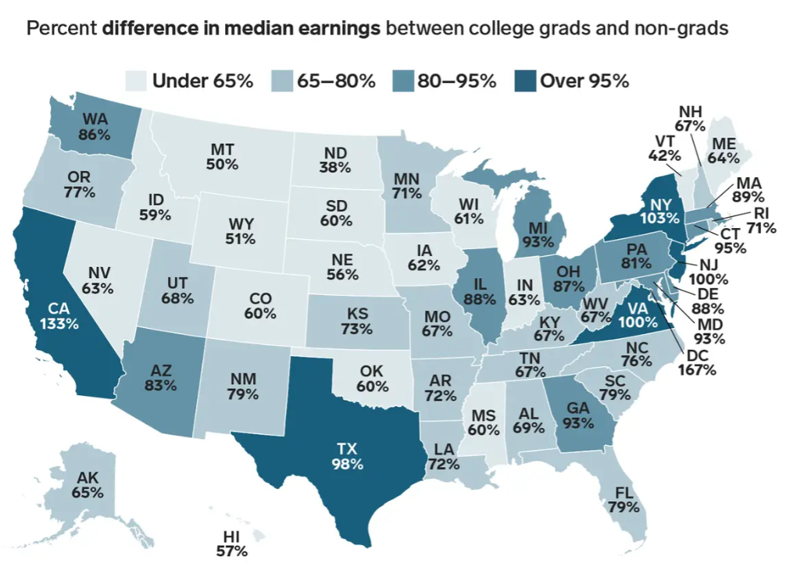
https://www.businessinsider.com/how-much-more-college-graduates-earn-than-non-graduates-in-every-state-2019-5

Slide 20






Talent and Skill
$45 million
$124 million
$185 million
$56 million
$622,421
$37.7 million

Slide 21
Highest Paid Jobs (Mean Incomes)
Anesthesiologists > $267,020 per year
Surgeons > $255,110 per year
Oral and Maxillofacial Surgeons > $242,370 per year
Obstetricians and Gynecologists > $238,320 per year
Orthodontists > $225,760 per year
Psychiatrists > $220,380 per year
Physicians > $196,490 per year

Slide 22
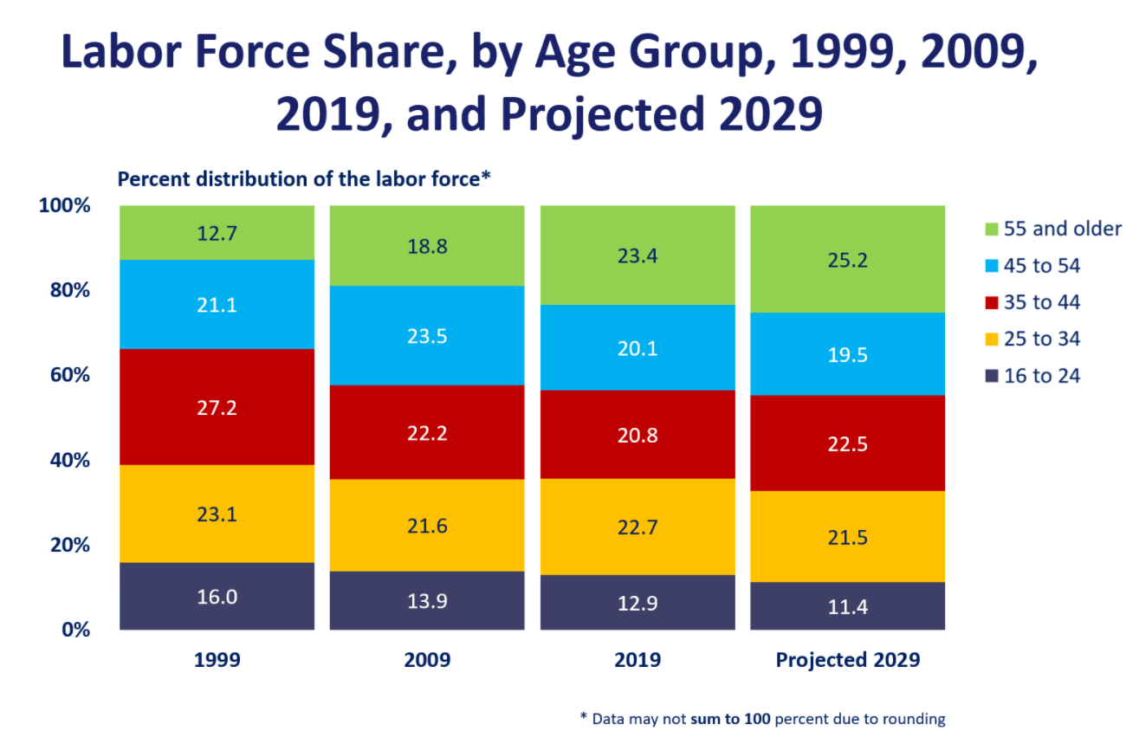

Slide 23
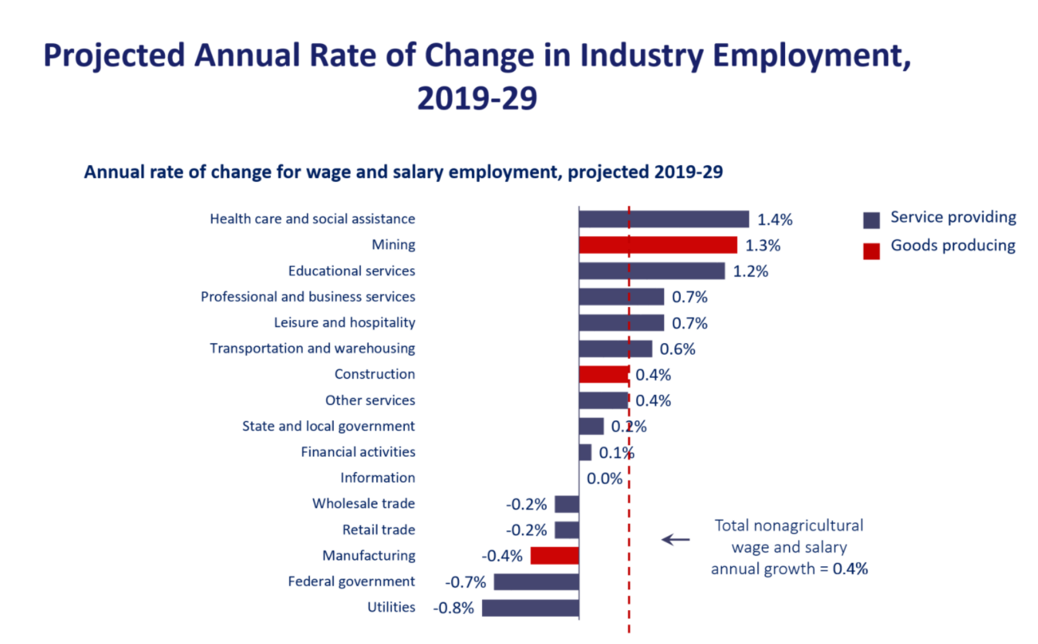

Slide 24
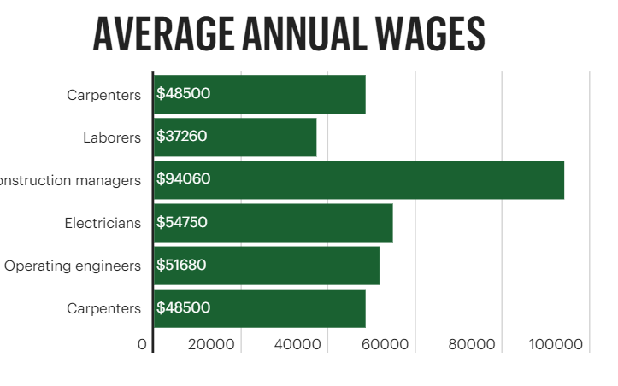
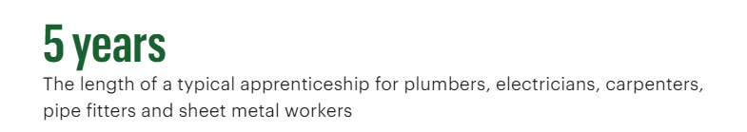
Construction work is there, but finding workers can be challenging…
CEO Luis Rodriguez Jr. said that his small, independently owned firm recruits workers by focusing on benefits such as health care coverage, 401k deposits, life insurance and paid vacations. The company has 65 employees and last year had more than $15 million in billings

Slide 25
Assessment Questions
When you invest in human capital, what does it mean in terms of your…
Knowledge?
Skills?
Work habits?
Health?
Financial security?

Slide 26
Activities
Work Force Solutions: “When I Grow Up” Guide to Employment
https://www.wrksolutions.com/Documents/WhenIGrowUp/WIGU_PDFS/High-School/WFS-WIGU-HighSchool-Lessons.pdf
Inside the Vault: Employment in the Future
https://www.stlouisfed.org/~/media/education/lessons/pdf/employment-growth.pdf?la=en
“Job Jungle Market” Game
https://www.fte.org/teachers/teacher-resources/lesson-plans/efllessons/the-job-jungle-a-labor-market-game/
Career Search
https://www.bls.gov >

Slide 27

CEE Affiliates
https://www.councilforeconed.org/resources/local-affiliates/

Slide 28




Thank You to Our Sponsors!

