Slide 1
The History of Social Security
Inquiry Based Lesson
Presented by Amanda Stiglbauer
November 9, 2020
Amanda.Stiglbauer@moore.sc.edu

Slide 2
EconEdLink Membership
You can now access CEE’s professional development webinars directly on EconEdLink.org! To receive these new professional development benefits, become an EconEdLink member. As a member, you will now be able to:
Automatically receive a professional development certificate via e-mail within 24 hours after viewing any webinar for a minimum of 45 minutes
Register for upcoming webinars with a simple one-click process
Easily download presentations, lesson plan materials and activities for each webinar
Search and view all webinars at your convenience
Save webinars to your EconEdLink dashboard for easy access to the event
You may access our new Professional Development page here

Slide 3
Professional Development Certificate
To earn your professional development certificate for this webinar, you must:
Watch a minimum of 45-minutes and you will automatically receive a professional development certificate via e-mail within 24 hours.
Accessing resources:
You can now easily download presentations, lesson plan materials, and activities for each webinar from EconEdLink.org/professional-development/

Slide 4
Agenda
Political Cartoon Analysis
Introduction to Inquiry Based Learning and Compelling Questions
Staging – Analysis of The Preamble
  Collaboration Board
  Mentimeter – How does the government provide for the general welfare?
Purpose of Social Security – Primary Source Analysis
Collaboration Board – Reason for creation of Social Security
Two Cents – Will Social Security Be Around for Millennials?
Collaboration Board -- Effects of Social Security
Was Social Security Successful?

Slide 5
National Standards
National Standards for Economics
Role of Government and Market Failure Standard: 16
Students will understand that: There is an economic role for government in a market economy whenever the benefits of a government policy outweigh its costs. Governments often provide for national defense, address environmental concerns, define and protect property rights, and attempt to make markets more competitive. Most government policies also have direct or indirect effects on people's incomes.

Slide 6

Objectives
I can:
Examine primary and secondary sources for information and interpretations.
Support positions with evidence.

Slide 7
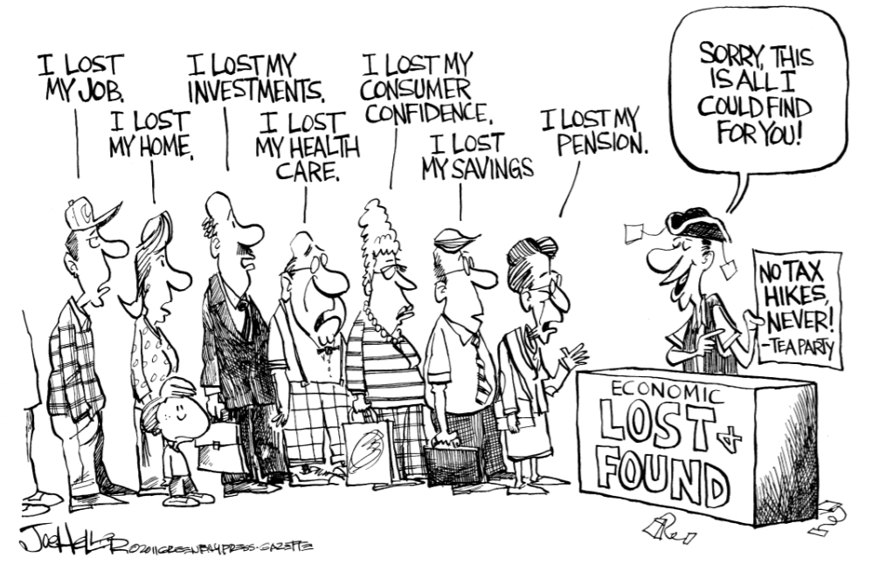

Slide 8
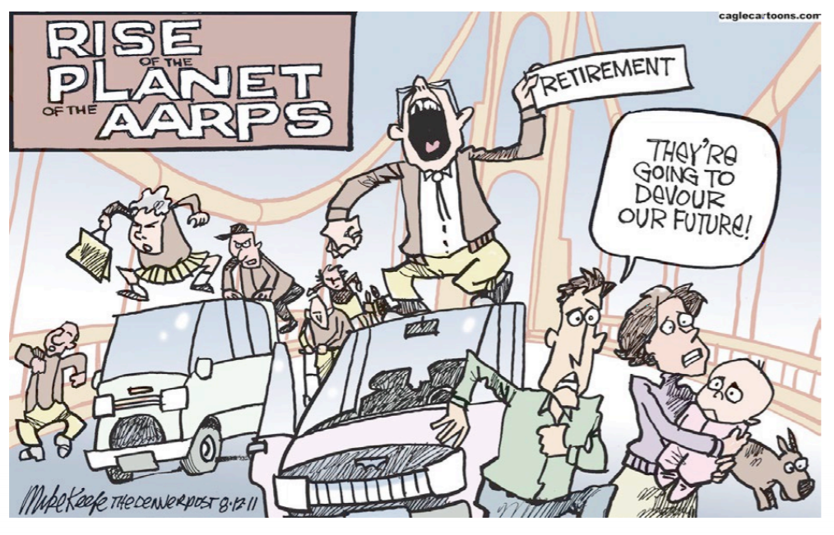

Slide 9


Slide 10
What is the common thread of these political cartoons?

Slide 11
Inquiry Based Learning Overview
Students develop questions they are curious about.
Students use time in class to research the topic.
Students present their learning.
Students reflect on what worked and what did not.
Notes:
For more information, check out this article from Edutopia: https://www.edutopia.org/blog/what-heck-inquiry-based-learning-heather-wolpert-gawron

Slide 12
Why Inquiry Based Learning?
Reinforces content
Warms up the brain for learning
Deeper understanding
Makes learning rewarding
Builds initiative and self-direction
Works in almost any classroom
Differentiated instruction

Slide 13


Slide 14

Compelling Questions
Was Social Security successful?
What is the purpose of Social Security?
What are the effects of Social Security?

Slide 15
Prior Knowledge
Role of Congress in the law- making process
The Federal budget
President Franklin Roosevelt
The Great Depression
The New Deal
Basics of fiscal policy

Slide 16
The Preamble
“We the People of the United States, in Order to form a more perfect Union, establish Justice, insure domestic Tranquility, provide for the common defence, promote the general Welfare, and secure the Blessings of Liberty to ourselves and our Posterity, do ordain and establish this Constitution for the United States of America.”

Slide 17
Discussion
What did the writers of the Constitution mean by “welfare”?

Slide 18
Mentimeter
How can the government provide for the general welfare?
www.menti.com
25 83 53 1

Slide 19
What was the purpose of Social Security?
A – M: Read the Social Security Act
N – Z: Read President Roosevelt’s Speech, 1935
**Respond on the Collaboration Board**

Slide 20
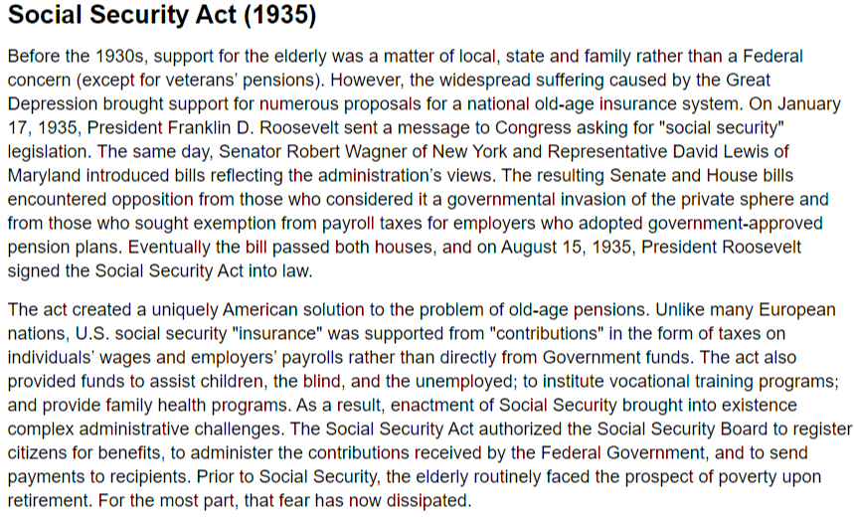
What was the purpose of Social Security?

Slide 21
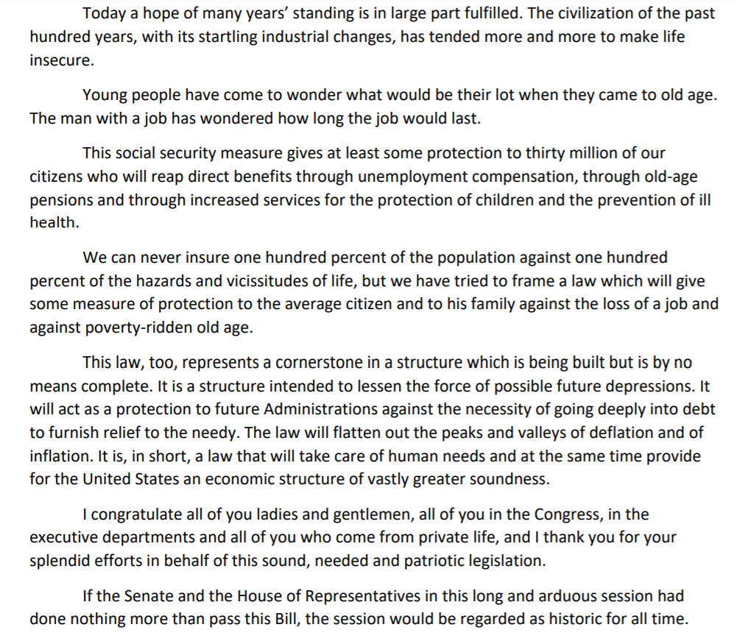
FDR’s Speech

Slide 22
Discussion
Why was Social Security created?

Slide 23

Will Social Security Be Around for Millennials?

Slide 24
Discussion
What have been the effects of Social Security?

Slide 25
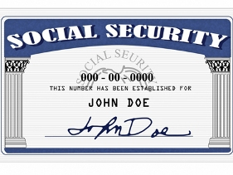
Assessment
Address the compelling question:
Was Social Security successful?
Ideas:
Research-based essay
Class debate
Structured debate
Commercial or video advertisement
Talk Show

Slide 26
Assessment Questions
Which clause of the Preamble is often used to support the purpose of Social Security? (“Promote the general welfare.”)
How does the government promote the general welfare? (By using tax dollars to provide schools, environmental protection, social security, welfare, making laws to promote fair and safe working conditions, the FDA and other regulatory bodies.)
Which important economic package was the Social Security Act of 1935 part of? (The New Deal.)
What was the original goal of the Social Security Act of 1935? (To promote economic security of the nation’s people by using contributions to pay retirees.)
Who does Social Security serve today? (Not only retirees, but also the disabled and survivors of deceased workers to name a few.)

Slide 27

CEE Affiliates
https://www.councilforeconed.org/resources/local-affiliates/

Slide 28




Thank You to Our Sponsors!

