Slide 1
The Economics of the Discrimination (High School and College Survey Courses)
25 February 2020
Tawni Hunt Ferrarini, PhD
Tawni.org

Slide 2
Presenter Bio
Holds a PhD in Economics who studied under Nobel Laureate Douglass C. North and a bachelor’s in mathematics
Publishes books, lesson plans, and journal articles. Books include Teachers Can Be Financially Fit (Forthcoming), Economic Episodes in American History (2019), Common Sense Economics (2016)
Leads efforts in economic education around the world, including Canada, Japan, and Brazil
Serves the profession in a variety of capacities ranging from the 2015 president of the National Association for Economic Educators to micro-credentialing, badging, and industry certification committee at Lindenwood University

Slide 3
Agenda
Welcome
Overview and goals of this webinar
Presentation of six core principles
Three topics and activities
Resources
Questions and answers
How to keep the momentum going through the CouncilForEconEd.org, EconEdLink.org, and Tawni.org

Slide 4
Webinar Learning Objectives & Agenda
List the six core economic principles that frame how to critically think about and analyze discrimination through economic inquiry.
Explain how low incomes limited the various alternatives open to African Americans with respect to transact, do business, start business, and invest.
Identify ways in which higher incomes, more transactions, and more economic freedoms give agency to and empower minorities so they can challenge discrimination (segregation in the South).
Demonstrate how segregation laws limit economic, social and political opportunities.
Identify the costs that segregation laws and discrimination imposed on all residents of a region and society as a whole.

Slide 5
BASIC ECONOMICS: The science of decision-making in a world of scarcity
People choose.
Every decision has a cost, an opportunity cost.
People respond to incentives in predictable ways.
Institutions or rules and regulations matter.
Mutually advantageous exchange creates wealth and improves health.
Today’s decisions have future consequences.

Slide 6
Activity #1. Plessy vs. Ferguson.
Applying the Six Core Principles
Homer Plessy (Research him and his support group)
Resources
Describe his and the railroad conductor’s incentives.
Look at costs, including opportunity costs.
Demonstrate marginal thinking when choices were made.
Evaluate how institutions impacted exchange.
Link the decisions of 1895 to today.
Resources
Media
Podcast: Stuff You Missed in History Class (30 min)
PBS “Plessy vs Ferguson”
Primary Documents - Library of Congress
Bill of Rights Institute

Slide 7
Activity #2. Constitutionality: To Segregate or Not?
The “Economics” of Homer vs Rosa
Homer Plessy (1896)
Rosa Parks (1955)
Low income per person in 1896
Life expectancy at birth was low
Plessy was connected to a visible few minority possessing restricted and facing unequal treatment based on race
Limited access to education
Relatively high income in 1955 income per person
Life expectancy was relatively high
Parks was connected to a growing group of visible minorities with protected rights, especially education
Comparatively “open” access to education
Notes:
I

Slide 8
Cont’d: Lawful to Segregate or Not?
Homer vs Rosa: Why Institutions Matter (Political, Social, and Economic)
Homer Plessy (1896)
Rosa Parks (1955)
Jim Crow Laws separated the White and Black races
Homer rode on a train in first class
Plessy v. Ferguson (1896) upheld “separate but equal” accommodations for blacks and whites under the equal protection clause of the 14th Amendment to the Constitution
Brown v. Board of Education (1954)
Montgomery’s bus law permitting in bus transportation based on race was declared to be in violation of the U.S. Constitution
Rosa rode on a bus in the front of the bus.
Rules had changed – politically, economically, and socially
Notes:
I

Slide 9
Topic #3. Economic Freedom and Discrimination.
Defining economic freedom and investigate its influences around the world…
Responsible and accountable individuals choose.
There is sound rule of law, not rule of men.
Government serves the people in a limited capacity to protect individual liberties and rights (and property).
Exchange is voluntary and free.
There is stable monetary policy and prices.
Taxes are relatively low, and regulation is limited.
Sound markets exist, especially for capital.

Slide 10
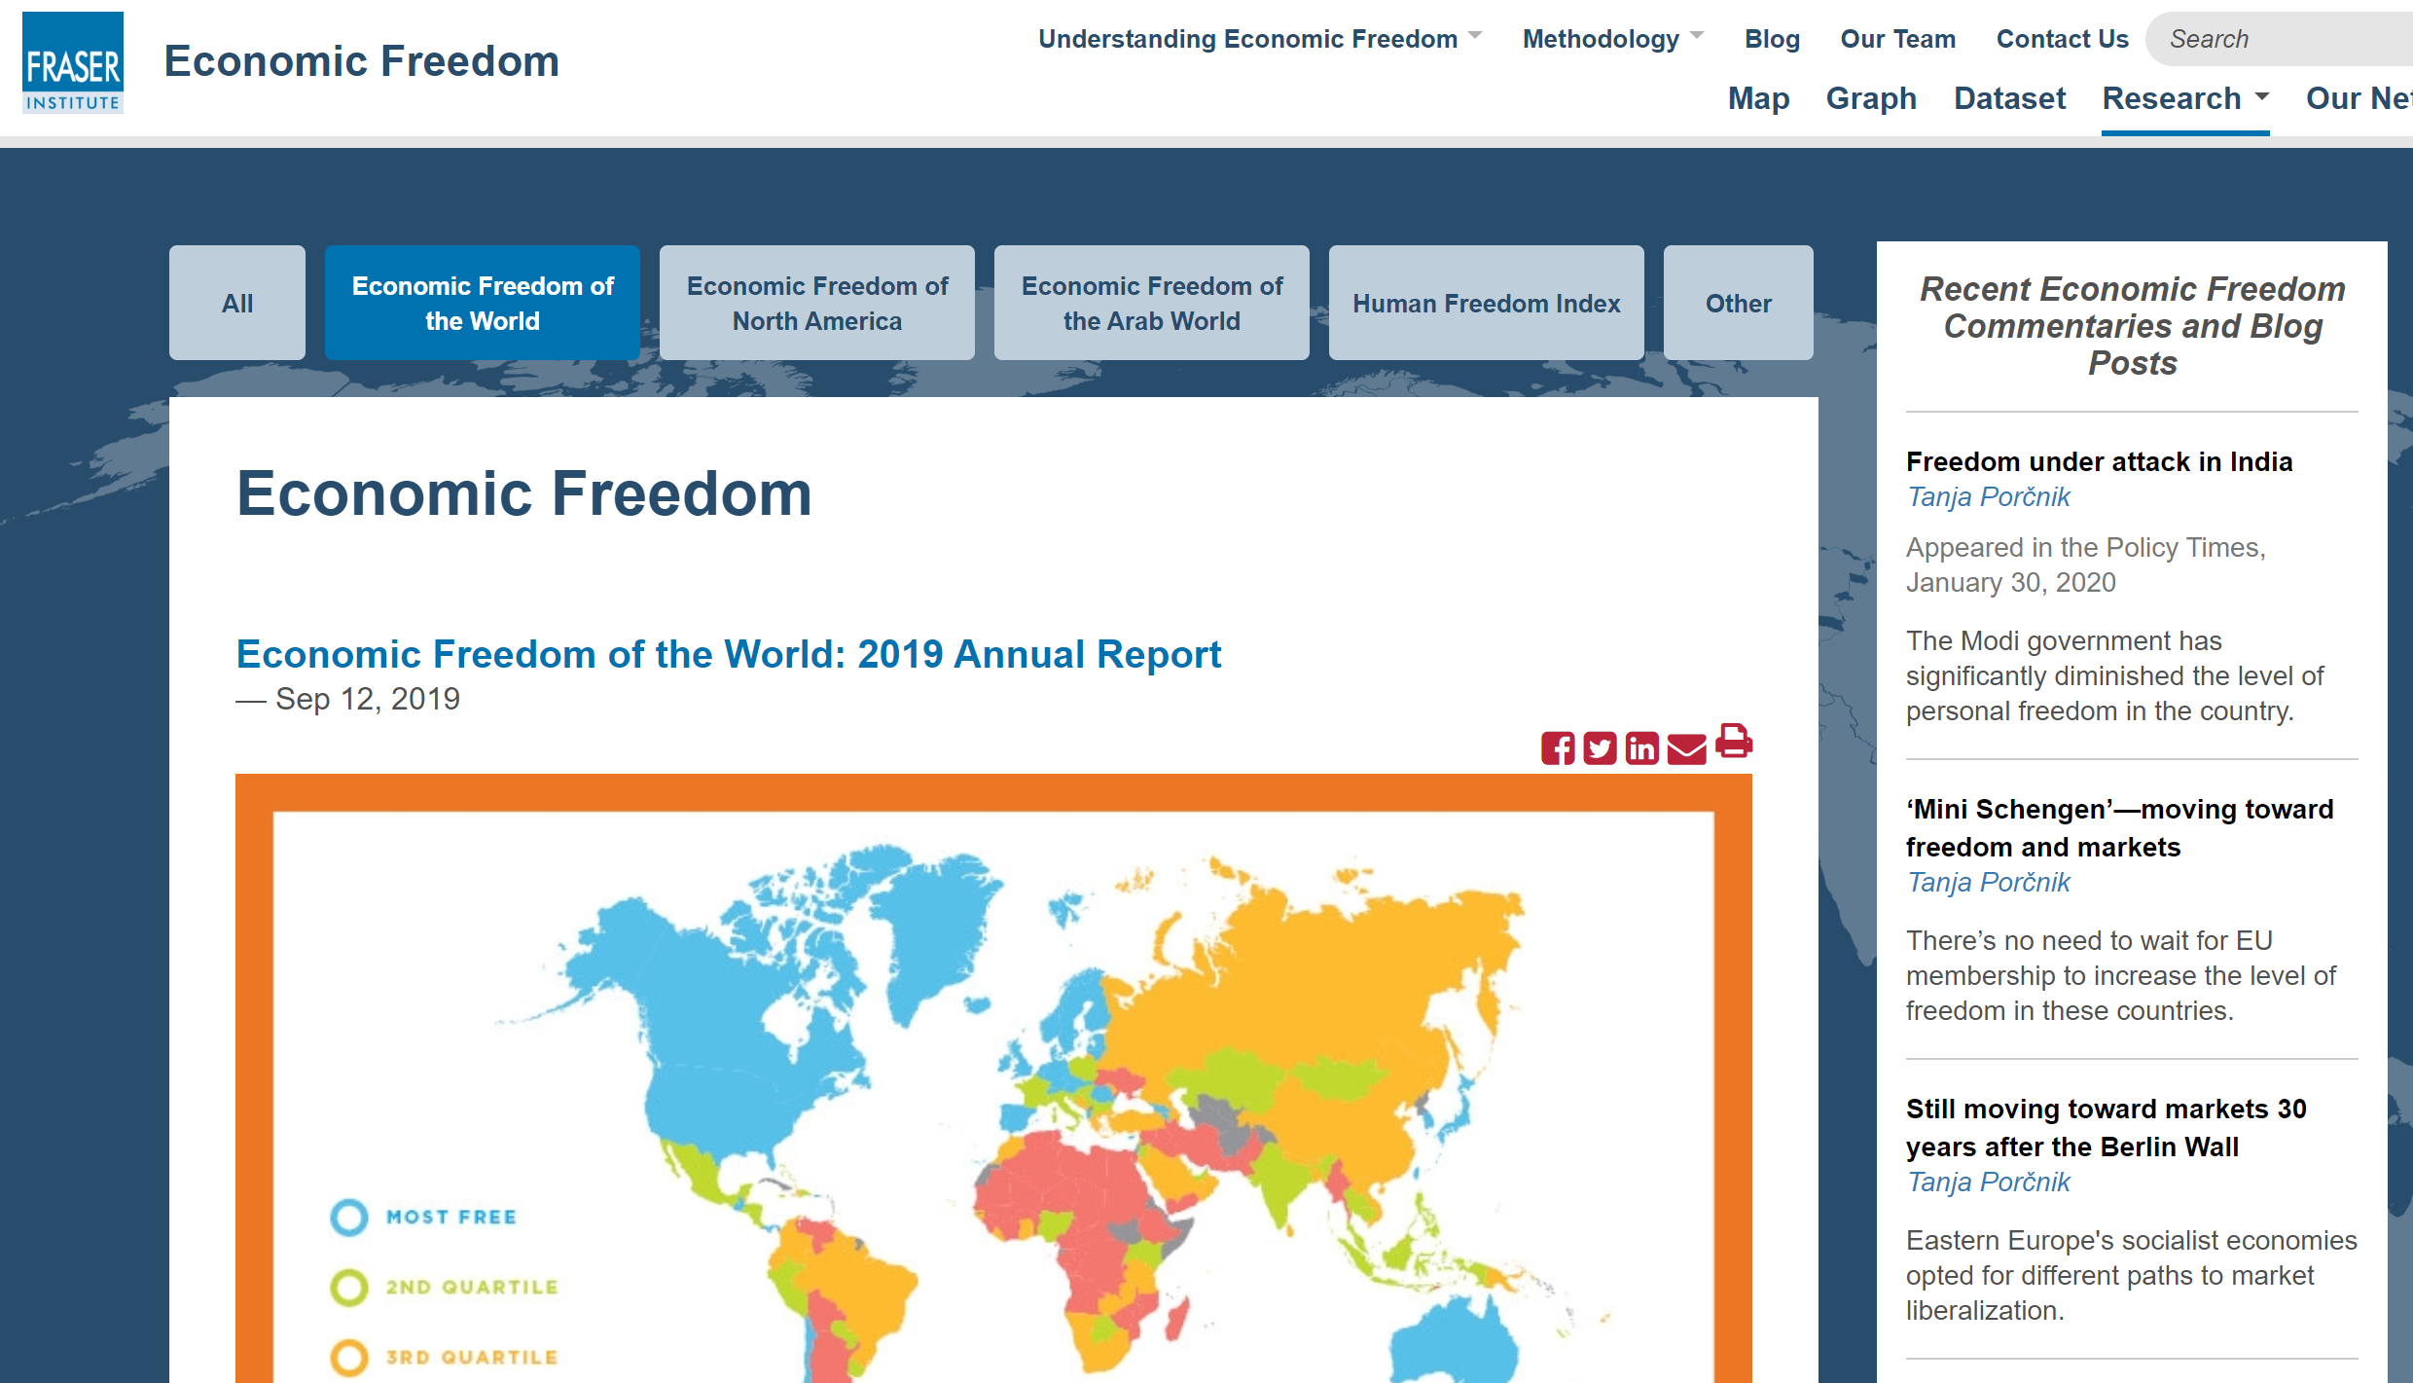
Look at the data

Slide 11
Rising Income

Slide 12
Life Expectancy

Slide 13
Income Earned by the Poorest 10%

Slide 14
Political Rights and Civil Liberties

Slide 15
Activity #3: Legal & Property Rights.
Rank levels of economic freedom of the people in this list, from highest to lowest. Interpret.
Systems and Rights Examples
Prominent Figures
Legal System and Property Rights
By states in the U.S.
By countries
Homer Plessy
Rosa Parks
Clifton Taulbert
David Steward
Ellen DeGeneres
Oprah Winfrey
LeBron James
Nelson Mandela

Slide 16
Summary of Key Ideas
Discrimination and segregations affect choices.
They have costs, including opportunity costs.
Incentives matter. People will move toward what they value and back up from what they do not.
Institutions matter.
The decisions of yesteryear impact us today.

Slide 17
Resources
www.econedlink.org
Economic Thinking Poster for Your Classroom Use
Economic Episodes in American History (2019) - Chapter 25 Who Desegregated Major League Baseball: Adam Smith or Jackie Robinson?
Common Sense Economics (2016)
Bill of Rights Institute

Slide 18
Thank you!
Tawni.Ferrarini@gmail.com
Tawni.org

