Slide 1
Green Eggs and…. Economics? A Literacy & Economics Pairing Presented by Dr. Cindy Fitzthum November 16th, 2020 cjfitzthum@stcloudstate.edu

Slide 2
EconEdLink Membership
You can now access CEE’s professional development webinars directly on EconEdLink.org! To receive these new professional development benefits, become an EconEdLink member. As a member, you will now be able to:
Automatically receive a professional development certificate via e-mail within 24 hours after viewing any webinar for a minimum of 45 minutes
Register for upcoming webinars with a simple one-click process
Easily download presentations, lesson plan materials and activities for each webinar
Search and view all webinars at your convenience
Save webinars to your EconEdLink dashboard for easy access to the event
You may access our new Professional Development page here

Slide 3
Professional Development Certificate
To earn your professional development certificate for this webinar, you must:
Watch a minimum of 45-minutes and you will automatically receive a professional development certificate via e-mail within 24 hours.
Accessing resources:
You can now easily download presentations, lesson plan materials, and activities for each webinar from EconEdLink.org/professional-development/

Slide 4
Agenda
Objectives
Standards
Lesson Overview & Application Ideas
Assessment
Resources
Q and A

Slide 5
Objective
Students will be able to interpret and analyze key economic concepts contained in popular Dr. Seuss books.

Slide 7
Book Summaries
The Cat In The Hat: A cat visits Sally and Sam and gives them perspective
Green Eggs and Ham: Multiple attempts to try this delicacy by Sam-I-Am shows how decisions can evolve
The Lorax: “Speaks for the trees” a.k.a. environmental protection and purposeful action
Oh, the Places You’ll Go!: The journey of life and unexpected but rewarding challenges
Horton Hears A Who!: Protecting a microscopic community, a.k.a. treating others fairly, “no matter how small”

Slide 8
Reflection Journal
Written on Paper or as Word document
Pause and reflect:
Answer the questions
Make connections to your situation
Question what you want to research further

Slide 9
National Standards
Name: Decision Making
Standard: 2
Students will understand that: Effective decision making requires comparing the additional costs of alternatives with the additional benefits. Many choices involve doing a little more or a little less of something: few choices "are all or nothing" decisions.
Students will be able to use this knowledge to: Make effective decisions as consumers, producers, savers, investors, and citizens.
Name: Incentives
Standard: 4
Students will understand that: People usually respond predictably to positive and negative incentives.
Students will be able to use this knowledge to: Identify incentives that affect people's behavior and explain how incentives affect their own behavior.

Slide 10
National Standards
Name: Role of Government and Market Failure
Standard: 16
Students will understand that: There is an economic role for government in a market economy whenever the benefits of a government policy outweigh its costs. Governments often provide for national defense, address environmental concerns, define and protect property rights, and attempt to make markets more competitive. Most government policies also have direct or indirect effects on people's incomes.
Students will be able to use this knowledge to: Identify and evaluate the benefits and costs of alternative public policies, and assess who enjoys the benefits and who bears the costs.

Slide 11
Reflect…
How do you integrate literacy into economics now? Share in chat and/or journal.

Slide 12
The Lesson
Reflect: How can you do this in person OR virtually with your students?

Slide 13
Who has heard of Dr. Seuss?
The Cat in the Hat & Green Eggs and Ham
The Lorax
Oh, the Places You’ll Go!
Horton Hears a Who!
Have students read the book within their groups.

Slide 14
Modeling
What economic concepts did you identify in your book? (note page number)
Find a role for each member (discourage free riders) by asking each student to do 1-2 concepts
Then, have the teacher go through the Concept Overview and Concept Powerpoint to check for understanding.

Slide 15
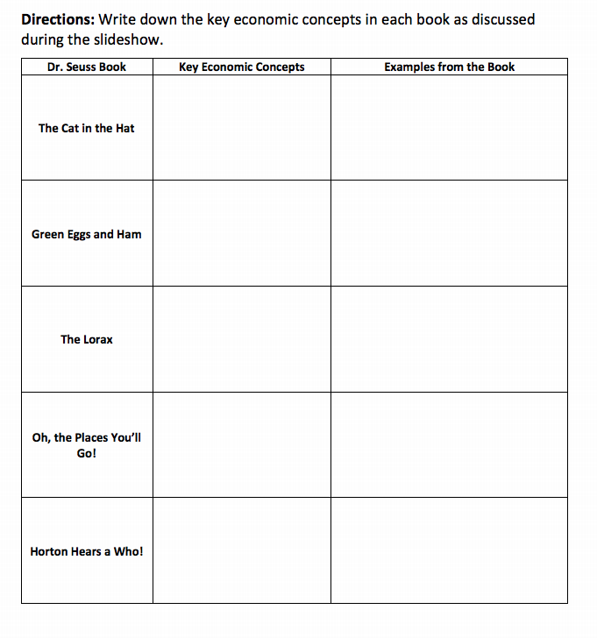

Slide 16
Green Eggs and… Economics?
Concepts Overview

Slide 17
What economic concepts are present in Dr. Seuss’ books?

Slide 18
The Cat in the Hat
What examples did you see of…
asymmetric information
environmental issues
externalities
monitoring costs
recreation/leisure

Slide 19
Green Eggs and Ham
What examples did you see of…
complements
experience goods
interpersonal differences in preferences
utility

Slide 20
The Lorax
What examples did you see of…
economies of scale
endangered species
environmental externalities
property rights and enforcement
specialization and division of labor
tragedy of the commons
wants

Slide 21
Oh, the Places You’ll Go!
What examples did you see of…
personal beliefs in ability and luck
choices
competition
individual interests and abilities
information
leisure/recreation
migration
opportunity cost
risk
uncertainty
utility
waste/inefficiency

Slide 22
Horton Hears a Who!
What examples did you see of…
asymmetric information
collective action/demonstrations
discrimination
endangered species
public choice
shirking
specialization
skills

Slide 23
Kahoot!
Use this tool to check for understanding of these definitions after review (on EconEdLink already created! ☺ )

Slide 24
Group Activity
Reflect: What terms might challenge your students? Journal and/or chat now.
Have each group outline their findings on a poster board or Powerpoint to present to the class the next day!
Encourage creativity!

Slide 25
Group Activity
Title of Book
Economic Concept(s) Found
Short Definition of Economic Concept
In what context it applies to the passage
Page number passage appears on.
Encourage images, visuals and take 5-10 minutes.

Slide 26
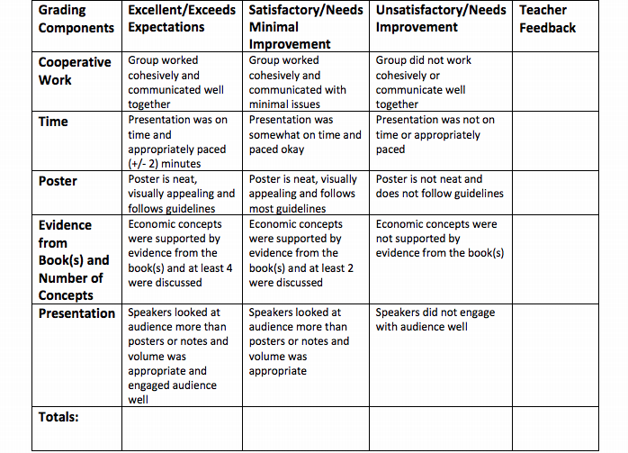

Slide 27
Individual Activity
During the presentations, have each student individually provide feedback to each group.
One Strength, One Weakness, One Idea
Self-reflection of their own group
Reflect: How will this strengthen their understanding of economic concepts?

Slide 28
Assessments
Locate one economic principle (from Dr. Seuss) and find a news article illustrating the same concept
One-page essay (summarize, define, explain)
Create an advertisement, song lyrics, poem or movie

Slide 29
Extensions
Freakonomics (2005) Movie or Book Review
Illustrate how “economics is all around us,” by journaling or other creative medium.

Slide 30
Assessment Questions
Please use/attach (from lesson):
Concept Powerpoint
Concept Worksheet
Kahoot!
Group Presentation Rubric

Slide 31
References
The Cat in the Hat (1957)
Green Eggs and Ham (1960)
The Lorax (1971)
Oh, the Places You’ll Go! (1990)
Horton Hears A Who! (1954)

Slide 32
Q and A
Thank you for attending!

Slide 33
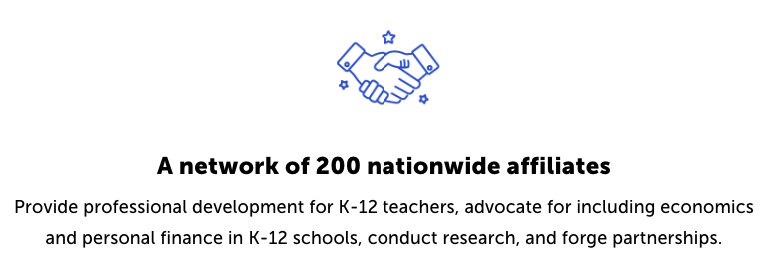
CEE Affiliates
https://www.councilforeconed.org/resources/local-affiliates/

Slide 34
Thank You to Our Sponsors!

