Slide 1
Pre-webinar
EconEdLink.org – Register and/or login ($0)
Conduct a search on “Demand Supply”
Save three resources in your Dashboard

Slide 2
1-2-3
Ready * Set * Go
Find a QUIET spot and insert your earbuds or put on your headphones
Prepare to be ACTIVE and INTERACTIVE
In Pear Deck answer, “What happened of economic interest in the Markets of the COVID Economy?”
Notes:
Bell-Ringer or Do-Now Transitioning from the hallway into class can be a chaotic time. Use this slide to help students know what to expect as they come into the room, and change the instructions to fit your activity.
🍐 This is a Pear Deck Text Slide
🍐 To edit the type of question, go back to the "Ask Students a Question" in the Pear Deck sidebar.

Slide 3
Using Current Events and Interactives to Engage Students
Demand, Supply, and Market Equilibrium
Presented by Tawni Hunt Ferrarini, PhD tferrarini@Lindenwood.edu
https://www.tawni.org/

Slide 4
EconEdLink Membership Provides
Automatically receiving a professional development certificate via e-mail within 24 hours after viewing any webinar for a minimum of 45 minutes;
Registering for upcoming webinars with a simple one-click process;
Access downloadable presentations, lesson plan materials, and webinar activities;
Searching and viewing the full inventory of webinars at your convenience;
Saving webinars to your EconEdLink dashboard for access.
https://econedlink.org/professional-development/

Slide 5
Professional Development Certificate
Earn a professional development certificate for this webinar after you:
Watch a minimum of 45-minutes.
It will automatically be sent to you as a professional development certificate as an e-mail attachment within 24 hours.
Accessing resources:
Easily download presentations, lesson plan materials, and activities associated with each webinar at: EconEdLink.org/professional-development/

Slide 6
Agenda
Welcome and introduction
List key learning and educational technology objectives
Links to national and state standards
Transform presentations on demand, supply, and market equilibrium into classroom conversations using examples drawn from the COVID economy
Connect different demand relative to supply considerations to predict price and output changes
Provide resources for instructors want to improve student outcomes and experiences in economics, personal finance, business, government, and history courses
Conclusion, followed by Q&A

Slide 7
Welcome to EconEdLink
Master teachers and instructional technology experts lead these webinars
Established network with a management system with deep and broad roots
Access to a university-based network of centers, state council affiliates, and research-driven organizations

Slide 8
Little about me
Currently at Lindenwood University
Previously at Northern Michigan University
Author and co-author

Slide 9
Apply the law of demand to explain the inverse relationship between price and the amounts consumers purchase
Demonstrate the law of supply by showing how higher prices motivate businesses to produce more in order to stay open by realizing profits and avoiding losses
Identify market equilibrium
Distinguish between a change in supply and quantity supplied using Excel
Academic
Learning Objectives

Slide 10
Educational Technology Objectives
Identify prompts for conversation to begin at the start of the session, engage students during the session, and get a pulse on their thinking by the end
Gather metrics through formative and summative assessments

Slide 11
National Standards

Slide 12
State Standards
In EconEdLink, find your state standards and teaching and learning resources connected to them
To participate in the demonstration, join EconEdLink
Search for “Would You Demand It?”
Click on State Standards

Slide 13
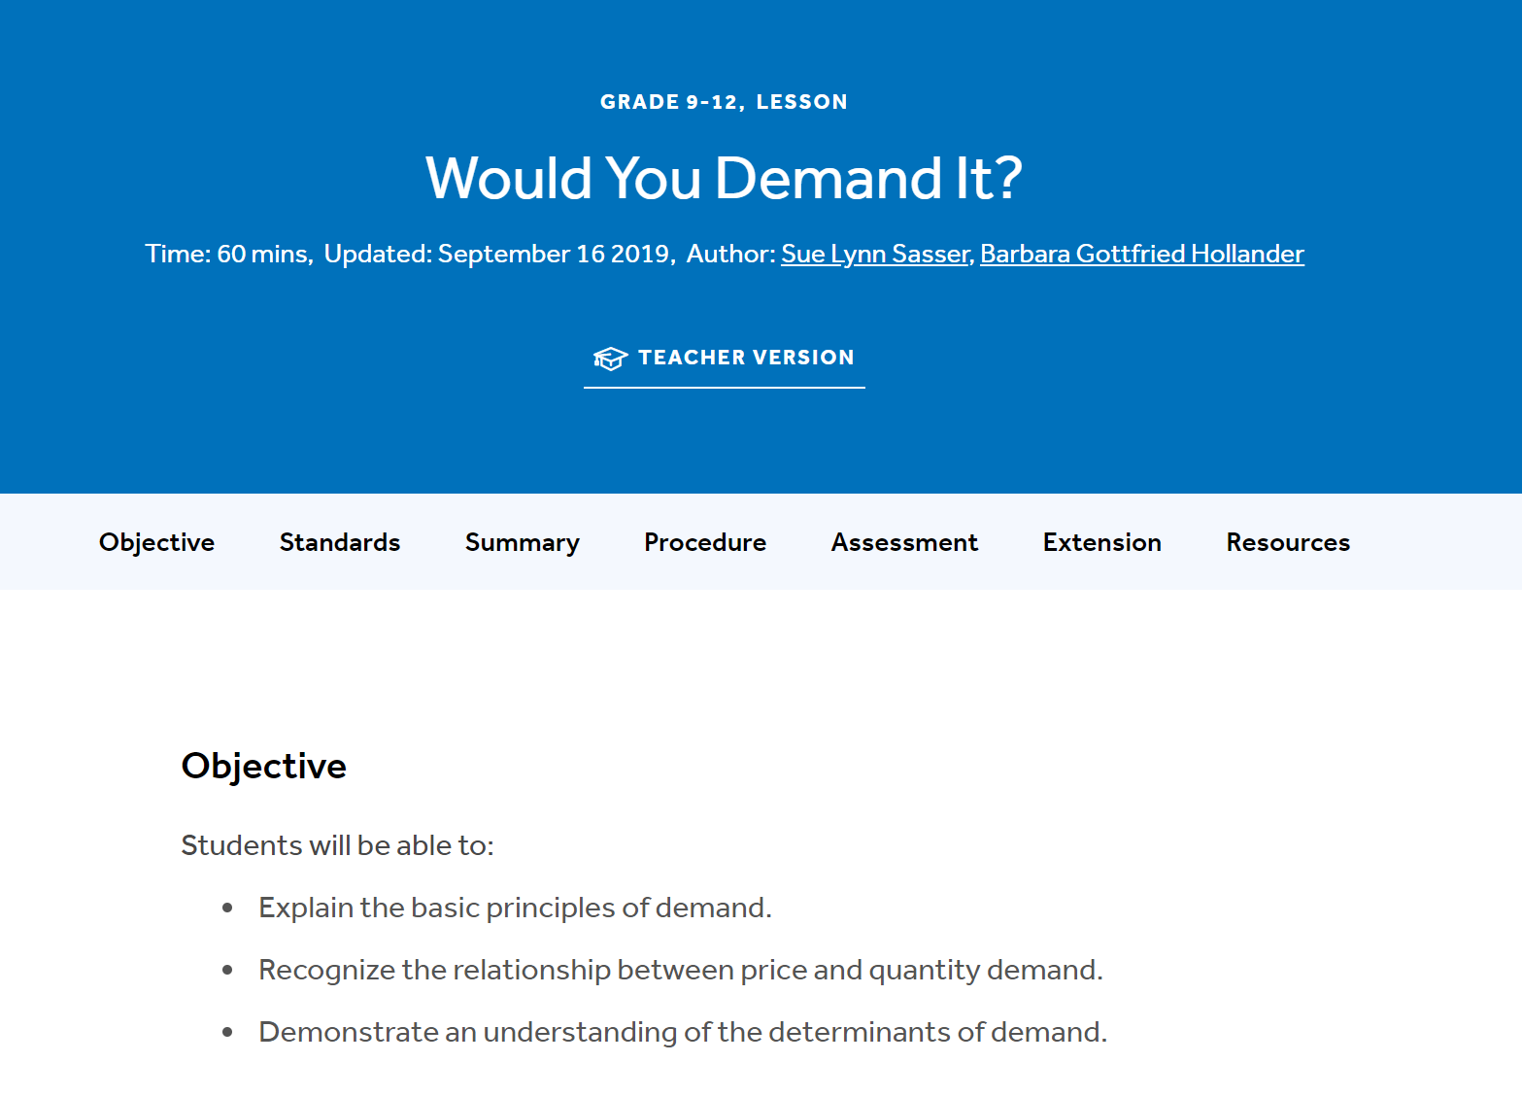

Slide 14
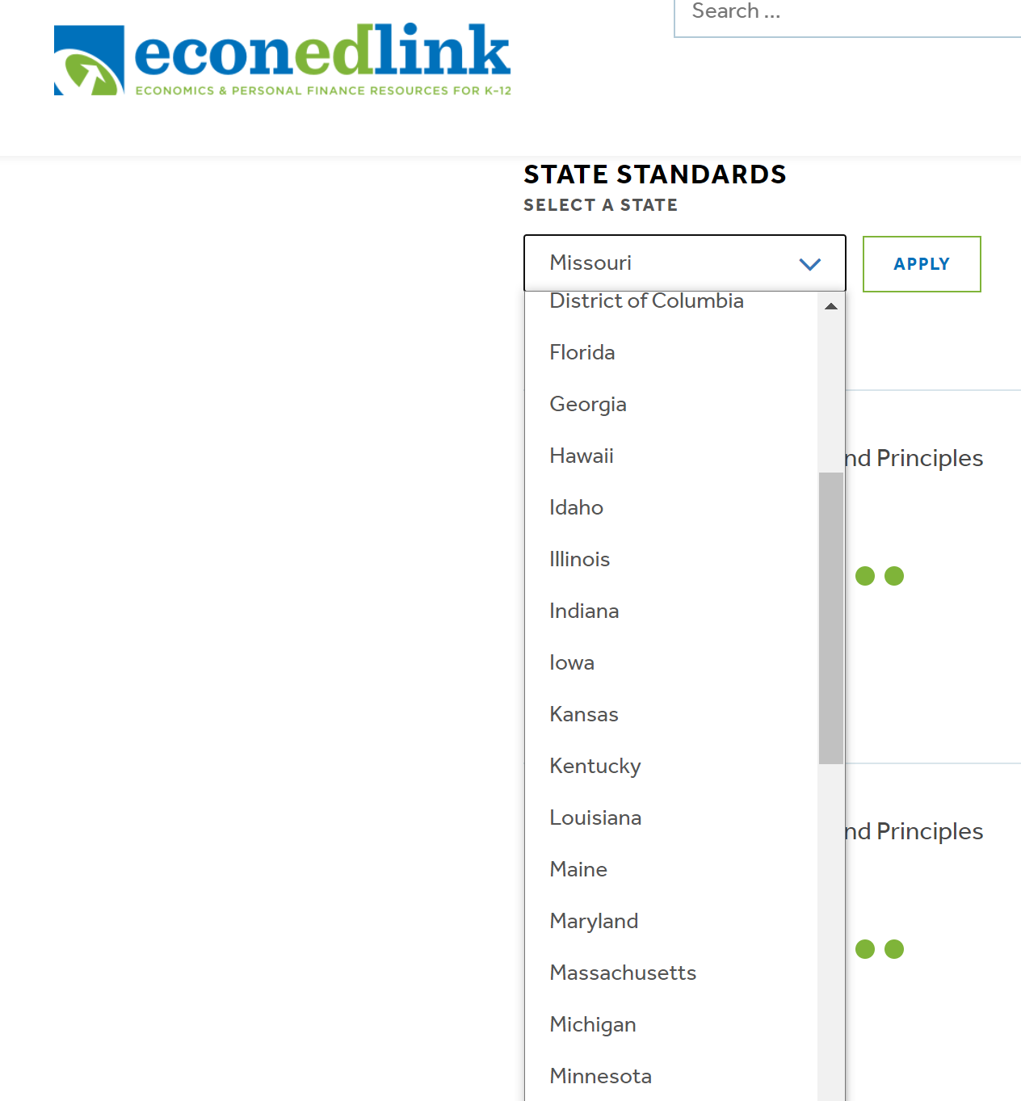

Slide 15
Students, are you ready?
Attention “students.”
Ready to get started???
Say “Yes or Let’s Go!” in the Chatroom.

Slide 16
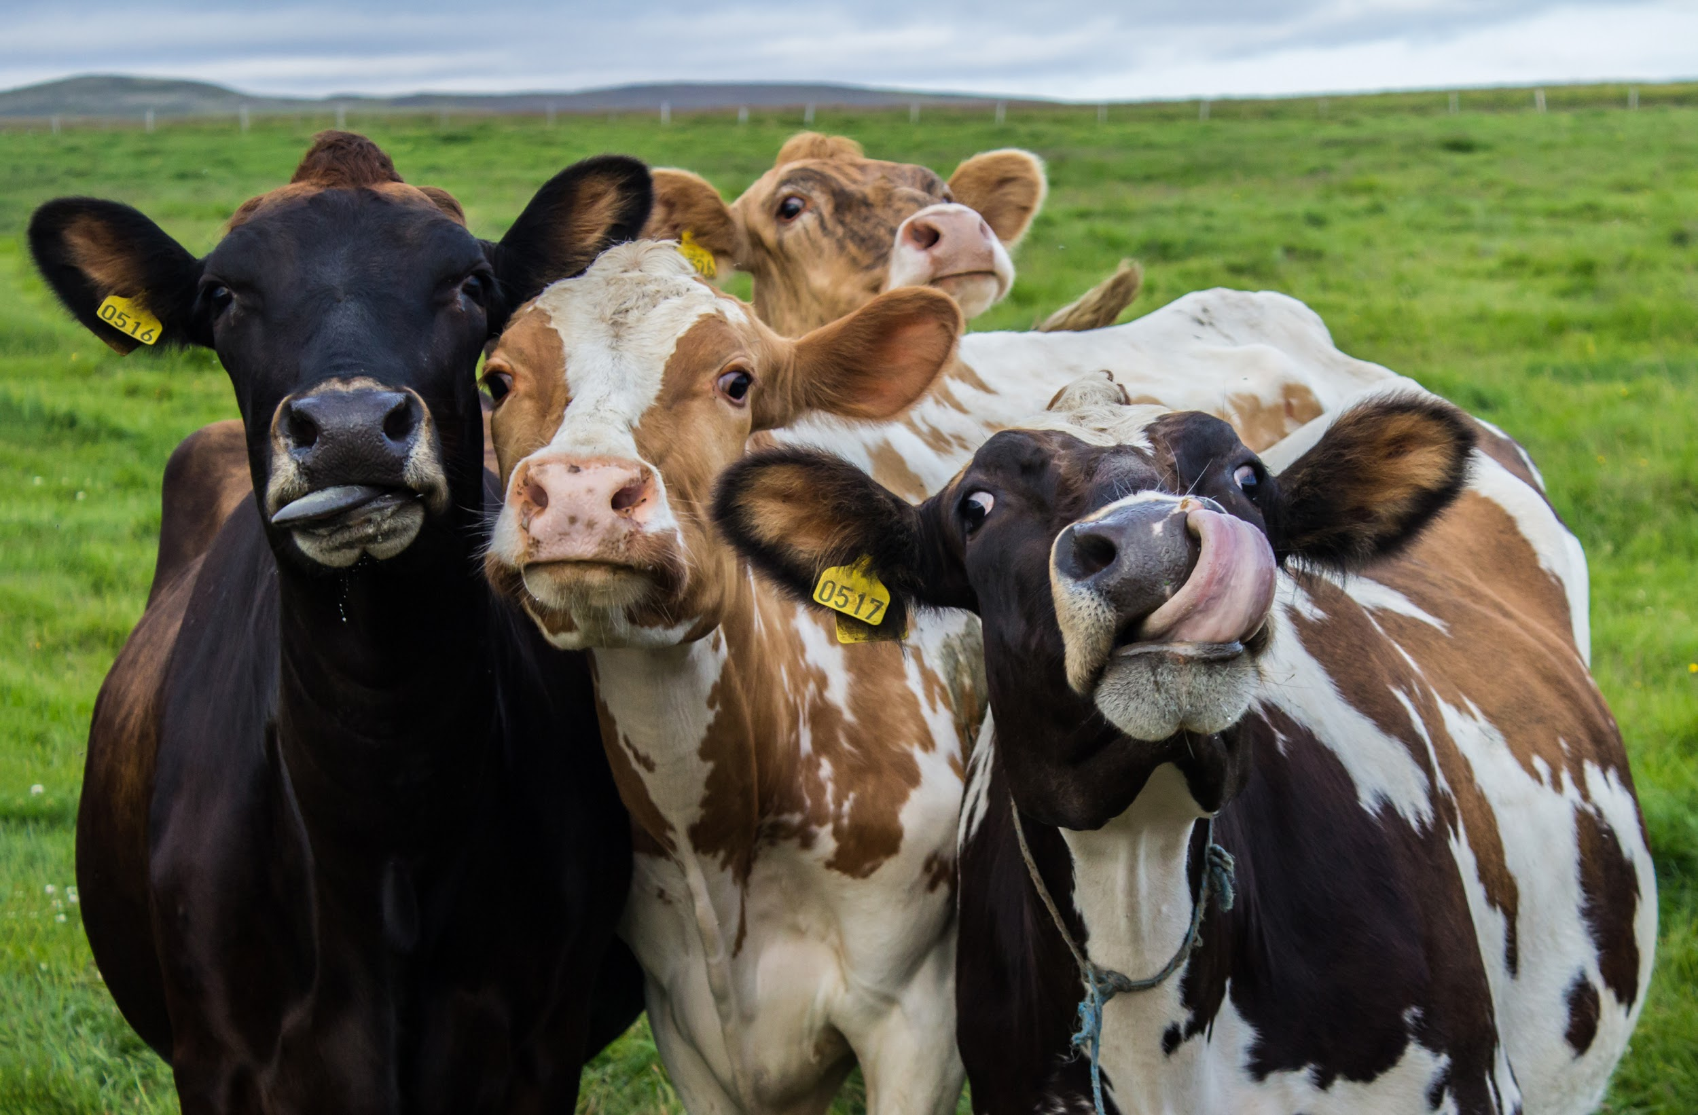
Start line
What is your start line with respect to demand for and supply of beef?
Notes:
🍐 This is a Pear Deck Multiple Choice Slide. Your current options are: A: Demand for beef and supply of beef have increased., B: Demand for beef and supply of beef have decreased., C: Demand for beef has remained constant but its supply has decreased., D: Demand for beef has increased while supply has remained constant.,
🍐 To edit the type of question or choices, go back to the "Ask Students a Question" in the Pear Deck sidebar.

Slide 17
“Demand, Supply, and Equilibrium” Intro
Welcome!
What has happened in the market for beef?
Price? | Production?
Notes:
🍐 This is a Pear Deck Draggable™ Slide.
🍐 To edit the type of question, go back to the "Ask Students a Question" in the Pear Deck sidebar.

Slide 18
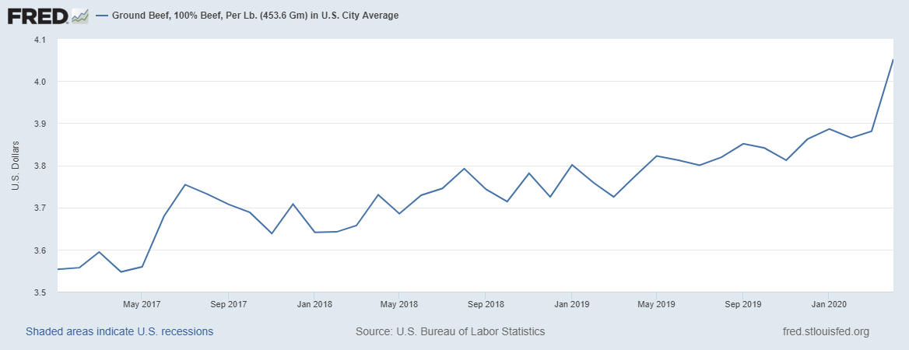
What’s the Data Reveal?

Slide 19
Learning Goals
Review and interpret the data on beef prices.
Apply the law of demand to explain the inverse relationship between price and the amounts you and other consumers purchase.
Demonstrate the law of supply by showing how higher prices motivate beef producers to supply more in order to stay open by realizing profits and avoiding losses. Lower prices do the opposite.
Identify equilibrium and explain the role of voluntary exchange in markets.
Analyze current events.

Slide 20
Law of Demand
$10
Price of beef
$9
$8
$7
$6
$5
$4
$3
$2
$1
$0/0
Quantity Demanded of Beef
Notes:
🍐 This is a Pear Deck Drawing Slide
🍐 To edit the type of question, go back to the "Ask Students a Question" in the Pear Deck sidebar.

Slide 21
Change in Price and Quantity Demanded
When price of an item increases, consumers
a. decrease the amount or quantity they purchase.
b. increase the amount or the quantity they purchase.
c. decrease the amount they purchase at each and every price.
d.increase the amount they purchase at each and every price.
Notes:
🍐 This is a Pear Deck Multiple Choice Slide. Your current options are: A: decrease the amount or quantity they purchase at the new price., B: increase the amount they purchase or quantity they purchase at the new price., C: decrease the amount they purchase at each and every price., D: increase the amount they purchase at each and every price.,
🍐 To edit the type of question or choices, go back to the "Ask Students a Question" in the Pear Deck sidebar.

Slide 22
Law of Demand
Quantity demanded is the amount of a good or service (Q^{d}) that consumers are willing and able to buy at specific prices (P) during a period of time.
The law of demand states that as price of the good or service changes, quantity demanded changes in the opposite direction. This relationship is inverse.
A change in anything other than the price of the specific product changes the demand of the product.

Slide 23
Compare and Contrast
Change in Quantity Demanded or Demand
Price of pork-dogs decreases (cents per pack of eight)
Price of beef (cents per pound) increases
Price of drinks sold with beef burgers increases (cents per bottle)
Household income (thousands of dollars per year) falls
Ground beef preference drops as people become vegans (index units; 100 is average taste for ground beef)
Notes:
🍐 This is a Pear Deck Draggable™ Slide.
🍐 To edit the type of question, go back to the "Ask Students a Question" in the Pear Deck sidebar.

Slide 24
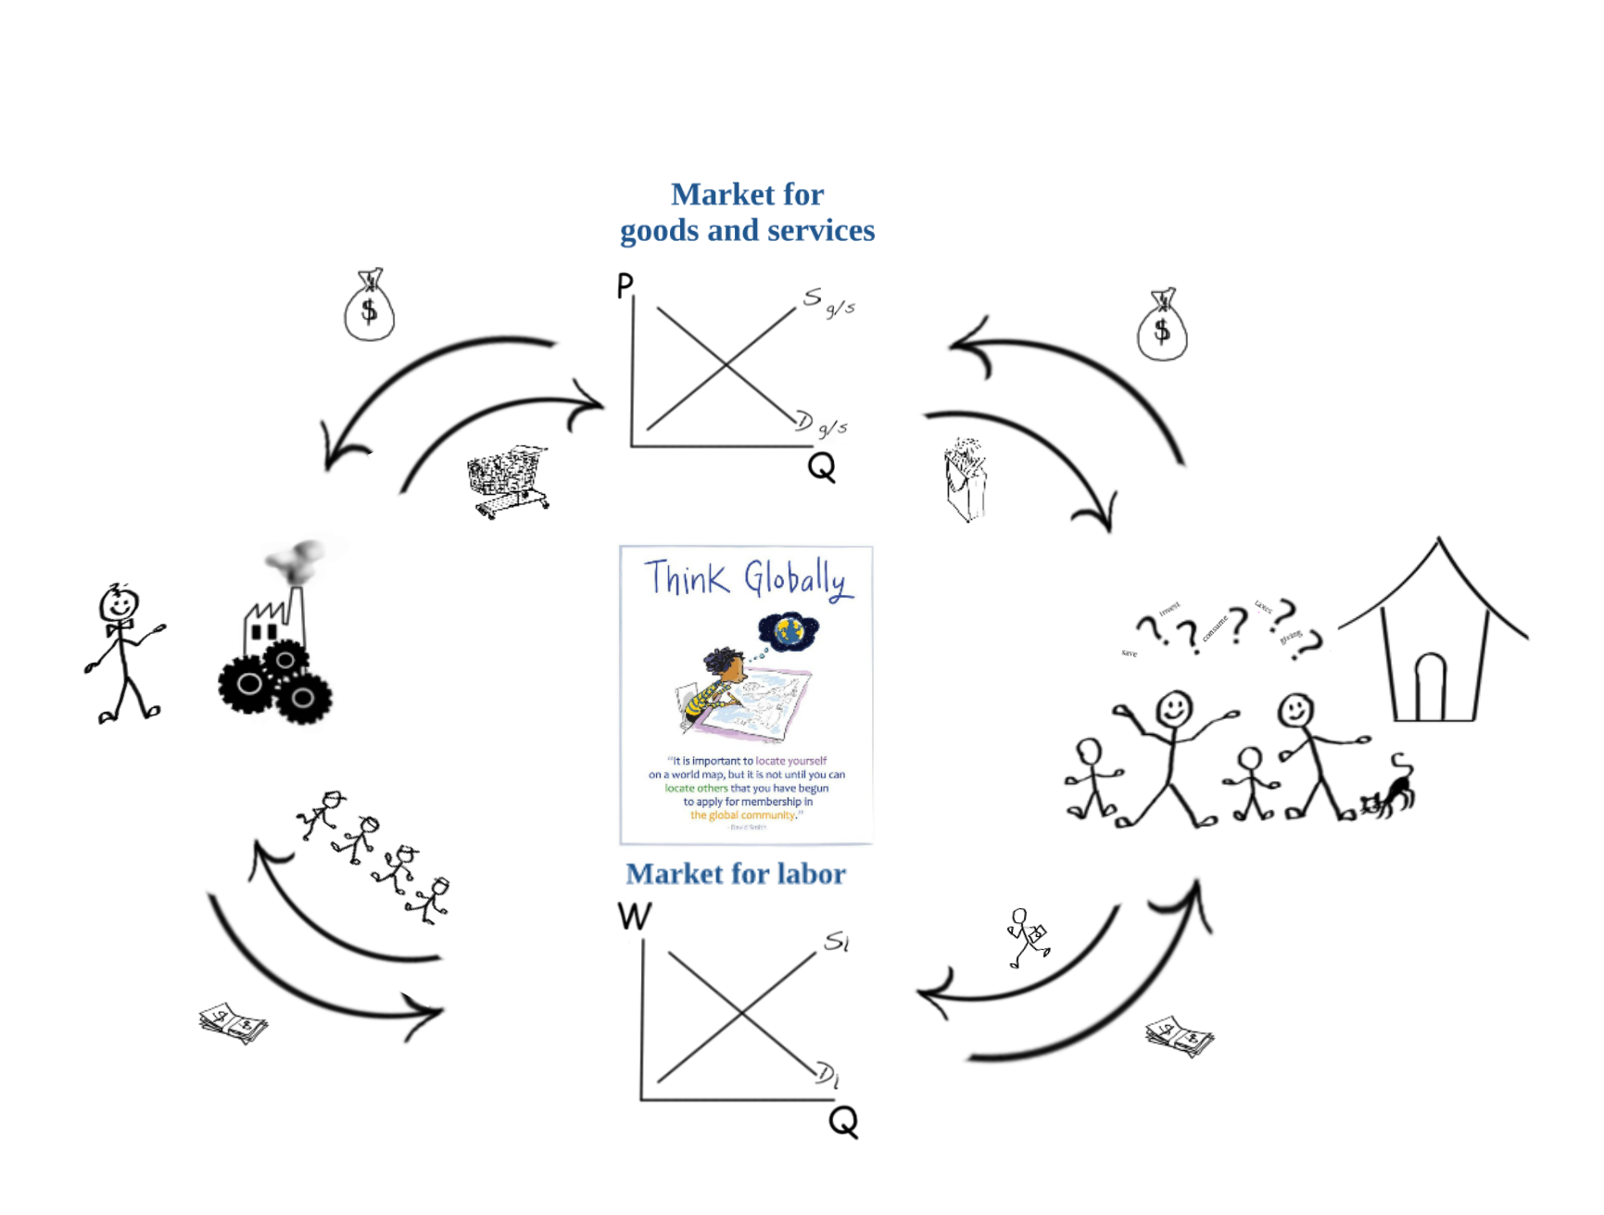
True or false
If consumers demand it, businesses will supply it.
Notes:
🍐 This is a Pear Deck Draggable™ Slide.
🍐 To edit the type of question, go back to the "Ask Students a Question" in the Pear Deck sidebar.

Slide 25
True or false
If consumers demand, businesses will supply it.
Notes:
🍐 This is a Pear Deck Draggable™ Slide.
🍐 To edit the type of question, go back to the "Ask Students a Question" in the Pear Deck sidebar.

Slide 26
Law of Supply
The positive relationship between the price of a good or service and the quantity producers will supply is known as the law of supply.
They will produce it as long as the price consumers are willing to pay covers the per unit costs.

Slide 27
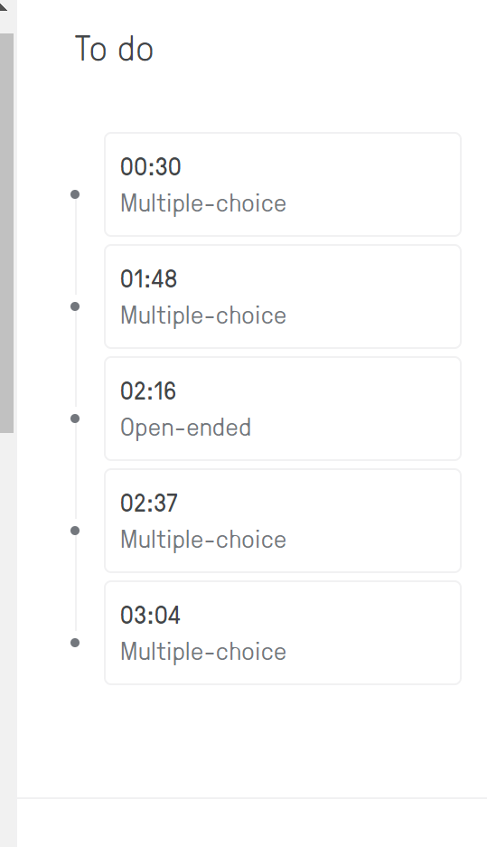
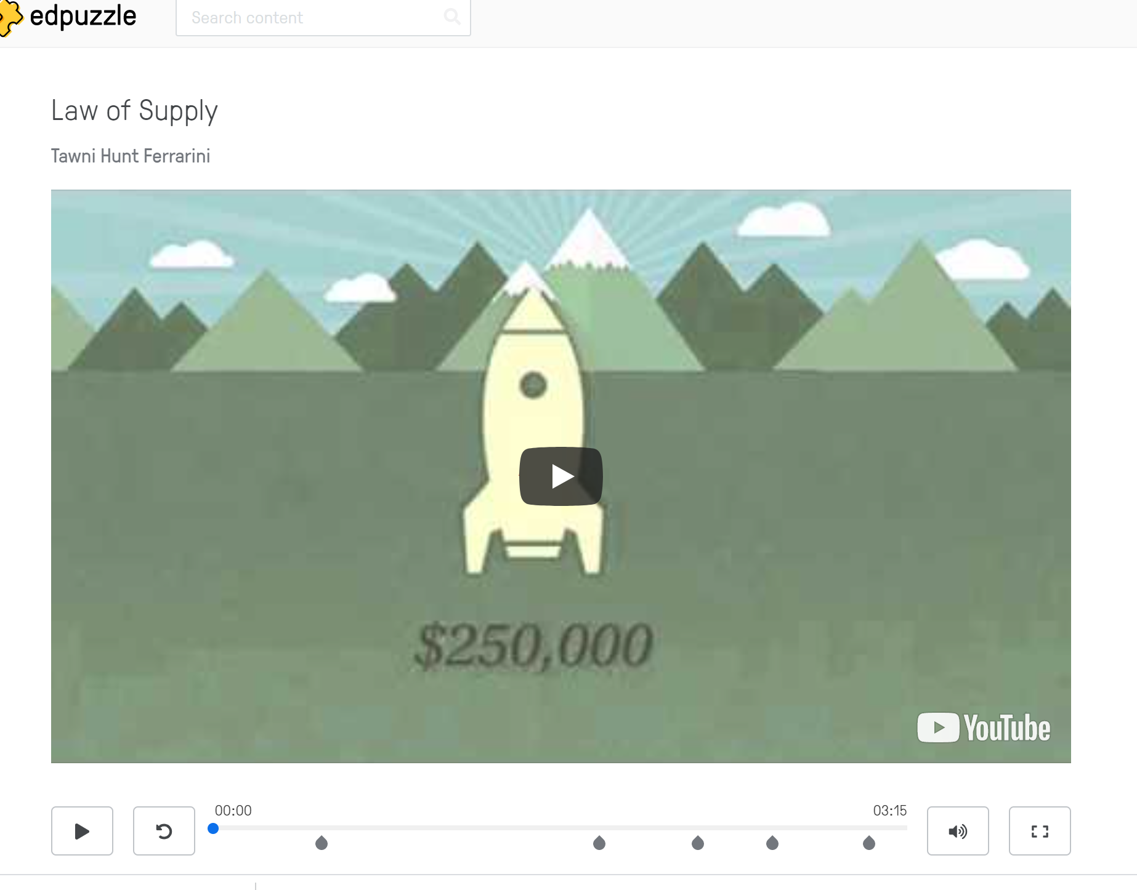
EDPuzzle

Slide 28
Why do they do that?
Like consumers, producers move toward things that they value and they back up from those that they do not.

Slide 29
Economic Realities
Producers stay in business when they satisfy consumers at prices higher than their per unit costs.
At higher prices, quantity demanded decreases. At lower prices, quantity demanded increases. There is a balance.

Slide 30
Supply Shifters
The most basic supply shifter is that one that change costs.
The big question to ask is “How do costs change with _______?”
A change in input prices?
Technological innovations?
Taxes and subsidies, expectations, entry or exit of producers?
Pandemics? Social unrest?

Slide 31
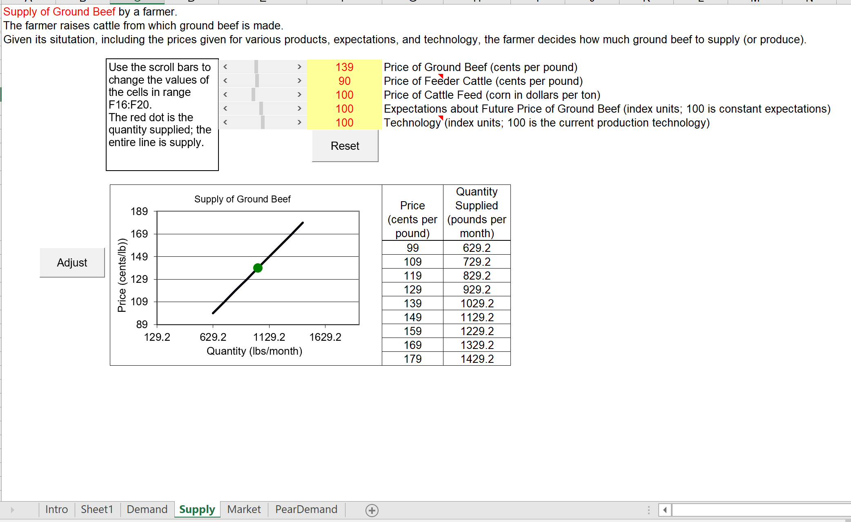
Teaching D/S with Excel
Barreto, Humberto. “Why Excel?” The Journal of Economic Education, (2015) 46(3), doi.org/10.1080/00220485.2015.1029177

Slide 32
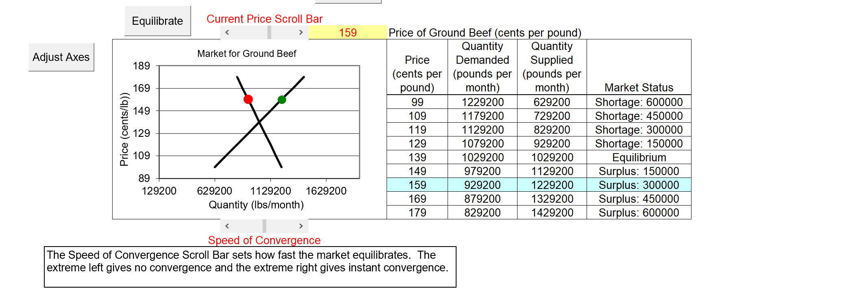
Market Equilibrium
Changes in D/S Factors

Slide 33
Finish Line
H5P Interactives for Formative Assessments
“Demand vs Supply”

Slide 34
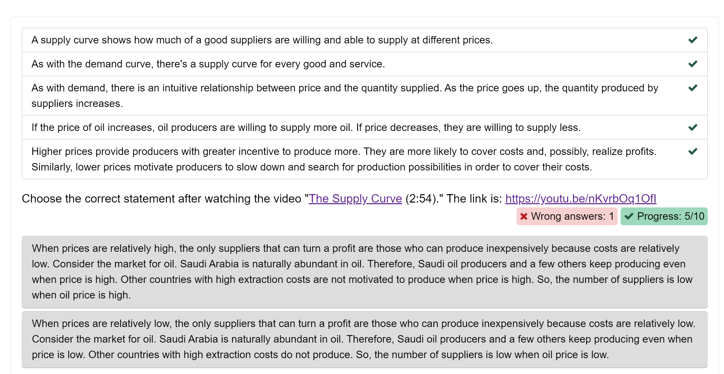
https://h5p.org/node/591995

Slide 35
Now Apply to Other Markets
The economy is made up of consumers and producers like you and me.
Each group flourishes by acting and interacting with others through voluntary, harmonious exchanges.
Disruptions can change all of that.

Slide 36
Review
During our time together, we:
Reached our learning objectives
Utilized educational technology
Identified interactive assessments
Connected students to the relevancy of the economic way of thinking and critical and analytical thinking in today’s economy

Slide 37
References for enhancements and entire courses
CommonSenseEconomics.com
EconEdLink.org
EdPuzzle.com
Fed Reserve of Atlanta
Fed Reserve of St. Louis
H5P Interactives
Marginal Revolution University
PearDeck ($0 basic)
Teaching Economics with Excel

Slide 38
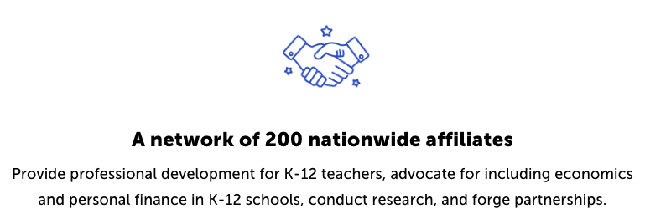
CEE Affiliates
https://www.councilforeconed.org/resources/local-affiliates/

Slide 39
Stay in touch!
Tawni.org
Email: Tawni.Ferrarini@gmail.com
Author - speaker - content creator

